Slide 1
November 13, 2014
Peak Energy Rent (PER)
Adjustment Mechanism
FCA-10 and Beyond: Discussion Materials
Catherine McDonough
cmcdonough@iso-ne.com | (413) 535-4027

Slide 2
Highlights
ISO is reviewing the PER Adjustment Mechanism to develop a proposal for the FCA-10 and beyond
  Proposal to be presented at December MC Meeting
The purpose of this presentation is to solicit feedback on several key issues the ISO has identified
Key points: PER Adjustment …
  Will have a greater impact on future FCM clearing prices/costs than in years past
  Is an incomplete and poor electricity price hedge for load
  May no longer be necessary to address market power concerns

Slide 3
Contents
PER Adjustment: In Theory
PER Adjustment: In Practice
  Prospective Impact on FCM Prices/FCM Costs
  Prospective Benefit For Load
  Value in Addressing Market Power Concerns
Proposed Schedule
Appendix
  Existing PER Adjustment: The Details

Slide 4
PER Adjustment: In Theory

Slide 5
In Theory, PER Adjustment Reduces Energy Market Risk for Resource Owners and Load
PER Adjustment is like an “insurance policy” between resource owners and load against peak energy rents
Load pays for expected peak energy rents up-front in the FCM to eliminate the risk associated with paying peak energy rents in the energy market

Slide 6
PER Adjustment Also Curbs Incentive to Exercise Market Power
Selling peak energy rents forward via the PER Adjustment Mechanism:
  Curbs incentive for resource owners to boost energy market prices by economic or physical withholding.
    Applies to entire Capacity Supply Obligation (CSO) even when the resource is not running
  Also attenuates suppliers’ incentive to overstate capacity since the deduction is applied to entire CSO

Slide 7
PER Adjustment: In Practice
Prospective Impact on FCM Prices/Costs

Slide 8
PER Adjustment Will Raise Future FCM Prices by More than in Years Past
PER Adjustment had minimal upward impact on FCM clearing prices in past years due to excess supply and price floor
(FCA 3-to-7) and the administrative price cap (FCA-8)
This will change when the FCM is cleared using a downward sloping demand curve for two reasons:
  Resource owners will add the expected PER Adjustment during the commitment period to their supply offers
  PER Adjustment raises Net CONE and, therefore, the demand curve (which is indexed to NET CONE)
PER Adjustment will have a greater impact on FCM clearing prices/costs than in years past — a cost impact that could be higher than PER Adjustment credits

Slide 9
PER Adjustment Raises the FCM Demand Curve and Supply Bids (Illustration)
With PER Adjustment
With no PER Adjustment
PER Adjustment Raises Net CONE and Shifts the Demand Curve
PER Adjustment Boosts Supply Bids

Slide 10
PER Adjustment Raises the FCA Demand Curve and FCM Prices (The Details)
PER Adjustment may add ~$0.68/kW-mo to NET CONE
  Expected PER Adjustment estimated by Brattle =$0.43/kW-mo
  FERC-Ordered Increase in RCPFs pushes this estimate by $0.25/kW-mo,
  using the same Brattle assumptions
The PER Adjustment raises the FCA starting price by
$1.09/kW- mo = 1.6 x $0.68/kW-mo
PER Adjustment has a decreasing impact on demand curve at capacity values above (1:5), or 33,132 MW and zero impact at (1:87), or 37,027 MW
If capacity equals NICR, the PER Adjustment increases the demand curve by ~0.73 x 1.09 = ~$0.80/kW-mo and this could add ~$330 million to FCM costs

Slide 11
PER Adjustment Will Raise Future FCM Prices
+$1.09/kW-mo
Demand Curve w/ no PER Adjustment (green)
+$.80/kW-mo
PER Adjustment could add
+0.68 to supply offers

Slide 12
PER Adjustment: In Practice
Prospective Benefit for Load

Slide 13
PER Adjustment is a Poor/Incomplete Hedge For Load: Summary of Key Points
PER Adjustment does not protect load against spiking fuel costs
PER Adjustment is not a complete or contemporaneous hedge against peak energy rents
Many end-use customers can opt for a flat, all hours retail rate and many customers choose to do so
Load Serving Entities have access to many other hedging products in the market place that may provide more cost-effective and comprehensive protection against electricity price risk

Slide 14
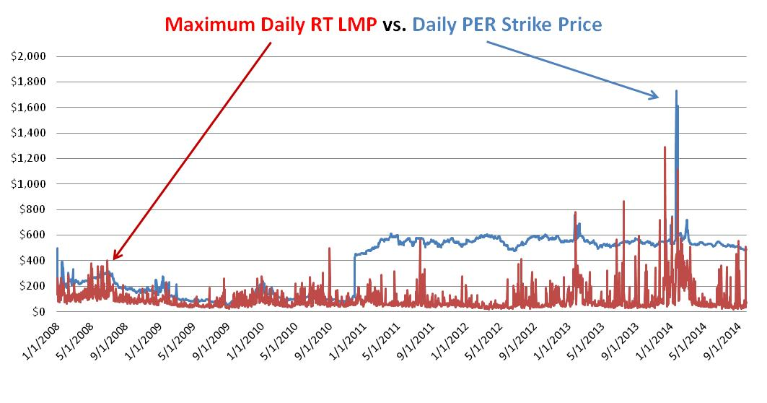
PER Adjustment Does Not Protect Load Against Spiking Fuel Costs: PER Strike Price Changes Daily with Fuel Costs

Slide 15
PER Adjustment Does Not Fully Hedge Against Peak Energy Rents
PER Adjustment does not fully offset peak energy rent paid by the LSE (either in real time or embedded in the DALMPs)
  PER strike price is based on an assumed 22,000 BTU/kWh heat rate--considerably higher than the ~16,000 BTU/kWh heat-rate when the system enters a scarcity condition
    PER Adjustment offsets only 73% the peak energy rent paid by LSEs
Fuel type used to set the PER strike price (gas or oil whichever is higher) can be different than the fuel used by the marginal unit dispatched that sets the RTLMP
  Hourly PER Value can be zero even when LSE pays a substantial peak energy rent

Slide 16
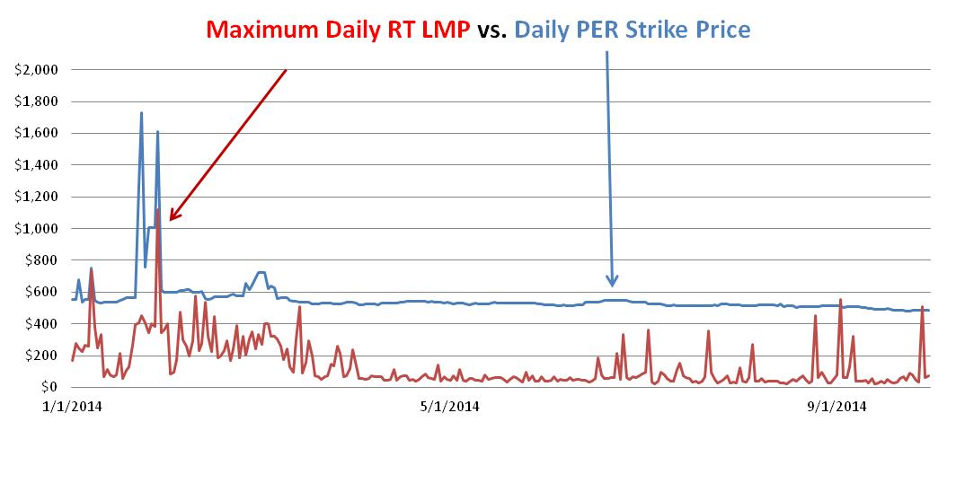
PER Adjustment Does Not Fully Hedge Against Peak Energy Rents
PER Adjustment was zero on February 28, 2014 despite the spike in electricity prices because PER Strike was set based on natural gas price and oil unit set the RTLMP
    PER Adjustment was zero on Feb 28, 2014 despite a spike in electricity prices because PER Strike was set based on price of natural gas and the RTLMP was set by an oil unit.

Slide 17
PER Adjustment Does Not Provide Contemporaneous Protection Against Peak Energy Rents
  PER Adjustment is based on a 12-month moving average of monthly PER Values (sum of hourly PER Values)
    LSEs still need to manage the monthly cash flow implications of spiking peak energy rents since PER Adjustment offsets only 1/12 of the peak energy rent paid for that month
    LSE loses any “un-recovered capacity payment offset” via the PER Adjustment when a customer migrates to another LSE within a year of a positive hourly PER value

Slide 18
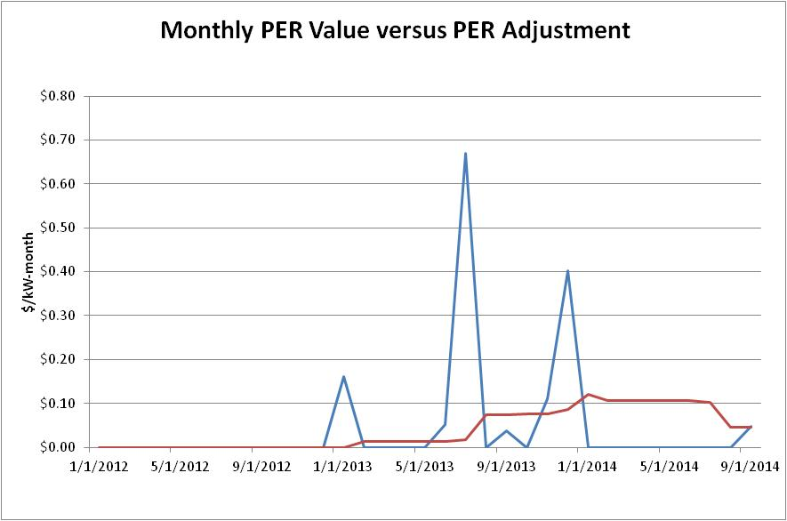
PER Adjustment Does Not Provide Contemporaneous Protection Against Peak Energy Rents (continued)
Peak Energy Rent
PER Adjustment Offset

Slide 19
  Most End-Use Customers are Served at Flat Retail Rates
  Most residential and many commercial customers in New England take Basic (Commodity) Service from LSEs at a flat, all-hours, price set (typically for a 6 month term) based on competitive solicitations
  Many commercial and industrial customers have negotiated commodity supply arrangements with LSEs but many of these are also flat-price arrangements
  Flat rate offers from LSEs depend on the expected cost of providing electric commodity service (capacity, energy and ancillaries) for the contract term including the cost of hedging
  LSEs could acquire these hedges with or without the PER Adjustment Mechanism

Slide 20
LSEs/End-Use Customers Have Better Hedging Options
The market place offers a variety of hedging options that can provide LSEs/End-Use Customers more comprehensive and customized protection against electricity-price volatility

Slide 21
PER Adjustment: IN PRACTICE
Prospective Value in Addressing Market Power Concerns

Slide 22
PER Adjustment May No Longer Be Necessary to Address Market Power Concerns
Close to 100% of real time load now clears in the Day-Ahead Energy Market (DAEM)
  Potential financial gain from withholding in real time is lower the more MWs are cleared in the Day-Ahead Energy Market even without the PER Adjustment or Pay-for-Performance (PFP)
Pay-for-Performance replicates key features of PER Adjustment
  Reduces the potential gain from physical withholding by resource owners who own a portfolio of resources
    Effectiveness of PFP in curbing the incentive to physically withhold will grow over time as Performance Payment Rate (PPR) rises
  Attenuates suppliers’ incentive to overstate available capacity since the performance payment is based on performance obligation MWs

Slide 23
PER Adjustment May No Longer Be Necessary to Address Market Power Concerns (continued)
Regulatory Oversight
  IMM has improved its scrutiny of and mitigation of energy-market offers from pivotal suppliers in recent years;
    More targeted way to curb economic withholding
  IMM can also scrutinize outage data from any supplier
  Risk of steep FERC sanctions

Slide 24
Summary & Proposed Schedule
ISO is developing a proposal for FCA-10 and beyond based on key findings and input/feedback from participants
Proposed effective date is June 2015 to be in place ahead of delist bids being due for FCA-10
Month | Activity
November | MC Discussion
December | MC Discussion of ISO Proposal
January | MC Discussion
February | MC Vote

Slide 25
APPENDIX
Existing PER Adjustment: The Details

Slide 26
Existing PER Adjustment Mechanism
Hourly PER = (RTLMP-S) * Scale Factor * Availability Factor
  RTLMP: for each Load Zone associated with particular capacity zone
  S: variable cost of marginal generating proxy unit (22,000 BTU/kWh) * daily cost of gas or oil, whichever is higher
  Scale factor: creates lower weighting for hours when load is low relative to forecasted peak
    Calculated as the actual hourly integrated load divided by the summer 50/50 predicted peak forecast
  Availability Factor: marginal proxy unit = 0.95
Monthly PER = Sum of Hourly PER values for the month
Average Monthly PER = 12 month moving average of Monthly PER values prior to the obligation month

Slide 27
Existing PER Adjustment Mechanism
(continued)
PER Adjustment = Average Monthly PER * PER CSO
  PER CSO = minimum [CSO, (CSO – Self Supply Obligation)]
  Monthly PER Adjustment is capped at the FCA Payment adjusted to account for obligations acquired or shed for the same commitment period after the FCA
  PER CAP = FCA Payment + [(ARA CSO+MRA CSO+IBTCSO) *FCA Clearing Price*)]
      FCA payment is payment received for activity in the Forward Capacity Auction
      [ARA CSO +MRA CSO +IBT CSO] are obligations acquired or shed
      FCA clearing price * is adjusted for price collar (This price is used as a proxy price to prevent opportunities to manipulate the PER CAP such as could be done with a bilateral at zero contract price)
      ARA is annual reconfiguration auction, MRA is the monthly reconfiguration auction and IBT is internal bilateral transactions

