Slide 1
January 27, 2015 | Reliability committee meeting
Forward Capacity Market (FCM)
2015 Network Topology Certifications
Simmi Chaudhury
Resource Analysis AND integration

Slide 2
Purpose of the Discussion
Review the FCM certification process and timeline
Review 2015 FCM certification timeline
Review the newly certified transmission projects
Review updates to the previously certified transmission projects

Slide 3
FCM Certification Process
The FCM certification process is an annual process that occurs during the fourth quarter.
The process is intended to adhere to the requirements in Market Rule 1 and Planning Procedure 10:
Section III.12 of Market Rule 1 is available at:
http://www.iso-ne.com/regulatory/tariff/sect_3/mr1_sec_1-12.pdf
Planning Procedure 10 is available at:
http://www.iso-ne.com/rules_proceds/isone_plan/pp10/index.html
The FCM certification process details are available in the appendix.

Slide 4
FCM Certification Process Timeline
Certified Topology presented at the Reliability Committee
RSP
Zonal Modeling & Transfer Limit Analysis
FCM Certification
Develop Installed Capacity Assumptions & Requirements
Oct | Nov | Dec | Jan | Feb | Mar | Apr | May | Jun | Jul | Aug | Sep | Oct | Nov | Dec | Jan | Feb | Mar
ARA3 _{N-4}
Bil.1 _{N-2}
Bil.2 _{N-3}
ARA1 _{N-2}
Delist/NPR analysis _{N}
ARA2_{N-3}
Bil.3 _{N-3}
FCA_{N}
Overlap/NCIS analysis _{N}

Slide 5
2015 FCM Certification Process Timeline
The certification process was initiated in October 2014
Every effort was made to coincide the request with the October RSP update to ensure consistency between the FCM and RSP updates
The TOs were required to provide models and contingency definitions for all projects being certified by late November 2014
The ISO’s review of the information and determination to accept certifications was made by mid January 2015.
The accepted certification will be used for all FCM model builds in 2015
May 2015 – Dec 2015: The Qualification, De-list/NPR model builds will occur for the upcoming Forward Capacity Auction (FCA#10 in February 2016)
Jan 2015 – Dec 2015: The ARAs and CSO Bilateral periods model build-ups will occur

Slide 6
2015 FCM Certification Process Timeline, cont’d Key Dates
October 1, 2014: Request for certification to the TOs
October 15, 2014: Deadline to certify transmission projects
November 30, 2014: Deadline for TOs to submit model information (PSSE idevs, contingency definitions, etc.) for the certified projects
November- December 2014: Communication with TOs and internal ISO review of the certifications
January 2015: Present the accepted FCM certified topology at the Reliability Committee

Slide 7
Newly Certified Transmission Projects Connecticut
State | Projected In-Service Date (RSP Date)* | Major Project | Project Component | RSP Project Number | I.3.9 Approval | TCA Approval | Responsible TO | FCM Certified In-Service Date
CT | Sep-15 |  | New Pootatuck 115/13.8 kV substation (formerly known as Shelton Substation) | 721 | 11/5/2009 | 3/6/2014 | UI | Jun-15
CT | Dec-17 | SWCT | Baird 115/13.8 kV Substation Rebuild (formerly known as Baird 115 kV Bus Upgrade) | 1381 | 8/27/2012 9/9/14 | NR | UI | Dec-17
CT | Dec-16 | SWCT | North Haven to Walrec 1630-3 115 kV relay upgrade (formerly known as North Haven to Walrec 1630-3 line & relay upgrade) | 1383 | 8/27/2012 | NR | UI | Dec-16
CT | Dec-17 |  | 1779 Line Partial Rebuild | 1606 | No | No | NU | Dec-17
CT | Dec-14 | Asset Replacement | Replace both 345/115 kV Montville autotransformers | 1607 | 8/8/2014 | No | NU | May-17
*Most recent RSP publication was the October 2014.
Please consult the Certified Projects listing included in the meeting materials for a complete list of certified projects

Slide 8
Newly Certified Transmission Projects, cont’d Rhode Island
State | Projected In-Service Date (RSP Date)* | Major Project | Project Component | RSP Project Number | I.3.9 Approval | TCA Approval | Responsible TO | FCM Certified In-Service Date
RI | 2017 | Brayton Point Non-Price Retirement | Reconductor V-148N Line between Washington and Woonsocket Substations | 1623 | 9/9/2014 | No | NGRID | Jun-17
*Most recent RSP publication was the October 2014.
Please consult the Certified Projects listing included in the meeting materials for a complete list of certified projects

Slide 9
Newly Certified Transmission Projects, cont’d New Hampshire
State | Projected In-Service Date (RSP Date)* | Major Project | Project Component | RSP Project Number | I.3.9 Approval | TCA Approval | Responsible TO | FCM Certified In-Service Date
NH | Jun-15 | LSP New Mill Pond Substation | Ad three 115 kV switches associated with the new Mill Pond Substation | 1557 | 4/28/2014 | No | NU | Mar-15
*Most recent RSP publication was the October 2014.
Please consult the Certified Projects listing included in the meeting materials for a complete list of certified projects

Slide 10
Newly Certified Transmission Projects, cont’d
No new transmission projects were certified in the states of:
Massachusetts
Maine
Vermont
Please consult the Certified Projects listing included in the meeting materials for a complete list of certified projects

Slide 11
Updates to Previously Certified Projects
State | Projected In-Service Date (RSP Date)* | Major Project | Project Component | RSP Project Number | I.3.9 Approval | TCA Approval | Responsible TO | FCM Certified In-Service Date
 |  |  |  |  |  |  |  | Original | Updated
NH | Feb-15 | Southern New Hampshire Solution | Uprate 115 kV line G146, Garvins-Deerfield | 1307 | 3/7/2013 | No | NU | Nov-15 | Mar-15
NH | Dec-14 | Northern New Hampshire Solution | Littleton Substation - Add a second 230/115kV autotransformer and associated 115 kV substation work | 1276 | 3/7/2013 | No | NU | Dec-15 | Jan-15
NH | Dec-14 | Southern New Hampshire Solution | Upgrade Merrimack 230/ 115 kV substation and relocate existing capacitor banks to Bus 1 and Bus 3 | 1312 | 3/7/2013 | No | NU | Dec-14 | May-15
NH | Dec-13 | Southern New Hampshire Solution | Add two 115 kV circuit breakers at Merrimack Substation | 1376 | 5/16/2012 | No | NU | Dec-14 | May-15
NH | Dec-15 | Southern New Hampshire Solution | Merrimack Substation - replace (1) 115 kV circuit breaker (Q171). (This circuit breaker is a different breaker than identified in project 1312) | 1495 | 3/7/2013 | No | NU | Dec-14 | May-15
NH | Dec-14 | Seacoast New Hampshire Solution | Three Rivers Substation-Add: (1) 115 kV circuit breaker | 1322 | 3/7/2013 | No | NU | May-14 | Oct-14
*Most recent RSP publication was the October 2014.
Please consult the Certified Projects listing included in the meeting materials for a complete list of certified projects

Slide 12
Updates to Previously Certified Projects, cont’d
State | Projected In-Service Date (RSP Date)* | Major Project | Project Component | RSP Project Number | I.3.9 Approval | TCA Approval | Responsible TO | FCM Certified In-Service Date
 |  |  |  |  |  |  |  | Original | Updated
CT | Dec-16 | SWCT | Milvon to Devon Tie 88005A - 89005B 115 kV Line Upgrade | 1384 | 8/27/2012 | No | UI | Oct-16 | Dec-16
MA | Dec-14 | NEEWS | Rebuild 1.2 mile length of line 336 with 2-900 ACSS conductor and replace 5, 345kV 2000 amp disconnect switches with 3000 amp switches at W. Medway station | 1202 | 3/30/2011 | NR | NU-NSTAR | Dec-13 | Nov-14
MA | Nov-14 | Greater Boston - Western Suburbs (Common) | Reconductor of the 115 kV line 211-508 from Woburn-Burlington | 1338 | 7/17/2012 | NR | NU-NSTAR | May-14 | Dec-14
MA | Jun-15 | NEEWS | Add a new 345 kV Series breaker to the existing 106 breaker at West Medway | 1342 | 7/17/2012 | NR | NU-NSTAR | Dec-13 | Feb-15
MA | Nov-14 |  | Add 345 kV breaker at Carver Station to double existing 862 breaker | 1394 | 3/7/2013 | NR | NU-NSTAR | Jun-14 | Dec-14
MA | May-17 | Central/Western Massachusetts Upgrades - Group 3 Bear Swamp/Pratts Junction Projects | Bear Swamp - install one 230-115 kV 333 MVA auto tranformer, one 115 kV breaker, four 230 kV breaker replacements and upgrade various terminal equipment. | 937 | 12/17/2007 | No | NGRID | May-16 | May-17
*Most recent RSP publication was the October 2014.
Please consult the Certified Projects listing included in the meeting materials for a complete list of certified projects

Slide 13
Updates to Previously Certified Projects, cont’d
State | Projected In-Service Date (RSP Date)* | Major Project | Project Component | RSP Project Number | I.3.9 Approval | TCA Approval | Responsible TO | FCM Certified In-Service Date
 |  |  |  |  |  |  |  | Original | Updated
ME | Apr-15 | Lakewood Substation Expansion | Sectionalize Section 241 by adding four 115 kV circuit breakers at Lakewood Substation and install a second 115/34.5 kV transformer Construct 4 miles of new 115kV from the existing Section 83B Tap point to the Lakewood Substation & rebuild the existing 115kV Section 83B | 1251 | 4/21/2011 | 12/5/2013 | CMP | Nov-13 | Apr-15
ME | Mar-15 | Maine Power Reliability Program (MPRP) | Add a new 345 kV transmission line (3024) between Albion Rd and Coopers Mills | 1402 | 7/31/2008 & 2/26/09 & 11/22/10 | 1/29/2010 | CMP | Jul-14 | Mar-15
ME | Mar-15 | Maine Power Reliability Program (MPRP) | Add a new 345 kV transmission line (3025) between Coopers Mills and Larrabee Road | 1403 | 7/31/2008 & 2/26/09 & 11/22/10 | 1/29/2010 | CMP | Jul-14 | Mar-15
ME | Mar-15 | Maine Power Reliability Program (MPRP) | Add a new 115 kV transmission line (254) between Orrington and Coopers Mills (separate TCA) | 1408 | 7/31/2008 & 2/26/09 & 11/22/10 | 6/16/2011 | CMP | Jul-14 | Mar-15
ME | Jan-17 | Maine Power Reliability Program (MPRP) | Add a new 115 kV transmission line (255) between Larrabee Road and Middle Street (Lewiston Loop) | 1411 | 7/31/2008 & 2/26/09 & 11/22/10 | 1/29/2010 | CMP | Jul-14 | Jan-17
*Most recent RSP publication was the October 2014.
Please consult the Certified Projects listing included in the meeting materials for a complete list of certified projects

Slide 14
Updates to Previously Certified Projects, cont’d
State | Projected In-Service Date (RSP Date)* | Major Project | Project Component | RSP Project Number | I.3.9 Approval | TCA Approval | Responsible TO | FCM Certified In-Service Date
 |  |  |  |  |  |  |  | Original | Updated
ME | Jan-17 | Maine Power Reliability Program (MPRP) | Add a new 115 kV transmission line (256) between Middle Street and Lewiston Lower | 1413 | 7/31/2008 & 2/26/09 & 11/22/10 | 1/29/2010 | CMP | Jul-14 | Jan-17
ME | Mar-15 | Maine Power Reliability Program (MPRP) | Replace the existing T3 autotransformer at Maxcys with the new Coopers Mills 345/115 kV autotransformer #1 at the new Coopers Mills substation | 1426 | 7/31/2008 & 2/26/09 & 11/22/10 | 1/29/2010 | CMP | Jun-14 | Mar-15
ME | Jan-15 | Maine Power Reliability Program (MPRP) | Install two new 40 MVAr 13.8 kV reactors on the tertiary of 345/115/13.8 autotransformers at Coopers Mills 345/115 kV substation (formerly Maxcys) | 1461 | 7/31/2008 & 2/26/09 & 11/22/10 | 1/29/2010 | CMP | Dec-13 | Jan-15
ME | Oct-15 | Section 242 Rebuild | Rebuild entire length (1.1 mile) of transmission line Section 242 | 1513 | 10/4/2013 | NR | CMP | Dec-14 | Oct-15
*Most recent RSP publication was the October 2014.
Please consult the Certified Projects listing included in the meeting materials for a complete list of certified projects

Slide 16
Appendix
FCM Certification Process

Slide 17
FCM Certification Process
Pursuant to Market Rule 1, Section III.12.6:
The ISO compiles a list of transmission projects, derived from the latest RSP Project Listing, that meet the following criteria:
May have a material impact on the network model, a potential interface constraint or Local Sourcing Requirements
The Transmission Owner (TO):
Reviews the list of transmission projects to determine which projects(or project components) are expected to be in-service no later than the first day of the relevant Capacity Commitment Period (June 1)
Certify those transmission projects(or project components) by providing the following documents in accordance with Planning Procedure 10 (PP-10), Section 3:
Detailed Critical Path Schedule (CPS)
Corporate Intent To Build form

Slide 18
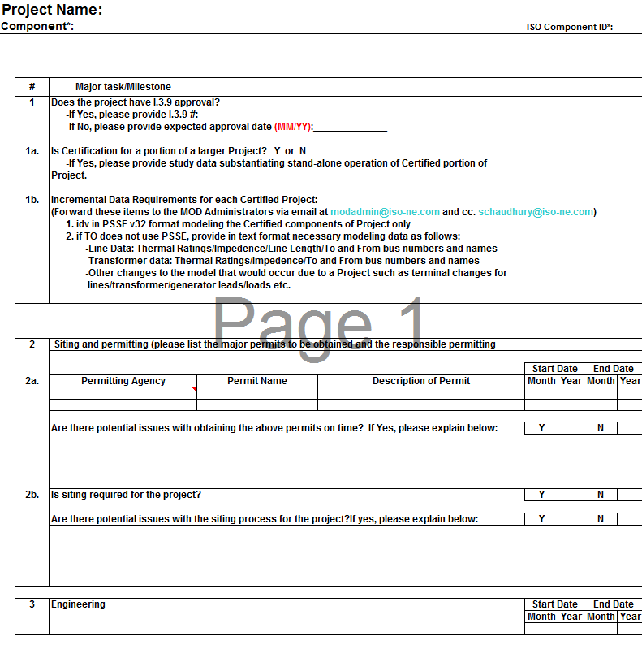
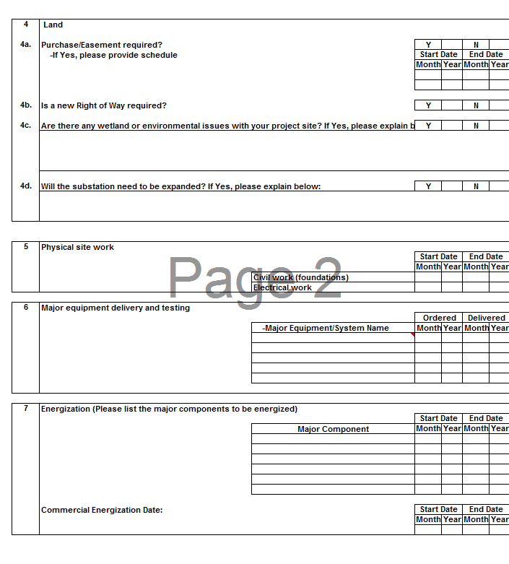
FCM Certification Process, cont’d Detailed Critical Path Schedule (CPS)

Slide 19
FCM Certification Process, cont’d Corporate Intent To Build form

Slide 20
FCM Certification Process, cont’d
Pursuant to Market Rule 1, Section III.12.6
The ISO accepts/denies certification based on criteria outlined in Section III.12.6.2 and in consultation with the TO
Publishes the topology for each Forward Capacity Auction (FCA) on the ISO external website
All accepted certified projects are then built into all future FCM models for which the certified in-service date qualifies
These include models for Capacity Supply Obligation (CSO) Bilateral periods and Annual Reconfiguration Auctions (ARA)

