Slide 1
RNS Rates: 2015 – 2019 PTF Forecast
PTO AC – Rates Working Group – Presentation
NEPOOL Reliability Committee/Transmission Committee – Summer Meeting
July 14-15, 2015

Slide 2
Presentation Overview
Page
3
4
5
6
7
8
2015 Forecast Comparison - Summary
2015 Forecast Comparison - Detail
2016 – 2019 Forecast - Disclaimer
2016 – 2019 Forecast - Summary
New England RNS Rate Forecast - Summary
2016-2019 Forecast Components

Slide 3
2015 Forecast Comparison - Summary
Three factors contribute to a variance:
Capital additions in-service and CWIP
Carrying charge factors
Average 12CP RNS loads
Actual June 1, 2015 RNS rate forecast reflects:
Updated PTF additions in-service and CWIP
Based on 2014 carrying charge factors
Based on 2014 average 12CP RNS load
These updates caused a $0.02 kW/yr decrease in the RNS rate relative to what was projected for 2015 last year.

Slide 4
2015 Forecast Comparison - Detail
Note: Figures may be off slightly due to rounding.

Slide 5
2016 - 2019 Forecast - Disclaimer
The 2016-2019 forecast herein provides an indicative RNS rate trend; it should be used for illustrative purposes only.
The estimated data utilized by the PTO AC to develop this forecast of RNS rates is based upon estimated capital additions provided to the Committee by all the New England Transmission Owners. Estimates for 2016 capital additions will be finalized during the normal course of update to the RNS rate effective June 1, 2016 and will reflect more current information.
The PTO AC acknowledges that this 2016-2019 forecast is based on a number of assumptions and variables including, among others, estimated project need, design, scope, labor & materials costs, inflation, site & permitting approvals, transmission in-service dates, estimated carrying charges & coincident peak network loads. It is therefore expected that such estimates and assumptions will change over time as more current data become available.
In addition, the 2016-2019 forecast reflects gross costs and does not include assumptions pertaining to savings (e.g., associated with congestion, unlocked capacity, etc.) or prior year true-up adjustments.

Slide 6
2016 - 2019 Forecast - Summary
Forecast is preliminary and for illustrative purposes only. Estimates are consistent with the March 2015 RSP and do not reflect revised ISO forecasts. Figures may be off slightly due to rounding.

Slide 7
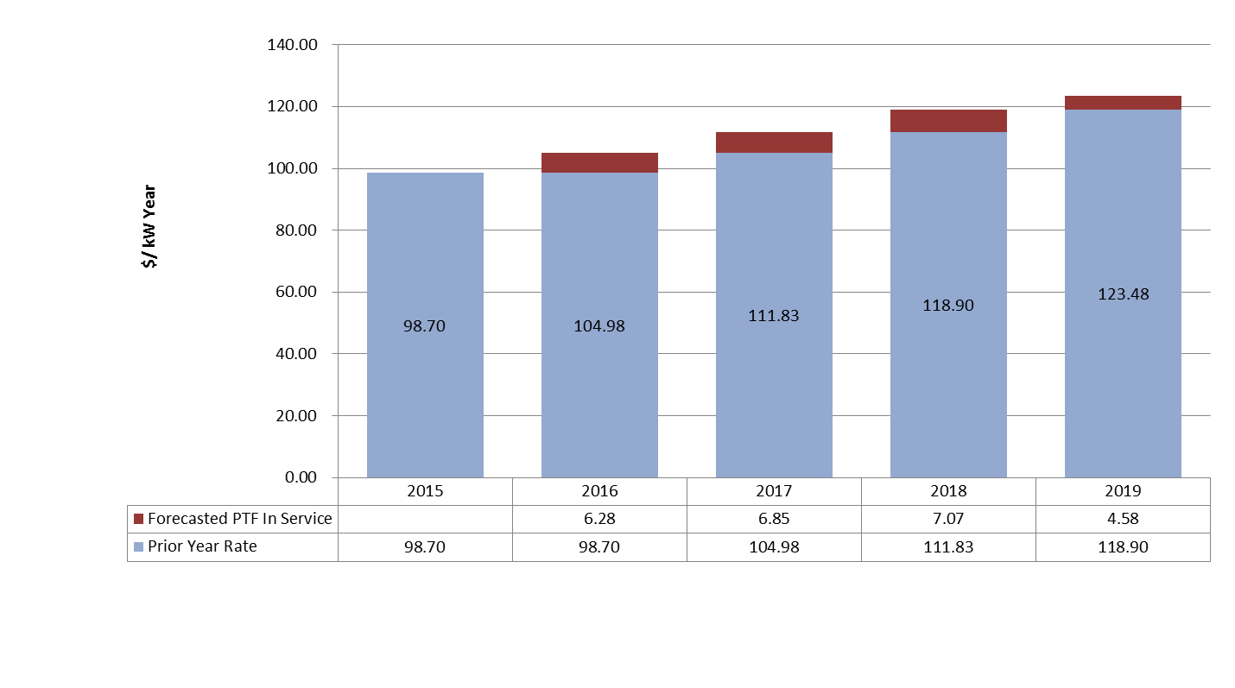
New England RNS Rate Forecast – Summary
Total RNS Rate Effective June 1 | 98.70 | 104.98 | 111.83 | 118.90 | 123.48
$/kWh (assumes a 59.4% load factor) | .019 | .020 | .021 | .023 | .024
Forecast is preliminary and for illustrative purposes only. Estimates are consistent with the March 2015 RSP and do not reflect revised ISO forecasts. Figures may be off slightly due to rounding.

Slide 8
2016-2019 Forecast Components

