Slide 1
March 28, 2016 / Planning Advisory Committee / Westborough, MA
Interconnection Cluster Studies
Summary and discussion of interconnection group study processes in the NYISO, CAISO, PJM, SPP, MISO and ISO-NE
Bruce Kay
Operations Tariff and agreement manager

Slide 2
Agenda
Provide an overview of grouped interconnection study and cost allocation processes in the NYISO, CAISO, PJM SPP, and MISO Tariffs
Summarize the relevant concepts for each ISO (e.g., cost allocation, re-study, withdrawal)
Briefly review the ISO-NE interconnection study process

Slide 3
Purpose
Seek stakeholder input on generator and ETU interconnection process cluster studies and cost allocation
For the purpose of the interconnection process, the ISO-NE OATT allows ISO to study:
Large and small generator Interconnection Requests serially or in clusters; however
While the ISO OATT reflects the pro forma cluster provisions, there are no supporting clustering implementation or cost allocation provisions and so interconnection requests are processed serially
ETU Interconnection Requests serially
Additional terms and conditions are required to facilitate the administration of such studies and also incorporate ETUs
ISO-NE seeks to engage stakeholders in discussion about cluster process and cost allocation approaches around the country

Slide 4
overview of grouped interconnection study and cost allocation processes
NYISO
CAISO
PJM
SPP
MISO
ISO-NE

Slide 5
Overview of FERC Pro Forma LGIP / SGIP
The 5 ISOs follow the FERC pro forma LGIP / SGIP basic interconnection structure
IR Request / Application (energy / capacity) Phase
Approval
Posting
Scoping Meeting
Coordinating with affected systems
Withdrawal
Establish Queue Position
Interconnection Study Phase
Feasibility Study
Preliminary evaluation of the system impact and cost of interconnecting the Generating Facility to the transmission system
Interconnection System Impact Study
Engineering study that evaluates the impact of the proposed interconnection on the safety and reliability of the transmission system and any other affected systems
Interconnection Facilities Study
Engineering study to determine a list of facilities (including Interconnection Facilities and Network Upgrades as identified in the ISIS), the cost of those facilities, and the time required to interconnect the IR with the transmission system
Agreement Phase
Engineering & Procurement (“E&P”) Agreement
Allows accelerate/begin engineering and procurement of long lead-time items necessary for the construction of the interconnection
Interconnection Agreement
Interconnection Facilities and Network Upgrades construction and payment agreement
Construction Phase

Slide 6
This presentation summarizes a subset of current CAISO, PJM, MISO and NYISO Tariff provisions
This presentation summarizes the group/cluster study and cost allocation provisions in the generators, and as applicable, merchant transmission, interconnection procedures in the NYISO, CAISO, PJM, SPP and MISO Tariffs. It is based on ISO-NE staff review of the filed Tariffs that were in effect on 1/1/2016, including limited follow-up with individuals at certain ISOs
In addition, summarizes:
MISO GIP Filing (ER16-675, dated 12/31/15)
CAISO GIP Order (ER16-693, dated 03/07/16)

Slide 7
Summary Table
Summary of Various ISO Cluster Study Processes |  | NYISO | CAISO | PJM | SPP | MISO*
Applicability | Large Gen, Small Gen, and/or Merchant Transmission | Large Gen some Small Gen Merchant Transmission | Large Gen some Small Gen Merchant Transmission | Large Gen Small Gen Merchant Transmission | Large Gen Small Gen - | Large Gen some Small Gen - ; all w/ firm service reservations
Entry Requirements | Application | Yes; elects ERIS or CRIS | Yes; elects energy or Option A or B capacity deliverability | Yes; elects ERS or CRS | Yes; elects ERIS or NRIS | Yes; elects ERIS, NRIS or NZIS
 | Deposit | Yes | Yes | Yes | Yes | Yes
 | Site control required | Yes, or additional deposit in lieu of | Yes, or additional deposit in lieu of | n/a | If proceeding past Feasibility Study, then Yes | Yes, or additional deposit in lieu of
 | Other concepts | n/a | n/a | n/a | n/a | Firm service reservation required
Cluster Study Period | Annual, Biannual, Other | Annual | Biannual | Biannual | Biannual | Annual
Cluster Study | Energy/Cap Assessments (Single or Separate ) | Separate, but in series | Single | Single | Single | Single
 | Determination if IR is studied in cluster or alone | ISO | ISO | ISO | ISO | ISO (Backfilling)
 | Restudy | Continues until all IRs either approve or drop out | At the end of Phase I; Phase II restudied annually | Case-by-case basis, grouping know or expected changes | In DISIS and IFS process | In DPP
 | When costs are locked in | At end of the study process, and prior to IA execution | IA execution | IA execution | IA execution | IA execution

Slide 8
Summary Table (cont.)
Summary of Various ISO Cluster Study Processes |  | NYISO | CAISO | PJM | SPP | MISO*
Cost Allocation | Study Costs (Study deposits are typically required at the beginning of each study phase) | Class Yr IRs in the study | Group Study IRs in the study | » 100% of the Attachment Facilities and Direct Assignment Facilities study costs » Local and Network Upgrades study costs in proportion to its projected cost responsibility for such upgrades | » 50% pro rata to # of cluster IRs; » 50% pro rata to requested MWs of cluster IRs | Study deposits offset study costs, and excess $ is refunded
 | Re-Study Costs | Class Yr IRs causing the restudy | -unclear- | -unclear- | Cluster study IR(s) being re-studied
 | Interconnection / Attachment Facilities Costs | 100% to IR | 100% to IR | 100% to IR | 100% to IR | 100% to IR
 | Common use Network Upgrade Costs | Pro rata to IRs in cluster w/ floor | Pro rata to IRs that contributed to the issue or based on IR total/delta MWs | Separate assessments for Thermal and Stability Upgrades and Short Circuit Upgrades; and costs < $5 mil / => $5 mil | Pro-rata to IRs based on positive incremental power flow impacts of the IR on such NU / ∑ all positive incremental power flow impacts on the NU
 | Capacity Upgrade Costs | Pro rata to IRs in cluster causing the degradation restored by upgrade | Pro rata based on flow impact of IR on the upgrade | n/a | n/a | n/a
 | Other concepts | Headroom | Cost cap applied to common use network upgrade cost assessment in Phase I | Includes a 5 year reach back for costs => $5 mi to IRs in subsequent queue groups | n/a | Late Comer Projects - a 5 year reach back for costs

Slide 9
Summary Table (cont.)
Summary of Various ISO Cluster Study Processes |  | NYISO | CAISO | PJM | SPP | MISO*
Elective Withdrawal | Who determines | IR | IR | IR | IR | IR
 | Obligated to pay for TOs out-of-pocket expenses | Yes | Yes | Yes | Yes | Yes
 | Obligated to pay for identified upgrades | - If other IRs are depending upon the upgrade - Yes - If not, pays TOs expenses | Allows for partial recovery under 6 conditions | If a committed IR withdraws and other IRs are expecting to utilize the Upgrade | Requires payment to TO for all prudently incurred costs with respect to that IR prior to the TP’s receipt of notice | Suspension of the IR construction requires an upfront payment of the greater of the IRs Network Upgrade costs or $5 million
Transition Language | Applicability of revised terms and conditions | Based on executed IA date | Limited discussion: transitioned separate SGIP into LGIP "cluster approach" | n/a | If not signed on to a GIA by effective date of revised tariff language, IR falls under the new language | If not signed on to a GIA by effective date of the revised tariff language, IR falls under the new language and must transition w/in 90 days
 | Other | Study cost allocation is different depending upon what Class Yr is involved | n/a | n/a | n/a | n/a
* Does not reflect MISO GIP Filing (ER16-675, dated 12/31/15)

Slide 10
Group/Cluster Study process Summary
NYISO Class Year Summary
CAISO Queue Cluster Study Summary
PJM Group Study Summary
SPP Cluster Study Summary
MISO Group Study Summary

Slide 11
NYISO Class Year Summary
Covers:
OATT, Attachment S – Rules To Allocate Responsibility for the Cost of New Interconnection Facilities
Manual 23 - Transmission Expansion and Interconnection Manual
Additional Summary Information
See Appendix C

Slide 12
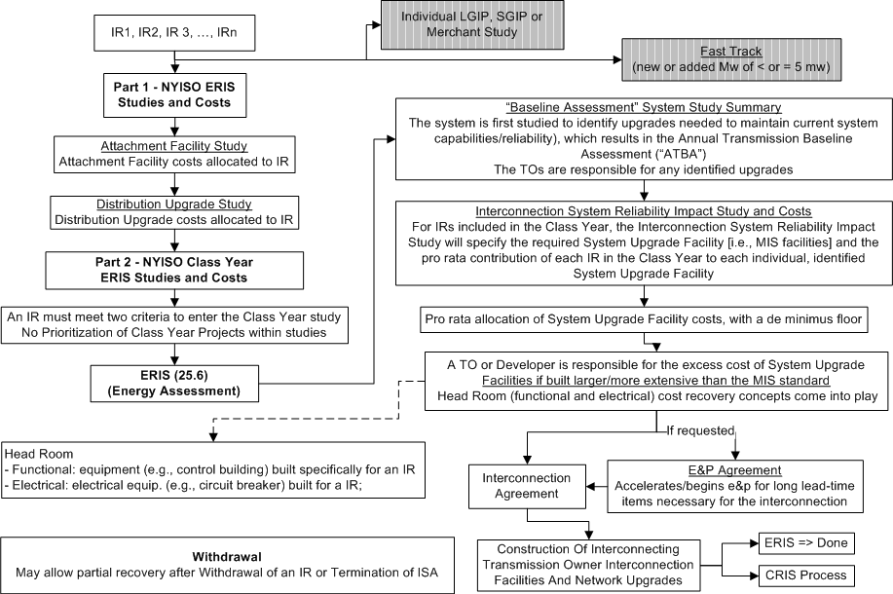
NYISO: ERIS Flow

Slide 13
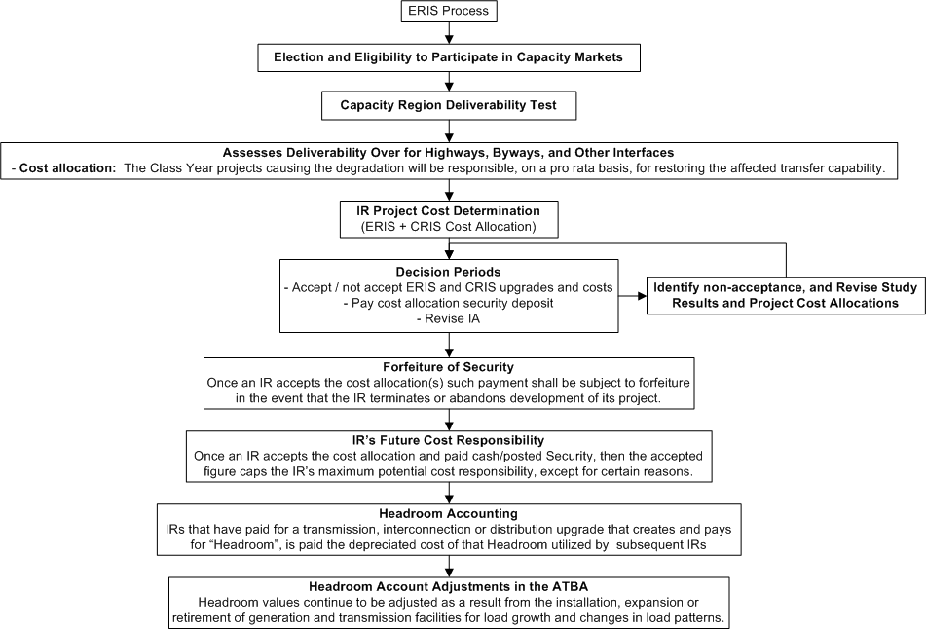
NYISO: CRIS Flow

Slide 14
NYISO: Class Year Study – Cost Allocation Summary
Applies to large and some small generators, and merchant transmission
Entry Requirements
Application and non-refundable $10,000 application fee
Elects Energy Resource Interconnection Service (ERIS) or Capacity Resource Interconnection Service (CRIS)
$30,000 refundable study deposit
Demonstration of Site Control (or an additional $10,000 deposit in lieu of)
Period
Annual Class Year studies
Includes a two-step study process that separately assesses energy and capacity deliverability in series
Restudy
Occurs until all IRs either agree to upgrades and cost allocation or drop out
An IR that agrees to “final round” upgrades and cost allocation is locked in to pay (exceptions)

Slide 15
NYISO: Class Year Study – Cost Allocation Summary (cont.)
Withdrawal
Once commit to upgrades and cost allocation, cash/security is subject to forfeiture
Obligates IR to pay TO for Interconnection Facilities constructed
If the SUF or SDU is required by more than one IR, then the IR must pay its allocated costs
Transition Language
Different terms for Class Years 2008-2010, 2011, and 2012 onward for study cost allocation
IRs without a filed IA as of a certain date fall under the new tariff language

Slide 16
NYISO: Class Year Study – Cost Allocation Summary
Cost Allocation
Study Costs
Energy Upgrade Studies: IR in the class year pays an equal share of the actual cost of energy studies
Capacity Upgrade Studies: IR in the class year requesting CRIS pays an equal share of the actual cost of capacity studies
Attachment Facility and Distribution Upgrade costs are allocation 100% to the IR
Utilizes “overage cost percentage” concept
Energy Upgrades: Pro rata allocation of costs to IRs needing the SUF
Utilizing a de minimus floor, the nature of the primary problem corrected, and certain exceptions
Capacity Upgrades: Pro rata allocation of costs to IRs causing the degradation restored by the SDU
Cost percentage threshold is dependent upon the IRs’ need for the SDU (>89.99% or <90%)
Ongoing Cost Responsibility
IR costs are capped at “final round” cost allocation amount
Exceptions: Accrued interest; actual expenses are less; actual expenses are more for certain reasons
IR not responsible for future upgrade costs
Headroom
Terminated and completed IRs that create and pay for the Headroom are paid the depreciated, adjusted Headroom cost subsequent IRs using the Headroom within the applicable period
IRs pay the prior IR for the utilized Headroom

Slide 17
CAISO QUEUE Cluster Study Summary
Covers:
Appendix DD - Generator Interconnection and Deliverability Allocation Procedures (GIDAP) of CAISO Fifth Replacement Tariff
Business Practice Manual For Generator Interconnection Procedures (GIP BPM)
Additional Summary Information
See Appendix A

Slide 18
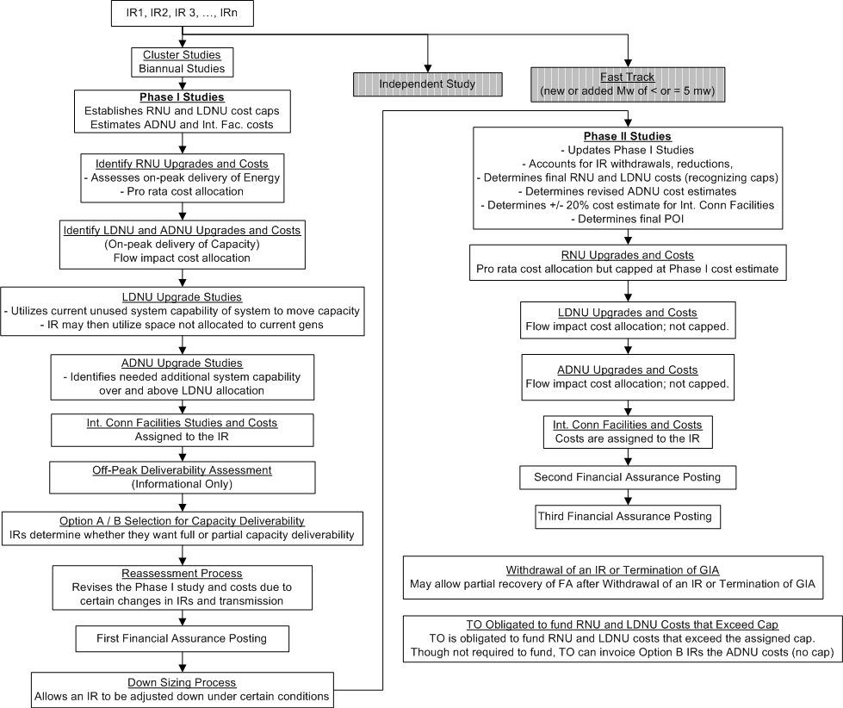
CAISO: Flow

Slide 19
CAISO: Cluster Study – Cost Allocation Summary
Applies to large gen, small gen and merchant transmission
Entry Requirements
Interconnection Study Deposit ($50,000 plus $1,000 per MW up to a maximum of $250,000)
Completed application
Demonstration of Site Exclusivity (i.e., site control) or an additional $100,000 for ≤20 MW and $250,000 for >20 MW deposit in lieu of
Period
Biannual cluster studies
Includes a two-step study process, that assesses energy and capacity deliverability within each step
Restudy
Occurs at the end of Phase I to adjust for withdrawals and system changes
Phase II is adjusted on an annual basis to account for annual downsizing and any withdrawals/terminations
Withdrawal/Termination
Once commit to upgrades and cost allocation, cash/security is subject to forfeiture
Obligates IR to pay TO for Interconnection Facilities constructed
Allows for partial recovery under certain conditions

Slide 20
CAISO: Cluster Study – Cost Allocation Summary
Cost Allocation
Study Costs are allocated pro rata to each IR assigned to the Group Study
To IR(s) requiring an upgrade
Cost caps for energy upgrade costs and certain capacity upgrade costs
No cost caps for interconnection facilities costs and certain capacity upgrades costs
Costs above the caps are allocated to the rate payers
Interconnection Facility Upgrades are allocated 100% to the IR
RNU (energy) cost allocation: Reason for upgrade drives cost allocation: pro rata to IRs that contributed to the issue or based on IR total/delta MWs. RNU costs equal Phase I cap or less if reduced due to restudies
LDNU (capacity) cost allocation: to IRs based on flow impact of gen on the needed network upgrade per distribution factor. LDNU costs equal Phase I cap or less if reduced due to restudies
ADNU (capacity ) costs allocation: to IRs based on flow impact of gen on an ADNU rate*requested Cap MWs, where the ADNU rate = ADNU costs / delta total increase in capability requested. ADNU costs can be modified during restudy and are locked in upon the upgrade’s commercial operations date
Once the IA is signed, the customer is committed to pay for the upgrades
Exception, if the need goes away, the IR does not have to pay (other than TOs out of pocket expenses) or build
Three-step payment plan
Transition
Limited discussion on the 2010 merging of the small and large gen queues

Slide 21
CAISO: GIP Order (ER16-693, dated 03/07/16)
Downgrades capacity deliverability IRs to energy deliverability IRs if in-service date is > 7 years in cluster study (> 10 yrs in serial study), unless meets certain criteria
Unless agreed to, parties have 120 days to negotiate the IA
Changes current variable study deposits to a flat $150,000
Modifies financial security requirements for IRs that want to self-build network upgrades
Allows IR to revise its commercial operation date (and associated dates) as a modification that would not require a material modification analysis, but only if requested shortly after the Phase I results meeting
Clarifies that where an IR makes a modification request after the Phase II study that changes the scope, schedule, or cost of the interconnection facilities or network upgrades, CAISO will issue a revised interconnection study report to the IR within 90 days of the request
Generally non-substantive and consistent with the Order No. 2003 standards, modifies the pro forma Large Generator Interconnection Agreement’s (LGIA) insurance provisions
Amends tariff to provide greater certainty with respect to the timing of when an IR must post financial security
Option A/B Clarification:
An IR that selects Option B and does not receive its requested deliverability capacity allocation has the option to change its deliverability status to energy-only (just like Option A customers)
All IRs must meet the minimum criteria identified in the tariff to be eligible to receive a deliverability allocation

Slide 22
PJM Group Study Summary
Covers:
PJM OATT - Section IV. Interconnections with the Transmission System
Manual 14A: Generation and Transmission Interconnection Process
Additional Summary Information
See Appendix D

Slide 23
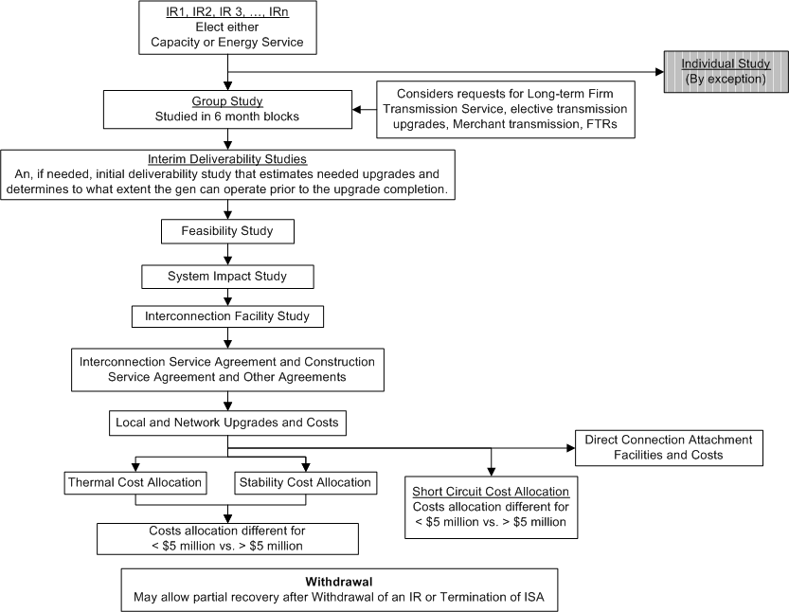
PJM: Flow

Slide 24
PJM: Group Study – Cost Allocation Summary
Applies to large gen, small gen and merchant transmission
Entry Requirements
Application
Elects Energy Resource Status (ERS) or Capacity Resource Status (CRS)
Deposits
refundable - $100/$150/$200/MW requested depending on application receipt, with maximum of $100,000
non-refundable - $10,000/$20,000/$30,000/MW requested depending on application receipt
Period
Queue is group studied in 6 month blocks
Includes a single study process that assesses energy and capacity deliverability in queue order
Restudy
Is on a case-by-case basis, with an attempt to group know or expected changes

Slide 25
PJM: Group Study – Cost Allocation Summary
Cost Allocation
Study Costs – IR pays
100% of the Attachment Facilities and Direct Assignment Facilities study costs
Local Upgrades and/or Network Upgrades study costs in proportion to its projected cost responsibility (as determined in the Interconnection Feasibility Study or the Initial Study) for such upgrades
100% allocation of Attachment Facility and Distribution Upgrade costs to IR
Thermal and Stability Upgrades - for Local and Network Upgrades that cost:
< $5 mil.: All IRs in the study group, which add loading to the facility and in aggregate cause the facility identified in the SIS to exceed 100% loading of the applicable rating (i.e., develops the need for the Upgrade), will be assigned costs in proportion to their contributing MW impacts
= > 5 mil.: All IRs in the group study, and IRs in subsequent group studies that occur less than 5 years after the first IR executes a construction agreement to build the facility, which cause the loading of the facility to exceed its capability as determined in the SIS will be assigned costs in proportion to their contributing MW impacts
Short Circuit Upgrades - for Local and Network Upgrades that cost:
An IR is assigned costs in proportion to its fault level contribution/fault level increase causing the Upgrade need
< $5 mil.: Costs are allocated to those IRs in the queue group. No allocation outside of queue group
= > 5 mil.: Costs are allocated to those IRs in the queue group and to IRs in subsequent queue groups that occur less than 5 years
Withdrawal Provisions
If a committed IR withdraws and other IRs are expecting to utilize the Upgrade, the withdrawing IR is required to pay its Upgrade cost share; hence, the other IRs are not financially harmed by the decision
Transition – No discussion

Slide 26
SPP Cluster Study Summary
Covers:
SPP OATT Attachment V Generator Interconnection Procedures
Additional Summary Information
See Appendix E

Slide 27
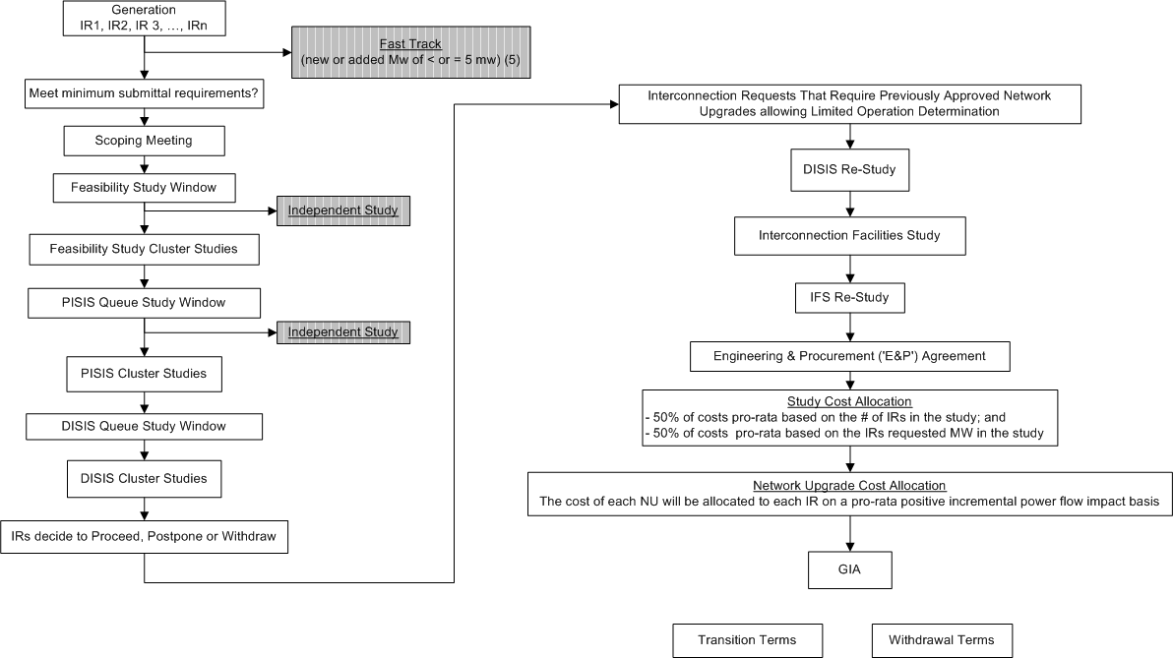
SPP: Group Study Flow

Slide 28
SPP: Cluster Study – Summary
Applies to generators
Merchant transmission is studied under a separate process
Entry Requirements
Application for interconnection
Elects Energy Resource Interconnection Service (ERIS) or Network Resource Interconnection Service (NRIS)
Deposit
Site control, if proceeding past Feasibility Study
Inclusion in cluster study
SPP determines which IRs are included in cluster study or independent study
Cluster Study
Period: biannual SISs
Additional deposits for each study (Feasibility, Preliminary SIS, Definitive SIS, Facilities)
Consists of a short circuit analysis, a stability analysis, and a power flow analysis
Provides a list of facilities that are required as a result of the IR and non-binding good faith cost and time to construct estimates
Includes Interconnection Facility cost estimate (+/- 20%) of connecting to the TS at the POI
Can determine limited operation value if certain upgrades are not available
Proceed, Postpone or Withdraw Decision: Upon receiving the DISIS report, the IR decides to proceed, postpone for up-to 2 DISIS cycles, or withdraw

Slide 29
SPP: Cluster Study – Summary (cont.)
Restudy
DISIS re-study
Occurs due to a higher or equally queued IR dropping out of the queue, a higher queued IR modification, POI re-designation, or certain changes to more than one similar IRs
Applies to DISIS Stand Alone Scenario study and not Cluster Scenario study, which is automatically re-studied in every subsequent DISIS
Re-study costs are borne by the IR(s) being re-studied
After the completion of the Restudy, an IR that is being restudied as a result of “certain changes to more than one similar IRs” may elect to continue to the Interconnection Facilities Study Queue, be considered the subsequent DISIS), or withdraw and may receive a refund of its security deposit
IFS Re-Study
Occurs due to a higher or equal priority queued IR dropping out of the queue or a modification of a higher queued project
Re-Study costs are be borne by the IR(s) being re-studied
Withdrawal
IR may withdraw at any time w/ notice
Results in the loss of IR's Queue Position and the forfeiture of milestone deposits
Requires payment to TO for all prudently incurs costs with respect to that IR prior to the TP’s receipt of notice

Slide 30
SPP: Cluster Study – Summary (cont.)
Cost Allocation Concepts
Study Costs
50% to IRs pro-rata based on number of IRs in the cluster study; and
50% to IRs pro-rata based on the IR’s requested MWs
Restudy Costs: 100% to IR(s) being re-studied
Interconnection Facilities – 100% to IR
Shared Facilities
Each NU’s costs are allocated to each IR on a pro-rata basis for the positive incremental power flow impacts of the requested service on such NU in proportion to the total of all positive incremental power flow impacts on such NU
Negative incremental flows (i.e., counter flow) on a NU are ignored
IR commits to pay for upgrades upon execution of GIA
Transition Provisions
If not signed on to a GIA by effective date of revised tariff language, IR falls under the new language

Slide 31
MISO Group Study Summary
Covers:
MISO Tariff - Attachment X. Generator Interconnection Procedures
Generator Interconnection Business Practices Manual BPM-015-r11
Additional Summary Information
See Appendix B

Slide 32
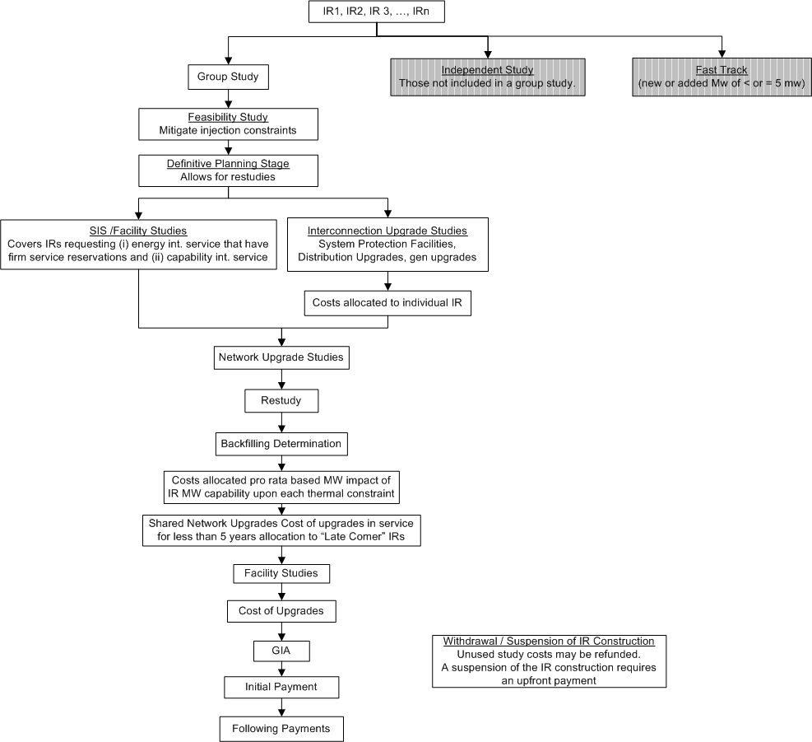
MISO: Group Study Flow

Slide 33
MISO: Group Study Overview
Applies to large gen and some small gen with firm transmission service reservations
Entry Requirements
Application
Selects Energy Resource Interconnection Service, Network Resource Interconnection Service or Net Zero Interconnection Service
Deposit
Site control, or $100,000 deposit in lieu of
Period
Annual group studies
Includes a single study process that assesses energy and capacity deliverability in queue order
Cost Allocation
Study Costs – Per milestone study deposits, which represent the cost of study in a MW range. Unused $ are refunded
Re-study Costs – Are offset by the milestone study deposits (above)
to IR(s) requiring:
Interconnection Facility Upgrades – 100% allocation to IR
Network Upgrades allocated pro rata based MW impact of an IRs MW capability upon each thermal constraint
Late Comer Projects - Costs for Network Upgrades that are in service for less than 5 years from the IR in service date are allocated a portion of the costs
Once IR executes the GIA, they are committed to pay
Initial and subsequent payments are stated in the GIA
Withdrawal/Termination
Suspension of the IR construction requires an upfront payment of the greater of the IRs Network Upgrade costs or $5 million
Transition

Slide 34
Recent MISO GIP Filing Summary (ER16-675, dated 12/31/15) - Streamline and add flexibility and efficiency to the queue study process
Minimization of Unscheduled Restudies
(1) subdivides the Definitive Planning Phase (DPP) into three sequential phases to provide for a structured restudy process;
each of the proposed DPP phases will include a System Impact Study at a defined point in the process: a preliminary study, a revised study and a final study
(2) creates two designated off-ramps for IRs to withdraw projects that are not ready to proceed;
allows an IR to withdraw its project from the queue on a more structured basis (i) immediately after the preliminary study and (ii) immediately after the revised study. This allows the revised study and the final study to be conducted by using updated facts and assumptions, incorporates a scheduled restudy in the process, eliminates the need for unscheduled restudies during the preliminary study and revised study process, and minimizes restudy in the final study process
(3) restricts restudies after the GIA stage
An IR with a completed GIA does not undergo a restudy due to a change to a higher-queued project, except when ordered by the Commission
Enhancement of Interconnection Customer Readiness
The current procedures require IRs to make a “cash-at-risk” payment (the “DPP Entry Milestone” payment) prior to entering the DPP
To prevent unscheduled restudies within the DPP, two new Milestones, M3 and M4, are added to DPP Phases II and III that includes a “cash-at-risk” payment. If an IR withdraws prior to these points, they are not required to the associated payment. Because of this, IRs choosing to remain in the queue have greater certainty because projects that are not ready to proceed are incentivized to exit at the designated Decision Points
IRs ‘“at-risk” milestone payments is used to fund cost increases, for projects that execute a GIA, in Network Upgrades caused by withdrawing projects
Additional Revisions to the GIP
(1) Includes a new, voluntary Pre-Queue Feasibility Phase while eliminating the current Interconnection Feasibility Study
Potential IRs benefit by providing them with an analysis that can help guide a decision to submit an IR, potentially saving time, money, and resources
(2) Eliminates the System Planning and Analysis (“SPA”) Phase from the process, replacing it with the Pre-Queue Feasibility Phase
(3) Allows IRs to be reduced in size during the preliminary study phase

Slide 35
ISO-NE INTERCONNECTION Study and CNR Group Study Flows
Covers:
Schedules 22, 23 and 25
FCM Process

Slide 36
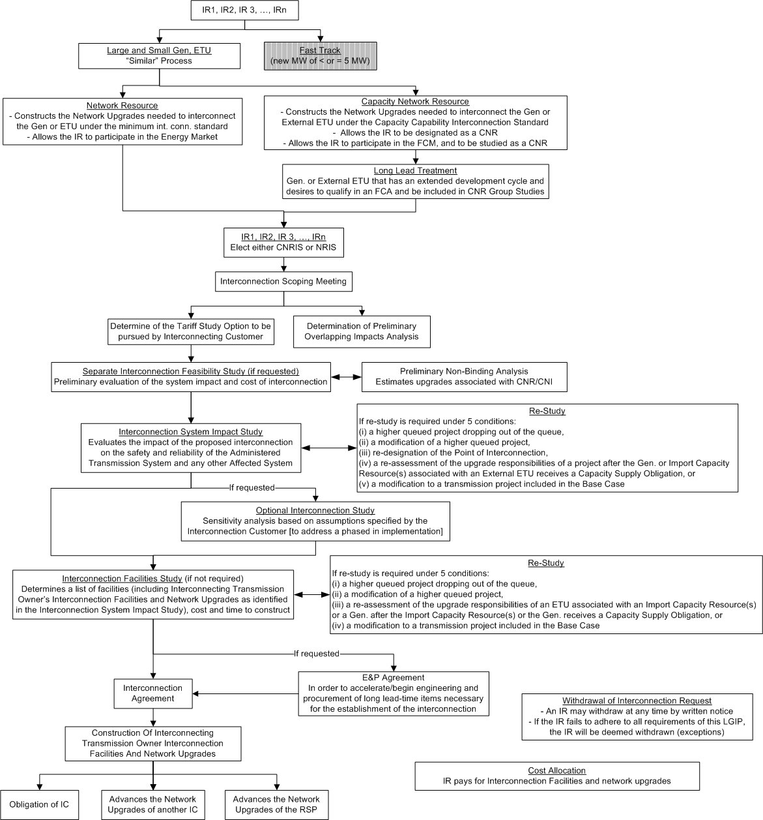
ISO-NE INTERCONNECTION Study Flow

Slide 37
ISO-NE CNR Study Flow

Slide 38
Cluster Study Concepts

Slide 39
Alternatives for consideration when exploring cluster approaches
IRs considered within the cluster study process
Large generator
Small generator
Merchant/elective transmission upgrades
Entry Requirements
Deposit
Application
Site control; site control or deposit in lieu of
Inclusion in cluster study
By IR request
ISO excludes by exception
By study type (FeasS vs. SIS)

Slide 40
Alternatives for consideration … (cont.)
Cluster Study
Limited clusters/trigger-specific clusters
Cluster Window Period: Annual / biannual / other
Determine/offer prequalified injection points
ISO determines which IRs are studied in cluster or independently
IRs studied in queue order or all together
Coordination with:
series IR studies
FCM process
Development of study base case
Reflect estimated completion of Network Upgrades currently being built
Approved I.3.9 projects
Stabilizing queue
Via non-refundable deposits
Via requirement to pay for build if current or subsequent IRs in cluster studies are depending on it
Limiting restudies
Limiting project modifications
Allow for off ramps
Treatment of project modifications (material mods)

Slide 41
Alternatives for consideration … (cont.)
Restudy (one of the most problematic features of clusters – caused by earlier queued project withdrawal)
Require “at risk” payments at certain milestones
Occurs until all IRs either agree to upgrades and cost allocation or drop out
An IR that agrees to “final round” upgrades and cost allocation is locked in to pay (exceptions)
Withdrawal Provisions
IR decides when to withdraw
Obligation to pay (beyond “at risk” payments )
Regardless or withdrawal / termination
Only if another IR also requires it
TOs out-of-pocket expenses
Cost Allocation Concepts
Study Costs
Actual costs charged pro rata to IRs in cluster group
High flat-rate deposit, where any unused portion is refunded to IRs in cluster group
Re-study costs
Actual costs charged pro rata to IRs causing re-study
High flat-rate study cost deposit covers restudy costs

Slide 42
Alternatives for consideration … (cont.)
Cost Allocation Concepts (cont.)
Interconnection Facilities – typically 100% to IR
Shared Facilities
Establish costs certainty
Based on “total upgrade costs” or “overage cost percentage” (transmission study net costs)
Cost percentage threshold – allocate all or a % of upgrade costs to the IRs requiring the upgrade
Allocation:
Caps - If cap, who pays for remainder – other IRs or load
Floor - If floor, remainder costs shift to other IRs
Pro rata;
Per generator/ETU
MW-based
Based on condition corrected (thermal, stability, short circuit)
Different allocation based on upgrade costs
Subsequent cluster study IRs utilizing Network Upgrade to pay share of costs
If TO or IR requests greater capability that identified in study, the TO or IR pays for 100% of the excess cost
Headroom
Payment schedule stated within OATT or established in Interconnection Agreement

Slide 43
Alternatives for consideration … (cont.)
Cost Allocation Concepts (cont.)
Costs that are not allocated
Ongoing O&M cost responsibility
Responsibility to pay for future upgrades
IR commits to pay for upgrades
When approve cost allocation
When sign the Interconnection Agreement
Any need to shorten time of SIS and IA development and execution
Process modifications in recent CAISO Order and MISO Filing
IA negotiation periods
Flat study deposits
Structure study/restudy process to defined points
Add off-ramps and at risk milestone payments
Transition Provisions

Slide 44
Next Steps

Slide 45
Next Steps
May PAC follow-up discussion
Provide summary of input received to date
Seek stakeholder input

Slide 46
Discussion …

Slide 47
Appendices

Slide 48
Appendix A Additional Summary Information CAISO QUEUE Cluster Study

Slide 49
CAISO: Study Options
Options/Paths
Cluster Study – primary path utilized to assess energy and capacity deliverability and required upgrades
Phase I
Phase II
Independent Study – must show that the cluster study won’t accommodate the IR
Fast Track – for < or = 5 MW IRs
Entry Requirements
Interconnection Study Deposit ($50,000 plus $1,000 per MW up to a maximum of $250,000)
Completed application
Elects energy or Option A or B capacity deliverability
Demonstration of Site Exclusivity (i.e., site control) or an additional $100,000 for ≤20 MW and $250,000 for >20 MW deposit in lieu of

Slide 50
CAISO: Study Cost Allocation and Phase I Study
Study Costs are allocated pro rata to each IR assigned to the Group Study
Terms
POI = Point of interconnection
Interconnection Facilities = gen lead facilities
RNU = energy upgrades
LDNU = capacity upgrades using unused space on existing system
ADNU = capacity upgrades over and above LDNU upgrades
Phase I Study
Determines preliminary costs and cost caps for:
RNU
LDNU
Determines preliminary costs for:
ADNU
Interconnection Facilities

Slide 51
CAISO: Identify RNUs and Costs
Assesses on-peak delivery of energy to the transmission system
Identifies needed short circuit, thermal and stability upgrades, which translate to RNU costs
Short circuit upgrade costs are allocated pro rata to IRs that contributed to the issue
Thermal and stability upgrade costs are allocated pro rata to all IRs in study based on total MWs (new gen) or delta MWs (existing gen)
TO is required to construct RNUs

Slide 52
CAISO: Identify LDNU and ADNU Costs
Assesses on-peak delivery of capacity to the transmission system
LDNU and ADNU cost allocation
LDNU costs are allocated to IRs based on flow impact of gen on the needed network upgrade per distribution factor
ADNU costs are allocated to IRs based on flow impact of gen on an ADNU rate * requested Cap MWs, where the ADNU rate = ADNU costs / delta total increase in capability requested
TO is required to construct LDNUs and ADNUs

Slide 53
CAISO: Interconnection Facilities and costs; and Off-Peak Deliverability Assessment
Interconnection Facilities and costs
Provides a good faith estimate of Interconnection Facilities costs based on TO estimates
Interconnection Facilities costs are allocated 100% to the IR
TO is required to construct certain facilities, per construction agreement
Off-Peak Deliverability Assessment
An informational assessment that identifies energy deliverability issues for a Group Study that contains location constrained intermittent generators (e.g., resources required to gen due to must-take fuel: wind, solar, land fill gas, etc.)
TO is not required to construct

Slide 54
CAISO: Option A / B Selection for Capacity Deliverability; and Reassessment Process
Option A / B Selection for Capacity Deliverability
IRs that require full or partial capacity deliverability select Option A or B
Option A - means that the gen needs the deliverable capacity covered under the RNU and allocated LDNU to continue to commercial operation
Option B - means that the gen will pay for the needed deliverable capacity by way of RNU, allocated LDNU and ADNU
Reassessment Process
Allows for a reassessment of the Phase I study and associated costs due to certain withdrawals, gen downsizing, actual commercial gen performance, delta delivery allocation, other transmission upgrade
Resulting cost caps reductions are allowed for reductions of at least “20% and 1 million”

Slide 55
CAISO: First Financial Assurance Posting
Due the later of 90 calendar days after the first posting of the final Phase I study or 40 calendar days after the posting of the revised final Phase I report
Small Gens
Energy Only IRs – lesser of 15% of Phase I RNU costs assigned to the IR or $20k/MW (total if new, delta if existing) but no less than $50k
Option A IRs - lesser of 15% of Phase I RNU and LDNU costs assigned to the IR or $20k/MW (total if new, delta if existing) but no less than $50k
Option B IRs - lesser of 15% of Phase I RNU, LDNU and ADNU costs assigned to the IR or $20k/MW (total if new, delta if existing) but no less than $50k
Plus:
Interconnection Facility – lesser of 15% of Phase I IR Interconnection Facility Costs or $20k/MW (total if new, delta if existing) but no less than $50k

Slide 56
CAISO: First Financial Assurance Posting (cont.) and Downsizing Process
First Financial Assurance Posting (cont.)
Large Gens
Energy Only IRs – lesser of 15% of Phase I RNU costs assigned to the IR, $20k/MW (total if new, delta if existing) or $7.5 mil., but no less than $500k
Option A IRs - lesser of 15% of Phase I RNU and LDNU costs assigned to the IR , $20k/MW (total if new, delta if existing) or $7.5 mil., but no less than $500k
Option B IRs - lesser of 15% of Phase I RNU, LDNU and ADNU costs assigned to the IR, $20k/MW (total if new, delta if existing) or $7.5 mil., but no less than $500k
Plus:
Interconnection Facility – lesser of 15% of Phase I IR Interconnection Facility Costs or $20k/MW (total if new, delta if existing) or $7.5 mil., but no less than $500k
If the cost estimates are less than the minimum posting amount, then use minimum amount
If fail to post F.A., then IR deemed withdrawn
Annual Downsizing Process
Allows an IR to be adjusted down under certain conditions prior to the start of the Phase II studies
The downsizing IR is still required to finance the RNUs, LDNUs and ADNUs, if the upgrades are required by other gens within its Cluster Study or later queued IRs
Minimal changes (0 MW < larger of 5% or 10 MW) to capacity reduction does not reduce Phase I cost responsibility
Also adjusts for IR withdrawals and terminations

Slide 57
CAISO: Phase II Studies
Phase II Studies
Updates Phase I Studies
Accounts for IR withdrawals, reductions
Determines final RNU and LDNU costs (recognizing caps)
Determines revised ADNU cost estimates
Determines +/- 20% cost estimate for Interconnection Facility
Determines final POI
Determines final RNU Upgrades and Costs
Further details the needed short circuit, thermal and stability upgrades, which translate to RNU costs
RNU Cost Allocation
Short circuit upgrade costs - are allocated pro rata to IRs that contributed to the issue but capped at Phase I cost estimate
Thermal and stability upgrade costs - are allocated pro rata to all IRs in study based on total MWs (new gen) of delta MWs (existing gen) but capped at Phase I cost estimate
Reassessment and Approval
Annually reassessed in the downsizing process
Phase I costs are “approved” with the first FA posting
RNU and LDNU costs equal Phase I cap or less if reduced due to restudies
ADNU can be modified during restudy and are “locked” in upon the upgrades’ commercial operations date
Allows for a reassessment of the Phase II study and associated costs following all IRs’ approval of deliverable capacity values

Slide 58
CAISO: Final LDNU, revised ADNU and Int. Conn Facilities and Costs
Determine final LDNU Upgrades and Costs
Further details the needed LDNUs and LDNU costs, which are capped at Phase I cost estimate
LDNU cost allocation
LDNU costs are allocated to IRs based on flow impact of gen on the needed network upgrade per distribution factor
Determine revised ADNU Upgrades and Costs
Further details the needed ADNUs and ADNU costs
LDNU cost allocation
ADNU costs are allocated to Option B IRs based on flow impact of gen on the ADNU based on an on-peak gen distribution factor. This is different from the Phase I cost estimate
Unclear whether the calculation is made on (total MWs of all Option B IRs) or (total MWs (new) or delta MWs (existing) of Option B IRs)
Interconnection Facility and costs
Further details the needed Interconnection Facility upgrades and costs
Interconnection Facility costs are allocated 100% to the IR

Slide 59
CAISO: Second Financial Assurance Posting
Due the later of 180 calendar days after the first posting of the final Phase II study report
Option A IRs that did not get any TP deliverability allocation that park their IR may extend the FA posting 12 months
Option A IRs that received some but not all TP deliverability allocation and seek the additional allocation in the next cycle post an FA for the RNU Interconnection Facility and allocated LDNU as above and may extend the FA posting for the unallocated LDNU by 12 months
If the cost estimates are less than the minimum posting amount, then IR posts 100% of costs
If IR fails to post F.A., then constitutes grounds for IR termination
Small Gens
Energy Only IRs – lesser of $1 mil. or 30% of Phase I/II RNU costs assigned to the IR but no less than $100k
Option A IRs - lesser of $1 mil. or 30% of Phase I/II RNU and LDNU costs assigned to the IR but no less than $100k
Option B IRs - lesser of $1 mil. or (30% of Phase I/II RNU and LDNU costs assigned to the IR plus 30% of Phase II ADNU adjusted for TP Deliverability allocation) but no less than $100k
Plus
Interconnection Facility – lesser of $1 mil or 30% of Phase II IR Interconnection Facility Costs but no less than $100k

Slide 60
CAISO: Second Financial Assurance Posting (cont.); and Third Financial Assurance Posting
Second Financial Assurance Posting (cont.)
Large Gens
Energy Only IRs – lesser of $15 mil. or 30% of Phase I/II RNU costs assigned to the IR but no less than $500k
Option A IRs - lesser of $15 mil. or 30% of Phase I/II RNU and LDNU costs assigned to the IR but no less than $500k
Option B IRs - lesser of $15mil. or (30% of Phase I/II RNU and LDNU costs assigned to the IR plus 30% of Phase II ADNU adjusted for TP Deliverability allocation) but no less than $500k
Plus
Interconnection Facility – lesser of $15 mil or 30% of Phase II IR Interconnection Facility Costs but no less than $500k
Third Financial Assurance Posting
Due on or before the start of construction activities for Network Upgrades or Interconnection Facilities
If fail to post F.A., then constitutes grounds for GIA termination
100% of Phase II RNU, LDNU and ADNU costs assigned to the IR plus
Option B IRs do not have to pay for ADNU costs associated with TP deliverability not allocated but have to show that they can finance that amount
Plus
100% of Phase II Interconnection Facility Costs

Slide 61
CAISO: Withdrawal or Termination
Withdrawal of an IR or Termination of GIA
Except for certain reasons, a w/d of an IR or GIA termination allows the TO to liquidate the interconnection F.A. to pay for (a) the RNUs, LDNUs and ADNUs, any excess must be returned to IR customer, and (b) the Interconnection Facility cost incurred or committed
Partial Recovery of FA after IR Withdrawal or Termination of GIA
6 conditions allow for the partial recovery of FA after Withdrawal of an IR or Termination of GIA
Failure to secure a Power Purchase Agreement
Failure to secure a necessary permit
Increase in the cost of TO’s Interconnection Facilities
Material change in IR’s Interconnection Facilities created by a CAISO change in POI
An IR having selected Option (A) is not allocated TP Deliverability and notifies the CAISO of its election to withdraw by the deadline for the second posting of Financial Security
For an IR having selected Option (B) an increase in the Phase II Interconnection Study cost estimates for ANDUs over the Phase I Interconnection Study cost estimates for ADNUs of the lesser of either twenty (20) percent or $20 million
Amount of refund is dependent on when the action is taken

Slide 62
CAISO: TO Obligated to fund RNU and LDNU Costs that Exceed Cap
Single IR
Where the RNUs and LDNUs costs are assigned to a single IR, the TO(s) can invoice the IR up to the RNU and LDNU caps
Multiple IRs
Where the RNU and LDNU costs are assigned to multiple IRs, the TO(s) can invoice each IR for such RNUs and LDNU in accordance with their respective cost responsibilities, up to a maximum amount no greater than the cost cap assigned to that IR
Where the ADNU costs are assigned to more than one Option (B) IR, the TO(s) shall invoice each IR for such ADNUs based on their respective cost responsibilities
RNUs and LDNUs costs above the total individual RNU and LDNU cost caps are allocated to transmission rate payers
Transition
Limited discussion in GIP Business Procedures (not Tariff) on the 2010 merging of the small and large gen queues

Slide 63
CAISO: GIP Order (ER16-693, dated 03/07/16)
Downgrades capacity deliverability IRs to energy deliverability IRs if in-service date is > 7 years in cluster study (> 10 yrs in serial study), unless meets certain criteria
Unless agreed to, parties have 120 days to negotiate the IA
Changes current variable study deposits to a flat $150,000
Modifies financial security requirements for IRs that want to self-build network upgrades
Allows IR to revise its commercial operation date (and associated dates) as a modification that would not require a material modification analysis, but only if requested shortly after the Phase I results meeting
Clarifies that where an IR makes a modification request after the Phase II study that changes the scope, schedule, or cost of the interconnection facilities or network upgrades, CAISO will issue a revised interconnection study report to the IR within 90 days of the request
Generally non-substantive and consistent with the Order No. 2003 standards, modifies the pro forma Large Generator Interconnection Agreement’s (LGIA) insurance provisions
Amends tariff to provide greater certainty with respect to the timing of when an IR must post financial security
Option A/B Clarification:
An IR that selects Option B and does not receive its requested deliverability capacity allocation has the option to change its deliverability status to energy-only (just like Option A customers)
All IRs must meet the minimum criteria identified in the tariff to be eligible to receive a deliverability allocation

Slide 64
Appendix B Additional Summary Information MISO Group Study

Slide 65
MISO: Study Options
Group Study – primary path utilized to assess energy and capacity deliverability and required upgrades
Independent Study – Those IRs not included in the group study
Fast Track – new or added MW of < or = 5 MW IRs

Slide 66
MISO: IR Service Request Types
Energy Resource Interconnection Service (ERIS) allows an IR to connect to the Transmission or Distribution System, and be eligible to deliver the facility’s output using the existing firm or non-firm Transmission System capacity on an “as available” basis
Net Zero Interconnection Service is restricted ERIS that allows an IR to increase the gross generating capability at the same POI of an existing generator without increasing the existing Interconnection Service limit at that POI
Network Resource Interconnection Service (NRIS) allows the IR to be designated on the Transmission System as a Network Resource, up to the Generating Facility's full output, on the same basis as existing interconnected Network Resources, and to be studied as a Network Resource on the assumption that such a designation will occur
Also allows Conditional NR Interconnection Service

Slide 67
MISO: Study Costs
Study costs/Allocation
Per stated milestone study deposits, which represent the cost of study in a MW range. Unused $ are refunded upon completion
Unclear how an IR’s share is determined
Re-study Costs
DPP restudy costs are offset by the above milestone study deposits

Slide 68
MISO: Group Study Process
MISO and TOs determine which IRs will be grouped
Group studies are: not limited by size; are based on constrained area, transmission voltage, right of way availability, substation room for expansion
Sub-groups may also be selected based on limiting constraints; engineering judgment
Other factors considered: number/type of projects, queue position, electrical proximity to POI
Injection constraints are mitigated for all IRs
An IR must mitigate the injection constraints it causes to the transmission system
Network Upgrade Facility Study for IRs requesting
(i) energy resource interconnection service (ERIS) with firm service reservations;
ERIS is studied at the firm service reservation value
(ii) “capability” network resource interconnection service (NRIS)
NRIS is studied at the requested capacity value

Slide 69
MISO: SIS /Facility Studies and Upgrade Costs
Determines Interconnection Upgrades and costs (including System Protection Facilities, Distribution Upgrades, gen upgrades)
Interconnection Upgrades are allocated to the individual IR
Backfilling
If an IR withdraws in the DPP, allows a lower queued IR meeting certain criteria to fill in for the withdrawn IR. The new IR has to:
Meet all the milestone requirements and deposits,
Be similar in type, POI and voltage level
Have the same or lower service request (ERIS, NRIS)
Determines Network Upgrades and costs
Network Upgrade costs are allocated pro rata based MW impact of an IRs MW capability upon each thermal constraint

Slide 70
MISO: Shared Network Upgrades Cost allocation to “Late Comer Projects”
Costs for Network Upgrades that are in service for less than 5 years from the IR in service date are allocated a portion of the costs if: (i) they connect to the N.U., (ii) they connect to a substation where the N.U. terminates, or (iii) the impact of the IR on the N.U. is > 5MW and is > 1% of the facility rating, and the power transfer distribution factor is > 20%
Note: The manual and tariff do not seem to describe how:
the allocation is determined (assume the thermal allocation assessment would be redone)
the accounting is corrected for the IRs that have already are committed to pay/paid for the Network Upgrades

Slide 71
MISO: Cost of Upgrades Reporting / GIA
Cost of Upgrades
The facility studies breakdown the type and cost of the Network Upgrades and Interconnection Upgrades
GIA
The GIA is developed and executed
Includes upgrade payment terms

Slide 72
MISO: Payment of N.U. and Int. Conn. Upgrades
Initial Payment
Within 30 days of executing the GIA, the IR must pay either:
(i) 20% of the Network Upgrades, Interconnection Upgrades, System Protection Facilities, Distribution Upgrades, gen upgrades if gen will be in service w/in 5 years;
(ii) 10% if in service date is beyond 5 years; or
(iii) the total cost in the form of security
Subsequent Payment(s)
Detailed in Attachment X to the GIA
The IR may pay the remainder of the upgrade/interconnection costs by way of:
(i) a single payment; or
(ii) an alternative payment schedule not to exceed 5 years from commercial operation, as set out in the GIA

Slide 73
MISO: Suspension of IR Construction
A suspension of the IR construction requires an upfront payment of the greater of the IRs Network Upgrade costs or $5 million

Slide 74
Recent MISO GIP Filing Summary (ER16-675, dated 12/31/15) - Streamline and add flexibility and efficiency to the queue study process
Minimization of Unscheduled Restudies
(1) subdivides the Definitive Planning Phase (DPP) into three sequential phases to provide for a structured restudy process;
each of the proposed DPP phases will include a System Impact Study at a defined point in the process: a preliminary study, a revised study and a final study
(2) creates two designated off-ramps for IRs to withdraw projects that are not ready to proceed;
allows an IR to withdraw its project from the queue on a more structured basis (i) immediately after the preliminary study and (ii) immediately after the revised study. This allows the revised study and the final study to be conducted by using updated facts and assumptions, incorporates a scheduled restudy in the process, eliminates the need for unscheduled restudies during the preliminary study and revised study process, and minimizes restudy in the final study process
(3) restricts restudies after the GIA stage
An IR with a completed GIA does not undergo a restudy due to a change to a higher-queued project, except when ordered by the Commission
Enhancement of Interconnection Customer Readiness
The current procedures require IRs to make a “cash-at-risk” payment (the “DPP Entry Milestone” payment) prior to entering the DPP
To prevent unscheduled restudies within the DPP, two new Milestones, M3 and M4, are added to DPP Phases II and III that includes a “cash-at-risk” payment. If an IR withdraws prior to these points, they are not required to the associated payment. Because of this, IRs choosing to remain in the queue have greater certainty because projects that are not ready to proceed are incentivized to exit at the designated Decision Points
IRs ‘“at-risk” milestone payments is used to fund cost increases, for projects that execute a GIA, in Network Upgrades caused by withdrawing projects
Additional Revisions to the GIP
(1) Includes a new, voluntary Pre-Queue Feasibility Phase while eliminating the current Interconnection Feasibility Study
Potential IRs benefit by providing them with an analysis that can help guide a decision to submit an IR, potentially saving time, money, and resources
(2) Eliminates the System Planning and Analysis (“SPA”) Phase from the process, replacing it with the Pre-Queue Feasibility Phase
(3) Allows IRs to be reduced in size during the preliminary study phase

Slide 75
Appendix C Additional Summary Information NYISO Class Year

Slide 76
NYISO: Interconnection Process
Options/Paths
Class Year Study – Large gen, some small gen, and Merchant Transmission meeting Class Year eligibility requirements
Independent Study
Fast Track – for < or = 5 MW IRs
Minimum submittal Requirements
Application
Elects either ERIS (energy) and/or CRIS (capacity), which may be for all or a portion of the resource’s capability
$10,000 non-refundable application fee
$30,000 refundable study deposit
Demonstration of Site Control, or an additional $10,000 deposit in lieu of Site Control

Slide 77
NYISO: Interconnection Process
Scoping Meeting and Feasibility Study
Discusses the interconnection options of the proposed facility
Feasibility study
requires an additional $30,000 deposit
develops the conceptual design and:
evaluates the IR’s energy (not capacity) delivery impact on the existing transmission system,
provides a preliminary assessment of POI(s), and
Identifies needed interconnection facilities and system upgrades

Slide 78
NYISO: Interconnection Process (cont.)
Interconnection System Reliability Study (SRIS)
Utilizes a model that reflects the “known” system in the next 5 years, and includes:
load and gen in “CELT” report;
planned gen and merchant transmission from a prior Class Year that have accepted their cost allocation;
planned upgrades - SUFs (reliability) and SDUs (capacity);
gen and transmission retirements and derates; and
other network changes
Assesses the required Attachment Facilities and supporting “local” System Upgrade Facilities for a single POI
Optional Interconnections Study
Allows for a concurrent study to assess an alternative POI

Slide 79
NYISO: Class Year Facility Study (“CYFS”)
An annual CYFS is conducted for a set of IRs that have:
met the eligibility requirements for entry into a Class Year (i.e., have Operating Committee approval of its SRIS; and
satisfy a regulatory milestone (e.g., secure permitting, environmental impact statement, MTF application, environmental impact statement), and
either were required or elected to do so
certain small generator IRs may be required or elect to be included (e.g., FERC-jurisdictional; increases to > 20 MW; interconnected to the >114.9 kV transmission system; selling into the wholesale market)
Is comprised of three sets of studies:
Part 1 ERIS Studies: Determine Attachment Facilities (CTOAFs) and Local System Upgrade Facilities (LSUFs) (collectively, interconn. facilities)
Part 2 ERIS Studies: Determine the energy deliverability upgrades
CRIS Studies: Determine the capacity deliverability upgrades

Slide 80
NYISO: CYFS - ERIS
Part 1 ERIS Studies
Utilizes each Class Year IR’s individual System Reliability Impact Studies (SRISs), identify the required Connecting TOs’ Attachment Facilities (CTOAFs) and Local System Upgrade Facilities (LSUFs), and associated costs
Cost Allocation: The IR is responsible for 100% of the cost of the CTOAFs and LSUFs
Part 2 ERIS Studies
A CYFS is conducted for a set of IRs that have:
met the Class Year eligibility requirements (i.e., Operating Committee approval) and satisfy a regulatory milestone (e.g., secure permitting, environmental impact statement, MTF application, environmental impact statement), and
either were required or elected to do so
Certain small generator IRs may be required or elect to be included

Slide 81
NYISO: CYFS – ERIS (Part 2 ERIS Studies cont.)
Annual Transmission Baseline Assessment (“ATBA”) establishes a base-line reliability study model to be utilized in Part 2 ERIS Studies
The ATBA is the SRIS model adjusted to meet applicable reliability requirements and mitigates any short circuit overloads
The adjustments/mitigation solutions may result in their own System Upgrade Facilities (SUFs)
IRs are not responsible for the cost of these SUFs
The Part 2 ERIS Studies utilize the ATBA to determine:
the least costly configuration of electrical equipment needed to maintain system reliability and meet the min. interconn. standard for each IR; and
the net SUFs cost and cost reduction benefits, which are the
Cost of SUFs not contained in the ATBA;
Any elimination or reduction of needed SUFs identified in the ATBA; and
Not less than zero
The Part 2 ERIS Studies result in the Annual Transmission Reliability Assessment (“ATRA”) model, which is utilized for
ERIS costs allocation, and
an input for CRIS studies

Slide 82
NYISO: CYFS – ERIS (Part 2 ERIS Studies cont.)
ERIS Cost Allocation
Cost Allocation among IRs
Each IR pays for ERIS Studies: IR in the class year pays an equal share of the actual cost of energy studies
The IRs’ share of the cost of SUFs is allocated among IRs based upon an ATBA / ATRA results comparison
Cost responsibility is adjusted based on SUFs year in service
The IR’s net cost responsibility for the SUFs will be determined using constant dollars, which the cost of SUFs in the out-years is discounted to a current value using the weighted average of the TO’s cost of capital
A report is generated that specifies the pro rata contribution of each IR in the Class Year to each individual SUFs

Slide 83
NYISO: CYFS – ERIS (Part 2 ERIS Studies cont.)
ERIS Cost allocation (cont.)
Facilities built larger or more extensive than the MIS standard
If they want to the facilities built larger or more extensive than the MIS standard, the requesting TO or IR pays for 100% of the excess SUF costs
Such construction may result in and payment for “headroom”
Pro rata cost allocation of SUFs with functional capacity not readily measured in amperes or other discrete electrical units
Example: system protection equipment, control building
The pro rata impact of each such IR in the Class Year equal to (1/a), where “a” is the total number of IRs in the Class Year needing the new SUF

Slide 84
NYISO: CYFS – ERIS (Part 2 ERIS Studies cont.)
ERIS Cost allocation (cont.)
Pro rata cost allocation of SUFs with capacity readily measured in amperes or other discrete electrical units
The pro rata impact of each such IR in the Class Year is its pro rata contribution to the total electrical impact on each individual SUF in the Class Year of all IRs that have at least a de minimus impact (i.e., is greater than a floor)
The pro rata impact is measured based on the transmission problem primarily causing the need for the individual SUF:
Short Circuit: Contribution to short circuit current for interrupting duty beyond the rating of equipment
Thermal Overloads: Contribution to MW loading on the critical element for thermal overloads under the test conditions that cause the need for a SUF. MW contribution will be calculated by multiplying the associated distribution factor by the declared maximum MW of the IR. The distribution factor is calculated by pro rata displacement of load by the added generation
Voltage: Contribution to voltage drop on the most critical bus for voltage problems. A critical bus will be defined as representative for voltage conditions during a specific contingency. The pro rata impact of each IR is measured as the ratio of the voltage drop at the critical bus caused by the IR when none of the other IRs are represented, to the voltage drop at the critical bus when all of the IRs in the Class Year are represented
Stability: Contribution to transient stability problems as measured by the fault current calculated for the most critical stability test that is causing the need for the SUF

Slide 85
NYISO: CYFS – ERIS (Part 2 ERIS Studies cont.)
ERIS Cost allocation (cont.)
Pro rata cost allocation of SUFs with capacity readily measured in amperes or other discrete electrical units (cont.)
de minimus impact determination - An IR is not responsible for the SUF cost if the IR’s contribution is less than the de minimus impacts defined below. In such cases, the SUF costs continue to be allocated to other IRs
Short Circuit Contribution: Equal to or greater than 100 amperes of the existing rating of the equipment that needs to be replaced
Thermal Loadings: Equal to or greater than 10 MW on the most limiting monitored element under the most critical contingency that is causing the need for transmission improvements
Voltage Effects: Equal to or greater than 2% of the voltage drop occurring with all Class Year IRs at the most critical bus
Stability Effects: Equal to or greater than 100 amperes of the fault current for the most critical stability test that is causing the need for the SUF

Slide 86
NYISO: CYFS – ERIS (Part 2 ERIS Studies cont.)
Cost Allocation among IRs (cont.)
The pro rata contribution is determined for each IR in the Class Year as it relates to each SUF identified in the ATRA
The total cost of SUFs identified in the ATRA is compared and netted with the total cost of SUFs identified in the ATBA
If total cost of SUFs in the ATRA are less than the upgrade costs in the ATBA, then no costs to be allocated among Class Year IRs
If total cost of SUFs in the ATRA are greater than the upgrade costs in the ATBA, then the exceeded amount is allocated among Class Year IRs
This amount (“Overage Cost”) is allocated among Class Year IRs
The Overage Cost represents a percentage of the total cost of System Upgrade Facilities identified in the ATRA (“Overage Cost Percentage”)
Each SUF identified in the ATRA will have a cost specified for it

Slide 87
NYISO: CYFS – ERIS (Part 2 ERIS Studies cont.)
Cost Allocation among IRs (cont.)
The pro rata contribution is determined for each IR to each of the SUFs
Each SUF identified in the ATRA has a cost specified for it. The pro rata contribution of each IR in the Class Year to a SUF identified in the ATRA represents a percentage contribution to the need for that SUF (“Contribution Percentage”)
Which is the product of (a) the Overage Cost Percentage; (b) the IR’s Contribution Percentage for the particular SUF; and (c) the cost of the particular SUF as specified in the ATRA
If the least cost solution is to install one SUF (e.g., a series reactor) rather than replacing a number of SUF (e.g., breakers), each IR’s Contribution Percentage is determined by calculating what each IR’s pro rata contribution would have been on the SUFs not replaced (e.g., breakers) and applying that percentage to the SUF that is installed (e.g., series reactor)

Slide 88
NYISO: CYFS – CRIS
Class Year CRIS Deliverability Study
ATRA Model: Utilizes the ATRA that resulted from the ERIS assessment and considers
Byways ≈ Transmission that is not Highways or Other Interfaces
Highways ≈ 115 kV or greater transmission
Other Interfaces ≈ External Interfaces, NY City and LILCO
IR pays for CRIS Studies: Each IR in the class year requesting CRIS pays an equal share of the actual cost of capacity studies
IR pays for SDUs: Each IR requesting full or partial CRIS in a Class Year will share in the ATRA’s available Transmission System deliverability capability, and will also share in the cost of any System Deliverability Upgrades (“SDUs”) required for its IR to qualify for CRIS at the requested CRIS level
Incremental deliverability and pre-existing issues: Where the ATRA representation demonstrates deliverability issues:
A CRIS IR is only required to address the incremental deliverability of its IR
not the deliverability of the pre-existing system depicted in the ATRA
TOs are not be responsible for curing any pre-existing issues related to the deliverability of generators

Slide 89
NYISO: CYFS – CRIS (cont.)
CRIS Deliverability Study allows the transmission system to deliver the aggregate of capacity IRs to the aggregate of the load under summer peak load conditions
Applies to new Large Facilities, new Small Generators larger than 2 MWs, and existing Large Facility increasing its capacity by more than the 2 MWs
Other modeling considerations
CRIS IRs will be evaluated on an aggregate Class Year basis within their individual Capacity Region
Each entity requesting External CRIS Rights will request a certain number of MW to be evaluated for deliverability
External system imports will be adjusted as necessary to eliminate or minimize overloads, other than the following external system imports: (i) the listed Attch. E grandfathered import contract rights, (ii) the operating protocols set forth in the OATT, (iv) the Existing Transmission Capacity for Native Load listed for the NYSE&G in the OATT, and (vi) any External CRIS Rights
Exports associated with generators selling capacity out of the market are modeled
Resources and demand are brought into balance in the baseline. If Load < Gen, then internal gen ratio’ed down; or If Load > gen, then external imports increased
PARs within the applicable Capacity Region will be adjusted as necessary
If during the CRIS Deliverability Study additional needed SUPs are identified a Class Year IR may elect to (1) withdraw in total; (2) withdraw its CRIS request and remain as ERIS; or (3) keep its CRIS request but to the extent that no SDUs are required
Failure to elect is the equivalent to a total withdrawal

Slide 90
NYISO: CYFS – CRIS (cont.)
Highway and Other Interfaces Cost Responsibility/Allocation
IRs in a Class Year that have impact on an interface of more than the lesser of 25 MW or 2 percent of the transfer capability upon the degradation of an interface transfer capability) are the pro rata share of the costs to restoring transfer capability
If the portion of the SDUs (measured in MW) required to make one or more IRs in a Class Year deliverable is ninety percent (90%) or more of the total size (measured in MW) of the SDUs, the IR(s) will be responsible for its pro rata Class Year share of one hundred percent (100%) of the cost of the SDUs
If the portion of the SDUs required to make one or more IRs in a Class Year deliverable is less than 90% of the total size (measured in MW) of the SDU, the IR(s) will be required to pay or commit to pay for a percentage share of the total cost of the SDUs equal to the estimated percentage megawatt usage by the Class Year IR of the total megawatts provided by the SDUs.
The rest of the cost of these SDUs will be allocated to Load Serving Entities and subsequent IRs
An IR’s cost responsibility for SDUs shall not increase as a result of such retesting, but it may decrease or be eliminated
Incremental TCCs are distributed to the IRs in proportion to their funding of the SDU. LSE paying of SDU will have their associate TCCs sold and will receive credit for the sale

Slide 91
NYISO: CYFS – CRIS (cont.)
IR Cost Allocation Figures/Approval
The IR is provided with (i) its share of the costs of the SUFs, (ii) its share of the costs of the SDUs required for the megawatt level of CRIS requested for the Class Year IR (“SDU Project Cost Allocation”), and (ii) the number of megawatts of Installed Capacity, if any, that are deliverable from the Class Year IR with no new SDUs
The IR has 30 / 7 days from the approval of the Class Year Deliverability Study / revised Class Year Deliverability Study to (i) accept or not accept the cost allocation and deliverable MWs. The IR may accept or not accept its (i) SDU Project Cost Allocation, (ii) accept, or not accept its Deliverable MWs, (iii) SUF Project Cost Allocation. A cash/security deposit must be submitted for the amounts accepted
Based on the acceptance/non-acceptance responses, the studies and cost allocations are revised and the IRs have a change to accept the resulting numbers. This continues until there isn’t any more non-acceptance

Slide 92
NYISO: CYFS – CRIS (cont.)
Forfeiture of Security
Once an IR accepts its Project Cost Allocation(s) and paid cash/security, such cash/security is irrevocable and is subject to forfeiture if the IR terminates or abandons the IR
Cash/security posted on a withdrawn/terminated interconnection project is subject to forfeiture to defray the cost of the associated SUF and SDUs that are included in the ATRA and Class Year Deliverability Study, but only as described below
Security for SUFs constructed by the IR, shall be reduced as portions of the SUF are completed, such reductions to be based on cost estimates from the Class Year Interconnection Facilities Study
Security for SUFs constructed by the Connecting TO, shall be reduced after discrete portions of the SUFs are completed by the TO and paid for by the IR, to the Connecting TO pursuant to an E&P Agreement or Interconnection Agreement

Slide 93
NYISO: CYFS – CRIS (cont.)
IR’s Future Cost Responsibility
The IR’s maximum potential responsibility is capped by its accepted SUFs and SDUs Project Cost Allocation and payment of cash/posted security
Exceptions
accrued interest associated with security payments;
if the IR’s share of the actual SUP and/or SDU costs are less than the accepted amounts, the IR will pay for the actual costs;
if the IR’s share of the actual SUP and/or SDU costs are greater than the accepted amounts because:
other projects have been expanded, accelerated, otherwise modified or terminated, the IR continues to pay the accepted costs
because of circumstances that are not within the control of the Connecting or Affected TO(s), the IR will pay for any additional costs
Circumstance examples:
changes to the design or operating characteristics of the IR that impact the scope or cost of related SUFs or SDUs
any costs that were not within the scope of the Class Year Interconnection Facilities Study that subsequently become known as part of the final construction design
cost escalation of materials or labor, or changes in the commercial availability of physical components required for construction

Slide 94
NYISO: Headroom Payment (functional / electrical)
If there is Headroom associated with SUFs and any subsequent IR interconnects and uses the Headroom within ten years of its creation, such subsequent IR shall pay the Connecting Transmission Owner or the IR for this Headroom
Functional and electrical headroom are calculated and allocated differently
Functional: equipment (e.g., control building) built specifically for a IR; and
Electrical: equipment (e.g., circuit breaker) built for the system are allocated differently

Slide 95
NYISO: Headroom Payment (cont.)
Headroom Accounting
If a commercial or terminated IR, Connecting or Affected TO or Load Serving Entity pays for any SUFs or SDUs, or for any Attachment Facilities or Distribution Upgrades that are later determined to be SUFs or SDUs, that create “Headroom”, then that entity will be paid the depreciated cost of that Headroom by any subsequent IR that interconnects and uses the Headroom within the 10 yrs following the creation of the Headroom
The depreciated cost of the Headroom is calculated using one of two methods:
The use that a subsequent IR makes of entity-created Headroom will be based on:
Functional capacity not readily measured in amperes or other discrete electrical units: the use that each subsequent IR makes of the Entity-created Headroom will be measured solely by using the total number of IRs in the current and prior Class Years needing or using the SUF, or
Electrical capacity readily measured in amperes or other discrete electrical units, the use the subsequent IR makes of the entity-created Headroom will be measured in terms of the electrical impact of the subsequent IRs
NYISO publishes and updates accounts showing the Headroom for each Class Year of IRs and other entities
If a subsequent IR uses up all the Headroom of an earlier entity, and also triggers the need for a new SUFs or SDUs, then the subsequent IR will pay the TO for the new SUFs or SDUs, but will not pay the earlier entity for the Headroom used up or the account extinguished
However, the earlier entity will get a new Headroom account and a pro rata share of the Headroom in the new SUFs or SDUs
Payment provisions are further detailed in the NYISO OATT

Slide 96
NYISO: Headroom Payment (cont.)
Headroom Account Adjustments in the ATBA
Headroom is adjustment to reflect the impact of ongoing changes in the ATBA that result from the installation, expansion or retirement of generation and transmission facilities for load growth and changes in load patterns
IRs are not compensated any resulting headroom reductions
No IR Responsibility for Future Upgrades
Once an IR has posted security for its share of the SUFs and SDUs, then the IR has no further responsibility for the cost of additional future upgrades

Slide 97
Appendix D Additional Summary Information PJM Group Study

Slide 98
PJM: Study Options
Group Study – primary path utilized to assess energy and capacity deliverability and required upgrades
Independent Study – There is the ability to study individual IRs but that is the exception
Fast Track – for < or = 5 MW IRs

Slide 99
PJM: Group Study Process
Entry Requirements
Application
Elects ERS or CRS
Energy Resource Status – Only ensures that the gen can connect to the system and determines transmission upgrade requirements
Capacity Resource Status – Ensures that there is sufficient transmission between IR and stated network load. Tested within Feasibility Study, SIS and Interconnection Feasibility Study to determine transmission upgrade requirements. May receive interconnection capacity rights in cap markets
Energy Resource studies are similar to Capacity Resource studies. Energy Resource Studies do not need to reinforce for single contingency overloads, while Capacity must reinforce for single contingency overloads
Deposits
Refundable - $100/$150/$200/MW requested depending on application receipt, with maximum of $100,000
Non-refundable - $10,000/$20,000/$30,000/MW requested depending on application receipt
Study base case
Includes requests for Long-term Firm Transmission Service, elective transmission upgrades, Merchant transmission, FTRs
IRs are studied in queue order

Slide 100
PJM: Interim Deliverability, Feasibility and System Impact Studies
Interim Deliverability Studies
Is an initial deliverability study for IR in the queue (ignoring IR’s commercial operations date) assessing gen-related upgrades that may be completed after the gen. commercial operations date) and determines to what extent the gen. can operate until the upgrade is completed
The study is conducted on a periodic basis, and as required (e.g., in support of RPM auctions and preparation of documents for service (e.g., Interconnection Service Agreement)
Feasibility Study
The FS assesses the practicality and cost of incorporating the IR or increased generating or transmission capacity into the PJM system
System Impact Study
The SIS refines and more comprehensively estimates cost responsibility and construction lead times for the IRs interconnection facilities and upgrades

Slide 101
PJM: Interconnection Facility Study; and ISA
Interconnection Facility Study
The IFS provides a good-faith estimate of the cost to be charged to the applicant for Attachment Facilities, Local Upgrades and Network Upgrades necessary to accommodate the IR and an estimate of the time required to complete detailed design and construction of the facilities and upgrades
Interconnection Service Agreement and Construction Service Agreement Execution and Other Agreements
The interim ISA binds the IR for all costs incurred for the construction activities. While the PJM SIS study costs are best estimates (determined in coordination with the affected TO(s) of the new facility costs) such estimates shall not be binding and the applicant must agree to compensate PJM and the affected TO(s) for all costs incurred due to those activities that were advanced

Slide 102
PJM: Cost Allocation
Study Costs
IR pays:
100% of the Attachment Facilities and Direct Assignment Facilities study costs
Local Upgrades and/or Network Upgrades study costs in proportion to its projected cost responsibility (as determined in the Interconnection Feasibility Study or the Initial Study) for such upgrades
Thermal and Stability Upgrades
For Local and Network Upgrades that cost < $5 mil.
For Local and Network Upgrades that cost = > 5 mil.
Short Circuit Upgrades
For Local and Network Upgrades that cost < $5 mil.
For Local and Network Upgrades that cost = > 5 mil.

Slide 103
PJM: Thermal and Stability Upgrades < $5 mil.
Any IRs in the group study that cause the need for the Upgrade receive cost allocation in proportion to their contributing MW impacts
All IRs in the study group, which add loading to the facility and in aggregate cause the facility identified in the SIS to exceed 100% loading of the applicable rating (i.e., develops the need for the Upgrade), will be assigned costs in proportion to their contributing MW impacts
Allocation of costs based on the total MW impact on the IR requiring a Upgrade as determined in the SIS
If IR 1 has a 100 MW impact and IR 2 has a 50 MW impact [e.g., IR 1 loads element to 85-95%, IR 2 loads element to 95-105%], then IR 1 pays 66.6% of the cost and IR 2 pays 25%. Then IR 3 is added and has a 50 MW impact [e.g., IR 1 loads element to 85-95%, IR 2 loads element to 95-105%, IR 3 loads element to 105-110%], then the allocation is revised so IR 1 pays 50% of the cost, and IRs 2 and 3 each pay 25%
Contingent to the individual IRs contributing MW impact being greater than 5 MW AND greater than 1% of the applicable line rating OR (if its Distribution Factor (DFAX) on the facility is greater than 5% AND its MW impact on the facility’s rating is greater than 3%), the contribution of an IR is determined by the voltage level of the facility that it impacts:
For a transmission facility whose rated voltage level is below 500 kV, an IR will have some cost allocation if its Distribution Factor (DFAX) on the facility is greater than 5% OR if its MW impact on the facility’s rating is greater than 5%
For a transmission facility whose rated voltage level is 500 kV or above, an IR will have some cost allocation if its DFAX on the facility is greater than 10% OR if its MW impact on the facility’s rating is greater than 5%

Slide 104
PJM: Thermal and Stability Upgrades = > $5 mil.
The first and any additional IRs in the group study and IRs in subsequent group studies that occur less than 5 years that cause the need to exceed the 100 % loading receive cost allocation in proportion to their contributing MW impacts
All IRs in the group study, and IRs in subsequent group studies that occur less than 5 years after the first IR executes a construction agreement to build the facility, which cause the loading of the facility to exceed its capability as determined in the SIS will be assigned costs in proportion to their contributing MW impacts
The cost allocation for this IR only considers the loading above the facility’s capability, and is based on the total MW impact of the IRs causing the loading of the upgrade facility above its capability
If IR 1 has a 100 MW impact and IR 2 has a 50 MW impact [e.g., IR 1 loads element to 85-95%, IR 2 loads element to 95-105%], then IR 1 pays 0% of the cost and IR 2 pays 100%. Then IR 3 is added and has a 50 MW impact [e.g., IR 1 loads element to 85-95%, IR 2 loads element to 95-105%, IR 3 loads element to 105-110%], then the allocation is revised so IR 1 pays 0% of the cost, and IRs 2 and 3 each pay 50%
Contingent to the contributing MW impact being greater than 5 MW AND greater than 1% of the applicable line rating, the contribution of an IR following the first IR to cause the need for the Upgrade is determined by the voltage level of the facility that it impacts:
For a transmission facility whose rated voltage level is below 500 kV, an IR will have some cost allocation if its Distribution Factor (DFAX) on the facility is greater than 5% OR if its MW impact on the facility’s rating is greater than 5%
For a transmission facility whose rated voltage level is 500 kV or above, an IR will have some cost allocation if its DFAX on the facility is greater than 10% OR if its MW impact on the facility’s rating is greater than 5%
An IR will be responsible for allocated costs, if they are in a subsequent queue group that occurs less than 5 years following the execution of the first Interconnection Service Agreement or Upgrade Construction Service Agreement which identifies the need for this Network Upgrade

Slide 105
PJM: Short Circuit Upgrade
For Local and Network Upgrades costing:
< $5 mil.: Costs are allocated to those projects in the queue group (i.e., the New Services Queue). No allocation outside of queue group
= > 5 mil.: Costs are allocated to those projects in the queue group and to IRs in subsequent queue groups that occur less than 5 years (as determined below)

Slide 106
PJM: Short Circuit Upgrades (cont.)
An IR will be assigned costs in proportion to its fault level contribution or the fault level increase as a result of the inclusion of a new Upgrade required by that IR
An IR will have some cost allocation if it results in a greater than 3% increase in fault current at the substation where a Network Upgrade is required
The first IR to cause the need for a Network Upgrade due to increased fault current will in all cases have some cost allocation. The cost allocation for this IR only consider the loading above the equipment’s capability
For a Network Upgrades with an “as-built” cost of $5.0 million or greater, an IR will be responsible for allocated costs, within previously stated cost allocation guidelines, if their New Service Queue Close Date occurs less than 5 years following the execution of the first Interconnection Service Agreement, or Upgrade Construction Service Agreement which identifies the need for the upgrade
No depreciation of the “as-built” Network Upgrade cost will be used when allocating costs between IRs
PJM will consider application of an individual component cost vs. an aggregate cost when determining the cost allocation window

Slide 107
PJM: Restudy / Material Modifications
Restudy
Is on a case-by-case basis, with an attempt to group know or expected changes
Material Modifications
IRs with material modifications are removed from the group study and placed in a subsequent group study

Slide 108
PJM: IR Withdrawal
When construction starts, an IR is committed to pay for a % of the Network Upgrade under the IA
If this IR wants to withdraw, PJM assesses (1) whether the system can be restored and (2) assess whether upcoming projects expect to use the Network Upgrade
If upcoming IRs (assuming that one or more IRs have signed their IAs) make a decision to move forward and had the expectation that the upgrade would be in place, the withdrawing IR is required to pay its upgrade cost share
If upcoming IRs make a decision to not move forward or did not expect that the upgrade would be in place, the withdrawing IR will not be responsible for the upgrade costs
In other words: If a committed IR withdraws and other IRs are expecting to utilize the Network Upgrade , the withdrawing IR is required to pay its upgrade cost share; hence, the other IRs are not financially harmed

Slide 109
Appendix E Additional Summary Information SPP Cluster Study

Slide 110
SPP: Study Options
Cluster Study
Independent Study
Fast Track – new or added MW of < or = 5 MW generators
Applies to interconnection of a generators
Merchant transmission is studied under a separate process
SPP decides whether an IR will be studied in a cluster or independently
IR may withdraw (or delay up to 2 study periods) during process

Slide 111
SPP: Cluster Study Process
Minimum submittal requirements
$10,000 deposit
Completed IR application
IR elects Resource Interconnection Service
Energy Resource Interconnection Service (ERIS; which is MIS-like)
allows IR to connect the facility to the TS to deliver the IR's output using the existing firm or non-firm capacity of the TS on an "as available" basis
ERIS studies will:
identify Interconnection Facilities required and the Network Upgrades necessary to address short circuit issues associated with the Interconnection Facilities
Identify via the stability and steady state studies:
the necessary upgrades to allow full output of the IR
the maximum allowed output of the IR without NUs
Network Resource Interconnection Service (NRIS; which is energy delivery to rest of system)
Identifies the Network Upgrades needed to integrate the IR in a manner that allows the IR to serve native load as Network Resources, up to it's full output
ERIS studies:
are w/ TS at peak load, under a variety of severely stressed conditions, to determine whether, with the IR at full output, the aggregate of generation in the local area can be delivered to the aggregate of load on the TS
assume that some portion of existing Network Resources are displaced by the output of IR
Site control, but not if the IR is only being studied in the Feasibility Study

Slide 112
SPP: Cluster Study Process (cont.)
Scoping Meeting
Feasibility Study
90-day window
$10,000 deposit / IR
90-day study period
SPP makes decision to study the IR in a cluster or not

Slide 113
SPP: Feasibility Study Cluster Studies
Applies to IRs submitted within Feasibility Study window that SPP has determined to cluster
Preliminarily evaluates the feasibility of the proposed interconnection to the Transmission System
Considers the Base Case as well as all generating facilities and identified NUs that, on the date the Interconnection Feasibility Study is commenced:
(i) are directly interconnected to the Transmission System;
(ii) are interconnected to Affected Systems and may have an impact on the IR;
(iii) have a pending higher queued IR to interconnect to the Transmission System; and
(iv) have no Interconnection Queue Position but have executed a GIA or requested that an unexecuted GIA be filed with FERC
Consists of a power flow and short circuit analysis
Provides a list of facilities and a non-binding good faith estimate of cost responsibility and a non-binding good faith estimated time to construct

Slide 114
SPP: Preliminary Interconnection System Impact Study
PISIS Queue Study
IR
Applies to participate within a 180-day window
Pays $10,000 - $90,000 deposit based on the IRs size
Demonstrates site control
Provides additional technical data
150-day study period
SPP makes decision to study the IR in a cluster or not
PISIS Cluster Studies
Applies to IRs submitted within PISIS Queue Study window that SPP has determined to cluster
Evaluates the impact of the proposed interconnection on the reliability of the TS
Considers the Base Case as well as all generating facilities that, on the date the PISIS study is commenced: (i) are directly interconnected to the TS; (ii) are interconnected to Affected Systems and may have an impact on the IR; (iii) have a pending higher queued IR to interconnect to the TS and any associated identified NUs; and (iv) have no Interconnection Queue Position but have executed or unexecuted GIA
Consists of a short circuit analysis, a stability analysis, and a power flow analysis
States the assumptions upon which it is based; state the results of the analyses; and provide the requirements or potential impediments to providing the requested interconnection service, including a preliminary indication of the cost and length of time that would be necessary to correct any problems identified in those analyses and implement the interconnection
Provide a list of facilities that are required as a result of the Interconnection Request and non-binding good faith cost and time to construct estimates

Slide 115
SPP: Definitive Interconnection System Impact Study
DISIS Queue Study
IR
Applies to participate within a 180-day window
Pays $15,000 - $80,000 deposit based on the IRs size
Provides POI and max MWs
Provides additional technical data
150-day study period
SPP makes decision to study the IR in a cluster or not
DISIS Cluster Studies
Applies to IRs submitted within DISIS Queue Study window that SPP has determined to cluster
Evaluates the impact of the IR on the reliability of the TS, and considers two different scenarios:
Cluster Scenario: considers the Base Case, all IRs in the DISIS, and all generating facilities that: (i) are directly interconnected to the TS; (ii) are interconnected to Affected Systems and may have an impact on the IR; (iii) have a pending higher queued IR to interconnect to the TS and associated identified NUs; and (iv) have no Interconnection Queue Position but have an executed or unexecuted GIA
Stand Alone Scenario: will consider the Base Case, all generating facilities that:(i) are directly interconnected to the TS; (ii) are interconnected to Affected Systems and may have an impact on the IR; (iii) have a pending higher queued IR to interconnect to the TS; and (iv) have no Interconnection Queue Position but have executed or unexecuted GIA
Consists of a short circuit analysis, a stability analysis, and a power flow analysis
States the assumptions upon which it is based; state the results of the analyses; and provide the requirements or potential impediments to providing the requested interconnection service, including a preliminary indication of the cost and length of time that would be necessary to correct any problems identified in those analyses and implement the interconnection
Provides a list of facilities that are required as a result of the IR and non-binding good faith cost and time to construct estimates

Slide 116
SPP: DISIS (cont.) and Facilities Analysis
Availability of Limited Operation
If the “Stand Alone Scenario” determines that an IR’s full requested interconnection capacity is not available by its Commercial Operation Date (C.O.D) due to transmission constraints that may be remedied by an upgrade(s) with an in-service date beyond the IR’s C.O.D., the TP determines the amount of interconnection capacity available to the IR prior to the in-service date of such upgrade(s)
The IR may choose to proceed with Limited Operation or wait until full operation is allowed
Facilities Analysis
The TP specifies/estimates the cost (+/- 20%) of physically and electrically connecting the IR to the Transmission System at the POI
Identifies the nature and estimated cost of any TO's Interconnection Facilities and NU Upgrades necessary to accomplish the interconnection; and an estimate of the time required to complete the construction and installation of such facilities

Slide 117
SPP: Proceed, Postpone or Withdraw; and Delayed Previously Approved Network Upgrades
Proceed, Postpone or Withdraw
Upon receiving the DISIS report, the IR decides to proceed, postpone for up to 2 DISIS cycles, or withdraw
IRs Depending Upon Previously Approved Network Upgrades
The DISIS may identify one or more NUs previously approved for construction and required to be in-service prior to an IR’s C.O.D. If the previously approved NU will not be in-service prior to the IR’s C.O.D., the IR’s C.O.D. may be extended for a maximum period of 3 years to accommodate the previously approved NU in-service date. If the 3 year extension is not sufficient for the previously approved NU to be placed into service prior to the IR’s C.O.D., the IR will not be tendered an Interconnection Facilities Study Agreement (IFSA). The Transmission Provider shall tender a Limited Operation IFSA (LOIFSA) to the IR. If the IR executes the LOIFS Agreement, the IR agrees to the following conditions for moving into the Interconnection Facilities Study:
The IR will be allowed to operate under Limited Operation before the previously approved NU is placed into service;
The IR will meet all requirements of the GIP; and
The IR will provide financial security and authorize engineering, procurement, and construction of its cost assigned NU and Interconnection Facilities no later than thirty (30) days after the GIA effective date
If the IR declines to execute the LOIFS Agreement, the IR may either remain in the DISIS Queue, withdraw the Interconnection Request or request a reduction in the amount of the IR’s interconnection capacity

Slide 118
SPP: DISIS Re-Study
A DISIS re-study is required due to a higher queued or equal priority queued IR dropping out of the queue, or a modification of a higher queued IR, or re-designation of the POI, or more than one IR (with similar electrical impacts as determined by the TP) meeting all requirements of the IFSA
Restudies will not be required of the Definitive Interconnection System Impact Study “Cluster Scenario” as the “Cluster Scenario” will be automatically re-evaluated for every open season
Any re-study costs are borne by the IR(s) being re-studied
After the completion of the Restudy, an IR that is being restudied as a result of more than one IR meeting all requirements of the IFSA may elect to continue to the Interconnection Facilities Study Queue, return to the DISIS Queue for up to 2 subsequent periods, or withdraw its IR and may receive a refund of its security deposit

Slide 119
SPP: Interconnection Facilities Study
The Interconnection Facilities Study
specifies and estimates to physically and electrically connect the IR to the TS
the nature and estimated cost of any TO's Interconnection Facilities and Network Upgrades necessary to accomplish the interconnection; and an estimate of the time required to complete the construction and installation of such facilities
The Interconnection Facilities Study utilizes the DISIS as a base
IFS Re-Study
Is required due to a higher or equal priority queued IR dropping out of the queue or a modification of a higher queued project
Re-Study costs are borne by the IR(s) being re-studied

Slide 120
SPP: Engineering & Procurement ('E&P') Agreement
Engineering & Procurement ('E&P') Agreement
Prior to executing a GIA, an IR may, in order to advance the implementation of its interconnection, may enter into an optional E&P Agreement that authorizes TO to begin engineering and procurement of long lead-time items necessary for the establishment of the interconnection
IR pays the cost of such authorized activities and any cancellation costs for equipment that is already ordered for its interconnection
which cannot be mitigated, whether or not such items or equipment later become unnecessary

Slide 121
SPP: Cost Allocation
Study Cost Allocation
50% of the applicable study costs are allocated to IRs pro-rata based on number of IRs included in the applicable study; and
50% of the applicable study costs to IRs pro-rata based on requested MWs included in the applicable study
Interconnection Facilities: 100% to the IR
Network Upgrade Cost Allocation identified in Cluster Studies
NU costs are allocated to each IR on a pro-rata impact basis
The cost of each NU is allocated to each IR on a pro-rata basis for the positive incremental power flow impacts of the requested service on such NU in proportion to the total of all positive incremental power flow impacts on such NU
For each NU, the average incremental power flow impact of each IR in the Cluster Study shall be determined using IR’s expected capacity and sequentially adding each IR
The cost of a NU allocated to each IR shall be proportional to the average positive incremental impact of each request on such NU divided by the total average positive incremental impact of all requests included in the Cluster Study on such NU
The cost of each NU are allocated to independently
Negative incremental flows (i.e., counter flow) on a NU are ignored

Slide 122
SPP: GIAs; Withdrawals; Transition
GIA
$250,000, non-refundable additional security
Final Invoice: Within six months after completion of the construction of Interconnection Facilities and the Network Upgrades, the Interconnection Customer receives a detailed final cost invoice and is required to pay
Withdrawal
May occur at any time w/ notice
Results in the loss of IR's Queue Position and the forfeiture of milestone deposits
Requires payment to TO for all prudently incurs costs with respect to that IR prior to the TP’s receipt of notice
Transition Provisions: If not signed on to a GIA by effective date of revised tariff language, IR falls under the new language

