Slide 1


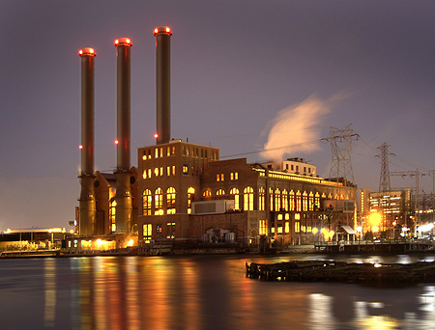
ISO-NE CONE and ORTP Analysis
September 13, 2016
ISO-NE
PUBLIC

Slide 2
Overview
    CONE Calculations
      Combustion Turbine
      Combined Cycle Turbine
      Two Aeroderivatives
      CONE Results and Recommendation
    ORTP Calculations
      Combustion Turbine
      Combined Cycle Turbine
      On-Shore Wind
      Solar
      Demand Response
      Energy Efficiency
      ORTP Results and Recommendation
    Next Steps

Slide 3
Follow-Up from Questions at August MC Meeting
    The issues raised at the August MC Meeting will be addressed in the discussion today:
      Updated Aurora modeling assumptions
      Changes to revenue calculation
      Simulation models have been re-run to remove the ANE gas pipeline
      Cost of capital peer group sensitivity
      CONE vs. ORTP gas-fired technologies
      Brownfield vs. greenfield definitions
      Network upgrades have been included in the installed costs for gas-fired resources

Slide 4
CONE: Assumptions and Initial Recommendation

Slide 5
CONE: Key Assumptions
Key Assumptions
Location: | Bristol County, MA
Electric Interconnection | 2 mile electrical interconnection (to 345 kV system) plus network upgrades
Gas Interconnection | 2 mile gas lateral plus metering station
Dual Fuel | No. 2 oil for backup
Environmental Controls | Selective Catalytic Reduction CO catalyst
Cooling | Dry Cooling for the frame units and aeroderivative Wet Cooling for the advanced aeroderivative
* Key assumptions details included in Appendix

Slide 6
CONE: Specifications by Technology
 | Combined Cycle | Simple Cycle GT | Aeroderivative | Advanced Aeroderivative
Model | 7HA.02 | 7HA.02 | LM6000 PF+ | LMS100PA
Capacity (MW) | 533 | 338 | 94 | 103
Net heat rate (btu/kWh) | 6,381/6,546 | 9,220 | 9,774 | 9,021
Duct firing | Yes | No | No | No
Environmental controls | SCR and CO catalyst | SCR | SCR | SCR
Primary fuel | Natural gas | Natural gas | Natural gas | Natural gas
Backup fuel | No. 2 oil | No. 2 oil | No. 2 oil | No. 2 oil
Plot size (acres) | 15.0 | 8.1 | 4.5 | 5.7
* Key specification details included in Appendix

Slide 7
CONE: Key Financial Assumptions
General
 | Inflation | 2.0%
 | Property Tax Rate | 3.0%
 | Depreciation | 15/20 year MACRS
 | Income Tax Rate (Effective) | 40.2%
 | Economic Life | 20 years
Weighted Average Cost of Capital
 | Return on Equity | 13.4%
 | Cost of debt | 7.75%
 | Debt/equity | 60/40
 | WACC | 10.0%
 | ATWACC | 8.1%
* Key financial assumption details included August MC Meeting Materials

Slide 8
CONE: Capital Costs
 | Combined Cycle | Simple Cycle GT | Aeroderivative | Advanced Aeroderivative
Total EPC Costs | $474,478,000 | $231,331,000 | $141,479,000 | $125,845,000
Total Non-EPC | $40,200,000 | $35,520,000 | $31,300,000 | $31,170,000
Total Overnight Costs | $514,678,000 | $266,851,000 | $172,779,000 | $157,015,000
Overnight Cost per kW | $966 | $790 | $1,838 | $1,524
* Detailed capital costs included in Appendix

Slide 9
CONE: O&M Costs
 | Combined Cycle | Simple Cycle GT | Aeroderivative | Advanced Aeroderivative
Fixed O&M
Labor, Materials and A&G | $18,979,000 | $6,940,000 | $3,537,000 | $3,146,000
Network Upgrade Maintenance | $1,000,000 | $1,000,000 | $1,000,000 | $1,000,000
Property Taxes | $7,684,000 | $2,916,000 | $1,900,000 | $ 1,725,000
Site Leasing | $375,000 | $202,500 | $112,500 | $142,500
Insurance | $ 3,568,000 | $1,847,000 | $1,191,000 | $ 1,082,000
Total Fixed O&M ($) | $31,606,000 | $12,906,000 | $7,740,000 | $7,095,000
Levelized Fixed O&M ($/kW-yr) | $59.30 | $38.18 | $82.34 | $68.89

Slide 10
CONE: E&AS Offsets by Technology
    E&AS offsets using LMP forecast
      Offsets for each technology type are based on the same LMP forecast
    Key changes since the September meeting:
      New gas price forecast excludes Access Northeast (ANE Project)
      Update load forecast to utilize 2016 CELT
      All plant capacities, retirements, and additions conform to CSOs
      Include 1,000 MW import project from Canada into New Hampshire, no network upgrades associated with the project

Slide 11
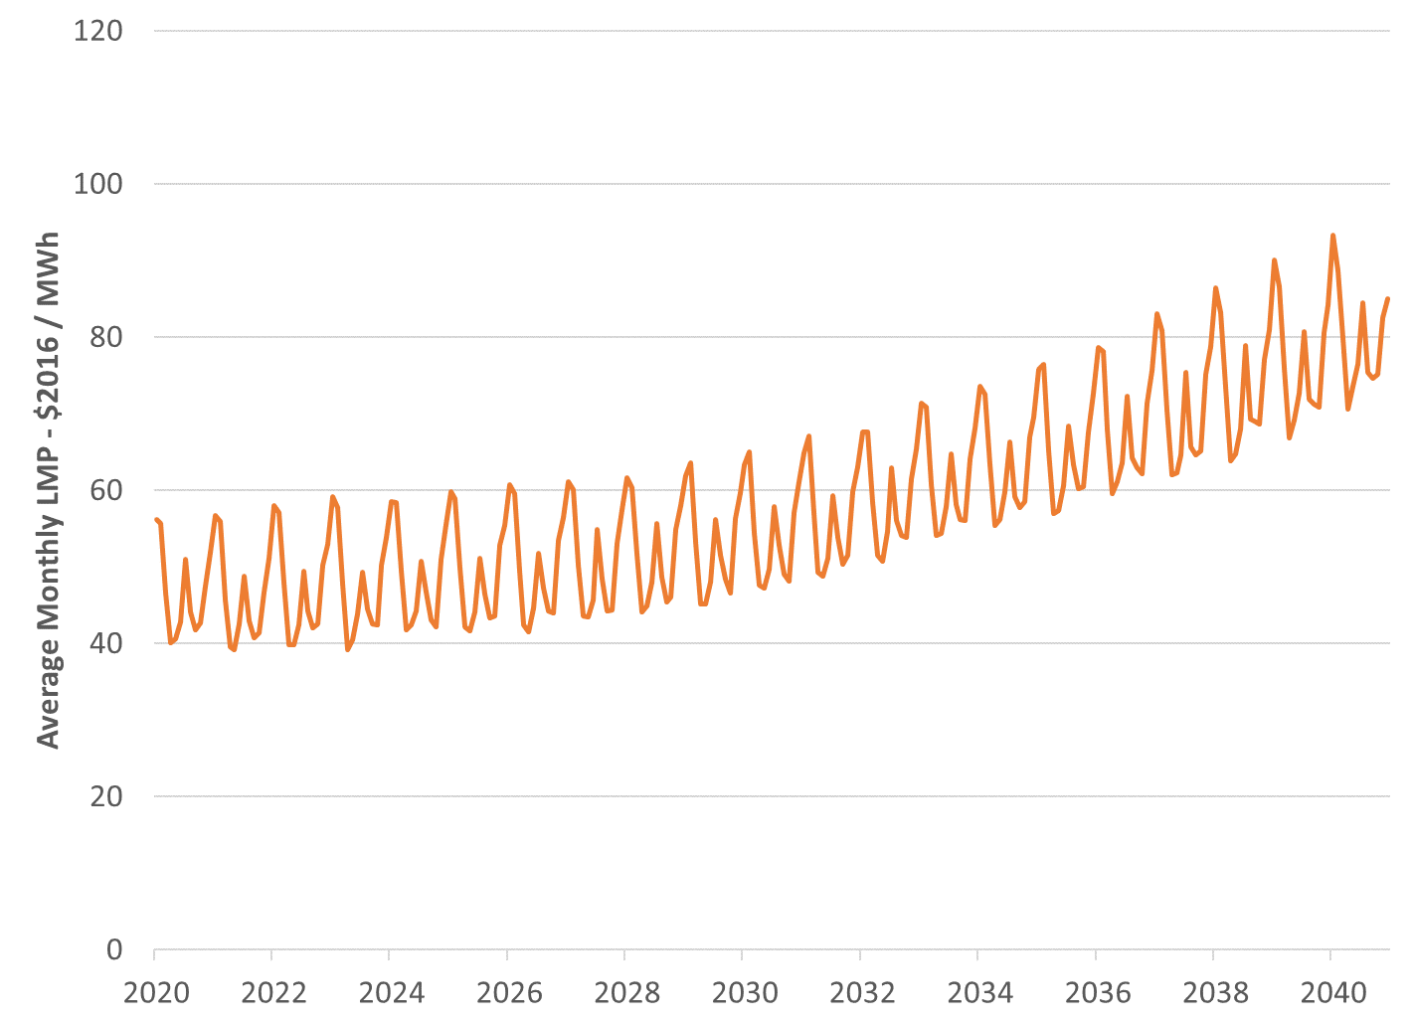
LMP Forecast – SEMA

Slide 12
Pay for Performance Methodology
    Assumptions on number of scarcity hours are based on ISO-NE studies and testimony filed at the FERC; ER14-1050 dated January 17, 2014
    The performance payment rate increased to $5,455/mWh beginning in 2024
    The assumed performance of the combined cycle unit is based on testimony filed in ER14-1050
    The assumed performance of the combustion turbine and aeroderivative machines is based on their assumed forced outage rates
    The assumed scarcity hours are consistent with the need for new resources consistent with the Aurora market simulation

Slide 13
CONE: Pay for Performance Revenues by Technology
Technology | Scarcity Hours at Criteria (hrs) | Performance Payment Rate ($/mWh) | Average Actual Performance (%) | Average Balancing Ratio (%) | Net Performance Payments ($/kW-mo)
Combined Cycle | 21.2 | $ 5,455 | 0.92 | 0.85 | 0.67 | years 4 - 20
Combustion Turbine | 21.2 | $ 5,455 | 0.98 | 0.85 | 1.25
Aeroderivative | 21.2 | $ 5,455 | 0.98 | 0.85 | 1.25
Combined Cycle | 10.0 | $ 3,500 | 0.92 | 0.85 | 0.20 | years 1-3
Combustion Turbine | 10.0 | $ 3,500 | 0.98 | 0.85 | 0.38
Aeroderivative | 10.0 | $ 3,500 | 0.98 | 0.85 | 0.38

Slide 14
CONE: Sensitivity to Assumptions
Input | Assumption Change | Impact on Net CONE
Overnight Cost | +/- 25% | +/- $3.40/kW-mo
Cost of Capital | +/- 1 percentage point | +/- $1.40/kW-mo
E&AS Revenues | +/- 25% | +/- $1.40/kW-mo
Fixed O&M | +/- 25% | +/- $0.70/kW-mo
Pay for Performance Revenues | +/- 25% | +/- $0.14/kW-mo

Slide 15
CONE: Estimates and Recommendation
Initial Recommendation of Reference Technology
  Combustion Turbine (CT) is the lowest Net CONE resource
  CTs in development are new generating units at existing plants (Medway, Canal, and Wallingford) CONE/Net CONE technology
  Several Combined Cycle (CC) units are also in development (Salem Harbor, Bridgeport Harbor, Towantic, Clear River)
  The CT is the recommended CONE technology

Slide 16
CONE: Recommended Annual Updates
    E&AS Annual Updates
    Based on changes to market expectations regarding spark spreads
    Change in implied spark spreads from ratio of MassHub and Algonquin forwards on NYMEX/CME
    Capital Cost Annual Updates
      Reviewed existing indices contained in Market Rule 1
      Reviewed alternative publicly available indices and approaches
      The existing indices are appropriate for updating the capital costs in the CONE value between recalculation periods

Slide 17
ORTP: Assumptions and Initial Recommendation

Slide 18
ORTP: Key Assumptions by Technology
 | Combined Cycle | Simple Cycle GT | Wind | Solar
Location | Bristol County, MA | Bristol County, MA | Central NH | Bristol County, MA
Net Plant Capacity (MW) | 533 | 338 | 52 | 5
Interconnection | 2 mile electrical interconnection (to 345 kV system) plus network upgrades 2 mile gas lateral plus metering station | 2 mile electrical interconnection (to 345 kV system) plus network upgrades 2 mile gas lateral plus metering station | 115kV along existing transmission corridor | 13.8kV
Environmental controls | SCR and CO catalyst | SCR | N/A | N/A
Lot size (acres) | 15.0 | 8.1 | 3,600 | 50

Slide 19
ORTP: Specifications by Technology
 | Combined Cycle | Simple Cycle GT | Wind | Solar
Model/ Configuration | 7HA.02 | 7HA.02 | GE | Ground mounted PV panels
Capacity (MW) | 533 | 338 | 52 | 5
Net heat rate (btu/kWh) | 6,546 | 9,220 | N/A | N/A
Capacity Factor |  |  | 30% | 16%
Qualified Capacity (%) | 100 | 100 | 30%¹ | 16%²
Duct firing | Yes | No | N/A | N/A
Primary fuel | Natural gas | Natural gas | Wind | Solar
Backup fuel | No. 2 oil | No. 2 oil | N/A | N/A
1 – Based on 5 yr historical capacity factors for similarly sized wind resources
2 – Based on 5 yr historical capacity factors for similarly sized solar resources

Slide 20
ORTP: Key Financial Assumptions
General
 | Inflation | 2.0%
 | Property Tax Rate | 1.0%
 | Depreciation | 5/15/20 year MACRS
 | Income Tax Rate (Effective) | 40.2% ; 40.5%
 | Economic Life | 20 years
Weighted Average Cost of Capital
 | Return on Equity | 12.4%
 | Cost of debt | 6.5%
 | Debt/equity | 60/40
 | WACC | 8.9%
 | ATWACC | 7.3%
* Key financial assumption details included August MC Meeting Materials

Slide 21
ORTP: Cost of Capital Assumptions
Input | ISO-NE (2013) | Recommendation
Return on Equity | 11.3 | 12.4
Cost of Debt | 5.2 | 6.5
Debt to Equity Ratio | 50/50 | 60/40
ATWACC | 7.2 | 7.3
* Key financial assumption and source details included in August MC Meeting materials

Slide 22
  ORTP: Adjustments from Net CONE Calculation for Gas Resources
 | CONE | ORTP
WACC | 10.0% | 8.86%
ATWACC | 8.14% | 7.29%
Property Tax Rate | 3.0% | 1.0%
Insurance | 0.6% Overnight Cost | 0.3% Overnight Cost
Electrical Interconnection | Baseline | CONE assumption minus 10%
Contingency | Baseline | CONE assumption minus 5%

Slide 23
ORTP: Wind and Solar Capital Costs
Cost Component | Wind 2016 $$ | Wind ($/kW) | Solar 2016 $$ | Solar ($/kW)
Total EPC Costs | 110,000,000 | 2,115 | 7,800,000 | 1,560
Owners Costs | 6,000,000 | 115
Interconnection | 14,000,000 | 269
Owners Contingency | 1,750,000 | 34
Working Capital | 930,000 | 18
Financing Fees | 2,300,000 | 44
Total Non-EPC Costs | 24,980,000 | 480 | 2,300,000 | 460
Total Overnight Costs | 134,980,000 | 2,596 | 10,100,000 | 2,020

Slide 24
ORTP: O&M Costs
 | Wind | Solar
Total Fixed O&M ($) | $3,581,000 | $227,000
Total Fixed O&M ($/kW-yr) | $68.86 | $45.40
Total Fixed O&M ($/kW-mo) | $5.74 | $3.78

Slide 25
ORTP: E&AS and PFP Revenues
  E&AS revenues
    For gas turbines, revenues are the same as used in the Net CONE analysis
    Wind and solar resources use the same LMP forecast, output based on analysis of existing resources
  PFP revenues
    Consistent with the values used in the CONE analysis for gas turbines
    PFP for wind and solar are based on average performance rates for existing (wind and solar) resources for operating reserve shortages in New England
Technology | Scarcity Hours at Criteria (hrs) | Performance Payment Rate ($/mWh) | Average Performance per Installed MW | Average Balancing Ratio (%) | Net Performance Payments per Installed MW ($/kW-mo)
Wind | 21.2 | $ 5,455 | 0.28 | 0.85 | 0.24 | years 4 - 20
Solar | 21.2 | $ 5,455 | 0.25 | 0.85 | 1.10
Wind | 10.0 | $ 3,500 | 0.28 | 0.85 | 0.07 | years 1-3
Solar | 10.0 | $ 3,500 | 0.25 | 0.85 | 0.33

Slide 26
CONE: Wind and Solar
 | Wind | Solar
Installed Capacity (MW) | 52 | 5
Qualified Capacity(MW) | 15.6 | 0.8
Capital Costs (Overnight) (2016$/kW) | 2,596 | 2,020
ATWACC | 7.3% | 7.3%
Fixed O&M ($/kW-mo) | 5.74 | 3.78
Revenue Offsets ($/kW-mo) | 19.51 | 11.23
ORTP ($/kW-mo) | 11.78 | 21.46

Slide 27
ORTP: EE and DR Assumptions
  Assume Energy Efficiency programs consistent with current state programs
  Assume Demand Response
    Mass Market DR
      Large-scale programs targeting residential or small commercial customers that control specific end uses, i.e. air conditioning, water heating,
      Assumed 1kW of reduction based on utility programs
    Medium – Large C&I Load Management
      Commercial or industrial customer that is using existing control technologies to implement load reductions
      Incremental costs include metering and communication technologies
      Assumed 1-4MW of load with 20% demand reduction

Slide 28
ORTP: EE and DR Approach
  EE Program Costs and Savings
    Followed similar approach to previous ORTP studies conducted in New England
    Reviewed 2016 state energy efficiency reports to determine costs across programs offered and the peak summer demand reduction
    Avoided energy savings based on projected wholesale prices from electricity simulation model
    Avoided T&D savings based on 2015 CT Conservation & Load Management Plan
  DR Program Costs and Savings
    Reviewed publicly available studies on Demand Response program costs and peak demand savings for residential and small C&I customers
    Conducted interviews with DR providers in NE to estimate the costs of these programs

Slide 29
ORTP: EE Specifications & Costs
Energy Efficiency
Installed Capacity (MW) | 1
Qualified Capacity (MW) | 1
Capital Costs (Installed) | 3,733
Inflation | 2.0%
ATWACC | 7.3%
ATWACC Real | 5.2%
Annual Energy Savings (MWh) | 7,009
Energy Benefit ($/MWh) | 59.91
Avoided T&D Costs ($/kW-yr) | 42.04
Gross CONE ($/kW-mo) | 35.97
Levelized Capital Costs ($/kW-mo) | 35.97
Fixed O&M ($/kW-mo) | 0.00
Revenue Offsets ($/kW-mo) | 38.50
Energy Savings ($/kW-mo) | 34.99
T&D Savings ($/kW-mo) | 3.50
Net CONE ($/kW-mo) | -2.53
ORTP ($/kW-mo) | 0.00
Sources: Annual Energy Efficiency Program reports for New England Investor-Owned Utilities

Slide 30
ORTP: DR Specifications & Costs
Large Commercial and Industrial (Load Management C&I)
 | Assumptions | Value ($/kW-mo)
Demand Reduction (kW) | 500
Contract Life (years) | 3
ATWACC (%) | 7.3%
Capacity Clearing Price | $7.03
Reconfiguration Auction Clearing Price | $1.03
Customer Incentive | 70% of Reconfiguration Clearing Price | $0.72
Sales Commission | 1% of FCA Clearing Price | $0.07
Equipment Costs |  | $0.24
ORTP Value ($/kW-mo) |  | $1.03
Mass Market (Load Management Residential)
 | Assumptions / Value
Demand Reduction (kW) | 1
Contract Life (years) | 10
ATWACC (%) | 7.3%
Installation Costs | $2.25
Annual Customer Incentives | $3.54
O&M Costs | $0.88
Software/Communication | $0.88
ORTP Value ($/kW-mo) | $7.56
Sources: 2013 ORTP Study sources and interviews with DR providers in New England

Slide 31
ORTP Estimates and Recommendation

Slide 32
Appendix – CONE Capital Cost Detail (2016$)
 | 2016$
Cost Component | 7HA.02 Combined Cycle | 7HA.02 Simple Cycle | LM6000 PF+ | LMS100PA
EPC Costs
Grand Total Civil/Structural and Architectural | 49,885,000 | 16,899,000 | 11,696,000 | 10,792,000
Grand Total Mechanical Costs | 250,493,000 | 137,485,000 | 78,496,000 | 69,026,000
Grand Total Electrical Instrumentation and Controls Cost | 58,309,000 | 27,482,000 | 17,132,000 | 14,929,000
Grand Total Major Equipment and Construction Cost | 358,687,000 | 181,866,000 | 107,324,000 | 94,747,000
Grand Total Construction Management | 12,531,000 | 3,866,000 | 3,392,000 | 3,392,000
Grand Total Other Project Costs including Freight, Startup Spares, A/E Support, Startup Testing | 26,507,000 | 9,055,000 | 8,230,000 | 7,645,000
SUBTOTAL PROJECT COST | 397,725,000 | 194,787,000 | 118,946,000 | 105,784,000
PROJECT CONTINGENCY - 5% on Major Equipment 7% on Balance | 24,121,000 | 11,115,000 | 6,981,000 | 6,227,000
SUBTOTAL PROJECT COST with Contingency | 421,846,000 | 205,902,000 | 125,927,000 | 112,011,000
EPC Contractor Fee | 30,038,000 | 14,413,000 | 8,815,000 | 7,841,000
Grand Total Project Cost | 451,884,000 | 220,315,000 | 134,742,000 | 119,852,000
Owner's Contingency | 22,594,000 | 11,016,000 | 6,737,000 | 5,993,000
Owner Project Cost | 474,478,000 | 231,331,000 | 141,479,000 | 125,845,000
Non-EPC Costs
Owner's Costs (Services)
Electrical Interconnection | 7,000,000 | 7,000,000 | 7,000,000 | 7,000,000
Electrical System Upgrade Costs | 20,000,000 | 20,000,000 | 20,000,000 | 20,000,000
Gas Interconnection | 2,000,000 | 2,000,000 | 2,000,000 | 2,000,000
Fuel Inventories | 4,200,000 | 4,200,000 | 900,000 | 900,000
Working Capital | 7,000,000 | 2,320,000 | 1,400,000 | 1,270,000
Total Non-EPC | 40,200,000 | 35,520,000 | 31,300,000 | 31,170,000
Total Overnight Capital Costs | $ 514,678,000 | $ 266,851,000 | $ 172,779,000 | $ 157,015,000

Slide 33
Appendix – ORTP Capital Cost Detail (2016$)
 | 2016$
Cost Component | 7HA.02 Combined Cycle | 7HA.02 Simple Cycle | Wind | Solar
EPC Costs
Grand Total Civil/Structural and Architectural | 49,885,000 | 16,899,000
Grand Total Mechanical Costs | 250,493,000 | 137,485,000
Grand Total Electrical Instrumentation and Controls Cost | 58,309,000 | 27,482,000
Grand Total Major Equipment and Construction Cost | 358,687,000 | 181,866,000
Grand Total Construction Management | 12,531,000 | 3,866,000
Grand Total Other Project Costs including Freight, Startup Spares, A/E Support, Startup Testing | 26,507,000 | 9,055,000
SUBTOTAL PROJECT COST | 397,725,000 | 194,787,000
PROJECT CONTINGENCY - 5% on Major Equipment 7% on Balance | 22,914,950 | 10,559,250
SUBTOTAL PROJECT COST with Contingency | 420,639,950 | 205,346,250
EPC Contractor Fee | 30,038,000 | 14,413,000
Grand Total Project Cost | 450,677,950 | 219,759,250
Owner's Contingency | 21,753,100 | 10,438,600
Owner Project Cost | 472,431,050 | 230,197,850 | 110,000,000 | 7,800,000
Non-EPC Costs
Owner's Costs (Services) |  |  | 6,000,000
Electrical Interconnection | 6,300,000 | 6,300,000 | 14,000,000
Electrical System Upgrade Costs | 18,000,000 | 18,000,000
Gas Interconnection | 1,800,000 | 1,800,000
Owners Contingency |  |  | 1,750,000
Financing Fees |  |  | 2,300,000
Fuel Inventories | 4,200,000 | 4,200,000
Working Capital | 7,000,000 | 2,320,000 | 930,000
Total Non-EPC | 37,300,000 | 32,620,000 | 24,980,000 | 2,300,000
Total Overnight Capital Costs | $ 509,731,050 | $ 262,817,850 | $ 134,980,000 | $ 10,100,000

