Slide 1
January 31, 2018
Demand Resources Working Group
Demand Resource Strategy Department
ISO New England, Inc.

Slide 2
Demand Resource Asset Enrolled MWs* by Demand Resource Type and Load Zone (as of 2/01/2018)
*Enrolled MWs are the ‘Max Interruptible Capacity’ values supplied by the Lead Participant as part of the asset registration process. Enrolled MWs are summed for Assets that are Ready to Respond and mapped to a Resource on the “as of” date.

Slide 3
Preliminary Capacity Supply Obligation (CSO)* MW by Demand Resource Type and Load Zone (as of 2/01/2018)
*CSO values include applicable T&D loss factor gross-up and are net of bilaterals and reconfigurations. These are preliminary numbers which may change.
Note: Final Capacity Supply Obligation (CSO) MW by Demand Resource Type for this month will be available in the next COO Report which will be posted at: http://www.iso-ne.com/committees/comm_wkgrps/prtcpnts_comm/prtcpnts/mtrls/index.html

Slide 4
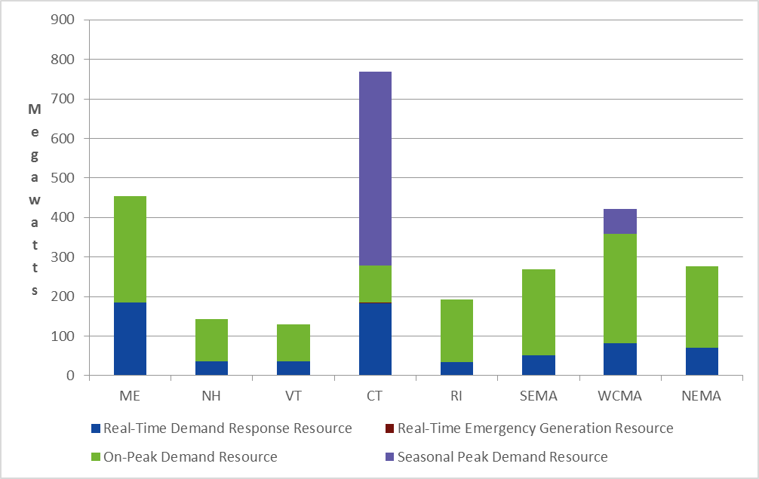
Demand Resource Asset Enrolled MWs* by Demand Resource Type and Load Zone (as of 2/01/2018)
*Enrolled MWs are the ‘Max Interruptible Capacity’ values supplied by the Lead Participant as part of the asset registration process. Enrolled MWs are summed for Assets that are Ready to Respond and mapped to a Resource on the “as of” date.

Slide 5
Transitional Price-Responsive Demand (TPRD) Enrolled MWs (as of 2/01/2018)
Displayed data is Enrolled MWs for Ready to Respond assets.

Slide 6
Active Demand Resource Asset Enrolled MWs* by Demand Resource Type, Load Zone and Dispatch Zone (as of 2/01/2018)
Passive Demand Resource assets are not included as they are not dispatchable and may not have a Dispatch Zone identified.
TPRD MWs are included in RTDR MWs.

Slide 7
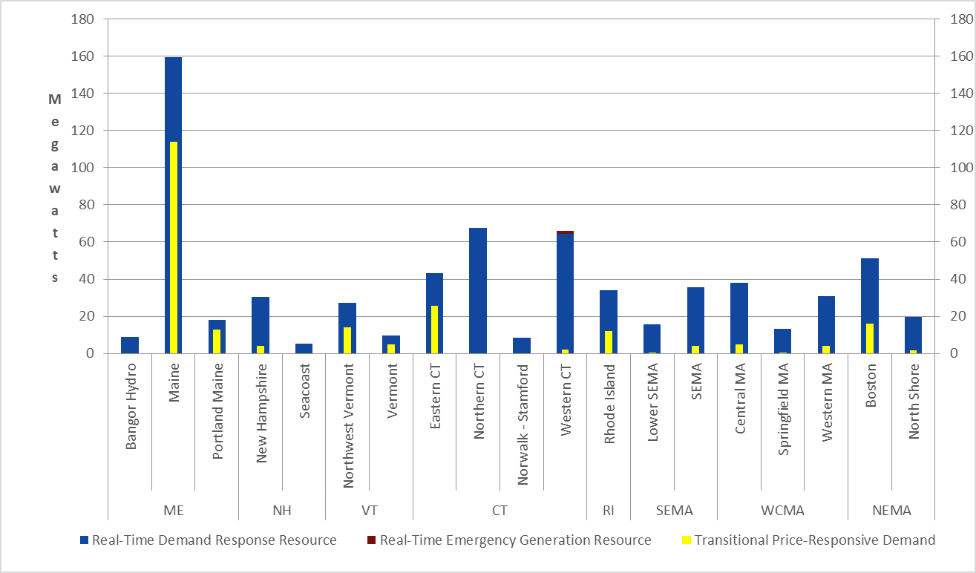
Active Demand Resource Asset Enrolled MWs* by Demand Resource Type, Load Zone and Dispatch Zone (as of 2/01/2018)
* Passive Demand Resource assets are not included as they are not dispatchable and may not have a Dispatch Zone identified. TPRD MWs are included in RTDR MWs.

Slide 8
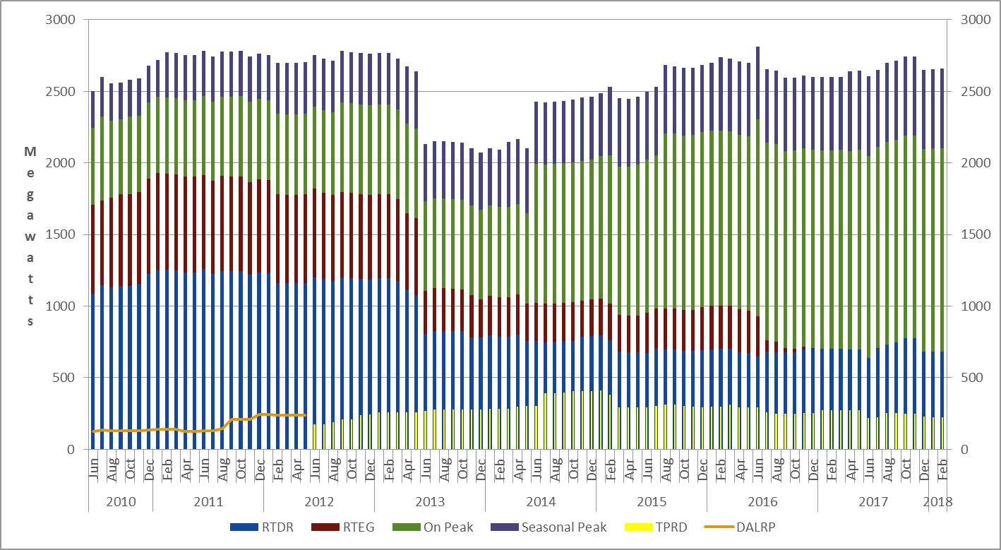
Demand Resource Asset and TPRD Asset Enrolled MWs by Month (as of 2/01/2018)
*TPRD MWs and DALRP MWs are included in RTDR MWs.

Slide 9
Additional Information
  Next DRWG meeting is Wednesday, February 28, 2018 in the Boston conference room.

