Slide 1
Net CONE for the
ISO-NE Demand Curve
Final Proposal
NEPOOL Markets Committee
Samuel Newell, Brattle
Chris Ungate, Sargent & Lundy
March 12, 2014

Slide 2
Agenda
Responses to Stakeholder Comments, and Associated Revisions
Electrical Interconnection Network Upgrade Costs
Oil Inventory and Other Non-Depreciable Assets
CT E&AS RTR Payback
CC E&AS Representative Units
Electricity Forwards and PER/PFP Assumption
Consideration of Lumpiness
Summary of Changes
Recommendation
Principles for Selecting Reference Technology
Review of Reference Technologies
Recommended Net CONE Based on CC
Locational Net CONE

Slide 3
Electrical Interconnection
Transmission Costs from 15.5 Applications
Based on stakeholder feedback, we re-visited network upgrade cost assumption
Transmission costs reported in Section 15.5 Applications show that the average historical cost of network upgrades beyond the generator lead was $35/kW (2013$)
We adopt the reasonable assumption that generic future projects expect to pay the same on a $/kW basis, plus $1.1m for ½ mile lead based on S&L estimate
Technology | Initial Costs (2013$) | Final Costs (2013$) | Net CONE Impact (2018$/kW-mo)
LM6000 | $7.1m | $7.2m | +0.01
LMS100 | $7.1m | $7.7m | +0.04
Frame CT | $7.1m | $15.8m | +0.27
CC | $7.1m | $26.2m | +0.37
Source: ISO-NE assembled from publicly available Section 15.5 Applications.

Slide 4
Oil Inventory and Other Non-Depreciable Assets
Stakeholders requested that we review how fuel inventory and working capital are accounted for in the financial model
As the fuel inventory will hold residual value at the end of the economic life, we credited back to the capital costs the present value of the fuel inventory in 2038 based on long-term EIA escalation rates (+2.4%/year)
Relatedly, we updated our calculation of depreciable costs based on accepted GAAP principles, which specifies that land, fuel inventory and working capital be considered non-depreciable
Technology | Fuel Credit Impact ($/kW-mo) | Non-Depreciable Assets Impact ($/kW-mo) | Total Net CONE Impact ($/kW-mo)
LM6000 | -0.05 | +0.09 | +0.04
LMS100 | -0.06 | +0.09 | +0.03
Frame CT | -0.06 | +0.07 | +0.01
CC | -0.04 | +0.05 | +0.01

Slide 5
Real-Time Reserve Charge-Backs and Other E&AS Adjustments to CTs
Real-Time Reserve Charge-Backs: To better estimate CT E&AS revenues, we incorporated data from ISO-NE on forward reserve obligation charges
Portfolios with FRM will receive real-time reserve revenues that will later be charged back
Using only asset-specific market settlement data over-estimates CT E&AS as the obligation charges occur after the settlement at the portfolio level
Adding ISO-NE’s portfolio-level charge-back data reduces the CT E&AS by $0.13/kW-mo
Heat Rates: We adjusted fuel costs for the Frame CT and LMS100 based on their heat rates relative to the LM6000 sample plants
Calculation Adjustments: We adjusted our calculation of the E&AS margin across the plants in our sample from a simple average to capacity-weighted average; also we resolved a fuel cost calculation issue during our final audits of the analysis
Technology | Initial E&AS ($/kW-mo) | Calculation Adjustments ($/kW-mo) | RTR Charge Back ($/kW-mo) | Heat Rate ($/kW-mo) | Net CONE Impact ($/kW-mo)
LM6000 | $1.95 | $1.86 | $1.73 | $1.73 | +0.22
LMS100 | $1.95 | $1.86 | $1.73 | $1.74 | +0.21
Frame CT | $1.95 | $1.86 | $1.73 | $1.72 | +0.23

Slide 6
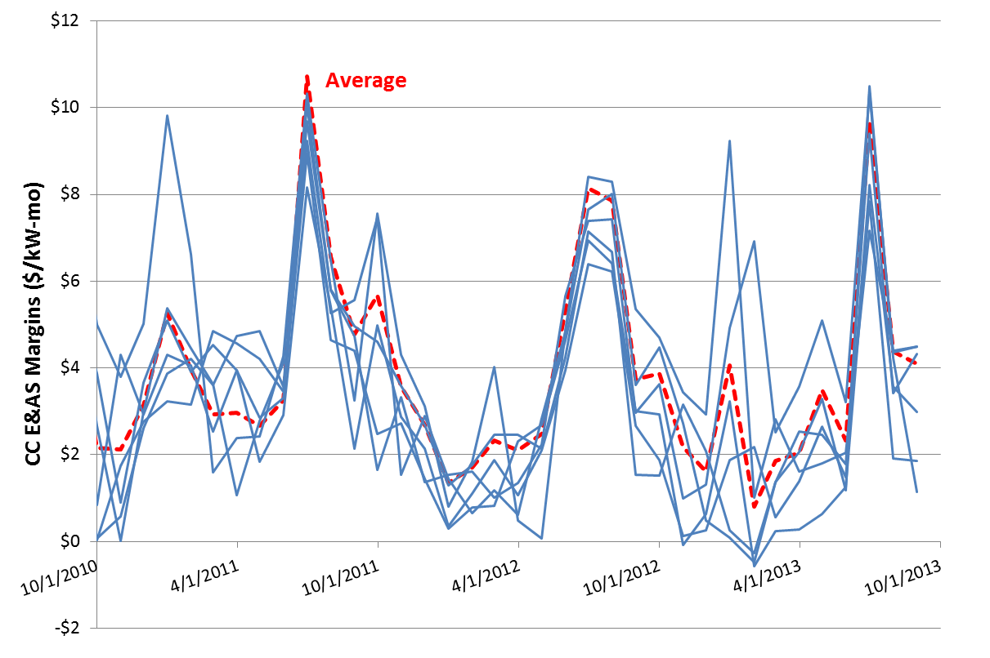
CC E&AS Representative Units
Based on stakeholder feedback, we refined our approach for selecting the representative CC plants used to calculate historical E&AS revenues
We received market revenue data from ISO-NE for 20 plants
We removed 6 plants with average realized heat rates above 8,000 Btu/kWh
We removed 6 plants with fuel costs that are not represented by Algonquin Citygates prices due to firm gas capacity, alternative sources of fuel, or plants with gas pricing based on Iroquois
We removed 2 plants with different operations mode such as district heating and low CF (<20%)
The remaining 6 plants have an average capacity factor of 58% and average heat rate of 7,400 Btu/kWh; the CC E&AS increases by $0.04/kW-mo due to this change
Technology | Initial E&AS ($/kW-mo) | Updated Units ($/kW-mo) | Net CONE Impact ($/kW-mo)
CC | $3.37 | $3.41 | -0.04

Slide 7
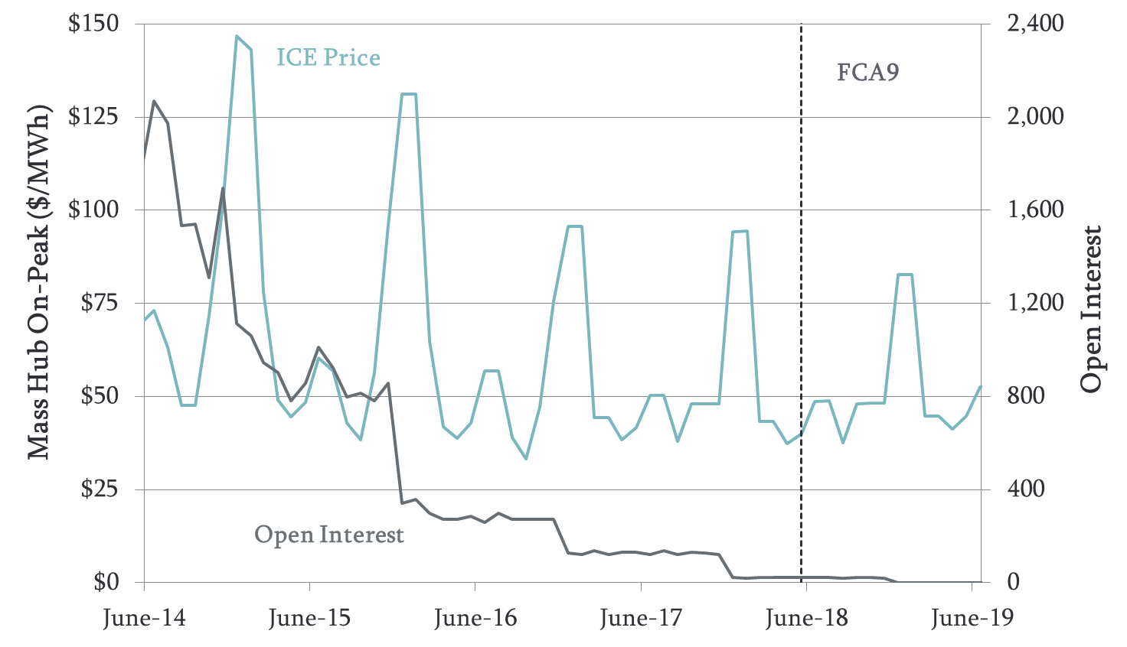
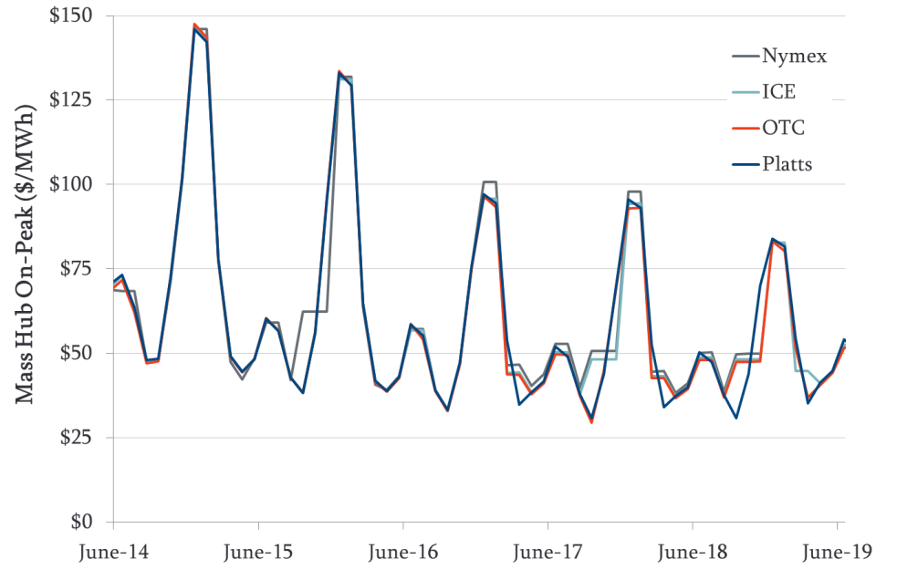
Forward Curves
Mass Hub On-Peak Futures and Open Interest (ICE)
Stakeholders requested futures data be used even if volume is thin
We show Open Interest for ICE, which expresses the amount of forward contracts actually doing daily mark-to-market settlement on these prices
We also compared to other sources available (NYMEX, ICE, Platts), which are in close agreement
We will use ICE data in E&AS analysis instead of previous average of NYMEX and OTC as it more often used and is publicly available
Mass Hub On-Peak Futures (All Sources)
Technology | Initial E&AS ($/kW-mo) | Final E&AS ($/kW-mo) | Net CONE Impact ($/kW-mo)
LM6000 | $1.73 | $1.67 | +0.06
LMS100 | $1.74 | $1.69 | +0.05
Frame CT | $1.72 | $1.66 | +0.06
CC | $3.41 | $3.33 | +0.08
Sources: See appendix.

Slide 8
H Value for PER/PFP Estimates
Stakeholders were concerned that assuming H = 10.9 for estimating PER and PFP is inconsistent with the electricity futures
We have reviewed the implied market heat rate from the ICE forward curves for gas and electricity and agree that the lowest H case (H = 5.8) is a better assumption for our analysis
At H = 5.8, the PER deduction will be $0.43/kW-mo and the PFP payment will be $0.06/kW-mo; this contributes $0.37 to Net CONE, which is $0.41/kW-mo less than the initial analysis
ICE Futures and Implied Market Heat Rates
Sources and Notes:
ICE futures were obtained from www.theice.com. Trades are averaged from Feb 20 to Feb 28, 2014

Slide 9
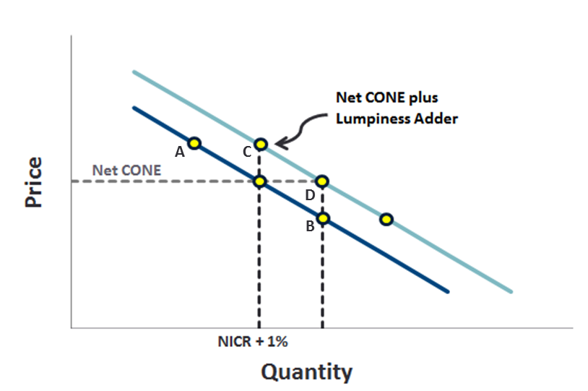
Why Lumpiness Should Not Add to Net CONE
The demand curve was designed so that Net CONE is the long-term average prices an entrant can expect, not their entry price
Our curve design and simulations are consistent with lumpiness and other sources of volatility making entry more likely when P > Net CONE, at the higher end of our price distributions
Consider a simple example where a 600 MW unit enters at point A and clears with 600 MW overhang (worst case for lumpiness); with 300 MW/yr load growth, the next auction clears about 300 MW to the right, at point B. The following auction adds 300 MW load, so we’re back at point A and the cycle repeats
The entrant earns Net CONE on average, and the curve achieves the reliability objectives of 1-in-10, with average quantity at about 1% above NICR (addressing reliability asymmetry)
If instead, we moved the curve up so the price at NICR + 1% were the entry price (pt. C) rather than Net CONE, we’d over-procure, with an average reserve margin at D

Slide 10
Summary of Impacts on Net CONE
Adjustments | CC | Frame CT | LMS100 | LM6000
Feb 27 Values | $11.71 | $8.95 | $17.85 | $20.60
Added Network Upgrades Costs | +0.37 | +0.27 | +0.04 | +0.01
Oil Inventory and Non-Depreciable Assets | +0.01 | +0.01 | +0.03 | +0.04
Updated CC E&AS Representative Units | -0.04 | --- | --- | ---
Adjusted CT E&AS for Payback and HR | --- | +0.23 | +0.21 | +0.22
Substituted ICE Futures | +0.09 | +0.06 | +0.05 | +0.06
Reduced H to 5.8 | -0.41 | -0.41 | -0.41 | -0.41
Removed Lumpiness | -0.64 | -0.64 | -0.64 | -0.64
Updated Values | $11.08 | $8.47 | $17.13 | $19.88

Slide 11
Agenda
Responses to Stakeholder Comments, and Associated Revisions
Electrical Interconnection Network Upgrade Costs
Oil Inventory and Other Non-Depreciable Assets
CT E&AS RTR Payback
CC E&AS Representative Units
Electricity Futures and PER/PFP Assumption
Consideration of Lumpiness
Summary of Changes
Recommendation
Principles for Selecting Reference Technology
Review of Reference Technologies
Recommended Net CONE Based on CC
Locational Net CONE

Slide 12
Principles for Selecting a Reference Technology
Objective
Estimate Net CONE that supports prices that are on a long-term average basis just high enough to attract sufficient new investment to meet resource adequacy objectives
Criteria for selecting the Reference Technology to meet the objective
Reliably able to help meet load
Complies with all environmental regulations
Dispatchable technology that could be available to generate whenever capacity is scarce
Likely to be economic for merchant entry as part of long-term equilibrium
Demonstrated commercial interest by merchant developers, as evidenced by projects recently completed, under construction, or in the queue in New England or the rest of U.S.
Estimated Net CONE is not so high as to make it implausible that the technology would be part of the long-term mix of resources entering the market
Available as standardized, utility-scale commercial plants without inherent constraints on the amount that could enter
Can estimate Net CONE with low uncertainty
Cost estimates have less uncertainty, based on established, standardized technologies
E&AS estimates have less uncertainty relative to other technologies
Additional considerations
Several technologies might be economic in a long-term equilibrium, with the same long-term average Net CONE, even if not currently economic due to temporary market conditions
It is important not to switch reference technologies back and forth over time, particularly not in pursuit of the technology whose Net CONE is temporarily lowest, as doing so will tend to under-procure
If multiple technologies meet the criteria, taking an average of their Net CONEs could help stabilize market outcomes and reduce the risk of estimation errors

Slide 13
Review of Reference Technologies
Criteria: | 1. Reliably able to help meet load during scarcity |  | 2. Likely economic |  | 3. Estimate with limited uncertainty
Technology | Meets Environ. Regulations | Dispatchable | Recently Built or Proposed | Net CONE Estimate | Accuracy of Capital and FOM Cost Estimates | Accuracy of E&AS Estimate
2x0 LMS100 188 MW | Yes | Yes | Limited | $17.13/ kW-mo | Well established technology | Similar magnitude, uncertainties exist
2x0 Frame CT 417 MW | Yes | Yes | Very limited | $8.47/ kW-mo | Well established technology, but less experience with SCR | Similar magnitude, uncertainties exist
2x1 CC 715 MW | Yes | Yes | Numerous | $11.08/ kW-mo | Well established technology | Similar magnitude, uncertainties exist

Slide 14
Net CONE Recommendation
We recommend the 2x1 CC as the Reference Technology with Net CONE at $11.08/kW-mo
CCs are clearly part of the equilibrium mix, so how wrong could choosing it be?
Clear signals from merchant developers through past, current, and proposed projects
Near-lowest Net CONE
CC Net CONE estimation uncertainty is no higher than for CTs
Most experience with technology
CC E&AS estimation uncertainty is not demonstrably higher than CTs in New England
Since the Frame CT’s Net CONE is lower, choosing it could risk under-procurement if it cannot actually be built at the cost we estimated
The lack of commercial activity suggests the possibility of risks or costs that are not captured in our analysis (alternatively, perhaps the SCR capability is too new to be showing up in projects yet but will soon; also possible that CTs just aren’t as economic as CCs in places where merchants are building)
Our simulation analysis showed that the reliability risks of understating True Net CONE are much more serious than over-procurement risks of overstating True Net CONE
In an FCM market with little history of merchant entry, launching a new demand curve that might not support sufficient entry could set up the new market for failure
The Aero CTs’ Net CONE is too high to be plausibly part of the economic equilibrium mix of technologies
Averaging multiple reference technologies could help stabilize market outcomes and reduce the risk of estimation errors; however, we recommend only the CC here
The reasons we identified for not 100% relying on turbines in ISO-NE suggest not relying on them 50% either

Slide 15
Locational Net CONE
CC CONE for NEMA/Boston is only slightly higher than rest-of-pool (ROP)
Assumed the plant would be located in Lowell, MA
Modified the ROP analysis based on labor and land costs, resulting in only a $0.21/kW-mo increase in CONE
Connecticut CONE would be even closer to ROP due to labor rates even closer to ROP’s (based on Middletown/Meriden/Bristol/New Britain/New Haven), but didn’t quantify it precisely
Energy prices have been pretty uniform across ISO-NE
Overall, the differences appear to small for us to recommend differentiating the Net CONE value across New England

Slide 16
Appendix

Slide 17
Sources for Forward Curves
ICE: Obtained from www.theice.com
NYMEX: Obtained from Ventyx Velocity Suite
OTC: Compiled by OTC Global Holdings and downloaded from SNL Financial
Platts: Purchased on March 4, 2014
Note: All futures were traded as of Feb 27, 2014, except for Platts, which was traded on March 3, 2014

