Slide 1
August 11-12, 2014 | woodstock, vt
Elective Transmission Upgrade Process Improvements
Background and Project Scope
RC/TC Summer Meeting
Monica Gonzalez
Senior regulatory counsel
Rich Kowalski
Director, transmission strategy & services

Slide 2
Purpose of the Presentation
There are shortcomings in the Elective Transmission Upgrade (ETU)* Process that need to be addressed
Today, we are providing you with the background necessary to establish a common understanding of the ETU Process Enhancement Project (ETU Project) and to facilitate the discussions about the project
* This presentation contains many acronyms most of which are spelled out and/or will be discussed. A list of acronyms is available at: http://www.iso-ne.com/support/training/glossary/index-p8.html.

Slide 3
Presentation Overview
Presentation objectives
ETU Project
Objective of the ETU Project
What the ETU Project will accomplish
What the ETU Project will not do
Background to facilitate understanding of ETUs and the ETU Project
OATT transmission service overview
OATT upgrades and cost responsibility
OATT Section II.47.5 ETU Process
Requirements
Rights
ETU constant “free-fall”
ETU’s relation to PTF, OTF and MTF
ETU examples under the current OATT (and the process shortcomings)
ETU Project schedule

Slide 4
The ETU Project
Objectives

Slide 5
What is the Objective of the ETU Project?
The ISO has identified certain shortcomings of the current ETU Process (OATT, Section II.47.5)
ETUs cannot establish a meaningful Queue Position that is not subject to constant “free-fall.” ETUs are not respected by other projects prior to receiving Section I.3.9 approval.
While the current ETU Process may be used to facilitate a certain resource objective, the absence of a meaningful Queue Position hinders the ability to associate an ETU with a resource
The ETU Process lacks specificity as compared to other OATT processes (e.g., generator interconnection process) thereby making it difficult to manage the process
ETU rights are not comparable to generation
The objective of the ETU Project is to fix these shortcomings within the framework of the existing ISO Tariff

Slide 6
What the ETU Project Will Accomplish
Replace the current Section II.47.5 ETU Process with a new OATT Schedule for ETU interconnections
The new Schedule may be based on the framework provided by Schedule 22 – Large Generator Interconnection Procedures/Agreement (LGIP/A)
Stop free-fall problem by creating new requirements and obligations so ETUs can establish and maintain a meaningful Queue Position
Allow ETUs to be associated with a resource seeking to achieve a specific resource objective
ETU Process to complement the Generator Interconnection Process
For certain ETUs, extend interconnection service products that are comparable to those available to generators
Market rule modifications to integrate the ETUs into the existing Forward Capacity Market structure

Slide 7
What the ETU Project Will Not Do
The ETU Project will not:
Change the fundamental structure of the ISO Markets, Transmission Service or Operations
Recognize any physical priority rights over Pool Transmission Facilities (PTF) tie-lines or any internal transmission facilities
Create a new capacity market construct
Create ISO authority for transmission upgrade interconnections to Non-PTF, Other Transmission Facilities (OTF), or Merchant Transmission Facilities (MTF)
Allow for an ETU to be proposed for the purpose of altering the completion of Regional System Planning (RSP) projects (regardless of process phase), which are not in commercial service

Slide 8
Background to facilitate Understanding of etus and the ETU project

Slide 9
OATT Transmission Service Overview

Slide 10
OATT Service Over the Transmission Facilities
PTF
Regional Network Service
MTF
e.g., CSC Point-to-Point Service
OTF
e.g., Phase I/II HVDC-TF Point-to-Point Service
Non-PTF
Local Network Service
Through or Out Service
Local Point-to-Point Service

Slide 11
OATT Transmission Services
 |  |  | OATT Transmission Services
 |  |  | Operating Authority Defined In | Transmission Facility Defined In | Transmission Owner(s) |  | Transmission Provider |  | Who Determines Transmission Rates | Transmission Service Offered over the Facility(ies) |  | Who Pays for Transmission Service
 |  | PTF | Transmission Operating Agreement (TOA) | II.49 (non-radial TF-owned by PTOs above 69kV/115 kV) | PTOs with PTF (See PTF catalog and Pool Supported PTF + HTF Revenue Requirements) |  | ISO-NE |  | PTOs (Schedule 9) | RNS (II.B) |  | Monthly RNL
 |  |  |  |  |  |  |  |  | PTOs (Schedule 8) | TOut Service (II.24-II.26, II.30-II.35) |  | Hourly TOut Reservation
 |  | Non-PTF | TOA | That which is not PTF, MTF or OTF | PTOs with Non-PTF (See Schedule 21 stubs) |  | Individual PTOs w/ Schedule 21 stubs |  | Individual PTOs w/ Schedule 21 stubs (Schedule 21+Stubs) | LNS (Schedule 21) |  | LNS Reservation
 |  |  |  |  |  |  |  |  |  | LPtP (Schedule 21) |  | LPtP Reservation
 | MTF | (currently, only CSC is recognized as MTF)
 |  | CSC | Section 9 of Attachment K to the OATT | Schedule 18 | CSC |  | CSC |  | CSC (Schedule 18) | PtP (Schedule 18) |  | PtP Reservations
 | OTF | (currently, only Phase I/II is recognized as OTF)
 |  | Phase I/II | HVDC TOA | Schedule 20A | New England Asset Owners |  | Schedule 20A Service Providers |  | Schedule 20A Service Providers (Schedule 20A+Stubs) | PtP (Schedule 20A) |  | PtP Reservations

Slide 12
OATT Transmission Services, cont.
 |  |  | OATT Transmission Services
 |  |  | Ancillary Services | Generator Interconnection |  | Generator Interconnection Service |  |  | Transmission Interconnection |  | Types of Transmission Upgrades
 |  | PTF | Schedules 1, 2, 16, 19 Schedules 3-7. 10, 11 | LGI (Schedule 22) SGI (Schedule 23) |  | Network Resource Interconnection Service (Allows a generator to participate in the New England Energy Markets) Capacity Network Resource Interconnection Service (Allows a generator to participate in the New England Capacity and Energy Markets) |  |  | Section II.G |  | Regional Benefit Upgrades: - Regional Reliability Transmission Upgrades - Market Efficiency Transmission Upgrades Public Policy Upgrades Generator Interconnection Related Upgrades: - Interconnection Facilities - Network Upgrades Elective Transmission Upgrades: - Everything else
 |  | Non-PTF | Schedule 21 stubs |  |  |  |  |  | Schedule 21+ stubs |  | Non-PTF
 | MTF | (currently, only CSC is recognized as MTF)
 |  | CSC | Schedule 18 | Schedule 18 |  | N/A |  |  | Schedule 18 |  | CSC
 | OTF | (currently, only Phase I/II is recognized as OTF)
 |  | Phase I/II | Schedule 20A | HVDC TOA |  | N/A |  |  | HVDC TOA |  | Phase I/II

Slide 13
Impact of Transmission Service upon Internal Generation and External Transactions in the DAM and RTM

Slide 14
Dispatch of Internal Generation, and Scheduling, Curtailment and Interruption of External Transactions in Day-Ahead Market (DAM) and Real-Time Energy Market (RTM)
 |  |  | Internal Generators | External Transactions
 |  |  |  | PTF | CSC (MTF) | Phase I/II (OTF)
 | DAM | Advance Reservation | Not Required
 |  | Dispatch of Internal Generators / Scheduling of External Transactions | Economics
 | RTM | Advance Reservations | Not Required * | Not Required | Required | Required
 |  | Dispatch of Internal Generation / Scheduling of External Transactions *** | Economic/Security Constrained Dispatch | Economics, Transmission Priority **, Timestamp
 |  | In-hour Curtailment of single interface (i.e., TTC Reductions) | N/A | Economics, Transmission Priority **, Timestamp | Transmission Priority **, Timestamp
 |  | In-hour Reduction of Multiple Interfaces (e.g., Min. Gen Emergency, Capacity Deficiency ***) | N/A | RTM Only => (Economics, Transmission Priority, Timestamp); then RTM that cleared DAM => (Economics, Transmission Priority, Timestamp)
 | * Non-PTF: Schedule 21 service providers administer Local Service provisions in accordance with Schedule 21. The economic scheduling and dispatch of resources and load within the wholesale energy markets by ISO-NE does not recognize Local Service physical rights.
 | ** Ties within Economics and Transmission Priority, and Transmission Priority: (i) Ties within Economics are decided upon based on the associated transmission priority; (ii) Transmission Priority over the associated external interface are recognized (includes PTF (including MEPCO Grandfathered Transmission Service Agreement (MGTSA), CSC and Phase I/II transmission service priorities). With the exception of MGTSAs, external transactions over PTF external interfaces all receive the same transmission service priority. External transactions over CSC and Phase I/II external interfaces receive the transmission service priority associated with their advance reservation; (iii) Ties within transmission priority are decided upon a "RTM Only” and "RTM that cleared DAM" status tiebreaker, and ties within a "RTM Only" or "RTM that cleared DAM" are decided upon a Section III.1.10.7(f) status tiebreaker (which recognizes Capacity Export Through Import Constrained Zone Transactions, FCA Cleared Export Transactions, Same Reserve Zone Export Transactions, Unconstrained Export Transactions); and (iv) Ties within the above are decided upon by way to the external transaction submittal or modification timestamp.
 | *** When action is taken by the ISO to reduce External Transaction sales due to a system wide capacity deficient condition or the forecast of such a condition, the External Transaction sales referencing non-Capacity Supply Obligation MWs are recognized per Section III.1.10.7(i).

Slide 15
Current ETU process

Slide 16
OATT Section II.47.5 ETU Process
Current ETU Process Requirements
Submit non-standardized application, along with $2,500 deposit
If required, initiate a System Impact Study with ISO and affected transmission owners
Complete System Impact Study and provide notice as to whether Section I.3.9 approval will be pursued
Obtain Section I.3.9 approval; ETUs are not respected by other projects prior to receiving Section I.3.9 approval
Enter into support and interconnection agreements with interconnecting and affected transmission owners

Slide 17
OATT Section II.47.5 ETU Process, cont.
Current ETU Rights
No energy or capacity service product/rights. It provides a mechanism for an entity to build a transmission upgrade on the system. Such upgrade may facilitate a specific resource objective (e.g., achieve a particular service/product), but the ETU itself does not result in the service/product.
May request market rights (e.g., Incremental Auction Revenue Rights (IARRs), Capacity Transfer Rights (CTRs))

Slide 18
Why is an ETU in Constant “Free-Fall” Today?
ETU Queue Position is meaningless
“The completion of a System Impact Study for an Elective Transmission Upgrade and the construction of an Elective Transmission Upgrade shall not delay the completion of a System Impact Study or Facilities Study for a Generator Owner applying to interconnect under the Capacity Capability Interconnection Standard or the Network Capability Interconnection Standard and shall not delay the construction of upgrades for a generating unit interconnecting under these interconnection standards” (§ II.47.5)
Currently
Conceptual project with limited deposit
No material modification provisions
ISO does not control the progress of the studies
There are no consequences for not moving forward
ETUs do not have the same requirements/obligations as generators to establish and maintain a meaningful Queue Position

Slide 19
Existing ETU vs. Generator Processes
 | ETU (II.47.5) | GENERATOR (SCHEDULE 22/23)
REQUIREMENTS TO INITIATE THE PROCESS | Complete Application $2,500 administration fee | Complete Interconnection Request $50,000 deposit Site Control if capacity or $10,000 if energy and no Site Control All required technical data
QUEUE POSITION | Uncertain Queue Position In constant free-fall until such time as I.3.9 approval is achieved | Certain Queue Position Used for study order and cost allocation
STUDIES | Need to respect: Earlier queued generators ETUs with I.3.9 approval New generators that enter the queue after the ETU and start their studies prior to the ETU studies & I.3.9 being complete Includes: System Impact Study and Facility Study Studies performed by ISO, ITO or Affected TO or ETU developers consultant under NDA | Need to respect: Earlier queued generators ETUs with I.3.9 approval Includes: Feasibility Study, System Impact Study, Facilities Study

Slide 20
Existing ETU vs. Generator Processes, cont.
 | ETU (II.47.5) | GENERATOR (SCHEDULE 22/23)
MATERIAL MODIFICATIONS | No rules to assess project modifications | Rules to assess project modifications
AGREEMENTS | Interconnection Agreements with Affected Transmission Owners (ISO is not a Party) Support Agreements with Affected Transmission Owners (ISO is not a Party) | 3-Party Interconnection Agreements with ISO, Interconnecting Transmission Owner & Interconnection Customer
MILESTONES | No milestones or monitoring | Monitoring of Major Milestones to assure project is moving forward
CONFIDENTIALITY | Merchant Transmission vs. Transmission Service Provider functional separation not sufficiently appreciated | Generation vs. Transmission Service Provider functional separation well understood

Slide 21
Can an ETU be PTF, MTF or OTF?
YES
An ETU is a transmission upgrade that modifies/interconnects to the PTF that is paid for by its proponent
Examples to follow

Slide 22
Examples of Types of ETUs under current tariff provisions

Slide 23
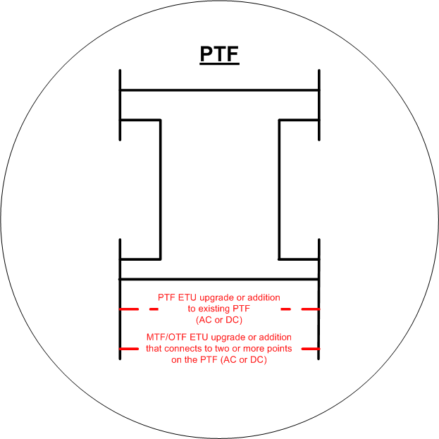
ETUs: PTF Upgrades and Additions
ETU Operation
ISO operates DAM/RTM (including the dispatch of the ETU) without recognizing transmission service rights over any internal facilities
ISO Operates the ETU consistent with Energy Management System (EMS) + ETU physical capabilities to facilitate Security Constrained Economic Dispatch
TOA required; OATT Schedule and Operating Protocol, if needed

Slide 24
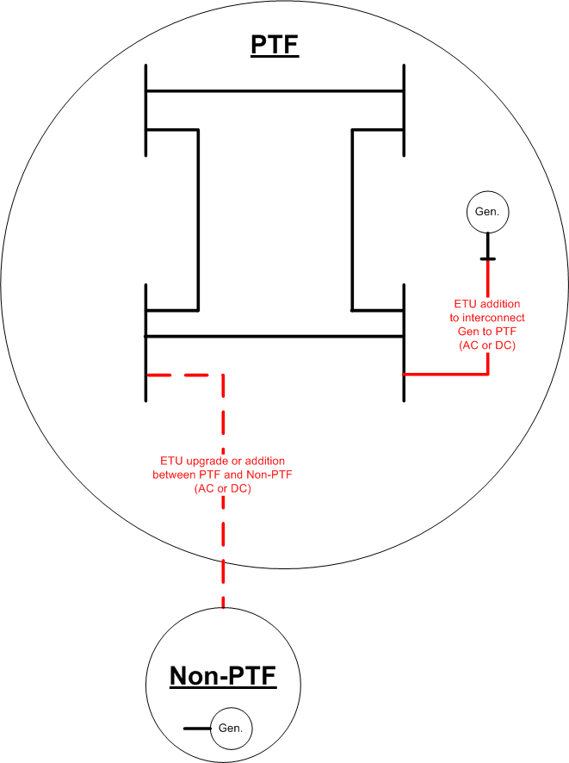
ETUs: - Connections between PTF + Non-PTF - Connections that facilitate future generator interconnection
ETU Operation
ISO operates DAM/RTM (including the dispatch of the ETU) without recognizing transmission service rights over any internal facilities
ISO dispatches the generator(s) based on market data/economic dispatch
In the case of a “Non-Generation Interconnection ETU that connects a generator(s) directly to PTF,” the ETU must be dynamically operated such that it follows the generator’s(s’) economic dispatch signal
ISO operates the ETU consistent with EMS + ETU physical capabilities to facilitate Security Constrained Economic Dispatch
TOA required; OATT Schedule and Operating Protocol (as applicable)

Slide 25
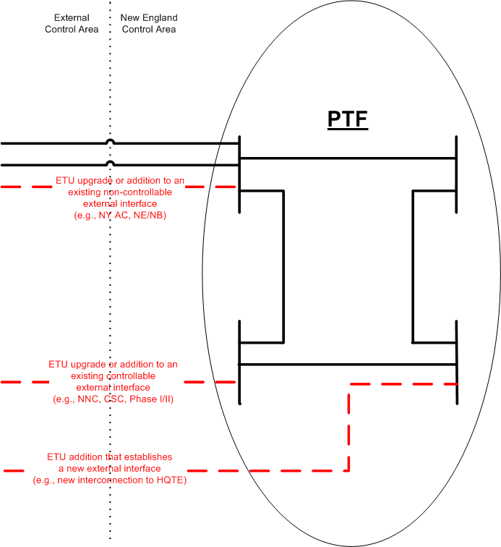
ETUs: 3 Types of Connections between ISO-NE and a Neighboring Control Area
ETU Operation
ISO schedules/curtails (S/C) RTM External Transactions over ETU consistent with similarly positioned external interfaces
An ETU upgrade or addition to an existing external interface must also apply the same transmission service provisions
Cannot administer non-pro forma PTF provisions and pro forma provisions over the same external interface
An upgrade or addition to an existing external interface that:
does not have advance physical reservation requirements (e.g., NY AC, NNC, NE/NB) must also apply PTF S/C logic
has advance physical reservation requirements (e.g., CSC, PI/II, OTF, MTF) must also apply the associated OATT transmission service schedule S/C logic
An addition that establishes a new external interface will be administered in accordance with its TOA and OATT transmission service schedule. Nothing precludes an OTF /MTF from eliminating advance reservation requirements and applying PTF S/C logic
TOA, OATT Schedule and Coordination Agreement required; Operating Protocol (as applicable)

Slide 26
For Each of the ETU Examples Described….
Market Considerations
Potential market rights (e.g., IARRs, CTRs) in accordance with the Tariff
The ETU itself does not result in the energy or capacity service/product. It is simply a mechanism for an entity to build a transmission addition/upgrade that could facilitate a specific goal to achieve a particular service/product (e.g., relief of congestion or assist in qualifying capacity).
Deficiencies of current ETU Process
ETU can experience Queue Position free-fall prior to I.3.9 approval
While the current ETU Process may be used to facilitate a certain resource objective, the absence of a meaningful Queue Position hinders the ability to associate an ETU with a resource
ETU Process lacks specificity as compared to other OATT processes (e.g., generator interconnection process)

Slide 27
Etu project schedule

Slide 28
Draft ETU TC Project Schedule
TC Schedule
September – Design presentation
October – Design discussion and rules presentation
November – Rules presentation
December – Vote
Filing early next year

