Slide 1
October 15 2025 | REV2025, Burlington VT
ISO New England and Interconnection Overview
Alex Rost
Director, Transmission Services

Slide 2
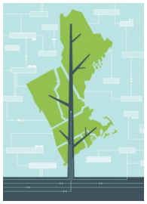
ISO New England’s Mission and Vision
Mission: What we do
Through collaboration and innovation, ISO New England plans the transmission system, administers the region’s wholesale markets, and operates the power system to ensure reliable and competitively priced wholesale electricity
Vision: Where we’re going
To harness the power of competition and advanced technologies to reliably plan and operate the grid as the region transitions to clean energy

Slide 3

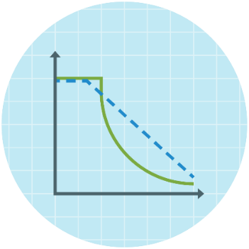
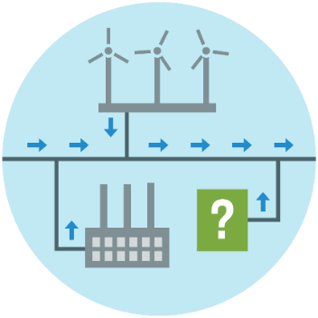
ISO New England Performs Three Critical Roles to Ensure Reliable Electricity at Competitive Prices
Grid
Operation
Coordinate and direct
the flow of electricity over the region’s
high-voltage
transmission system
Market Administration
Design, run, and
oversee the markets where wholesale electricity is bought
and sold
Power System Planning
Study, analyze, and plan to make sure New England's electricity needs will be met over the next 10 years

Slide 4
Things We Don’t Do
×
×
×
×
×
×
Handle
retail electricity
Own power grid infrastructure
Have a stake in companies that own grid infrastructure
Have jurisdiction
over fuel infrastructure
Have control over siting decisions
Plan the resource mix

Slide 5
Resource Mix
Nearly 400 dispatchable generators
About 28,900 MW of generating capability
99.5% of the region’s electricity in 2024 was provided by natural gas, nuclear, hydro, imported electricity (mostly hydropower from Eastern Canada), and renewables
About 37,000 MW of new generating capacity proposed to be built, though many projects ultimately withdraw (source: ISO-NE Interconnection Request Queue, April 2025)
More than 7,000 MW of generation have retired since 2013 or may retire in the next few years
About 3,000 MW of demand capacity resources (DCRs)—including active DCRs, energy efficiency, and other passive DCRs—are registered in New England
About 1,500 MW of imported electricity are obligated to be available for the region—mostly hydropower from Eastern Canada
About 400,000 distributed solar power installations totaling about 7,500 MW (nameplate), with most connected “behind the meter”

Slide 6
Close Coordination Between ISO and State Interconnection Processes Required
The region has successfully brought online a significant amount of distribution connected projects
The ISO works with developers, utilities and state entities to ensure transmission system reliability as projects connect to distribution systems
  Close coordination of ISO and state-jurisdiction interconnection studies required
  Close coordination of performance requirements for these resources supports distribution and transmission system reliability
  Everyone needs a reliable transmission system

Slide 7
The ISO’s Interconnection Process is Under Transition
In July 2023, FERC issued Order No. 2023 with an aim to prioritize projects with a high development likelihood/deter speculative ventures
The ISO’s Order No. 2023 compliant Interconnection Procedures include several major changes to its previous “first-come, first-served” serial study-based interconnection process
  Adopts a “first ready, first-served” cluster study process
  Increased financial/site control requirements for those entering the ISO’s interconnection process
  A penalty structure applied to the ISO and transmission owners for delays in study completion beyond established deadlines
The ISO started the Transitional Cluster Study on October 11, 2025, which must be completed by August 6, 2026
State-jurisdiction interconnection studies will continue to closely coordinate with ISO Interconnection Studies

Slide 8
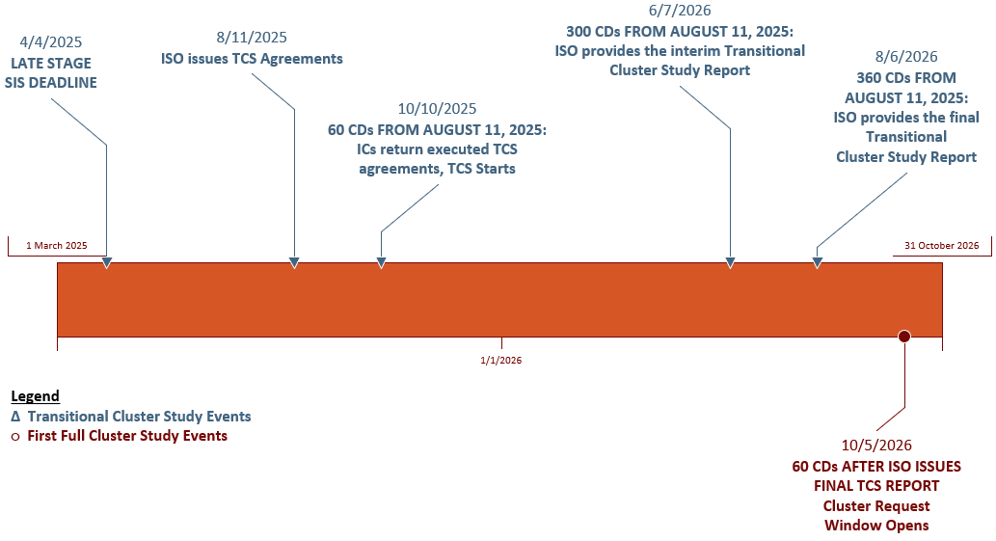
Transitional Cluster Study Timeline

Slide 9
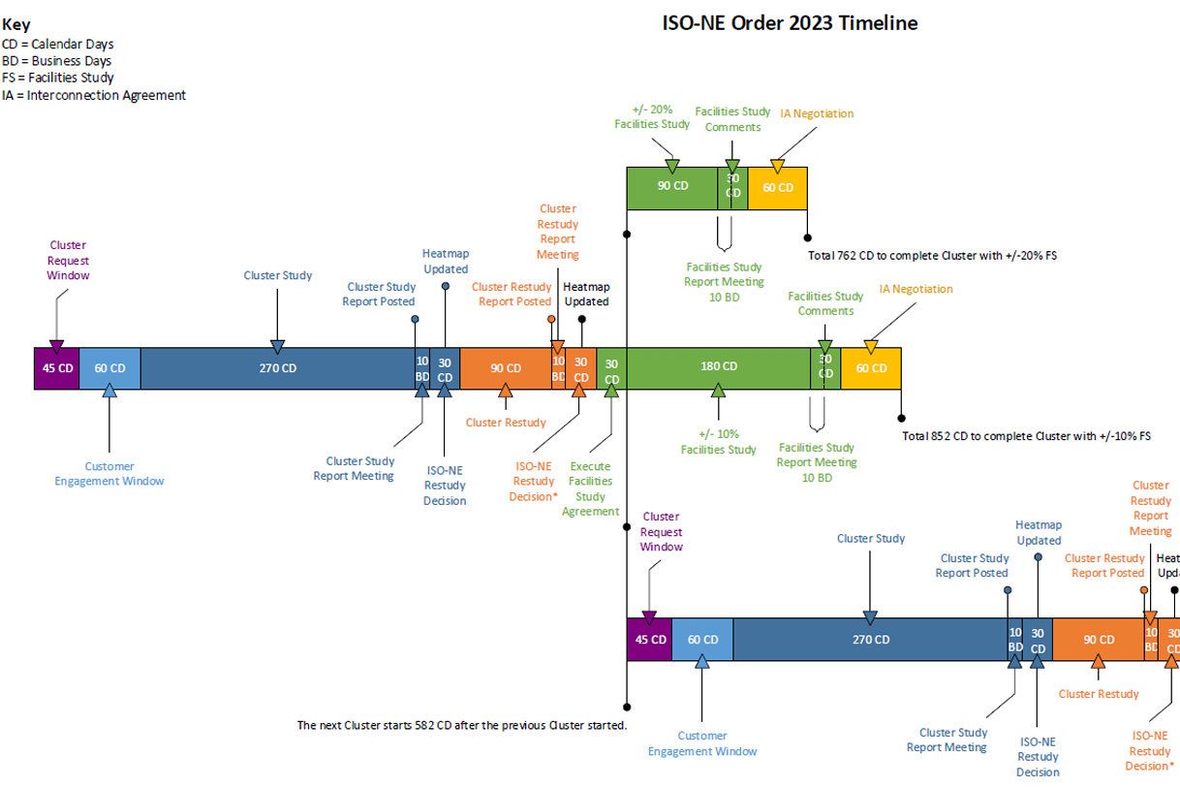
General Cluster Study Timeline
Additional details available in Planning Procedure 5-6

Slide 10
The ISO has a History of Innovation
Some examples include:
  Using automation to run power system studies and analyze study results (for many years)
  Using cloud computing to run power system studies (full implementation in 2017)
  Introducing and implementing Tariff rule changes that allowed new distributed energy resources interconnecting to distribution facilities to always proceed through the applicable state interconnection process
    Before this rule change, certain types of distributed energy resources were subject to the ISO interconnection process
Innovation is one of the ISO’s core values

Slide 11

Conclusion
ISO New England is actively working to:
  Coordinate, as needed, with state-jurisdiction interconnection to ensure transmission system reliability
  Continually improve its interconnection process rules, including implementing required changes to comply with FERC Order No. 2023

