Slide 1


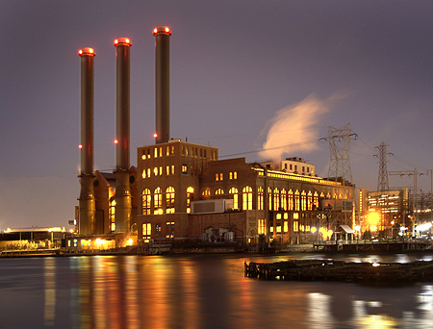
ISO-NE CONE and ORTP Analysis
August 16, 2016
ISO-NE Public
© Concentric Energy Advisors, Inc. 2016

Slide 2
Discussion Topics for CONE & ORTP
    Resource Screening
    General Assumptions
    Technology Specifications
    Energy & Ancillary Services Revenue Calculation
    Financial Model Inputs
    Financial Model Mechanics

Slide 3
Screening Criteria: CONE/Net CONE and ORTP
CONE/Net CONE technology screening criteria:
  Must be likely to be economic for merchant entry under long-term equilibrium conditions
  Must have reliable cost information available to calculate a CONE value using a full “bottom up” analytical approach
ORTP technology screening criteria:
  Represent technologies that have been installed in the region and participated in recent FCAs
  Have reliable cost information available to calculate an ORTP using a full “bottom up” analytical approach
  Have a first year revenue requirement below the FCA starting price

Slide 4
Resource Screening: CONE/Net CONE

Slide 5
CONE: Resources Screened and Recommendations
  Gas-fired resources that pass the screening criteria for a full bottoms up evaluation:
    Simple cycle gas turbine(s)
      GE 7HA.02
      GE LM6000
      GE LMS100
    Combined cycle gas turbines
      GE7HA.02 1x1
  Other technologies and manufacturers were considered but will not be fully evaluated

Slide 6
Projects in Development in New England
Source: SNL Energy

Slide 7
CONE: Resources Screened and Recommendations (cont’d)
 | Economic For Merchant Entry | Reliable Cost Information for a Full Bottoms Up Approach
On-Shore Wind | Higher cost than other CONE alternatives without a contract for output | Inconsistencies in project size and arrangement that differentiate projects. A “Standard Design” more than likely would not fit multiple projects.
Off-Shore Wind | Since no projects are in commercial operation in the US, the economics for merchant entry are unknown | Since no projects are in commercial operation in the US, there is insufficient data to perform a full analysis
Coal | Unlikely to be developed in New England
Nuclear | Unlikely to be developed in New England
Solar | Higher cost than other alternatives due to low solar irradiance and high land cost | Current significant differences in costs and incentives result in inconsistent data
Large-Scale Battery | Since no projects are in commercial operation in the US, the economics for merchant entry are unknown | Since no projects are in commercial operation in the US, there is insufficient data to perform a full analysis

Slide 8
CONE Analysis: General Assumptions

Slide 9
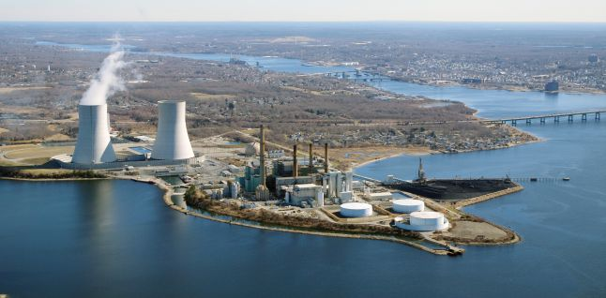
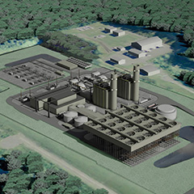
Assumptions: Approach and Preliminary Recommendations
  Location
    Approach – Identify locations where power infrastructure already exists including electric and gas transmission, and where retirements are scheduled, preferably in reasonable proximity to load centers or nodes.
    Locations analyzed in detail - Southeastern Connecticut and Bristol County Massachusetts fulfilled requirements. Connecticut and Massachusetts fulfilled the approach with Bristol County having more retirement MW’s and fewer current development projects.
    Recommendation - Bristol County Massachusetts is a location where it is reasonable to assume there will be development in the next three to five years.
www.kiewit.com
www.gemmapower.com

Slide 10
Assumptions: Approach and Preliminary Recommendations (cont’d)
  Plant Size and Configuration
    Based on likely anticipated market drivers such as baseload, peaking, fast to market, and flexible operation
    Plant capacity based on the market history of specific technologies utilized to address market needs
  Interconnection Assumptions
    Gas – 2 mile interconnection plus metering station
    Electrical - 2 mile interconnection to the 345kV system plus network upgrades
  Dual Fuel Assumptions
    Liquefied Petroleum Gas (LPG), Liquefied Natural Gas (LNG), and No. 2 oil were considered
    No. 2 oil is by far the most commonly installed backup fuel utilized, and public cost estimates are available

Slide 11
Assumptions: Approach and Preliminary Recommendations (cont’d)
  Environmental Assumptions
    Based on ease of permitting and proven methods for New England project development
    All technologies include:
      Selective Catalytic Reduction (SCR) devices
      Combined Cycle also includes a Carbon Monoxide (CO) catalyst
    Cooling System Assumptions
      All plants utilize dry cooling systems to ease permitting
      Dry cooling is a well proven method for development projects in New England

Slide 12
CONE Specifications: Simple Cycle Gas Turbine

Slide 13
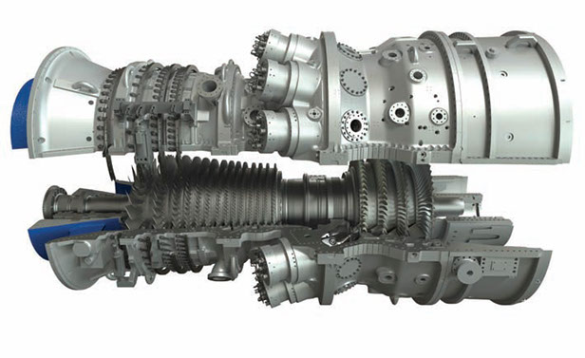
Simple Cycle Gas Turbine GE 7HA.02
  Characteristics of the 7HA.02
  Technology
    Size
      Large Frame machine designed with latest materials and combustion technology available
      Highest capacity available for a simple cycle machine
    Efficiency
      High simple cycle efficiency
    Flexibility
      GT has a low minimum load point and high ramp rates for flexible operation
    Basis for a combined-cycle
      If arranged properly can become the basis for a future combined cycle
Reference: GE

Slide 14
Technology Specifications: Simple Cycle Gas Turbine GE 7HA.02
Turbine model | 7HA.02
Configuration | Simple cycle frame machine
Net plant capacity (MW) | 338
Location | Bristol County, Massachusetts
Cooling system | Fin fan coolers
Power augmentation | Evaporative coolers
Net heat rate (Btu/kWh) | 9,220
Environmental controls | Selective catalytic reduction
Duel-fuel capability | Natural gas w/ No. 2 oil backup
Black start? | No
On-site gas compression? | No
Gas interconnection | Onsite connection
Electrical interconnection | Onsite connection
Plot size (acres) | 8.1

Slide 15
Capital Costs: Simple Cycle Gas Turbine GE 7HA.02
Cost Component | 2016 $$ | $/kW
Total Civil/Structural and Architectural | 16,899,000 | 50
Total Mechanical Costs | 130,210,000 | 385
Total Electrical Instrumentation and Controls Cost | 27,482,000 | 81
Total Major Equipment and Construction Cost | 174,591,000 | 517
Total Construction Management | 3,866,000 | 11
Other Project Costs including Freight, Startup Spares, A/E support and Startup Testing | 9,055,000 | 27
Subtotal Project Cost | 187,512,000 | 555
Project Contingency - 5% on Major Equipment 7% on Balance | 10,751,000 | 32
Subtotal Project Cost with Contingency | 198,263,000 | 587
EPC Contractor Fee | 13,878,000 | 41
Total Project Cost | 212,141,000 | 628
Owner's Contingency | 10,607,000 | 31
Total Owner Project Cost | 222,748,000 | 659
Working Capital (approximately 1% of EPC Costs) | 2,200,000
Financing Fees (approximately 4% of total costs financed by debt) | 8,000,000
Fuel Inventory - 1,400K gal @ $3/gal | 4,200,000
Source: Data is based on Mott MacDonald confidential estimating database

Slide 16
O&M Costs: Simple Cycle Gas Turbine GE 7HA.02
Fixed O&M | Proposed Values
O&M. Labor, Materials, Contract Services, A&G | $26/kW-yr
Site Leasing | $20,000/acre/yr
Property Taxes | 3%
Insurance | 0.6% of installed costs

Slide 17
Aeroderivative Gas Turbine LM6000
  Characteristics of the LM6000
  History
    Huge installed base
      One of the largest installed bases of any gas turbine
    Based on GE jet engine technology with millions of hours of operation
  Speed to Market
    One of the fastest turbines to engineer, procure, construct, and operate above 20MWe in capacity
    One of the most widely installed machines in ISO-NE
  Basis for a Combined Cycle
    If arranged properly can become the basis for a future combined cycle
Reference: GE

Slide 18
Technology Specifications: Aeroderivative Gas Turbine LM6000
Turbine model | LM6000
Configuration | Two SC Aeroderivative GTs
Net plant capacity (MW) | 94
Location | Bristol County, Massachusetts
Cooling system | Fin fan coolers
Power augmentation | Evaporative coolers
Net heat rate (Btu/kWh) | 9,774
Environmental controls | Selective catalytic reduction
Duel-fuel capability | Natural gas w/ No. 2 oil backup
Black start? | No
On-site gas compression? | No
Gas interconnection | Onsite connection
Electrical interconnection | Onsite connection
Plot size (acres) | 4.5

Slide 19
Capital Costs: Aeroderivative Gas Turbine LM6000
Cost Component | 2016 $$ | $/kW
Total Civil/Structural and Architectural | 11,696,000 | 124
Total Mechanical Costs | 78,496,000 | 831
Total Electrical Instrumentation and Controls Cost | 17,132,000 | 181
Total Major Equipment and Construction Cost | 107,324,000 | 1136
Total Construction Management | 3,392,000 | 36
Other Project Costs including Freight, Startup Spares, A/E Support, Startup Testing | 8,230,000 | 87
Subtotal Project Cost | 118,946,000 | 1,259
Project Contingency - 5% on Major Equipment 7% on Balance | 6,981,000 | 74
Subtotal Project Cost with Contingency | 125,927,000 | 1,333
EPC Contractor Fee | 8,815,000 | 93
Total Project Cost | 134,742,000 | 1,427
Owner's Contingency | 6,737,000 | 71
Total Owner Project Cost | 141,479,000 | 1,498
Working Capital (approximately 1% of EPC Costs) | 1,400,000
Financing Fees (approximately 4% of total costs financed by debt) | 7,000,000
Fuel Inventory - 300K gal @ $3/gal | 900,000
Source: Data is based on Mott MacDonald confidential estimating database

Slide 20
O&M Costs: Aeroderivative Gas Turbine LM6000
Fixed O&M | Proposed Values
O&M. Labor, Materials, Contract Services, A&G | $60/kW-yr
Site Leasing | $20,000/acre/yr
Property Taxes | 3%
Insurance | 0.6% of installed costs

Slide 21
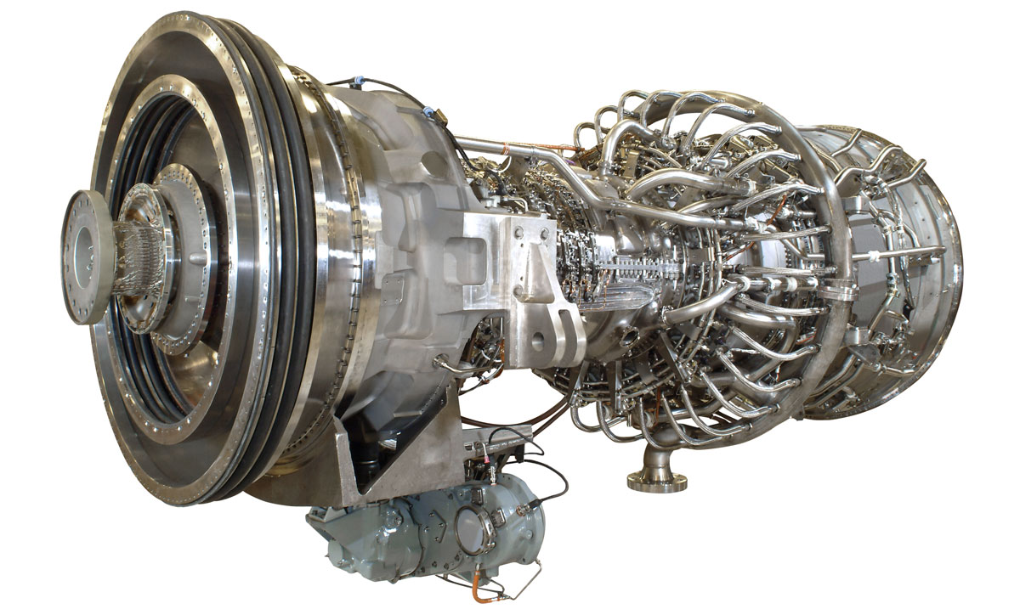
Advanced Aeroderivative Gas Turbine LMS100PB
  Characteristics of the LMS100PB
  Hybrid design
    Based on GE jet engine technology and GE Frame Gas Turbine technology
  Efficiency
    Highest simple cycle efficiency of any gas turbine
  Flexibility
    Has a very fast startup times and ramp rates for flexible operation
  Combined Cycle
    Gas turbine is so efficient, exhaust gas is cold, so not the best option for combined cycle
Reference: GE

Slide 22
Technology Specifications: Advanced Aeroderivative Gas Turbine LMS100PB
Turbine model | LMS100PB
Configuration | SC advanced aeroderivative
Net plant capacity (MW) | 97
Location | Bristol County, Massachusetts
Cooling system | Fin fan coolers
Power augmentation | Evaporative coolers
Net heat rate (Btu/kWh) | 9,105
Environmental controls | Selective catalytic reduction
Duel-fuel capability | Natural gas w/ No. 2 oil backup
Black start? | No
On-site gas compression? | No
Gas interconnection | Onsite connection
Electrical interconnection | Onsite connection
Plot size (acres) | 5.7

Slide 23
Capital Costs: Advanced Aeroderivative Gas Turbine LMS100PB
Cost Component | 2016 $$ | $/kW
Total Civil/Structural and Architectural | 10,792,000 | 112
Total Mechanical Costs | 76,026,000 | 786
Total Electrical Instrumentation and Controls Cost | 14,929,000 | 154
Total Major Equipment and Construction Cost | 101,747,000 | 1052
Total Construction Management | 3,392,000 | 35
Other Project Costs including Freight, Startup Spares, A/E Support, Startup Testing | 7,645,000 | 79
Subtotal Project Cost | 112,785,000 | 1,166
Project Contingency - 5% on Major Equipment 7% on Balance | 6,577,000 | 68
Subtotal Project Cost with Contingency | 119,362,000 | 1,234
EPC Contractor Fee | 8,355,000 | 86
Total Project Cost | 127,717,000 | 1 321
Owner's Contingency | 6,386,000 | 66
Owner Project Cost | 134,103,000 | 1,387
Working Capital (approximately 1% of EPC Costs) | 1,350,000
Financing Fees (approximately 4% of total costs financed by debt) | 6,500,000
Fuel Inventory - 300K gal @ $3/gal | 900,000
Source: Data is based on Mott MacDonald confidential estimating database

Slide 24
O&M Costs: Advanced Aeroderivative Gas Turbine LMS100PB
Fixed O&M | Proposed Values
O&M. Labor, Materials, Contract Services, A&G | $55/kW-yr
Site Leasing | $20,000/acre/yr
Property Taxes | 3%
Insurance | 0.6% of installed costs

Slide 25
Questions

Slide 26
CONE Specifications: Combined Cycle Gas Turbine

Slide 27
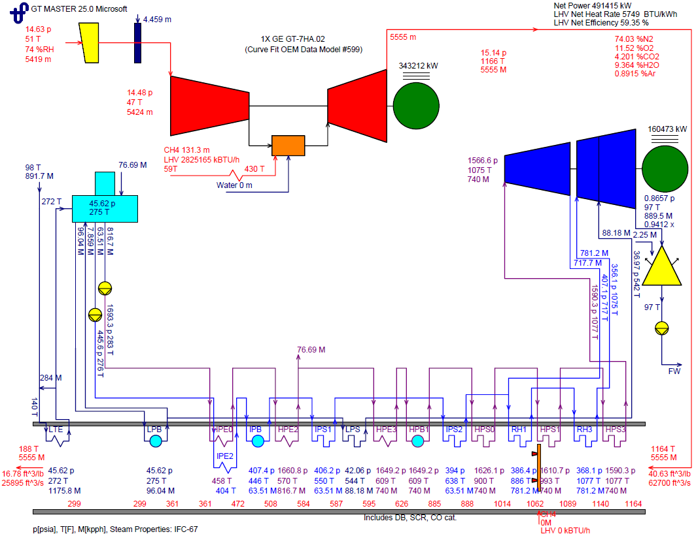
Assumptions: Combined Cycle Diagram – Basic Design

Slide 28
Technology Specifications: Combined Cycle Gas Turbine GE 7HA.02
Turbine model | 7HA.02 combined cycle
Configuration | Combined cycle w/ frame GT
Net baseload capacity (MW) | 491
Net capacity w/ duct firing (MW) | 533
Location | Bristol County, Massachusetts
Cooling system | Fin fan coolers
Power augmentation | Evaporative coolers
Baseload net heat rate (Btu/kWh) | 6,381
Duct firing net heat rate (Btu/kWh) | 6,546
Environmental controls | SCR and CO catalyst
Duel-fuel capability | Natural gas w/ No. 2 oil backup
Black start? | No
On-site gas compression? | No
Gas interconnection | Onsite connection
Electrical interconnection | Onsite connection
Plot size (acres) | 15

Slide 29
Capital Costs: Combined Cycle Gas Turbine GE 7HA.02
Cost Component | 2016 $$ | $/kW
Total Civil/Structural and Architectural | 49,885,000 | 102
Total Mechanical Costs | 250,493,000 | 510
Total Electrical Instrumentation and Controls Cost | 58,309,000 | 119
Total Major Equipment and Construction Cost | 358,687,000 | 730
Total Construction Management | 12,531,000 | 25
Other Project Costs including Freight, Startup Spares, A/E Support, Startup Testing | 26,507,000 | 54
Subtotal Project Cost | 397,725,000 | 809
Project Contingency- 5% on Major Equipment 7% on Balance | 23,758,000 | 48
Subtotal Project Cost with Contingency | 421,483,000 | 858
EPC Contractor Fee | 29,504,000 | 60
Total Project Cost | 450,987,000 | 918
Owner's Contingency | 22,549,000 | 46
Total Owner Project Cost | 473,536,000 | 964
Working Capital (approximately 1% of EPC Costs) | 7,000,000
Financing Fees (approximately 4% of total costs financed by debt) | 16,800,000
Fuel Inventory - 1,400K gal @ $3/gal | 4,200,000
Source: Data is based on Mott MacDonald confidential estimating database

Slide 30
O&M Costs: Combined Cycle Gas Turbine GE 7HA.02
Fixed O&M | Proposed Values
O&M. Labor, Materials, Contract Services, A&G | $39/kW-yr
Site Leasing | $20,000/acre/yr
Property Taxes | 3%
Insurance | 0.6% of installed costs

Slide 31
Questions

Slide 32
Energy & Ancillary Services

Slide 33
E&AS Overview
  Single 20-year forecast of Locational Marginal Prices (LMPs) based on expected value conditions
Used to estimate revenues for the reference technology (CONE) and each technology type (ORTP)
LMPs are based on a simulation via AURORAxmp
  Optimal commitment and dispatch model that forecasts hourly zonal prices
  Unit-specific dispatch, imports/exports, hourly loads, transmission constraints, etc., for New England and surrounding regions
  Finer resolution of forward contract data for modeling operating hours and margins
LMPs are used to develop revenue estimates (CONE and ORTP) and are calculated outside of the simulation model
  All revenue calculations will be based on the same price forecast
Recommended price curves will be available at the September meeting

Slide 34
Key forecast drivers
Delivered fuel prices
Retirements
New additions
Demand growth
Topology changes

Slide 35
Fuel Price Forecast
Gas price forecast – simulation via GPCM
  Industry-standard model of North American production, delivery, prices, imports/exports, LNG, etc., using detailed network model
RBAC Base Case
  Key pipeline projects included:
        Connecticut Expansion (Tennessee), AIM (Algonquin), Access Northeast (Algonquin), Atlantic Bridge (Algonquin)
    Projects excluded:
        Northeast Energy Direct (Tennessee), Constitution Pipeline
Oil price forecast – econometric model based on historical relationship between distillates and crude
  Simple and transparent, robust statistical results
      Crude curve from NYMEX
      Settlements on NYMEX through 2024, linear extrapolation thereafter

Slide 36
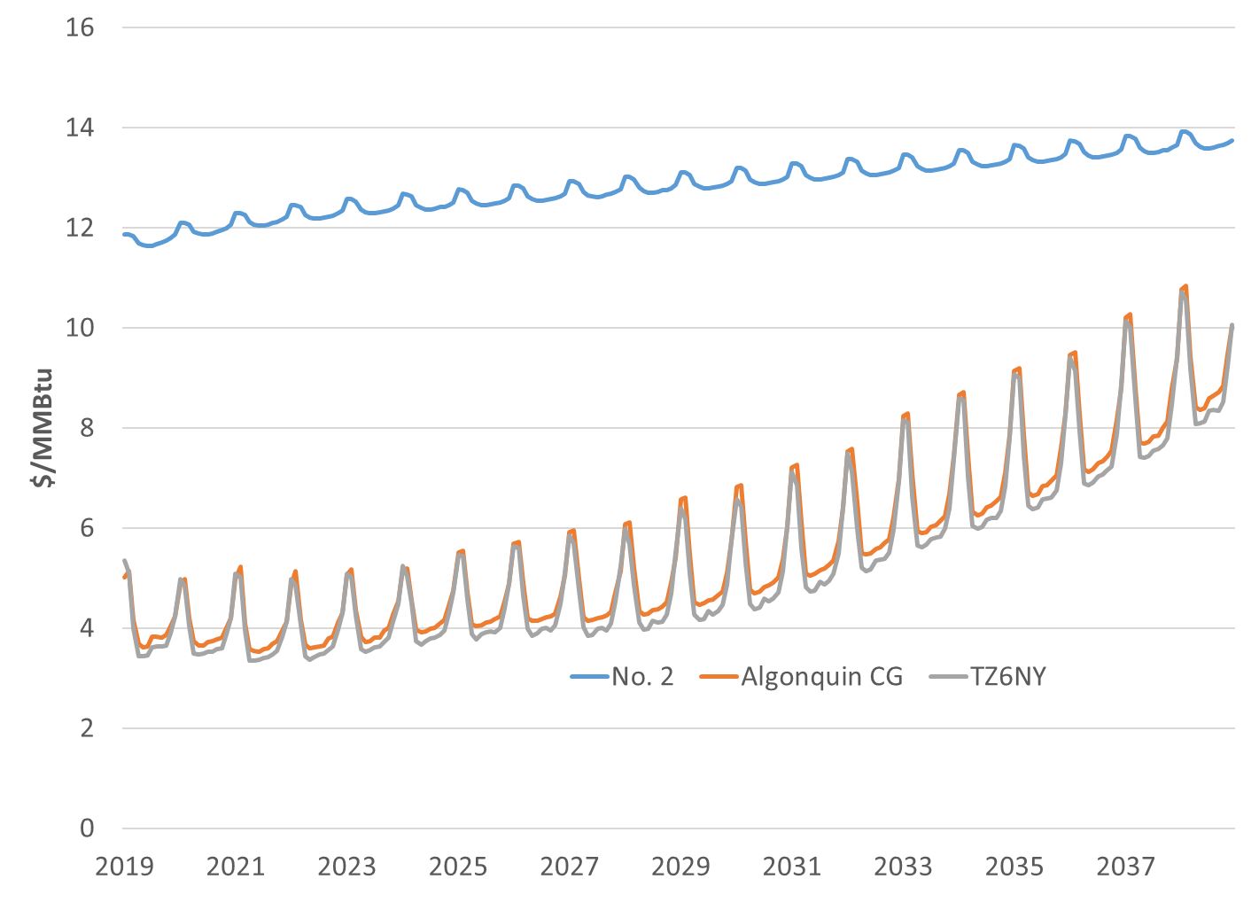
Delivered Fuel Price Forecast

Slide 37
Retirements (for E&AS modeling purposes)
Retirements for purposes of modeling E&AS revenues only
  Based on public data
Announced retirements (early in forecast) and retirements based on economics (later years)
Major Retirements – list is not exhaustive
Plant | Date | Fuel type | Capacity (MW)
Brayton Point | 2017 | Coal/Oil | 1,516
Middletown | 2019 | Oil | 760
Pilgrim 1 | 2019 | Nuclear | 681
Mystic | 2021 | Oil | 560
Canal 1 & 2 | 2023 | Oil | 1,094
Yarmouth | 2024 | Oil | 822
Stony Brook CTs | 2025 | Oil | 336
Millstone 2 | 2035 | Nuclear | 875

Slide 38
Additions (for E&AS modeling purposes)
Additions for purposes of modeling E&AS revenues only
Known additions (early) and generic additions to maintain reserve margins (later), plus wind and PV to meet regulatory mandates
Major Additions – list is not exhaustive
- Approx. 2,000 MW of wind capacity and 150 MW of PV added over the forecast period
Plant | Date | Fuel type | Capacity (MW)
Footprint | 2017 | Gas | 650
CPV Towantic | 2018 | Gas | 724
Canal 3 | 2019 | Gas | 321
PSEG Bridgeport | 2019 | Gas | 467
Next Gen CC | 2019 | Gas | 768
Medway Peaker | 2019 | Gas | 188

Slide 39
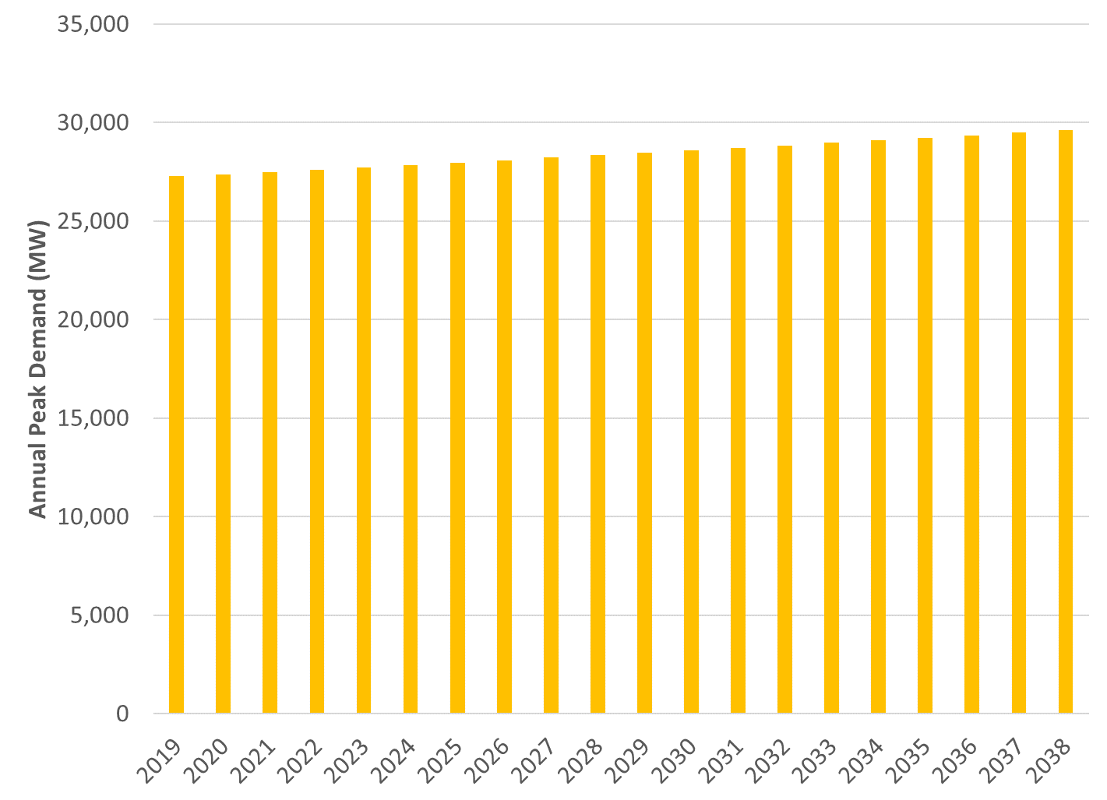
Demand Outlook – 2015 CELT Report

Slide 40
Key Transmission Topology Changes
Key changes are imports via new Canadian projects
  Model includes approx. 1,000 MW of import capacity from Canada
  Imports dispatched based on marginal economics
Transmission inputs are still under review and subject to change prior to the September meeting

Slide 41
Unit Revenues
Framework needs to support both CONE and ORTP
  Endogenous calculation of revenues not practical
Revenue calculation steps:
    Develop LMP forecast (see above)
    Develop fuel forecast
    Assumptions re heat rate (if any), Variable Operating and Maintenance (VOM) costs
    4-hour block dispatch algorithm
        Divide each day into 6 four hour blocks
        If spark spreads are positive in two or more hours within a block, unit is assumed to run for the entire block
    Provides more detailed revenue modeling than on-peak/off-peak pricing coupled with a static capacity factor
        Constraining dispatch to 4-hour blocks provides an approximation of plant operating constraints
        Transparent approach that can be reviewed by participants and used for ORTP

Slide 42
Financial Model Inputs

Slide 43
Inflation
Blue Chip Long Term Consensus Forecast, March 2016
      Consumer Price Index (for all urban consumers), 10-year average (2018-2027), 2.3%
Treasury Inflation-Protected Securities (TIPS) Implied Inflation
    Daily Treasury Yield Curve – Daily Treasury Real Yield Curve
      30-day average of 20-year: 1.37%
Recommendation:
2.0%

Slide 44
Depreciation
      Modified Accelerated Cost Recovery System (MACRS)
          Capitalized cost of tangible property is recovered over the specified life by an annual depreciation allowance
          Allows for faster recovery of asset
      MACRS 15 or 20 year by technology type
IRS Publication 946
    Table B-2
    Mid-quarter convention; placed in service in Q1
15yr MACRS | 20yr MACRS
8.750% | 6.563%
9.130% | 7.000%
8.210% | 6.482%
7.390% | 5.996%
6.650% | 5.546%
5.990% | 5.130%
5.900% | 4.746%
5.910% | 4.459%
5.900% | 4.459%
5.910% | 4.459%
5.900% | 4.459%
5.910% | 4.460%
5.900% | 4.459%
5.910% | 4.460%
5.910% | 4.459%
0.740% | 4.460%
0.0% | 4.459%
0.0% | 4.460%
0.0% | 4.459%
0.0% | 4.460%
0.0% | 0.565%

Slide 45
Property Taxes
Property taxes will be equal to the product of the assessed value and the appropriate municipal C&I tax rate
C&I rate in Massachusetts has ranged from approximately 0.2-4% in last three years
Federal and State tax rates will be reflected in the ATWACC
 | Attleboro | Fall River | Taunton | New Bedford
2013 | 2.05% | 2.54% | 3.06% | 2.95%
2014 | 2.16% | 2.67% | 3.12% | 3.11%
2015 | 2.13% | 2.81% | 3.32% | 3.36%
Recommendation:
3.0%

Slide 46
Production Tax Credits / Investment Tax Credits
PTC and ITC both being phased-down in coming years
Phase-down schedule for ITC:
Technology | 12/31/16 | 12/31/17 | 12/31/18 | 12/31/19 | 12/31/20 | 12/31/21 | 12/31/22 | Future
All solar except hybrid lighting | 30% | 30% | 30% | 30% | 26% | 22% | 10% | 10%
Hybrid lighting, fuel cells, small wind | 30% | N/A | N/A | N/A | N/A | N/A | N/A | N/A
Geothermal pumps, microturbines, CHP | 10% | N/A | N/A | N/A | N/A | N/A | N/A | N/A
Geothermal electric | 10% | 10% | 10% | 10% | 10% | 10% | 10% | 10%
Large wind | 30% | 24% | 18% | 12% | N/A | N/A | N/A | N/A

Slide 47
Cost of Capital
  Weighted Average Cost of Capital
    Return on Equity
    Cost of Debt
    Debt to Equity Ratio
    WACC = ROE * Weight of Equity + COD * Weight of Debt
Input | Preliminary Recommendation
Return on Equity | 13.4
Cost of Debt | 7.75
Debt to Equity Ratio | 60/40
WACC | 10.0

Slide 48
Peer Group – Cost of Capital
Cost of capital inputs should reflect risk of future cash flows over the life of the project
No PPA reflected in revenue streams
Generally, project-specific costs of capital are not publicly available
Appropriate cost of capital for the CONE resource is bounded by publicly available data subject to reasonable adjustments
Peer group:
  Pure-play merchant generation companies
  Publicly traded
Peer Group
Talen
AES
Dynegy
Calpine
NRG Energy

Slide 49
Cost of Debt
Generic corporate bond yields
Recommendation: 7.75%
Generally consistent with “B” rating
 | B | BB
2016 Average | 8.12% | 5.59%
Recommendation | 7.75%

Slide 50
Return on Equity
Reflects investor’s willingness to take equity stake in ownership
Capital Asset Pricing Model (CAPM): where common equity investors are deemed to measure their required return based on a risk free rate of return plus compensation for the relative risk of a specific security in relation to the broader market. This model may be expressed as:
    R_{e} = R_{f} + β (R_{m} – R_{f})
    where:
    R_{e} = the required return on equity
    R_{f} = the risk free rate of return
    R_{m} = the return required for the market as a whole
    β = Beta, a measure of the covariance between the returns (dividends plus capital gains) of the market average and those of a specific security.
Recommendation:
13.4%
R_{f} | 2.24 | Current 30-day average of 30-year U.S. Treasury bond yield
R_{m} | 9.5 | Duff & Phelps, 2016
β | 1.53 | Peer group average, Yahoo Finance & CEA calculation (TLN)
R_{e} | 13.4 | = 2.24 + 1.53 ( 9.5 – 2.24 )
Notes:
Beta – peer group average of Yahoo Finance beta
Equity Risk Premium – Duff & Phelps 2016 (Ibbotson)

Slide 51
Debt to Equity Ratio
Four year average weight of debt for peer group
  Results: 64% Debt/36% Equity
Current D/E ratios are higher than historical levels
Observed increase in debt weighting is due in part to:
  Relatively low costs of debt
  Declining market value of equity
Recommendation:
60/40%
Public statements indicate merchant developers may begin to deleverage

Slide 52
Recommendation – CONE Cost of Capital
Input | ISO-NE (2013) | PJM (2013) | NYISO (In progress) | Preliminary Recommendation
Return on Equity | 13.8 | 13.8 | 13.4 | 13.4
Cost of Debt | 7.0 | 7.0 | 7.75 | 7.75
Debt to Equity Ratio | 60/40 | 60/40 | 55/45 | 60/40
WACC | 9.7 | 9.7 | 10.3 | 10.0

Slide 53
Resource Screening: ORTP

Slide 54
Technology Type vs. ORTP Screening Criteria
Technology Type | Installed In New England and Participated in Recent FCAs * | Reliable “Bottom Up” Cost Data | 1st Year Revenue Requirements < FCA Starting Price
Simple Cycle Gas Turbine | Yes | Yes | Yes
Combined Cycle Gas Turbine | Yes | Yes | Yes
On-Shore Wind | Yes | Yes | Yes
Solar | Yes | Yes | Yes
Biomass | Yes | No | N/A
Off-Shore Wind | No | No | N/A
Batteries | No | No | N/A
* Does not include resources exempt from IMM cost review

Slide 55
ORTP: Resources Screened and Recommendations
  Resources passing the screening criteria
    Gas-fired resources that pass the screening criteria for a full evaluation consistent with CONE calculation:
      Frame simple cycle gas turbine selected over Aeroderivative, and Advanced Aeroderivative
        Recommended Size: 338 MW
        Recommended Location: Bristol County, MA
      Combined cycle gas turbine is designed around Frame over Aeroderivative gas turbine
        Recommended Size: 491 MW
        Recommended Location: Bristol County, MA

Slide 56
ORTP: Resources Screened and Recommendations (cont’d)
  Resources passing the screening criteria
    On-Shore Wind
        Onshore Wind has been installed in New England
        Data is available on the different ways to construct these facilities
        Facilities do have site specific details, but commonalities exist
        Projects are not anticipated to significantly increase in capacity from recent installations
        The location of the project is based on wind resource and transmission interconnection
        Recommended size: 52 MW facility with 3 MWe wind turbines
        Recommended location: central New Hampshire

Slide 57
ORTP: Resources Screened and Recommendations (cont’d)
  Resources passing the screening criteria
    Solar
        Solar facilities have been constructed in New England although most are 10 MW or smaller.
        A limited number of facilities have been constructed over 20 MW
        Primary market to this point has been commercial and residential not industrial in NE
        Solar irradiance is limited and real estate is expensive, which also limits project area and thus the size of the facilities.
        State tax structures and incentive plans differ from state to state
        Recommended size: 10 MW solar facility
        Recommended location: Bristol County, MA
    Energy Efficiency [to be reviewed at the September Meeting]
    Demand Response [to be reviewed at the September Meeting]

Slide 58
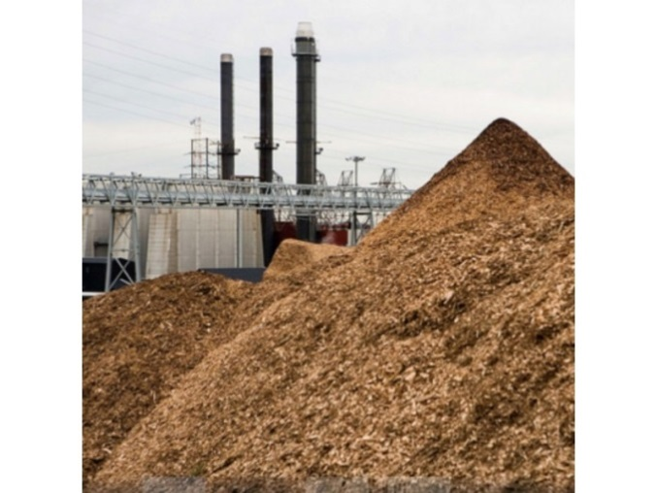
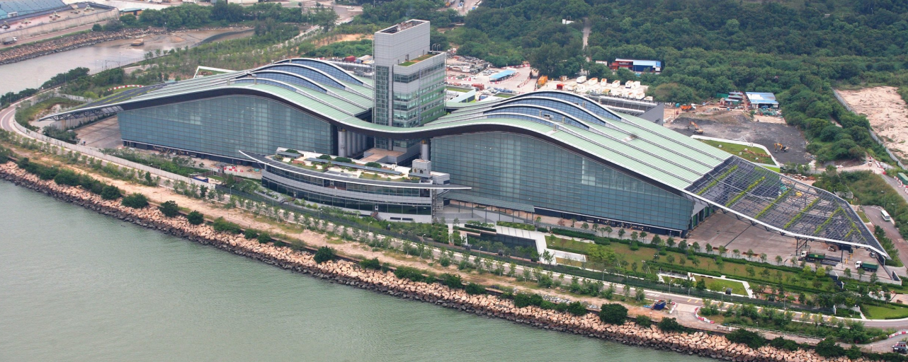
ORTP: Resources Screened and Recommendations (cont’d)
  Resources that do not pass the screening criteria
    Biomass
      The fuel utilized in Biomass plants is specific to each location. Every source of wood, waste, sludge, biomass, etc. is different
      Different fuels mean that the combustion process must be changed for each kind of fuel. Sawdust is different than bark, which is different than pellets, which is different than sewage sludge, which is different than grass. This means the design is customized for each site, so data is not applicable for a standard design across the entire New England region

Slide 59
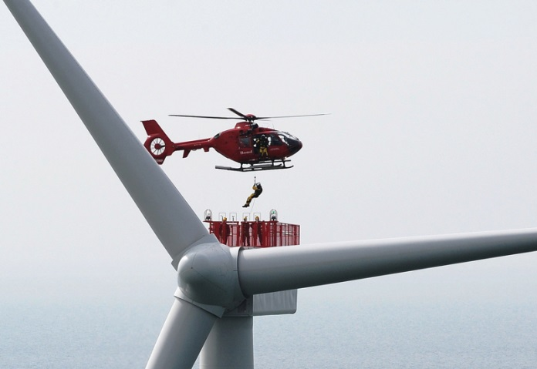
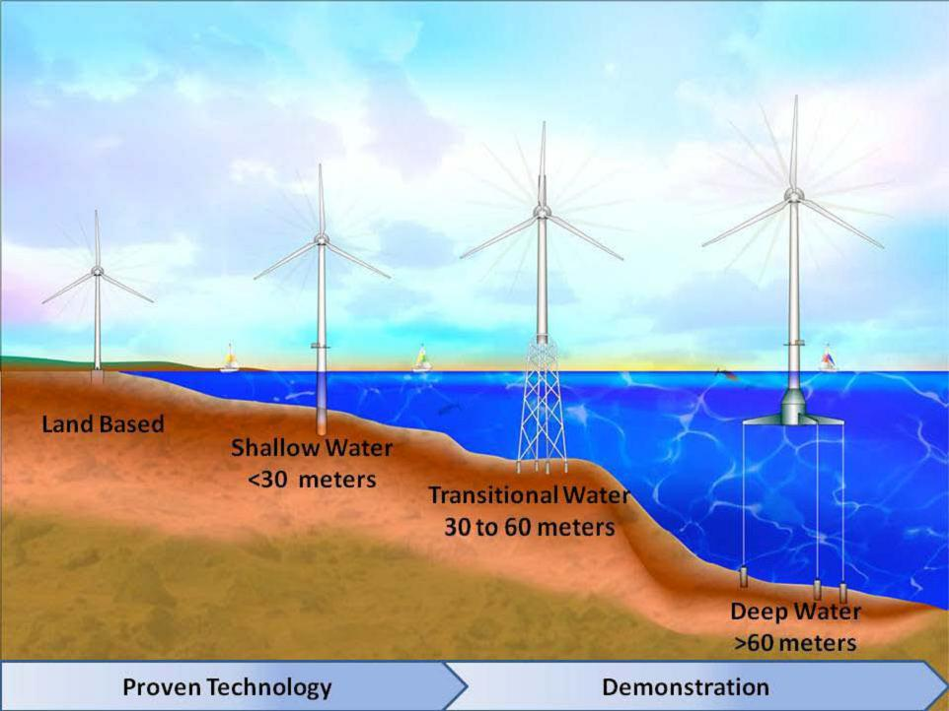
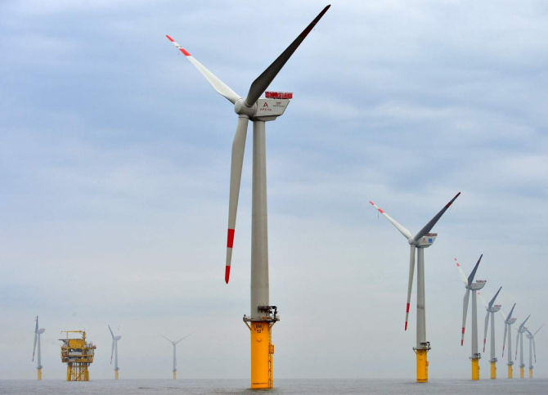
ORTP: Resources Screened and Recommendations (cont’d)
  Resources that do not pass the screening criteria
    Off-Shore Wind
      Insufficient data; "top down" cost data will not provide the IMM with sufficient confidence to effectively implement buyer-side mitigation
      Estimates from other regions of the world are based on different: wind, underwater geotechnical data, currents, waves, labor rules rates and productivity, maintenance practices, rules where transmission comes ashore, etc.
      Do not all apply in offshore New England waters
www.ainonline.com
www.boem.gov
www.scottishenergynews.com

Slide 60
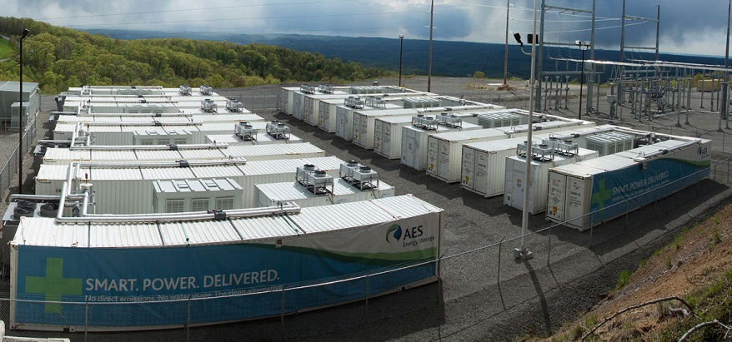
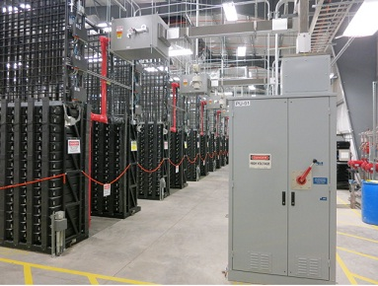
ORTP: Resources Screened and Recommendations (cont’d)
  Resources that do not pass the screening criteria
    Batteries
      No stand alone largescale battery storage installations have been installed in New England
      Insufficient data; "top down" cost data will not provide the IMM with sufficient confidence to effectively implement buyer-side mitigation
      Technologies including lithium ion, sodium-sulfur, redox, flow etc. technologies are still being developed
      The criteria of how capacity is to be measured (MW vs. MWH) and how the systems are to operate has not been agreed to, duration and sustainability of discharge is of particular focus.
www.aesenergystorage.com
www.duke-energy.com

Slide 61
Questions

Slide 62
ORTP Specifications: Gas Turbines

Slide 63
Technology Specifications: Simple Cycle and Combined Cycle
  Continuing to evaluate cost components that have a material range in values
    Low end of the competitive range
  Preliminary areas of further analysis:
    Labor
    Contingency
    Interconnection
    Taxes
    Insurance
    Other

Slide 64
Questions

Slide 65
ORTP Specifications: On-Shore Wind

Slide 66
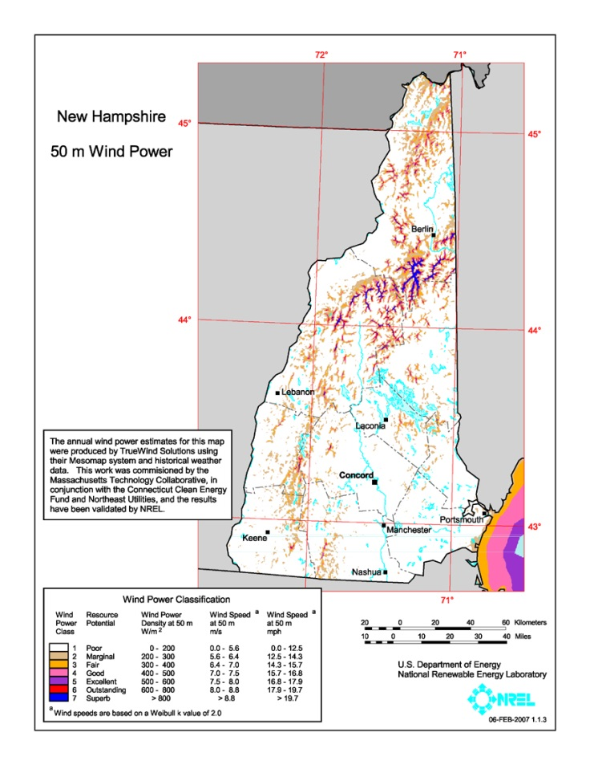
Assumptions: Approach and Recommendations, On-Shore Wind
  Location
    Approach
      Onshore has two primary focal points: wind and transmission
      Altitude improves wind resources in general; northern New England has the advantage
      Transmission to market was the final differentiator
    Locations analyzed included Vermont, Maine, and New Hampshire
    Central New Hampshire has wind and transmission to market
  Plant Size and Configuration Assumptions
    Land area is a significant expense in New England, therefore we do not anticipate large installations in the NE region
    Based on recent NE project trends we are using a 52MW wind farm size based on 3 MW turbines for ORTP
  Interconnection Assumptions
    New wind farms will interconnect with existing transmission along the corridor

Slide 67
Technology Specifications and Cost Ranges: On-Shore Wind
Specification | Preliminary Review
Turbine Size | 3 MWe
Net Plant Capacity | 52 MW
Location | Central New Hampshire
Electrical Interconnection | Onsite, along the wind farm field or line
Plot Size | Property will be leased for the duration of the project. Most land can still be utilized for farming, commercial, industrial, or even residential purposes while the farm is producing power. An acre or so will be required for a switchyard near the interconnection point
Overnight Capital Costs | 1250-2000 $/kW
Fixed O&M Costs | 30-45 $/kW-yr
Capacity Factor | 30-40%

Slide 68
Questions

Slide 69
ORTP Specifications: Solar

Slide 70
Assumptions: Approach and Recommendations, Solar
  Location
    Approach – Identify a standard size solar facility that would be considered typical over the next three to five years for New England
    Max installed facility size in New England is 50 MW, with a few facilities making it to 20 MW in Vermont
    Multiple 10 MW installations exist across the region
    Locations analyzed – Location criteria was most dependent on available land area and connectivity
    Recommended location: Bristol County Massachusetts
  Plant Size and Configuration Assumptions
    Standard size is assumed to be 10 MW
  Interconnection Assumptions
    Site will have local onsite access to transmission

Slide 71
Technology Specifications and Cost Ranges: Solar
Specification | Preliminary Review
Net Plant Capacity | 10 MW
Location | Bristol County, MA
Electrical Interconnection | Onsite
Overnight Capital Costs | $1400-1800
Fixed O&M Costs | $9-13 / kW-yr
Capacity Factor | 14%

Slide 72
Questions

Slide 73
E&AS Revenues – ORTP
Based on same LMP curves as Net CONE except in a case where a PPA is assumed
Method for dispatch will vary
  For fossil units, similar approach to Net CONE
  PV and wind will be based on output expectations
  DR/EE will be dispatched based on a “strike price”
Approach to E&AS still under development, to be finalized by September meeting

Slide 74
Cost of Capital – ORTP
PPA-backed non-capacity revenues
WACC_{ORTP} < WACC_{CONE}
Low end of competitive range for merchant generation
Adjust ROE using a higher risk free rate in CAPM calculation
Adjust COD using BB rated debt costs
Maintain debt to equity ratio
Preliminary Recommendation:
ROE | 12.4
COD | 6.5
D/E | 60/40
WACC | 8.9

Slide 75
Next Steps
To be reviewed at September meeting:
    Pay for Performance approach and recommendations
    Energy & Ancillary Services revenues by resource type
    Methodologies for energy efficiency and demand response ORTP calculation
    Recommended CONE/Net CONE values
    Recommended ORTP values for wind, solar, combined cycle, simple cycle generating resources

