Slide 1
Grid Impacts & Challenges Arising from the Integration of Inverter-Based Variable Resources
Eamonn Lannoye
Erik Ela
Daniel Brooks
ISO New England Stakeholder Meeting
October 19, 2016

Slide 2

Outline
Changing System Characteristics
Capabilities of New and Existing Resources
Transmission System Planning with High Penetrations of Inverter Based Generation
Protection & Control Considerations for Future Grid Scenarios

Slide 3
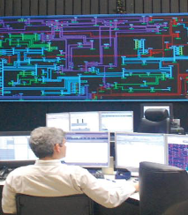
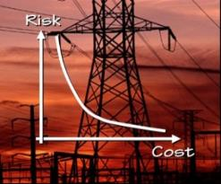

EPRI Grid Operations & Planning R&D Area at a Glance
Grid Operations
Grid Planning
Operator Visualization
Synchrophasor Applications
Operating Limit Assessment
Reactive Power & Voltage Management & Control
System Restoration Support
Modeling & Validation
System Protection
Risk-Based Planning
Contingency Screening
Special Planning Studies (GMD, TOV, etc.)
Market Operations
Bulk Renewables Integration
Technical Market Design
Market Software Implementation
Price Formation
Energy, Ancillary Services, FTRs, Capacity
Modeling & Protection
Flexibility Planning
Operator Tools for Variability & Uncertainty
Voltage & Frequency
DER Impacts on Bulk System
Reliability Analysis Methods/Tools
Economic Analysis Methods/Tools
Decision Support Methods/Tools
Model Development & Validation
Operator/Planner Reference Guides
Common approach to all programs

Slide 4
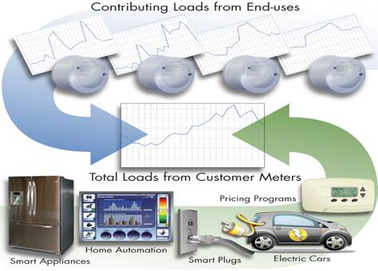

Trends Impacting Planning Processes & Tools
Changing Generation Mix
Consumer Choice/Control
Active Distribution Systems
Notes:
Obviously inter-related
Also missing emerging technologies angle that fits into some of these – storage, HVDC, etc.

Slide 5
Emerging System Characteristics & Planning Impacts
Technology Trends
System Impacts
Planning Needs
Variability/Uncertainty
Load Forecast
Models
Rush to Renewables & Gas
Inverter Resources
New Resource
Models
Gas System Interaction
Customer Behavior
& “Prosumers”
New Resource Characteristics
New Analytics
(incl. Probabilistic)
Operational Reliability
Load Uncertainty
Dist. Resources & Automation
T&D Interactions
Non-Power System Interactions
2-Way Power Flow
T & D System Interactions
Displace Central Gen
Notes:
Models to characterize load and performance of emerging resources
Operational reliability must be considered – ramping, thermal, voltage, frequency
Stochastic methods to address uncertainty
Interactions between Trans and Dist and Customer
Interactions with other systems – gas infrastructure

Slide 6
Emerging System Characteristics & Planning Impacts
Technology Trends
System Impacts
Planning Needs
Variability/Uncertainty
Load Forecast
Models
Rush to Renewables & Gas
Inverter Resources
New Resource
Models
Gas System Interaction
Customer Behavior
& “Prosumers”
New Resource Characteristics
New Analytics
(incl. Probabilistic)
Operational Reliability
Load Uncertainty
Dist. Resources & Automation
T&D Interactions
Non-Power System Interactions
2-Way Power Flow
T & D System Interactions
Displace Central Gen
Notes:
Models to characterize load and performance of emerging resources
Operational reliability must be considered – ramping, thermal, voltage, frequency
Stochastic methods to address uncertainty
Interactions between Trans and Dist and Customer
Interactions with other systems – gas infrastructure

Slide 7
Emerging System Characteristics & Planning Impacts
Technology Trends
System Impacts
Planning Needs
Variability/Uncertainty
Load Forecast
Models
Rush to Renewables & Gas
Inverter Resources
New Resource
Models
Gas System Interaction
Customer Behavior
& “Prosumers”
New Resource Characteristics
New Analytics
(incl. Probabilistic)
Operational Reliability
Load Uncertainty
Dist. Resources & Automation
T&D Interactions
Non-Power System Interactions
2-Way Power Flow
T & D System Interactions
Displace Central Gen
Notes:
Models to characterize load and performance of emerging resources
Operational reliability must be considered – ramping, thermal, voltage, frequency
Stochastic methods to address uncertainty
Interactions between Trans and Dist and Customer
Interactions with other systems – gas infrastructure

Slide 8
Emerging System Characteristics & Planning Impacts
Technology Trends
System Impacts
Planning Needs
Variability/Uncertainty
Load Forecast
Models
Rush to Renewables & Gas
Inverter Resources
New Resource
Models
Gas System Interaction
Customer Behavior
& “Prosumers”
New Resource Characteristics
New Analytics
(incl. Probabilistic)
Operational Reliability
Load Uncertainty
Dist. Resources & Automation
T&D Interactions
Non-Power System Interactions
2-Way Power Flow
T & D System Interactions
Displace Central Gen
Notes:
Models to characterize load and performance of emerging resources
Operational reliability must be considered – ramping, thermal, voltage, frequency
Stochastic methods to address uncertainty
Interactions between Trans and Dist and Customer
Interactions with other systems – gas infrastructure

Slide 9
Emerging System Characteristics & Planning Impacts
Technology Trends
System Impacts
Planning Needs
Variability/Uncertainty
Load Forecast
Models
Rush to Renewables & Gas
Inverter Resources
New Resource
Models
Gas System Interaction
Customer Behavior
& “Prosumers”
New Resource Characteristics
New Analytics
(incl. Probabilistic)
Operational Reliability
Load Uncertainty
Dist. Resources & Automation
T&D Interactions
Non-Power System Interactions
2-Way Power Flow
T & D System Interactions
Displace Central Gen
Notes:
Models to characterize load and performance of emerging resources
Operational reliability must be considered – ramping, thermal, voltage, frequency
Stochastic methods to address uncertainty
Interactions between Trans and Dist and Customer
Interactions with other systems – gas infrastructure

Slide 10
Potential Impacts of Distributed Energy Resources (DER)
DER Characteristic | Potential Benefits | Potential Challenges
Point of Interconnection | T&D deferral Congestion & losses Supply capacity | T&D expansion need Congestion & losses Protection Voltage regulation Disturbance ride-thru
Visibility & Control (DER) | Increased potential to manage local issues | Ops awareness/control Power flow mgmt. Balancing
Inverter Interface | Voltage & frequency support | Protection Voltage & Frequency control Power Quality
Variability & Uncertainty | Increased diversity | Forecast challenge Other resource O&M Reserves & Flexibility Frequency and ACE control
Emissions & Fuel Costs | Low fuel costs Low emissions | Revenue Sufficiency
Resource Adequacy & System Flexibility
Operational Dispatch & Balancing
Transmission Performance
Transmission Expansion
Not all Benefits & Challenges apply to all VER resource types & locations
Notes:
Main concerns and usually limitating factor is: voltage
For radial distribution systems, the impact on voltage and regulation equipment is main concern
Transition: One of the questions we get a lot is “how much PV can be added” before these problems arise

Slide 11
Short-term Operational Needs – Impact on Operating Reserve
Instantaneous events
Primary
Stabilize frequency
Contingency Reserve
Secondary
Return frequency to nominal and/or ACE to zero
Tertiary
Return system to secure state (replace other reserves)
Event
Longer duration events
Secondary
Return frequency to nominal and/or ACE to zero
Ramping Reserve
Operating Reserve
Tertiary
Return system to secure state (replace other reserves)
Flexibility Reserve
Correct the anticipated ACE
Non-Event
Manual (Part of Optimal Dispatch)
Regulating Reserve
Correct the current ACE
*Terminology not universal
Automatic (Within Optimal Dispatch)
Different reserve capacity may be required to be held for different reasons

Slide 12
Long-Term Planning Needs –What “Type” of Capacity is Needed?
New need to ensure flexibility adequacy in long-term planning?
Source: California Public Utility Commission Workshop

Slide 13
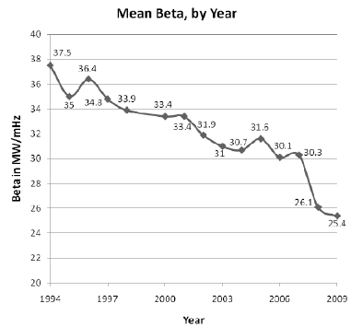
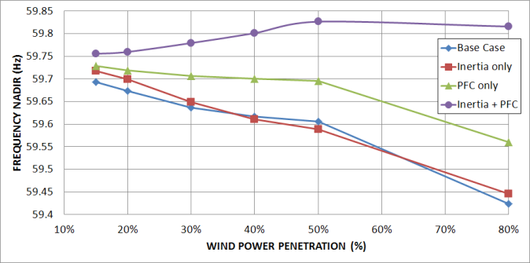
Frequency Response Impacts
Current issues exist
  Governor dead bands
  Blocked governors
  Operational modes (e.g., sliding pressure)
Variable renewables (wind and PV) are non synchronous resources and do not inherently provide inertia or frequency control
600-700 MW/Hz/year Decline
J. Ingleson and E. Allen, “Tracking the Eastern Interconnection Frequency Governing Characteristic,” IEEE Power and Energy Society General Meeting 2010.
Load Shedding!
More realistic Governor Participation
60%
50%
40%
E, Ela et al., Active Power Control from Wind Power: Bridging the Gaps, NREL Technical Report, December 2013.

Slide 14
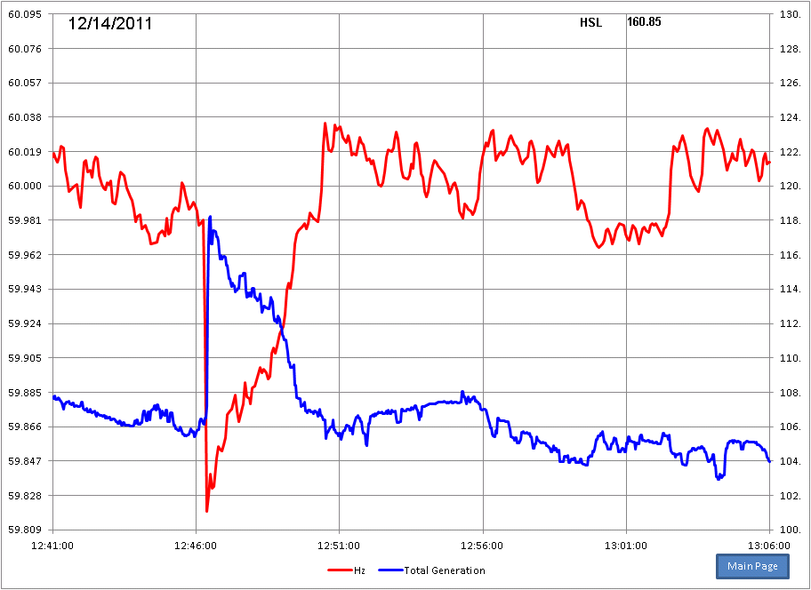
Variable Generation Can Be Part of the Solution
Hz
Wind Generation
Wind (and solar) can provide many of the services they displace–
need to enable controls and compensation/requirements
SOURCE: Sandip Sharma, ERCOT, “Frequency control requirements and performance in ERCOT ISO,”
presented at EPRI/NREL/PJM Inverter Generation Interconnection Workshop, Apr 11-12, 2012.

Slide 15
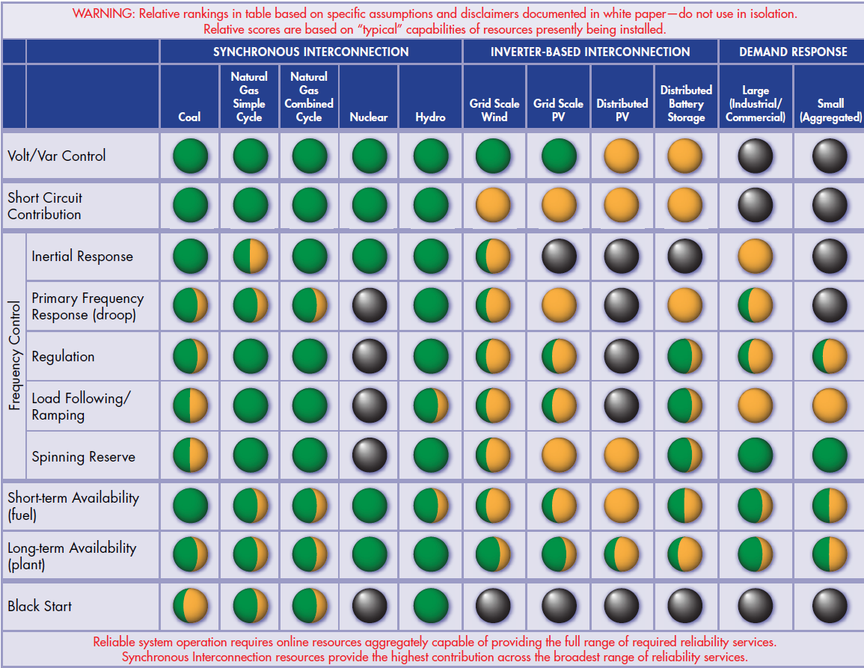
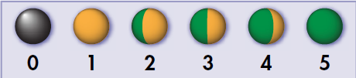
Resource Reliability Contributions
EPRI whitepaper (2015): Contributions of Supply & Demand
Resources to Required System Reliability Services
http://www.epri.com/abstracts/Pages/ProductAbstract.aspx?ProductId=000000003002006400

Slide 16
Transmission System Planning with High Penetrations of Inverter Based Generation
Eknath Vittal
Sr. Engineer
Mahendra Patel
Tech. Executive
ISO New England Stakeholder Meeting
Oct. 19th, 2016

Slide 17
Motivation and Outline
Provide background on planning methodologies and strategies that assess the impact of inverter based renewable generation in power systems
Inverter based technologies offer challenges in their variability and uncertainty but benefits through their advanced dynamic control capabilities
Risk Based Planning can help cover more scenarios and develop more robust planning strategies to account for the variability and uncertainty offered by renewables
Energy Storage and Power Flow Controllers offer increased system flexibility and efficiency
Synchronous Condensers can provide dynamic support and replace decommissioned conventional plants in some cases
Distributed Energy Resources (DER) can play an important role and needs to be taken into account at the transmission planning level

Slide 18
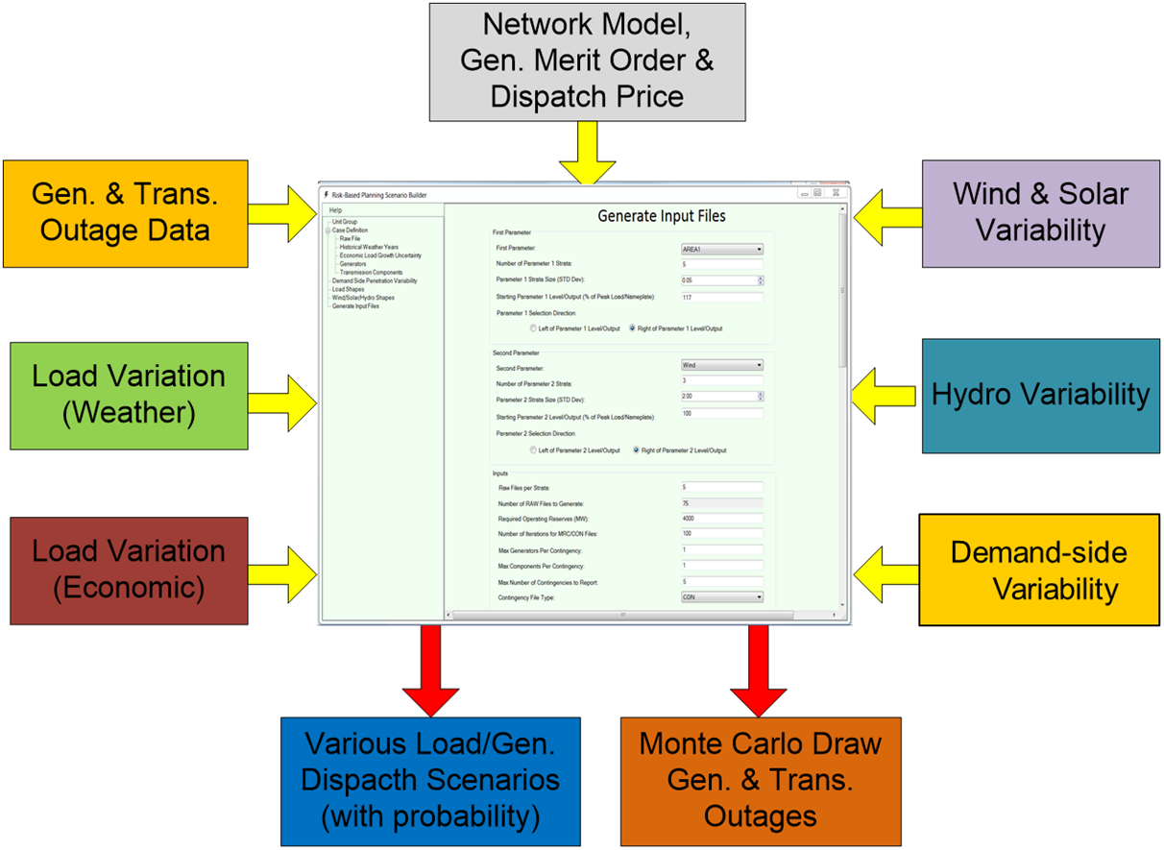
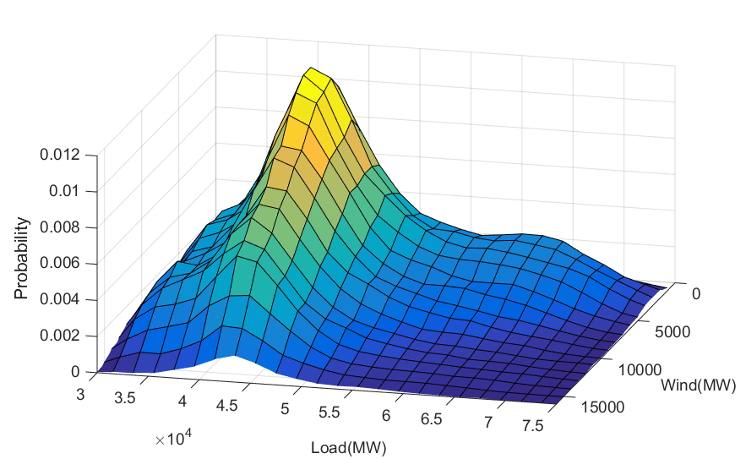
Risk Based Planning – Scenario Builder Tool
Takes into account several data sources to develop probabilistic scenarios to improve system planning
Steps away from traditional “snapshot” planning approach
Allows you to identify scenarios that you may not have studied but are critical to the stability of the system
Average scenarios (more likely)
High load scenarios/low wind
Low load/high wind scenarios

Slide 19
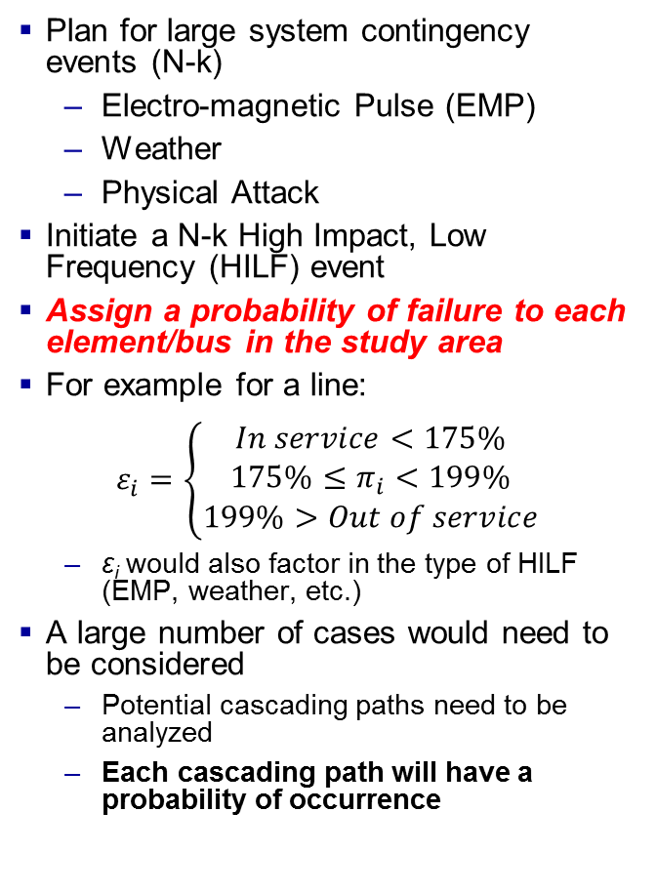
Risk Based Planning – Resiliency and Cascading Analysis
Plan for large system contingency events (N-k)
  Electro-magnetic Pulse (EMP)
  Weather
  Physical Attack
Initiate a N-k High Impact, Low Frequency (HILF) event
Assign a probability of failure to each element/bus in the study area
For example for a line:
$$ε_{i}=\left\{\begin{matrix}In service<175\% \\ 175\%≤π_{i}<199\% \\ 199\%>Out of service\end{matrix}\right.$$
  ε_{i} would also factor in the type of HILF (EMP, weather, etc.)
A large number of cases would need to be considered
  Potential cascading paths need to be analyzed
  Each cascading path will have a probability of occurrence

Slide 20
Energy Storage to Enhance Transmission System
Improve transient and voltage stability
Better post-fault voltage recovery than shunt compensation
Corrective control actions & temporary active power support
Load or generation source to balance circuit conditions:
  Locating storage at strategic locations can increase transmission capability
Combination of energy storage and dynamic reactive power can be effective for voltage control & stability improvement

Slide 21
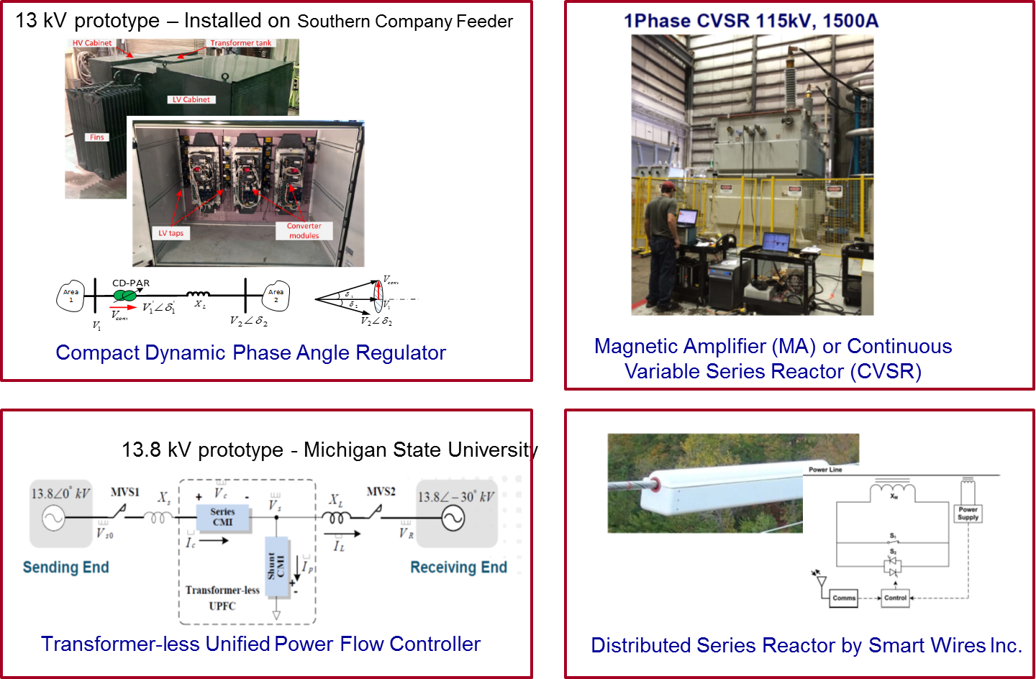
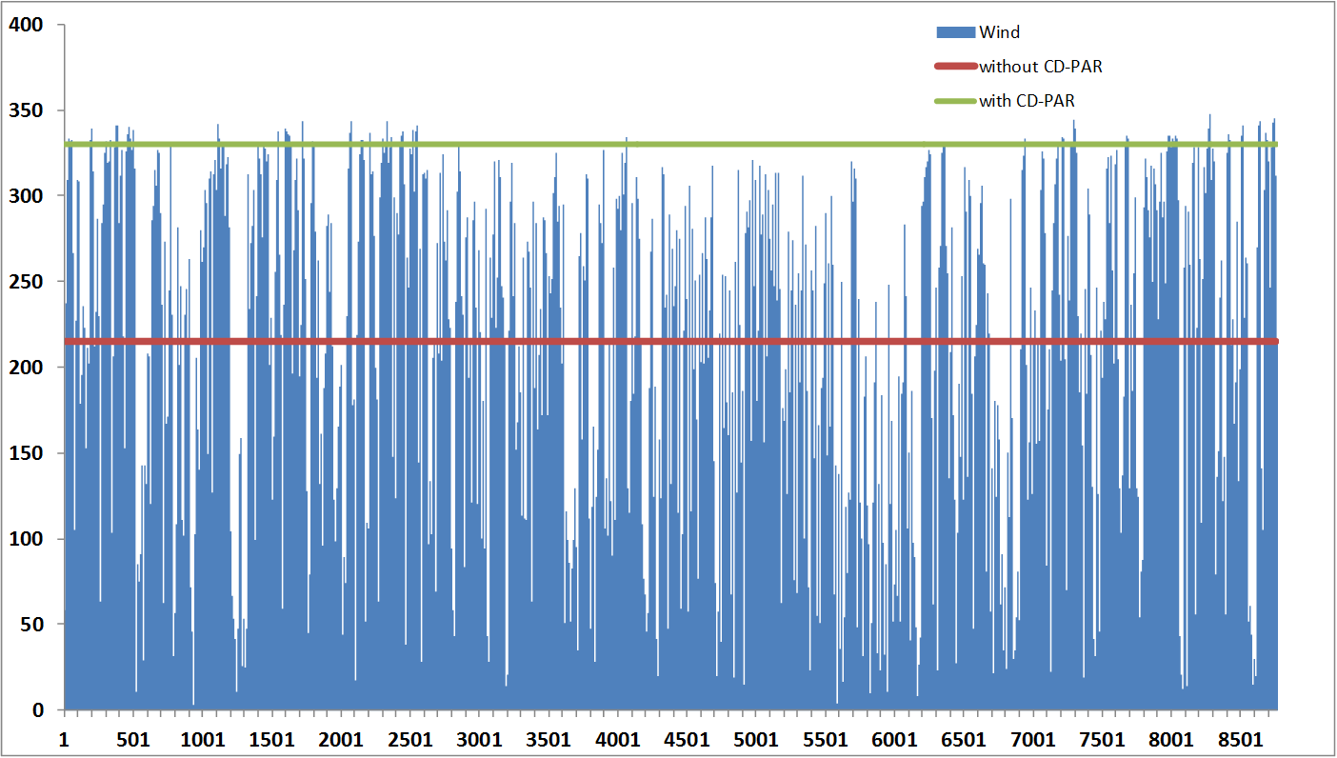
Power Flow Controllers
Variety of new technologies being developed through ARPA-E projects
Reactive power control of the system has always been the focus of FACTS devices
PFCs seek to change the impedance of existing transmission lines for short-term active power control
  Reduction of congestion
  Reduction of renewable curtailment

Slide 22
Synchronous Condensers
Synchronous condensers provide local dynamic voltage support and inject short-circuit current into the system
Beneficial as wind resources are often located further away from the load
Possible to additional inertia to the system using flywheel technology
Conversion of decommissioned fossil-fuel plants are a possibility

Slide 23
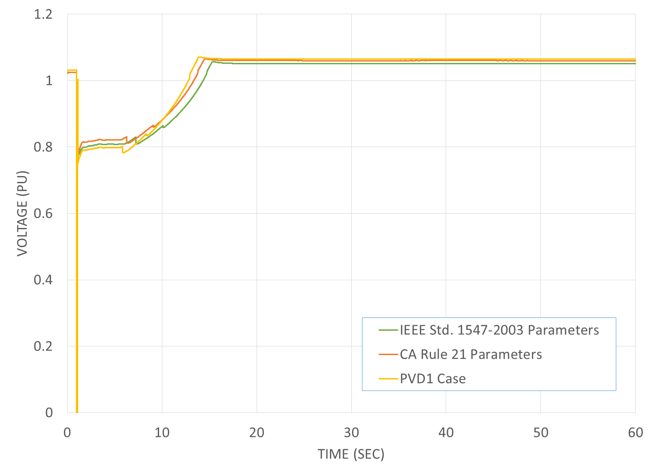
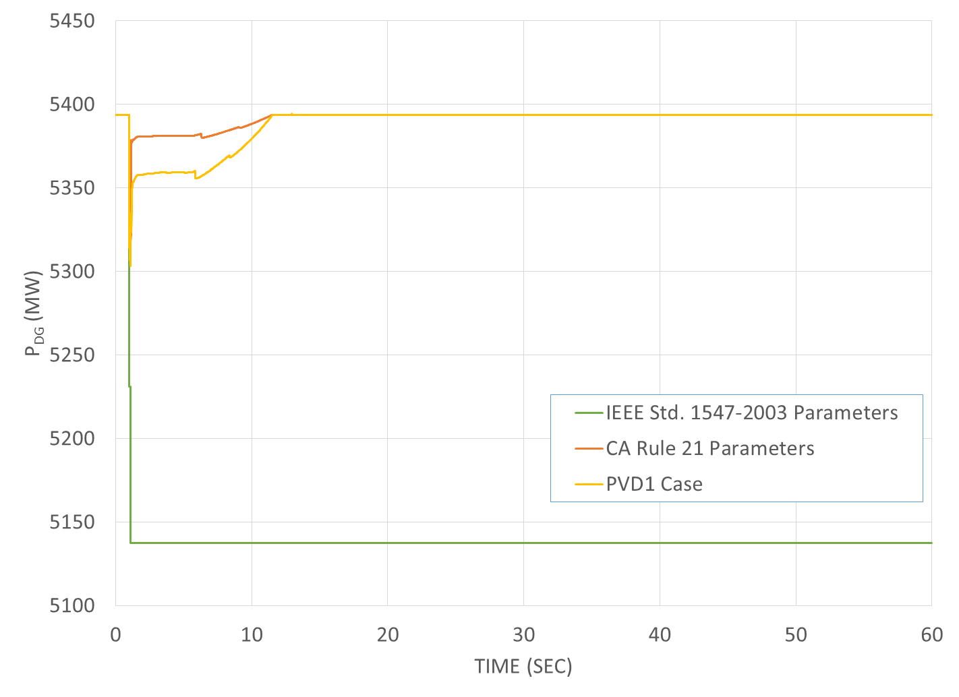
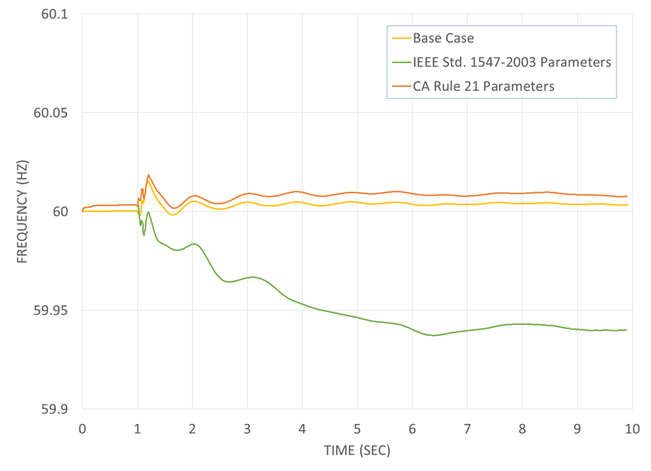
DER Representation for Bulk System Analysis
1. Transmission Fault Causes Voltage Dip at Distribution Level
FIDVR
2. Aggregate Loss of Active Power Infeed from DERs
3. Deterioration of
System Frequency
DER Impacts
System stability &
reliability.
Frequency performance.
Voltage performance and reactive power.
System visibility and control.

Slide 24
DER Representation for Bulk System Analysis
Voltage Ride-Through Requirements in CA Rule 21 and IEEE P1547 for Category III DER
IEEE P1547 Definitions of Ride-Through Control Modes:
mandatory operation – Required continuance of active current and reactive current exchange of DER with Area EPS as prescribed.
momentary cessation – Temporarily cease to energize in response to an Area EPS voltage or frequency disturbance, with the capability of immediate restore output of operation.
Explicit representation of load and distributed PV at distribution level.
Multiple models, additional efforts needed to integrate
Modular approach, incl. PVD1
Flexibility to represent advanced inverter functions
IEEE P1547
DRAFT
→ Need to be adequately modeled in bulk system studies.
Notes:
Specification of the reactive support has not been defined.
Momentary cessation requires inverters remain online for zero voltages (block inverters), but inject current
Adds potential to not only support stability requirements locally, but also at the transmission system level

Slide 25
Conclusions
Challenges are continuously appearing and are increasingly complex:
  Need for continued development of state of the art tools to assess stability and system impacts
Variety of methods and strategies are available to planners that can aid with the integration of inverter based generation, but needs to develop further
In addition to the planning topics mentioned here, the additional capability provided by the devices themselves can be of benefit
  Reactive power control
  Frequency response and active power control
Key is to address and study the issues in detail to assess impacts

Slide 26
Protection & Control Considerations for Future Grid Scenarios
Evangelos Farantatos
Mahendra Patel
Sean McGuinness
ISO New England Stakeholder Meeting
October 19th, 2016

Slide 27
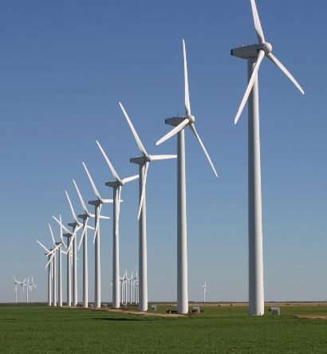
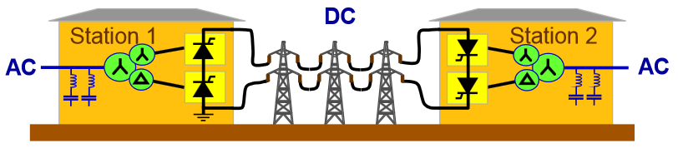
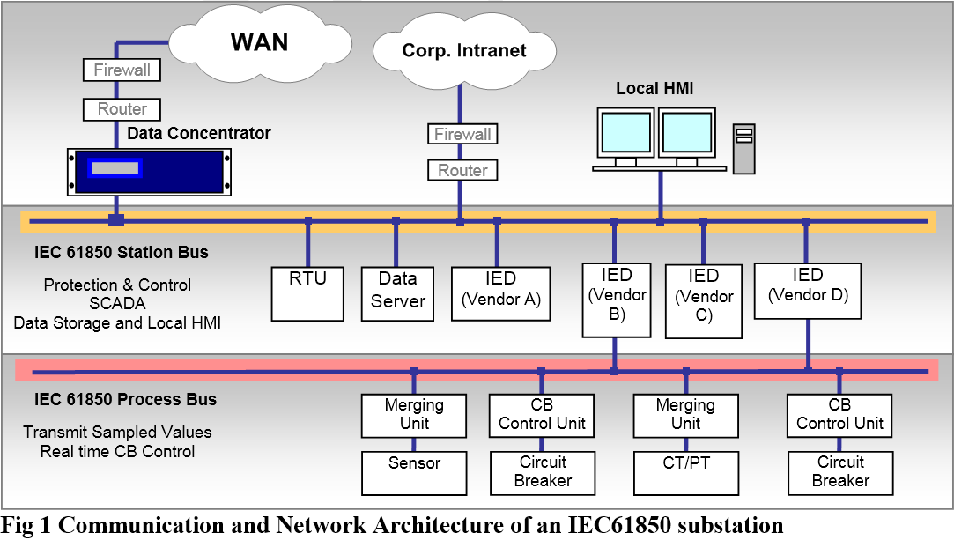
Future Grid Characteristics
Grid Changes
Generation mix changes
    Growing penetration levels of renewable resources (transmission and distribution)
    Retiring generators
    Less frequently dispatched generators
  Significant seasonal deviations between inverter-interfaced and synchronous generation capacity
  Increasing use of Voltage Source Converter HVDC
  Increasing use of FACTS (SVC, STATCOM etc)
  Increasing undergrounding of transmission circuits
Technology Advances
Inverter Controls
Substation Automation – IEC 61850
Communications - Fiber Optics
Gas Insulated Substations

Slide 28
Converter Interfaced Renewables Fault Response
Type III
Differs significantly from synchronous generator short-circuit current contribution (SCC)
SCC close to nominal load current (typically 1.2-1.5 pu)
SCC contribution affected by Wind Turbine Generator (WTG) /Photovoltaic (PV) control scheme (typically proprietary)
Many designs have control loop to minimize/eliminate negative sequence contribution
No zero sequence contribution (transformer connection)
Type IV
PV

Slide 29
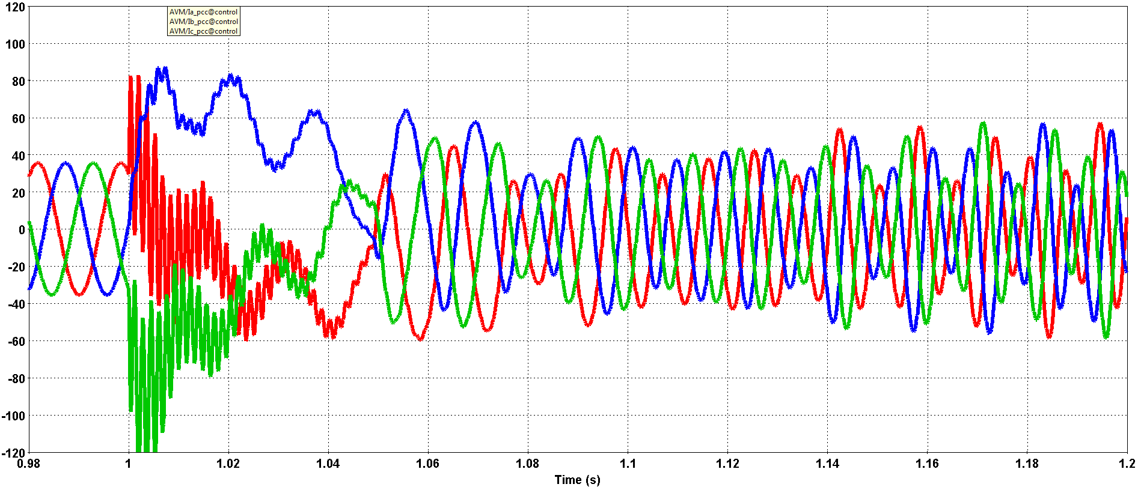
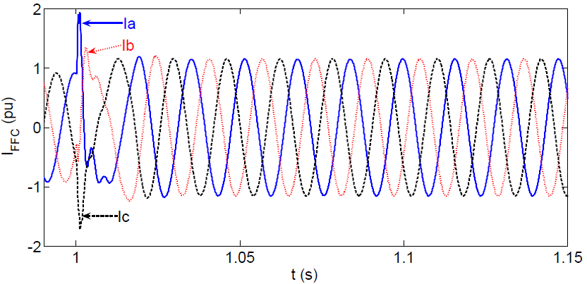
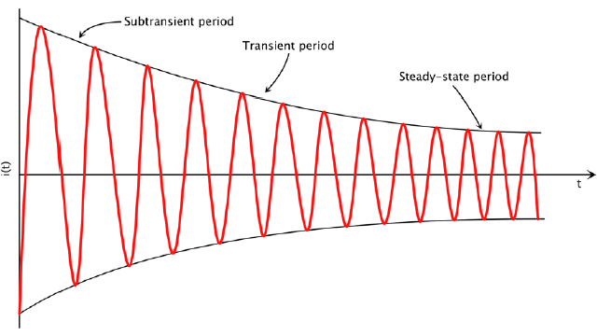
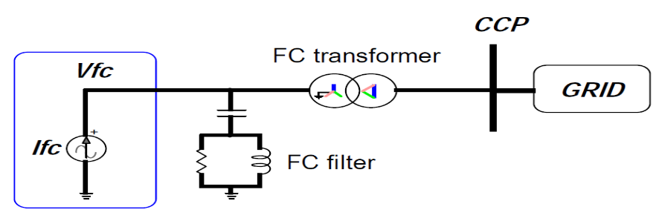
Converter Interfaced Renewables Fault Response
Type III
Need for accurate short-circuit models for protection/planning studies
IEEE Power Systems Relaying Committee Working Group C24 “Modification of Commercial Fault Calculation Programs for Wind Turbine Generators”
Type IV
EPRI proposed model:
  Controlled current source
  Considers impact of converter controls
  Respects converter current limits
  Iterative solution
  Model for balanced & unbalanced faults
Synchronous Generator

Slide 30

System Short-Circuit Strength
Weak grid - Low Short-Circuit Ratio (SCR)
  Bigger sensitivity of system voltage to load fluctuations
    But less VAr required for voltage control
  Adequate short circuit current (minimum operating current) for backup distance protection
Decreased damping of harmonics

Slide 31
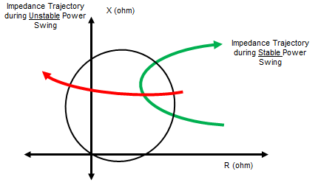
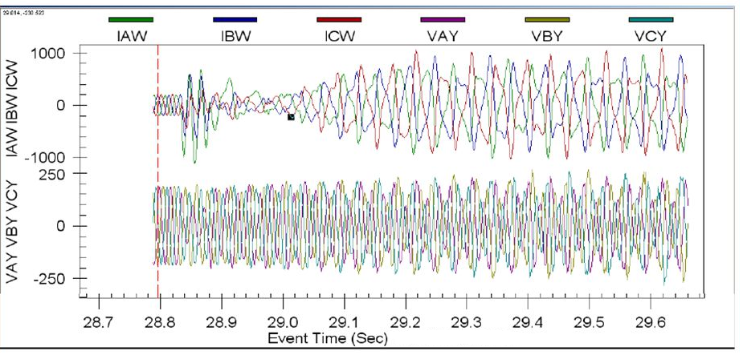
System Stability Impacts
Reduced system inertia
  But less MW required for control
Varying generators coherency
    Special Protection Schemes (SPS) designed offline - potential vulnerability
Decreased active power injection from converter interfaced renewables during faults → loss of synchronism
Delayed inverter based generation active power recovery → delayed system recovery → line power swings, interarea oscillations
Low frequency phenomena
  Inverter control interactions
  Sub-Synchronous Resonance/Tortional Interaction/Control Interaction of series compensated lines and wind turbines, HVDC
Source: AEP

Slide 32
Operation, Control and Protection Challenges
Unconventional loading of transmission system
  Low transmission system loading / massive distribution level DER integration
  Flows from Distribution to Transmission
Voltage control
  Expected voltage dips, delayed active power recovery, frequency instability
  Potential solution: STATCOM, SVC installation – distance protection under-reaching
  Voltage control through T/D transformer
Under-frequency/Under-voltage load shedding
  Challenging with smart inverters providing reactive support
Transmission/Distribution islanding protection
  Present schemes most likely potentially insecure and unreliable
  Frequency control provided by DG make island detection more challenging
  Direct Transfer Trip (DTT) schemes more reliable but require communications
  Microgrids potential solution

Slide 33
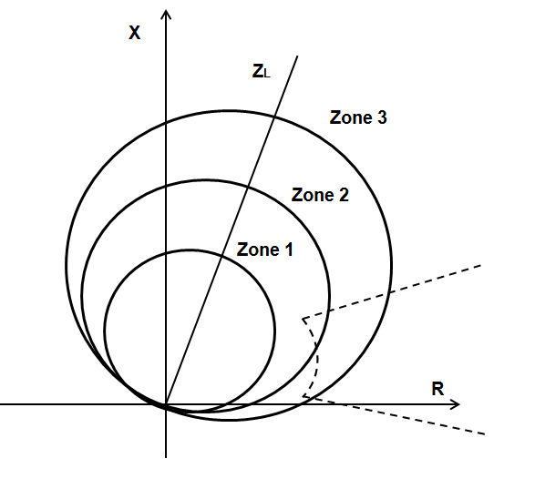
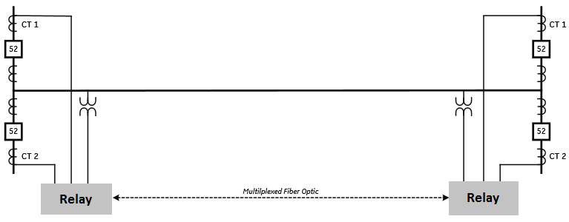
Protection System Performance
Line Distance Protection
Primary protection expected to be fine
Backup protection sensitivity
Under-reach for tapped lines
Line Differential Protection
Most reliable.
Takes advantage of fiber optics/communications advances
Expected wider adoption especially in lower kV lines
Negative sequence based differential

Slide 34
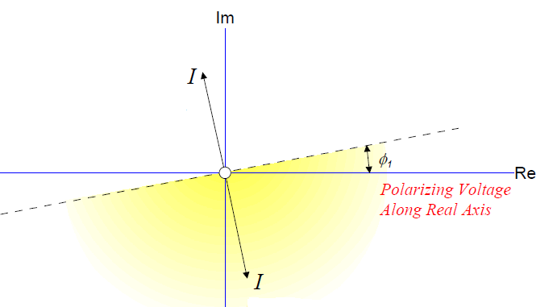
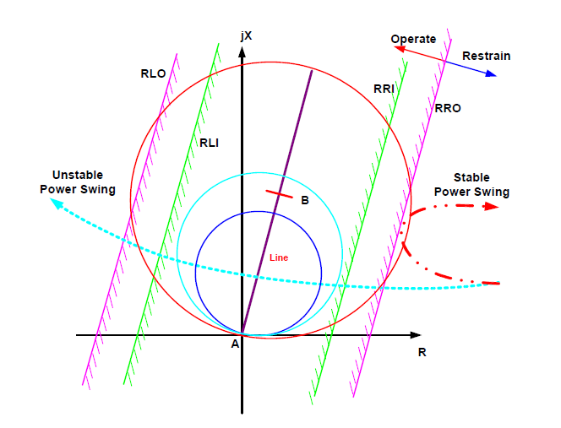
Protection System Performance
Directional Element
Negative sequence directional element potential misoperation
Injected reactive power for voltage support
Power Swings
Converter interfaced generation impacts the rate of change of the measured impedance
Potential Power Swing Blocking and Out-of-step Tripping functions misoperation

Slide 35

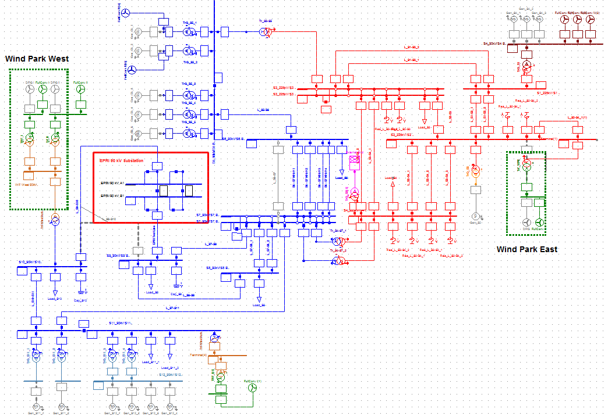
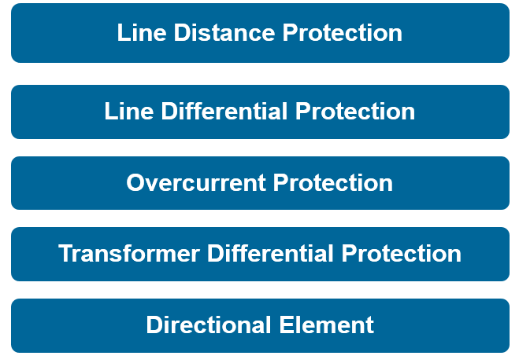
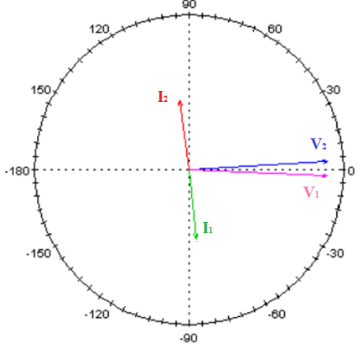
Protection System Performance Evaluation - Guidelines
  Protection System Performance Evaluation: Study relays response & identify relay misoperation scenarios on benchmark systems with high renewable penetration.
  Guidelines Document: Provide recommendations and study practices to protection engineers when conduction protection studies to prevent relay misoperation/miscoordination

Slide 36

Protection Scheme and Defense Plan for the Future Grid of RTE
Targeted Horizon: 2030-2050
Generation Scenarios:
  Predominantly Transmission-Connected Renewables
  Renewables Shared between Transmission and Distribution Systems
  Predominantly Distribution-Connected Renewables
Analysis and Evaluation of Protection Scenarios & Defense Plans proposed by RTE
EPRI Proposed Protection Scheme and Defense Plan

