Slide 1
June 14-15, 2017| Westborough, ma
Zonal Demand Curves:
CSO Transactions using MRI Demand Curves
Jeffrey Mislak
Andrew Gillespie
(413) 540-4121
jmislak@iso-ne.com
(413) 540-4088
agillespie@iso-ne.com

Slide 2
Zonal Demand Curves: CSO Transactions using MRI Demand Curves
WMPP ID:
103
Proposed Effective Date: ARA1 for Capacity Commitment Period 11
The current annual CSO Bilateral construct is incompatible with the use of zonal Marginal Reliability Impact (MRI) demand curves in annual reconfiguration auctions
This presentation will review:
  How reconfiguration auctions work with the various demand parameters (i.e., fixed requirements and sloped demand curves)
  Explain the incompatibilities and the practical complications of using the current CSO Bilateral construct with MRI-based demand curves

Slide 3
Introduction
On April 15, 2016 the ISO filed proposed Tariff changes to provide sloped zonal demand curves and a new sloped system-wide demand curve for both the primary and annual reconfiguration auctions
On June 28, 2016 the Commission approved the filing
In the filing it was noted that it may be appropriate to make additional changes for annual reconfiguration auctions, monthly reconfiguration auctions, and Capacity Supply Obligation Bilaterals (‘CSO Bilaterals’)

Slide 4
Problem Summary
The problem: The current annual CSO Bilateral construct is incompatible with the use of zonal Marginal Reliability Impact (MRI) demand curves in annual reconfiguration auctions
The substitutability of capacity across constrained zone boundaries is now variable at all capacity levels
CSO Bilaterals are done before each reconfiguration auction
  The first annual reconfiguration auction (ARA1) conducted for Capacity Commitment Period (CCP11) using MRI-based curves is in June 2018
Where the MRI-based curves are not used (monthly auctions and bilaterals) some basic conforming changes will be required

Slide 5
Today’s Topics
Review how demand parameters and reconfiguration auctions work with:
  Fixed system and zonal requirements (CCP8)
  Sloped system demand and fixed zonal requirements (CCP 9 & 10)
  MRI-based curves for the system and zones (for CCP 11+)
Explain the incompatibilities and the practical complications of using the current CSO Bilateral construct with MRI-based demand curves
At the next Markets Committee meeting we will cover the ISO’s proposed solution

Slide 6
2017 Annual Auctions
This year the ISO will conduct four annual auctions using the three variations of demand parameters
Month Conducted | Auction Conducted | Commitment Period | Comments
February | FCA 11 | CCP11 | MRI-based curves (system and zones)
March | ARA3 | CCP8 | Fixed demand requirements for both the system and zones
June | ARA1 | CCP10 | Sloped system demand curve; fixed zonal demand requirements
August | ARA2 | CCP9

Slide 7
Reconfiguration auction Basics

Slide 8
Annual Reconfiguration Auctions (ARAs)
Participants may submit a demand bid to shed a CSO or a supply offer to acquire a CSO for the entire twelve-months of the commitment period
All demand bids and supply offers are rationable
The demand parameters used in the FCA are also used in the respective annual reconfiguration auctions
  If fixed requirements were used in the FCA, they will also be used in the ARAs; if a demand curve was used in the FCA, the same type of demand curve will be used in the ARAs

Slide 9
‘ISO Participation’ in ARAs
Through CCP10 Only
The ISO may, under certain conditions, submit a demand bid or supply offer on behalf of load to compensate for a change in a fixed requirement used in the ARA
(a.k.a. ‘ISO participation’)
  Only where and when fixed requirements are used in the ARA would the ISO ‘participate’
  Fixed requirements are calculated annually (e.g., the Installed Capacity Requirement ‘ICR’)
‘ISO participation’ is not required where and when sloped demand curves are used
  Demand curves are also updated annually (e.g., an increase in ICR would effectively shift the demand curve to the right)

Slide 10
Monthly Reconfiguration Auctions
Same as the ARAs, except:
Fixed demand requirements are used
  No ‘ISO participation’
  A ‘zero-sum’ trading situation among suppliers
  Demand curves are not used in monthly reconfiguration auctions
The ISO will continue to use fixed demand requirements in the monthly reconfiguration auctions
  There exist no MRI-based demand curves of a monthly frequency

Slide 11
Background – the early years: capacity commitment period 8
Fixed demand requirements and alignment with CSO Bilaterals
Month Conducted | Auction Conducted | Commitment Period | Comments
March ‘17 | ARA3 | CCP8 | Fixed demand requirements for both the system and zones

Slide 12
ARAs
CCP 8
Fixed demand requirements were used for both the system and for constrained zones to clear the FCA and ARAs
  This was a zero-sum quantity situation among suppliers; e.g., a demand bid could only clear if there was an offsetting supply offer
The clearing algorithm enforces the fixed requirements
  A demand bid or supply offer will not clear if it would violate a zonal fixed demand requirement (i.e., the Local Sourcing Requirement ‘LSR’ for an import-constrained zone, or the Maximum Capacity Limit ‘MCL’ for an export-constrained zone)
The total system CSO amount remains constant
  Transfers among suppliers within the ARA cannot change the total system CSO amount (bids and offers are rationable)

Slide 13
CSO Bilaterals – Consistency
CCP 8
CSO Bilaterals are allowed between suppliers provided they are consistent with transfers allowed by a reconfiguration auction
Specifically:
The transfer does not change payments by load
  Transfers amongst suppliers in the ARA do not change the total system CSO amount
  Transfers via CSO Bilaterals cannot change the total system CSO amount (CSO Bilaterals are kW-of-kW), and therefore do not change cost to load
The transfer does not impact system reliability
  Transfers across constrained zone boundaries in the auction are not permitted if the zone’s fixed demand requirement is binding
  Transfers across constrained zone boundaries via CSO Bilaterals are not permitted if the zone’s fixed demand requirement is binding

Slide 14
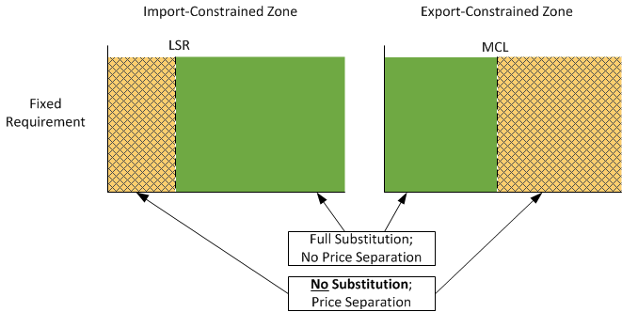
CSO Transferability
CCP 8
For both reconfiguration auctions and CSO Bilaterals, transfers of CSOs across constrained zone boundaries were either:
Fully substitutable (kW-for-kW) – keeping total payments by load constant, or
Not allowed if it would violate a fixed demand requirement – must maintain resource adequacy

Slide 15
The “in between years”: capacity commitment periods 9 & 10
Sloped system curve and fixed zonal demand requirements and alignment with CSO Bilaterals
Month Conducted | Auction Conducted | Commitment Period | Comments
June ‘17 | ARA1 | CCP10 | Sloped system demand curve; fixed zonal demand requirements
August ‘17 | ARA2 | CCP9

Slide 16
ARAs
CCP 9 & 10
A linear system sloped demand curve and zonal fixed demand requirements are used to clear the FCA and ARAs
The clearing algorithm enforces system sloped demand curve and like CCP8, zonal fixed requirements
  A demand bid or supply offer will not clear if it would violate a zonal fixed demand requirement
The total CSO amount in the system can change
  A single demand bid or supply offer can clear against the system sloped demand curve
  Any change in total CSO amount is settled with load; the change will increase or decrease total payments by load, in consideration for the impact on resource adequacy

Slide 17
CSO Bilaterals – Consistency
CCP 9 & 10
CSO Bilaterals are allowed between suppliers provided they are consistent with transfers allowed by a reconfiguration auction
Specifically:
The transfer does not change payment by load
  Transfers via CSO Bilaterals cannot change the total system CSO amount (CSO Bilaterals are kW-for-kW), and therefore do not change payments by load
The transfer does not impact system reliability
  Transfers across constrained zone boundaries via CSO Bilaterals are not permitted if the zone’s fixed demand requirement would be violated

Slide 18
CSO Transferability
CCP 9 & 10
For both reconfiguration auctions and CSO Bilaterals, transfers of CSOs across constrained zone boundaries are still either:
Fully substitutable (kW-for-kW) – keeping total payments by load constant
Not allowed if it would violate a fixed demand requirement – must maintain resource adequacy
This part is the same as CCP8 and prior CCPs

Slide 19
The next generation: capacity commitment period 11 and future commitment periods
MRI-based curves and misalignments with CSO Bilaterals
Month Conducted | Auction Conducted | Commitment Period | Comments
June ‘18 | ARA1 | CCP11 | MRI-based curves (system and zones)

Slide 20
A road map: where we’re headed now
ARAs with MRI-based demand curves:
  Key properties: Substitutability across zones
  Graphical examples of how ARAs clear
Key challenges to conform the CSO Bilateral construct

Slide 21
ARAs with MRI-Based Curves
CCP 11 +
MRI-based demand curves, for both the system and constrained zones, are used to clear the FCA and ARAs
The clearing algorithm enforces the MRI-based demand curves
The total CSO amount in the system and in any constrained zone may change per the MRI demand curves
  No fixed demand requirements are used; nothing to ‘bind’
Changes in total CSO amounts, at the system level or in any zone are settled with load
  Payment changes are commensurate with the overall impact on resource adequacy, since they are based on the MRI values

Slide 22
Refresher: MRI Curve Basics
CCP 11 +
The MRI-based demand curves are structured to procure the most cost effective combination of capacity levels among the zones that meets the system’s resource adequacy objective
The “1-day-in-10” Loss of Load Expectation planning standard applies to the system overall; not each capacity zone in isolation – there are no fixed zonal requirements at all
Interface transfer limits restrict the ability of capacity in one zone to serve load in another zone – but both the total capacity in the system as well as the share of capacity in each zone determines overall resource adequacy

Slide 23
Substitutability Across Zones
CCP 11 +
The auction will clear capacity in a constrained zone based on the incremental value of capacity inside the zone, and will meet the resource adequacy objective by determining the most cost efficient mix of capacity from the various zones
A MW in a constrained zone may be worth more or less than a MW outside the constrained zone
  The slope of the zonal MRI demand curves is not constant
Capacity is partially substitutable across zones
(not kW-for-kW)
The partial substitutability rates are not constant – they vary with the supply in each zone!

Slide 24
Clearing ARAs Using Sloped Demand Curves
The ISO enters:
  A supply offer representative of all CSO
  Sloped demand curve
Participants may enter:
  Supply offer for a resource
  Demand bid for a resource
The interaction of these components determines:
  The amount cleared in the auction (MW)
  The auction clearing price
  The remaining total CSO
In all cases, total cleared supply equals total cleared demand

Slide 25
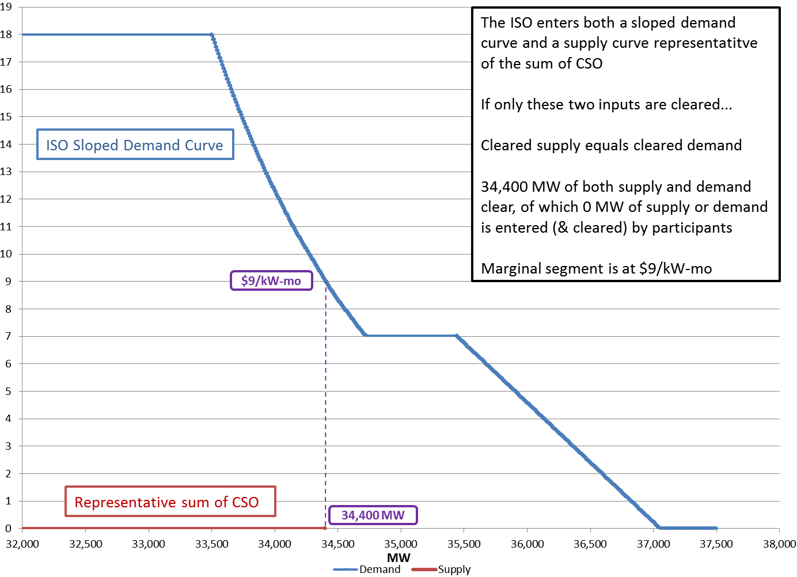
Clearing ARAs – Nothing Clears
$/kW-mo

Slide 26
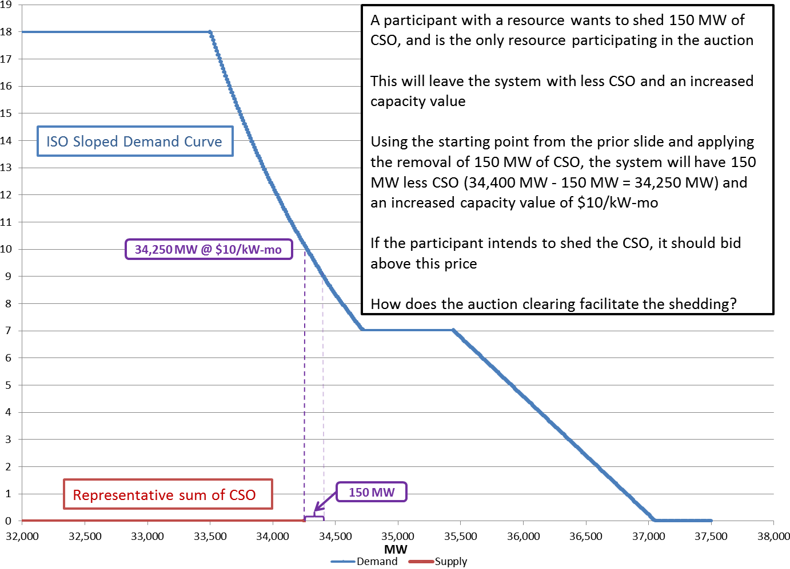
Clearing ARAs – Demand Bid
$/kW-mo

Slide 27
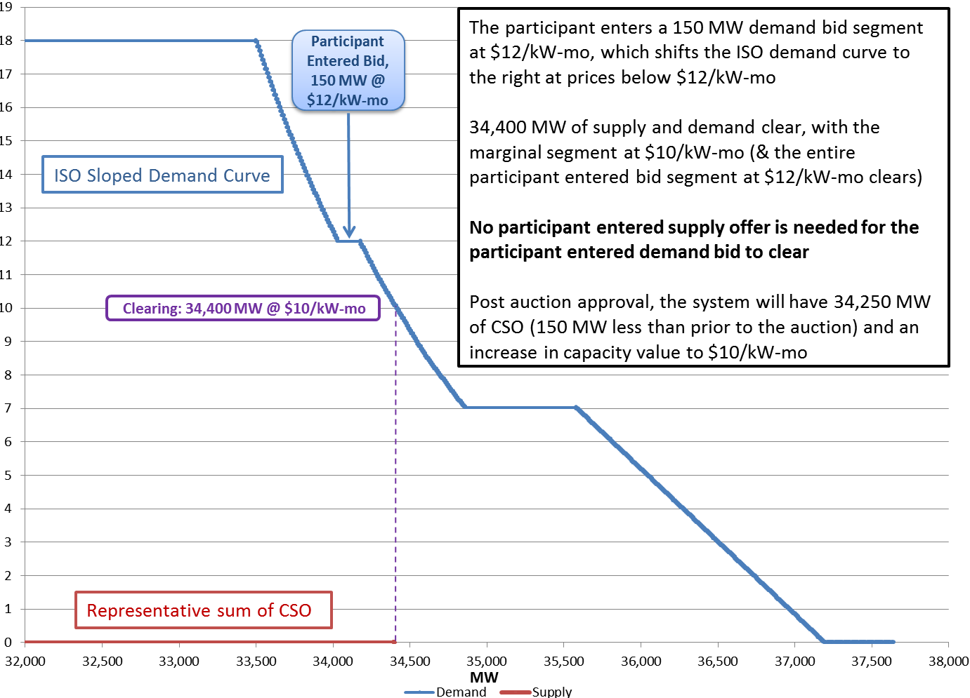
Clearing ARAs – Demand Bid (cont.)
$/kW-mo

Slide 28
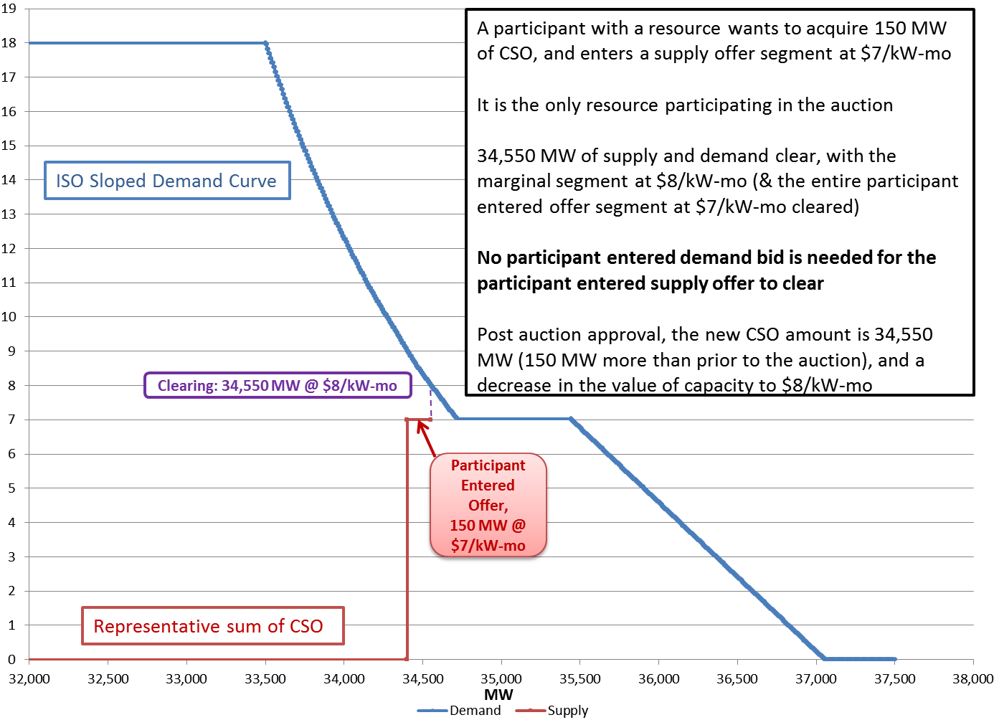
Clearing ARAs – Supply Offer
$/kW-mo

Slide 29
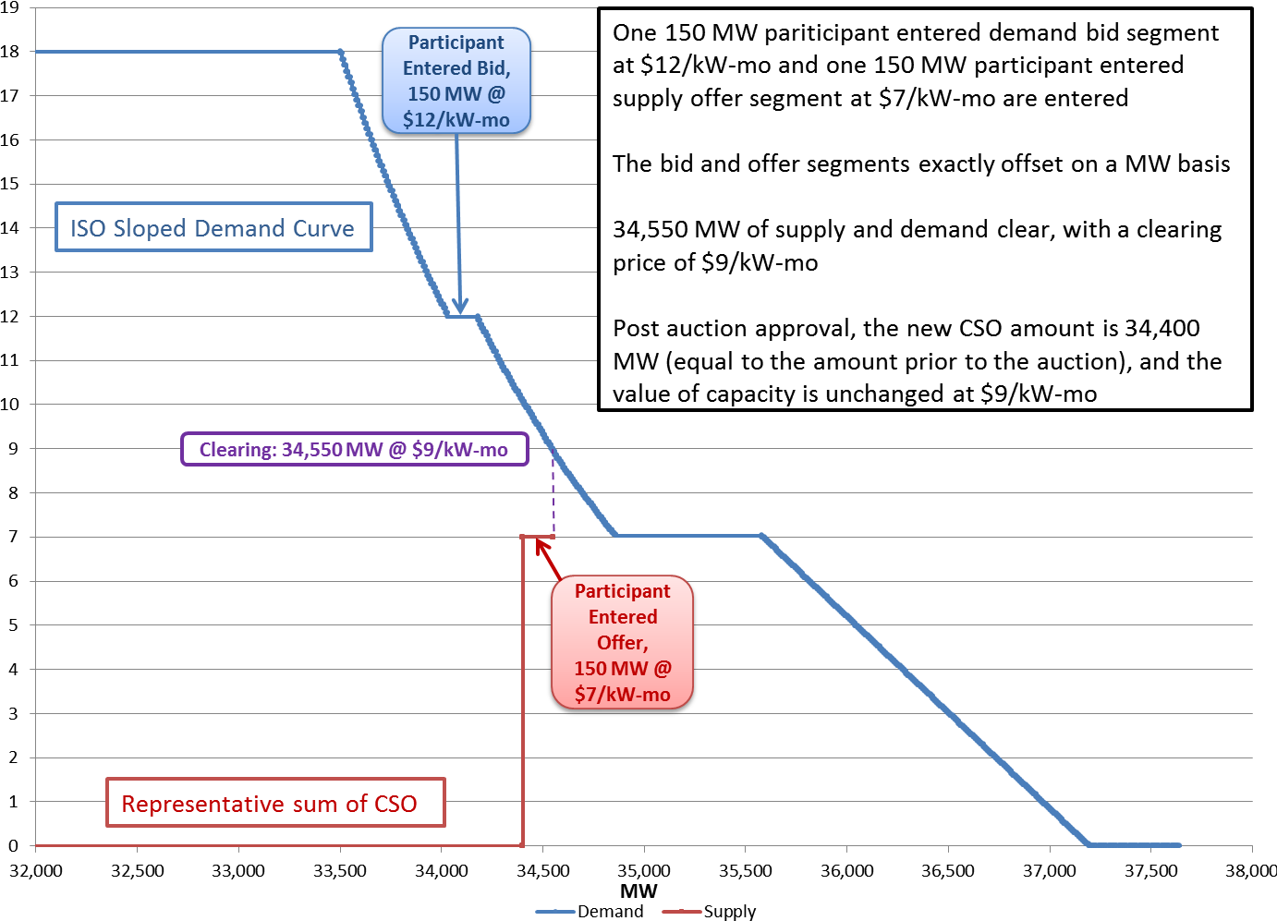
Clearing ARAs – Demand Bid and Supply Offer
$/kW-mo

Slide 30
key challenges to conform the CSO bilateral construct
CSO Bilaterals should allow for partial substitutability across constrained zone boundaries
CSO Bilateral quantities might require ‘adjustments’ if they do not reflect substitutability rates properly
The order in which CSO Bilaterals are processed (administratively) can affect outcomes
To conform the existing bilateral construct, solutions to these challenges are required

Slide 31
Challenge 1: Partial Substitutability
CSO transferability is different now - no fixed demand requirements are used in the ARA
CSO transfers across constrained zone boundaries are always substitutable, just not kW-for-kW along the MRI curve
The total CSO in a zone can change and impact system reliability (resource adequacy)
CSO Bilaterals are now misaligned – they rely on fixed requirements to ensure transfers are either:
Fully substitutable (kW-for-kW) – keeping total cost constant, or
Not allowed if violating a fixed demand requirement – maintaining system reliability

Slide 32
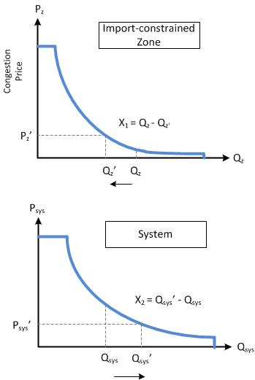
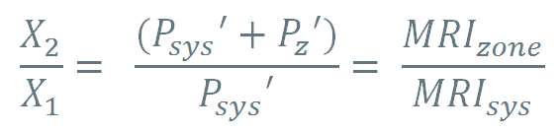
Substitutability Ratios – Example 1
A resource in an import-constrained zone transfers a CSO (X₁) to a resource outside the zone (X₂)
To keep system reliability constant the following ratio must apply to the CSO Bilateral:
A ratio is required - CSO Bilaterals cannot be a simple kW-for-kW transfer

Slide 33
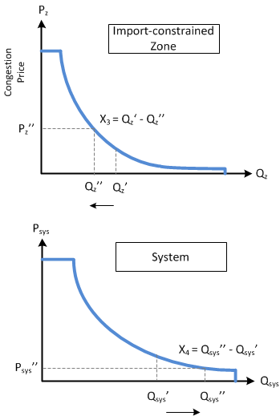
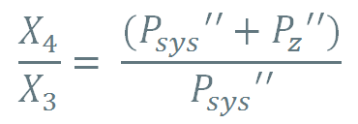
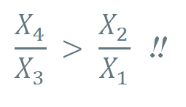
Substitutability Ratio – Example 2
A second resource in the same import-constrained zone transfers a CSO (X₃) to a second resource outside the zone (X₄)
In order for this CSO Bilateral to keep system reliability constant the following new higher ratio must apply:
Ratio changes with subsequent transfers!

Slide 34
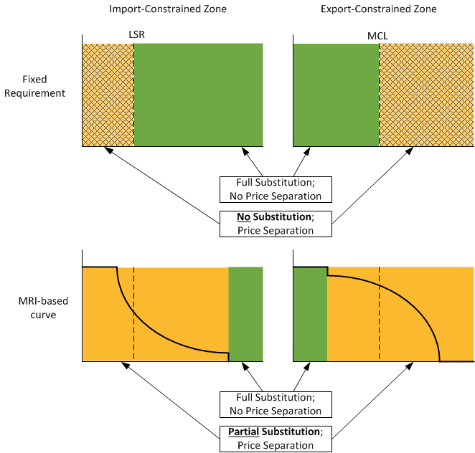
Substitutability Comparison
CCP 8
CCP 9 & 10
CCP 11 +

Slide 35
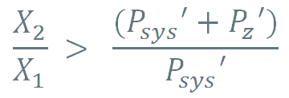
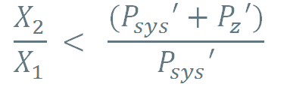
Substitutability and System Reliability
If we instead ignore partial substitutability, consumers could be adversely impacted
Current CSO Bilateral specifications
  Transfer X₁ CSO from Resource A; acquire X₂ CSO for Resource B
  X₁ = X₂ (kW-for-kW)
  Private unit transfer price ($/kW-month)
System reliability is improved if:
(Load credits suppliers?)
System reliability is worsened if:
(Suppliers credit load?)

Slide 36
Challenge 2: Adjusting CSO Bilateral Quantities
Presuming CSO Bilaterals can be submitted with different amounts, what should be done if the ratio does not maintain system reliability?
Simply reject the transaction?
In order to maintain system reliability (i.e., to get the ratio right) one side of the transaction must be increased or decreased while also adhering to qualification limits:
  Resource A (buyer): X₁ ≤ the resource’s CSO
  Resource B (seller) : X₂ ≤ the resource’s unsubscribed Qualified Capacity
  What side is adjusted?
  Who makes these adjustments?
  What to do if the adjustment violates a qualification limit?
What ratio should apply when the zonal MRI-based curve is flat?
(e.g., at the MRI-based curve cap price)

Slide 37
Challenge 3: How to Process CSO Bilaterals
Presuming CSO Bilaterals can be submitted with different amounts, and presuming they can be adjusted to maintain reliability, how are CSO Bilaterals going to be administered?
Sequential processing?
  The ratio of the 1st bilateral may be accurate, but the proper ratio for 2nd bilateral will be different from what the parties submitted
  The adjustments may become more dramatic for subsequent bilaterals, perhaps far more than the parties to the transaction anticipated
Batch processing?
  A common ratio could be determined taking into account all the bilateral transfers across that boundary, and then used to adjust all CSO Bilaterals
  However, the different permutations possible make solving for this a complex problem (e.g., if a bilateral requires further adjustment to satisfy qualification limits, or is rejected for reliability reasons)

Slide 38
Challenges – Bottom Line
Extending the existing CSO Bilateral construct as is to an MRI-based world gets very complicated
There must be an easier way…

Slide 39
Alternative to CSO bilaterals
Concept: Yes, there’s an easier way

Slide 40
A New Mechanism
All demand bids and supply offers in an ARA can clear using MRI-based curves (no fixed limits preventing clearing)
The main interest in transferring a CSO is the price to the two parties:
  What price can I shed this CSO?
  What price can I acquire a CSO?
The advantage of a ‘private’ transfer versus submitting a demand bid or supply offer into the ARA is price certainty
Concept: Provide a means to achieve the equivalent of a known transaction price for a CSO transfer that actually occurs in the ARA

Slide 41
Stakeholder Schedule
Stakeholder Committee and Date | Scheduled Project Milestone
Markets Committee June 14, 2017 | Problem discussion
Markets Committee July 11-12, 2017 | Proposal presentation
Markets Committee August 8-10, 2017 | Proposal discussion and Tariff language presentation
Markets Committee September 12-13, 2017 | Vote
Participants Committee October 13, 2017 | Vote

Slide 42
Jeffery Mislak
(413) 540-4121 | jmislak@iso-ne.com
Andrew Gillespie
(413) 540-4088 | Agillespie@iso-ne.com

Slide 43
Acronyms Used in this Presentation
ARA – Annual reconfiguration auction
MRI – Marginal Reliability Impact
FCA – Forward Capacity Auction
CSO – Capacity Supply Obligation
CCP – Capacity Commitment Period
ICR – Installed Capacity Requirement
LSR – Local Sourcing Requirement
MCL – Maximum Capacity Limit

Slide 44
Appendix

Slide 45
Annual Reconfiguration Auction Schedule and Demand Parameters Used
Jun - May | Capacity Commitment Period | FCA | ARA1 | ARA2 | ARA3 | System Demand Parameter | Zonal Demand Parameter | CSO B/L Parameters/Limits
2017-2018 | CCP8 | Feb '14 | June '15 | Aug '16 | Mar '17 | Fixed (ICR) Fixed (LSR, MCL) |  | Full/no substitution
2018-2019 | CCP9 | Feb '15 | June '16 | Aug '17 | Mar '18 | Sloped linear - continuous | Fixed (LSR, MCL) | Full/no substitution
2019-2020 | CCP10 | Feb '16 | June '17 | Aug '18 | Mar '19
2020-2021 | CCP11 | Feb '17 | June '18 | Aug '19 | Mar '20 | MRI - continuous |  | Variable substitution
2021-2022 | CCP12 | Feb '18 | June '19 | Aug '20 | Mar '21
2022-2023 | CCP13 | Feb '19 | June '20 | Aug '21 | Mar '22

Slide 46
Forward Capacity auction 11
MRI-based demand curves and auction results

Slide 47
FCA 11 Results
FCA 11 was held on February 6, 2017
The system cleared 35,835 MW of capacity with a price in Rest-of-Pool of $5.297
SENE cleared 11,736 MW with a congestion price of $0.000
NNE cleared 8,344 MW with a congestion price of $0.000
 | Truncation Point (MW) | Quantity Cleared (MW) | Clearing Price ($/kW-month)
System | n/a | 35,835 | $5.297
SENE | 10,538 | 11,736 | $5.297
NNE | 8,510 | 8,344 | $5.297

Slide 48
FCA 11 Final System-wide Demand Curve
35,835 MW Cleared

Slide 49
FCA 11 SENE Demand Curve
Truncation Point
10,538 MW
11,736 MW Cleared

Slide 50
FCA 11 NNE Demand Curve
8,344 MW Cleared
Truncation Point
8,510 MW

Slide 51
Clearing Annual reconfiguration auctions using MRI-Based demand curves
Conceptual explanation

Slide 52
Clearing ARAs with MRI-Based Curves
Zonal demand curves set the congestion price to be paid inside the zone in addition to the system clearing price
Clearing engine will continue to maximize social welfare by simultaneously solving for the system and zonal quantities and prices
For example, this allows for more capacity to clear in the Rest-of-Pool zone when less is purchased in an import-constrained zone

Slide 53
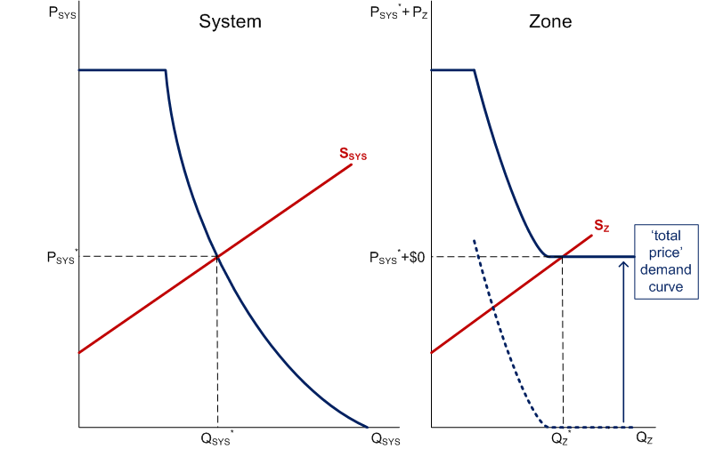
Clearing ARAs with MRI-Based Curves
Example 1: No Price Separation
First, assume that the system price is P_{SYS}* (left graph)
Shift zonal congestion price demand curve up by P_{SYS}* to get zone’s ‘total price’ demand curve in zone (right graph)
Sufficient zonal capacity is offered to clear Q_{Z}* at a price of P_{SYS}*+ $0
Congestion price associated with zone is equal to $0

Slide 54
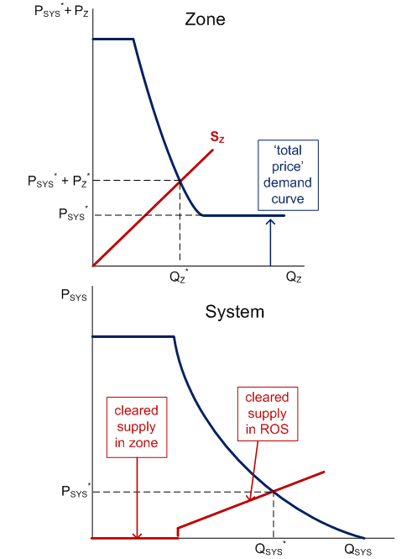
Clearing ARAs with MRI-Based Curves
Example 2: Price Separation
Zone clears at intersection of zonal supply and ‘total price’ demand curve (zonal curve shifted ‘up’ by P_{SYS}*)
System clears enough ROS offers to meet system demand curve

