Slide 1
March13,2018 | Milford, MA
Review of Assumptions Relating to ICR and Related Values and Discussion of the 2018 Long Term Load Forecast
Robert Ethier
(413) 540-4412 | RETHIER@iso-ne.com

Slide 2
Assessment of ICR/LSR and Discussion of the 2018 Long Term Load Forecast
Proposed Effective Date: For ICR calculations for FCA 13 and FCA 14*
As part of the stakeholder discussion of the Installed Capacity Requirement (ICR) for FCA 12 last year, ISO-NE was asked to address stakeholder issues related to the methodology for modeling of behind-the-meter photovoltaic (BTM PV) and other issues related to the assumptions used in the calculation of the ICR and related values
These issues were introduced at the February 13th RC meeting
At today’s meeting, the ISO will discuss:
  Potential changes in the ICR and Local Sourcing Requirement (LSR) assumptions
  The upcoming 2018 load forecast
  The methodology used for modeling BTM PV
*For proposed modifications that involve Tariff changes

Slide 3
Background
The ICR is a measure of the installed resources that are projected to be necessary to meet both ISO New England’s and the Northeast Power Coordination Council’s reliability standards, with respect to satisfying the peak demand forecast for New England while maintaining reserve capacity
LSR for import-constrained Capacity Zones is one of the ICR related values calculated*
The ICR and LSR calculations are important in determining the capacity requirements needed for the Forward Capacity Auctions and annual reconfiguration auctions
The ISO develops a long-term load forecast each year, which is used for a variety of purposes, including as an input to the ICR and LSR calculations
Both the load forecast and ICR/LSR calculation are reviewed with the PSPC and RC each year as part of their development
  The ICR/LSR (and other related values) are ultimately filed with the FERC
Section III.12 of the Tariff contains provisions related to the ICR and LSR calculations and the load forecast assumptions
*Local Resource Adequacy (LRA) Requirements for import-constrained Capacity Zones and Maximum Capacity Limits (MCL) for export-constrained Capacity Zones are not specifically being addressed

Slide 4
Project Scope
ISO-NE has identified a number of possible specific changes to the ICR/LSR assumptions based on stakeholder input and changing system conditions
  A change in the assumed level of 10-minute operating reserves maintained before load shedding
  An adjustment to the amount of load relief assumed due to voltage reduction*
  A change in the assumed 20% derate of peaking generation resources when calculating the Transmission Security Analysis (TSA) Requirement which is an input to the LSR*
While no changes to the load forecast methodology are being proposed, continued changes in the forecast outlook are relevant to the ICR discussion
  The draft 2018 load forecast is lower than last year
As part of the discussion for the ICR and Related Values for FCA 12 regarding the BTM PV hourly profile methodology introduced last year, Stakeholders had remaining questions which ISO-NE will address
  Also exploring a way to incorporate uncertainty into the BTM PV modeling
*Proposed assumption changes requiring Tariff changes

Slide 5
Review of Minimum Operating Reserve Assumption

Slide 6
  Review of the Minimum Operating Reserve Assumption
Historically, the ICR calculation has assumed a minimum level of operating reserve of 200 MW system-wide
  This level was established in 1980 with a different resource mix
  At that time there were more synchronous machines capable of fast response
  Also did not have the limited energy variable resources now on the system
This assumes that during peak load conditions, under extremely tight capacity situations, ISO-NE System Operations will maintain a minimum level of 200 MW of operating reserves for transmission system protection, prior to invoking manual load shedding procedures
This assumption was previously discussed at the Reliability Committee (RC) in 2010 as part of the review of the tie benefits methodology*
  Members of the PSPC asked ISO-NE to review this assumption during the stakeholder discussions of ICR for FCA 12
In light of changing system conditions this assumption is too low and is no longer appropriate
  *https://www.iso-ne.com/static-assets/documents/committees/comm_wkgrps/relblty_comm/relblty/mtrls/2010/aug252010/a2_iso_ne_tie_benefits_operational.ppt

Slide 7
  Review of the Minimum Operating Reserve Assumption, cont.
NERC Reliability Standards have evolved over time
NPCC Requirements have evolved over time
Concern about the declining frequency response on the Eastern Interconnection
A review of current requirements and potential operating conditions suggests that 200 MW of reserves would be inadequate in actual operations

Slide 8
NERC Reliability Standards
BAL-001-2 – Real Power Balancing Control Performance
  To control Interconnection frequency within defined limits
    Frequency & external tie-line regulation
BAL-002-2 – Disturbance Control Standard – Contingency Reserve for Recovery from a Balancing Contingency Event
  Ensure the Balancing Authority balances resources and demand and returns the Control Error to defined values following a Contingency
    Measures the ability to activate operating reserves

Slide 9
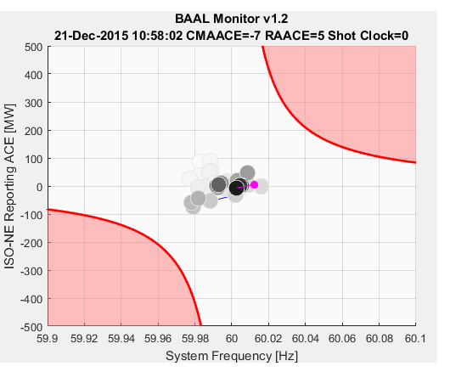
NERC Control Performance BAAL Limits
Essentially must regulate the system so that a Balancing Authority’s ACE is not pushing when frequency is high or dragging when frequency is low

Slide 10
NPCC Reserve Requirements
NPCC Directory 5 - Reserve
  Operating capacity is required to meet forecast demand, including an allowance for error, to provide protection against equipment failure which has a reasonably high probability of occurrence, and to provide adequate regulation of frequency and tie line power flow
  Each Balancing Authority shall have ten-minute reserve available to it that is at least equal to its first contingency loss
  Must plan for and deploy adequate reserve
NPCC Directory # 2 - Emergency Operations
  Provides actions to address transmission or capacity emergencies
  If a Balancing Authority can not maintain frequency regulation or tie-line flow may need to shed firm load

Slide 11
NPCC – Synchronized Reserves
NPCC requires synchronized reserves as a portion of a Balancing Authority’s ten-minute operating reserves
  The requirements starts at 100%
  Can be reduced based on demonstrated performance but not less than 25%
Currently New England maintains 37% of the ten-minute reserve requirement as synchronized
  Provides inertia and governor response to arrest and control frequency deviation

Slide 12
Frequency Response & Control
Inertial
Response
Milliseconds
Primary
Control
Seconds to 1-2 minutes
(Gen. Response)
Secondary
Minutes
Control
(AGC)
Spinning
Reserves
Primary Frequency Response is needed to arrest and stabilize frequency

Slide 13
Ten-Minute Spinning Reserves & AGC
ISO-NE currently utilizes 1400 MW as the largest first contingency
  Spin requirement 520 MW
The 2017 average largest contingency was 1467 MW
  Spin requirement 540 MW
The 2017 Ten-Minute Average requirement was 1760 MW
  20% non-performance factor for ten-minute reserves
  Spin requirement 650 MW
In addition New England utilizes approximately 150 MW+ for frequency and tie line regulation (AGC)

Slide 14
Minimum ICR Operating Reserve Assumption
A Balancing Authority must always be able to regulate frequency and control tie-line flows
  ISO-NE utilizes it operating reserves and AGC to meet this obligation
  Synchronized reserves and AGC requirements are between 670 MW - 850 MW
A source loss greater than the remaining depleted ten-minute reserve would require load shedding
  If available Simultaneous Activation of ten-minute Reserve (SAR) would provide the Operators up to 30 minutes to shed load; if not available would need to be shed within 10 minutes
Recommend utilizing at least 50% of the reserve requirement in the ICR calculation
  Still requires carrying 50% of the ten-minute reserves on load shedding
  Balances interconnection reliability risk
  Provides ISO-NE System Operations with the resources to prevent being a burden on the interconnection

Slide 15
Review of the Load Relief from 5% Voltage Reduction Assumption

Slide 16
  Review of the Voltage Reduction Assumption
Assumed load relief from the implementation of a 5% voltage reduction is used in the development of the ICR
  Consists of Actions 6 & 8 of ISO-NE Operating Procedure No. 4, Actions During a Capacity Deficiency (OP4)
  Includes both voltage reduction that can be achieved ≤10 minutes (Action 8) and >10 minutes (Action 6)
ISO-NE conducts tests to verify a 1.5% reduction in system load from 5% voltage reduction and is documented in ISO-NE Operating Procedure No. 13, Standards for Voltage Reduction and Load Shedding Capability
  The 1.5% benchmark has been used by ISO-NE System Operations in the past to estimate the MW value of load relief obtainable from Actions 6 & 8 of OP4
  ISO-NE uses this value to calculate the MW reduced as a result of a 5% voltage reduction assumed in the ICR model
    Calculated as [90/10 peak load (Net of BTM PV) – all Active & Passive Qualified Demand Resources] *1.5%
Based on the changing nature of system loads, ISO-NE System Operations has observed that the 1.5% benchmark reduction may no longer be appropriate to assume in the ICR model, as the MW reduction associated with voltage reduction can degrade quickly and can not be sustained as it was in the past

Slide 17
Voltage Reduction
Historically a 5% voltage reductions in New England obtained greater than 1.5% load relief when implemented
The penetration of energy efficient loads have resulted in the implementation of a voltage reduction being less effective than in the past
  It is becoming more difficult to obtain the 1.5% load relief
In addition, load relief obtained from a voltage reduction tends to erode the longer the voltage reduction has been implemented
  This is due to the loss of load diversity and increasing penetration of energy efficiency

Slide 18
Voltage Reduction, cont.
Even though the load relief obtained from a voltage reduction continues to decrease with greater penetration of energy efficient loads, ISO-NE System Operations wants to maintain this load relief option within OP4
Recommendation is to maintain the test threshold for voltage reduction at 1.5% but within the ICR calculation only take credit for 1.0%
  For the most recent ICR calculation (FCA 12), the assumed load relief from 5% voltage reduction was 431 MW summer and 317 MW winter
  Under this proposal, the assumption would be 288 MW summer and 212 MW winter

Slide 19
Review of 20% Derate Factor on Peaking Generation in Transmission Security Analysis

Slide 20
  Review of the 20% Derate Factor on Peaking Generation in the TSA
The Local Resource Adequacy (LRA) Requirement and the TSA Requirement are inputs into the calculation of the LSR, which is the minimum amount of capacity that must be electrically located in an import-constrained Capacity Zone
  LRA is a probabilistic analysis of an import-constrained Capacity Zone used to evaluate resource adequacy
  TSA is a deterministic reliability screen of an import-constrained Capacity Zone used to maintain transmission security
  The higher of LRA and TSA Requirements is used to determine the LSR
Currently in the TSA, a 20% deterministic adjustment factor is used as the outage rate for peaking generation resources
  The LRA uses a historical five-year average generating unit performance measured by NERC GADS Equivalent Forced Outage Rate - Demand (EFORd)
ISO-NE is not suggesting a change to ISO-NE System Operations use of the 20% fast start derate factor
  ISO-NE System Operations uses this factor for recovery from a contingency in real-world operating conditions including much smaller areas where they may have fewer options than Capacity Zones

Slide 21
  Review of the 20% Derate Factor on Peaking Generation in the TSA, cont.
ISO-NE is conducting an analysis to see if the 20% derate on peaking resources in the TSA calculation is still appropriate
  Preliminary results of analyses using data of start-up failures and forced outages on high load days show that peaking resources perform better than the current 20% derating
    The full analysis will be presented at the April 18th PSPC meeting
  NERC GADS data would yield a total New England peaking resources’ weighted 5-year average EFORd of 11.58%*
*Based on 2017 CELT primary fuel type and 2017 Summer SCC rating; In the ICR model, resource-specific EFORd values are used for import-constrained Capacity Zones; currently only peaking resources located in the Southeast New England Capacity Zone are used in TSA calculations

Slide 22
  Review of the 20% Derate Factor on Peaking Generation in the TSA, cont.
Reasons for the change from the 20% derate to a resource-specific EFORd include
  Better alignment of the TSA and the LRA analyses which are used to determine the LSR
  Brings consistency with the Transmission Probabilistic Planning initiatives* with is using the 5-year average EFORd for all non-renewable resources
  Will eliminate the question of what is a peaking resource as new, larger combustion turbines that may run more often are proposed
* For more information see the Transmission Planning Technical Guide at: https://www.iso-ne.com/static-assets/documents/2017/11/transmission_planning_technical_guide_rev2.pdf

Slide 23
  Review of the 20% Derate Factor on Peaking Generation in the TSA, cont.
This change is proposed for use beginning with the LSR calculations for FCA 14
  There is insufficient time to apply this to FCA 13 due to timeline for the Capacity Zone Trigger Analysis which will also use this assumption
The detailed analysis of the 20% derate factor will be presented to the PSPC at the April 18th meeting
Tariff language and PP-10 Appendix A – Assumptions Summary Table to Support Section 6 & 7 will need to be revised
  Discussion of the proposed Tariff changes will begin in August at the RC
  PP-10 changes will be presented to the RC at a later date

Slide 24
2018 Draft Load Forecast Update

Slide 25
Load Forecast Discussion
As an input to ICR, the ISO uses its annual “gross” load forecast, which reflects a forecast of demand without reductions from passive demand resources (PDR) and BTM PV
The same methodology used to develop the CELT 2017 summer peak demand forecast was used to develop the draft 2018 CELT forecast
  The input data were refreshed as is done each year
The 2018 draft gross regional summer peak demand forecast is lower than the CELT 2017 forecast
The following upcoming stakeholder discussions will cover the 2018 load forecast:
  March 15, 2018 – Planning Advisory Committee
  March 28, 2018 – Load Forecast Committee
  April 26, 2018 – Planning Advisory Committee
The final 2018 CELT forecast will be published by May 1st

Slide 26
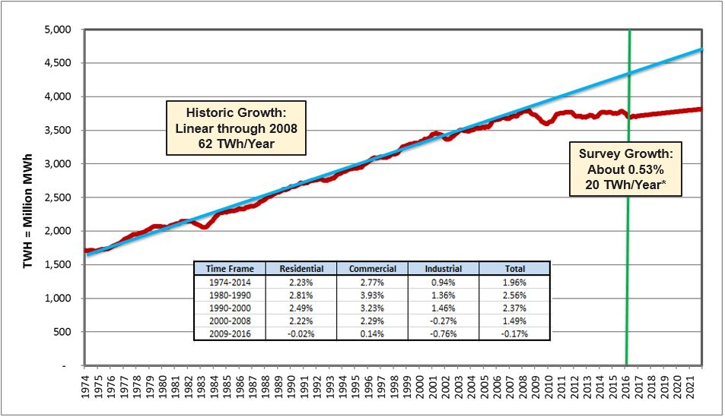
Total U.S. Electricity Sales
Recent trends in U.S. electricity consumption since 2009 have been different than long-term trends
  New England has witnessed a similar shift
Source: Itron 2017 Benchmarking Survey

Slide 27
New England Macroeconomic Outlook
Moody’s Analytics Forecast (October 2017)
Moody’s forecasts roughly the same economic growth in the region:
  Recent forecast: compound annual growth rate (CAGR) of 1.95% from 2017 to 2026
  Previous forecast: CAGR of 1.89% from 2017 to 2026
Macroeconomic assumptions included:
  Federal Reserve increases interest rates, with values reaching 4% by end of decade
  Federal tax cuts pass Congress, impacting corporations the most, and will increase the federal deficit
  Oil prices increase slowly to $55-$60 per barrel; natural gas prices remain low
Macroeconomic forecast is an input to the ISO’s annual energy forecast

Slide 28
Draft 2018 Gross Summer Demand Forecast
Demand models were estimated using reconstituted daily peak demand from 2003-2017 (15 years)
  Reconstitution includes load reductions from PDR resources, price responsive demand resources (PRD), BTM PV installations, and Real- Time Demand Resources (RTDR) during OP4*
  The term “gross” load implies reconstitution
  The term “net” load implies net of PDR resources, PRD resources and BTM PV and is representative of demand observed in real-time
Summer demand model includes both July and August daily peaks for estimation
Demand models use the annual energy forecast as an input variable
* Includes RTDR dispatch during OP4 Action 2 and audit events

Slide 29
Draft 2018 Gross Summer Demand Forecast
Observations
The 2018 draft gross regional summer peak demand forecast is lower than the CELT 2017 forecast by 1.3% in 2018 (-394 MW) and 2.1% in 2022 (-629 MW)
The lower forecast is primarily the result of the updated 15-year model estimation period, which reflects more recent load trends since the 2007-2009 recession
  Years 2002 thru 2016 were used for final CELT 2017 models
  Years 2003 thru 2017 were used for draft CELT 2018 models
The 2018 draft forecast includes summer peak demand growth for the region at a CAGR of 0.80% from 2017 thru 2027, down from 0.98% from CELT 2017

Slide 30
Draft 2018 Gross Summer Demand Forecast
New England 50/50 Peak

Slide 31
BTM PV Forecast & Modeling

Slide 32
  BTM PV Forecast and Modeling Discussion
The hourly BTM PV modeling introduced last year for ICR is based on:
  Hourly BTM PV profiles for the 2002 weather year
  The long-term BTM PV nameplate forecast developed annually by the ISO
The hourly BTM PV profiles were developed based on high-resolution 2002 weather data and state-of-the-art PV simulation tools developed by the National Renewable Energy Laboratory (NREL)
  More than 27,000 individual BTM PV system simulations were factored into profiles for the region
  Final aggregate profiles were benchmarked and validated against measured BTM PV data to ensure consistency with actual performance, especially during summer peak weather conditions
  Details of the modeling methodology were discussed at the June 22, 2017 PSPC meeting
The nameplate BTM PV forecast is approximately the same in 2022 as last year’s forecast
  The ISO will be discussing the final 2018 BTM PV forecast at the March 19 DGFWG meeting

Slide 33
Incorporation of PV Panel Degradation
The BTM PV hourly profile used for the ICR calculations for FCA 13 will include the effects of a 0.5%/year degradation rate to account for expectations regarding a solar panel’s declining conversion efficiency over the longer term
Common causes of long-term panel degradation are:
  Degradation of silicon or solder joints
  Problems with the encapsulant that cause delamination, increased opacity, or water ingress
Based on research by the National Renewable Energy Laboratory (NREL), the median rate of degradation is 0.5%/year
  More information available here: https://www.nrel.gov/pv/lifetime.html
Accounting for this degradation becomes more important as the region’s PV panels age
The ISO estimated the capacity-weighted composite age of the forecasted PV fleet to develop appropriate degradation factors to use for the forecast

Slide 34
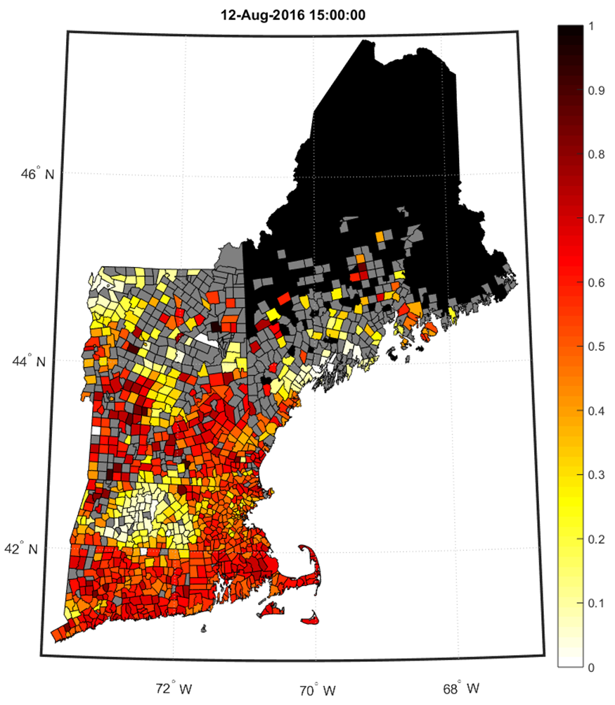
BTM PV Production Data Heat Map
Description
ISO has contracted with a third-party vendor for PV production data services
  Data are 5-minute and at the town level
  Data provided begins in 2014
An example heat map illustrating the BTM PV data is plotted to the right
  Data are from August 12, 2016 at 03:00 p.m.
  Yellow/red coloring shows level of PV production as a percent of installed nameplate capacity in each town
  No data available in towns colored gray
  Data not requested in towns colored black
The ISO uses town-level production data coupled with town-level historical BTM PV installation data provided by distribution utilities to estimate BTM PV profiles
Figure notes:
1. Graphic developed by ISO New England
2. Data source: Quantitative Business Analytics, Inc.

Slide 35
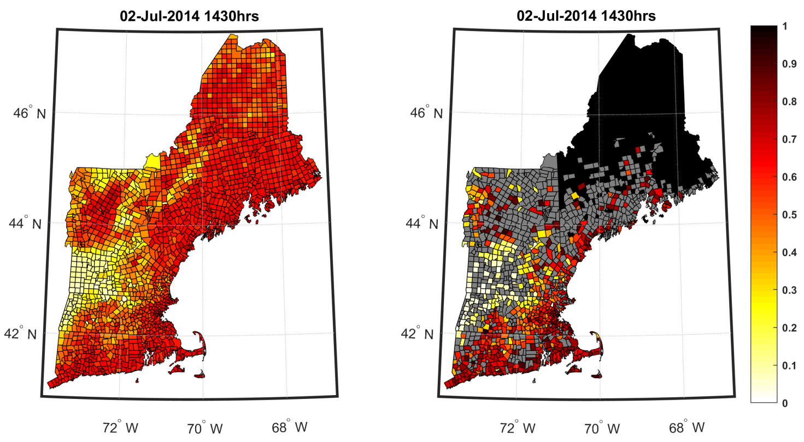
Additional Validation of BTM PV Simulation
Heat Map Comparison of Simulated and Measured Data
Below are heat maps of the simulated BTM PV data (left) and measured BTM PV data (right) for July 2, 2014 at 02:30 p.m.
  The maps illustrate significant agreement between datasets regarding the amount of BTM PV production across the region
A similar comparison for other days and times will be shared at the April PSPC
Data Source: Quantitative Business Analytics, Inc.

Slide 36
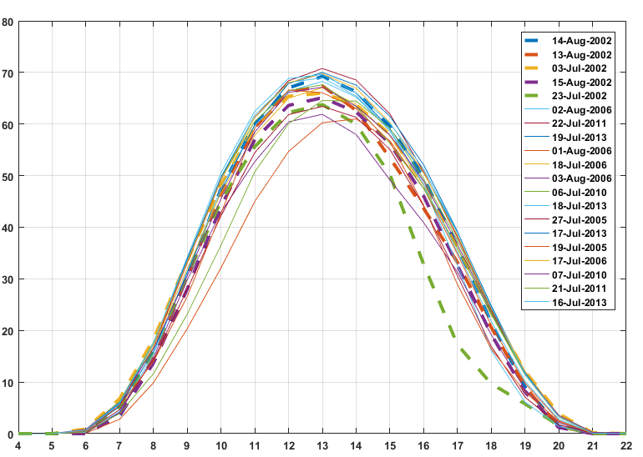
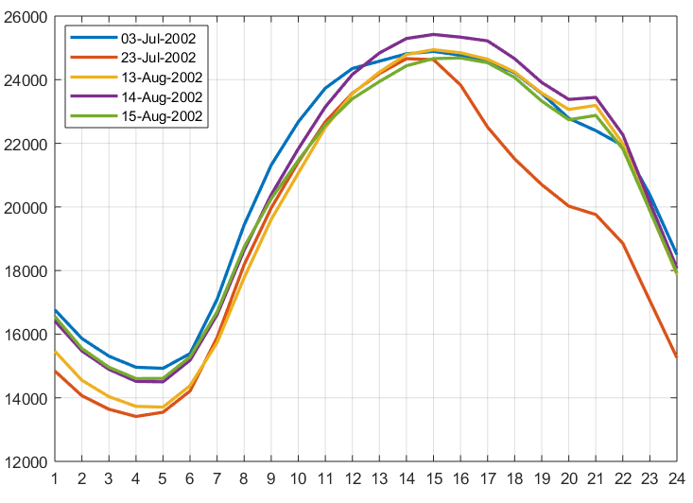
2002 Peak Load and Simulated BTM PV Profiles
Finalized simulated profiles for the highest 15 all-time peak load days and highest 5 peak load days in 2002 (left plot below) suggest peak load conditions are associated with high solar availability
  Additional validation is described in materials presented at the June 22, 2017 PSPC meeting
Effects of afternoon thunderstorms on BTM PV output (left plot) and regional load (right plot) are also highlighted
BTM PV Profile on ISO-NE Peak Load Days
System Load, MW
2002 Peak Load Days
Percent of Nameplate Capacity, %
Effects of thunderstorms on July 23, 2002
Hour Ending
Hour Ending

Slide 37
BTM PV Hourly Profile in the ICR Model
In 2017, ISO-NE began using the BTM PV hourly profile methodology in the ICR calculations to capture the load reduction impacts of these installations
  An hourly BTM PV forecast was used to more accurately reflect the PV output during all hours of the year
  The hourly profile is based on the weather profile of the same historical year (2002) used for the hourly load model
  The BTM PV hourly profile reflects the load reduction of BTM PV deterministically in the ICR model
Weather variables are key drivers to both BTM PV output and system loads
  Results of an analysis* indicate that New England peak load conditions are consistently associated with high solar availability, with BTM PV output primarily determined by time of day
  Since the hourly load forecast and BTM PV hourly profile both use the 2002 historical year load shape, they are closely aligned
*From the June 22, 2017 PSPC Meeting: https://www.iso-ne.com/static-assets/documents/2017/06/pspc_6_22_2017_2002_PV_profile.pdf

Slide 38
BTM PV Hourly Profile in the ICR Model, cont.
Stakeholders asked the ISO if it was possible to model the uncertainty of the BTM PV output
  In the ICR model hourly loads are modeled probabilistically, using an uncertainty multiplier, to reflect a wide range of weather conditions while the hourly BTM PV forecast is modeled deterministically
A newer version of GE MARS provides a way to model the uncertainty associated with the output of variable resources such as the BTM PV
  For resources such as wind and solar that are being modeled with an 8,760 hourly shape, GE MARS has the option to randomly select a 24-hour day within a specified window which will be used to model the output of the variable resources for that study day
  The ISO is evaluating this option and testing various windows (i.e. 3-day, 5-day etc.) to determine the impacts
  More information will be provided on this topic at the April 18th PSPC meeting

Slide 39
Proposed Implementation Dates
Proposals that Do Not Require Tariff Changes For Use in ICR/LSR Calculations for FCA 13 and beyond including 2019-20 3rd ARA, 2020-21 2nd ARA, and 2021-22 1st ARA (i.e. – ICR Calculations Performed in 2018) | Proposals that Require Tariff Changes For Use in ICR/LSR Calculations for FCA 14 and beyond including 2020-21 3rd ARA, 2021-22 2nd ARA, and 2022-23 1st ARA (i.e. – ICR Calculations Performed in 2019)
Adjustment to Operating Reserve Amounts | Adjustment to Voltage Reductions
BTM PV Uncertainty Modeling in ICR | Adjustment to Peaking Generation Derate Factor
Updated Load Forecast will be published by May 1, 2018 as part of the normal CELT & ICR development process

Slide 40
Stakeholder Schedule
Stakeholder Committee and Date | Scheduled Project Milestone
Reliability Committee February 13, 2018 | Review the Project Scope; materials at: https://www.iso-ne.com/static-assets/documents/2018/02/a7_assessment_of_icr_lsr_and_long_trem_load_forecast.pptx
Reliability Committee March 13, 2018 | Review the proposals
Power Supply Planning Committee April 18, 2018 | Discuss study assumptions and begin technical studies
Power Supply Planning Committee May 29, 2018 | Technical review of calculations utilizing the proposal
Power Supply Planning Committee June 21, 2018 | Technical review of calculations Review of ICR impacts of proposed assumption changes
Reliability Committee July 10, 2018 | Discussion of draft Power Supply Planning Committee calculation results under proposed changes
Reliability Committee August 7-8, 2018 | Discussion of proposed Tariff changes and proposed ICR and related values results
Reliability Committee September 26, 2018 | Vote on proposed Tariff changes Vote on ICR and related values/MRI curves
Participants Committee October 4, 2018 | Vote on proposed Tariff changes Vote on ICR and related values/MRI curves

Slide 41
Summary of Issues Relating to ICR Assumptions and Review Timeline

Slide 42
Summary of Issues
The next two slides review the issues brought up by ISO-NE and stakeholders at the February 13, 2018 RC meeting and a timeline for review

Slide 43
ICR Issues and Review Timeline
For implementation in the ICR calculation for FCA 13 – can be implemented without Tariff changes
  Minimum operating reserve assumption
  BTM PV hourly profile uncertainty and addressing any remaining questions about the hourly profile development
For implementation in the ICR calculation for FCA 14 (discussion in 2018) – require Tariff changes
  5% Voltage Reduction
  20% derate on peaking resources in the TSA
Items ISO-NE is considering addressing for FCA 14 or future FCAs
  Incorporation of resources late to commercial operation
    Current Tariff provisions state that all capacity qualified as Existing for an FCA will be modeled in the ICR
    Waiting on resolution of project as listed in the 2017 Wholesale Market Project Plan
  Generator availability issues relating to peak load/high temperature conditions and common mode failures
    ISO-NE has looked at these issues in the past and plans to add this back into the project list
  Intermittent power variability concerns
    ISO-NE is addressing BTM PV at this time and may investigate other intermittent resources, if needed
  Load forecast modeling in light of changing system conditions
    This is something ISO-NE plans to study but is uncertain if it will be ready for FCA 14

Slide 44
ICR Issues and Review Timeline, cont.
Items ISO-NE does not plan to address as part of the ICR Review
  Use of 2002 historical load shape in the ICR model
    The 2002 load shape has been chosen by NPCC for regional planning studies and is revisited annually by NPCC to assure its appropriateness
  Incorporation of fuel security risk
    This is not an ICR related issue and will not be addressed since ICR determines the amount of capacity needed to meet the 1 day in 10 LOLE; if a loss of load event occurs in the winter due to fuel security issues, adding capacity would not necessarily address the problem
  Tie benefits and the treatment of HQICCs
    Deferred until ISO-NE has significant Pay for Performance (PFP) experience

Slide 45
Acronyms Used in this Presentation
ACE = Area Control Error
AGC = Automatic Generation Control
BAAL = Balancing Authority ACE Limit
BTM PV = Behind the Meter Photovoltaic
CMAACE = Clock Minute Average ACE
CELT = Capacity, Energy, Loads, and Transmission Report
DGFWG = Distributed Generation Forecast Working Group
EFORd = Equivalent Forced Outage Rate - Demand
FCA = Forward Capacity Auction
GADS = Generator Availability Database System
GE MARS = General Electric Multi-Area Reliability Simulation Program
ICR = Installed Capacity Requirement
LOLE = Loss of Load Expectation
LRA = Local Resource Adequacy Requirement
LSR = Local Sourcing Requirement
MC = Markets Committee
MRI = Marginal Reliability Impact
NERC = North America Electric Reliability Corporation
NPCC = Northeast Power Coordinating Council
NREL = National Renewable Energy Laboratory
PDR = passive demand resources
PFP = Pay for Performance
PRD = Price Responsive Demand resources
PSPC = Power Supply Planning Committee
RAACE = Rolling Average ACE
TSA = Transmission Security Analysis Requirement

Slide 46
Robert Ethier
(413) 540-4412 | RETHIER@iso-ne.com

