Slide 1
May 2, 2018 | Holyoke MA
Demand Response Resource
Dispatch Timing Details
Doug Smith
Technical manager | market operations

Slide 2
Purpose
Provide an understanding of how the dispatch of both fast start and non-fast start DRRs works in terms of timing and the impact of offer parameters on performance calculations
Although non-fast start commitments of DRRs are expected to be rare (DRRs are typically flexible and can be elligible for offline reserves) there are key differences that are important to understand

Slide 3
Background
Reference slides 46-54 of Oct. 2017 DRWG PRD Project Overview (also copied in the appendix of this presentation)
Electronic dispatch will always respect offer parameters
Scenarios of both fast start and non-fast start assume back to back dispatches which, while probably unlikely, are instructive
For simplicity, scenarios assume 1 Demand Response Asset in the DRR
  For aggregated DRRs energy market performance is calculated at the asset level then summed to the DRR
  Reserves are designated at the DRR level

Slide 4
Acronyms Used
DRR – Demand Response Resource
TMOR – Thirty Minute Operating Reserves
TMNSR – Ten Minute Non Spinning Reserves
TMSR – Ten Minute Spinning Reserves
BL – Baseline
UCM – Unit Control Mode
NCPC – Net Commitment Period Compensation
DDP – Desired Dispatch Point
RT – Real Time

Slide 5
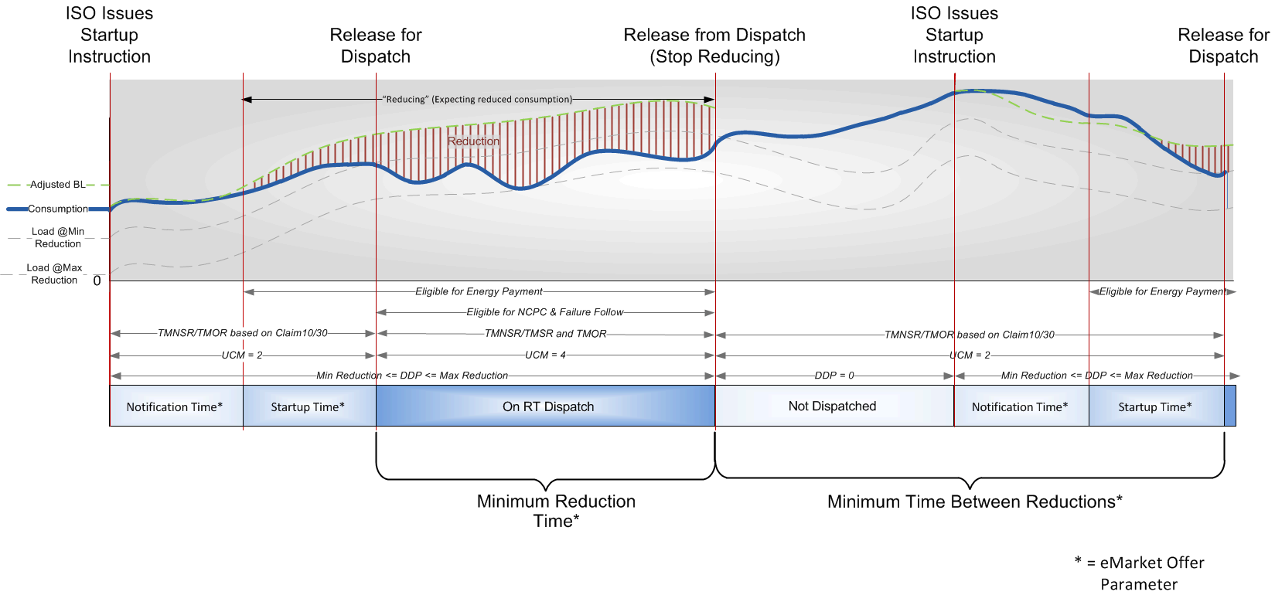
Fast Start Demand Response Resource Scenario

Slide 6
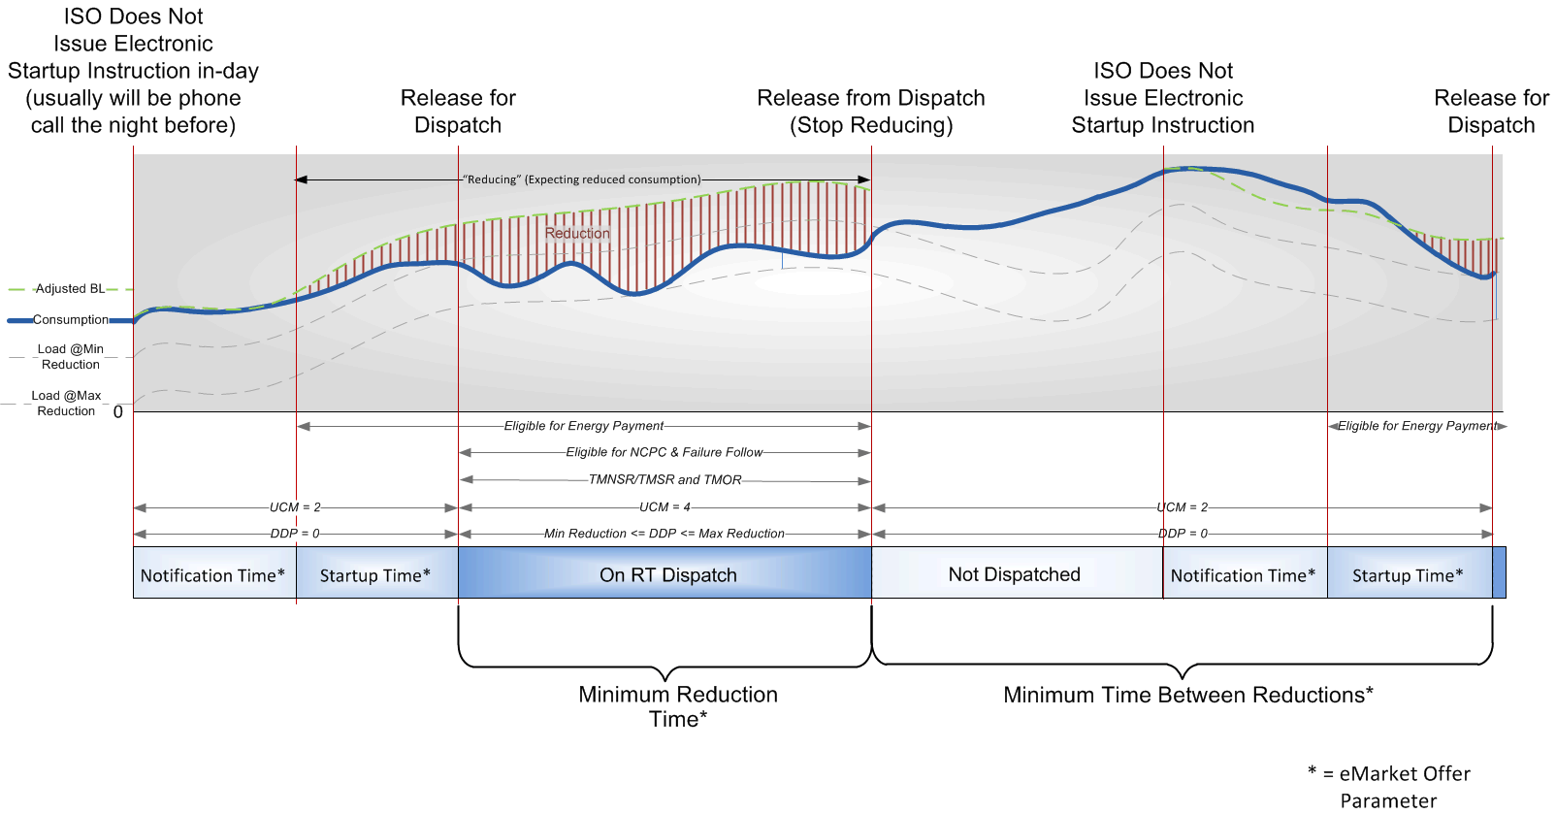
Non-Fast Start Demand Response Resource Scenario

Slide 8
Appendix – Slides 46-54 of Project Overview covered in Oct 2017 DRWG meeting

Slide 9
DRR Commitment
  DRR’s may be committed in five ways:
    Non fast start DRR can clear day-ahead
    Non fast start DRR can be committed via RAA day ahead or in-day
    Fast start DRR can be committed in real time based on economics and optimization engines
    Lead market participant or ISO requested audits
    Manually committed by the ISO control room operator via phone
  All commitments respect then-current offer parameters
  Non fast start DRRs will not be committed or dispatched in real time except via a manual action by an ISO control room operator
  DRRs offering as fast start will be electronically committed based on their offer parameters
    If the fast start DRR cleared day-ahead or was committed via RAA, its commitment is not a dispatch instruction

Slide 10
DRR Commitment (Cont.)
Day-ahead or RAA commitment of a non fast start DRR is a dispatch instruction unless cancelled by ISO
  Physical offer data is ‘locked down’ when DRR is committed
  DRR expected to be at minimum reduction at commitment time and follow DDP within submitted parameters
  Baseline adjustment startup instruction time is:
  (commitment time) – (startup time + notification time)
  Note: no electronic start-up signal is sent to non fast start DRRs
  Baseline adjustment may skew performance if the DRR begins reducing during or before the baseline adjustment period
  System operators may cancel a commitment for a reliability need

Slide 11
DRR Dispatch
  DRRs may be re-dispatched based on the timing of the control room system runs and offer parameters
  Energy reduction dispatch and reserve designations assume dispatched DRRs are following their dispatch instruction
  Any dispatch will be between minimum reduction and maximum reduction and will respect offer parameters

Slide 12
Performance Measurement
  DRR performance is the sum of the performance of each associated DRA
  Performance calculations are separated into demand reduction and net supply components for application of the appropriate gross-up values
  DRA performance is calculated separately for energy and capacity markets if the DRA is on curtailment
  When a DRR is dispatched, associated DRA baselines are adjusted by the difference between actual load in the three intervals immediately prior to the start up instruction and the unadjusted baseline, to account for weather based loads etc.

Slide 13
Performance Measurement (Cont.)
  Performance in each dispatch interval is the difference between the actual load and the adjusted baseline
    Performance calculations begin for the interval when the ‘notification time’ ends
    Performance calculations end for the interval after a dispatch instruction to provide a demand reduction of 0 MW is sent

Slide 14
Performance Measurement Example
Adjustment Period
Start up
Time
Dispatch instruction received at 10:29 with a 0 minute notification and 30 minute startup time
Adjustment period
10:10 to 10:25
Actual load is much higher than the baseline during the adjustment period
Baseline adjustment will increase the baseline to accurately calculate the demand reduction MW
Dispatch
Demand Reduction
Note that at the 30 minute point in this example (10:59), the
load = the adjusted baseline, so based on this dispatch, this
asset was not capable of providing 30 minute reserves.

Slide 15
Reserve Market Performance
  Real time reserve designations are determined based on offers and caps that are established based on historic DRR performance at the 10 or 30 minute point following a dispatch
  Reserves will not be designated above:
    Offered claim 10/30 values
    Claim 10/30 values
    Offered maximum reduction
  Every fast start qualified dispatch is evaluated towards updating the claim 10/30 values

Slide 16
Resource Obligations for Providing Reserves
  Reserve energy must be sustainable for at least 60 minutes
  Resources activated for reserves will operate without relief until ISO determines they are no longer needed
  Certain offer parameters are utilized in real time to calculate reserves available on a resource
  Because these offer parameters are used to calculate reserves, these parameters must be kept up to date in real time

Slide 17
Real Time Reserve Calculations
TMNSR is calculated as the minimum of:
  Maximum reduction
  Claim 10 value
  Offered claim 10 value
TMSR is the minimum of:
  (Maximum reduction – current reduction)
  10 × (response rate)
TMOR for a dispatched DRR is the minimum of:
  (Maximum reduction – current reduction)
  30 × (response rate)
TMOR for a DRR that is not dispatched is the minimum of:
  Maximum reduction
  Claim 30 value
  Offered claim 30 value

