Slide 1
May 23, 2018 | Holyoke, ma
DRA Meter Issues
Review & Notification Process
Trista Ristvedt
Analyst, asset registration & auditing

Slide 2
Topics
Review of DRR/DRA operational status requirements
Process for indicating and clearing meter issues
Additional data review items

Slide 3
DRR Operational Status Requirements
Must be mapped to a DDE
Must be mapped to an RTU
At least one modeled DRA in the same DRR aggregation zone must be mapped to the DRR
*Note: Cutover assets are
already mapped to DRRs;
search with an ‘as of’
date ≥ 6/1/2018 to view.
Demand Response Resource
Demand Designated Entity
Remote Terminal
Unit
Demand Response Asset

Slide 4

DRA Operational Status Requirements
  It is in the Monthly Communications Model (registration)
    ‘Approved’ by ISO in CAMS
    Telemetry is installed & operational
    Mapped to an operational DRR
  It has a baseline built for the day-type (only done once)
  Meter issue flag is set to ‘N’ in CAMS
  Has no scheduled curtailments in CAMS for the operating day
  If any of these criteria are not met the DRA’s status is automatically non-operational and it will not contribute to DRR reduction values

Slide 5
Meter Issue Flag
Flag Selection | Meaning
Yes | Yes, there is a meter problem. My DRA is not operational.
No | No, there are no meter issues. My DRA is operational.

Slide 6
Meter Issue Flag Considerations
Either the ISO or Lead Participant can set the meter issue flag to ‘Y’
Flagging is effective for the following day
Flagging remains in place for a minimum of 1 day
Status of the DRA will change to non-operational on the day the meter issue flag takes effect

Slide 7
Data Quality Issues: Internal Monitor
Monitor the telemetry data of your DRAs regularly
  Be proactive
  Set the meter issue flag to ‘Y’ when you detect problems
Setting this flag will also change the DRA status to non-operational starting the day the flag is effective

Slide 8





Data Quality Issues: ISO Monitor
ISO will review real-time telemetry data for operational DRAs on Mondays & Thursdays, completed by noon
If we detect bad data we will notify you via Ask ISO issue
Participants will have until 3:00 PM to respond
  Acknowledgment requested, but not required
After 3:00 PM flags will be set to “Y,” effective the next day
Ask ISO issue will be updated with actions taken

Slide 9

Ask ISO: DRA Meter Issue
Ask ISO issues will be sent to all individuals associated with the DRA’s Lead Participant with the CAMS contact type “Demand Asset Maintainer”
Ask ISO issues will have the summary line “DRA Meter Issue”

Slide 10
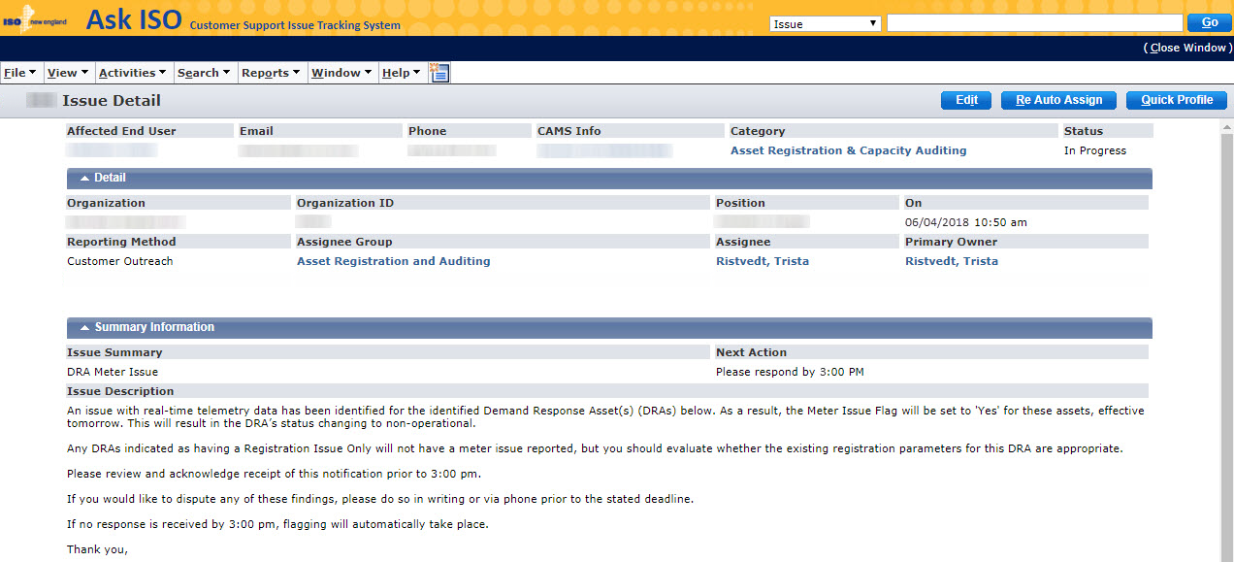
Ask ISO Example

Slide 11
Clearing a DRA Meter Issue
Only ISO may set a meter issue flag back to ‘N’
ISO will only review telemetry data of non-operational DRAs if we are informed of a repair
If ISO determines real-time telemetry data is of good quality we will change the meter issue flag to ‘N’ effective the following day
  If all other requirements are met, DRA will return to operational status as of the effective date chosen above

Slide 12
Request ISO Review: Ask ISO
Request review of repaired DRA telemetry by submitting a request via Ask ISO:
  Reopen the original Ask ISO issue and add a comment with your request, or
  Create a new Ask ISO issue. To ensure fast processing:
    Select “Asset Registration & Capacity Auditing” as the ‘category’
    Enter the text “DRA Meter Issue” in the ‘summary’ line
We recommend requesting a review prior to 3:00 pm to allow for processing time

Slide 13

Monthly Review
ISO will conduct monthly checks to identify:
DRAs that exhibit meter issues for extended periods
DRAs do not advance to the operational status for an extended period after registration
You may be asked to retire these DRAs

Slide 14
Process Development
As we become more familiar with the new systems, we may make changes to this process
New Ask ISO system launching this summer
  https://www.iso-ne.com/participate/support/customer-readiness-outlook/customer-contact-center-solution

Slide 15
Controllable Generation
DRA enrollment: Be sure to correctly set the ‘controllable generation’ flag – many registrations have come in with this flag incorrectly set to “N”
  If you are able to synchronize to the grid and can pushback you must enter a ‘Max Net Supply’ MW value, or any positive load values will be flagged as bad quality
Telemetry data for controllable generators at DRAs must be provided prior to the final customer data submission deadline

Slide 16
Additional Items
BLTS bad quality flag criteria are as follows:
MW values exceeding 125% of Max Load or Max Net Supply
Zeros
Null/latent EMS values

Slide 18
Appendix

Slide 19
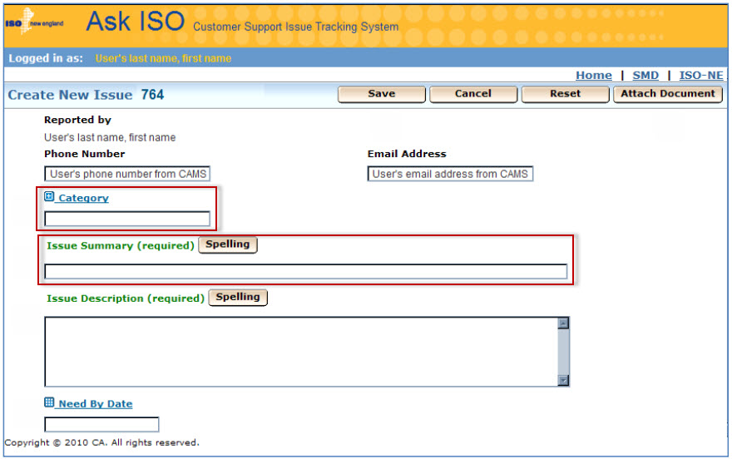
Ask ISO Issue Inputs
Select: Asset Registration & Capacity Auditing
Enter: DRA Meter Issue

Slide 20
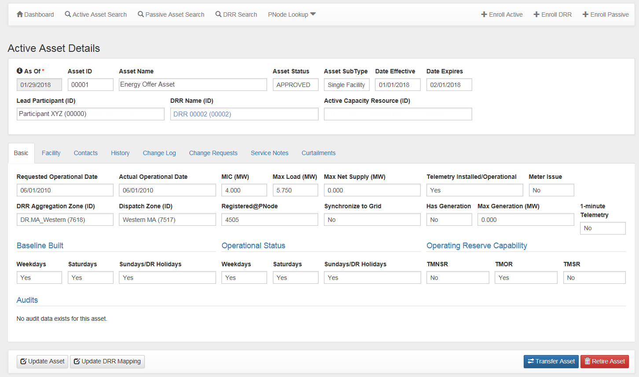
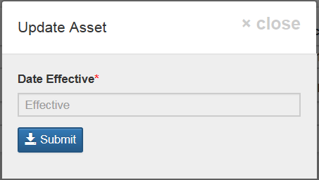
Meter Issues - CAMS

Slide 21
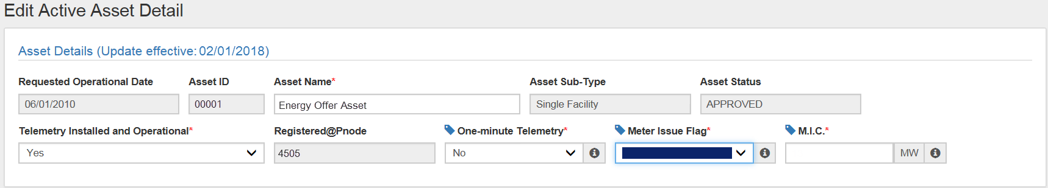

Setting the Meter Issue Flag in CAMS

