Slide 1
October 17, 2018| Westborough, ma
Eastern Interconnection Planning Collaborative
Update
Planning Advisory Committee
Richard V. Kowalski
Technical Director, SYSTEM PLANNING

Slide 2
Purpose
Provide a status update on the activities of the Eastern Interconnection Planning Collaborative (EIPC)

Slide 3
Overview
Background
EIPC Activities
Appendix I
Past EIPC activity details
Appendix II
Frequency response analysis objectives

Slide 4
Background

Slide 5
What is the Eastern Interconnection Planning Collaborative (EIPC)?
EIPC is a voluntary membership organization – members are NERC registered Planning Authorities (Planning Coordinators/PCs)
Currently there are 20 members out of approximately 40 Eastern Interconnection (EI) PCs
However, current membership covers over 95% of the EI load
EIPC’s members contribute their resources to the work that is undertaken and fund the EIPC budget
EIPC utilizes regional and interconnection-wide stakeholder processes
Seek input on current and future activities
Broad dissemination of study results
Transparency of study work

Slide 6
EIPC’s Purpose
Formed in 2009 to establish a process for the coordinated assessment of existing regional and system specific plans on an Eastern Interconnection-wide basis
Open and transparent process through an interactive planning dialogue with industry stakeholders
DOE studies used a Stakeholder Steering Committee
Non-DOE work using regional stakeholder processes, webinars, outreach
Fosters additional consistency and coordination in the Eastern Interconnection
Provides an interface with other interconnections (WECC, ERCOT, HQ)
Provides policy makers and regulators with current and technically sound transmission planning information

Slide 7
EIPC, EISPC/NCEP, and DOE
EIPC won a 2010 DOE grant, under ARRA funding, to perform interconnection-wide analysis of various energy policy options
The grant lasted 5 years in three parts: Phase 1, Phase 2, and Gas-Electric Interface
EISPC (Eastern Interconnection States’ Planning Council) also won a grant from DOE
Provided significant planning information to state regulators and policy makers, and a significant educational opportunity through joint studies
Established a working relationship that continues today
EISPC is now part of the National Council on Electricity Policy (NCEP)

Slide 8
EIPC Activities

Slide 9
Past EIPC Activities
Summarized In Appendix I
Visit website – http://www.eipconline.com/
Tabs for DOE study results and non-DOE “Roll-up” work

Slide 10
Current EIPC Activities
Frequency response analysis of the Eastern Interconnection for NERC Long Term Reliability Assessments
Development of an EIPC-reviewed production cost database
Issuance of “State of the Eastern Interconnection” report
Initiation of a new Eastern Interconnection-wide “roll-up” analysis
Continued discussions with NERC to explore EIPC’s assumption of the Designated Entity role described in the NERC MOD-032 Reliability Standard
Ongoing dialogue with NCEP regarding possible studies and other activities of common interest
Providing input to DOE on QER and Annual Transmission Data Report

Slide 11
Eastern Interconnection Frequency Response Analysis
Address a request from the NERC Essential Reliability Services Working Group (ERSWG)
ERSWG frequency response Measures 1, 2, & 4 (see Appendix II)
Input to the NERC Long Term Reliability Assessment (LTRA)
Change in generation resource mix / reduced inertia due to non-synchronous generation
Concern with potential exposure to under-frequency load-shedding (UFLS) events
Establish trending of interconnection frequency response over time
Report documenting analysis & recommendations has been prepared, results delivered to NERC
Need for improved frequency responsive simulation models
New models recommended as part of NERC/MMWG modeling library

Slide 12
Production Cost Data Base
Development of production cost database motivated by member and other potential stakeholder interests
Substantial EIPC-member effort to update PROMOD (ABB product) data base
PROMOD used by majority of PCs
Not the platform used by ISO New England, but can be converted to Gridview
Currently working with ABB to debug model info and finalize data base
Expect to be completed by end of year
Final database will be converted to Gridview format (used by ISO New England and NYISO)
No current plan for specific EIPC production cost analyses

Slide 13
“State of the Eastern Interconnection” Report
Describes EIPC activities and summarizes results from studies and analyses on the collective transmission plans in the Eastern Interconnection
Details how the Eastern Interconnection grid is being planned in a coordinated manner, facilitated in part by the work of the EIPC
The EIPC analysis, itself, did not highlight apparent deficiencies which would require substantial alteration of plans or additional interregional transmission enhancements to address identified regional reliability concerns.
The “roll-up” analyses should not be construed as indicating that an identified concern is necessarily due to unanticipated interregional interaction. In some cases, known problems are identified for which solutions are being developed or which are or will be addressed through operating practices at the regional level.
Link to report: https://static1.squarespace.com/static/5b1032e545776e01e7058845/t/5bb502d41905f4207c241e4d/1538589397643/EIPC-State+of+the+Eastern+Interconnection+10-3-18.pdf

Slide 14
“Roll-up” Analysis
“Roll-up” analysis assesses the Eastern Interconnection’s PCs’ combined planned transmission systems
Complements the PCs’ respective Order 1000 interregional coordination processes
Interconnection-wide review of the regional transmission plans coordinated through respective Order 1000 and generator interconnection processes
Resulting models available for stakeholder use and further EIPC analysis
Workplan being developed for upcoming analysis
Analysis to be performed in 2019
2028 study year under consideration

Slide 15
NERC - Related
General EIPC/NERC collaboration opportunities?
Exploring the potential for EIPC stepping into the role of the Designated Entity described in NERC standard MOD-032 for interconnection-wide network model building
Eastern Interconnection Reliability Assessment Group (ERAG) is currently the Designated Entity
ERAG composed of Regional Entities (NPCC, MRO, ReliabilityFirst, etc…)
PCs have the compliance obligations for developing & validating models pursuant to MOD-032 and MOD-033, respectively
PCs are performing the model assembly through the Multiregional Modeling Working Group (MMWG)

Slide 16
Other EIPC Activities
Continue interface with industry groups – e.g., EISPC and the new National Council on Electricity Policy
Provide input to DOE on QER and Annual Transmission Data Report
New website under development - https://eipcwebsite.squarespace.com/

Slide 17
Possible Future Directions ???
Scenario studies based on stakeholder input
More in-depth analysis of roll-up cases, beyond power flow reliability studies, possibly to include production cost simulation and sensitivity analysis
Continue philosophy that interconnection-wide processes supplement regional planning requirements rather than attempt to replace them
Coordination with other wide-area studies (e.g., ERAG regional studies) to reflect respective group focus and expertise and reduce inefficiencies and unnecessary overlap

Slide 19
Appendix I
Past EIPC Activities

Slide 20
Past EIPC Studies and Activities
2010: Roll-up of 2020 Summer regional system expansion plans as input to DOE grant work
Modify Roll-up case to accommodate Stakeholder Specified Infrastructure
2010 to 2015: DOE Interconnection Studies Grant
Three distinct parts – Phase 1, Phase 2, and Gas-Electric Interface
Develop process for stakeholders to access study data considered to be CEII
Completely transparent process
Interface with WECC and ERCOT on their grant work

Slide 21
Past EIPC Studies and Activities, cont.
2013: Roll-up of 2018 and 2023 Summer regional system expansion plans
2014: Scenario analysis using 2018 and 2023 cases
Heat wave and drought
2015: Roll-up and analysis of 2025 Summer and Winter regional system expansion plans
Provided input to DOE on the Annual Transmission Data Reports
Provided input to NERC on the revised MOD 32 model development process
Provided input to DOE-NREL on Eastern Renewable Integration Study and use of EIPC Roll-up modeling as basis for that study

Slide 22
Past EIPC Studies and Activities, cont.
Numerous presentations to industry groups on study results and current work activities
Continue to maintain a transparent process through interconnection-wide and regional stakeholder activities
Maintained coordination with EI states through EISPC/NCEP
Provided input to the DOE Quadrennial Review process
Presentation to NCEP on the status of transmission and distribution system intersection points
Prepared NCEP webinar on renewable integration

Slide 23
DOE Study Results
Phase 1 – generation expansion plans under 8 different energy policy futures, with 72 sensitivity cases to show how policy drivers impact the future generation mix
Phase 2 – transmission “build-outs” for three scenarios chosen by stakeholders
Scenario 1 – low carbon
Scenario 2 – regional RPS
Scenario 3 – “business as usual”

Slide 24
DOE Study Results, cont.
Gas-Electric Interface
Target 1: Catalog of interstate natural gas pipelines and service to electric generators
Target 2: 2018 and 2023 analysis of interstate natural gas pipeline constraints when serving electric generators – frequency and duration
Target 3: Contingency analysis of pipeline failures and electric system failures to determine impacts on other infrastructure
Target 4: Economics of purchasing firm gas supply versus dual fuel

Slide 25
Appendix II
Frequency Response Analysis Objectives

Slide 26

Objectives
Determine Measures 1, 2, and 4 from the ERSWG Measures Framework Report for the Eastern Interconnection (EI)
Measurement 1 – Synchronous Inertial Response (SIR) of EI
Measurement 2 – Initial Frequency Deviation Following Largest Contingency
Measurement 4 – Frequency Response at Interconnection Level
(Measures explained in detail on following slides)

Slide 27


Objectives – Measurement 1
Measurement 1 – Synchronous Inertial Response (SIR) of EI
Measure of kinetic energy at the interconnection level. It provides both a historical and future (5-years-out) view.
vs.

Slide 28
Objectives – Measurement 2
Measurement 2 – Initial Frequency Deviation Following Largest Contingency
At minimum SIR conditions from Measure 1, determine the frequency deviation within the first 0.5 seconds following the largest contingency (as defined by the Resource Contingency Criteria [RCC] in BAL-003-1 for each interconnection).
See picture on next slide

Slide 29
Objectives – Measurement 2, cont.
Calculated ERCOT System Frequency Response after largest generation trip (2010-2017)
Shows inertial response of system with increased wind penetration
Figure 2 from NERC Essential Reliability Services Task Force: Measures Framework Report, November 2015

Slide 30
Objectives – Measurement 4
Measurement 4 – Frequency Response at Interconnection Level
Measure 4 is a comprehensive set of frequency response measures at all relevant time frames: (see picture on next slide)
Point A to C frequency response in MW/0.1 Hz
Point A to B frequency response in MW/0.1 Hz (similar to ALR1-12)
C:B Ratio
C:C’ Ratio as well as three time-based measures (t0 to tC, tC to tC’, and t0 to tC’), capturing speed of frequency response and response withdrawal

Slide 31
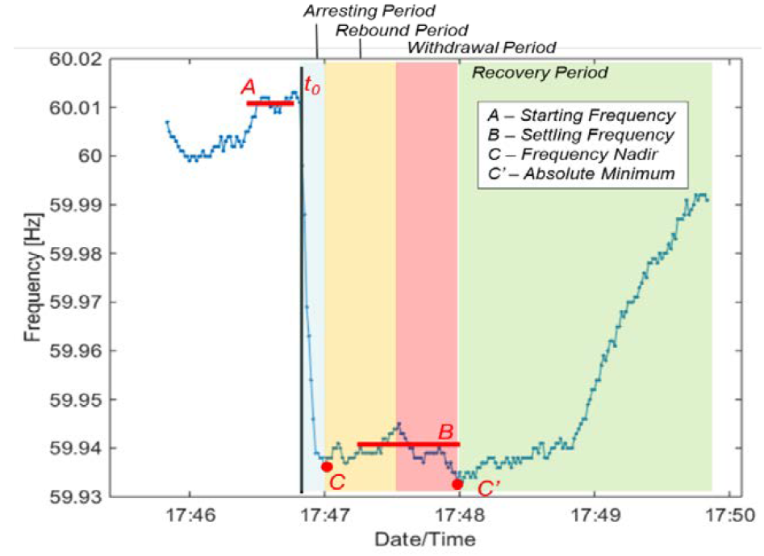
Objectives – Measurement 4, cont.
Frequency response example for large disturbance in Eastern Interconnection
Demonstrates governor withdrawal
Figure 4 from NERC Essential Reliability Services Task Force:
Measures Framework Report, November 2015

