Slide 1
october 9-10, 2018 | westborough, MA
Opportunity Costs and Energy Market Offers (Phase 1)
ISO’s Proposal to Estimate Opportunity Costs for Oil and Dual-Fuel Resources with Inter-temporal Production Limitations
Jonathan Lowell
jlowell@iso-ne.com | 413-540-4658

Slide 2
Opportunity Costs and Energy Market Offers
(Phase 1)
WMPP ID:
131
Proposed Effective Date: December 2018
ISO is proposing implementation in December of a system to daily estimate energy opportunity costs for oil and dual-fuel resources with limitations on energy production over a 7-day horizon
No tariff changes are required – MR-1 Appendix A already provides for the inclusion of opportunity costs in energy offers
Today’s presentation will focus on:
  Two simple numerical examples illustrating opportunity cost outcomes that are unique to dual fuel resources

Slide 3
Summary of opportunity cost objectives
Factors motivating the ISO opportunity cost proposal

Slide 4
An Enhanced Ability to Estimate Appropriate Generator-specific Opportunity Costs Provides a Number of Benefits
Facilitates efficient use of fuel-constrained resources over multi-day time horizons
Improves both reliability and overall system cost-effectiveness
Improves price formation by reflecting the opportunity cost of energy supply limitations in market prices
Helps to avoid market dislocations and price distortions that can result from manual actions
More information on the motivating factors, historical background, implementation notes and future plans is provided in the ISO’s opportunity cost presentation at the September 2018 Markets Committee meeting:
  Opportunity Costs and Energy Market Offers (Phase 1) - Revision 2

Slide 5
review of proposed methodology
How the ISO plans to calculate estimated opportunity costs

Slide 6
How is Opportunity Cost Defined?
Think of the opportunity cost (OC) as the reduction in maximum Net Revenue (over the opportunity cost horizon) associated with a 1 MWH reduction in the available fuel supply
“Net Revenue” is the difference between energy revenue (LMP x MWH) and cost of production for each MWH
  Cost of production includes fuel cost, emission allowance costs, VOM
These concepts are defined more precisely in the October 9, 2018 memo accompanying this presentation:
“Energy Market Opportunity Costs for Oil and Dual-Fuel Resources with Inter-temporal Production Limitations – Revised Edition”

Slide 7
Important Input Assumptions to OC Calculations
Covering the 7-day OC Horizon
Hourly (zonal) electricity price projections
Daily fuel spot price projections
  Algonquin (non-G)
  Oil (#2, #6 1% S, #6 0.3% S, Jet (kerosene)
Emission allowance prices (SO2, NOx and RGGI CO2)
Temperature forecast

Slide 8
Daily Spot Gas Price Projection for 7-Day OC Horizon
Spot gas prices in the winter can change significantly from day-to-day
Cold temperatures are a major factor influencing gas prices
  gas heating demand
  electric demand
Gas-fired resources set the clearing price approximately 60% of the time
A 7-day forecast of gas prices will be a key input in the estimation of opportunity costs for oil and dual-fuel resources.

Slide 9
Neural Network Model used to Project 7-Day Spot Gas Prices
ISO’s vendors for spot fuel price indices only provide “next day” prices
To fill this gap, ISO has developed a “neural network” gas price forecast model to support the estimation of opportunity costs
  A number of econometric model formulations and driver variables were tested
  Neural network model performed best
Key model inputs:
  Mean temperature (historical and forecast)
  Mean daily hub LMP (historical and forecast)
Model specification and performance is described in the October 9, 2018 memo accompanying this presentation:
“Natural Gas Price Forecast Method for Energy Market Opportunity Costs”

Slide 10
Opportunity Cost Model Design
The OC model solves an optimization problem to find the feasible generation schedule producing the maximum Net Revenue over the 7-day OC horizon
Fuel supply (inter-temporal production) limitations are modeled as constraints
Operating characteristics (EcoMin, EcoMax, Min Run Time, etc.) are also modeled as constraints
The difference in Net Revenue when the fuel supply is reduced by 1 MWH is the estimated energy opportunity cost
The two new examples presented later illustrate the application of this design to dual fuel resources

Slide 11
Opportunity cost examples
Illustration of Opportunity Cost Principles as applied to Dual Fuel Resources

Slide 12
The Accompanying Memo Provides Important Additional Detail
The memo¹ that accompanies this presentation provides
  A high-level mathematical formulation of the optimization problem
  A detailed explanation of examples #1 - #4 presented at the September Markets Committee meeting focused on oil-fired generators
  A detailed explanation of new examples #5 & #6 that explore aspects of opportunity costs for dual fuel resources
The new dual fuel examples illustrate several outcomes and insights that might seem unusual or counterintuitive on initial review
  The insights are explained and will be helpful when evaluating and understanding actual ISO estimated OCs for dual fuel units this winter
The October version of the memo includes two new examples:
  Impact of dual fuel optionality on oil-related opportunity cost
  Impact of dual fuel capability when gas is in merit but not called for in the optimal dispatch
¹ “Energy Market Opportunity Costs for Oil and Dual-Fuel Resources with Inter-temporal
Production Limitations – Revised Edition”

Slide 13
Example 5: Dual Fuel Unit Optimal Dispatch with Both Fuel Types In Merit (1)
Key Points to look for:
  The optimal dispatch of a dual fuel unit with limited oil inventory may not necessarily use the oil when the oil produces the highest profit margin.
  The oil-related opportunity cost may be associated with the profit margin when burning gas
In this example, the gas-related opportunity cost will be zero
  Gas is not stored on-site and is assumed to be available from the pipeline to be consumed on-demand

Slide 14
Example 5: Dual Fuel Unit Optimal Dispatch with Both Fuel Types In Merit (2)

Slide 15
Example 5: Dual Fuel Unit Optimal Dispatch with Both Fuel Types In Merit (3)
Oil-only dispatch would run in hours 1 & 2
Net revenue = $20 + $40 = $60
With dual fuel, the dispatch must consider the unit’s margin on gas:
Simply selecting the fuel in each hour with the highest margin for dispatch produces:
With gas available, oil is pushed to hour 3 with a lower oil margin. This occurs because the oil margin exceeds the gas margin by a greater amount in hour 3 than in hour 1:
Net Revenue is increased to $67

Slide 16
Example 5: Dual Fuel Unit Optimal Dispatch with Both Fuel Types In Merit (4)
With one less MWh of oil available, what happens to the optimal dispatch?
Oil is no longer dispatched in hour 3 (the marginal hour) and gas is dispatched instead
Net revenue is decreased by $10 of lost oil margin in hour 3, and increased by $5 of gas margin
Net revenue becomes $62
Opportunity cost is the change in net revenue associated with a 1 MWh decrease in available fuel supply
In this example, the opportunity cost for a 1 MWh decrease in oil supply is $67 - $62 = $5/MWh
The oil-related OC stems from the marginal hour in which the optimal dispatch burns gas

Slide 17
Example 5: Dual Fuel Unit Optimal Dispatch with Both Fuel Types In Merit (5)
What are the appropriate offer schedules for this dual fuel generator?
  The oil offers should include the $5/MWh opportunity cost
  There is no opportunity cost for the gas
With these offer schedules, the optimal dispatch would use gas in hour 1 and oil in hour 2.
The optimal dispatch in hour 3 is indifferent to fuel type. Either choice will still maximize net revenue.

Slide 18
Example 6: Dual Fuel with Gas in Merit but not Used in Dispatch (1)
Key Points to look for:
  Dual fuel capability may not always improve net revenue, even if the generator is generally in-merit on both of the fuels
  The oil-related opportunity costs is determined by the difference in oil & gas margins in hours when both fuels are in merit

Slide 19
Example 6: Dual Fuel with Gas in Merit but not Used in Dispatch (2)
Generator is nominally profitable in all hours on oil
Only profitable on gas in hours 1 & 2

Slide 20
Example 6: Dual Fuel with Gas in Merit but not Used in Dispatch (3)
As in Ex. 5, Oil-only dispatch would run in hours 1 & 2 with highest margins
Net revenue = $20 + $40 = $60
Gas margins are only profitable in the first two hours:
Moving oil dispatch to hour 3 to allow gas to run profitably in hour 1 or 2, but does not increase net revenue:
In both cases, net revenue decreases to $55
Optimal dispatch (with apologies to John Belushi) is “No gas. Oil!”

Slide 21
Example 6: Dual Fuel with Gas in Merit but not Used in Dispatch (4)
With one less MWh of oil, the optimal dispatch will be to use gas in hour 1 and oil in hour 2
The OC is the change in net revenue for a 1 MWh reduction in oil inventory:
  $60 - $45 = $15/MWH
This is equivalent to the difference in the margin on oil and the margin on gas in hour 1:
$40/MWh - $25/MWh = $15/MWh
Similarly, the OC at the start of hour 2 the OC will be the lost margin on oil, offset by the gas margin gained
$40/MWh - $25/MWh = $15/MWh

Slide 22
Example 6: Dual Fuel with Gas in Merit but not Used in Dispatch (5)
Suppose the generator in Example 6 was not dual-fuel, and burned only oil
With 1 less MWh of oil, at the start of hour 1, the OC would be the $20/MHr lost oil margin.
At the start of hour 2, the OC would be $40/MWh
The single fuel OC is higher in both hours than the $15/MWh dual fuel OC

Slide 23
Example 6: Dual Fuel with Gas in Merit but not Used in Dispatch (6)
How should the dual fuel resource offer?
From the previous slides, we see the oil-related OC is $15/MWh in hours 1 & 2
The appropriate offer is the sum of the oil price plus the oil-related OC = $135
In hour 3, with no oil remaining in the tank, the offer price is irrelevant
With no gas OC, the gas offer is simply the price of the purchased gas
Note that to ensure the unit is dispatched on oil, the generator may choose to offer a small amount less then $135/MWh

Slide 24
questions from september 2018 markets committee meeting

Slide 25
What can I do to preserve limited fuel for an anticipated scarcity event?
Some thoughts:
Buy more fuel.
Be sure to include the OC in your offer. The Daily OC (which is the maximum of the hourly OC estimates) will act to preserve the fuel for use in the highest priced hour(s).
That said, OCs are estimated using a Day-Ahead price forecast. It would be extremely unusual for the DAM to clear with a scarcity condition.
Scarcity events are likely caused by an unexpected contingency in real-time. If it could be foreseen, ISO typically would have taken preventive steps.

Slide 26
Will using a daily OC equal to the maximum of hourly OC estimates likely results in a generator setting high LMPs for many hours in the day?
Thoughts:
If the daily OC value was included in a generator’s offer throughout the day, it would result in the generator being dispatched only in the highest priced hour of the day, and being offline the rest of the day.
  The maximum hourly OC value will correspond to the hour with the maximum LMP
When offline, the generator will not be participating in price formation and will not be setting price.

Slide 27
Should a generator’s offer strategy always include the full estimated opportunity cost?
The ISO estimated OC reflected in a generator’s reference price will be the maximum of the hourly estimated OCs calculated for the day.
As we have seen in the examples, hourly OCs may increase or decrease during a day as time passes and fuel is consumed.
Ideally, Market Participants develop an internal forecast of expected prices during the day, and use that to inform the offer strategy
Offers that include the full daily OC value risk missing out on profitable hours during the day.
  This is illustrated on the following two slides

Slide 28
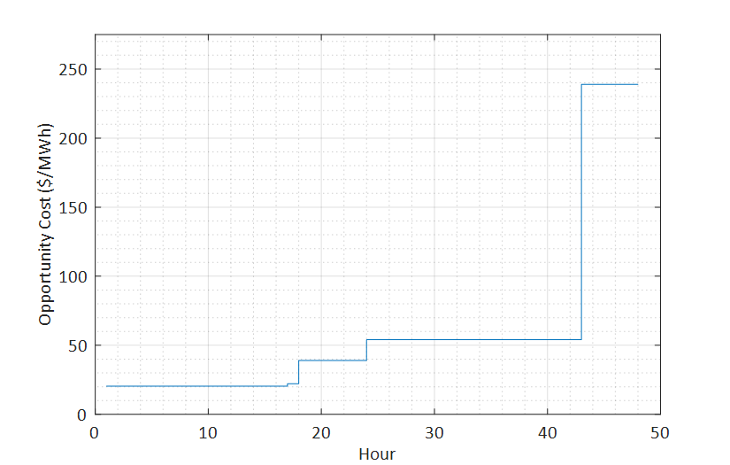
Potential Impacts of Including OCs in Offers (1)
ISO estimated Daily OC will be the maximum of hourly OC values calculated for the day
Since hourly OCs will tend to increase¹ as hours become history, including the full Daily OC value in all 24 hourly offers for the day may forego the chance to generate during early hours that would maximize net revenues
From Example 2 – September MC Mtg
Day 1 Day 2
OC = 20.42
OC = 22.15
OC = 39.04
OC = 54.07
¹This is true when input assumptions for the day are held constant. If real-time OC updates become
feasible in the future, estimated OC values could decrease if the LMP forecast decreases.

Slide 29
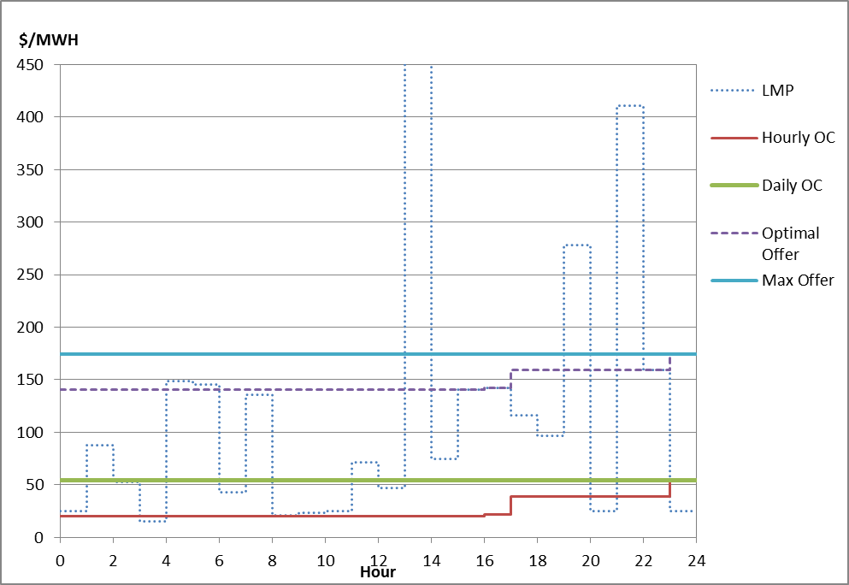
Potential Impacts of Including OCs in Offers (2)
From Example 2 – September MC Mtg
Five hours of optimal dispatch that would lead to maximizing Net Revenue will be missed if every hourly offer price includes the Daily (maximum) OC value
Consider an alternate strategy – include less than 100% of Daily OC estimate in early hours

Slide 30
Conclusion
Starting in December, ISO proposes to incorporate a daily estimate of opportunity cost into the reference price for oil and dual-fuel generators
The OC estimates will be available to Participants by 9am each day
Participants are encouraged to incorporate opportunity costs in generators’ energy market offers
Doing so should improve reliability and the system’s cost-effectiveness during constrained fuel conditions
The ISO seeks information and comment from Participants to enhance the OC model to better address fuel and other real-world constraints that impact a generator’s ability to operate continuously at maximum output

Slide 31
Quick Quiz – Test Your Knowledge!
All generators are required to include opportunity costs in Day-Ahead offers (true or false)
The best offer strategy is to always include the full amount of the ISO’s estimated opportunity cost in a generator’s offer (true or false)
ISO estimated opportunity costs will only be included in a generator’s reference price if requested by the Lead Participant (true of false)
Opportunity costs included in reference prices – it doesn’t get any better than this! (true or false)

Slide 32
Stakeholder Schedule
Stakeholder Committee and Date | Scheduled Project Milestone
Markets Committee August 3, 2018 | Discussed ISO’s plans for Opportunity Costs for the coming winter
Markets Committee September 12-13, 2018 | Discussion of OC proposal details and detailed examples for oil units
Markets Committee October 2018 | Further discussion of examples for dual-fuel units
Markets Committee November 2018 | Discussion of market power issues related to opportunity costs
Early/mid November 2018 | Webex training targeted to back-office personnel responsible for energy offer submission
December 2018 | Implementation of OC estimates included in oil/dual-fuel generator reference prices

Slide 34
Acronyms Used in this Presentation
IMMAC – Internal Market Monitor’s Asset Characteristics interface
CAMS – Customer Asset Management System
OC – opportunity cost
DAM – Day-Ahead Market
LMP – Locational Marginal Price
MRT – Minimum Run Time
SO2 – Sulfur Dioxide
NOx – Nitrogen Oxide
CO2 – Carbon Dioxide
RGGI – Regional Greenhouse Gas Initiative

