Slide 1
November 7-8, 2018| Markets committee
WINTER ENERGY SECURITY IMPROVEMENTS: MARKET-BASED APPROACHES
Discussion of approaches for developing a market-based solution to improving energy security in the region
Andrew Gillespie
Christopher Parent
413.535.4088 | agillespie@iso-ne.com
413.540.4599 | CPARENT@iso-ne.com

Slide 2
Winter Energy Security Improvements
WMPP ID:
125
Proposed Effective Date: TBD
In accordance with FERC’s order in EL18-182-000, the ISO must develop and file improvements to its market design to better address regional fuel security by July 1, 2019
The ISO shared its high-level views on conceptual approach elements at the October Markets Committee meeting
  Multi-Day Ahead Markets
  New Ancillary Service in RT/Multi-DA Markets: Energy Inventory Reserve Constraint
  Seasonal Forward Procurement of Energy Inventory: Forward Inventory Reserve Mechanism

Slide 3
Today’s Topics
A discussion of the problem, including insights gained from an examination of the current single day ahead construct using examples to demonstrate the concern/challenge
An elaboration of the first two conceptual design elements (Multi-Day Ahead Markets, and Energy Inventory Reserve Constraint) including a review of the structure being considered and some examples
A review of stakeholder questions not covered or addressed in this presentation

Slide 4
Stakeholder Input
(from October presentation)
The ISO seeks the following at today’s meeting:
  Stakeholder views on a conceptual approach to address the problem
  Stakeholder feedback on the ISO’s conceptual approach
The ISO anticipates the sequencing of design details and implementation timeframes of the various elements may need to be tiered
  The initial emphasis for the July 1, 2019 filing will require a robust design approach for winter energy security
  The ISO expects that after that filing, additional efforts over the next few years will be needed on the development and implementation of the design
  This will be a multi-year implementation effort requiring significant time and resources

Slide 5
PROBLEM and insights

Slide 6
Problem Statement
(from October Presentation)
There may be insufficient energy available to the New England power system during extended cold winter weather conditions to satisfy electricity demand, given the system’s evolving resource mix and fuel delivery infrastructure
  While there has been no loss of load to date on the bulk power system attributable to these conditions, the ISO is concerned this emerging issue will worsen over time due to observed industry trends

Slide 7
Concerns
The concern is whether there will be sufficient energy available during extended cold winter weather (i.e., beyond tomorrow)
The challenge is assuring that the region’s resources, regardless of fuel or technology, are able to meet the demand for electricity and required operating reserves throughout the winter, i.e. energy security
  Can load be served during extended cold weather? Extended meaning beyond the next day?
  Can load be served if some other uncertainty materializes during extended cold weather?

Slide 8
Insights
New England’s energy markets are not currently designed to provide forward price signals beyond the single (next) day-ahead market
The ISO (the Reliability Coordinator), market participants, and state entities have distinct roles, interests, and information, and therefore different expectations and concerns about conditions beyond the next day
The single day, day-ahead market construct does not consider the potential for insufficient energy during future days, which can result in the premature use of limited energy and adverse but preventable (in hindsight) outcomes if uncertainties materialize (e.g. limited replenishments, etc.)

Slide 9
Examples Ahead
The next two examples show the key problem that arises with a successive single day-ahead market in a tightly limited-energy system
Later we will examine how the ISO’s proposed multi-day ahead market, with new energy inventory constraints, can solve this key problem with outcomes that are simultaneously cost effective and more reliable

Slide 10
Single Day-Ahead Market (SDAM) Clearing
Taking it One Day at a Time…
Currently, each successive day is cleared after the prior day has been cleared
  E.g., Tuesday’s day-ahead is cleared after Monday’s day-ahead has been cleared
Clearing the next day considers, among other things:
  Each unit’s available starting input energy, if that amount would limit the total possible production from the unit, and
  Each unit’s expected (offered) availability
Clearing one day at a time does not consider or plan for the system on the following day (i.e., beyond the one day cleared)
  E.g., clearing Tuesday’s day-ahead market does not consider Wednesday (what’s left to serve Wednesday’s demand?)
  While the ISO looks beyond tomorrow operating the system, SDAM does not

Slide 11
Example 1 – SDAM Clearing
For demonstration purposes in this and in all the following examples:
  The period examined spans four days, and for simplicity assume there is only one hour in each day
  The system’s “energy reservoir” represents the total amount of energy available to meet demand each day
  The supply sources shown (Wind, Nuclear, etc.) are meant to represent the different classifications of supply (Intermittent, non-intermittent, with storage, without storage, etc.)
In this example:
  The Oil unit is priced below the Gas 1 and Gas 2 units (as might occur during a cold snap)
  There are no fuel replenishments planned during the four day period
  Resource do not offer based on their opportunity costs

Slide 12
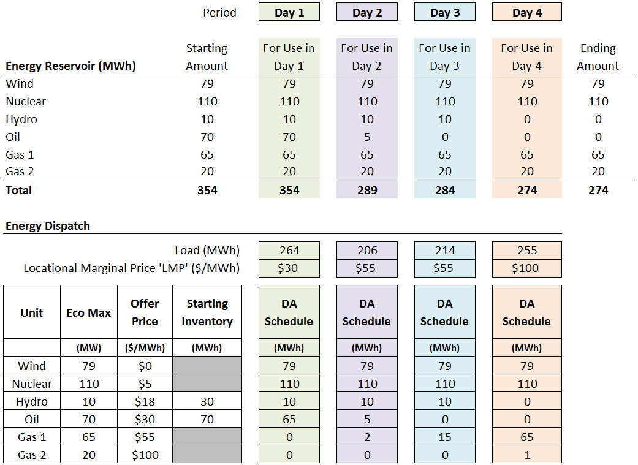
Example 1 – SDAM Clearing
Total Payments = $56,520
Total Production Cost = $9,450

Slide 13
Observations on SDAM Example 1
The largest draw on the energy reservoir is on Day 1
  Because the market horizon is one day (singe day clearing) the available energy from Hydro and Oil is exhausted early
  In hindsight, this may not be the most cost effective use of the limited energy
  As we will see, single day clearing produces higher production costs than necessary (and, if uncertainties materialize, is less reliable)
This approach does not place any value on leaving energy in the reservoir for use in the subsequent day
  Next: What if something happened, foreseeable or unexpectedly

Slide 14
Example 2 – SDAM with Tighter Energy Supply
If a change to the energy reservoir was to materialize on (say) Day 4, what would be the impact?
We can examine the impact by modifying the SDAM example
In this example we will use the same starting conditions and assumptions as in Example 1, but now we will introduce some realistic operational challenges
For this Example 2:
  There is a limited amount of natural gas available for generation (only enough for one of the two gas units to operate), and
  The Wind unit in on outage and unavailable day-ahead when clearing Day 4. (Note, the results are the same if instead the Nuclear unit had a derate of the same magnitude – the technology isn’t the issue here).

Slide 15
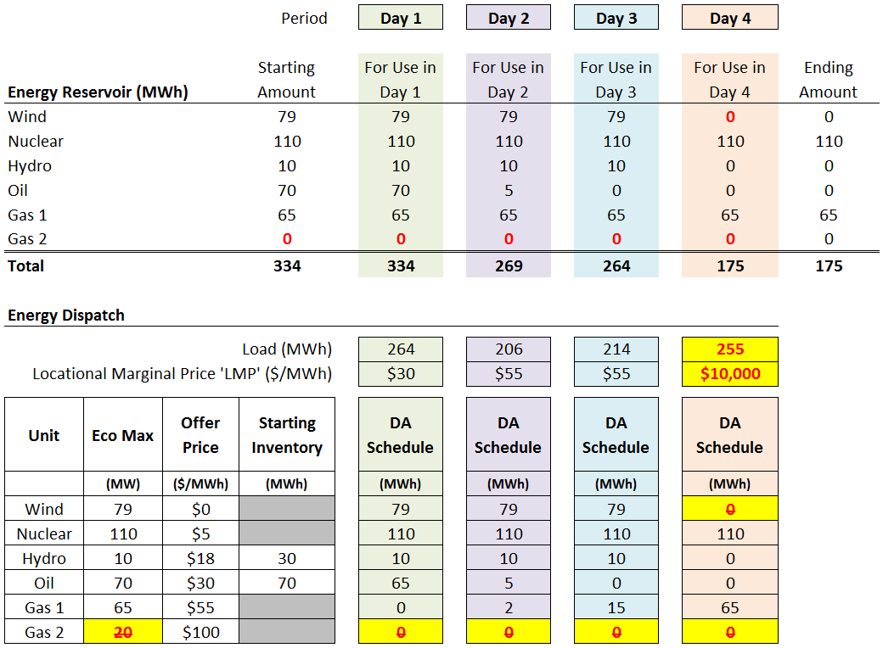
Example 2 – SDAM with Tighter Energy Supply
Day 4 LMP is set by the penalty factor due to insufficient energy
($10,000 is for demonstration purposes only)

Slide 16
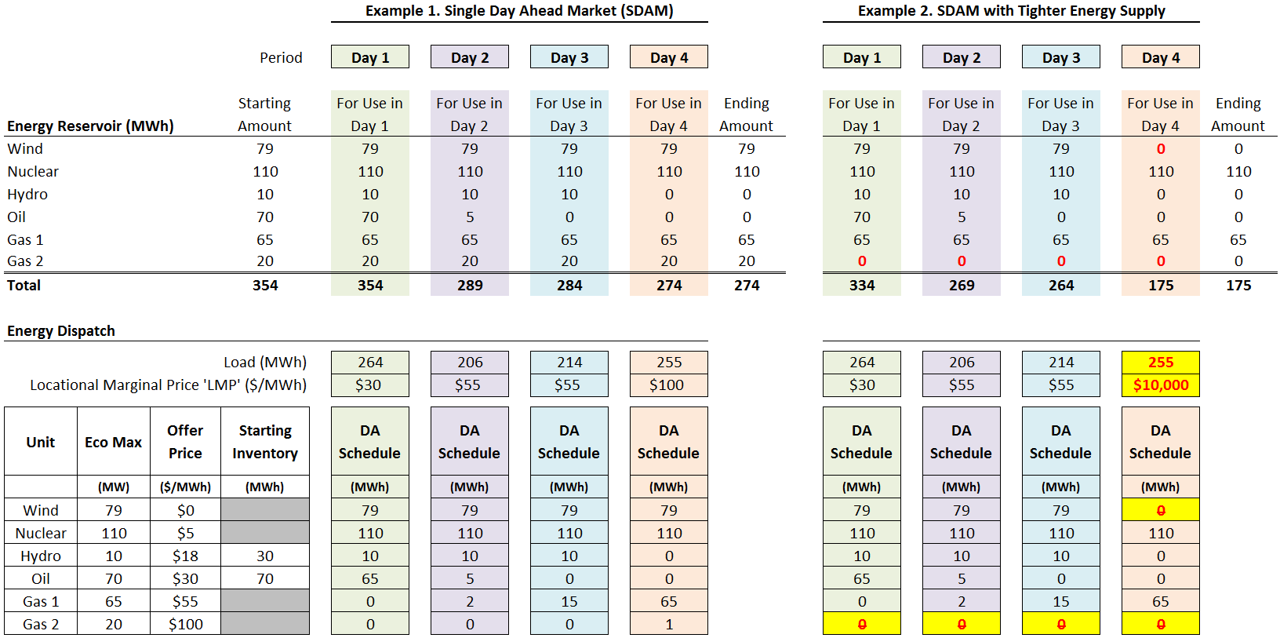
Comparing Example 1 and Example 2

Slide 17
Observations on SDAM Example 2
Like Example 1, the biggest draw on the system’s total “energy reservoir” is on Day 1
Consequently:
  There isn’t enough in the energy reservoir to meet demand on Day 4, and
  There may not be enough in the reservoir to meet demand on Day 5 (not shown) if demand is like Day 4
Key Point: In a limited-energy system, a SDAM has a very short horizon (one-day) and by the time the market signals there is a problem it may be too late
It is this outcome that is a central concern

Slide 18
Conceptual Design Element #1
A review of the concept behind a Multi-Day Ahead Market (MDAM) construct

Slide 19
Conceptual Approach Elements
(from October Presentation)
Multi-Day Ahead Markets
  Optimizes limited energy inventories cost-effectively over the
  multi-day horizon
  Provides a forward price signal to replenish when prospective supplies are tight and influence consumption decisions
  Creates financially binding obligations for cleared quantities using the multi-day ahead clearing prices
  Should reduce (or eliminate) need for out-of-market posturing of resources for fuel

Slide 20
Examples Ahead: The Main Points
Next, we will do two more numerical examples, now with a multi-day ahead market.
  Same assumptions as before
We will see:
  How and why a multi-day ahead market can optimize a limited energy system more cost-effectively that a SDAM;
  How and why a multi-day ahead market can produce more reliable outcomes in situations when a SDAM cannot
These dual benefits of a MDAM become ever more important when the system is energy (not capacity) limited
In simple terms, a MDAM does not wait until it is “too late” to manage limited energy constraints

Slide 21
Multi-Day Ahead Market (MDAM) Clearing
The MDAM would be run every day and would clear a rolling, longer forward horizon (several days rather than just one day)
Like SDAM, MDAM considers among other things:
  Each unit’s starting input energy available, if that amount would limit the total possible production from the unit, and
  Each unit’s expected (offered) availability
Like SDAM, the MDAM does not consider or plan for the system beyond the horizon (i.e., beyond the days cleared)
  That is, until the next day arrives, when the MDAM would clear one more day as the horizon rolls forward….

Slide 22
Example 3 - MDAM Clearing
This is a simplified example for demonstration purposes only (see the first bullet’s comments on slide 10)
This and the next example use the same starting conditions in Example 1
  The Oil unit is priced below Gas 1 and Gas 2 units
  There are no fuel replenishments planned during the four day horizon
  Resources do not incorporate opportunity costs in their supply offers
MDAM is clearing all four days at the same time
  The MDAM algorithm produces the least-cost dispatch to meet demand in every day in the dispatch horizon
  Units with limited available energy are dispatched in periods when they are needed most (i.e., when their dispatch serves to reduce production costs the most)

Slide 23
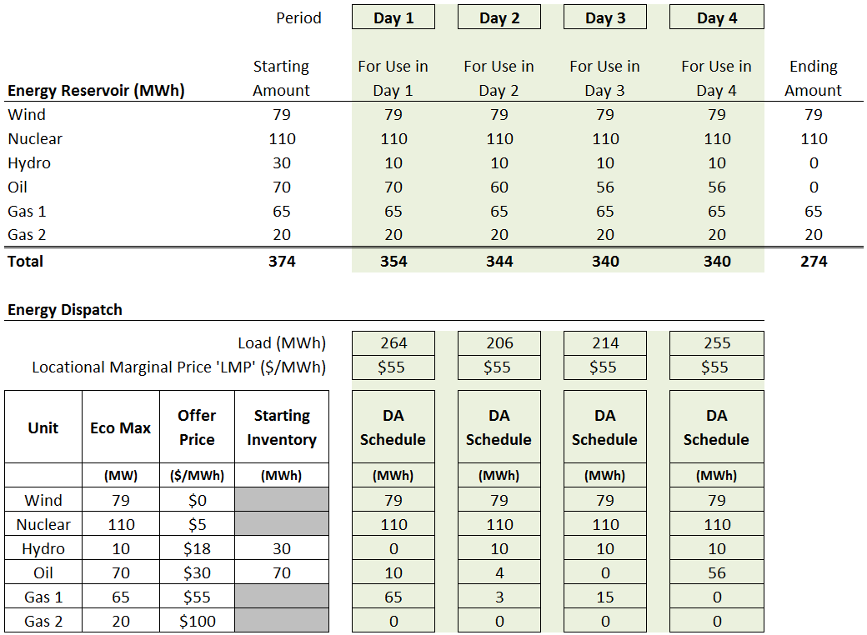
Example 3 – MDAM Clearing
Total Payments = $51,645 ($4,875 lower than SDAM Example 1)
Total Production Cost = $9,405 ($45 lower than SDAM Example 1)

Slide 24
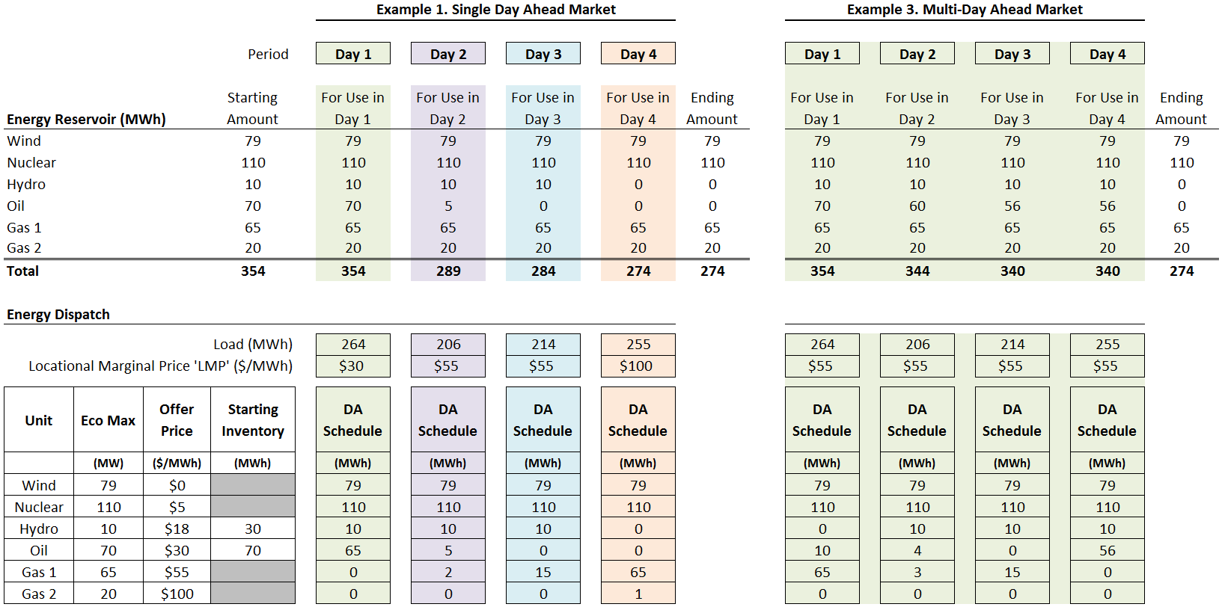
Comparing Example 1 and Example 3

Slide 25
Observations on MDAM Example 3
Cost Effectiveness. Total payments and production costs are lower with the MDAM than the SDAM from Example 1
  Several suppliers’ daily schedule(s) are different
  No explicit payment of lost opportunity costs in offer prices was necessary to achieve this outcome
  The Locational Marginal Price (LMP) is paid to all resources; there is no ‘eligibility’ requirement
  Total production costs are always lower with the MDAM than SDAM (i.e., MDAM is more efficient)
  However, total payments may not always be lower with MDAM than SDAM
The largest draw on the energy reservoir is now on Day 4
The “energy reservoir” is in the same ending state as in Example 1

Slide 26
MDAM Locational Marginal Price
The LMP is $55/MWh each day because the MDAM is re-dispatching across the entire market horizon
  In this example all intervals have been re-dispatched (i.e., the one hour in each day)
  This may not be the case in practice (across 24 hours in each day) as load will be more variable than shown in this example – in practice it is not expected that all hours in a day would be re-dispatched
Each day’s LMP is the ‘shadow’ price of serving an incremental amount of energy (simplistically, the cost of the next MWh)
  In this example adding one MWh of demand would increase the total production costs by $55; hence, the LMP is $55/MWh

Slide 27
Example 4 - MDAM with Tighter Energy Supply
If the same tight energy supply conditions examined in Example 2 occur, what would be the impact with an MDAM?
In Example 2, the SDAM resulted in load-shedding on Day 4
We can examine the impact by modifying the MDAM example
Like Example 2, for this example:
  There is a limited amount of natural gas available for generation (only enough for one gas unit to operate), and
  The Wind unit will be unavailable on Day 4 (unavailable in MDAM on Day 4)

Slide 28
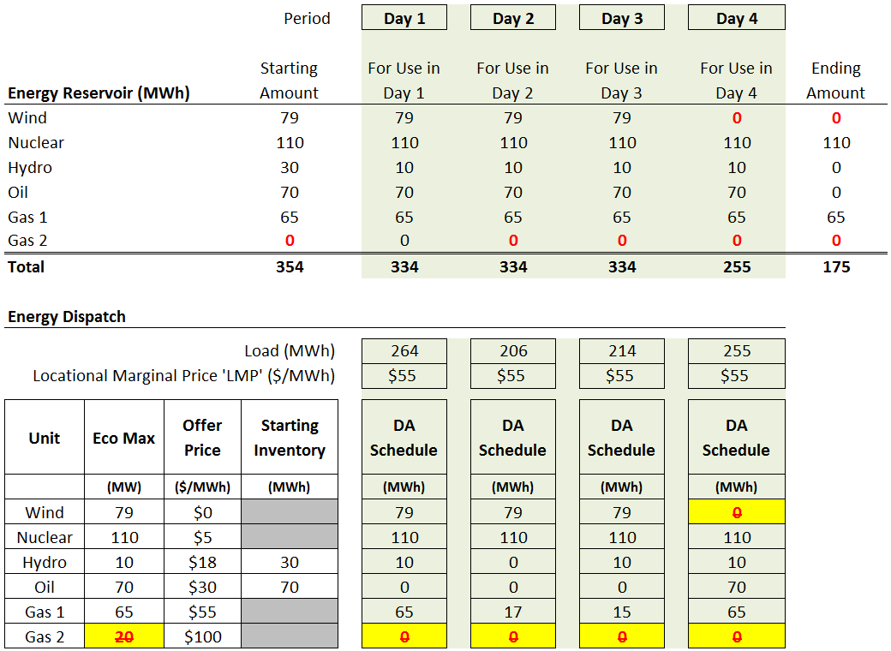
Example 4 - MDAM with Tighter Energy Supply
Total Payments = $51,645 (the same as Example 3)
Total Production Cost = $13,750 (higher than Example 3)

Slide 29
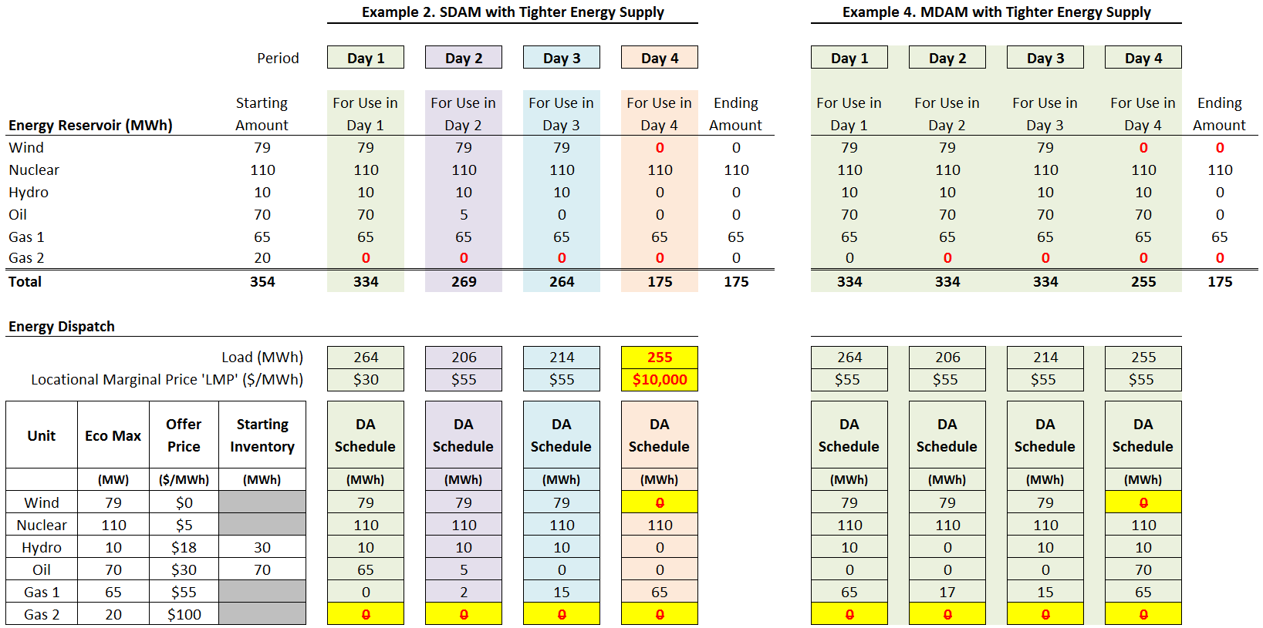
Comparing Example 2 and Example 4

Slide 30
Facing Tight Energy Supply Conditions
Compared to the SDAM, the MDAM - facing tight energy supply conditions – is able to:
Produce more reliable outcomes; the MDAM doesn’t wait until it is too late to try and solve the problem
  It was possible to avoid the energy deficiency on Day 4, but this may not always be the case using MDAM alone
Produce more cost effective outcomes
These twin, simultaneous benefits are general properties of an MDAM, relative to a sequential SDAM – they are not ‘special’ results for just this example
The difference between the SDAM and MDAM outcomes becomes more important as the power system is more energy (as opposed to capacity) constrained, in practice

Slide 31
General MDAM Observations
Benefits. The MDAM approach better optimizes the system’s energy reservoir and better positions the system days ahead of time to deal with tight energy supply conditions
A Key Caveat, However. Like single day clearing, a single run of the MDAM does not by itself provide a “cushion” to manage uncertainties, and it ‘uses up’ the energy reservoir at the end of the market horizon
  In Example 4, the Day 4 energy reservoir had just enough to meet demand
  Take away: The system can be closer to violating the energy constraint than the market may be signaling

Slide 32
Multi-Day Ahead Market (MDAM): Structure and mechanics
A brief review of the structure being considered
Settlement examples
Other aspects requiring further consideration

Slide 33
Multi-Day Ahead Market (MDAM)
Current Thinking
MDAM market horizon – six days
  Aligns with ISO Operations’ current forward outlook
Obligations to bid/offer in real-time and in the next day’s day-ahead market (D1) would remain
Participation in additional MDAM days (Days 2 – 6) would be voluntary
Other notes on participation in Days 2 – 6
  Offers and bids may be different across the MDAM horizon
  All cleared quantities would be financially binding
  Virtual transactions (Increment Offers and Decrement Bids) would be allowed (possibly with lower NCPC charge risk)

Slide 34
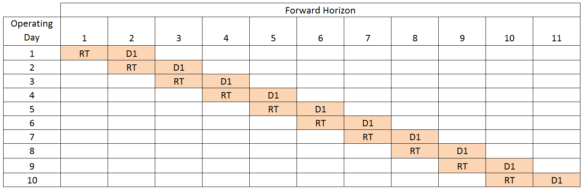
Visual of Day-Ahead and Real-Time
(How it works today)
The first column shows the Operating Days (going down)
In any given Operating Day, real-time ‘starts’ with the day-ahead schedule (i.e., financial position) for that Operating Day
For example, Operating Day 2 is using the day-ahead schedule for Operating Day 2 (D1) – which was generated the day before (in Operating Day 1)

Slide 35
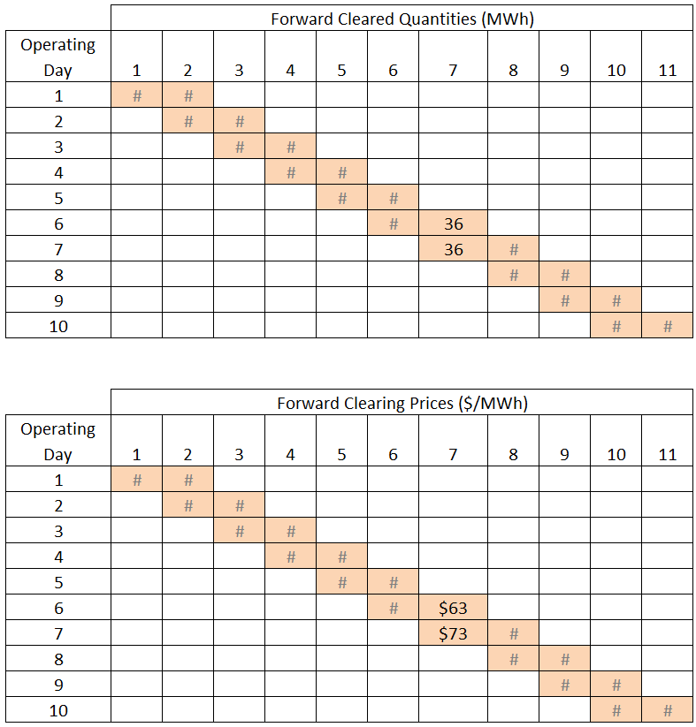
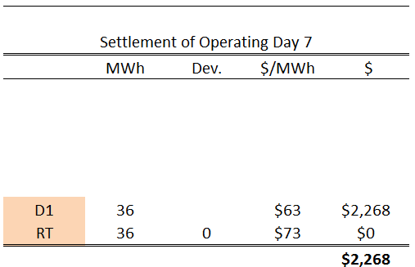
Day-Ahead and Real-Time Settlement Example
Day-ahead positions are settled against real-time positions (deviations)
Settlement = (Q_{RT} – Q_{D1}) x LMP_{RT}

Slide 36
Multi-Day Ahead Market - Mechanics
Each day the MDAM would be run for a rolling forward horizon
  For example, if today is Monday the MDAM would clear day-ahead positions for Tuesday through Sunday
Each time the MDAM is run it would be using the latest bids, offers, etc.
  All inputs to the MDAM are updated to reflect any changes from the prior day
The next day, the MDAM would re-clear a portion of this rolling forward horizon
  For example, if it is now Tuesday, the MDAM would clear day-ahead positions for Wednesday through Monday
Settlement would now include not only the prompt day-ahead vs. real time energy market (D1 to RT in the prior example) but also settlement of each forward-day to forward-day (see next example)

Slide 37
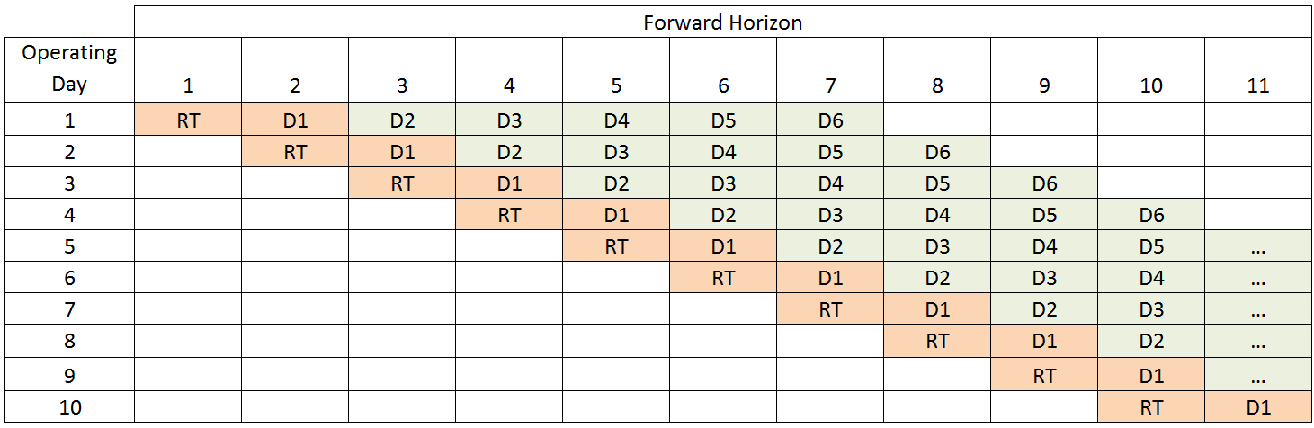
Visual of Multi-Day Ahead Market
The first column again shows the Operating Days (going down)
In any given Operating Day, real-time again ‘starts’ with the last day-ahead schedule for that Operating Day (D1)
However, the MDAM construct re-clears the day-ahead market several times before D1

Slide 38
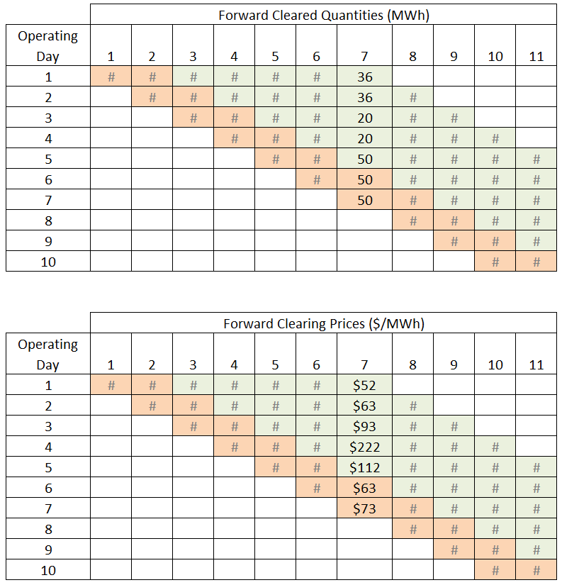
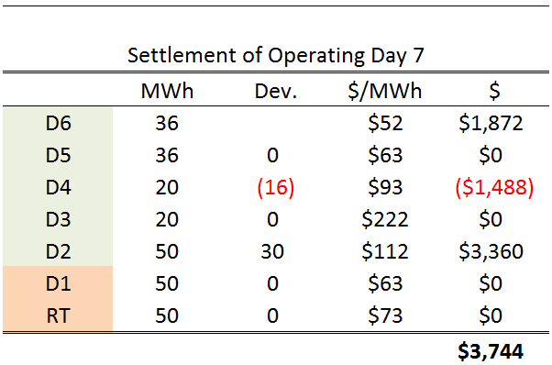
Multi-Day Ahead Market Settlement Example
Early day-ahead positions (Days 2 – 6) are settled against subsequent re-cleared day-ahead positions using the same mechanics
But instead of real-time, the deviation is based on the next day’s day-ahead position and price
Settlement = (Q_{Dn} – Q_{Dn+1}) x LMP_{Dn}
Day-ahead (D1) is still settled against real-time deviations as shown in the previous example

Slide 39
Conceptual design Element #2
A review of the concept of an Energy Inventory Reserve Constraint (EIRC)

Slide 40
Conceptual Approach Elements
(from October Presentation)
Energy Inventory Reserve Constraint
  Would be integrated into the multi-day ahead optimization
  Provides a price signal to maintain a “buffer stock” of energy inventory, for technologies capable of doing so
  Re-dispatches the system to preserve these energy inventories, shifting production as needed to higher-cost resources with “use or lose it” energy
  Conceptually familiar solution approach – logic mirrors operating reserve designs

Slide 41
Multi-Day Ahead Market Clearing:
Strengths and a Key Limitation
MDAM alone produces the least-cost, efficient solution if nothing unexpected happens over the horizon;
But it does not preserve any margin, of energy, in case load turns out to be higher, or scheduled generation is unexpectedly lost, for an extended period (whether over the current horizon, or the next day just over the current horizon)
  Operating reserves provide that capability for short durations, but they may not be sustainable for an extended period (e.g., for more than their one-hour sustainability requirement)
Example 3 showed how MDAM optimizes the use of this limited energy to achieve the lowest production costs possible; but also how all of this energy is used within the market horizon

Slide 42
MDAM and Uncertainty
If a problem were to materialize between MDAM runs (e.g., a large unit becomes unavailable, or replenishments are delayed system-wide, etc.), the next run of the MDAM may not have enough starting energy in the reservoir to meet demand over the next market horizon
The prior MDAM may have prematurely used (in hindsight) some portion of the storable energy early in the horizon; energy that we now wish we had saved for future periods
Uncertainties that can affect the system for extended periods can be prepared for, in a cost-effective way, using a co-optimized ancillary service designed expressly to protect for such situations

Slide 43
Energy Inventory Reserve Constraint (EIRC)
An Energy Inventory Reserve Constraint can ensure it is physically feasible to meet load for an extended period if uncertainties actually materialize (up to a limit, of course)
This constraint would create and preserve a margin by preventing the MDAM from using up all of the storable energy within the market horizon
In Example 3 if the higher priced Gas units were used more, in lieu of the lower priced Hydro and Oil units, some of the system’s storable energy would remain in the reservoir across the market horizon
Mechanically, the EIRC would be a separately-priced ancillary service product that is co-optimized with energy in the MDAM, so its reliability benefit is achieved at least-cost

Slide 44
The EIRC Margin
Preserving a margin to deal with uncertainties:
  May not require extensive re-dispatching when energy is in ample supply, or
  It may require more extensive re-dispatching as the system becomes more and more stressed
  But this coverage will be there
The EIRC helps ensure that the region does not end up in a situation where it is too late to avoid a shortage after something unforeseen happens
  Because part of the region’s limited energy reservoir was used prematurely (in hindsight) instead of saving something for later
  (later in that same market horizon, and later meaning for the days after the current market horizon)

Slide 45
Analogy to Operating Reserve Market -
Ancillary Service Price
In the operating reserve market when the system is re-dispatched to maintain the reserve requirement:
  The reserve clearing price, which is based on the opportunity cost incurred to provide reserves, is paid to the unit providing reserves instead of energy
In the MDAM/EIRC context, conceptually this means when the system is re-dispatched to maintain an energy reservoir requirement
  The EIRC price will be based on the (marginal) opportunity cost of a resource economically ‘re-dispatched’ down (or off) to optimally maintain its inventory for future periods
  Technically, this ancillary service’s price is calculated from the shadow price of the energy inventory reserve constraint in the MDAM optimization

Slide 46
Analogy to Operating Reserve Market -
Cascading Prices
In the operating reserve market when the system is re-dispatched to maintain the reserve requirement:
  The opportunity cost of the unit that is backed down to create reserves is reflected in the LMP, and the (higher) LMP is paid to all units cleared to produce energy
In the MDAM/EIRC context, conceptually this means when the system is re-dispatched to maintain an energy reservoir requirement
  The opportunity cost (i.e., the EIRC price) of those units backed down to preserve the energy will be reflected in the LMP, and the (higher) LMP is paid to all units cleared to produce energy

Slide 47
Next Steps

Slide 48
Next Steps
Continued discussion of the ISO’s proposed conceptual approach
Discussion of stakeholders’ conceptual approaches
Discussion of ISO’s proposed design analysis/evaluation approach
The ultimate goal is a workable solution that can be filed by July 1, 2019
The ISO welcomes and will be looking for feedback throughout the entire process

Slide 49
Impact Analysis
ISO is planning to provide analysis focused on the addition of the energy inventory reserve constraints
  Initial overview of approach in December
  Additional discussion of scenarios in January
  Share results in the March timeframe
Objective of analysis is to inform stakeholders on how the design performs under different scenarios
While analysis will include review of historical periods, focus will be on future scenarios
  ISO is looking for input on what scenarios should be considered
ISO will including qualitative analysis of implications to other aspects of the market (e.g., Forward Capacity Market)

Slide 50
Stakeholder Schedule
Stakeholder Committee and Date | Scheduled Project Milestone
Markets Committee and Reliability Committee June 20, 2018 | Introduce challenges, drivers behind them, and frameworks for assessing problem and solutions
Markets Committee September 13, 2018 | Discuss design objectives, design principles and problem
Markets Committee October – December 2018 | Define problem and discuss conceptual approaches by the ISO and stakeholders
Markets Committee (other committees as needed) January – March 2019 | Discuss formal proposals by ISO and stakeholders, and analysis; draft Tariff changes distributed for March meeting
Markets Committee April 9, 2019 | Discuss final tariff language (including for amendments)
Markets Committee May 7, 2019 | Vote
Participants Committee June 7, 2019 | Vote

Slide 51
Appendix A

Slide 52
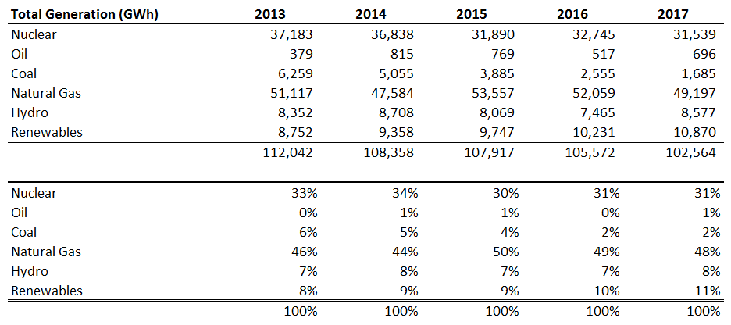
Trend of Natural Gas Used for Electric Generation
Source: https://www.iso-ne.com/isoexpress/web/reports/load-and-demand/-/tree/net-ener-peak-load

Slide 53
Where Else are Multi-Period Forward Markets Used?
Most well-developed physically-delivery commodity markets concurrently clear forward positions for multiple different forward periods
  Ex: Oil, copper, FCOJ, etc. can be sold for delivery the next day, the next week, the next month, the next year, etc., etc.
  Each forward position (on the same venue) is net-settled analogously to the examples illustrated on the prior slide
ISO-administered electricity markets are just now evolving toward this design, to deal with increasing uncertainties over energy supplies in multi-day operating timeframes
  The southern Europe (Iberian) ISO’s electricity market clears using 7 distinct forward periods and a rolling horizon (though not over 7 days)
  MISO is implementing a rolling horizon multi-day commitment optimization process (though not presently financially binding)

Slide 54
Appendix B:
Lost Opportunity Cost Bidding

Slide 55
Opportunity Cost Bidding
It is not necessary to incorporate opportunity costs in supply offers over the MDAM horizon
The following examples show that bidding without opportunity costs in the MDAM/EIRC construct achieves the same outcome when opportunity costs are included in the SDAM construct
  Example B.1 SDAM without opportunity costs included in offers
  Example B.2 SDAM with opportunity costs included in offers
  Example B.3 MDAM without opportunity costs included in offers
The outcome of Examples B.2 and B.3 are identical

Slide 56
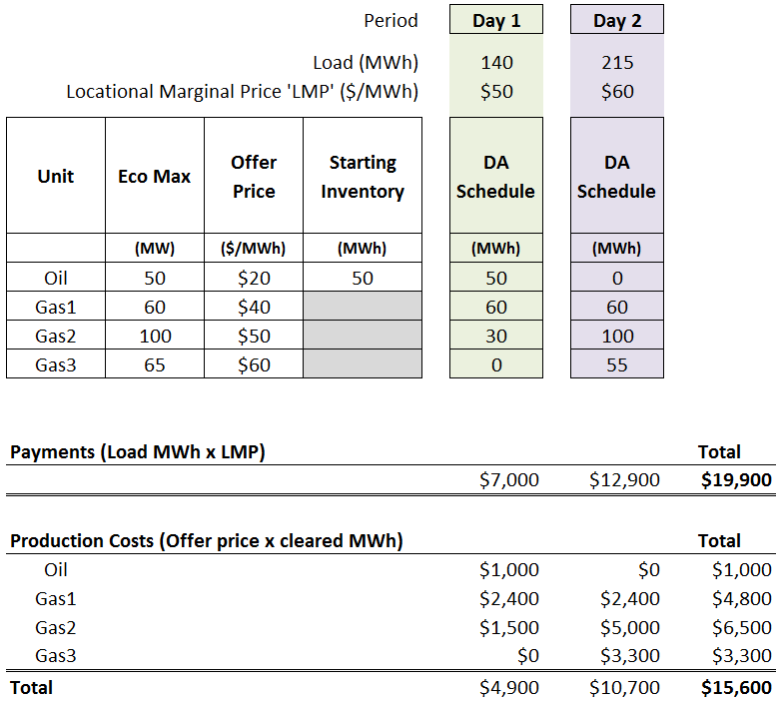
Example B.1
Single day, Day-Ahead Market
Opportunity cost not included in Oil unit offer
In hindsight, Oil unit would have done better to run on Day 2

Slide 57
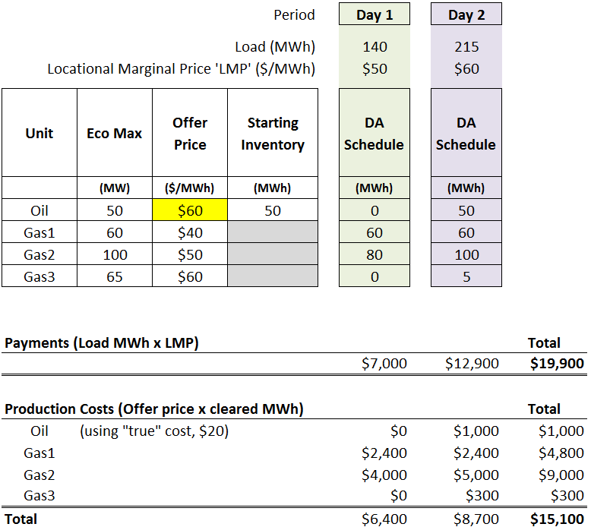
Example B.2
Single day, Day-Ahead Market
$40/MWh opportunity cost included in Oil unit offer –unit runs on Day 2 instead of Day 1

Slide 58
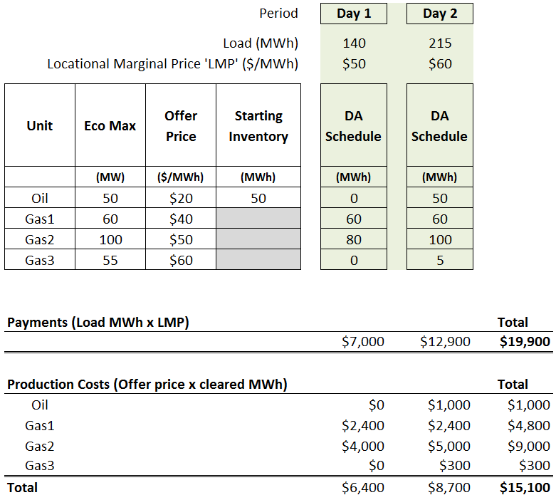
Example B.3
Multi-Day Ahead Market
Opportunity cost not included in Oil unit offer
Outcome is identical to Example B.2

