Slide 1
December 11-12, 2018| Markets committee
WINTER ENERGY SECURITY IMPROVEMENTS: MARKET-BASED APPROACHES
Discussion of approaches for developing a market-based solution to improving energy security in the region
Andrew Gillespie
413.535.4088 | agillespie@iso-ne.com

Slide 2
Winter Energy Security Improvements
WMPP ID:
125
Proposed Effective Date: TBD
In accordance with FERC’s order in EL18-182-000, the ISO must develop and file improvements to its market design to better address regional fuel security by July 1, 2019
The ISO shared its high-level views on conceptual approach elements at the October Markets Committee meeting
  Multi-Day Ahead Markets
  New Ancillary Service in RT/Multi-DA Markets: Energy Inventory Reserve Constraint
  Seasonal Forward Procurement of Energy Inventory: Forward Inventory Reserve Mechanism

Slide 3
Today’s Discussion
Continue to elaborate on the first two conceptual design elements
At the last meeting we reviewed the Multi-Day Ahead Market (MDAM) construct
Today we will review the mechanics of the Energy Inventory Reserve Constraint (EIRC)

Slide 4
Problem Statement
(from October Presentation)
There may be insufficient energy available to the New England power system during extended cold winter weather conditions to satisfy electricity demand, given the system’s evolving resource mix and fuel delivery infrastructure
  While there has been no loss of load to date on the bulk power system attributable to these conditions, the ISO is concerned this emerging issue will worsen over time due to observed industry trends

Slide 5
The Energy Inventory reserve constraint (EIRC) mechanism
A conceptual explanation

Slide 6
MDAM – Summary
(see appendix for more details)
The MDAM algorithm produces the least-cost solution to meet demand in every hour over the market horizon
  Current thinking: the algorithm would make the same commitment and dispatch determinations the current 24 hour day-ahead algorithm does, but now instead of 24 hours it would consider 144 hours
Resources with limited available energy are dispatched in periods when they are needed most (i.e., when their dispatch serves to reduce production costs the most)
  The algorithm may ‘re-dispatch’ the system in some intervals to meet the energy requirement in all intervals within the market horizon

Slide 7
New Ancillary Service: Energy Inventory Reserve Constraint (EIRC)
MDAM alone produces the least-cost, efficient solution but it does not preserve any margin of energy to account for operational uncertainties that may materialize, for example:
  Load being higher than expected
  Scheduled generation being unexpectedly unavailable for an extended period
Uncertainties that can affect the system for extended periods can be prepared for, in a cost-effective way, using a co-optimized ancillary service designed expressly to protect for such situations
The goal: Ensure there is sufficient deliverable energy in every interval to feasibly meet expected demand and preserve a margin should uncertainties materialize

Slide 8
Energy Inventory Reserve Constraint (EIRC)
Adding an Energy Inventory Reserve Constraint into the MDAM would create and preserve an energy margin
  It would cause the MDAM to re-dispatch the system, including re-dispatching prior intervals as necessary, to satisfy the constraint
The Energy Inventory Reserve Constraint*
Energy Reservoir ≥ Demand + Margin
This is not one constraint but a set of constraints; an EIRC is applied to each market interval (hour)
The next two slides will examine each side of the equation in more detail
*This equation is a conceptual representation only. It is not intended nor should it be interpreted as a technical representation of the constraint.

Slide 9
Energy Reservoir (left-hand side)
Energy Reservoir = Stock supply + Flow supply
  Stock (energy) supply:
  The capability of resources that have inter-temporal production limits (i.e., by not using limited ‘fuel’ to make one MWh now, a resource can produce one more MWh later)
  Current thinking: The energy capability from resources that might be usefully re-dispatched within the market horizon (energy that can be used in the next interval)
  Flow supply (forecasted flow units’ capability):
  The capability of resources that are not stock supply resources
    Current thinking: The energy capability from dual-fuel units and LNG contracts may, to some degree, be both stock and flow supply
The energy reservoir is based on end-of-interval capabilities
Resource capabilities can change within the market horizon
  Stock supply with usage and replenishment
  Flow supply with output limitations (e.g., gas available for generation)

Slide 10
Demand and Margin (right-hand side)
Energy Reservoir ≥ Demand + Margin
  Demand: Forecasted energy demand in the next interval
    Forecasted demand in the next interval affects the constraint, whether or not demand bids have cleared in the next interval (recall, this is about energy feasibility for the next interval)
    The constraint does not result in the ISO (on behalf of load) assuming any demand position in the next interval
  Margin: Energy margin
    The magnitude of the margin will be based on what the ISO is protecting against; uncertainties that may materialize (details under development)
    Precisely how the event the ISO is protecting against is translated into an interval-to-interval margin (M) may be an intermediate calculation (details under development)

Slide 11
EIRC – Application
The EIRC applies to the end of each interval within the market horizon, and at the terminus of the MDAM market horizon
Conceptually, the EIRC calculation is based on:
On the left-hand side: the energy reservoir amount at the end of the interval
  Stock supply that does not offer or does not have a cleared offer has no direct effect on the EIRC ; the EIRC uses the capability of each supply resource at the end of the prior interval
  However, the capability of a stock resource would be lessened with a cleared supply offer; the inventory used may lessen the resource’s capability at the end of the interval (or subsequent intervals)
On the right-hand side: the forecasted demand and margin amount in the next interval

Slide 12
EIRC – Function
Energy Reservoir ≥ Demand + Margin
Reductions in the energy reservoir amount (e.g., using stock, or limits on aggregate flow capability) within the market horizon will tend to bind the EIRC in later intervals
To maintain the EIRC in these later intervals the MDAM will re-dispatch the system in earlier intervals
  The MDAM may ‘push’ the capability of an (otherwise) in-rate stock supply offer further out in the market horizon

Slide 13
EIRC - Price
The uniform EIRC price will be based on, at a minimum, the lost opportunity costs incurred by the (marginal) resources that are re-dispatched to satisfy the constraint
  A stock supply resource re-dispatched/held-down to maintain an EIRC would incur a lost opportunity cost
  Technically speaking: The EIRC ‘shadow’ price would be the change in total production cost of a one MWh increase in forecasted demand for that (next) interval
Current thinking:
  Stock supply not scheduled to produce energy (whether or not the unit was ‘held-down’) would be paid the EIRC price
  All supply scheduled to produce energy is paid the (higher) LMP
  EIRC payments (costs) would be allocated to real-time load

Slide 14
EIRC – Slack, Binding, and Violated
Conceptually speaking
Energy Reservoir > Demand + Margin
  The EIRC is not binding and the MDAM would not re-dispatch the system; the EIRC price is zero
Energy Reservoir = Demand + Margin
  The EIRC is binding; the MDAM is re-dispatching the system to meet the EIRC; a positive EIRC price is produced (prior slide)
Energy Reservoir < Demand + Margin
  The EIRC is violated despite the MDAM re-dispatch of the system; the EIRC price will be set by a penalty factor
Current thinking:
EIRC penalty factors would be coordinated with operating reserve penalty factors (probably slightly less than the operating reserve penalty factors)

Slide 15
EIRC - Specifications
No separate EIRC offer is required
  The re-dispatch done by the MDAM to maintain EIRCs is, like operating reserves, based on energy offers
  Current thinking: A unit’s supply status (i.e., energy inventory) would be incorporated into the unit’s supply offer
No EIRC-specific obligations are incurred
  Real-time operating reserve designations do not create reserve-specific obligations (beyond deviation/settlement implications)
  Current thinking: An EIRC designation will not create any EIRC-specific obligations (beyond deviation/settlement implications)

Slide 16
Design Summary: EIRC and MDAM
When the EIRC and MDAM are used together the market can incorporate aggregate energy reservoir information, available only to the ISO, to efficiently and effectively manage the use of the energy reservoir several days out through the market
  This would also provide an advanced market signal of pending/future tightening energy conditions
The primary effect, achieved by re-dispatching the system in earlier intervals, is to preserve and efficiently compensate the capability of stock supply and instead use flow supply earlier in the market horizon
  This re-dispatch will also impact LMPs
The progressive (day-to-day) clearing of the MDAM may move stock supply out several times
  Each MDAM may push stock supply capability to the out days

Slide 17
Example
Using an example, show how the EIRC when used with the MDAM re-dispatches the system to meet tightening energy conditions in later intervals

Slide 18
Example – Assumptions and Set-Up
Time-compressed, simplified examples
  Only three forward days (D1, D2, and D3)
    An EIRC is calculated for (at the end of) each interval, and each interval is one day, with only one hour per day
  Three unit system; market clears all days within market horizon
    Two flow units (Wind and Gas)
    One stock unit (Oil)
  Margin = 20MWh
    This amount is useful for this simple demonstration, but it is not intended to be representative of the margin amount that may be used in practice
Intervals of Interest: Operating Days 4 and 5
  We start the example in Operating Day 1, and will run the MDAM for three forward days
  The market expects stressed system conditions in a few days, as reflected in the Gas unit offers

Slide 19
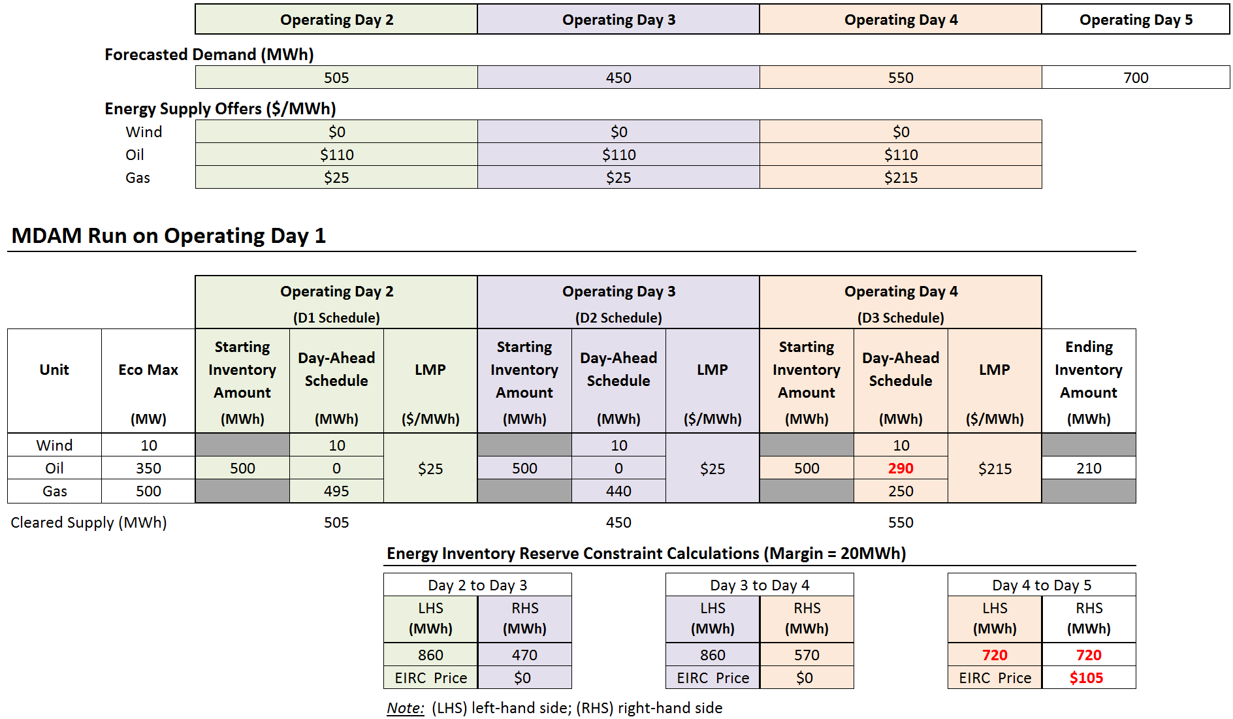
Table 1 – Day-Ahead Run on Operating Day 1

Slide 20
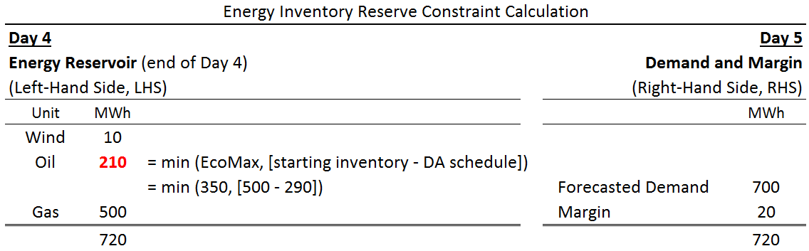
Table 1 - EIRC Function
In Table 1 the EIRC is binding between the Day 4 and Day 5 intervals
To satisfy that constraint while minimizing production costs, the MDAM
re-dispatched the stock unit (Oil) on Day 4
  On Day 4 the Oil unit is scheduled for 290MWh; less than it’s output at EcoMax, 350MWh
The EIRC price, in this simple example, is the lost opportunity cost of the oil unit (LMP – Oil unit offer price); $105/MWh
Current thinking: The Oil unit would be paid the EIRC price for 210MWh; this is the (minimum) amount is needed to satisfy the constraint for the Day 5 interval

Slide 21
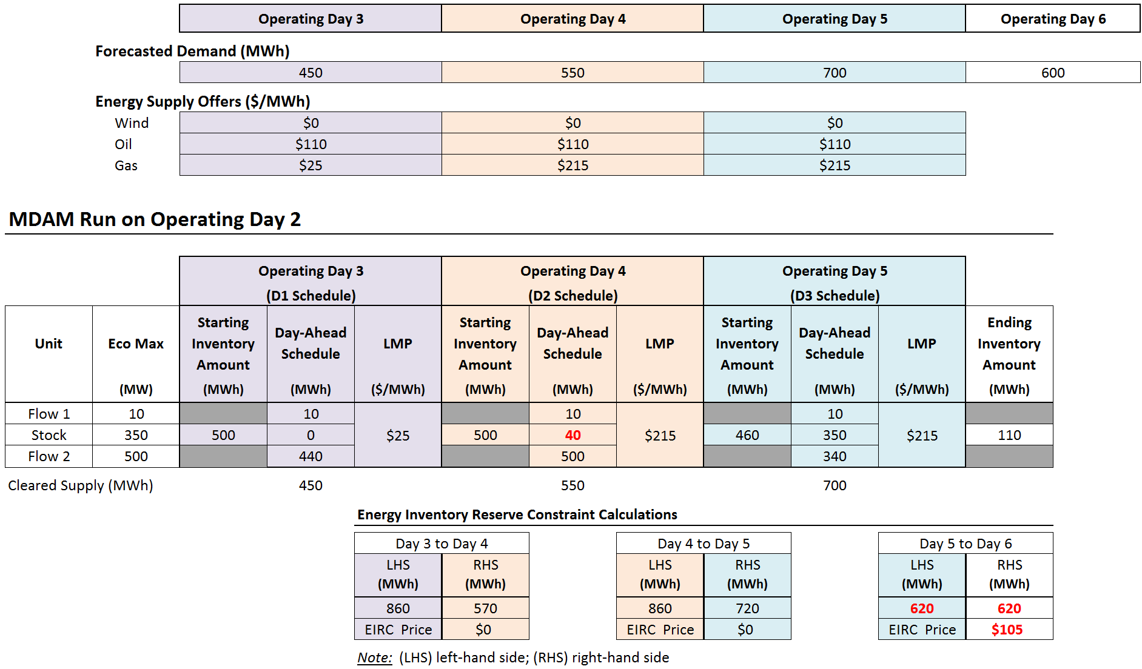
Table 2 – Day-Ahead Run on Operating Day 2

Slide 22

Table 2 - EIRC Calculations
In Table 2 the EIRC is now binding between the Day 5 and Day 6 intervals
To satisfy that constraint while minimizing production costs, the MDAM
re-dispatched the stock unit (Oil) on Day 4
  On Day 4 the Oil unit is (now) scheduled for 40MWh
The EIRC price is the lost opportunity cost of the Oil unit, $105/MWh
Current thinking: The Oil unit would be paid the EIRC price for 110MWh; this is the (minimum) amount is needed to satisfy the constraint for the Day 6 interval

Slide 23
Example Observations
Different intervals within the MDAM may have different LMPs
A binding EIRC in an interval would cause the MDAM to re-dispatch the system in prior intervals
  The constraint is satisfied by re-dispatching (holding down) stock supply in earlier intervals in exchange for EIRC compensation
Progressive clearing of the MDAM (day-to-day clearing) may push out the capability of stock supply

Slide 24
Stakeholder Schedule
Stakeholder Committee and Date | Scheduled Project Milestone
Markets Committee and Reliability Committee June 20, 2018 | Introduce challenges, drivers behind them, and frameworks for assessing problem and solutions
Markets Committee September 13, 2018 | Discuss design objectives, design principles and problem
Markets Committee October – December 2018 | Define problem and discuss conceptual approaches by the ISO and stakeholders
Markets Committee (other committees as needed) January – March 2019 | Discuss formal proposals by ISO and stakeholders, and analysis; draft Tariff changes distributed for March meeting
Markets Committee April 9, 2019 | Discuss final tariff language (including for amendments)
Markets Committee May 7, 2019 | Vote
Participants Committee June 7, 2019 | Vote

Slide 25
Appendix A: Energy and Reserve Co-optimization

Slide 26
Energy and Reserve Co-optimization Training
This proposal has many conceptual similarities to operating reserves, particularly co-optimization and system ‘re-dispatch’
For more information, see the ISO’s Energy and Reserve Co-optimization training module, part the ISO’s Intermediate Wholesale Electricity Markets (WEM 201) training course
  https://www.iso-ne.com/static-assets/documents/2018/11/2018f-wem201-05-energy-reserve-coopt-posted.pdf

Slide 27
Appendix B: Multi-Day Ahead Market (MDAM)

Slide 28
Conceptual Approach Elements
(from October Presentation)
Multi-Day Ahead Markets
  Optimizes limited energy inventories cost-effectively over the
  multi-day horizon
  Provides a forward price signal to replenish when prospective supplies are tight and influence consumption decisions
  Creates financially binding obligations for cleared quantities using the multi-day ahead clearing prices
  Should reduce (or eliminate) need for out-of-market posturing of resources for fuel

Slide 29
MDAM Description
The MDAM is an extension of the current day-ahead mechanism
The MDAM would be run every day and would clear a rolling, longer forward horizon
  MDAM market horizon – six days (144 hours)
  Aligns with ISO Operations’ current forward outlook
Each time the MDAM is run it would be using the latest bids, offers, etc.
  All inputs to the MDAM are updated to reflect any changes from the prior day
  The system is re-cleared each day and does not carry commitments over from one day to the next
Each day the MDAM would re-clear a portion of this rolling forward horizon
  The ‘prompt’ day rolls off, and one ‘out’ day is added

Slide 30
MDAM Specifications
No changes contemplated to the current bid/offer requirements regarding the prompt day (D1)
Participation in additional MDAM days (Days 2 – 6) would be voluntary
  Current thinking: being voluntary there would be no need for offer mitigation in these out days
Other notes on participation in Days 2 – 6
  Offers and bids may be different across the MDAM horizon
  All cleared quantities would be financially binding
  Virtual transactions (Increment Offers and Decrement Bids) would be allowed (possibly with lower NCPC charge risk)
Settlement would be based on day-to-day changes (akin to current day-ahead to real-time settlement

Slide 31
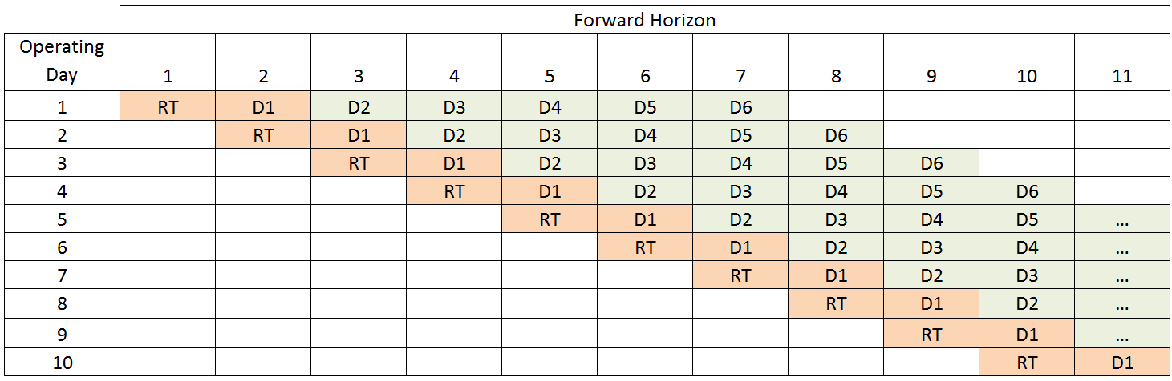
Visual of Multi-Day Ahead Market
The first column shows the Operating Days (going down)
In any given Operating Day, real-time again ‘starts’ with the last day-ahead schedule for that Operating Day (D1) – the prompt day-ahead schedule

