Slide 1
Energy Efficiency in Capacity Scarcity Condition Events
NEPOOL Markets Committee
March 5, 2019
Doug Hurley On behalf of Vermont Energy Investment Corp.

Slide 2
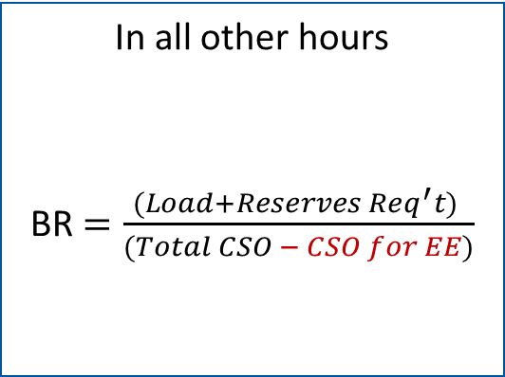
Summary of Proposed Change
During DR On Peak or Seasonal Peak hours
BR $=\frac{(Load+Reserves Req^{′}t) }{Total CSO}$
In all other hours
BR $=\frac{(Load+Reserves Req^{′}t) }{(Total CSO − CSO for EE)}$
Reminder: Load = Total ACP excluding RT Reserves, where ACP for EE is set to 0 during DR On Peak or Seasonal Peak hours
EE Resources remain in the “mutual insurance pool” for all scarcity events.
Approach only exists as long as DR On Peak and Seasonal Peak hours exist. If and when EE resources are subject in all hours, this change is revoked.
EE in Capacity Scarcity Conditions

Slide 3
Reminder from Nov - Feb
Current calculation of BR when Capacity Scarcity Conditions occur during DR On Peak or DR Seasonal Peak hours seems to work as expected
Current calculation of BR when these events occur outside of EE performance hours (e.g., Labor Day 2018) had unexpected results. EE resources are treated as if they had hit the stop-loss limits, and all resources suffer the consequence.
Original proposal had three components:
Primary component: Adjustment to Balancing Ratio
Associated changes to:
Actual Capacity Provided from EE
Share of charges or credits from over/under-collection (the “mutual insurance pool”)
Discussion with NEPOOL and ISO-NE has already led to numerous compromises and adjustments in the proposal. Proposal now has just one component: Adjustment to Balancing Ratio
EE in Capacity Scarcity Conditions

Slide 4
Framing the Issue
Not correct to refer to this as a “Settlement Shortfall caused by Energy Efficiency” that must be recovered from all resources
The issue is more correctly identified as “An Adjustment to the Balancing Ratio.” Current calculation deflates the Balancing Ratio in some hours by removing EE from the numerator but not from the denominator
Our proposal rectifies the current situation and the mutual insurance pool reverts to its original intent, to cover resources that reach stop-loss limits.
Without this change the mutual insurance pool triggers charges to all resources with a CSO during any scarcity condition that occurs outside of DR On Peak or Seasonal Peak hours, introducing uncertainty for all participants.
EE in Capacity Scarcity Conditions

Slide 5
Response to Feedback
Thank you to those participants who have offered thoughtful, considered feedback.
I understand that some participants are frustrated that EE resources are subject to PfP only during DR On Peak and Seasonal Peak hours.
This treatment is in direct compliance with the FERC order.
Cannot be changed until at least CP-15, and will be addressed later today in this meeting.
Our proposal is separate from addressing that issue. It would apply only if and as long as the FERC-ordered treatment exists.
As such, for the sake of the Committee and our Chairman, please refrain from comments on the Stage 2 proposal until that issue is raised later today.
This approach will not materially change total payment or penalty during an event. Examples provided.
EE in Capacity Scarcity Conditions

Slide 6
Proposed Change to Balancing Ratio
Current formula for Balancing Ratio during any interval is:
BR = (Load + Reserve Requirement) / Total CSO, where
Load = “the total amount of Actual Capacity Provided (excluding applicable Real-Time Reserve Designations) from all resources in the New England Control Area during the interval.”
Because the ACP for EE is set to zero in any interval outside of DR On Peak or Seasonal Peak hours, EE is excluded from the numerator, but not excluded from the denominator.
This approach artificially deflates the balancing ratio
Our proposal is to change “Total CSO” to “(Total CSO – EE CSO)” in the denominator for all intervals outside of DR On Peak or Seasonal Peak hours
Under our proposal, the BR for any interval would be calculated based upon those resources that are subject to payments or penalties in that interval, as the FERC order intended.
EE in Capacity Scarcity Conditions

Slide 7
Mutual Insurance Pool
Intent of this component of the PfP design was to issue a small credit to all resources with a CSO during any month with Capacity Scarcity Conditions wherein no resource has a significant stop-loss amount.
If a resource hits a stop-loss limit an under-collection would result. If large enough, a charge is applied pro-rata to all resources with CSO.
Proposed change to BR would result in under-collection only if a resource hits stop-loss limits, reverting the Mutual Insurance Pool to it’s original intent.
Proposal: EE included in the insurance pool. No change to the existing tariff language. All resources receive a credit during all “normal” events, and risk suffering a charge if a resource hits the stop-loss limit.
EE in Capacity Scarcity Conditions

Slide 8
Examples, p.1
Several participants requested examples that show only how their resources might be affected. The examples show total event payments to a hypothetical 100 MW resource on Labor Day under various approaches.
 | Current Rules |  | VEIC Proposal
Event ACP: | 100 MW | 10 MW | 100 MW | 10 MW
Capacity Performance Pay | $148k | $(332k) | $119k | $(361k)
Pool Credit / (Charge) | $(22k) | $(22k) | $5k | $5k
Total Event Pay | $126k | $(354k) | $124k | $(356k)
EE in Capacity Scarcity Conditions

Slide 9
Examples, p.2
Total event payments to a hypothetical 100 MW resource if EE is required to report in all hours, as NEPGA suggests for Stage 2. Various assumptions for EE performance to show potential variation.
 | NEPGA EE at Full CSO |  | NEPGA EE at 75% CSO |  | NEPGA EE at 0 MW
Event ACP: | 100 MW | 10 MW | 100 MW | 10 MW | 100 MW | 10 MW
Capacity Performance Pay | $111k | $(369k) | $120k | $(360k) | $148k | $(332k)
Pool Credit / (Charge) | $5k | $5k | $5k | $5k | $5k | $5k
Total Event Pay | $115k | $(365k) | $125k | $(355k) | $153k | $(327k)
Examples demonstrate that the long-term solution sought by NEPGA does not enact a material difference from either current rules or our proposal. As expected, if we assume EE at 75% (roughly the BR on Labor Day), the total event payment is nearly identical to current rules.
EE in Capacity Scarcity Conditions

Slide 10
Tariff Language
Parallel changes in subsections (b) and (c)
III.13.7.2.3 Capacity Balancing Ratio.
For each five-minute interval in which a Capacity Scarcity Condition exists, the ISO shall calculate a Capacity Balancing Ratio using the following formula:
(Load + Reserve Requirement) / Total Capacity Supply Obligation
(a) If the Capacity Scarcity Condition is a result of a violation of the Minimum Total Reserve Requirement such that the associated system-wide Reserve Constraint Penalty Factor pricing applies, then the terms used in the formula above shall be calculated as follows:
i. If the interval Load = the total amount of Actual Capacity Provided (excluding applicable Real-Time Reserve Designations) from all resources in the New England Control Area during the interval.
Reserve Requirement = the Minimum Total Reserve Requirement during the interval.
Total CSO =
For each interval that occurs during Demand Resource On Peak or Demand Resource Seasonal Peak Hours, the total amount of Capacity Supply Obligations in the New England Control Area during the interval.
For each interval that occurs outside of Demand Resource On Peak or Demand Resource Seasonal Peak Hours, the total amount of Capacity Supply Obligations in the New England Control Area during the interval excluding the Capacity Supply Obligations associated with Energy Efficiency measures.
EE in Capacity Scarcity Conditions

Slide 11
Comments on NEPGA Approach
NEPGA proposes a combination of two approaches. The second part requires that EE resources provide load reduction values in every hour of the year beginning with CP-14.
This issue is being referred to the DRWG to be resolved.
Our proposed approach would be enacted immediately, and would be effective only if and until EE resources are subject to penalties or payments in all hours.
NEPGA continues to repeat false justification that has already been debunked and dismissed. Resources consisting of both EE and non-EE assets are de minimus and no longer an impact. (NEPGA Stage 1 at Slide 2)
We agree that the current treatment violates cost causation principles, but the NEPGA approach only prolongs this error. Our approach rectifies it by correctly calculating the BR rather than creating a false “settlement imbalance” akin to a stop-loss that has not occurred, which is then distributed to all capacity resources.
EE in Capacity Scarcity Conditions

Slide 12
Comments on ISO-NE Memo
ISO-NE released a memo dated January 3, 2019. We agree that the status quo is inconsistent with cost-causation principles.
We disagree with the assessment that our proposal shifts the cost of a “shortfall” to non-EE resources. Instead, our proposal correctly applies the Balancing Ratio to all resources subject to PfP payments in each interval, whenever that interval occurs.
Status quo is contrary to the intent of the FERC order, and narrowly singles out one resource for guaranteed penalties.
The current implementation of the tariff guarantees that EE resources will always receive a charge during any event outside of EE performance hours. There is no opportunity to avoid this charge, and no opportunity to earn offsetting payments, regardless of actual EE performance.
Our proposal is simple and straightforward, and we hope it can be adopted quickly.
EE in Capacity Scarcity Conditions

Slide 13
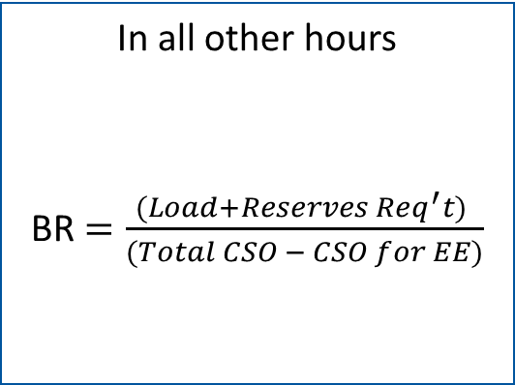
Summary of Proposed Change
During DR On Peak or Seasonal Peak hours
BR $=\frac{(Load+Reserves Req^{′}t) }{Total CSO}$
In all other hours
BR $=\frac{(Load+Reserves Req^{′}t) }{(Total CSO − CSO for EE)}$
Reminder: Load = Total ACP excluding RT Reserves, where ACP for EE is set to 0 during DR On Peak or Seasonal Peak hours
EE Resources remain in the “mutual insurance pool” for all scarcity events.
Approach only exists as long as DR On Peak and Seasonal Peak hours exist. If and when EE resources are subject in all hours, this change is revoked.
EE in Capacity Scarcity Conditions

Slide 14
Process
This amendment would replace the NEPGA motion in its entirety.
A vote in favor of the amendment would remove NEPGA’s proposed tariff changes, and replace them with the one change to the calculation of the Balancing Ratio.
Thank you for your support for this simple, effective change.
EE in Capacity Scarcity Conditions

Slide 15
Any confusion?
Guide dog in training Horace. February 2019. Photo Credit: Kerry Lemerise. Puppy Program Manager. Guiding Eyes for the Blind.
EE in Capacity Scarcity Conditions

