Slide 1
2019 Economic Study Request: Offshore Wind Integration
Planning Advisory Committee Meeting
April 25, 2019

Slide 2
Economic Study Request
Scenario Analysis
  Increasing levels of incremental offshore wind resources
Transmission Analysis
  High-Level Conceptual Transmission Overlays
  Transmission Upgrade Cost Estimates
  Various Points of Interconnection
Wholesale Market Impacts
  Energy, Capacity, Ancillary Services
  Prices and Air Emissions
  Ancillary Services Requirements

Slide 3
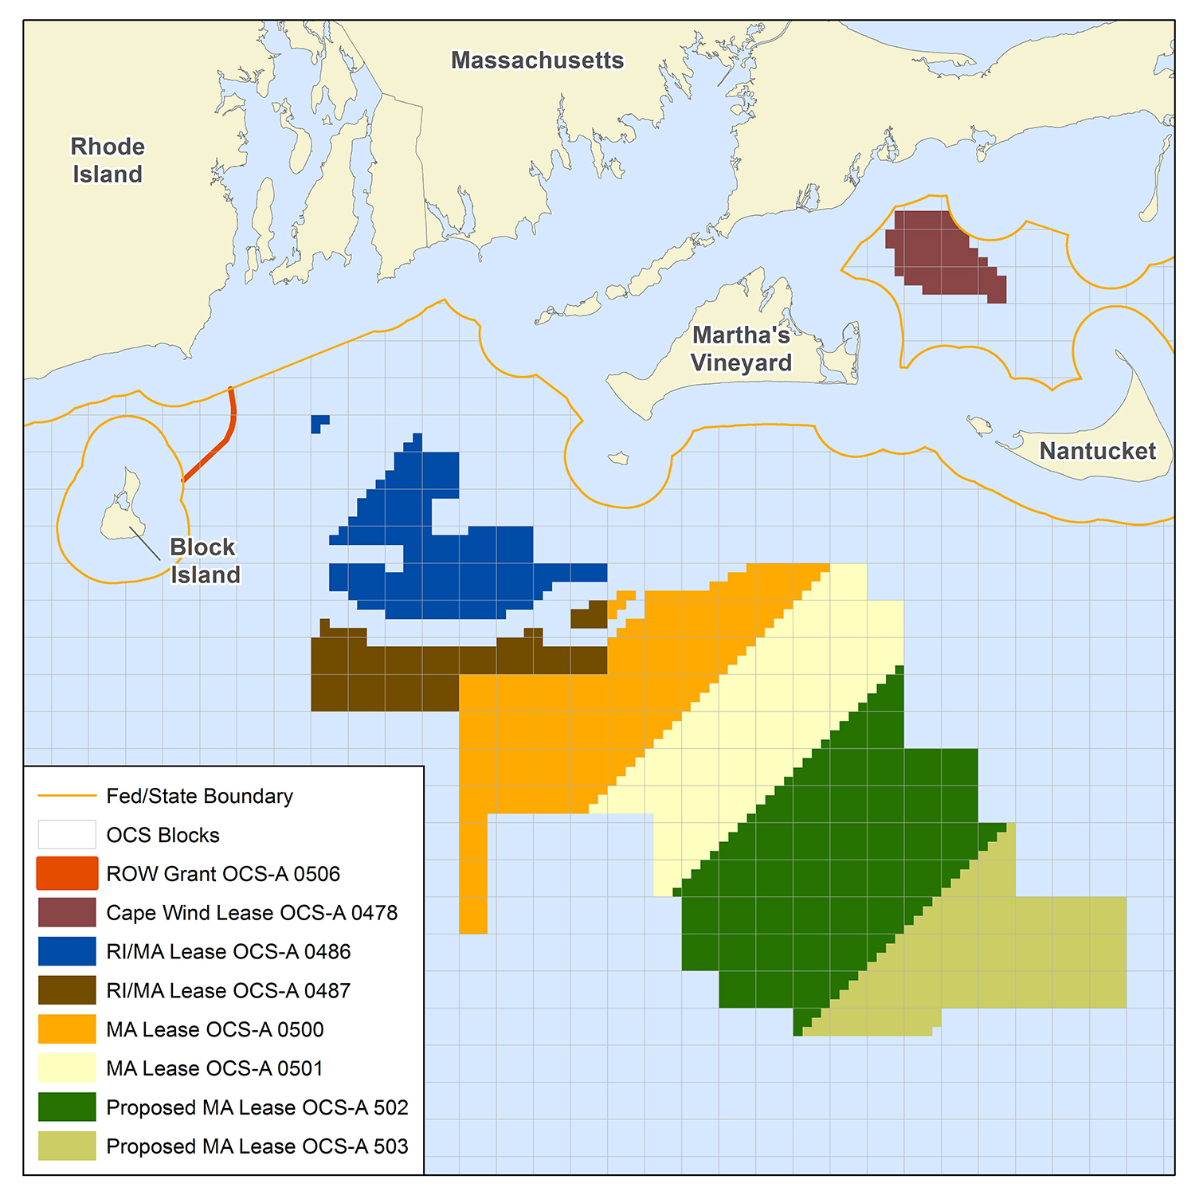
Scenarios Requested
MW of New Offshore Wind
By 2030 | 1,000
 | 2,000
 | 4,000
By 2035 | 5,000
 | 7,000
Primary location of new resources: MA or RI/MA Wind Energy Areas (WEA) on the outer Continental Shelf
Remaining amount of new offshore wind resources would be from a yet-to-be determined WEA in the Gulf of Maine

Slide 4
Transmission Analysis Request
Integrate new wind resources at different points of interconnection into New England and estimate transmission upgrade costs associated with these conceptual configurations
Consider all reasonable points of interconnection in New England, including the prospect of interconnecting southern WEAs north of Cape Cod

Slide 5
Examples of Transmission Analysis done in previous Economic Studies
2015 Economic Study: Evaluation of Offshore Wind Deployment
2009 Economic Study: New England 2030 Power System Study

Slide 6
Questions
NESCOE.com

