Slide 1
May 21, 2019|westborough, ma
2019 Economic Studies
Draft Scope of Work & High-Level Assumptions
Resource adequacy

Slide 2
Three Economic Study Requests Were Made in 2019
Three requests for an Economic Study were submitted to the ISO in 2019
Requests were submitted by the New England States Committee on Electricity (NESCOE), Anbaric Development Partners (Anbaric) and RENEW Northeast (Renew)
Presented to the PAC on April 25, 2019
The purpose of today’s presentation is to discuss draft scope of work and high-level assumptions for each of these requests
Requester | Purpose of request
NESCOE | Impacts on transmission system and wholesale market of increasing penetration of off-shore wind resources https://www.iso-ne.com/static-assets/documents/2019/04/a2_nescoe_2019_economic_study_request_presentation.pptx
Anbaric | Impacts on energy market prices, air emissions and regional fuel security of large penetration of off-shore wind resources https://www.iso-ne.com/static-assets/documents/2019/04/anbaric_2019_economic_study_request.pdf
Renew | Economic impact of conceptual increases in hourly operating limits on the Orrington-South interface from conceptual transmission upgrades https://www.iso-ne.com/static-assets/documents/2019/04/a2_renew_2019_economic_study_request_presentation.pdf

Slide 3
The 2019 NESCOE and Anbaric Scenarios Will Model Varying Degrees of Resource Expansions
NESCOE Year 2030 | Gross Demand | Energy Efficiency | Behind-the-Meter PV (Nameplate) | Utility Scale PV (Nameplate) | Supply (incl. Demand Resources) | Retirements | RFP Committed Generation | Off-Shore Wind Additions (Nameplate) | Demand from Heat Pumps | Demand/Supply from Electric Vehicles | Battery Storage Additions
NESCOE_2000 | Based on 2019 CELT Forecast |  |  |  | FCA 13 | FCA 13 and Mystic 8&9 | NECEC (1,090 MW of firm import) 1,000 MW of off-shore wind (nameplate)¹ | 1,000 MW | None | Some amount TBD | Some amount TBD
NESCOE_3000 |  |  |  |  |  |  |  | 2,000 MW
NESCOE_5000 |  |  |  |  |  |  |  | 4,000 MW
NESCOE_6000 |  |  |  |  |  |  |  | 5,000 MW | Some amount TBD
NESCOE_8000 |  |  |  |  |  |  |  | 7,000 MW
 | ¹ Includes Vineyard Wind (800 MW) and Revolution Wind (200 MW)
Anbaric Year 2030 | Gross Demand | Energy Efficiency | Behind-the-Meter PV (Nameplate) | Utility Scale PV (Nameplate) | Supply (incl. Demand Resources) | Retirements | RFP Committed Generation | Off-Shore Wind Additions (Nameplate) | Demand from Heat Pumps | Demand/Supply from Electric Vehicles | Battery Storage Additions
Anbaric_8000 | Based on 2019 CELT Forecast |  |  |  | FCA 13 | FCA 13, Mystic 8&9, 2,000 MW of nuclear generation, oil/coal units in CT & ME | NECEC (1,090 MW of firm import) 2,300 MW of off-shore wind (nameplate)² | 5,700 MW | None | None | 1,500 MW
Anbaric_10000 |  |  |  |  |  |  |  | 7,700 MW
Anbaric_12000 |  |  |  |  |  |  |  | 9,700 MW
Anbaric_Sens |  |  |  |  |  |  |  | One of the above scenarios | Some amount TBD | Some amount TBD
 | ² Includes 1,600 MW from Massachusetts RFPs, 300 from Connecticut RFPs and 400 from Rhode Island RFPs

Slide 4
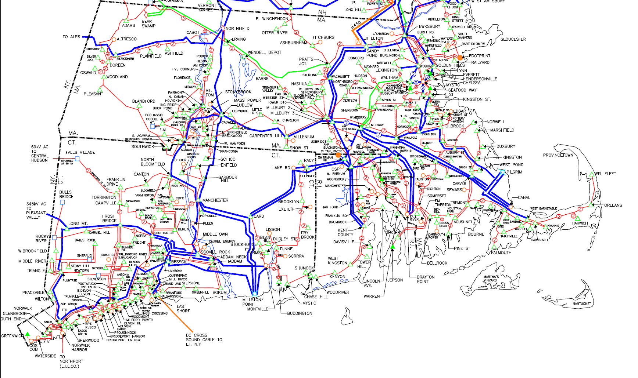
The 2019 NESCOE and Anbaric Scenarios Will Model Different Transmission Expansion Options
The transmission system will be modeled using 2030 internal transmission-interface transfer capabilities
Based on the currently expected transmission system for 2030, the ISO anticipates that the following levels of off-shore wind additions (approximately 7,000 MW) have the potential to avoid major additional 345 kV reinforcements*
This assumes FCA 13 retirements have occurred, including the retirement of Mystic 8 & 9
Possible off-shore wind additions* (MW and location)
*Some 345 kV reinforcement/expansion
may still be needed for this scenario.
This anticipation is preliminary
(system impact studies have
not been completed for all of these MW).
This anticipates minimal interconnection
at nameplate levels and capacity
interconnection at intermittent capacity
values – does not anticipate all of the
MW being able to run simultaneously
at nameplate levels.
Mystic (MA): 1,200 MW
Bourne/Canal/Pilgrim (MA): 2,400 MW
Brayton Point (MA): 1,600 MW
Montville (CT): 800 MW
Kent County/Davisville (RI): 1,000 MW

Slide 5
The 2019 NESCOE and Anbaric Scenarios Will Model Varying Degrees of Transmission Expansions, cont.
Additional off-shore wind additions beyond those shown on the prior slide would require:
For additional large units to be assumed retired and the new injections to replace those retirements; and/or
Potential significant transmission reinforcements, as shown below
The ISO will have to assess the level of injections that such transmission reinforcements would allow
Direct injection into K Street
345 kV reinforcements from the Cape to Stoughton/K. Street
345 kV reinforcements from Brayton Point to Millbury/West Medway/West Walpole
345 kV reinforcements between Montville and Kent County

Slide 6
The 2019 Renew Scenarios Will Model Varying Degrees of Increases in Orrington South
Renew Year 2025 | Gross Demand | Energy Efficiency | Behind-the- Meter PV (Nameplate) | Utility Scale PV (Nameplate) | Supply (incl. Demand Resources) | Retirements | RFP Committed Generation | Off-Shore Wind Additions (Nameplate) | Demand from Heat Pumps | Demand/Supply from Electric Vehicles | Battery Storage Additions
Renew_Base | Based on 2019 CELT Forecast |  |  |  | FCA 13 | FCA 13 and Mystic 8&9 | NECEC (1,090 MW of firm import) 1,200 MW of off-shore wind (Nameplate)³ 100 MW PV in Maine | None
 | ³ Includes Vineyard Wind (800 MW) and Revolution Wind (400 MW)
The transmission system will be modeled using 2025 internal interface transfer capabilities, with the exception of the Orrington-South interface
The base scenario will assume modified 2016 raw operating limits, as provided by Renew
Scenarios 1 and 2 will assume increases in operating limits
In scenario 1, the increase in operating limits requested by Renew ranges from 0 to 170 MW from the assumed modified 2016 raw operating limits
In scenario 2, the increase in operating limits requested by Renew ranges from 100 to 825 MW from the assumed modified 2016 raw operating limits
The analysis will be performed in two ways: with and without the interfaces downstream of Orrington-South being modeled at the limits projected for 2025

Slide 7
Draft Common Assumptions For All Three Requests
FCM and energy-only generators will be modeled at their Seasonal Claimed Capability
These capabilities will be reduced to reflect potential forced outages
All other demand and supply variables will be modeled through the use of specific profiles, as discussed on the following slides
For each scenario, an assessment will be performed to confirm that the anticipated Net Installed Capacity Requirement (NICR) will be met
The NICR will be derived using the expected reserve margin from the 2028 representative Installed Capacity Requirement
If additional supply is needed, a representative Natural Gas Combined Cycle will be added; in scenarios with larger amounts of retirements (Anbaric), the amount of retirements will be reduced until the NICR is met
Fuel prices for coal, oil, and natural gas will be based on recent forecasts from the Energy Information Administration (EIA) for New England
Emission allowance prices for carbon dioxide, sulfur dioxide and nitrogen oxide will be reflected for fossil-burning generation units
The ISO will review the need to update the assumptions used in the most recent Economic Studies

Slide 8
Draft Common Profiles To Be Considered in All Three Requests
The reconstituted (gross) load shape for the year 2015 will be used in all scenarios
Scaled to reflect both Summer and Winter gross peaks for the years 2025 and 2030 as applicable
Adjusted to reflect behind-the-meter resources: behind-the-meter photovoltaic (BTM PV) and energy efficiency (EE) resources
Off-shore, on-shore wind, and photovoltaic profiles that are compatible with the 2015 load shape will be developed
Develop specific hourly profiles for the year 2015 using data from the National Renewable Energy Laboratory (NREL) and/or the National Aeronautics and Space Administration (NASA)
External energy delivery transfers (imports) on existing external ties will be modeled using historical diurnal profiles, averaged over the last three years (2016 through 2018)
A profile for local New England hydroelectric generation (hydros) will be developed that shifts their energy production to the higher net load hours

Slide 9
Draft Common Profiles To Be Considered in All Three Requests, cont.
Plug-in hybrid electric vehicles (PHEVs) profiles will be developed to model vehicles charging at night
The ISO will review the possibility to model some charging during the day time
A profile for the charge and discharge of storage facilities will be designed to flatten the net load profile after all other profiles have been accounted for (BTM and non-BTM PV, wind, imports, hydro, and PHEVs)
The ISO will review the need to differentiate between storage from batteries and storage from pumped-storage facilities
For scenarios/sensitivities with additional electric demand from heat pumps, profiles may be developed to model the behavior of the heat pumps

Slide 10
Threshold Prices Will Be Used to Decrease Production of $0/MWh Resources When There is Oversupply in All Three Requests
The 2019 study will use similar threshold prices as have been used in prior Economic Studies (2016 and 2017), with two adjustments:
The behind-the-meter PV and utility scale PV will now be differentiated
A threshold price will be added to account for the firm energy delivery from the NECEC tie
These threshold prices are used to facilitate the analysis of load levels where the amount of $0/MWh resources exceeds the system load
They are not indicative of “true” cost, expected bidding behavior or the preference for one type of resource over an other
Price-Taking Resource | Threshold Price ($/MWh)
Behind-the-Meter PV | 1
NECEC (1090 MW) | 2
Utility Scale PV | 3
Onshore/Offshore Wind | 4
New England Hydro | 4.5
Imports from QC (Highgate & Ph. II) | 5
Imports from NB | 10

Slide 11
The 2019 Study Will Generally Produce Similar Metrics to Those Produced in Prior Studies
 | NESCOE | Anbaric | Renew
Economic results
Systemwide production costs | X | X | X
Average locational marginal prices | X | X | X (zonal)
Load-serving entity energy expenses | X | X | X (zonal)
Congestion | X | X | X
Relative annual resource cost | X | X
Wholesale energy market revenues and contributions to annual fixed costs | X | X
Resource results
Total energy production by resource/fuel type | X | X | X (zonal)
Approximate gas and oil consumption of electric generating units |  | X | X
Operable capacity analysis on representative summer and winter days |  | X
Transmission results
Interface flow duration curves | X | X | X
Interface flows on representative summer and winter days | X | X
Percent of hours interface flows exceed 100% of ratings | X | X
Cost estimates for transmission expansions | X | X
Environmental results
Emissions (CO₂, NO_{x}, SO₂) | X | X | X
Total spilled renewable resource energy | X | X | X

Slide 12
Next Steps of the 2019 Economic Studies
Study process for each request
Finalize detailed assumptions based on preliminary analysis
Targeted for July/August
Present draft results
Present final results and draft report
Post final report
The ISO will attempt to complete all 2019 requests by Q2 of 2020
The ISO plans on conducting all three Economic Studies
NESCOE’s request will be handled by starting with the maximum amount of offshore wind (8,000 MW) and finishing with the minimum amount (2,000 MW)
Anbaric’s request will be handled by starting with the minimum amount of offshore wind (8,000 MW) and finishing with the maximum amount (12,000 MW)
Renew’s request will be handled in parallel to NESCOE’s and Anbaric’s requests

