Slide 1
July 30, 2019| Markets committee
ENERGY SECURITY IMPROVEMENTS: MARKET-BASED APPROACHES
Discussion of a market-based solution to improve energy security in the region
Andrew Gillespie
413.540.4088 | agillespie@iso-ne.com

Slide 2
Winter Energy Security Improvements
WMPP ID:
125
Proposed Effective Date: Mid 2024
In accordance with FERC’s July 2, 2018 order in EL18-182-000, the ISO must develop and file improvements to its market design to better address regional fuel security, and file by October 15, 2019
Key Projects – Energy-Security Improvements
Discussion paper 2019-04-09 and 2019-04-10 MC A00 ISO Discussion Paper on Energy Security Improvements – Version 1
Prior Energy-Security Improvement presentations:
July ESI presentation
June ESI presentation
May ESI presentation
April ESI presentation

Slide 3
Today’s Presentation Agenda
Discuss the following design aspects and address broad questions from prior presentations:
EIR & RER awards
EIR cost allocation
Import resource eligibility
Notes:
The use of the term ‘unit’ throughout is meant generically (a.k.a., resource, asset, etc.)
For brevity, energy call option awards to satisfy a given ancillary service requirement are referred to as awards (e.g., a option to meet a GCR requirement is labeled a GCR award, to meet the forecast energy requirement an EIR award, etc.)

Slide 4
Design Overview & design objectives and principles

Slide 5
Three Conceptual Components
Slide 6: April ESI presentation
Multi-day ahead market. Expand the current one-day-ahead market into a multi-day ahead market, optimizing energy (including stored fuel energy) over a multi-day timeframe and producing multi-day clearing prices for market participants’ energy obligations
New ancillary services in the day-ahead market. Create several new, voluntary ancillary services in the day-ahead market that provide, and compensate for, the flexibility of energy ‘on demand’ to manage uncertainties each operating day
Seasonal forward market. Conduct a voluntary, competitive forward auction that provides asset owners with both the incentive, and necessary compensation, to invest in supplemental supply arrangements for the coming winter

Slide 6
Design Objectives for a Market-Based Solution
Slide 46: April ESI presentation
Risk Reduction. Minimize the heightened risk of unserved electricity demand during New England’s cold winter conditions by solving Problems 1, 2, and 3
Cost Effectiveness. Efficiently use the region’s existing assets and infrastructure to achieve this risk reduction in the most cost-effective way possible
Innovation. Provide clear incentives for all capable resources, including new resources and technologies that can reduce this risk effectively over the long term

Slide 7
Design Principles for a Market-Based Solution
Slide 47: April ESI presentation
Product definitions should be specific, simple, and uniform. The same well-defined product or service should be rewarded, regardless of the technology used to deliver it
Transparently price the desired service. A resource providing an essential reliability service (for instance, a call on its energy on short notice) should be compensated at a transparent price for that service
Reward outputs, not inputs. Paying for obligations to deliver the output that a reliable system requires creates a level playing field for competitors that deliver energy reliably through cold-weather conditions
Sound forward markets require sound spot markets. Forward-market procurements work well when they settle against a transparent spot price for delivering the same underlying service
Compensate all resources that provide the desired service similarly.

Slide 8
Categories of New Day-Ahead Ancillary Services
Slide 10: June ESI presentation
Procure an energy call option in the Day-Ahead Energy Market (co-optimized with clearing energy schedules) to provide three new ancillary services corresponding to the three operational categories previously discussed*
Generation Contingency Reserves (GCR) – A day-ahead means to assure operating reserve energy
Replacement Energy Reserves (RER) – A day-ahead means to assure replacement energy
Energy Imbalance Reserves (EIR) – A day-ahead means to assure energy to cover the load-balance gap
Combined, these provide the ‘margin for uncertainty’ in an increasingly energy-limited system
* See slides 15-18 of May ESI presentation: Covering the Energy Gap

Slide 9
The forecast energy requirement (FER) and Energy imbalance reserve (EIR)

Slide 10
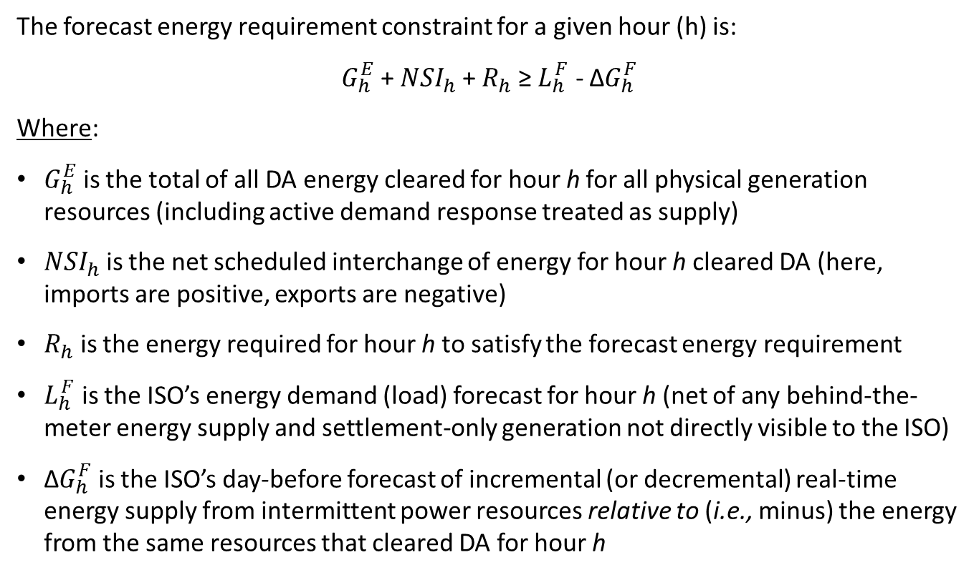
Forecast Energy Requirement Constraint
Slide 18: July 8-10 ESI presentation
The forecast energy requirement constraint for a given hour (h) is:
$G_{h}^{E}$ + ${NSI}_{h}^{ }$ + $R_{h}^{ }$ ≥ $L_{h}^{ F}$ - ${\text{Δ}G}_{h}^{F}$
Where:
$G_{h}^{E}$ is the total of all DA energy cleared for hour h for all physical generation resources (including active demand response treated as supply)
${NSI}_{h}^{ }$ is the net scheduled interchange of energy for hour h cleared DA (here, imports are positive, exports are negative)
$R_{h}^{ }$ is the energy required for hour h to satisfy the forecast energy requirement
$L_{h}^{ F}$ is the ISO’s energy demand (load) forecast for hour h (net of any behind-the-meter energy supply and settlement-only generation not directly visible to the ISO)
${\text{Δ}G}_{h}^{F}$ is the ISO’s day-before forecast of incremental (or decremental) real-time energy supply from intermittent power resources relative to (i.e., minus) the energy from the same resources that cleared DA for hour h

Slide 11
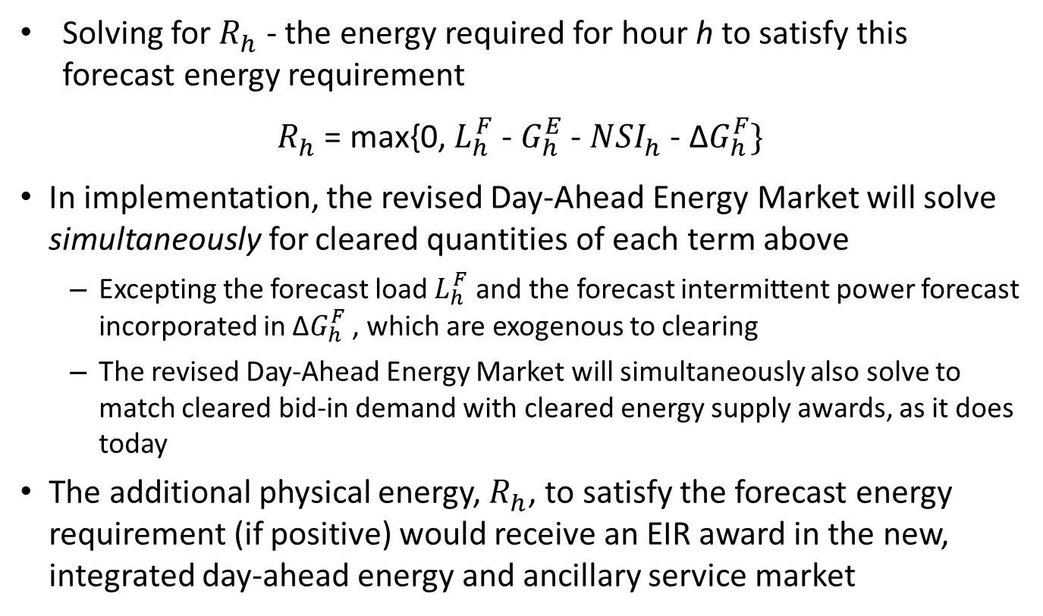
EIR Requirement
Slide 19: July 8-10 ESI presentation
Solving for $R_{h}^{ }$ - the energy required for hour h to satisfy this forecast energy requirement
$R_{h}^{ }$ = max{0, $L_{h}^{ F}$ - $G_{h}^{E}$ - ${NSI}_{h}^{ }$ - ${\text{Δ}G}_{h}^{F}$}
In implementation, the revised Day-Ahead Energy Market will solve simultaneously for cleared quantities of each term above
Excepting the forecast load $L_{h}^{ F}$ and the forecast intermittent power forecast incorporated in ${\text{Δ}G}_{h}^{F}$ , which are exogenous to clearing
The revised Day-Ahead Energy Market will simultaneously also solve to match cleared bid-in demand with cleared energy supply awards, as it does today
The additional physical energy, $R_{h}^{ }$, to satisfy the forecast energy requirement (if positive) would receive an EIR award in the new, integrated day-ahead energy and ancillary service market

Slide 12
EIR Awards
A unit’s energy call option awards to satisfy the forecast energy requirement (a.k.a. EIR awards), and its day-ahead energy schedule, will jointly satisfy the unit’s (physical) supply offer parameters
The sum of any EIR option award and any day-ahead energy schedule within the same hour will be at least equal to the unit’s Economic Minimum, and not greater than unit’s Economic Maximum
Day-ahead energy and EIR awards across hours of the operating day will satisfy the unit’s Minimum Run Time (MRT), and will satisfy its Minimum Down Time (MDT)
Recall: The day-ahead co-optimization, in finding the most economic day-ahead solution, may award a unit that offers both energy and energy options:
A day-ahead energy schedule only,
An EIR award/schedule only,
Both (for some or all hours), or none

Slide 13
Stakeholder Question
Is it correct to think that resources with an EIR award should expect to be committed to meet the forecast for the next day?
Yes. A unit with an EIR option awarded to meet the day-ahead forecast energy requirement should expect to receive a commitment instruction, which would be consistent with its start-up and notification times.
But it might not always be committed, if it has only an EIR option award (that is, if it has no day-ahead energy schedule).
More on the following slide.

Slide 14
EIR Awards vs. Commitment Instructions
Remember, the market clearing objective is to maximize social surplus
Meaning: if an EIR award is made, and the award is comparable to an energy award (in the sense it honors EcoMin, EcoMax, MRT, MDT, etc.) it means that this EIR award was the most efficient means to meet the Forecast Energy Requirement day-ahead
And by deduction, the EIR award was a more efficient (i.e., cost-effective) solution than buying energy from that same unit
However, a unit with an EIR award will not ‘automatically’ be issued a commitment instruction
Units can (and do) re-offer energy supply offer prices after the day-ahead market
Energy from this unit may not necessarily be needed, or be the most efficient solution, to satisfy actual load during the operating day
Continued on next slide

Slide 15
Forecast Energy Requirement – Notes
The forecast energy requirement (FER) constraint is used in the Reserve Adequacy Analysis (RAA) process today, and this constraint is being brought into the Day-Ahead Energy Market clearing process
The entire RAA process is not being brought into the Day-Ahead Energy Market
The RAA process will, like today, determine which unit(s) among those without a day-ahead energy schedule, will be the most economical to commit (if any) to meet the (latest) forecast energy requirement
Based on the latest supply offer data on record at that time (i.e., based on all unit re-offers)

Slide 16
Replacement Energy reserve (RER)

Slide 17
Stakeholder Question
Will a unit’s options awarded for RER, and for both options and energy generally, respect a unit’s physical parameters?
This is discussed further in the following slides.

Slide 18
Distinction Between EIR and GCR/RER Awards
The forecast energy requirement is not like the operating reserve requirements
The forecast energy requirement relates to the energy constraint
The operating reserve requirements relate to needed ancillary services
EIR awards are unlike GCR/RER awards in the sense that:
EIR awards apply to the known and needed energy quantity
The real-time analog is energy to meet demand
GCR/RER awards apply to the energy that might be needed to recovery and restore the system if a major contingency (or other unforeseen event) were to occur
The real-time analog are the operating reserves

Slide 19
RER Awards
Energy call option awards to satisfy the RER requirement (a.k.a. RER awards), in combination with energy, would not exceed a unit’s physical capabilities
The sum of any option award and any day-ahead energy schedule within the same hour will be at least equal to the unit’s Economic Minimum, but not greater than unit’s Economic Maximum
However, RER awards specifically may not necessarily satisfy a unit’s Minimum Run Time (more on next slide)
RER awards will satisfy all other parameters (including Minimum Down Time, EcoMax, etc.)

Slide 20
Hourly RER Awards – Notes
Day-ahead RER awards are to set-up the system to withstand the 1st largest contingency (recover energy imbalance and restore contingency reserves) should it occur in any hour
This is done by basing hourly awards (for both GCR and RER) on the 1st largest contingency were to occur in hour 1, or
If the 1st largest contingency were to occur in hour 2, or
If the 1st largest contingency were to occur in hour 3, or
…
If the 1st largest contingency were to occur in hour 24
In day-ahead we are preparing for any one of 24 possible real-time scenarios

Slide 21
Hourly RER Awards – Feedback
Current thinking: Why the Minimum Run Time (MRT) isn't honored
This would effect a unit with a MRT greater than one hour, that across a span of hours, day-ahead, has no energy award/schedule but, for example, clears in one of those hours an RER award
Incorporating the MRT has significant technical implications that require further assessment
However, the benefit of honoring the MRT for RER awards is unclear
The ISO would appreciate stakeholder input and feedback on this aspect

Slide 22
Energy imbalance reserve (eir) cost allocation

Slide 23
EIR Cost Allocation
Allocated to negative deviations (INCs and load) are the option costs, including any associated close-out, incurred to meet the forecast energy requirement (i.e., EIR awards)
Concept: allocate costs based on the EIR clearing price
INCs are allocated part of the cost
Realized negative load deviations are allocated part of the cost – and any imbalance would be allocated to Real Time Load Obligation (RTLO) – see example on next slide

Slide 24
Mechanics
Recall the cost allocation example in the July 8-10 ESI presentation (First Step case, slide 82)
The cost incurred for the EIR awards due to day-ahead demand being 20MWh less the forecast energy amount was $110.80 = 20MWh x $5.54/MWh (slide 82)
Case A: The negative realized load deviation is 20MWh
Cost allocated to deviations = 20MWh x $5.54/MWh = $110.80
Case B: The negative realized load deviation is smaller, 10MWh
Cost allocated to deviations = 10MWh x $5.54/MWh = $55.40
Cost allocated to RTLO = 10MWh x $5.54/MWh = $55.40
Case C: The negative realized load deviation is larger, 30MWh
Cost allocated to deviations = 30MWh x $5.54/MWh = $166.20
Cost allocated to RTLO = (10MWh) x $5.54/MWh = ($55.40) – a credit

Slide 25
Import resource eligibility

Slide 26
Import Eligibility for EIR Awards
The co-optimized day-ahead market clearing is intended to achieve a reliable next-day operation plan through the markets
Presently: The ISO relies upon cleared day-ahead energy imports in its next-day operating plan, and in the RAA, to meet the forecast energy requirement
See the forecast energy requirement formula on slide 10
Consistent with that practice, we propose to allow imports across external interfaces to offer and to receive (if economic) day-ahead EIR awards to meet the forecast energy requirement

Slide 27
Import Eligibility for GCR and RER
Current thinking: Imports across external interfaces would not be awarded GCR or RER in the day-ahead market
Recall: EIR is unlike GCR/RER in the sense that:
The forecast energy requirement relates to the (day-ahead) forecast
GCR/RER awards apply to the energy that might be needed to respond and restore the system if a major contingency were to occur
Balancing Authorities are not expected to rely on other areas’ operating capacity for reserves (to respond and to recover) as part of their Operating Plans
Ex: NPCC standards (Sec. 5.9) indicate a Balancing Authority should provide its reserves using resources within its Balancing Area

Slide 28
Next steps

Slide 29
Stakeholder Schedule
Stakeholder Committee and Date | Scheduled Project Milestone
Markets Committee March 5-6, April 9-10, April 23, May 7-8, June 10-12, July 8-10, 2019 | See previous ISO presentations for scheduled project milestones
Markets Committee July 30, 2019 | Continued discussion of ISO proposal; Continued discussion of impact analysis: mechanics, assumptions, and outputs of the production cost model as well as scenarios being evaluated and preliminary results
Markets Committee August 13-14-15, 2019 | Continued discussion of ISO and stakeholder proposals and review of ISO draft Tariff language; Impact analysis results; Initial discussion of seasonal forward component
Markets Committee September 4, 2019 | Final draft ISO Tariff language and wrap-up; Final draft stakeholder amendments/ associated Tariff language
Markets Committee September 18-19, 2019 | Final review of proposed Tariff language (ISO proposal and proposed stakeholder amendment(s)); Vote on ISO proposed Tariff language and submitted stakeholder amendments
Participants Committee October 4, 2019 | Vote on ISO proposed Tariff language and submitted stakeholder amendments

