Slide 1
august 21, 2019 | WESTBOROUGH, MA
Interconnection Reliability Operating Limit Critical Infrastructure Protection Cost Recovery
Jonathan Lowell
(413) 540-4658 | jlowell@iso-ne.com

Slide 2
Interconnection Reliability Operating Limit (IROL) Critical Infrastructure Protection (CIP) Cost Recovery
Proposed Effective Date: January 1, 2020
Generators designated by the ISO as “critical” to the determination of Interconnection Reliability Operating Limits (IROL) must meet higher North American Electric Reliability Corporation (NERC) Critical Infrastructure Protection (CIP) standards than “non-critical” generators
These costs cannot be competitively offered and recovered through the energy and capacity markets
ISO is proposing a new tariff mechanism to allow “IROL-critical” generators and similarly-situated transmission facilities to recover costs approved by FERC
Today’s discussion
Changes in the proposal to strike a balance between concerns expressed by stakeholders and features necessary to ensure a successful ISO implementation

Slide 3
Cost recovery framework
Pre-filing reviews, Section 205 filings, FERC orders, and filing flexibility enhancements

Slide 4
ISO’s design goals for IROL-CIP compensation, based on stakeholder feedback received
New - 8/21/19
TC Meeting
Reduce the time and expense involved to prepare and review the CIP cost filings
Provide some timing flexibility to mitigate the need for reviews and filings every year
Provide guidance on cost identification and categorization
Facilitate standardization of filings to simplify review and future CIP compliance cost updates
Allow for differences in how different facilities identify and track incurred costs
Emulate a “formula rate” construct as much as possible
Avoid the need for reconciliation and true-up procedures
Ensure regulatory acceptance of costs to be recovered prior to initiation of ISO billing
Approved costs recovered over a simple, clearly defined period

Slide 5
High level outline of revised IROL-CIP cost recovery filings
Updated - 8/21/19
TC Meeting
ISO makes a 205 filing to implement a new Schedule 17 for incremental CIP cost recovery. Schedule 17 will include:
Provisions for ISO’s role as billing and collection agent for IROL-CIP Costs
Eligibility conditions for Schedule 17 compensation including:
pre-filing review process
Section 205 FERC filing using standardized cost categories
Cost allocation
Cost summary template with standardized categories
IROL-critical facility cost recovery filings - summary of steps:
Provide an initial draft 205 filing to the ISO for posting on the ISO web site
ISO sends “new content” notification email to anyone self-subscribed to a Schedule 17 notification list
The facility manages a pre-filing review process with interested parties requesting to participate
The facility submits a finalized Section 205 filing to FERC
Following a notice period, FERC issues an order indicating the costs approved for recovery
Facility notifies ISO of the FERC order
ISO commences billing of the approved costs in 12 equal monthly installments

Slide 6
Schedule 17 Eligibility Requirements
Updated - 8/21/19
TC Meeting
To be eligible for compensation under Schedule 17, the facility’s Section 205 filing to FERC would need to include, at a minimum:
The “direct cost” categories identified in the Schedule 17 cost summary template
“Direct costs” are those expenditures necessary to comply with the NERC CIP medium impact standards
A designated facility may add cost categories, as necessary, to the Schedule 17 cost summary template to reflect costs that do not fit into the ISO-identified categories
Of course, additions would need to be described in sufficient detail to allow for FERC to accept or reject their inclusion

Slide 7
Pre-filing review requirements
New - 8/21/19
TC Meeting
Initial draft 205 filing posted on ISO website with notification to NEPOOL Participants, NESCOE and subscriber list
Webex-style and/or in-person briefing provided for parties requesting to participate in the pre-filing review
At least 15 days after draft posting on ISO website
Review process
Developed by the IROL-critical facility to be responsive to interested party concerns
Communication and logistics managed by the IROL-critical facility owner
At least 60 days, with opportunities for interested parties to request additional information and clarification

Slide 8
Section 205 cost recovery filing
New - 8/21/19
TC Meeting
Includes only actual incurred costs (no forecast or projected costs) for a historical period defined by the facility
Avoids the additional complexity of a reconciliation or true-up process
Eliminates the need to administratively allocate common costs to individual units
Schedule 17 will include a standardized cost template that identifies CIP compliance direct cost categories, as well as “Other” costs
No need to segregate costs into “recurring” or “non-recurring” categories, as was originally proposed
Limiting recovery to costs already incurred also simplifies treatment of retirements and ISO “undesignation” of facilities
Facilities no longer designated as IROL-critical may still file to seek compensation of costs incurred while designated, but not-yet-recovered
205 filings may be made at a time convenient to the facility
May occur at intervals 12 months or greater
Not tied to calendar years or any specific starting period month
Flexible timing will reduce the risk of “filing pileups” at year end
A filing’s defined period may not overlap with defined periods of prior or subsequent 205 filings
May include more or less than 12 months

Slide 9
What happens after FERC approval of costs for recovery?
New - 8/21/19
TC Meeting
IROL-critical facility notifies the ISO and provides the order and the approved amount.
ISO initiates the billing process in the following month
Approved costs are billed (payments and charges) over 12 months in 12 equal monthly amounts
Billing period is always 12 months, regardless of the period over which costs were incurred
Billing continues for full 12 months, even if the facility is no longer designated as IROL-critical
The 24-month and 36-month amortization periods have been eliminated
Additional compliance costs incurred after the 205 filing’s defined period would be included in a subsequent 205 filing

Slide 10
ISO proposal seeks to balance the feedback and concerns expressed by stakeholders in previous discussions
Modified - 8/21/19
TC Meeting
Schedule 17 eligibility requirements attempt to encourage a measure of standardization in facilities’ 205 filings
Pre-filing review encourages uncontested FERC filing
Provides a definitive outcome/order that ISO can rely on for billing
Standardized cost template will make subsequent 205 filings easier to contrast and compare during the pre-filing review
Filing prep and cost review is facilitated because no projections, forecasts or estimates are required. Actual costs can be more easily identified with specificity and precision
The need to reconcile forecasts with actuals is eliminated
Timing flexibility allows filings to occur at irregular intervals that are less frequent than annual

Slide 11
Iso recommendation on cost allocation

Slide 12
Cost Allocation - Key Points from March TC Meeting
Restated from
3/27/19 TC Meeting
NERC “medium impact” CIP standards that IROL-critical facilities must meet apply to a very limited set of resources:
Enhances reliable operation of the grid, but does not directly benefit the facility itself
Provides no competitive advantage
Cannot be minimized or avoided by actions under the facility’s control
Since non-designated facilities need only meet “low impact” requirements, IROL-designated facilities cannot recover “medium impact” costs through competitive markets
Accurate IROLs allow the ISO to maximize reliable utilization of the transmission system
Beneficiary Pays is the most relevant allocation principle
Users of the transmission system, i.e. transmission customers, are the beneficiaries of a reliable, maximized transmission grid
Transmission system usage in this context can best be measured by Monthly Regional Network Load and monthly average Through or Out Service
Incremental CIP compliance costs are not a transmission cost, but it is correct and efficient to allocate these costs to transmission customers as beneficiaries
Charges for incremental CIP compliance costs will be clearly labeled and separately identified on ISO customers’ Monthly Non-Hourly Charges statements.

Slide 13
Proposed schedule 17 tariff language

Slide 14
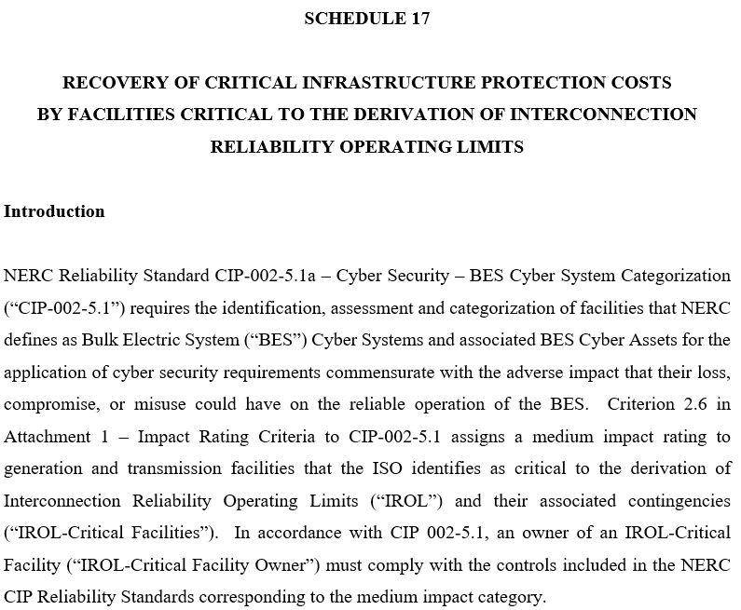
Schedule 17 - Introduction

Slide 15
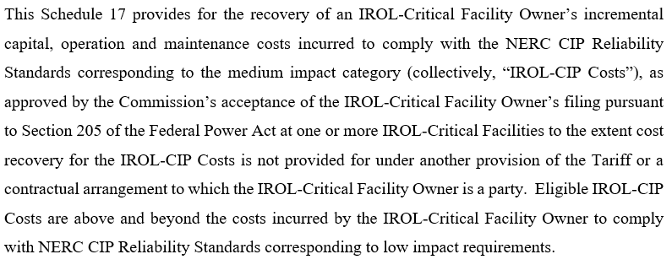
Schedule 17 – Introduction (continued)

Slide 16
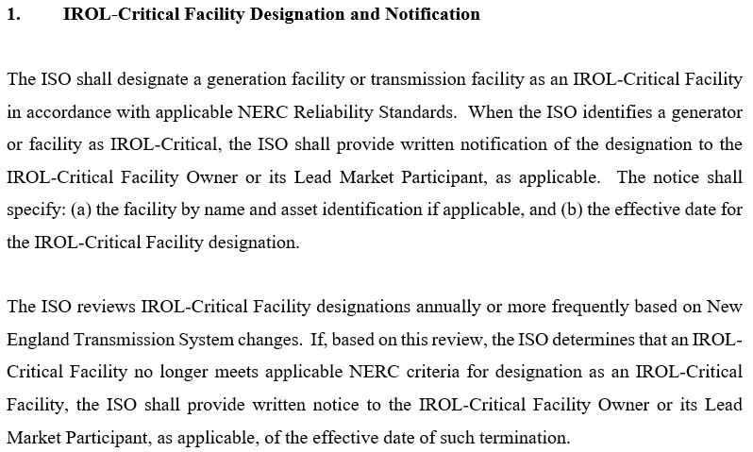
Schedule 17 – Section 1 - Designation and Notification

Slide 17
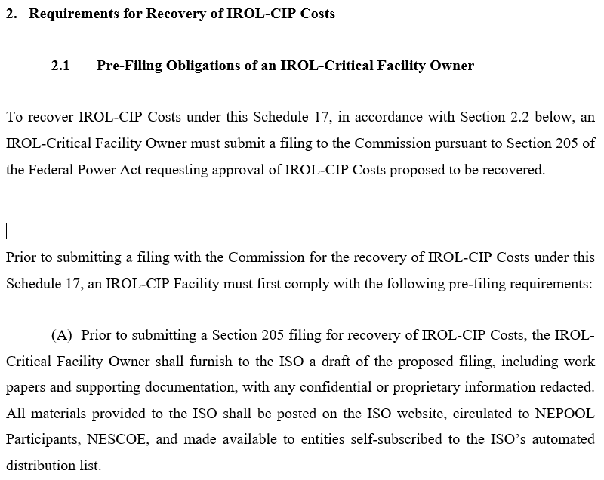
Schedule 17 – Section 2.1 – Pre-filing Obligations of the Facility Owner

Slide 18
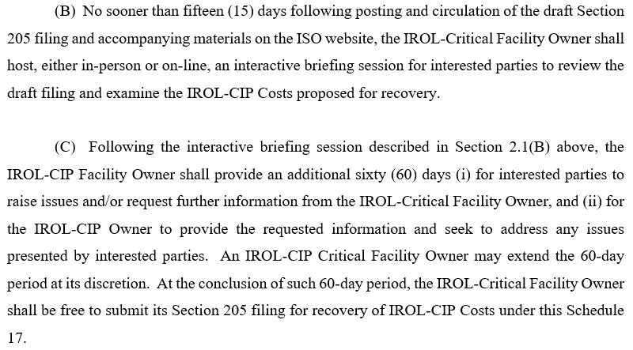
Schedule 17 – Section 2.1 (continued)

Slide 19
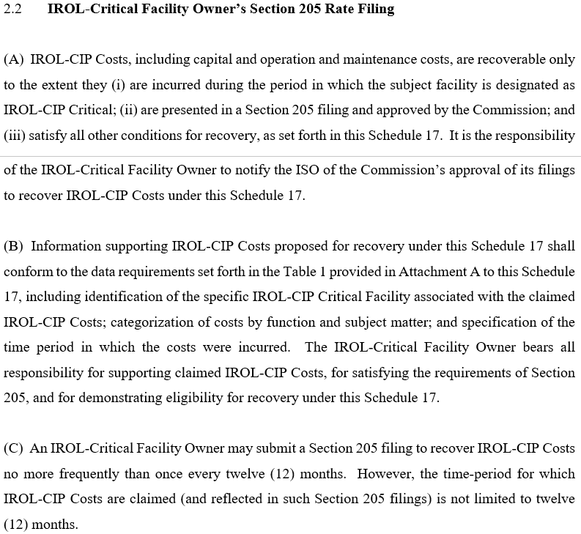
Schedule 17 – Section 2.2 – Facility Owner’s 205 Rate Filing

Slide 20
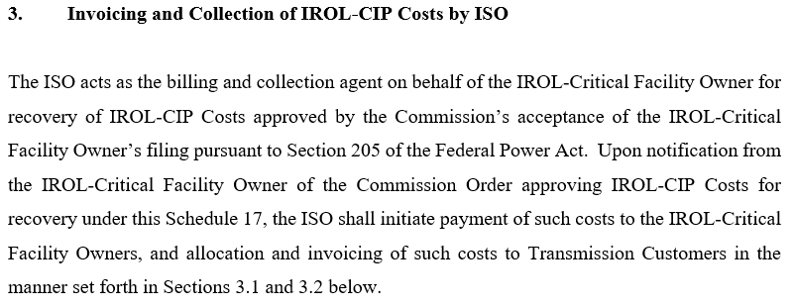
Schedule 17 – Section 3 – Invoicing and Collection of Costs by ISO

Slide 21
Schedule 17 – Section 3.1 - Monthly Payment to Facilities

Slide 22
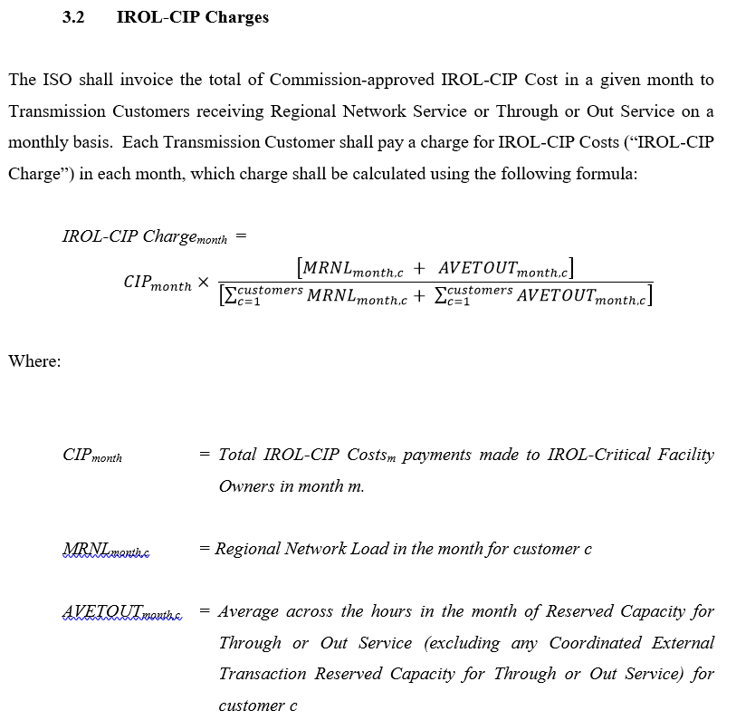
Schedule 17 – Section 3.2 – IROL-CIP Charges

Slide 23
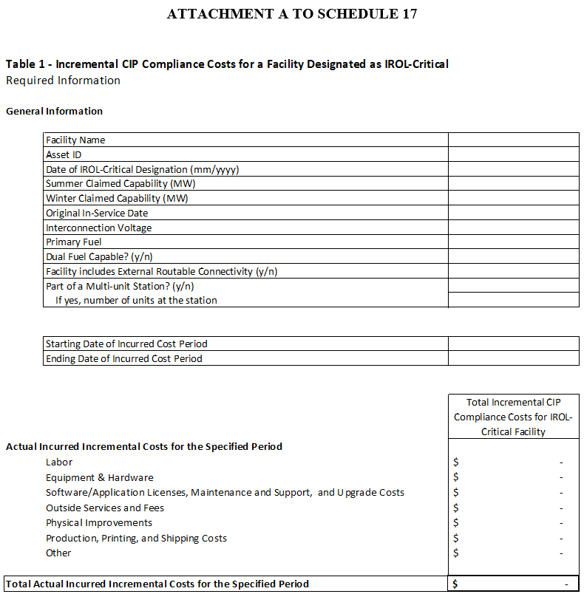
Schedule 17 – Attachment A

Slide 24
Compliance Costs - Suggested supporting templates
The suggested templates for reporting CIP compliance costs include four separate tables
Table 1 is a high level cost summary by primary categories
This is the only required table, and is part of Schedule 17
Tables 2, 3 and 4 provide greater cost detail, and are optional
A facility that chooses not to utilize the optional tables should plan to provide an alternate set of work papers that supports the costs shown in Table 1
These optional tables will not be part of Schedule 17
Feel free to adapt or modify the supporting tables to align them with accounting records, compliance documentation, etc.
A single Excel spreadsheet that includes all four tables will be made available to Participants on the ISO web site

Slide 25
Conclusion
The ISO is proposing a new OATT Schedule 17 where ISO acts as a billing agent for IROL-critical facilities’ incremental CIP costs accepted by FERC
The proposal seeks to:
Establish a requirement for a pre-filing review process
Support standardized direct cost categories with flexibility for non-standard or indirect costs
Provide regulatory confirmation through Section 205 filings of costs to be recovered prior to billing payments and charges to Participants
Provide flexibility in the timing and frequency of 205 filings
The ISO’s Schedule 17 205 filing will support, with independent expert testimony, the categories of CIP compliance direct costs that must minimally be included in the facility’s 205 filing
Each IROL-critical facility would need to incorporate and support these categories in the facility’s individual Section 205 filing, plus any additional categories appropriate to that facility

Slide 26
Stakeholder Schedule
Stakeholder Committee and Date | Scheduled Project Milestone
Transmission Committee February 20, 2019 | Initial presentation of proposal
Transmission Committee March 27, 2019 | Review proposal, respond to participant’s concerns, discuss alternatives
Transmission Committee April 17, 2019 | Further discussion and Tariff review
Transmission Committee May 16, 2019 | Discussion of formula rate template BMcD’s recommendations for the formula rate
Transmission Committee June 13, 2019 | Discussion of modified proposal and pre-filing review process
Transmission Committee August 21, 2019 | Discussion of proposal modifications Tariff language review
Transmission Committee September 17, 2019 | Further discussion and tariff review
Transmission Committee October 10, 2019 | Vote
Participants Committee November 1, 2019 | Vote

Slide 27
Jon Lowell
(413) 540-4658 | jlowell@iso-ne.com

Slide 28
Acronyms Used in this Presentation
BES = Bulk Electric System
CIP = Critical Infrastructure Protection
IROL = Interconnection Reliability Operating Limit
NERC = North American Electric Reliability Council
NPCC = Northeast Power Coordinating Council
OATT = Open Access Transmission Tariff

