Slide 1
September 3-4, 2019| Markets committee
ENERGY SECURITY IMPROVEMENTS: MARKET-BASED APPROACHES
Discussion of a market-based solution to improve energy security in the region
Andrew Gillespie
413.540.4088 | agillespie@iso-ne.com

Slide 2
Winter Energy Security Improvements
WMPP ID:
125
Proposed Effective Date: June 1, 2024
In accordance with FERC’s July 2, 2018 order in EL18-182-000, the ISO must develop and file improvements to its market design to better address regional fuel security, and file by April 15, 2020
Key Projects – Energy-Security Improvements
Discussion paper 2019-04-09 and 2019-04-10 MC A00 ISO Discussion Paper on Energy Security Improvements – Version 1

Slide 3
Prior Energy-Security Improvement Presentations
August ESI presentation
July 30 ESI presentation
July 8-10 ESI presentation
June ESI presentation
May ESI presentation
April ESI presentation

Slide 4
Today’s Presentation Agenda
Review the Tariff modifications that describe the new day-ahead ancillary services
A few notes:
In many places the new rules have a ‘vintage’ so that they can become effective before they are put into production (e.g., “commencing on June 1, 2024”)
We will focus on the core Tariff language, but of course will answer any questions on comporting changes
To facilitate the discussion a few slides have been prepared to explain the mechanics within the Tariff language

Slide 5
Acronyms
For brevity and clarity of messaging the following acronyms may be used in this presentation
GCR - Generation Contingency Reserve
RER - Replacement Energy Reserve
EIR - Energy Imbalance Reserve
FER - Forecast Energy Requirement

Slide 6
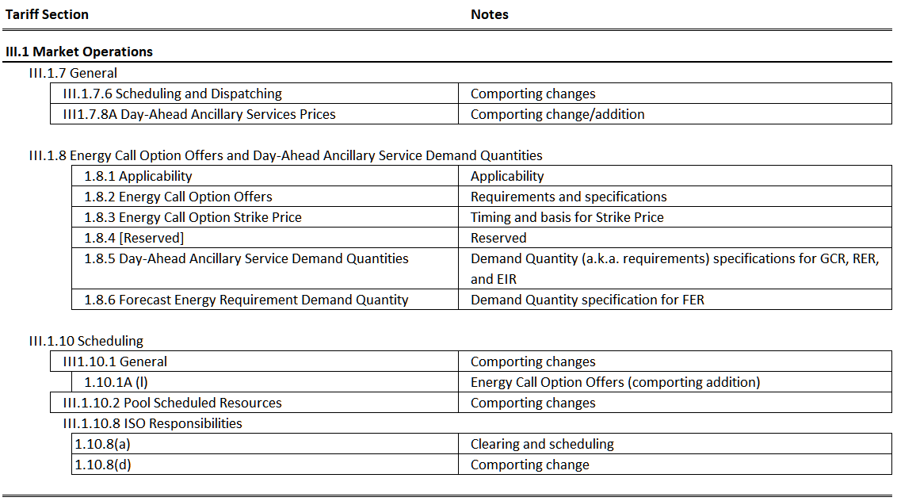
Tariff Revisions to Section III.1

Slide 7
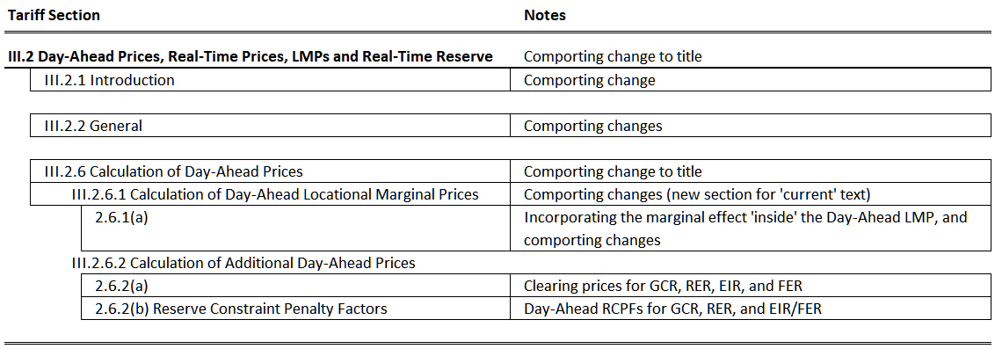
Tariff Revisions to Section III.2

Slide 8
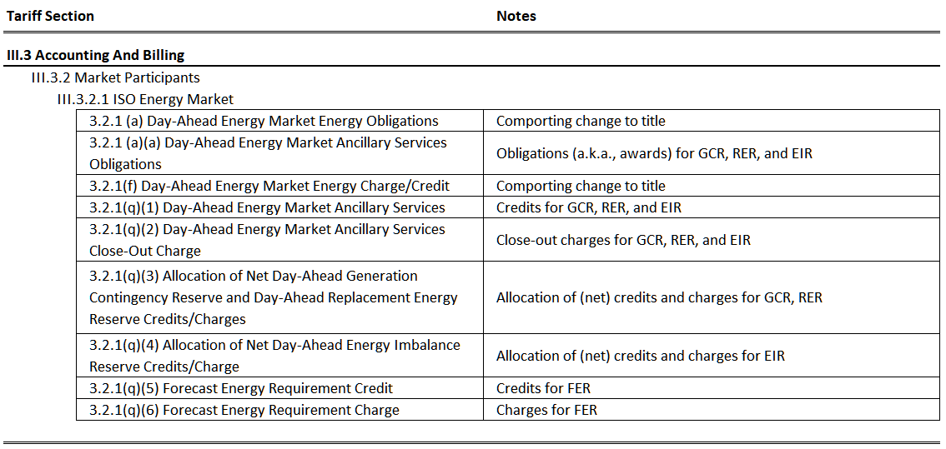
Tariff Revisions to Section III.3

Slide 9
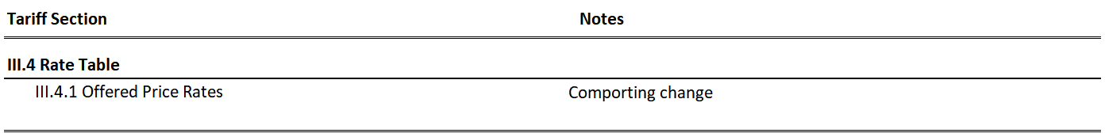
Tariff Revisions to Section III.4

Slide 10
Payment principle
A review of the core principle behind the payments for GCR, RER, EIR and FER

Slide 11
Day-Ahead Payments
Resources that contribute toward satisfying one or more demand quantities (i.e., ‘requirements’), whether an energy demanded quantity or an ancillary service demanded quantity, are paid the shadow price (i.e., the change in the system cost if the demanded quantity was incrementally higher) of each constraint to which the contribute

Slide 12
Payments for Day-Ahead Ancillary Service Demand Quantities
Example: A resource with Day-Ahead (DA) Ten-Minute Spinning Reserve (TMSR) capability would, if awarded an energy call option, contribute to satisfying not only the DA TMSR Demand Quantity, but would also contribute to satisfy all the ‘subordinate’ demand quantities (listed below)
The DA Total Ten-Minute Reserve Demand Quantity, and
The DA Total Thirty-Minute Operating Reserve Demand Quantity, and
The DA Total Ninety-Minute Reserve Demand Quantity, and
The DA Total Four-Hour Reserve Demand Quantity
Because an energy call option awarded to a resource based on its DA TMSR capability contributes to satisfying more than one demanded quantity, it is paid the shadow price of each constraint to which it contributes

Slide 13
Payments for Day-Ahead Energy Demand Quantities
Resources that contribute to satisfying the day-ahead energy balance constraint (the day-ahead bid-in demand quantity) are paid the energy balance constraint shadow price (i.e., the LMP)
This would include ‘physical’ as well as virtual supply
Resources that contribute to satisfying the Forecast Energy Requirement Demand Quantity are paid the Forecast Energy Requirement Price (i.e., the forecast energy requirement shadow price
A ‘physical’ supply resource can contribute to satisfying the FER Demand Quantity
Virtual supply (e.g., an Increment Offer or ‘INC’) cannot contribute to satisfy the FER Demand Quantity
Both day-ahead energy from physical supply resources and Day-Ahead Energy Imbalance Reserve Obligations contribute to satisfying the Forecast Energy Requirement Demand Quantity
Consequently, both are paid the FER Price

Slide 14
Forecast energy requirement
In this section we discuss the Tariff provisions related to EIR and FER

Slide 15
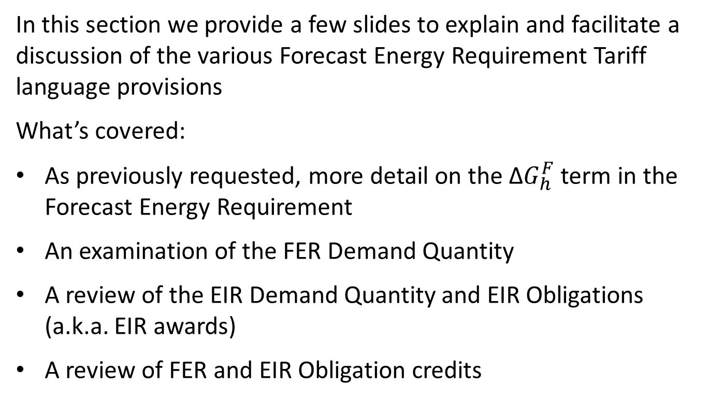
Forecast Energy Requirement
In this section we provide a few slides to explain and facilitate a discussion of the various Forecast Energy Requirement Tariff language provisions
What’s covered:
As previously requested, more detail on the ${\text{Δ}G}_{h}^{F}$ term in the Forecast Energy Requirement
An examination of the FER Demand Quantity
A review of the EIR Demand Quantity and EIR Obligations (a.k.a. EIR awards)
A review of FER and EIR Obligation credits

Slide 16
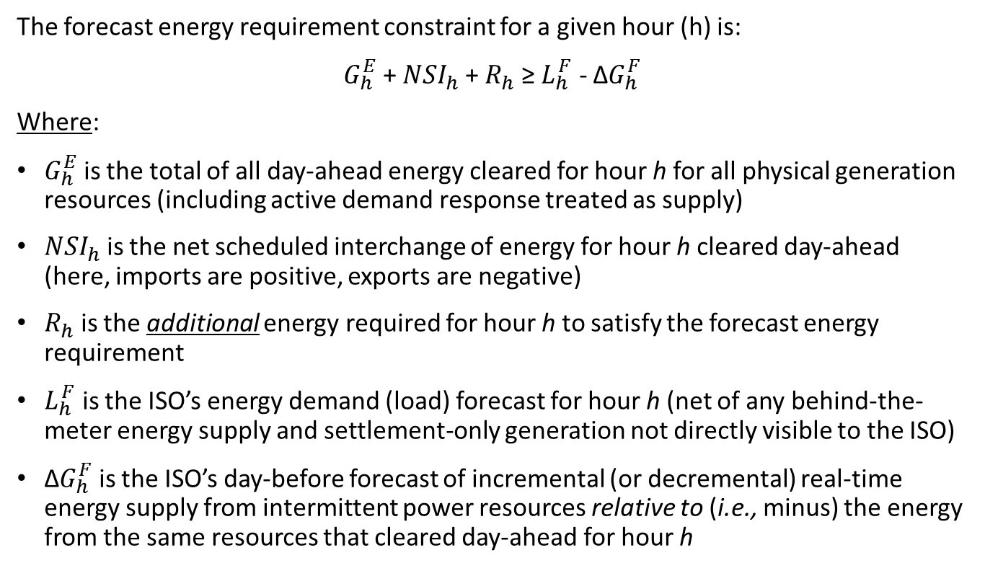
Forecast Energy Requirement Constraint
Slide 18: July 8-10 ESI presentation
The forecast energy requirement constraint for a given hour (h) is:
$G_{h}^{E}$ + ${NSI}_{h}^{ }$ + $R_{h}^{ }$ ≥ $L_{h}^{ F}$ - ${\text{Δ}G}_{h}^{F}$
Where:
$G_{h}^{E}$ is the total of all day-ahead energy cleared for hour h for all physical generation resources (including active demand response treated as supply)
${NSI}_{h}^{ }$ is the net scheduled interchange of energy for hour h cleared day-ahead (here, imports are positive, exports are negative)
$R_{h}^{ }$ is the additional energy required for hour h to satisfy the forecast energy requirement
$L_{h}^{ F}$ is the ISO’s energy demand (load) forecast for hour h (net of any behind-the-meter energy supply and settlement-only generation not directly visible to the ISO)
${\text{Δ}G}_{h}^{F}$ is the ISO’s day-before forecast of incremental (or decremental) real-time energy supply from intermittent power resources relative to (i.e., minus) the energy from the same resources that cleared day-ahead for hour h

Slide 17
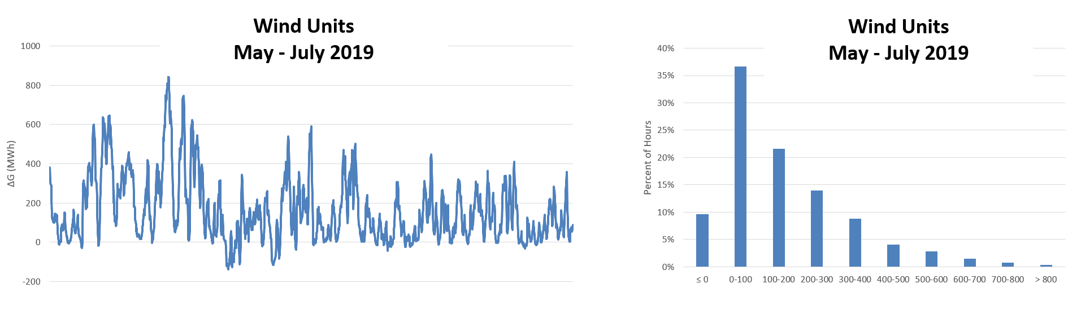

A Note About ${\text{Δ}G}_{h}^{F}$
This term is specific to Intermittent Power Resources (IPRs) for which the ISO forecasts the generator’s real-time generation for each hour of the operating day separate from, and in advance of clearing the day-ahead market
Note: This is a current practice, and is not proposed to be altered with the addition of day-ahead ancillary services

Slide 18
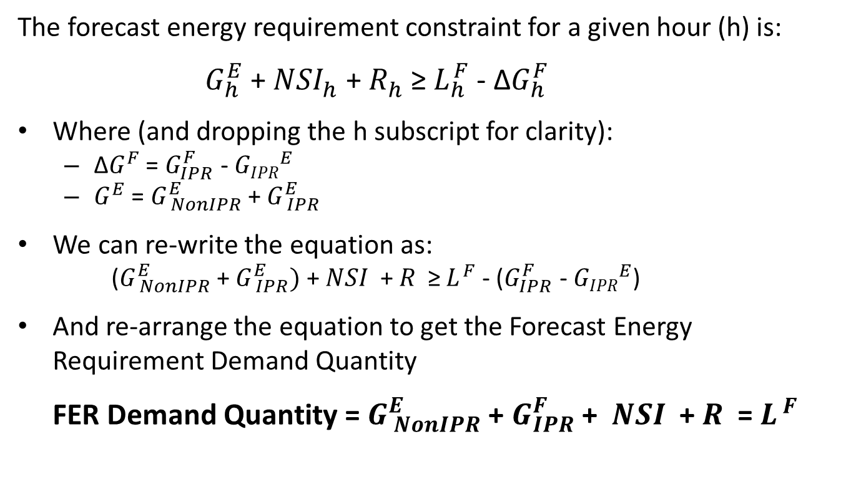
Section III.1.8.6 Forecast Energy Requirement Demand Quantity
The forecast energy requirement constraint for a given hour (h) is:
$G_{h}^{E}$ + ${NSI}_{h}^{ }$ + $R_{h}^{ }$ ≥ $L_{h}^{ F}$ - ${\text{Δ}G}_{h}^{F}$
Where (and dropping the h subscript for clarity):
${\text{Δ}G}_{ }^{F}$ = $G_{IPR}^{F}$ - ${GIPR}_{ }^{E}$
$G_{ }^{E}$ = $G_{ NonIPR}^{E}$ + $G_{ IPR}^{E}$
We can re-write the equation as:
($G_{ NonIPR}^{E}$ + $G_{ IPR}^{E})$ + ${NSI}_{ }^{ }$ + $R_{ }^{ }$ ≥ $L_{ }^{ F}$ - ($G_{IPR}^{F}$ - ${GIPR}_{ }^{E}$)
And re-arrange the equation to get the Forecast Energy Requirement Demand Quantity
FER Demand Quantity = $G_{ NonIPR}^{E}$ + $G_{IPR}^{F}$ + ${NSI}_{ }^{ }$ + $R_{ }^{ }$ = $L_{ }^{ F}$

Slide 19
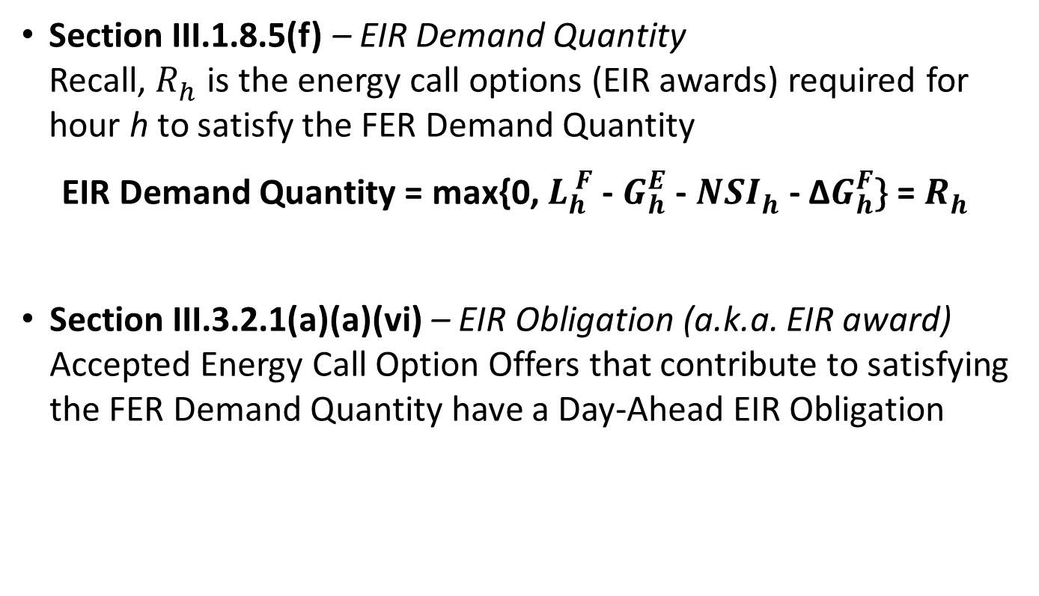
Day-Ahead Energy Imbalance Reserve: Demand Quantity & Obligation Amount
Section III.1.8.5(f) – EIR Demand Quantity Recall, $R_{h}^{ }$ is the energy call options (EIR awards) required for hour h to satisfy the FER Demand Quantity
EIR Demand Quantity = max{0, $L_{h}^{ F}$ - $G_{h}^{E}$ - ${NSI}_{h}^{ }$ - ${\text{Δ}G}_{h}^{F}$} = $R_{h}^{ }$
Section III.3.2.1(a)(a)(vi) – EIR Obligation (a.k.a. EIR award) Accepted Energy Call Option Offers that contribute to satisfying the FER Demand Quantity have a Day-Ahead EIR Obligation

Slide 20
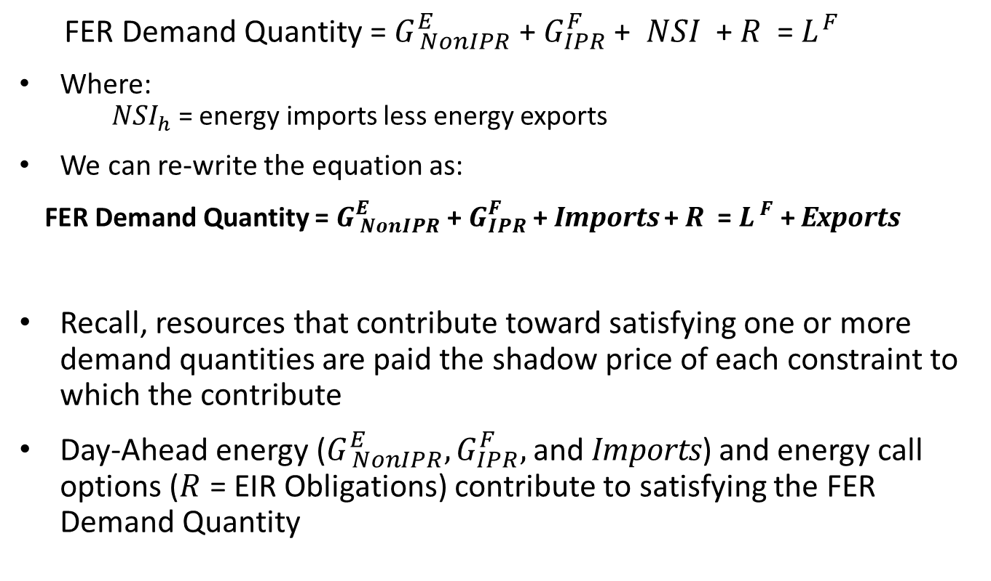
Contributions to Satisfy the FER Demand Quantity
FER Demand Quantity = $G_{ NonIPR}^{E}$ + $G_{IPR}^{F}$ + ${NSI}_{ }^{ }$ + $R_{ }^{ }$ = $L_{ }^{ F}$
Where: ${NSI}_{h}^{ }$ = energy imports less energy exports
We can re-write the equation as:
FER Demand Quantity = $G_{ NonIPR}^{E}$ + $G_{IPR}^{F}$ + Imports + $R_{ }^{ }$ = $L_{ }^{ F}$ + Exports
Recall, resources that contribute toward satisfying one or more demand quantities are paid the shadow price of each constraint to which the contribute
Day-Ahead energy ($G_{ NonIPR}^{E},G_{IPR}^{F},$ and Imports) and energy call options ($R$ = EIR Obligations) contribute to satisfying the FER Demand Quantity

Slide 21
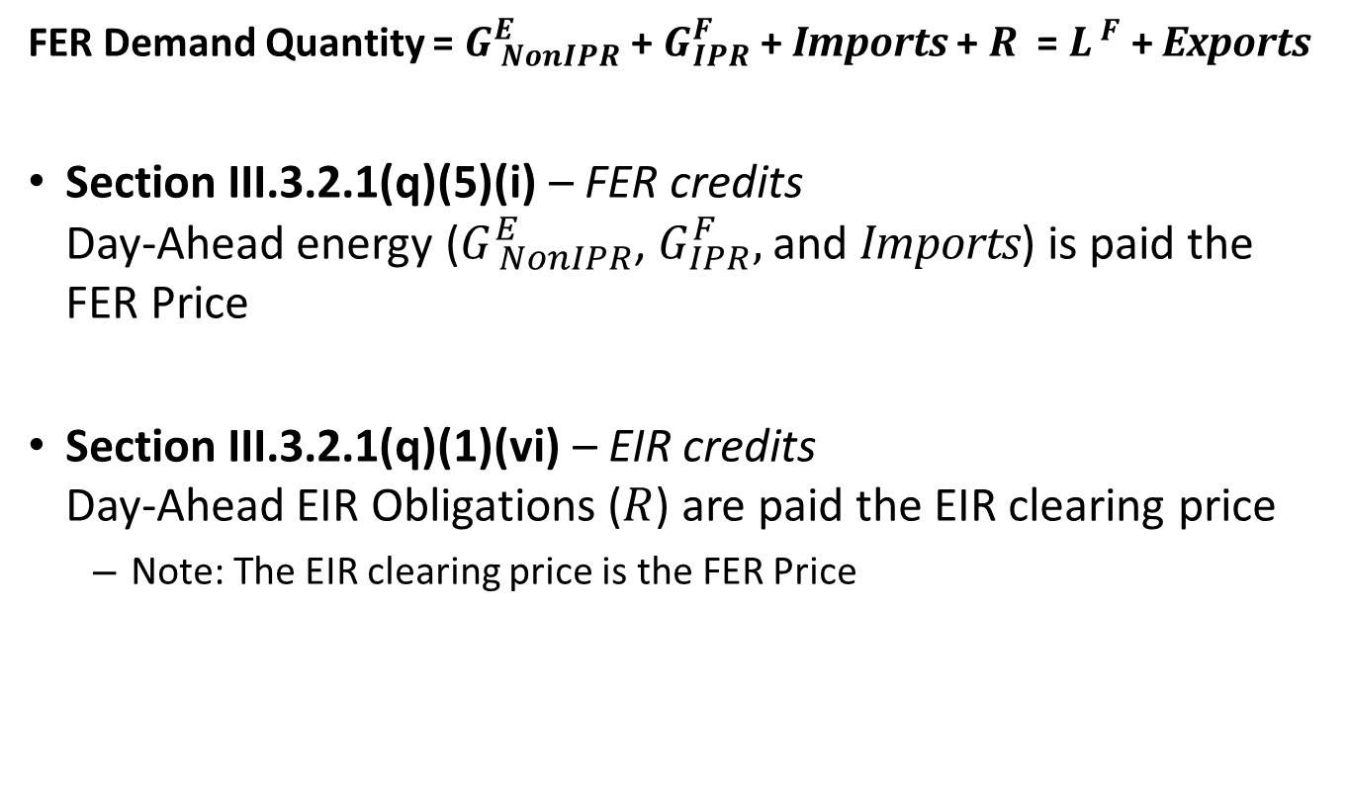
FER and EIR Credits
FER Demand Quantity = $G_{ NonIPR}^{E}$ + $G_{IPR}^{F}$ + Imports + $R_{ }^{ }$ = $L_{ }^{ F}$ + Exports
Section III.3.2.1(q)(5)(i) – FER credits Day-Ahead energy ($G_{ NonIPR}^{E}$, $G_{IPR}^{F},$ and Imports) is paid the FER Price
Section III.3.2.1(q)(1)(vi) – EIR credits Day-Ahead EIR Obligations ($R$) are paid the EIR clearing price
Note: The EIR clearing price is the FER Price

Slide 22
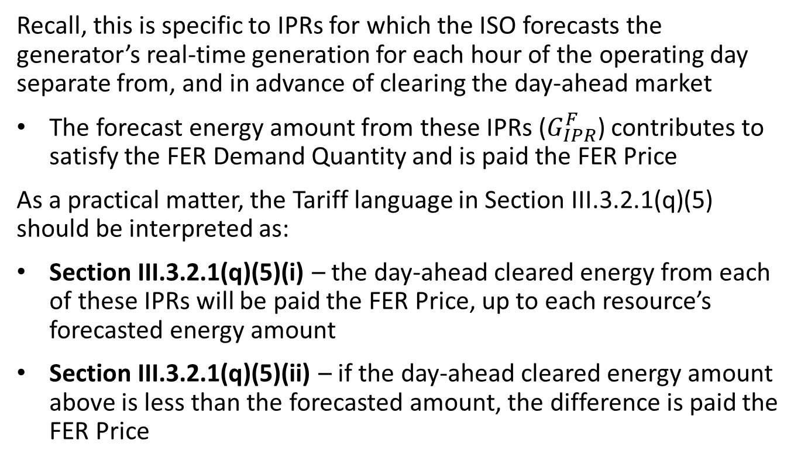

FER Credits to IPRs ($G_{IPR}^{F}$)
Recall, this is specific to IPRs for which the ISO forecasts the generator’s real-time generation for each hour of the operating day separate from, and in advance of clearing the day-ahead market
The forecast energy amount from these IPRs ($G_{IPR}^{F}$) contributes to satisfy the FER Demand Quantity and is paid the FER Price
As a practical matter, the Tariff language in Section III.3.2.1(q)(5) should be interpreted as:
Section III.3.2.1(q)(5)(i) – the day-ahead cleared energy from each of these IPRs will be paid the FER Price, up to each resource’s forecasted energy amount
Section III.3.2.1(q)(5)(ii) – if the day-ahead cleared energy amount above is less than the forecasted amount, the difference is paid the FER Price

Slide 23
Day-ahead ancillary services
In this section we discuss the Tariff provisions related to GCR and RER

Slide 24
Day-Ahead Ancillary Services
In this section we discuss the Tariff provisions related to GCR and RER
We will expand on two slides from the July 8-10 presentation to demonstrate how a resource’s capabilities will be considered, with particular attention to the time-dimension associated with RER

Slide 25
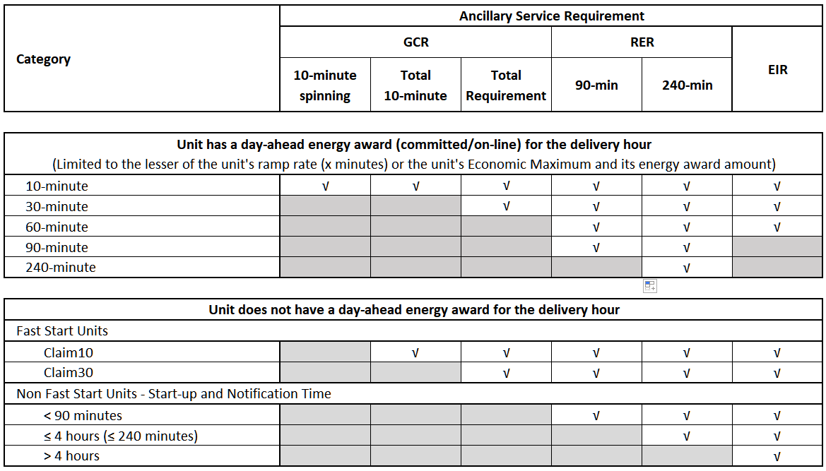
Day-Ahead Eligibility/Capability
Slide 67: July 8-10 ESI presentation

Slide 26
Contingency Recovery and Restoration Timeline
Slide 45: July 8-10 ESI presentation

Slide 27
GCR and RER
In the July 8-10 presentation we discussed the reliability standards that are the basis for the day-ahead GCR and RER ancillary services
In particular, we noted that while the ISO takes into account the (unloaded) supply capability available to recover from a large supply contingency (i.e., GCR), the ISO must also take into account what additional (unloaded) supply capability is available to fill the energy gap created when the reserve requirement is restored (i.e., RER)

Slide 28
GCR and RER - Continued
As applied to the day-ahead market, the objective is to prepare the system should a large supply contingency occur (in real-time) in any hour of the Operating Day
This means prepared to recover within the hour, and restore the system within the required multiple-hour timeframes (see timeline graph)
For example, 10-minute reserves are to be restored within 90 minutes from the end of the Contingency Event Recovery Period, shown on the timeline graph as RER (90-min)
The tables on following slides are a visual representation of the Tariff provisions as they relate to GCR and RER
To help visualize the time-dimension associated with RER each table represents each hour of the Operating Day
The tables represent the requirements in any given hour (each hour of the Operating Day is ‘hour 0’)
Requirements are applied to each hour of the market horizon

Slide 29
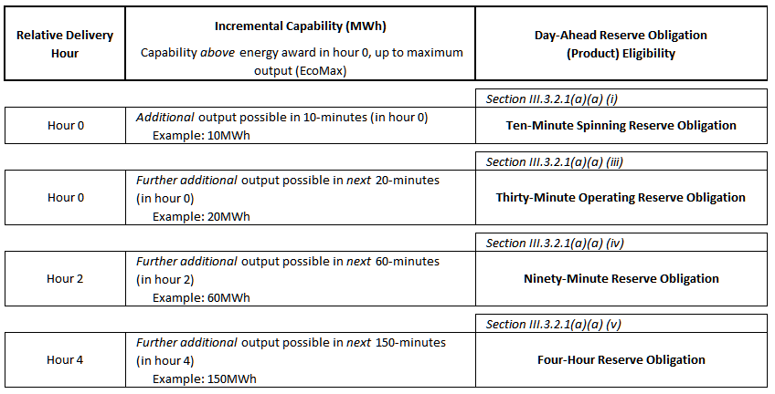
Resource Capabilities
A resource’s capabilities in the day-ahead market depends on the status of the resource in the hour
The table below is a representation of a resource’s capabilities if, as a result of the joint optimization, the resource has a day-ahead energy award (i.e., committed/on-line) in hour 0
Example: A resource with a 1MW/min ramp rate, a 10MWh energy award in hour 0, and an maximum output of 500MW

Slide 30
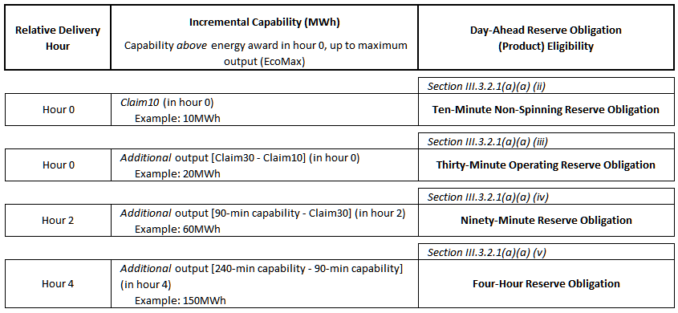
Resource Capabilities - Continued
A resource’s capabilities in the day-ahead market depends on the status of the resource in the hour
The table below is a representation of a resource’s capabilities if, as a result of the joint optimization, the resource does not have a day-ahead energy award (i.e., is not committed/on-line) in hour 0
Example: A resource with a Claim10 = 10MW, Claim30 = 30MW, 90-min capability = 90MW, and 240-min capability = 240MW

Slide 31
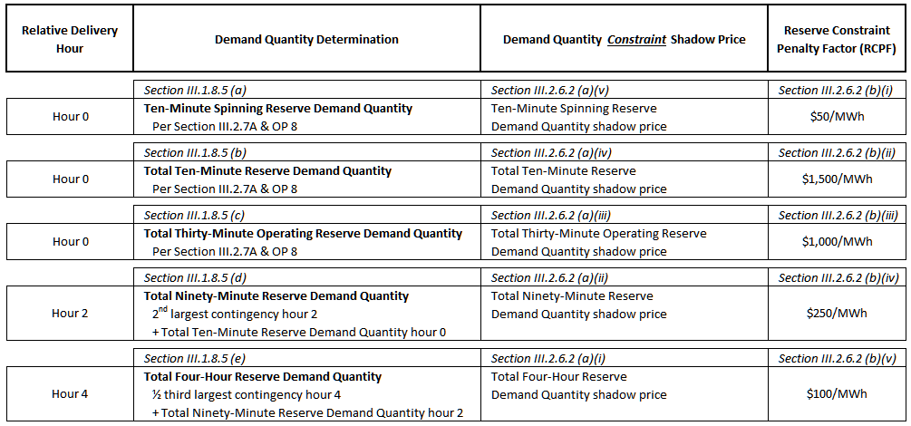
GCR & RER: Demand Quantities, Shadow Prices, and Reserve Constraint Penalty Factors
Shadow prices and Reserve Constraint Penalty Factors are for demand quantity constraints
Recall, the shadow price is the change in the system cost if the demanded quantity was incrementally higher
In the next section we will discuss the basis for the values of the various day-ahead Reserve Constraint Penalty Factors

Slide 32
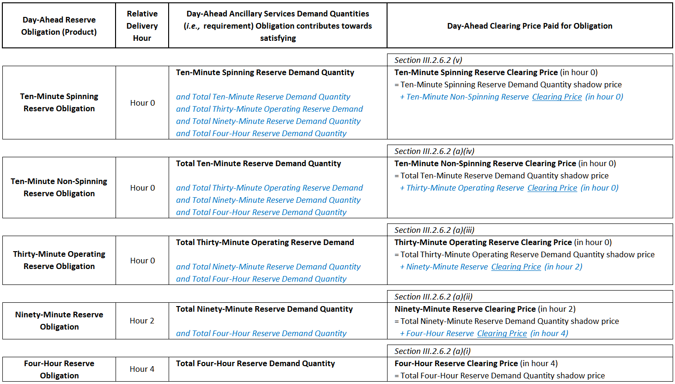
GCR and RER Clearing Prices

Slide 33
Reserve Constraint Penalty Factors
Logic, rationale, and proposed values (What we are thinking…)

Slide 34
Reserve Constraint Penalty Factors (RCPFs)
RCPFs are the maximum redispatch cost to meet an ancillary service ‘demand quantity’ (i.e., the requirement)
RCPFs can set clearing prices for ancillary services in a shortage
RCPFs apply to demand quantities (requirements) not to ‘products’
The Tariff requires an RCPF value for:
Each GCR Demand Quantity (3 values)
Each RER Demand Quantity (2 values)
The FER Demand Quantity (1 value)
There is no separate RCPF for the EIR Demand Quantity, as that requirement is based on the FER
The maximum redispatch cost to acquire EIR is the FER RCPF

Slide 35
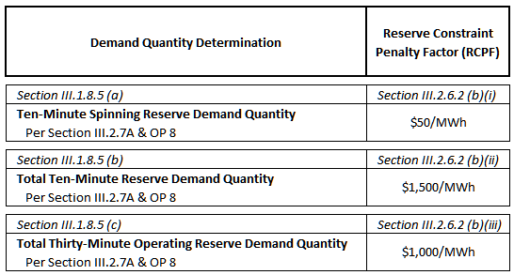
Section III.2.6.2(b) – RCPFs for GCR
For GCR the RCPFs will be same values as used in real-time (in a table in Section III.2.7A(c) of the Tariff)
Currently these values are:
Rationale: to ensure pricing consistency if one of these reserve products is in shortage in both markets (both day-ahead and real-time)

Slide 36
Section III.2.6.2(b) – RCPFs for RER240
The RCPF for the Total Four-Hour Reserve Demand Quantity is $100/MWh
This value is based on the maximum redispatch costs observed across the various scenarios for RER in the ESI Impact Analysis modeling (typically about $70/MWh)
See September ESI Impact Analysis presentation
In the ESI Impact Analysis model there is only one RER product
The redispatch costs in the ESI Impact Analysis model for this one RER product more closely aligns with the maximum redispatch cost for RER240 than RER90 (next slide)

Slide 37
Section III.2.6.2(b) – RCPFs for RER90
The RCPF for the Total Ninety-Minute Reserve Demand Quantity is $250/MWh
This value is based on the current Replacement Reserve RCPF
The Replacement Reserve was added to the real-time market, in part, to address similar concerns as the RER 90: “[it] can maintain a quantity of replacement reserves… for the purposes of meeting the NERC requirement to restore its total system TMR [Ten-Minute Reserve] Requirement” ER13-1736
Simulations at the time showed that $250/MWh is a reasonable guide to the maximum redispatch cost for incremental reserve amounts above the Total 30-Minute Requirement

Slide 38
Section III.2.6.2(b) – RCPF for FER
The RCPF for the Forecast Energy Requirement Demand Quantity is 101% of the sum of all day-ahead RCPFs
The value is $2,929/MWh (see slide 31)
Rationale: if there are insufficient offers (of both energy and options) to simultaneously meet the FER and all ancillary services, we want to clear offers to satisfy the FER first (before satisfying other ancillary service requirements - GCR and RER)
Mechanically, this requires the FER RCPF be greater than the sum of all the RCPFs for all the other Day-Ahead Ancillary Service demand quantities

Slide 39
Cost Allocation
In this section we will briefly review the allocation provisions, and using examples examine the allocation of EIR Obligation credits and charges more closely

Slide 40
Cost Allocation of GCR, RER, and FER
Based on the beneficiary-pays principle for cost allocation the credits and charges for GCR and RER Obligations, and FER credits, are allocated to Real Time Load Obligation (RTLO), excluding RTLO incurred by Storage DARDs
Section III.3.2.1(q)(3) – GCR and RER
Section III.3.2.1(q)(5) & Section III.3.2.1(q)(6) - FER

Slide 41
Cost Allocation of EIR
Based on the cost-causation principle for cost-allocation the credits and charges for EIR Obligations are allocated to accepted Increment Offers ‘INCs’ and ‘negative’ load deviations (both create an ‘energy gap’)
Section III.3.2.1(q)(4) – EIR
The rest of this section reviews the allocation of EIR Obligation credits and charges in more detail

Slide 42
A Few Notes on Negative Deviations
In clearing the day-ahead market ‘known’ negative deviations are offset by EIR Obligations
‘Known’ in this sense meaning cleared INCs and when the total cleared day-ahead demand is less than the forecasted real-time total energy demand
As noted previously, ‘negative’ deviations as described here are when the Market Participant’s real-time delivery/consumption is different from their day-ahead scheduled amount (i.e., creating an energy gap in real-time)
Accepted Increment Offers are a virtual sale of energy in the day-ahead market, but do not deliver energy in real-time
The ISO’s real-time load forecast is not an aggregation of individual Market Participant load forecasts
Consequently, we do not know which Market Participants have ‘under-bid’ in the day-ahead market
All we can infer is that day-ahead (and to the extent the total EIR Obligation amount is greater that the total accepted INC amount) there is an energy gap from under-bidding, and that a fixed amount of EIR Obligations are associated with covering that gap

Slide 43
EIR Obligation Credit/Charge Allocation
Section III.3.2.1(q)(4)(i) - We calculate for each Market Participant a negative load deviation, which is the lesser of (a) the MWh amount of the Market Participant’s Real-Time Load Obligation minus their Day-Ahead Load Obligation (excluding Real-Time Load Obligation incurred by Storage DARDs), or (b) zero
Section III.3.2.1(q)(4)(ii) – Explains how the credits for EIR Obligations are charged
Section III.3.2.1(q)(4)(iii) – Explains how the close-out charges for EIR Obligations are credited

Slide 44
EIR Obligation – Cost Allocation Examples
For these examples, assume for a given hour:
There are 20MWh of EIR Obligations
And there are 9MWh of accepted Increment Offers
As noted previously, we do not know which Market Participants have ‘under-bid’ - but we do know that in this example total day-ahead cleared demand was 11MWh less than the forecast total real-time demand
Consequently, the allocation to negative load deviations is limited to the credits and charges associated with this amount (11MWh), and
The allocation methodology does not create an ‘exploding’ deviations type problem
The EIR clearing price is $4.75/MWh
Total EIR Obligation credits = $4.75/MWh x 20MWh = $95.00
The close-out rate (LMP –K) is $7.65/MWh
Total EIR close out charges = $7.65/MWh x 20MWh = $153.00

Slide 45
Example A Deviation Amount = EIR Obligation Amount
Total negative load deviations = 11 MWh
The sum of total negative load deviations and accepted Increment Offers = 11MWh + 9MWh = 20MWh, which is equal to the EIR Obligation amount of 20MWh
Charges (totaling $95.00)
Accepted Increment Offers; charged $4.75/MWh x 9MWh = $42.75
Negative load deviations; charged $4.75/MWh x 11MWh = $52.25
Credits (totaling $153.00)
Accepted Increment Offers; credited $7.65/MWh x 9MWh = $68.85
Negative load deviations; credited $7.65/MWh x 11MWh = $84.15

Slide 46
Example B Deviation Amount < EIR Obligation Amount
Total negative load deviations = 6 MWh
Sum of total negative load deviations and accepted Increment Offers = 6MWh + 9MWh = 15MWh, which is less than EIR Obligation amount of 20MWh
Charges (totaling $95.00)
Accepted Increment Offers; charged $4.75/MWh x 9MWh = $42.75
Negative load deviations; charged $4.75/MWh x 6MWh = $28.50
RTLO; charged $95.00 - $42.75 - $28.50 = $23.75
Credits (totaling $153.00)
Accepted Increment Offers; credited $7.65/MWh x 9MWh = $68.85
Negative load deviations; credited $7.65/MWh x 6MWh = $45.90
RTLO; credited $153.00 - $68.85 - $45.90 = $38.25

Slide 47
Example C Deviation Amount > EIR Obligation Amount
Total negative load deviations = 30 MWh
Sum of total negative load deviations and accepted Increment Offers = 30MWh + 9MWh = 39MWh, which is greater than EIR Obligation amount of 20MWh
Charges (totaling $95.00)
Accepted Increment Offers; charged $4.75 x 9MWh = $42.75
Negative load deviations; charged $1.74/MWh x 30MWh = $52.25 (Each Market Participant is charged based on their pro rata share of total negative load deviations; the effective rate in this example is $1.74/MWh = $52.25 ÷ 30 MWh)
Credits (totaling $153.00)
Accepted Increment Offers; credited $7.65 x 9MWh = $68.85
Negative load deviations; credited $2.81/MWh x 30MWh = $84.15 (Each Market Participant is credited based on their pro rata share of total negative load deviations; the effective rate in this example is $2.81/MWh = $84.15 ÷ 30 MWh)

Slide 48
Stakeholder Schedule
Stakeholder Committee and Date | Scheduled Project Milestone
Markets Committee March 5-6, April 9-10, April 23, May 7-8, June 10-12, July 8-10, July 30, August 13-15, 2019 | See previous ISO presentations for scheduled project milestones
Markets Committee September 3-4, 2019 | Initial discussion of seasonal forward component; Review ISO Tariff language and wrap-up; Final draft stakeholder amendments/ associated Tariff language
Markets Committee September 18-19, 2019 | Final review of proposed Tariff language (ISO proposal and proposed stakeholder amendment(s)); Vote on ISO proposed Tariff language and submitted stakeholder amendments
Participants Committee October 4, 2019 | Vote on ISO proposed Tariff language and submitted stakeholder amendments

