Slide 1
August 2019
Demand Resources Working Group
Monthly Statistics Report
Demand Resource Strategy Department
ISO New England, Inc.

Slide 2
Seasonal Audited Capability MWs* by Demand Resource Type and Load Zone (as of 8/01/2019)
Summer MW
Zone | Demand Response Assets | On-Peak Demand Resources | Seasonal Peak Demand Resources | Total
ME | 98.901 | 200.762 |  | 299.66
NH | 28.84 | 124.28 |  | 153.12
VT | 27.188 | 116.976 |  | 144.16
CT | 89.424 | 104.249 | 497.332 | 691.01
RI | 22.282 | 244.061 |  | 266.34
SEMA | 21.464 | 405.697 |  | 427.16
WCMA | 48.967 | 399.97 | 57.705 | 506.64
NEMA | 45.349 | 740.862 |  | 786.21
Total | 382.415 | 2336.857 | 555.037 | 3274.3
* Seasonal audited capability MWs do not include avoided T&D losses, and are summed for assets that are ready-to-respond and mapped to a Resource on the “as of” date.

Slide 3
Seasonal Audited Capability MWs* by Demand Resource Type and Load Zone (as of 8/01/2019)
* Seasonal audited capability MWs do not include avoided T&D losses, and are summed for assets that are ready-to-respond and mapped to a Resource on the “as of” date.

Slide 4
Capacity Supply Obligation (CSO)* MW by Demand Resource Type and Load Zone (as of 8/01/2019)
Zone | Active Demand Capacity Resource | On-Peak Demand Resource | Seasonal Peak Demand Resources | Total
ME | 102.053 | 184.397 |  | 286.450
NH | 30.784 | 107.845 |  | 138.629
VT | 30.243 | 119.953 |  | 150.196
CT | 103.523 | 109.386 | 457.899 | 670.808
RI | 19.982 | 230.536 |  | 250.518
SEMA | 25.437 | 390.892 |  | 416.329
WCMA | 58.487 | 404.330 | 49.645 | 512.462
NEMA | 36.636 | 669.002 |  | 705.638
Total | 407.145 | 2,216.341 | 507.544 | 3,131.030
*CSO values include applicable avoided T&D losses and are net of bilaterals and reconfigurations.

Slide 5
Demand Response Asset Seasonal Audited Capability MWs* by Load Zone and DRR Aggregation Zone (as of 8/01/2019)
Load Zone | DRR Aggregation Zone or Pnode | Audited Capability
ME | Bangor Hydro | 3.171
ME | Maine | 6.328
ME | Portland | 1.54
ME | Pnode | 87.862
NH | New Hampshire | 19.155
NH | Seacoast | 7.617
NH | Pnode | 2.068
VT | Northwest Vermont | 4.07
VT | Vermont | 1.962
VT | Pnode | 21.156
CT | Eastern | 4.83
CT | Northern | 6.588
CT | Norwalk-Stamford | 1.548
CT | Western | 7.985
CT | Western SWCT | 12.819
CT | Pnode | 55.654
RI | Rhode Island | 13.97
RI | Pnode | 8.312
SEMA | Lower SEMA | 9.787
SEMA | SEMA | 11.677
WCMA | Central | 22.871
WCMA | Springfield | 10.941
WCMA | Western | 13.439
WCMA | Pnode | 1.716
NEMA | Boston | 17.973
NEMA | North Shore | 8.444
NEMA | Pnode | 18.932
Total |  | 382.415
* Seasonal audited capability MWs do not include avoided T&D losses.

Slide 6
Demand Response Asset Seasonal Audited Capability MWs* by Load Zone and DRR Aggregation Zone (as of 8/01/2019)
* Seasonal audited capability MWs do not include avoided T&D losses.

Slide 7
Demand Resource Seasonal Audited Capability* Over Time (as of 8/01/2019)
* Seasonal audited capability MWs do not include avoided T&D losses. “REAL_TIME” includes Real-Time Demand Response Assets before June 2018, and Demand Response Assets on and after June 2018.

Slide 8
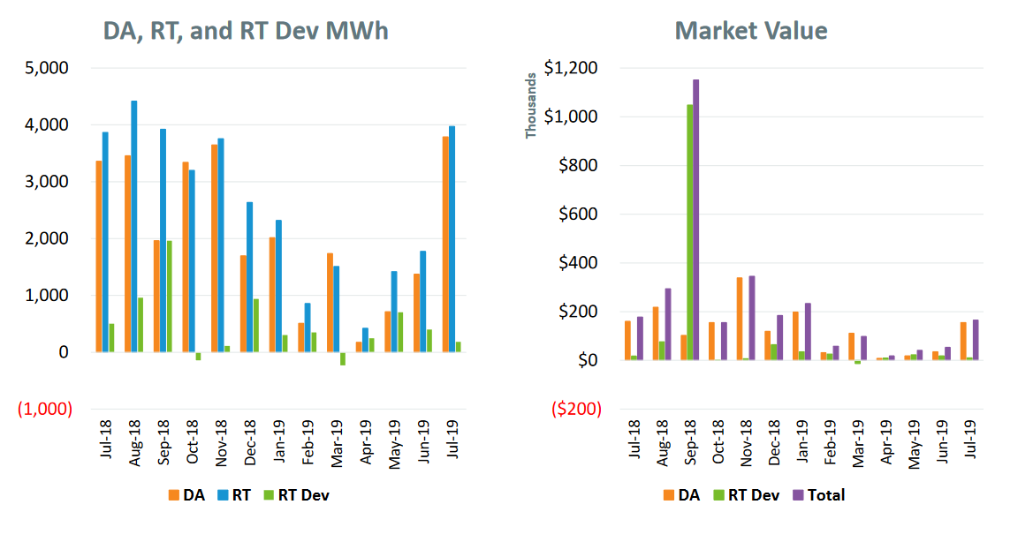
Price Responsive Demand (PRD) Energy Market Activity by Month
Note: DA and RT (deviation) MWh are settlement obligations and reflect appropriate gross-ups for distribution losses.

Slide 9
Additional Information
Next DRWG meeting is September 23, 2019 in the Boston conference room.

