Slide 1
September 12, 2019 | boston, ma
2019 Regional System Plan
(RSP19)
2019 Regional System Plan Meeting
Anne C. George
VICE PRESIDENT, External Affairs and Corporate Communications

Slide 2
Agenda: 2019 Regional System Plan Meeting Westin Copley Hotel, Boston, MA
11:15 a.m. | Registration
11:45 a.m. | Lunch
12:45 p.m. | Welcoming remarks
1:00 p.m. | Keynote: Damir Novosel, President and Founder of Quanta Technology
1:30 p.m. | ISO New England report on 2019 Regional System Plan and Q&A
2:15 p.m. | Break
2:30 p.m. | Panel: Transition to the Grid of the Future: Adapting to Disruptive Technologies
4:00 p.m. | Closing remarks and adjourn

Slide 3
Panel Discussion
Moderator
Brook Colangelo, ISO New England, Board of Directors
Panelists
Marshall Van Alstyne, Boston University and Fellow at MIT’s Initiative on the Digital Economy
Katherine Prewitt, Eversource Energy
Mark O’Malley, National Renewable Energy Laboratory
Damir Novosel, Quanta Technology
3

Slide 4
2019 Regional System Plan
Summary Overview
Michael I. Henderson
Director, Regional Planning and Coordination

Slide 5
RSP19 Satisfies Tariff Requirements
The ISO carries out regional planning with the Planning Advisory Committee (PAC) as part of an open, transparent stakeholder process
RSP19 reflects the results and findings of the ongoing ISO regional planning process
RSP19 satisfies all tariff obligations and reports on activities that satisfy required planning procedures and criteria

Slide 6
Key Messages: The Planning Process Works
Markets and Planning
Two decades of competitive markets and transmission planning and development have significantly enhanced reliability and improved overall market efficiency
Transformation of the Grid
The system is evolving to a hybrid grid with lower-emitting resources
Stakeholder Input
The ISO seeks and receives feedback from our stakeholders through an open planning process with the PAC
Meeting the Challenges
The region is working to meet challenges related to energy security, transmission development, and grid transformation

Slide 7
ISO New England Is Focused on Developing Solutions to Today’s Grid Challenges
Energy Security
Energy-production limitations result from “just-in-time” fuel sources and environmental compliance requirements
Short-term measures, longer-term market improvements, and development of infrastructure will address the issue
Transmission Development
Improvements are required to enhance reliability
Processes and plans are in place to meet system needs
Grid Transformation
Inverter-based technologies (e.g., wind, photovoltaics, FACTS* and HVDC*) pose physical and structural challenges
Analysis, procedures, and technology improvements are underway to enhance the reliable, economical, and environmental performance of the system
* FACTS: Flexible Alternating Current Transmission Systems; HVDC: High Voltage Direct Current

Slide 8
The Energy Security Risk
Gas pipelines serving the region operate at or near capacity, particularly during the winter, and major expansion supplying New England generation is unlikely
The lack of firm fuel contracts means fuel may not be available when needed
Most dual-fuel generators (i.e., oil back-up) have limited on-site fuel-storage capability, and may need additional time to switch fuels
Older oil and coal resources face energy-production constraints, related to issues with fuel availability, delivery, and environmental restrictions
The retirement of older, uneconomic generation that can store fuel (e.g., nuclear, coal, and oil) will increase the region’s reliance on the remaining gas-fired generators

Slide 9
The Region Is Addressing the Energy Security Issue
Short Term
Long Term
Operational enhancements
Coordination and communication among the ISO, generators, and natural gas pipelines
Fuel-security reliability review in the Forward Capacity Market
Some help provided by new resources, including renewable resources
Elective transmission upgrades to neighboring systems that provide access to diversified resources
Increased use of wind and solar resources provide some relief
Greater efficiency gains in natural gas and electricity use
New markets that provide financial incentives for supply certainty that better utilize existing infrastructures

Slide 10
Energy Efficiency and Behind-the-Meter Solar Are Reducing Peak Demand and Annual Energy Use
Projected Annual Energy Use (GWh) With and Without EE and PV Savings
l
●
The gross peak and load forecast minus existing and anticipated “behind-the-meter” (BTM) solar PV resources
●
The gross peak and load forecast minus existing and anticipated BTM solar PV and energy efficiency
The gross peak and load forecast
Note: Summer peak demand is based on the “90/10” forecast, which accounts for the possibility of extreme summer weather (temperatures of about 94⁰ F).
Source: ISO New England 2019-2028 Forecast Report of Capacity, Energy, Loads, and Transmission (2019 CELT Report) (April 2019)

Slide 11
Resource Adequacy Is Met Through Competitive Markets
Forward Capacity Market attracts new resources
To date, over 5,400 MW of capacity retired
The 12th and 13th Forward Capacity Auctions, for Capacity Commitment Periods 2021/22 and 2022/23 respectively, procured sufficient system resources to meet resource adequacy criteria, regionally and in import-constrained zones
Assuming no further retirements and new resources cleared under FCM, the region will meet resource adequacy requirements over the planning horizon
However, Actions During a Capacity Deficiency (OP-4) would be required, especially during hot and humid conditions and winter cold snaps
The most reliable and economic place for resource development remains in southern New England near load centers
New economic resources reduce congestion and the need for transmission development
Over 19,000 MW in the interconnection queue

Slide 12
Environmental Issues Renewable development anticipated to further reduce carbon emissions
State environmental regulations likely have a greater impact on generators in the region than national environmental requirements
Existing and potential new environmental regulations will continue to affect the region’s generators
Emissions have been greatly reduced over the last decade due to the shift in generation production, lower demand, and increasingly stringent air quality rules
Compliance could lead to higher operating costs, reduced capacity, or reduced energy production
Additional resource retirements and retrofits expected to meet compliance requirements and to provide flexibility
Increased use of natural-gas-fired generation is likely, and permitting for dual-fuel capabilities can be challenging
Relicensing conditions for hydro facilities could reduce output and flexibility

Slide 13
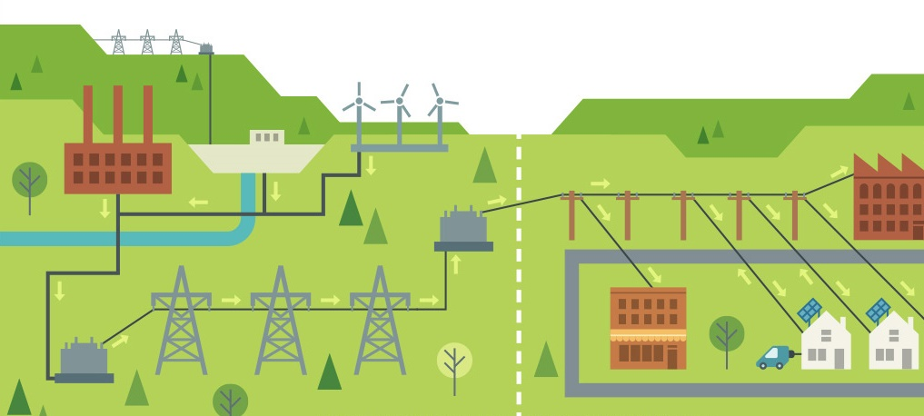
What Is Grid Transformation? Growth of HVDC, FACTS, grid-connected and distributed renewable resources, prosumers, microgrids, storage, and electrification of demand Fewer conventional generation resources

Slide 14
High Solar Power Output on April 21, 2018 More solar reduces midday demand, increases ramp rates, and causes the net peak load to occur later in the day

Slide 15
Grid Transformation Issues and Actions Required Issues being identified and studied; participation with DOE, IEEE, EPRI, and PSERC is vital
System Needs
Actions Underway
Observability, controllability, and system protection
Regulation, ramping, and reserves
Operational enhancements
Coordination and communication among the ISO, transmission owners, distribution owners, and prosumers
Interconnection and testing standards
Price formation
Industry structure changes and rate reform
Improve forecasting techniques and system modeling
Add and tune control systems for inverter technologies
Apply phasor measurement units and adaptive protection techniques
Cluster interconnection studies
Transmission system upgrades
Application of smart inverters
New interconnection standards and wholesale market rules
Facilitate use of storage, prosumer participation, and system flexibility

Slide 16
Transmission Projects to Maintain Reliability Have Progressed throughout New England
Major Projects Since RSP17
Completed or nearing completion
Maine Power Reliability Program
New Hampshire/Vermont 2020 Upgrades
Connecticut River Valley Upgrades in Vermont
Greater Hartford Central Connecticut 2022 Upgrades
Southwest Connecticut 2022 Upgrades
Pittsfield and Greenfield 2022 Upgrades
Two dynamic voltage compensators
Improvements identified
Southeast Massachusetts/Rhode Island
Greater Boston
Source: RSP Transmission Project List, June 2019; RSP Transmission Project List also includes 115 kV projects
Notes:
16

Slide 17
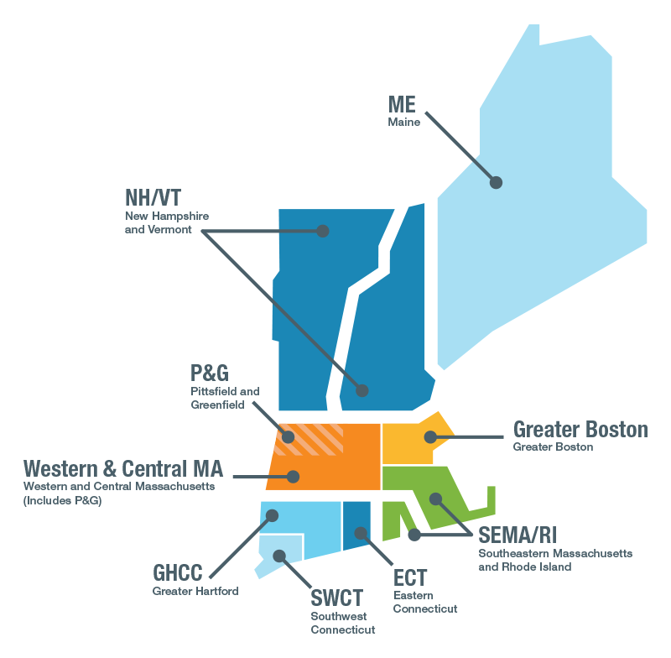
Key Transmission Planning Study Areas in New England
17

Slide 18
Changes in Long-Term Transmission Planning Process, Criteria, and Assumptions
Process
Material changes are being made to the ISO’s planning process to account for FERC Order 1000 with the first competitive solicitation expected for the Boston area
Compliance with NERC and NPCC requirements
Revisions to the Transmission Planning Process Guide
Criteria and Assumptions
Planning Procedure No. 3, Reliability Standards for the New England Area Pool Transmission Facilities, reflects the evolution of the NERC transmission planning standards
Probabilistic planning was incorporated for selecting generator dispatch in studies
Updates to the Transmission Planning Technical Guide

Slide 19
Meeting Future Transmission System Needs
RSP19 discusses approximately $1.3B of new reliability-based transmission upgrades
Many of these are in siting or under construction
The need for reliability-based transmission upgrades is changing
Reduced need for additional reliability-based transmission to meet peak demand periods
Generator retirements and studies reviewing system performance, which account for the integration of inverter-based technologies and improved load modeling, may drive the need for additional reliability-based transmission upgrades
Market efficiency transmission upgrades are not required at this time
The process for “Planning for Public Policy” under Order 1000 will be reinitiated in 2020

Slide 20
Planning Activities Are Closely Coordinated with Neighboring Systems
ISO-NE, NYISO, and PJM successfully implemented the Northeastern ISO/RTO Planning Protocol
ISO-NE participates with NPCC, NERC, and the Eastern Interconnection Planning Collaborative (EIPC)
New elective transmission upgrades that would form new ties between New England and Canada or New York are in various stages of study and development
ISO-NE coordinates activities with the US Department of Energy and ISO/RTO Council

Slide 21
Summary: Meeting Regional Challenges
Energy security remains a key issue. The region continues making progress to address reliability concerns.
Grid transformation is underway. The region has experienced significant development of renewable resources and shows significant potential development of additional inverter-based technologies. Preparations are underway.
Transmission projects provide reliability, resiliency, market efficiency, and environmental benefits, and additional projects are progressing throughout the region.
Interregional planning is increasingly important, and new ties are in various stages of study and development.

Slide 22
Special Thanks To:
The Planning Advisory Committee and all stakeholders involved in the development of the 2019 Regional System Plan

Slide 24
Transition to the Grid of the Future: Adapting to Disruptive Technologies
Panel Discussion

Slide 25
Panel Discussion
Moderator
Brook Colangelo, ISO New England, Board of Directors
Panelists
Marshall Van Alstyne, Boston University and Fellow at MIT’s Initiative on the Digital Economy
Katherine Prewitt, Eversource Energy
Mark O’Malley, National Renewable Energy Laboratory
Damir Novosel, Quanta Technology
25

