Slide 1



Platform Ecosystems: How Networks Invert the Firm
Marshall Van Alstyne
Boston University
mva@bu.edu
InfoEcon@twitter.com
MIT Leading Disruption
Notes:
Open Group July 21, 2014

Slide 2
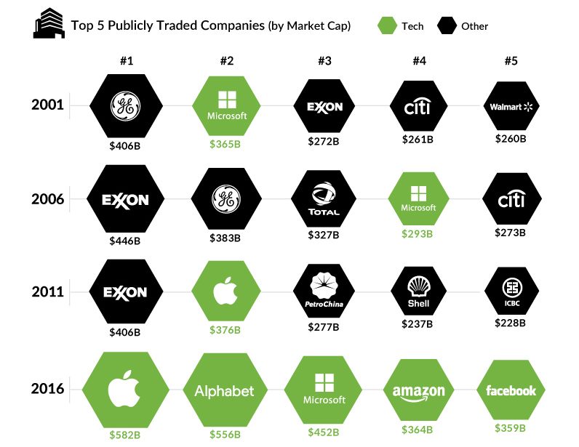
Platforms are overtaking energy and banking
Source: Visualcapitalist.com, Bloomberg
Notes:
Lightbulb lasts longer than your lease. Why would you buy?!?

Slide 3
Platforms are replacing Oil & Banking at the top
Top 7 Market Cap
$1.7 T
$1.5 T
$4.8 T
Notes:
Lightbulb lasts longer than your lease. Why would you buy?!?

Slide 4
Platforms employ an order of magnitude fewer resources
Firm | Start year | Employees | Mkt Cap ($B) | Ratio
BMW | 1916 | 131,000 | 51 | 389,300
Uber | 2009 | 16,000 | 76 | 4,750,000
Marriott | 1927 | 177,000 | 39 | 220,300
Airbnb | 2008 | 10,000 | 38 | 3,800,000
Walt Disney | 1923 | 199,000 | 163 | 819,000
Facebook | 2004 | 30,000 | 473 | 15,766,667
IBM | 1911 | 350,000 | 125 | 357,000
Salesforce | 1999 | 35,000 | 123 | 3,514,300
New York Times | 1851 | 3,700 | 6 | 1,621,600
Twitter | 2006 | 3,300 | 25 | 7,575,800
12x
17x
19x
10x
5x
Platforms are “inverted firms” having shifted production from inside to outside
Notes:
Lightbulb lasts longer than your lease. Why would you buy?!?

Slide 5
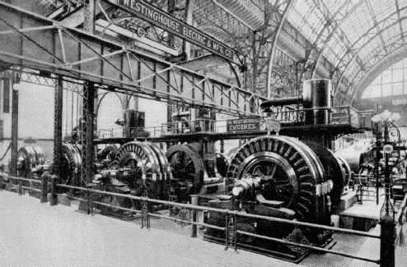
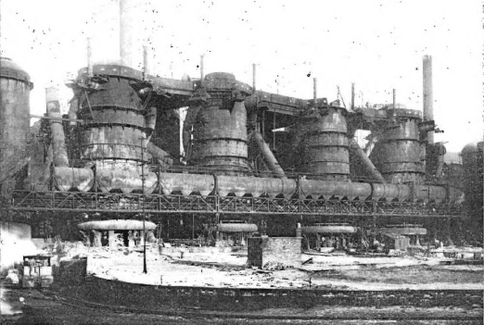
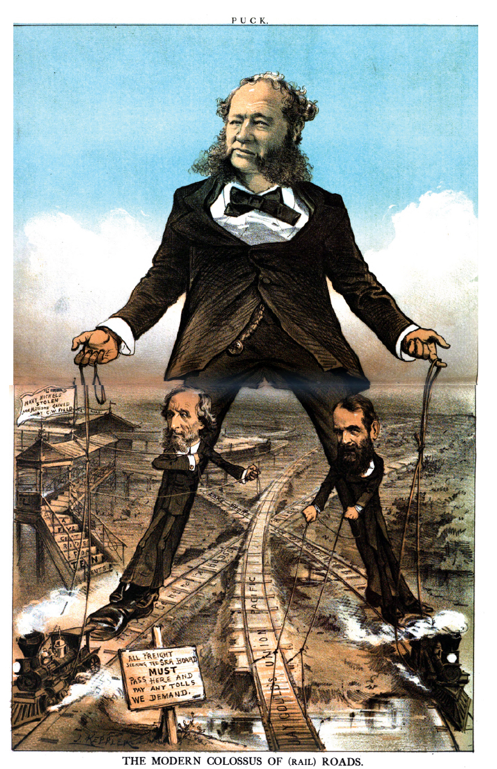
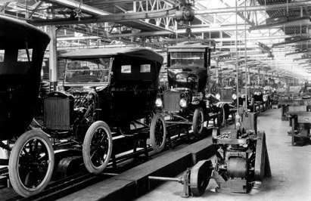
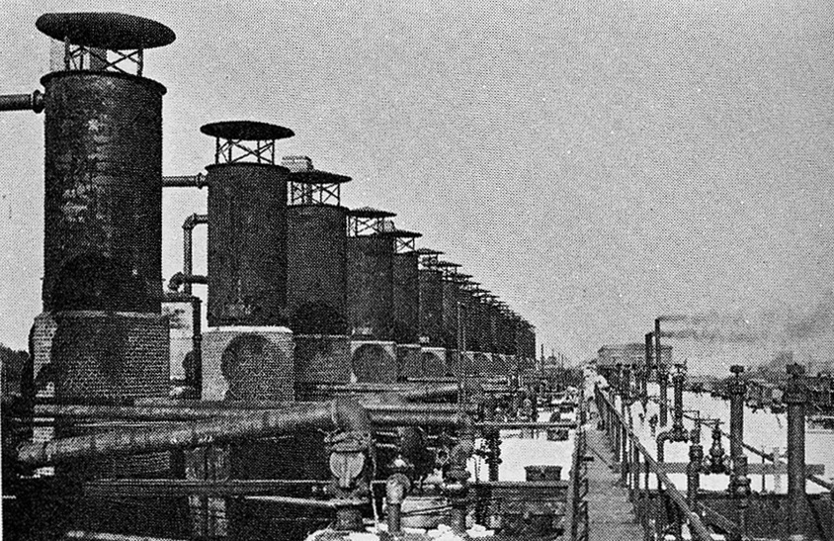
Giants of Supply Side Economies of scale
@InfoEcon
Electric
Dynamo
1893
Acklam Ironworks
1924
Ford Model T
1908
Standard Oil
1909
Vanderbilt
Colossus of
(Rail) Roads
Notes:
Ford Model T 1908-27
Locomotives 1860s
William Henry Vanderbilt Collosus of (rail) roads 1879
Westinghouse dynamo 1893
Blast furnace Acklam Ironworks Middleborough 1924
Rockefeller Standard Oil (Linden, US), Royal Dutch Shell (Netherlands)
Siemens co-invented electric motor without permanent magnets
Siemens laid first Indo European telegraph cable from Calcutta to London

Slide 6










Giants of Demand Side Economies of scale
Micro Blog
Now
@InfoEcon
Online Books
Desktop OS
Mobile
Social
Commerce
Social Networks
Merchant Mkts
Notes:
Bill Gates for OS
Dick Costolo (joined later)
Jack Ma - Alibaba
WeChat / Tencent / QQ– Ma Huateng worth 12B+
Mark Zuckerberg – more people than China
Professional Networks – LinkedIn, Reed Hoffman
Mobile operating systems – Android, Brin & Page
Taxi Service – Uber, Kalnikov
Hotels – Airbnb, (team)
Android 87% market share
Amazon 65% all online book (digital & print) http://www.theatlantic.com/business/archive/2014/05/amazon-has-basically-no-competition-among-online-booksellers/371917/
YouTube 77% market share online video https://www.statista.com/statistics/266201/us-market-share-of-leading-internet-video-portals/

Slide 7
Economies of Scale
@InfoEcon
Supply Econ of Scale
Demand Econ of Scale
Price
Demand
Demand
Supply
Supply
Quantity
Falling average costs
Monopoly production
Utilities, Semiconductors
Rising average value
Monopoly consumption
IM, Social Networks
Notes:
Lightbulb lasts longer than your lease. Why would you buy?!?

Slide 8
How is B2B Different from B2C?
Transaction
B2C is typically higher Value x Volume whereas B2B is typically higher Value x Volume. Network effects are usually easier with volume.
Fewer developers for B2B. Deeper expertise needed e.g. nuclear pwr, turbine engines, might need to employ directly. Enable employees of clients to help.
Do NOT overlook M2M. This could massively increase volume.
High
B2B
Value
Low
B2C
Low
High
Volume
Notes:
Honk Honk Catch a Taxi

Slide 9
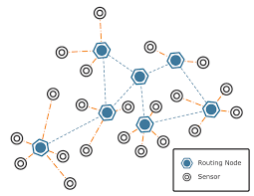
Platforms Exist on Top of Asset Heavy Industries
Hierarchal
Organization +
Physical Assets*
Platform
ecosystem
Example
Companies
Platform
Structure
Daimler Moovel
Johnson Controls Panopix
GE Predix
Asset Heavy
Apple App store
Amazon App store
HP SDN App Store
Samsung Samsung Apps
Mixed
Enterprise type
Google Google Play
Uber Uber app
Airbnb Airbnb app
Asset Light
* Includes HQ, other rooftops, retail outlets, manufacturing plants, service shops, etc.
Source: P. Evans, CGE; CB Insights, Capital IQ, 2015
Notes:
Lightbulb lasts longer than your lease. Why would you buy?!?

Slide 10


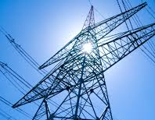

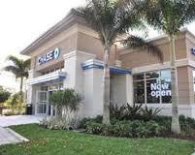
Criticality of the Data layer
New locus of value creation and capture
DATA Layer
DATA Layer
DATA Layer
DATA Layer
Physical Layer
Physical Layer
Physical Layer
Physical Layer
Agriculture
Energy
Healthcare
Banking
Source: P. Evans, CGE, 2015

Slide 11
Ready for Transformation
Transformation Checklist
@InfoEcon
Resistant to Transformation
High proportion of value from information (e.g. news, video)
Provides NFX spillover
Precise, fine-grained, modular output (e.g. tweet, ride, stay, retail)
Allows 3rd party supply / curation
Lightly regulated, fault tolerant (e.g. videos, apps, tweets)
Safe for experimentation
Spare Capacity (e.g. Uber, Airbnb, loans, after markets)
Utilization market, Decouple asset from use
High proportion of value from physical assets (e.g. mining, construction)
Prevents NFX sharing
Highly complex products / services (e.g. Boeing airplanes)
Prevents 3rd party supply
Highly regulated industries. Fault intolerant (e.g. pacemaker, nuclear pwr)
Dangerous experiments, malice
High utilization (e.g. surgeons, phones, perishables)
Own not rent
Notes:
Large fragmented communities/industries, not yet talking (e.g. IoT, law) – can’t get NFX. Joining communities moves from N^2, M^2, to O(M+N)^2. Method: reduce friction & add curation

