Slide 1
Energy Efficiency Resources
Capacity Obligations During Scarcity Conditions
New England States Committee on Electricity
November 12/13, 2019

Slide 2
Today’s Intent
Inform the Committee of our intention to move forward in proposing a tariff change that would implement Shaping Option A from the Demand Resources Working Group (DRWG) final report.
Seek additional feedback from the committee on the proposed change to better inform NESCOE’s understanding.

Slide 3
Background
During the Nov. 2018 – Mar. 2019 timeframe, the NEPOOL Market Committee was presented with different proposals to address settlement imbalances associated with Capacity Performance Payments during Capacity Scarcity Conditions (“CSCs”) in off-peak hours
On March 5, 2019, the NEPOOL Markets Committee instructed the Demand Resources Working Group (DRWG) to:
  Consider how energy efficiency resources (“EERs”) performance in all hours for existing and new measures could be established and what, if any, additional methodological standards and reporting mechanisms are required to accommodate such a change
The DRWG considered various different and described them in a report for the September 2019 MC meeting.

Slide 4
Summary of the Final Report*
Shaping Option A received the most support of the options discussed
  Preliminary analysis indicated that performance and load levels are generally correlated
  All of the inputs needed to estimate the ACP of EERs using Shaping Option A are available immediately after a CSC occurs
  Implementable at low cost and in reasonably short order after a FERC Order is issued
Shaping Option A was identified as the option requiring the least time and expense to develop and implement
There were significant difficulties with the other options:
  Three of the five other options require retrieval of data not previously captured or reported, and/or additional analysis that would increase cost and require more time to implement
  The Modelling Option will not be available until the 2021-2022 timeframe
  The bottom up approach would burden Market Participants with developing EER savings for all hours, which may not meet current precision and confidence interval requirements
* Slide 7 of September 18, 2019 ISO-NE presentation of the DRWG report

Slide 5
The Final Report Does Not Represent a Consensus*
Some asserted that Shaping Option A can overstate performance and give EERs an ACP exceeding their balancing ratio-adjusted Capacity Supply Obligation (“CSO”) during off-peak hours
  These participants argued that this does not make sense given that most end-use facilities are closed during non-business, overnight, and/or weekend hours
Others familiar with M&V and EER delivery responded to this by explaining:
  Many Energy Efficiency measures produce savings during off-peak hours – e.g., residential lighting, commercial lighting at retail stores, street lighting, parking lot lighting, security lighting, HVAC, refrigeration
    Some extent of EER performance during all off-peak hours is expected because savings are correlated with load
    These participants concluded that Shaping Option A would result in an accurate representation of the capacity delivered by EERs in any interval
  The ACP of an EER may exceed its balancing ratio-adjusted CSO because Market Participants with EERs tend to install more Energy Efficiency measures than the quantity needed to meet their CSO
Some who supported Shaping Option A as a feasible option requiring the least amount of time and expense to develop and implement did not necessarily support its use in establishing the ACP of EERs in off-peak hours
  Their preferred approach would be to treat EERs neutrally during off-peak hours
* Slide 8 of September 18, 2019 ISO-NE presentation of the DRWG report

Slide 6
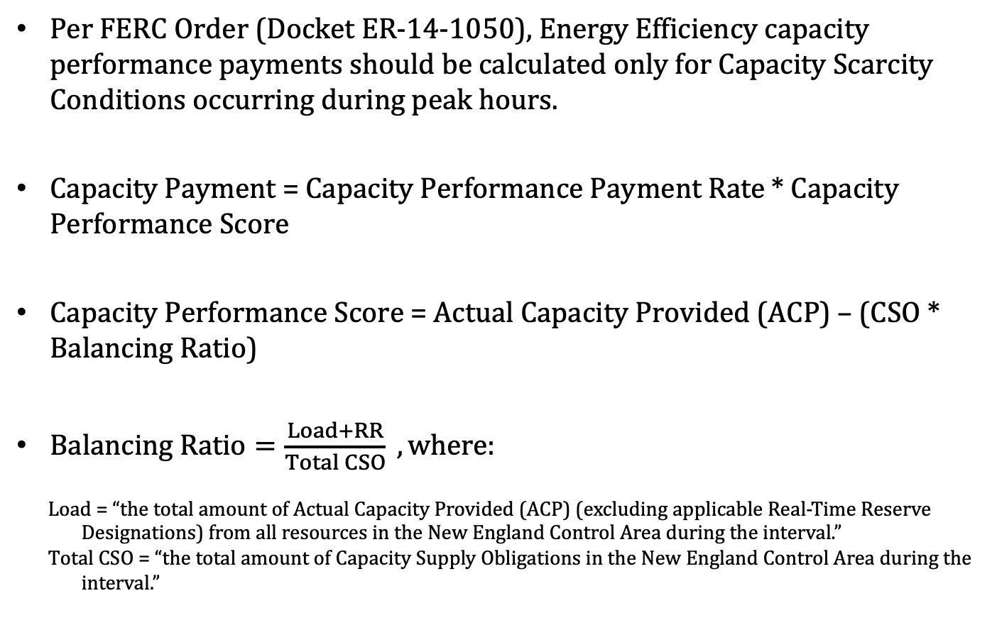
Current Treatment of EE During Off-Peak Hours
Per FERC Order (Docket ER-14-1050), Energy Efficiency capacity performance payments should be calculated only for Capacity Scarcity Conditions occurring during peak hours.
Capacity Payment = Capacity Performance Payment Rate * Capacity Performance Score
Capacity Performance Score = Actual Capacity Provided (ACP) – (CSO * Balancing Ratio)
$Balancing Ratio=\frac{Load+RR}{Total CSO} , where:$
    Load = “the total amount of Actual Capacity Provided (ACP) (excluding applicable Real-Time Reserve Designations) from all resources in the New England Control Area during the interval.”
    Total CSO = “the total amount of Capacity Supply Obligations in the New England Control Area during the interval.”

Slide 7
Current Treatment of EE During Off-Peak Hours
Tariff Treatment of Energy Efficiency during Off-Peak Hours
      III.13.7.2.2.(c)(i) states that Actual Capacity Provided (ACP) “shall be zero” during intervals outside of Seasonal Peak Hours or On-Peak Hours.
      III.13.7.2.4 states that ACP and Capacity Supply Obligations (CSOs) “shall be excluded” from the EE’s performance score calculation during CSCs occurring outside of On-Peak or Seasonal Peak hours.
  Energy Efficiency CSOs are not excluded from the “Total CSO” denominator of the balancing ratio; however, EE ACP is excluded from the “Load” portion of the numerator.
  Thus the Balancing Ratio is depressed, resulting in more overperformance payments than underperformance penalties.
      This is the cause of the “settlement shortfall” experienced on Labor Day 2018.
In order to ensure that the Balancing Ratio accurately reflects system conditions, the ratio must either:
      Recognize some ACP from Energy Efficiency during off-peak hours; or
      Remove Energy Efficiency CSOs from the Total CSO value

Slide 8
NESCOE Considerations
  Under the current implementation, EE resources are guaranteed to always incur a penalty during any event that occurs outside of On-Peak or Seasonal Peak hours.
    This contradicts the language in the FERC order.
  Providing certainty to EER’s is important to New England states
  Shaping Option A meets ISO-NE’s original PFP “no excuses” concept
    Does so in a manner that still requires the existing level of metering costs, but does not require EER’s to incur significant additional costs to measure and verify their load reductions

Slide 9
Proposed Solution
Shaping Option A approximates the performance of energy efficiency during off-peak hours in order to provide an ACP input into the Balancing Ratio
Once ACP has been calculated, it is also used to determine EE’s performance score.
ACP is determined as a function of load.
Option is preferred for three (3) reasons:
  Simple to implement
  Does not require EE to “incur significant costs to measure and verify their load reductions around-the-clock” (see FERC order at pg. 35, ¶ 89)
  Backed by prior studies demonstrating relationship between EE performance and load.

Slide 10
Energy Efficiency Performance as a Function of Load is a Valid Assumption
“Publicly available data on end-use load and energy savings shapes are limited, concentrated regionally, and should be expanded.”
  Source: Berkeley Lab ‘Time Varying Value of Electrical Energy Efficiency’ July 10, 2017 Presentation and Report PDF links at https://emp.lbl.gov/publications/time-varying-value-electric-energy.
Energy efficiency resources are not similarly situated to other capacity resources because they do not actively perform in real-time—they represent a pre-determined level of load reduction that is constant as a percentage of that resource’s load—and therefore are not able to respond to the ISO-NE proposal’s performance incentive
  FERC Order (Docket ER-14-1050)
There is evidence that Energy Efficiency ‘Energy-to-Peak’ ratios of 0.55-0.59 do correlate well with ISO-NE load factor (0.54 in 2018)
  The Brattle Group “Assessment of Load Factor as a System Efficiency Earning Adjustment Mechanism” February 10, 2017 pp 6-7
  http://documents.dps.ny.gov/public/Common/ViewDoc.aspx?DocRefId=%7B92F01814-118C-4BCA-9B42-5A81B4205BAD%7D
Note: Information as previously presented by ISO-NE at DRWG Meeting in April 2019

Slide 11
Energy Efficiency Performance as a Function of Load is a Valid Assumption
Review of Energy Efficiency Measure (EEM) data currently participating in ISO-NE FCM indicates wide diversity of measures and end use types though lighting is dominant
Note: Information as previously presented by ISO-NE at DRWG Meeting in April 2019

Slide 12
Next Steps
Continue to seek stakeholder feedback.
Work with ISO-NE to create the appropriate tariff and manual changes needed to implement Shaping Option A.
Present those changes at the December NEPOOL Market Committee meeting.
Seek a January 2020 NEPOOL Market Committee Vote.
Seek a NEPOOL Participants Committee vote in February 2020.

Slide 13
appendix
Detailed Description of Shaping Option A
For more details, see Final Report, pp. 7-9.
See ISO-NE September 18, 2019 presentation

Slide 14
  Shaping Option A: Hourly EER Performance as a Function of On-Peak Savings and System Load Levels
  Savings produced by a portfolio of Energy Efficiency measures affecting a cross-section of end-use applications should be greater during high-load periods, and lower during low-load periods
Preliminary analysis indicate that the performance of EERs and load levels are correlated
Building on this concept, on-peak energy savings could be allocated to all hours based on load levels
Hourly EER performance is correlated to hourly energy consumption levels, but observed ISO System Load is net of the impact of behind-the-meter (BTM) generation
  The largest component of BTM generation is PV, and this component continues to grow significantly
  Hourly EER performance should be based on system loads that have been reconstituted (increased) by data on BTM PV performance
  The ISO presented refinements to Shaping Option A, which were discussed on April 18 and 29 – See: https://www.iso-ne.com/static-assets/documents/2019/04/ee_performance_evaluation_revised_option_a_4_23.pptx

Slide 15
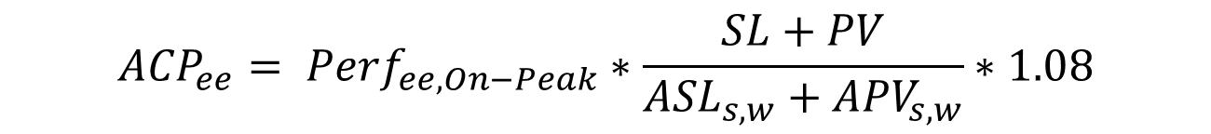
On-Peak Demand Resource Shaping Proposal
$${{ACP}_{ee}= Perf}_{ee, On−Peak}∗\frac{SL+PV}{{ASL}_{s,w}+{APV}_{s,w}}∗1.08$$
Where:
  ACP_{ee}= Actual Capacity Provided by the EER
  Perf_{ee, On-Peak} = The EER’s reported On-Peak performance for the month
  SL = System load during CSC interval
  PV = BTM PV during CSC interval
  ASL_{s,w} = Average System Load during On-Peak hours of most recently completed 3 summer or 2 winter performance months
  APV_{s,w} = Average BTM PV output during On-Peak hours of most recently completed 3 summer or 2 winter performance months
  1.08 = gross-up for avoided T&D losses

Slide 16
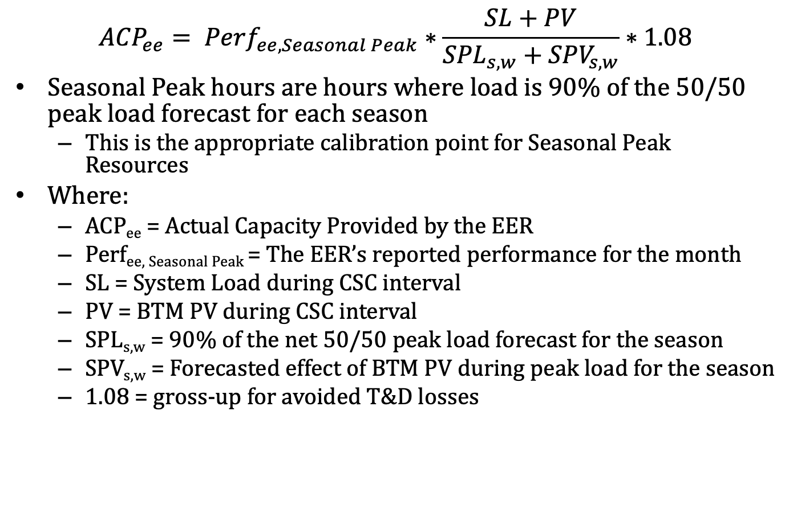
Seasonal Peak Demand Resource Shaping Proposal
$${{ACP}_{ee}= Perf}_{ee,Seasonal Peak}∗\frac{SL+PV}{{SPL}_{s,w}+{SPV}_{s,w}}∗1.08$$
Seasonal Peak hours are hours where load is 90% of the 50/50 peak load forecast for each season
  This is the appropriate calibration point for Seasonal Peak Resources
Where:
  ACP_{ee} = Actual Capacity Provided by the EER
  Perf_{ee, Seasonal Peak} = The EER’s reported performance for the month
  SL = System Load during CSC interval
  PV = BTM PV during CSC interval
  SPL_{s,w} = 90% of the net 50/50 peak load forecast for the season
  SPV_{s,w} = Forecasted effect of BTM PV during peak load for the season
  1.08 = gross-up for avoided T&D losses

