Slide 1
November 12-13, 2019| Markets committee
ENERGY SECURITY IMPROVEMENTS: MARKET-BASED APPROACHES
Discussion of the Forecast Energy Requirement and Energy Imbalance Reserves
Ben Ewing
413.535.4361 | Bewing@iso-ne.com

Slide 2
Winter Energy Security Improvements
WMPP ID:
125
Proposed Effective Date: June 1, 2024
In accordance with FERC’s July 2, 2018 order in EL18-182-000, the ISO must develop and file improvements to its market design to better address regional fuel security, and file by April 15, 2020
Key Projects – Energy-Security Improvements
Discussion paper 2019-04-09 and 2019-04-10 MC A00 ISO Discussion Paper on Energy Security Improvements – Version 1

Slide 3
Prior Energy-Security Improvement Presentations
September ESI presentation
August ESI presentation
July 30 ESI presentation
July 8-10 ESI presentation
June ESI presentation
May ESI presentation
April ESI presentation

Slide 4
Acronyms
For brevity and clarity of messaging the following acronyms may be used in this presentation
DA or DAM - Day-Ahead Market
EIR - Energy Imbalance Reserve
ESI - Energy Security Improvements
FER - Forecast Energy Requirement constraint
FS - Fast-Start resources
IPR - Intermittent Power Resources
RAA - Reserve Adequacy Assessment
RT - Real-Time

Slide 5
Today’s Presentation Agenda
Our goal today is to address stakeholder questions and concerns regarding the Forecast Energy Requirement (FER) constraint, the Energy Imbalance Reserve (EIR) awards that may clear to satisfy that constraint, and the existing RAA process
First, review how the FER works today
Discuss how the FER is applied in the existing RAA process
Review historical data for insights
Then, review the FER under ESI
Discuss how the FER will be applied in the DAM
Discuss a practical simplification – an “online” approach to EIR clearing

Slide 6
FER Overview
The FER constraint ensures that the ISO has a current operating plan that can meet forecast load throughout the next operating day
See July 3, 2019 ISO memo on the FER-related reliability standards
Today, the FER is applied after the clearing of the DAM, through the RAA process – an ‘out-of-market’ approach
Physical generation, net scheduled interchange, and, when needed, supplemental commitments are used to satisfy the FER today
Under ESI, the FER constraint will be applied in the clearing of the DAM
Physical generation, net scheduled interchange, and EIR awards will be used to satisfy the FER

Slide 7
A market approach to improved energy security
Applying the FER in the DAM will:
Ensure the market produces reliable operating plan that can meet the forecast energy requirement
Current approach, through RAA, is an out-of-market process
Improve energy security, by providing resource capability not presently cleared DA with a DA award, DA compensation, and greater incentives to ensure they can deliver energy in real-time
Signal to the market, through transparent prices, the cost of a reliable next-day operating plan

Slide 8
‘Commitment’ can mean different things
Commitment Schedule
Initially produced by the clearing of the DAM, issued to physical resources with cleared energy awards
Resources (non-FS, non-IPR) with a commitment schedule should anticipate running during these hours in real-time
Commitment Evaluation
RAA process evaluates need for additional resources that do not have a commitment schedule from the DAM
RAA process may issue additional commitment schedules as needed
Commitment Instruction
Non-FS: a phone call from ISO requesting the resource to start up at a specific time during the operating day
FS: an electronic dispatch signal instructing the resource to operate

Slide 9
How the FER works today
In this section, we will
Discuss how the FER works today, in the RAA process
Review recent historical data from the DAM and RAA outcomes for insights

Slide 10
How the FER is applied today
Today, the ISO clears the DAM using a single energy demand curve, and a single energy balance constraint
Offered energy supply is cleared against bid-in energy demand (FER is not considered)
This yields an hourly commitment schedule for each (non-FS, non-IPR) cleared supply resource
Today, the FER constraint is applied after the DAM clears, as part of the RAA process
The FER constraint is effectively a second energy “demand” curve
It is satisfied by the RAA’s out-of-market optimization process (if not already satisfied by the DAM process)

Slide 11
Key inputs to the RAA process
Demand:
Forecast load
Operating reserve requirements
Note: Bid-in energy demand is not considered in the out-of-market RAA process
Supply:
Resources (non-FS, non-IPR) with DAM commitment schedules
DAM cleared net interchange
Available FS resources
Expected real-time output of IPRs

Slide 12
Timeline – developing a reliable operating plan
09:30 – Load Forecast is finalized and published
10:00 – DAM clearing begins
13:30 – DAM clearing finalized
DA commitment schedules and cleared net scheduled interchange are established and distributed
14:00 – Re-offer window closes, RAA process begins
17:00 – RAA process complete
RAA commitment schedules are provided to resources (note: not financially binding)
Resource-specific Wind Forecast is updated every three hours
00, 03, 06, etc.
Wind forecast is fairly static between running of DAM and RAA
Items in blue text are RAA inputs

Slide 13
Commitment Evaluation performed by RAA
RAA commitment evaluation ensures that the available supply can satisfy the energy (FER) and operating reserve requirements
FER and reserve requirements are satisfied by a second commitment and dispatch optimization, that:
Can “dispatch up” a resource with a DA commitment schedule, above its DA energy award
Can extend the run-time of a resource with a DA commitment schedule
May schedule additional generation (a ‘supplemental commitment’ of a unit without a DA commitment schedule) - more on this next
The RAA’s commitment objective function minimizes the system’s incremental commitment costs to satisfy the FER and operating reserve requirements, starting with the DAM commitment schedules

Slide 14
Supplemental Commitments in the RAA
In order to complete a reliable next-day operating plan, the RAA process may schedule additional generation for two main reasons:
To ensure sufficient physical supply to meet FER (energy) and operating reserve requirements
In ISO operations presentations and reports, these are collectively referred to as supplemental commitments for “Capacity ”
To address reliability concerns that were not resolved in the DAM clearing
Ex: Voltage support, Local Control Center request, extreme storms
Often, commitments for these reasons can be (and are) incorporated in the DAM
RAA supplemental commitments are rare in recent years – more on this ahead

Slide 15
Supplemental Commitments in Real-Time
Supplemental commitments may also be made during the operating day, in real-time, in response to changing system conditions
Supplemental commitments are indicated on the ISO’s Morning Report
Additional information on RAA and real-time supplemental commitments is provided in the Operator-Initiated Commitment reports (since January 2019)

Slide 16
Observations on Supplemental Commitments
Today, RAA supplemental commitments are out-of-market actions
The costs of resources scheduled out-of-market are not reflected in DA market prices
Supplemental commitments can result in RT LMPs that are higher or lower than DA LMPs
If supplemental commitment resource replaces a less expensive resource that becomes unavailable, RT LMPs can be higher than DA LMPs
If supplemental commitment resource addresses an forecast energy gap that does not materialize, RT LMPs can be lower than DA LMPs
See the ISO’s February 2015 technical session “Real Time Price Formation: Supplemental Commitments” for detailed examples

Slide 17
Timing of Commitment Schedules
Resources receiving commitment schedules from the DAM or RAA are informed electronically as soon as the commitment schedules are finalized
13:30 – DAM commitment schedules are issued
These are financially binding
17:00 – RAA commitment schedules are issued
These reflect changes from the DAM commitment schedule: re-dispatch, extensions of run-time, and supplemental commitments
These are not financially binding

Slide 18
Timing of Commitment Instructions
Resources with commitment schedules (non-FS, non-IPR) receive commitment instructions via a phone call from ISO operators the evening prior to the operating day
Applies regardless of scheduling process source (DAM or RAA)
Confirms specific operational expectations for next day (time of breaker close, etc.)
FS resources receive commitment instructions via electronic dispatch only during operating day
IPRs do not receive commitment instructions from the ISO

Slide 19
Key Points: Satisfying the FER through the RAA
Today, the FER is applied after the DAM, as part of the RAA process
The RAA process can, if necessary, make supplemental commitments to satisfy the FER
Such supplemental commitments are rare
RAA actions to satisfy the FER are out-of-market actions
Re-dispatch of resources with DAM commitment schedules, extension of DAM commitment schedules, supplemental commitments
The cost of these RAA actions are not reflected in DA market prices

Slide 20
Recent Historical data
In this section, we’ll review historical data from the DAM for insights as to how the FER is typically satisfied

Slide 21
DAM produces excess supply capability
After the DAM clearing, there is typically an excess of supply capability available to meet the FER and operating reserve requirements
Today, this capability is relied upon to satisfy reliability requirements
Today, there is no pricing or compensation associated with providing this capability
More on the sources of this excess supply capability in a few slides
As a result, supplemental commitments in the RAA process are rare
There have been zero supplemental commitments to meet the FER and operating reserve requirements (i.e., for “Capacity”) in the RAA process to date in 2019.

Slide 22
Comparing the available supply to the demand
The following slide depicts, for 2019
Day-ahead total hourly “available” supply expected prior to the RAA process, and
Day-ahead hourly forecast load plus operating reserve requirement
“Available” supply means, in this context:
Total hourly MW capability (i.e. EcoMax) of all resources (non-FS, non-IPR) with a DA commitment schedule in that hour ; plus
Hourly available FS resource capability; plus
Expected hourly real-time output of IPRs; plus
Hourly cleared DAM net interchange (positive for net imports, negative for next exports)

Slide 23
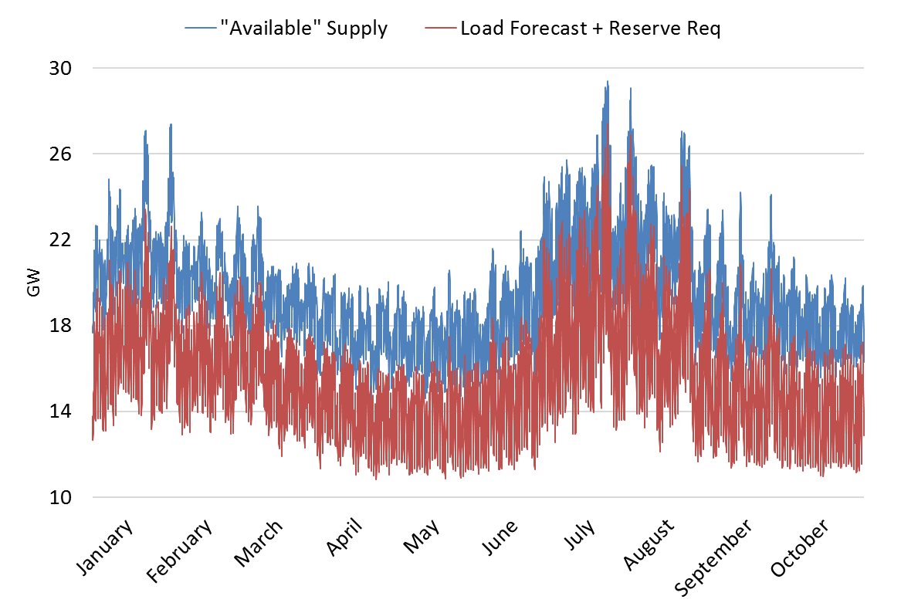
DA total hourly supply vs. demand (2019)

Slide 24
The DA excess supply capability
The following slide depicts the day-ahead excess supply capability - the difference between “available” supply and expected demand
Contributors to this excess supply capability:
Resources (non-FS, non-IPR) with DAM commitment schedules and with DAM energy schedules below their EcoMax
In simple terms: the DAM-uncleared capability, or headroom, of “online” scheduled generation
Forecast IPR output in excess of their DAM cleared energy
Fast start resources, which are available in RT with or without a DAM commitment schedule

Slide 25
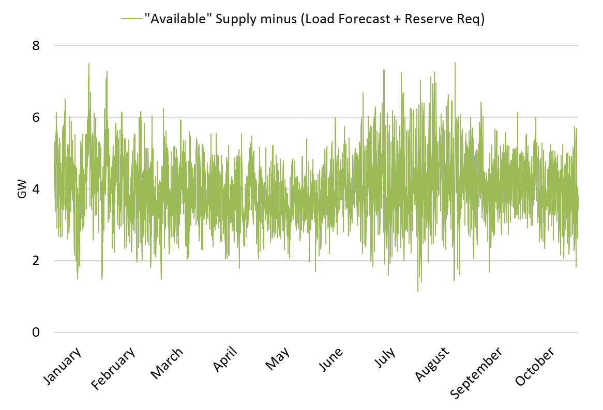
The DA excess supply capability (2019)

Slide 26
The DA excess supply capability (2019)
On average, across all hours, the breakdown of this excess supply capability (after satisfying FER and reserve requirements) is as follows:
Type | MW | %
Non-FS, Non-IPR Resources | 1,300 | 32%
FS Resources | 2,800 | 68%
Total | 4,100 | 100%

Slide 27
Takeaways from historical data
There is substantial excess “available” supply capability after the DAM that the ISO counts toward meeting the FER and next-day operating reserve requirements presently
As a result, in recent years, supplemental commitments in the RAA are rare
As noted previously:
ISO currently relies upon this capability to achieve a reliable next-day operating plan
However, there is currently no market compensation for these MW (which are uncleared in the DAM)

Slide 28
FER in the DA market under ESI
In this section, we will
Discuss why and how the FER will be applied in the DAM
Discuss a proposed revision (from prior discussions) for how EIR is cleared

Slide 29
Recap: Benefits of applying FER in-market
Ensure the market produces reliable operating plan that can meet the forecast energy requirement
As noted, current practice is out-of-market
Improve energy security, by providing resource capability not presently cleared DA with a DA award, DA compensation, and greater incentives to ensure they can deliver energy in real-time
Signal to the market, through transparent prices, the cost of a reliable next-day operating plan

Slide 30
Recap: DAM will have two energy constraints
Conceptually, there will be two demand curves for energy in the DAM:
(1) Bid-in energy demand of market participants.
Same as today
(2) Forecast energy requirement
New to the DAM ; exists out-of-market today
Mechanically: There will be two energy constraints applied in the DAM co-optimization
(1) Existing: clear offered supply to satisfy bid-in demand
DA LMP = constraint 1 shadow price. Same as today.
(2) New to DAM: simultaneously clear physical energy supply offers and/or energy options (EIR) to satisfy the FER
FER price = constraint 2 shadow price. New.

Slide 31
Recap: Pricing follows standard principles
A market with two demand curves for energy produces two prices
Each price reflects the system’s incremental cost of satisfying each demand curve, at the margin
The incremental cost includes the marginal resource’s opportunity costs, if present
See example from July MC, slides 29-34
Conceptually:
DA LMP is the incremental cost to satisfy another unit of bid-in energy demand
FER price is the incremental cost to satisfy another unit of forecast energy demand

Slide 32
Recap: Compensation follows standard principles
Compensation follows the ‘participation payment principle’: offers cleared to help satisfy a constraint receive the shadow price of that constraint
See August MC, slides 15-17
A MWh of cleared energy, or of cleared energy option, is compensated for the value it provides in avoiding the need to purchase another, more costly MWh at the margin
Practical Implications:
Cleared physical energy supply offers satisfy both constraints, so are paid both prices: LMP and FER price
Cleared EIR options satisfy only the FER, so are paid only the FER price (= EIR price)
Cleared INCs satisfy only bid-in energy demand, so are paid only the DA LMP

Slide 33
The FER price is not uplift
Uplift is a resource-specific payment, providing cost recovery when a pool-scheduled resource’s energy offer prices are not covered by LMPs
The FER price is the shadow price of a modeled constraint, and reflects the incremental cost of preparing the system to meet forecast real-time load
The FER price is distinct from uplift
It represents the marginal cost of satisfying a market-wide reliability requirement
It is a uniform, transparent price paid to all resources contributing to satisfying this constraint, and
It is not resource-specific, and is it not intended to provide energy offer-cost recovery

Slide 34
Commitment of Resources with EIR awards
In this section, we’ll discuss a proposed revision to how EIR is cleared

Slide 35
Stakeholder questions about EIR and commitment
The ISO previously indicated that a resource could receive an EIR award regardless of whether it had a DA commitment schedule for energy
ISO also indicated that EIR awards will respect a unit’s physical parameters, such as Min Run Time, Min Down Time, etc.
This raised stakeholder questions regarding the commitment process for resources with EIR awards but without a DA commitment schedule for energy (i.e., “offline” resources):
Would such a resource receive a commitment schedule?
When would such a resource receive a commitment instruction?
Should such resources be ‘automatically’ committed?

Slide 36
Technical review has highlighted challenges
The ISO has further evaluated how EIR clearing, and any subsequent commitment schedules and commitment instructions, would work
Technical Issue: Clearing EIR on “offline” non-FS resources requires increasing the number of integer commitment variables in the DAM clearing
These are needed to respect Min Run Time and Min Down Time
This adds significant complexity to DAM optimization
Practical Consequence: the optimization required to clear EIR on “offline” non-FS resources could adversely impact DAM solve time
Difficult to estimate impact until future software development

Slide 37
Practical resolution: an “online” EIR approach
Recommendation: To address this complexity, and reduce risk for the initial ESI implementation, allow EIR to clear on the following sets of resources
Resources (non-FS) that have a DA commitment schedule – units that are “online” for energy
The existing commitment variable (for energy) will allow for proper consideration of intertemporal constraints
Fast-start resources (both “online” and “offline”)
An additional EIR commitment variable for each FS resource will not add intertemporal complexity, due to the inherent flexibility of these resources.

Slide 38
Practical resolution: an “online” EIR approach
In practice, the “online” EIR approach can yield the following outcomes from the DAM optimization in any given hour
Resource Type | Energy Award only | Energy and EIR Awards | EIR Award only
Non-Fast Start | ✓ | ✓ | ✗
Fast Start | ✓ | ✓ | ✓

Slide 39
“Online” EIR approach is not exclusionary
It’s important to note that no resources are explicitly excluded from receiving an EIR award under this approach
The DAM optimization algorithm can issue any non-FS resource a commitment schedule for energy in order to clear EIR on it
These awards, to satisfy bid-in demand and the FER constraint, will be made on a social-welfare maximizing basis

Slide 40
“Online” EIR approach: economic considerations
Expectation: “Online” EIR approach would tend to yield similar outcomes to approaches which allow clearing of EIR on “offline” non-FS resources
The ISO expects that EIR may “naturally” clear on resources with DA energy schedules
Why? Resources with lower marginal costs will tend to have lower risk premiums, and therefore lower energy option offers
The DAM clearing may award EIR to “online” resources in their MW range that, today, is part of the day-ahead excess supply capability
That MW range on “online” resources receives no DAM compensation today

Slide 41
DAM provides ample supply for “online EIR” approach
The data on slides 25-26 indicate that in nearly all hours, there exists ample excess supply capability to clear as EIR
Non-FS resources with DA commitment schedules for energy
Available FS resources
These data show excess supply capability in excess of FER and reserve requirements

Slide 42
Back to stakeholder commitment questions
The “online” EIR approach also resolves concerns about whether, and when, non-FS resources with cleared EIR awards would be committed
All non-FS resources with cleared EIR awards will also be cleared for energy DA
All non-FS resources will receive DA commitment schedules and commitment instructions in the same timeframe that they do today
Real-time operational practices are unchanged
Real-time dispatch will dispatch non-FS resources above their DA energy award levels (i.e., into their possible “EIR award range”) based on economics

Slide 43
“Offline” EIR approaches considered
In theory: Awarding EIR to “offline” non-FS units could be more efficient
The efficiency of such an approach results from starting an offline, EIR-awarded resource only if needed during the operating day
In practice: our expectation is that such benefits are likely to be minimal
The current DA excess supply capability exceeds the FER nearly every hour (recall: supplemental commitments are rare)
The ISO can revisit this issue in the future, when better tools and information are available to:
Study “offline” EIR feasibility and measure DAM solve-time impacts
Assess economic efficiency gained from “offline” EIR

Slide 44
Summary: “Online” EIR is a practical approach
The ISO proposes the “Online” EIR approach for its initial ESI implementation
For non-FS resources, award EIR to resources with a DA commitment schedule for energy in the same hour
FS resources can receive EIR awards regardless of whether “online” or “offline”
This approach will:
Reduce initial implementation complexity and risk
Continue existing commitment schedule/instruction processes
This approach is a reasonable initial implementation approach for clearing EIR
It does not preclude consideration of an “offline” EIR in the future, if improved modeling capabilities indicate significant benefits

Slide 45
Takeaways and next steps

Slide 46
Takeaways
Including the FER in the DAM is a market solution to ensuring the ISO is able to meet the forecast load in real-time
It better signals the cost of a reliable next-day operating plan, and provides both compensation and incentives to improve energy security in New England
Ample DA excess supply capability exists to meet the FER
Today, supplemental commitments in the RAA process are rare (zero in 2019 to date)
An “online” EIR approach is reasonable and practicable, and can be refined in the future as technology permits

Slide 47
Stakeholder Schedule for ISO Proposal
Stakeholder Committee and Date | Scheduled Project Milestone
Markets Committee November 2019 | Further explanation of how the forecast energy requirement is applied today and review of the forecast energy requirement under ESI; Discussion of impact analysis modeling enhancements; Discussion of ISO memo on plans for developing mitigation of day-ahead ancillary services
Markets Committee December 2019 | Discussion of ISO proposal, refinements as needed; Discussion of impact analysis modeling results;
Markets Committee January 2020 | Discussion of ISO proposal, refinements as needed; Draft ISO Tariff language; Continued discussion of impact analysis modeling results; Discussion of conceptual mitigation design; Update on initial forward market construct assessment
Markets Committee February 2020 | Final review of draft ISO Tariff language and wrap-up; Discussion of draft impact analysis report; Continued discussion of conceptual mitigation design; Discussion of the forward market construct
Markets Committee March 2020 | Continued discussion of conceptual mitigation design; Continued discussion of forward market construct including future plans; Vote on ISO proposed Tariff language and submitted stakeholder amendments
Participants Committee April 2, 2020 | Vote on ISO proposed Tariff language and submitted stakeholder amendments

