Slide 1
November 19, 2019 | Westborough, ma
Estimated Hours of System Operating Reserve Deficiency for CCP 2023-2024 (FCA 14)
With and Without Mystic 8 & 9
Fei Zeng
Resource Studies and assessments

Slide 2
Objective
To provide information regarding the estimates of hours of system operating reserve deficiency for Capacity Commitment Period (CCP) 2023-2024
Prior studies:
Study conducted in 2013 for CCP 2016-2017
http://www.iso-ne.com/static-assets/documents/committees/comm_wkgrps/mrkts_comm/mrkts/mtrls/2013/jul10112013/a12a_iso_memo_07_05_13.pdf
Study conducted in 2016 for CCP 2020-2021
https://www.iso-ne.com/static-assets/documents/2016/12/iso_memo_operating_reserve_deficiency_dec_19_2016.pdf
Study conducted in 2017 for CCP 2021-2022
https://www.iso-ne.com/static-assets/documents/2017/12/pspc_oprting_resrve_deficiency_memo_12072017.pdf
Study conducted in 2018 for CCP 2022-2023
https://www.iso-ne.com/static-assets/documents/2018/12/pspc_oprting_resrve_deficiency_memo_12072018.pdf

Slide 3
Study Assumptions
Resources and load assumptions are based on those presented to the Power Supply Planning Committee (PSPC) on May 30, 2019 for developing the Installed Capacity Requirement (ICR) – Related Values* for FCA 14
Two scenarios, with and without Mystic 8 & 9, are simulated
https://www.iso-ne.com/static-assets/documents/2019/07/loadandresourceassumptionsforfca14revision4.pptx
Operating Reserve requirement
2,305 MW
Resources and load relief available during ISO New England Operating Procedure No. 4, Action During a Capacity Deficiency (OP-4), are assumed available after the declaration of a reserve deficiency
Tie benefits
1,940 MW for scenario with Mystic 8 & 9
1,910 MW for scenario without Mystic 8 & 9
Load relief from implementing 5% voltage reduction
1% of 90/10 peak net of the Behind-the-Meter PV and demand resources = 270 MW
Depletion of operating reserve to a minimum of 700 MW
* The ICR, net ICR, Local Sourcing Requirement, Maximum Capacity Limits, Marginal Reliability Impact (MRI) system and zonal Demand Curves and the HQICCs are collectively referred to as the ICR-Related Values

Slide 4
Study Approach
Start with the ICR model using the assumptions as specified in the prior slide
Calculate the expected number of hours per year in which there are insufficient resources to meet the New England system-wide load and reserve requirements
Scale the system load up or down to a chosen system installed capacity margin (in 400 MW increments above or below the net ICR)
The 400 MW increment size is based on the most recent study to determine the size and characteristics of proxy units*
The purpose of scaling the load up or down is to mimic the condition of the system installed capacity margin being long or short
Calculate the expected number of hours per year in which there are insufficient resources to meet the system’s load and reserve requirements at the chosen system installed capacity margins
* The 2014 proxy unit study is available at: http://www.iso-ne.com/static-assets/documents/committees/comm_wkgrps/relblty_comm/pwrsuppln_comm/mtrls/2014/may222014/proxy_unit_2014_study.pdf

Slide 5
Study Approach, cont.
The study does not consider:
Operational constraints associated with the generation resources such as ramp rates, minimum up/down times, maximum number of starts per day, etc.
Operational requirements associated with unit commitment/economic dispatch
Generating resource unavailability associated with lack of fuel supply, violation of generation air emission guidelines, etc.
Transmission constraints associated with transmission outage due to maintenance, construction associated with system upgrades or unforeseen loss of transmission elements
Operational risks associated with under commitment of resources due to load forecast error or loss of resources due to abnormal weather conditions

Slide 6
Interpretation of Study Results
This analysis can be considered as an extension of the ICR calculation
Use the same model and underlying assumptions
Load and resource availability are also the main drivers
Focus on the risk of not having adequate amount of installed capacity to satisfy load and operating reserve requirement instead of meeting the 0.1 days/year Loss of Load Expectation
This analysis simulates all the hours of year, but the reserve deficiency hours are observable only during the summer months
High load conditions during the summer
Conditions, listed in the prior slide, that could trigger reserve shortage hours any time of the year are not modeled

Slide 7
Interpretation of Study Results, cont.
The table in the next slide provides a summary information regarding (a) the expected number of hours of operating reserve deficiency conditions annually, and (b) the estimated relative frequency of hours of operating reserve deficiency conditions annually
Entries in “Expected” column are the average hours; entries in the column titled “5 / 95” indicate the lower 5th percentile of the simulation results for the number of hours with system operating reserve deficiency conditions; entries in the “50 / 50” column indicate the median hours; and entries in the “95 / 5” column show the 95th percentile
For example, in the results of the analysis with Mystic 8 & 9, the value 0.5 in the first row under “5 / 95” column means that, based on the model, there is a 1-in-20 (or 5%) chance that the annual total hours with operating reserve deficiency conditions would equal 0.5 hour or less when installed capacity equals net ICR plus 3,200 MW. Similarly, the value of 2.0 in the far-right “95 / 5” column means that, based on the model, there is a 19-in-20 (or 95%) chance that the total hours with operating reserve deficiency conditions would be 2.0 or less annually

Slide 8
Study Results – CCP 2023-2024, cont.
Estimated annual hours of system operating reserve deficiencies
Capacity Level | Expected |  | 5 / 95 |  | 50 / 50 |  | 95 / 5
 | w/ | w/o | w/ | w/o | w/ | w/o | w/ | w/o
net ICR + 3,200 MW | 0.9 | 1.1 | 0.5 | 0.5 | 0.8 | 0.8 | 2.0 | 2.5
net ICR + 2,800 MW | 1.3 | 1.4 | 0.6 | 0.6 | 1.0 | 1.1 | 3.0 | 3.6
net ICR + 2,400 MW | 1.7 | 2.0 | 0.7 | 0.8 | 1.3 | 1.5 | 4.1 | 4.8
net ICR + 2,000 MW | 2.4 | 2.8 | 1.0 | 1.0 | 1.8 | 2.1 | 5.8 | 6.9
net ICR + 1,600 MW | 3.5 | 4.0 | 1.2 | 1.3 | 2.7 | 3.1 | 8.3 | 9.7
net ICR + 1,200 MW | 5.0 | 5.7 | 1.8 | 1.9 | 4.1 | 4.5 | 11.6 | 13.5
net ICR + 800 MW | 7.1 | 8.1 | 2.5 | 2.9 | 5.9 | 6.6 | 15.8 | 18.0
net ICR + 400 MW | 10.1 | 11.3 | 3.9 | 4.4 | 8.5 | 9.5 | 21.3 | 24.2
net ICR | 14.1 | 15.6 | 5.8 | 6.4 | 12.4 | 13.8 | 28.1 | 31.9
net ICR - 400 MW | 19.4 | 21.3 | 8.4 | 9.3 | 17.5 | 19.2 | 36.8 | 41.2
net ICR - 800 MW | 26.1 | 28.4 | 12.4 | 13.4 | 24.0 | 25.8 | 47.3 | 51.9
net ICR - 1,200 MW | 34.6 | 37.3 | 18.1 | 19.2 | 32.3 | 34.3 | 58.8 | 64.6
net ICR - 1,600 MW | 44.9 | 48.0 | 25.1 | 26.7 | 42.5 | 45.2 | 72.9 | 78.0
Note: w/ - with Mystic 8 & 9; w/o - without Mystic 8 & 9

Slide 9
Study Results – CCP 2023-2024, cont. With Mystic 8 & 9
net
(MW)

Slide 10
Study Results – CCP 2023-2024, cont. Without Mystic 8 & 9
net
(MW)

Slide 11
Comparison between results for ccp 2023-2024 (fca 14) and ccp 2022-2023 (fCa 13)

Slide 12
Comparison Between Results for CCP 2023-2024 (FCA 14) and CCP 2022-2023 (FCA 13)
(MW)

Slide 13
Observations
The estimated annual hours of operating reserve deficiency for CCP 2023-2024 are higher as compared to CCP 2022-2023
FCA 14 reserve deficiency hours increase faster under capacity shortage conditions as compared to FCA 13
The increase in operating reserve deficiency hours is attributed to:
Updated load forecast (see slide 14 -15 )
The probability of occurring is lower for the extreme high load levels (high exposure to load shedding conditions) in the FCA 14 forecast, resulting in fewer loss of load events and a reduction to ICR
However, the probability of occurring is higher for the intermediate high load levels (high exposure to reserve shortage conditions) in the FCA 14 forecast, resulting in more reserve deficiency hours
Updated resources’ 5-yr average EFORds (see slide 16)
The probability is lower for the extreme high outage levels (high exposure to load shedding conditions) in the FCA 14 forecast, resulting in fewer loss of load events and a reduction to ICR
However, the probability is higher for the intermediate high outage level (high exposure to reserve shortage conditions) in the FCA 14 forecast, resulting in more reserve deficiency hours

Slide 14
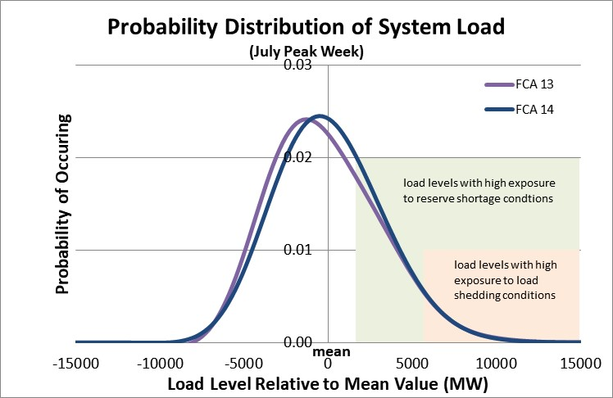
Probability Distribution of System Load July Peak Week
The probability is higher for the intermediate high load levels (high exposure to reserve shortage conditions) for CCP 2023-2024 (FCA 14)
The probability is similar for the extreme high load levels (high exposure to load shedding conditions) for CCP 2023-2024 (FCA 14)
* The load levels with high exposure to different shortage conditions shown in the graph are for illustration purpose

Slide 15
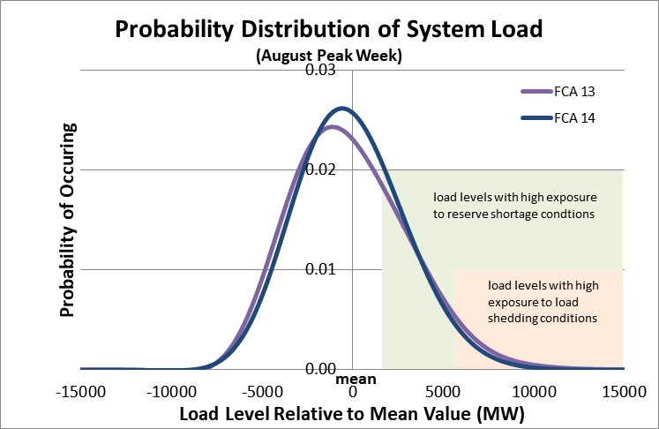
Probability Distribution of System Load August Peak Week
The probability is higher for the intermediate high load levels (high exposure to reserve shortage conditions) for CCP 2023-2024 (FCA 14)
The probability is lower for the extreme high load levels (high exposure to load shedding conditions) for CCP 2023-2024 (FCA 14)
* The load levels with high exposure to different shortage conditions shown in the graph are for illustration purpose

Slide 16
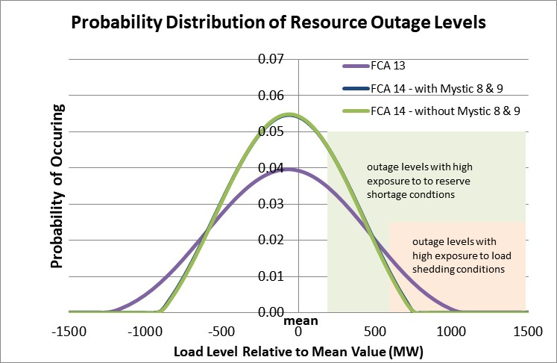
Probability Distribution of Resource Outage Levels
The probability is higher for the intermediate high outage levels (high exposure to reserve shortage conditions) for CCP 2023-2024 (FCA 14)
The probability is lower for the extreme high outage levels (high exposure to load shedding conditions) for CCP 2023-2024 (FCA 14)
* The resource outage levels with high exposure to different shortage conditions shown in the graph are for illustration purpose

Slide 17
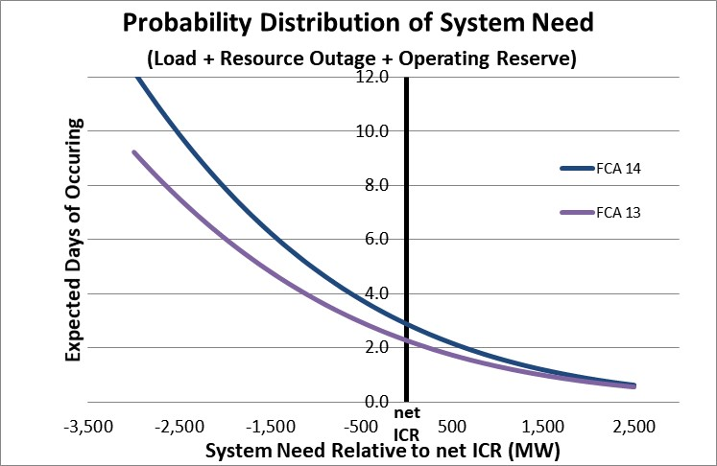
Cumulative Probability Distribution of System Need (Relative to net ICR level)
System need represents the amount of resources required to satisfy the system load and operating reserve requirement; The probability distribution of system need reflects the combined impacts from the load probability distribution of all weeks and resource outage distribution
As the capacity level decreases relatively to the net ICR, the expected number of days that may be exposed to reserve shortage conditions is higher and increases faster for CCP 2023-2024 (FCA 14)

