Slide 1
Energy Efficiency Resources
Capacity Obligations During Scarcity Conditions
New England States Committee on Electricity
December 10, 2019

Slide 2
Today’s Objectives
Answer questions from the November MC meeting
Review proposed tariff and manual language changes
Seek additional feedback from the committee on the proposed changes to better inform NESCOE’s understanding

Slide 3
NESCOE Considerations
As PFP is currently implemented, EE resources are guaranteed to incur a charge during any event that occurs outside of On-Peak or Seasonal Peak hours.
This contradicts language in FERC’s order.
This surprised all participants by using the mutual insurance pool for charges outside of the designed intent, which was to cover stop-loss.
Shaping Option A better aligns implementation with ISO-NE’s original PFP “no excuses” concept
It does so in a manner that still requires the existing level of metering costs, but does not require EERs to incur the significant additional costs to measure and verify load reductions in every hour of the year, per FERC’s order

Slide 4
Question 1: Transition from Peak to Off-peak
Question: How would the transition from the current calculation during On-Peak hours work with the “Shaping Option A” calculation work with Off-Peak hours?
Answer: To avoid any discontinuities at the boundary of on-peak and off-peak, the “Shaping Option A” methodology would be used in all hours.

Slide 5
Question 2: Effective Date
Question: When is the effective date of the change if approved by FERC? (upon FERC approval, FCA15 commitment period, or some other date)
Answer: Currently considering an effective date tied to FERC approval and a reasonable timeframe in which the changes could be implemented by ISO-NE.

Slide 6
Question 3: Overperformance -1
Question: Under this proposal, will EER’s be (1) overstating their performance and (2) exceeding their balancing ratio-adjusted CSO?
Answer: (1) No. Annual energy savings performance predicted by Shaping Option A slightly understate evaluated EE program energy savings projections.
 |  | 2012 | 2013 | 2014 | 2015 | 2016 | 2017
Annual GWh per 100 MW EER | Shaping Opt A | 676 | 680 | 690 | 694 | 671 | 694
 | M&V Studies | 781 | 725 | 763 | 714 | 694 | 730

Slide 7
Question 3: Overperformance - 2
Question: Under this proposal, will EER’s be (1) overstating their performance and (2) exceeding their balancing ratio-adjusted CSO?
Answer: (2) Yes, this is no different than today during on-peak hours because the BR would be less than 1.0. Also, if the EER installed measures that save more than its CSO during performance hours in a given month, then its performance during a Capacity Scarcity Condition in any hour of that month will likely exceed its balancing ratio-adjusted CSO. If, on the other hand, the EER installed measures that save less than its CSO during performance hours in a given month, then its performance during a Capacity Scarcity Condition in any hour of that month will likely be less than its balancing ratio-adjusted CSO.
The Shaping Option A approach is meant to apply EER performance during average seasonal peak hours to performance in a specific interval. EERs perform at a level greater than the Balancing Ratio in every hour, proportionate to system load.

Slide 8
Question 4: Supporting Data
Question: How do the pie charts in the November presentation support this proposal?
Answer:
These charts were originally presented by ISO-NE at the April 2019 DRWG Meeting. ISO-NE reported that they demonstrate the following:
The diverse portfolio of energy efficiency measures offered by the programs, yielding reductions that match system load.
Reductions of diverse EERs correlate with load (Brattle, 2017)
The current dominance of lighting.
Lighting is closely correlated with load (LBNL/DNV-GL, 2014)
Note: The proportion of lighting in the EE portfolios is expected to decline due to high penetration of CFLs and LEDs, long measure lives, and lighting standards.

Slide 9
Question 5: Formula Change
Question: Please indicate what variables are changing in formula on slide 15 of the November presentation.
Answer: The formulas in red on the next slide indicate the changing variables.
Please note that the actual manual language has been clarified from what we presented in November.
Also the 1.08 multiplier has been removed from the manual language because it’s already included in the tariff section 13.7.2.2 in subsection (c)

Slide 10
On-Peak Demand Resource Shaping Proposal
$${{ACP}_{ee}=(Perf}_{ee, On−Peak}∗1.08) ∗\frac{SL+PV}{{ASL}_{s,w}+{APV}_{s,w}}$$
Where:
ACP_{ee}= Actual Capacity Provided by the EER
Perf_{ee, On-Peak} = The EER’s reported On-Peak performance for the month
1.08 = gross-up for avoided T&D losses
SL = System load during CSC interval
PV = BTM PV during CSC interval
ASL_{s,w} = Average System Load during On-Peak hours of most recently completed 3 summer or 2 winter performance months
APV_{s,w} = Average BTM PV output during On-Peak hours of most recently completed 3 summer or 2 winter performance months

Slide 11
Seasonal Peak Demand Resource Shaping Proposal
${{ACP}_{ee}=(Perf}_{ee,Seasonal Peak}∗1.08)∗ \frac{SL+PV}{{SPL}_{s,w}+{SPV}_{s,w}}$
Further Explanation:
Perf_{ee, Seasonal Peak} =The summer or winter EER audit value, measured at the customer’s meter.
1.08 = Gross-up applied to performance at customer meter, to be equivalent to how all other capacity is measured (at the point of interconnection to the Transmission system)
SL = System load during CSC interval. Measured as total Generation Output (which is equivalent to total customer load, with T&D losses)
PV = BTM PV during CSC interval
SPL_{s,w} = Average System Load during Seasonal Peak hours of most recently completed 3 summer or 2 winter performance months¹
SPV_{s,w} = Average BTM PV output during Seasonal Peak hours of most recently completed 3 summer or 2 winter performance months
¹ Seasonal Peak Reference Load = 90% x Gross Summer Peak Forecast (1.1 on CELT report page 1.1) minus Passive DR Capacity (2.2.2 on CELT report page 1.1). https://www.iso-ne.com/isoexpress/web/reports/auctions/-/tree/season-peak-hour-data.

Slide 12
Question 6: T&D Multiplier
Question: Is the 1.08 multiplier appropriate for T&D losses?
Answer: We are not suggesting any changes to the tariff language that sets the “multiplier”.

Slide 13
Question 7: Applying Shaping to Off-Peak Hours
Question: Does applying the shaping option to off-peak hours create a difference in payments to EERs?
Answer: Yes. It will remove any off-peak settlement shortfall amount charged to EERs and provide a positive PFP payment. Based on prior work comparing the Labor Day event to current market rules and the VEIC proposal,¹ EERs would not have been charged the $551k shortfall amount and would have instead received a $113k payment.
Our understanding is that under this proposal, the payment amount would increase to match the amount of performance.
¹ Please see ISO-NE memo dated April 5, 2019 “ISO Quantitative Review of Vermont Energy Investment Corporation’s Proposed Modifications to the Balancing Ratio”

Slide 14
Tariff Language Changes

Slide 15
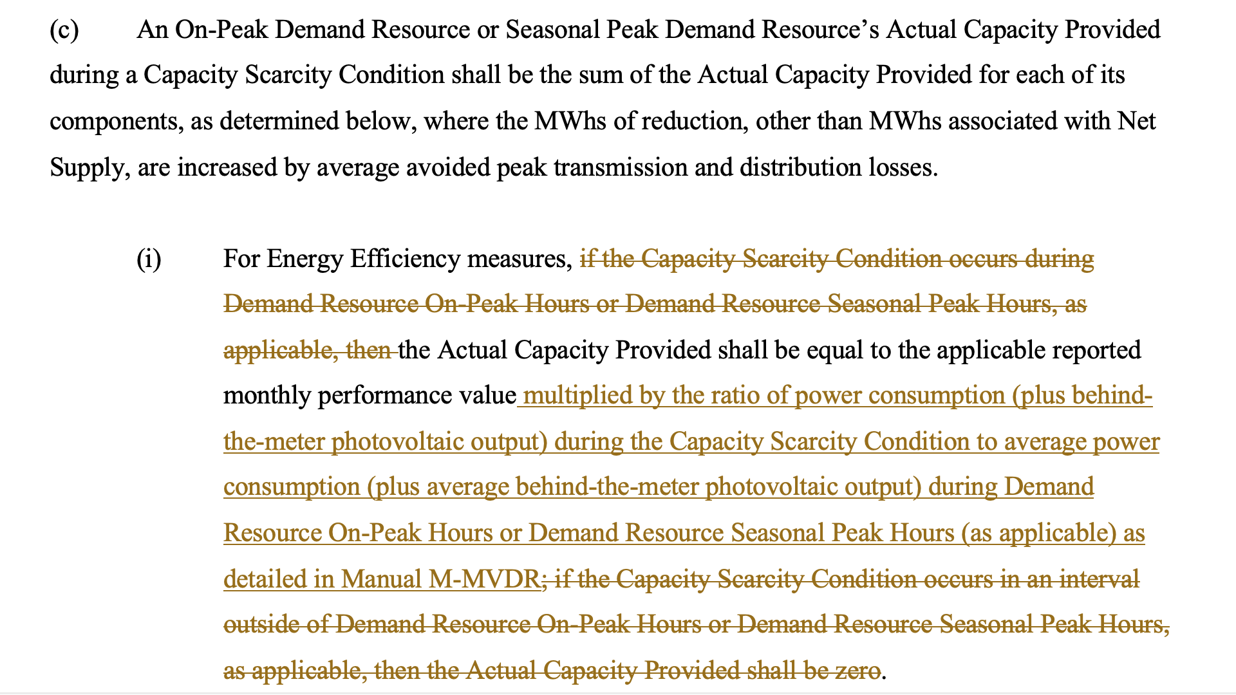
Section III.13.7.2.2
III.13.7.2.2 Calculation of Actual Capacity Provided During a Capacity Scarcity Condition.

Slide 16
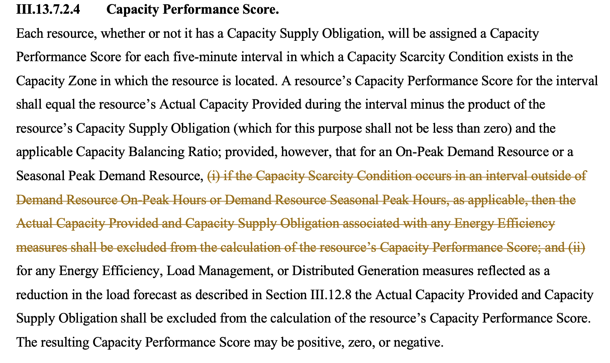
Section III.13.7.2.4

Slide 17
Manual Changes

Slide 18
Manual Changes
See posted manual revisions to M-MVDR - Section 8.3 Performance Calculations for Energy Efficiency Measures During Capacity Scarcity Conditions

Slide 19
Next Steps
Continue to seek stakeholder feedback.
Continue to work with ISO-NE on the appropriate tariff and manual changes needed to implement Shaping Option A.
Seek a January 2020 NEPOOL Market Committee Vote.
Seek a February 2020 NEPOOL Participants Committee.

Slide 20
Questions
www.nescoe.com
Jeffbentz@nescoe.com

