Slide 1
Energy Security Improvements Impact Analysis
Todd Schatzki
Principal
December 10, 2019

Slide 2
Agenda
  Model Enhancement Status
  Preliminary Central Case Results

Slide 3
Model Enhancement Status

Slide 4
Status of Model Enhancements
Modeling enhancements have been made (see November presentation)
  AG has been undertaking a number of enhancements to the model and analysis
    Details about these enhancements were provided in November
    The next slide summarizes these changes, along several additional changes in assumptions not previously discussed
  To date, AG has largely implemented all of the planned model enhancements
    Central Case results presented today incorporate these model enhancements
    Refinements to certain assumptions may be made subsequently given further analysis and feedback from stakeholders

Slide 5
Overview of Model Enhancements
Multiple enhancements have been to model structure and assumptions
  DA energy/EIR substitution ‒ Model enhancements (flexible EIR constraint, sloped demand curve) are made to capture DA energy and EIR interactions, thus allowing substitution between energy and EIR quantities
  Fuel Oil ‒ adjustments to inventory and fuel delivery decisions to better align with profit-maximizing responses by market participants
  New eligibility requirements for EIR and RER:
    Eligibility limited to 60- and 240-minute capability for EIR and RER, respectively
    Both off-line and on-line (given ramp rate) capability considered
  ESI awards for NG-only resources ‒ awards for DA energy and ESI products assumed not to exceed available NG supply
  DA energy option offers ‒ Enhancements to methodology for estimating DA energy options, including more explicit accounting for operational/intertemporal limitations when calculating risk premium
  Data inputs ‒ Data input improvements, such as modified load assumptions to better account for future load profiles

Slide 6
Overview of Plan for Impact Analysis Results
Analysis of cases and scenarios is ongoing
  Today
    Update to Central Case results with model enhancements
  January
    Non-winter scenarios
    Updated scenario analysis
    Responses to stakeholder questions

Slide 7
Preliminary Central Case Results

Slide 8
ESI Impacts
Fundamentals of Impact Approach
  Framework for analysis of ESI is largely unchanged
  Impacts are measured as the difference between two cases:
    Current Market Rules (“CMR”) Case, reflecting current market rules and market responses
    ESI Case, reflecting ESI proposed rules and expected market responses
  Analysis considers different levels of stressed conditions in a future winter, 2025/26:
    Frequent Stressed Conditions based on 2013/2014
      Multiple, shorter periods with fuel system constraints (e.g., multiple, shorter cold-snaps)
    Extended Stressed Conditions based on 2017/2018
      One extended period with fuel system constraints (e.g., one extended cold-snap)
    Infrequent Stressed Conditions based on 2016/2017
  Results are preliminary, but provide reasonable estimates of impacts for the cases evaluated

Slide 9
Preliminary Central Case Results – Overview
Scope of results to be discussed today
  Results today will cover the key impacts evaluated in our preliminary analysis, including:
    Changes in total customer payments under ESI
    Price signals, including LMPs and DA AS prices
    Quantities of DA energy and AS procured, and the shifts in DA cleared energy compared to current market rules
    Incentives for energy inventory created by ESA
    Changes in net revenues to resource owners
    DA energy option offer enhancements, to account for operational and cost factors
    Operational and reliability outcomes

Slide 10
Total Customer Payments

Slide 11
Total Customer Payments
Framework reflects all customer payments
  Customer payments reflect payments made in DA and RT markets to meet physical energy load plus AS requirements
    DA cleared energy plus FER payments (the latter being ESI only)
    DA ESI products (ESI only)
    RT energy and AS payments (given deviations with DA cleared energy)
    Settlement of DA ESI products (ESI only)

Slide 12
Total Customer Payments
Central Case, Frequently Stressed Conditions
Total Payments by Load, Frequent Stressed Conditions ($ Million)
Two-part settlement for DA and RT energy
Net of DA Energy Option Payment and RT Settlement
FER payment to resources supplying energy

Slide 13
Total Customer Payments
Central Cases
Total Payments by Case ($ Million)
  Customers payments under ESI increase in all three cases (market conditions)
  Increases due to FER payments, plus net cost of DA energy options (ESI AS)
  These increases in payments are partially offset by savings in energy (LMP) costs, caused, party, by the incremental energy inventory under ESI

Slide 14
LMP and DA Ancillary Service Prices and Payments

Slide 15
Market Clearing and Price Determination
Market-clearing Now Reflects Sloped Demand and Energy-EIR Substitution
  Model simulates market-clearing under current market rules and ESI
    Prices for energy (LMPs) and other AS product reflect co-optimization to minimize costs (maximize benefits) subject to meeting various AS constraints
    The ESI market design allows for the substitution of energy and Energy Imbalance Reserves (EIR) to minimize the costs of meeting forecasted load
    The model has been enhanced to allow for this substitution by:
      Allowing the model to (endogenously) solve for the EIR quantity
      Modeling demand as price-sensitive
  Estimated prices reflect these enhancements, but also the effect of all other model enhancements and changes in assumptions

Slide 16
LMPs
Central Cases
Average Day-Ahead and Real-Time LMPs by Case ($ per MWh)
Note: [1] Prices are the unweighted average across hours.
  With ESI, LMPs generally decline compared to current market rules
    Reductions range from $0.85 to $8.11 per MWh day-ahead, and $0.19 to $4.29 per MWh in real-time
    Reductions driven by incremental energy supplies and other factors
  DA and RT prices are generally aligned
    Alignment of DA and RT prices reflects opportunities to arbitrage DA and RT prices if they do not converge in expectation (accounting for other factors that may cause a deviation)
    If DA and RT prices were significantly different on average, market participants would trade (using virtual supply/demand) such DA and RT prices would generally converge

Slide 17
Accounting for Adjustments to Bid-In Demand with ESI
Market-clearing now reflects sloped demand and energy-EIR substitution
  Analysis accounts for expected (generally upward) shifts in bid-in demand in response to ESI
    The substitution of energy for EIR tends to increase the quantity of cleared DA energy for any given bid-in demand (compared to current market rules)
    When the LMP is set by the ‘last cleared’ demand bid, an increase in quantity cleared reduces LMP (all else equal)
      A reminder: DA energy awards receive the LMP + FER payments, where the FER payments ensure suppliers are no worse off selling DA energy
      See ISO-NE, MC Materials, July 8-10, 2019, slides 21 to 37
    But, because of DA-RT price arbitrage, an outcome with lower DA LMPs is not stable
      With low LMPs, market participants will increase demand to purchase additional supplies of low price energy to arbitrage with higher price RT energy
    Within the model, to maintain alignment between DA and RT LMPs, bid-in demand is adjusted upward so that there is not an inconsistency between DA and RT LMPs

Slide 18
Payments to Day-Ahead Energy
Central Case
Weighted Average DA Payments to Generators, CMR vs ESI ($ per MWh)
Note: [1] Prices are weighted by hourly quantity of generation.
  DA energy is compensated with both LMPs and FER payments
    Average FER payment (column [C]) is the weighted average across all DA energy
  Total compensation to DA energy increases under ESI (compared to CMR) reflecting LMPs and FER payments
  FER payments (more than) offset decrease in LMPs across cases

Slide 19
Day-Ahead Option Prices
Weighted Average DA Energy Option Clearing Prices ($ per MWh)
Note: [1] Prices are weighted by hourly quantity of each ESI product.
  Weighted average hourly prices for EIR, GCR10, GCR30, and RER are:
    Varied across cases given differences in price volatility (and intra-day price variation) in each winter and some RER shortages in the Frequent and Extended Conditions
    RER and GCR prices are relatively similar within Cases, although this masks significant hour-to-hour variation in each
    EIR price is generally higher because prices are typically highest in hours when EIR quantity is large
  EIR price can be positive in hours when the EIR quantity is zero and DA clearing exactly meets load forecast (see ISO-NE MC materials, June 10-12, Slides 115-127).
    In these hours, there is no EIR payment, but the EIR price sets the price for FER payments

Slide 20
Changes in DA Generation

Slide 21
Changes in DA Cleared Energy Under ESI
Changes in DA energy due to substitution between energy and EIR
  As discussed above, substitution between DA energy and EIR will tend to increase the supply of energy cleared in the DA market
  The model allows us to quantify these adjustments in DA cleared energy, compared to amounts that would clear under current market rules
  This mechanism causes the market to clear quantities of DA energy closer to the ISO-NE load forecast, rather than meeting this demand through RAA commitments
EIR Quantity
Sloped Demand
Load
Forecast
Supply
P
Fixed Demand
Q

Slide 22
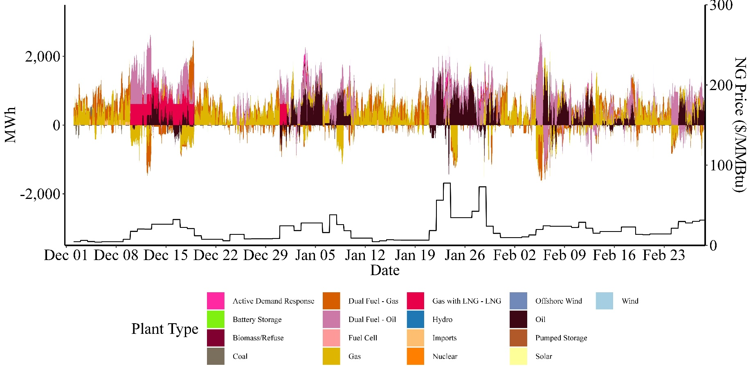
Changes in DA Cleared Energy With ESI
Difference in Hourly Cleared DA Energy by Resource Type, CMR vs ESI, Frequent Central Case
With ESI, total cleared DA energy increases (compared to CMR) in most hours due to cost savings of substituting DA energy for EIR
Incremental energy comes from a wide range of different technologies, dependent on market conditions

Slide 23
Changes in DA Energy With ESI
Difference in Cleared DA Energy by Resource Type, CMR vs ESI, Central Cases
  With ESI, total cleared DA energy increases (compared to CMR) due to cost savings of substituting DA energy for EIR
    EIR is relatively small in most cases, as energy is substituted for EIR
    EIR is comparatively larger in the Infrequent case, in part, because DA energy option offers are lower, thus reducing the savings from substituting energy for EIR
  With ESI, the total of cleared DA energy and EIR is more similar to system real-time demand than under current market rules

Slide 24
Total Winter Generation Mix
Energy and DA Options by Resource Type, CMR vs ESI, Frequent Stressed Conditions

Slide 25
Incentives for Energy Inventory

Slide 26
Overview of Incentives for Energy Inventory
  The ESI market proposal creates incentives for market participants to increase the quantity of energy inventory they are holding
    Under ESI, payments to resources with energy inventory increase because (1) resources receive FER payments, in addition to LMPs, and (2) resources can supply DA energy options
    These incremental revenues compared to current market rules increase the incentives to maintain inventoried energy
  Incentives for oil-fired resources to increase fuel oil inventory
    Below, we assess the additional incentives to hold oil inventory under ESI as compared to the existing incentives under current market rules
    In January, we will provide information on a second, related question ‒ the extent to which, once ESI is in place, resources are incented “at the margin” to hold more fuel than they present do (i.e., consistent with the CRM fuel assumptions)

Slide 27
Analysis of Incentives for Energy Inventory
  Incentives for gas-only resources to forward contract for LNG
    We quantity the incremental revenues provided to ESI to incent resource to enter into forward supply contracts with LNG terminals
  Our analysis shows that ESI increases incentives for resources to procure incremental energy inventory ‒ compared to current market rules:
    Fuel-oil resources earn greater returns from holding fuel oil under ESI
    Gas-only resources earn greater returns from a forward LNG contract under ESI
  We evaluate these incentives for both oil-fired resources (including dual fuel resources) and gas-only resources that can forward contract for LNG supply
    Below, we first consider the analysis of oil-fired resources
    We then turn to gas-only resources

Slide 28
Fuel Oil Analysis
  Incentives for energy inventory reflect the plant’s initial inventory and refueling decisions
    Plant-level inventory reflects refueling model, which incorporates many parameters
    Enhancements to the fuel oil analysis have been undertaken to refine the parameters used in plant refueling
    Parameter refinement performed through analysis of plant economics given different assumptions about model parameters
    Refinements are preliminary, and further adjustments may be made
  Refueling model parameters
    Certain parameter values differ between CMR and ESI
      Initial storage level – Start of winter (Dec 1st) fuel inventory levels
      Daily replenishment quantity – Quantity, in gallons, received per day
    Other parameters remain fixed
      Refill threshold – The threshold at which refueling occurs (% of initial storage)
      Last refill date – The last date in the winter during which a resource would order more fuel (Feb 1 for barge resources, Feb 28th for truck resources)
      Order lead time – Time in days between order and shipment received

Slide 29
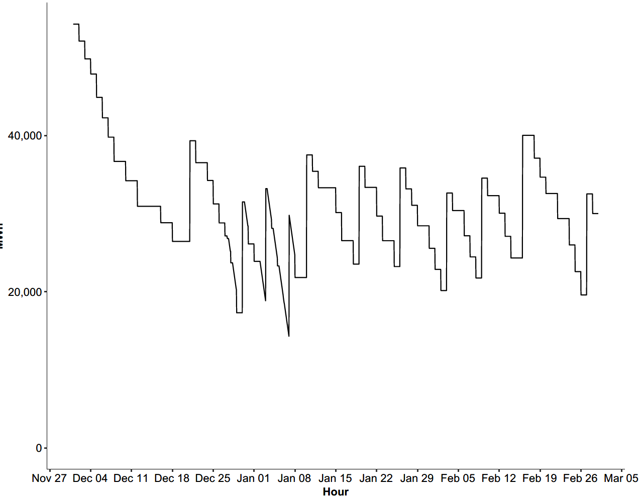
Operational Constraints
Fuel Replenishment – Illustrative Resource-Level Examples
Parameters will vary across resources given tank size and other resource characteristics
Fuel Consumption
Fuel Inventory (MWh)
Daily Replenishment Quantity
Floor to Trigger Fuel Replenishment
Lag in Replenishment

Slide 30
Incremental Fuel Oil Incentives Relative to Current Market Rules
Direct Mechanisms by Which ESI Incents Action to Secure Energy Inventory
  We evaluate the magnitude of the additional incentives to hold energy inventory created by ESI, incremental to the current incentives under current market rules
    Tables quantify the direct incentives created by ESI to procure additional fuel inventory ‒ these incentives are new to the market, incremental to incentives under current market rules
    The analysis estimates incremental revenues created by ESI from holding fuel oil against the incremental costs of holding more fuel (due to holding a larger quantity of fuel at the end of the winter due to a larger fuel inventory)
    Our approach to analyzing these incentives has not changed from our prior analysis (reported at the September MC)

Slide 31
Incremental Fuel Oil Incentives Relative to Current Market Rules
Direct Mechanisms by Which ESI Incents Action to Secure Energy Inventory
  The following tables summarize our analysis
  These tables report net revenues and each of the elements of the net revenue calculation:
    “ESI FER Payments” – reflects all FER payments
    “ESI DA Energy Option Revenue” ‒ reflects risk premium component of all DA energy option awards
    “Change in Holding Costs” – reflects difference in holding costs between CMR and ESI case; provided for context regarding the magnitude of costs of incremental fuel
      Reminder: Fuel inventory levels differ between CMR and ESI
    “Incremental Net Revenues” ‒ sum of (1) FER Payments and (2) DA Energy Option Revenue net of (3) Change in Holding Costs

Slide 32
Incremental Fuel Oil Incentives Relative to Current Market Rules
Cost Effectiveness of Additional Fuel – Central Case, Frequent Stressed Conditions
  Table shows net revenues, with plants grouped by tank size relative to plant capacity
  Compared to CMR, oil-fired resources have positive net incentives to maintain energy inventory
    For all categories of plants, direct ESI incremental incentives (FER payments and DA energy options) exceed the additional fuel holding costs

Slide 33
Incremental Fuel Oil Incentives Relative to Current Market Rules
Cost Effectiveness of Additional Fuel – Central Case, Extended Stressed Conditions
  Results are similar for the Extended Stressed Conditions Case

Slide 34
Incremental Fuel Oil Incentives Relative to Current Market Rules
Cost Effectiveness of Additional Fuel – Central Case, Infrequent Stressed Conditions
  In the Infrequent Stressed Conditions Case, all plants have increased incentives for energy inventory, except the plants with large tanks
    For plants with large tanks, the additional holding costs of the assumed level of incremental fuel inventory exceeds the total ESI payments
    Important to recognize that incremental energy inventory may not be beneficial under all market conditions, particularly when market conditions (including weather conditions) provide sufficient supplies of energy inventory

Slide 35
Incremental Fuel Oil Incentives Relative to Current Market Rules
Are Incentives for Energy Inventory Greater than Current Market Rules?
  ESI unambiguously increases incentives for energy inventory
    For any given level of energy inventory, ESI increases payments for holding energy inventory
      FER payments
      DA energy options (risk premium portion)
    These incremental payments exceed the incremental costs of holding additional fuel
    ESI provides incremental revenues in all cases, not only those with stressed conditions

Slide 36
Incentives for Additional Energy Relative to Assumed Levels
Are ESI Incentives Sufficient to Incent Assumed Additional Energy Inventory?
  In September, we provided analysis that demonstrated the incremental incentives for resources to increase energy inventory “at the margin” when ESI is in place
    Specifically, this analysis estimated, with ESI in place, returns to increasing fuel inventory from inventory levels assumed under CMR
    This analysis demonstrated that, with ESI in place, resources would have the incentive to increase their energy inventory above the inventory levels assumed under CMR
  Status
    This analysis is on-going
    We plan to provide stakeholders with information relevant to this question in January

Slide 37
Forward LNG Contract
Analysis of forward LNG Contract for gas-only resources
  For gas-only resources, a forward LNG contract is an important option to improve the security of their fuel supplies
  We analyze the changes in incentives for gas-only resources to enter into a forward contract with an LNG terminal under ESI as compared to current market rules
    Our approach to analyzing these incentives has not changed from our prior analysis (reported at the September MC)
  Our analysis is based on a specific forward contract, with 10 calls and strike price = $10 per MMBtu
    Same contract assumed in Chapter 2B analysis
    In practice, generators and terminals may enter into different contract structures, some of which may provide greater net benefits under ESI
  Analysis of ESI benefits for CC units reflects FER payments and ramp capabilities
    Model awards DA AS to individual CC units for their ramp capability only if the resource is already running (spinning)

Slide 38
ESI Incentives for Forward LNG Contract
Incremental ESI Revenues from FER Payments
  In Frequent and Stressed Conditions cases, all call options are exercised ‒ price exceeds assumed (static) trigger threshold for exercising call options ($16 per MMBtu)
    This trigger threshold is greater than the commodity price to avoid exercising calls when gains are small
  In Infrequent Stressed Conditions case, options are not exercised due to low NG prices
  With more complex decision-making regarding when to exercise call options, contract would likely earn positive FER payments in some hours

Slide 39
Incremental Incentives Relative to Current Market Rules
Incremental revenues through FER and DA energy options
  Our analysis shows that ESI will provide incremental incentives for gas-only plants to enter into a forward LNG contract relative to the incentives under current market rules
    Incentives reflect both FER payments and DA energy option awards
    FER payments increase the value of holding energy inventory by over $2,000 per MW in two of three cases
    As discussed in September, the analysis captures some, but not all, of the potential gains to resources from incremental fuel inventory, and thus likely understates the incremental benefits of an LNG contract under ESI

Slide 40
Potential for ESI to Increase Forward LNG Contracting
ESI diminishes (and potentially) closes gap for additional LNG contracting
  Under current market rules, there may be a gap between prices a generator and LNG terminal are willing to accept for a forward LNG contract
    Chapter 2B estimate of gap, aimed to ensure program participation, is $2,705 per MW
    In practice, gap likely to vary across market participants, with some higher and others lower (e.g., some market participants currently enter into forward LNG contracts, implying no gap)
  Incremental ESI revenues may close whatever gap there is between additional generators and the region’s LNG terminals to reaching agreement
    Incremental ESI revenues in Extended and Frequent Cases are of the same order of magnitude as Chapter 2B estimated gap ‒ that is, incremental revenues are $3,204 per MW in the Extended Case and $2,077 per MW in the Frequent Case, as compared to an estimated gap of $2,705 per MW

Slide 41
Incentives for Additional Energy Inventory
Least-cost options for oil-fired and gas-fired resources considered
  Analysis demonstrates that ESI increases incentives for both oil-fired and gas-fired resources to increase energy inventory
    Certain least options for increasing energy inventory are considered
    ESI also provides incentives for other options not considered (e.g., dual fuel)
  Analysis shows that ESI would be expected to increase energy inventory held by oil-fired resources
  Analysis shows that ESI would provide meaningful incentives to help close any gap between generators and LNG terminals to signing LNG contract, but do not quantity the amount of incremental contracting that would be achieved

Slide 42
Net Revenues Analyses

Slide 43
Net Revenues
Impact on Energy Market Net Revenues Reflects Multiple Factors
  The proposed ESI market rules will impact net revenues earned by generators in the New England energy markets
    Changes to net revenues may impact offers and clearing prices in the Forward Capacity Market; such impacts are not quantified in our analysis
  Changes in net revenue are quantified within the production cost model, AG-EMM (Energy Market Model), reflecting multiple factors:
    Changes in payments for energy, including changes in LMPs and FER payments
    Changes in quantity of energy sold
    Award and settlement of DA energy options
    Changes in energy inventory costs

Slide 44
Net Revenues
Impact on Energy Market Net Revenues Reflects Multiple Factors
  Across Cases,
    ESI generally increases net revenues across different resource types (technology/fuel), although there are exceptions
    Estimated impacts vary across resource types and across Cases
  Some caution should be exercised in over-interpretation of results as they reflect specific cases and the model may not fully capture all factors affecting plant-level economics

Slide 45
Net Revenues
Average Net Revenues by Resource Type, Winter Season, Frequent Stressed Conditions ($ per MW)

Slide 46
Net Revenues
Average Net Revenues by Resource Type, Winter Season, Extended Stressed Conditions ($ per MW)

Slide 47
Net Revenues
Average Net Revenues by Resource Type, Winter Season, Infrequent Stressed Conditions ($ per MW)

Slide 48
Net Revenues
Frequent Stressed Conditions Case
Average Net Revenues, Selected Resources, Winter Season, Frequent Stressed Conditions

Slide 49
Production Costs
Model Production Costs and Fuel Holding Costs Quantified
  We quantity two aspects of production costs.
  First, we quantify the marginal costs of meeting energy market requirements, including load, operating reserves and DA energy options
    Marginal costs include fuel and variable operations and maintenance (O&M) costs
    Marginal costs are quantified within the production cost model
  Second, we quantify the incremental holding costs between cases
    Holding costs reflect the opportunity cost of holding fuel in storage
    Fuel oil holding costs reflect financial opportunity costs, price risk and liquidity constraints
    LNG holding costs reflect financial opportunity costs and operational storage costs
  Other factors not quantified by the analysis are being assessed qualitatively

Slide 50
Production Costs
Production Costs, with and without ESI, Central Cases
  Production costs lower in 2 of 3 cases despite increased DA energy market requirements

Slide 51
Day-Ahead Ancillary Services Bid Enhancement

Slide 52
DA Option Offer Enhancements
Multiple Enhancements to Day-Ahead Option Offers
  The underlying approach to estimating DA energy option offers has not changed
  Offer estimates have been enhanced to account for operational/intertemporal limitations and additional cost factors
    Parameters vary based on technology type (CT, CC and ST) and fuel type (Gas, Oil, and Dual fuel)
    Operational/intertemporal limitations account for performance risk, lead time, and limited energy
    Additional cost factors include fuel cost risk and start-up cost
    The next slide describes there factors in greater detail
  Forthcoming Scenarios
    Introduce variation across offers to component of DA energy option offers reflecting expected closeout costs, which is currently equal across all offers
    Adjustment to level of risk premiums (e.g., scale up all premiums)

Slide 53
DA Option Offer Enhancements
Multiple Enhancements to Day-Ahead Option Offers
  Operational/intertemporal limitations
    Performance risk - Risk that the plant does not dispatch when requested (e.g., forced outage)
    Lead time – Lag between offers being in merit and plant delivery supply given, for example, intertemporal offer parameters (e.g., minimum run-time, minimum down-time)
    Limited energy - Risk that limited energy supplies constrain a resource’s ability to hedge financial risk in all hours; when estimating DA energy option offer, we assume that MC reflects opportunity costs, and thus do not make an incremental adjustment for this factor
  Additional cost factors
    Fuel cost risk - for natural gas plants, risk that NG prices are higher in real-time than day-ahead, causing DA energy option offer to be under-priced
    Start-up cost - Accounts for recovery of start-up costs over an assumed dispatch period

Slide 54
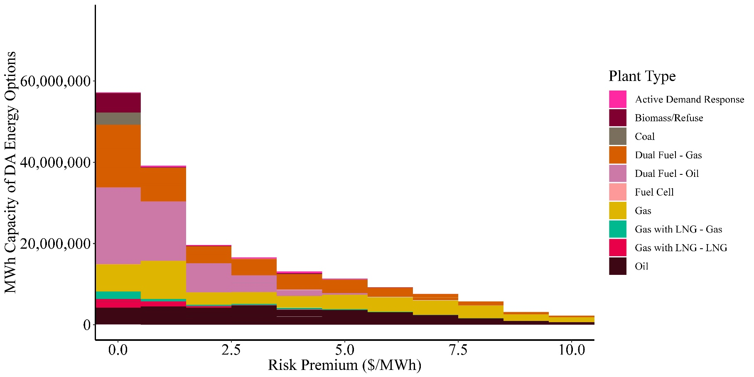
Risk Premium
Estimated Risk Premium, MWh Capacity by Premium Size & Technology Type
All Offers, Frequent Stressed Case
Notes:
[1] “Gas with LNG – [fuel]” refers to Gas units with an LNG contract, offering with the specified fuel type.

Slide 55
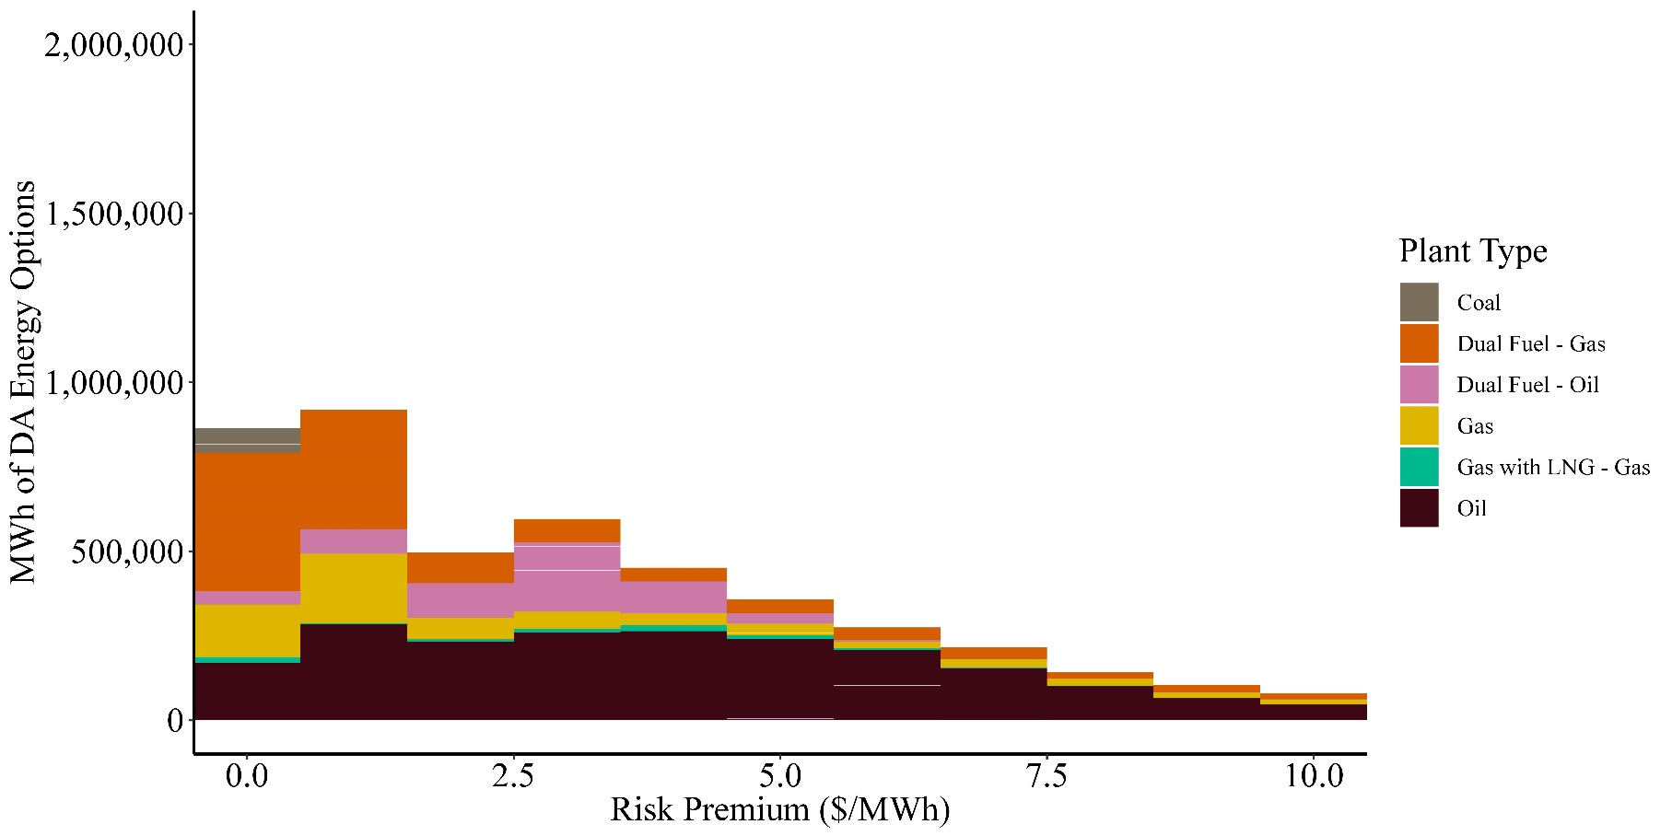
Risk Premium
Estimated Risk Premium, MWh by Premium Size & Technology Type
Cleared Offers, Frequent Stressed Case
Figure represents marginal and infra-marginal risk premiums for offers that clear
Notes:
[1] “Gas with LNG – [fuel]” refers to Gas units with an LNG contract, offering with the specified fuel type.

Slide 56
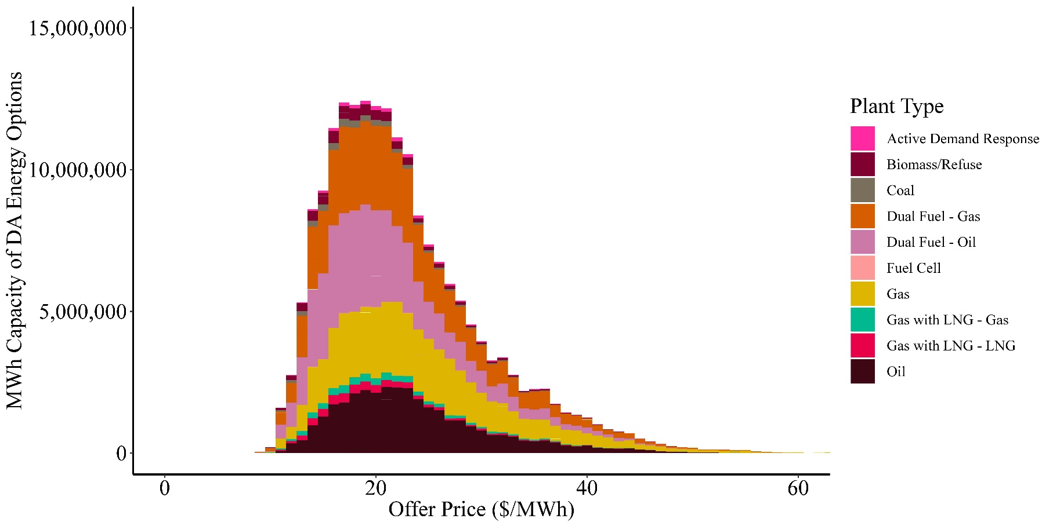
DA Energy Option Offers
Estimated DA Energy Option Offer, MWh by Offer Size & Technology Type
All Offers, Frequent Stressed Case
Notes:
[1] “Gas with LNG – [fuel]” refers to Gas units with an LNG contract, offering with the specified fuel type.

Slide 57
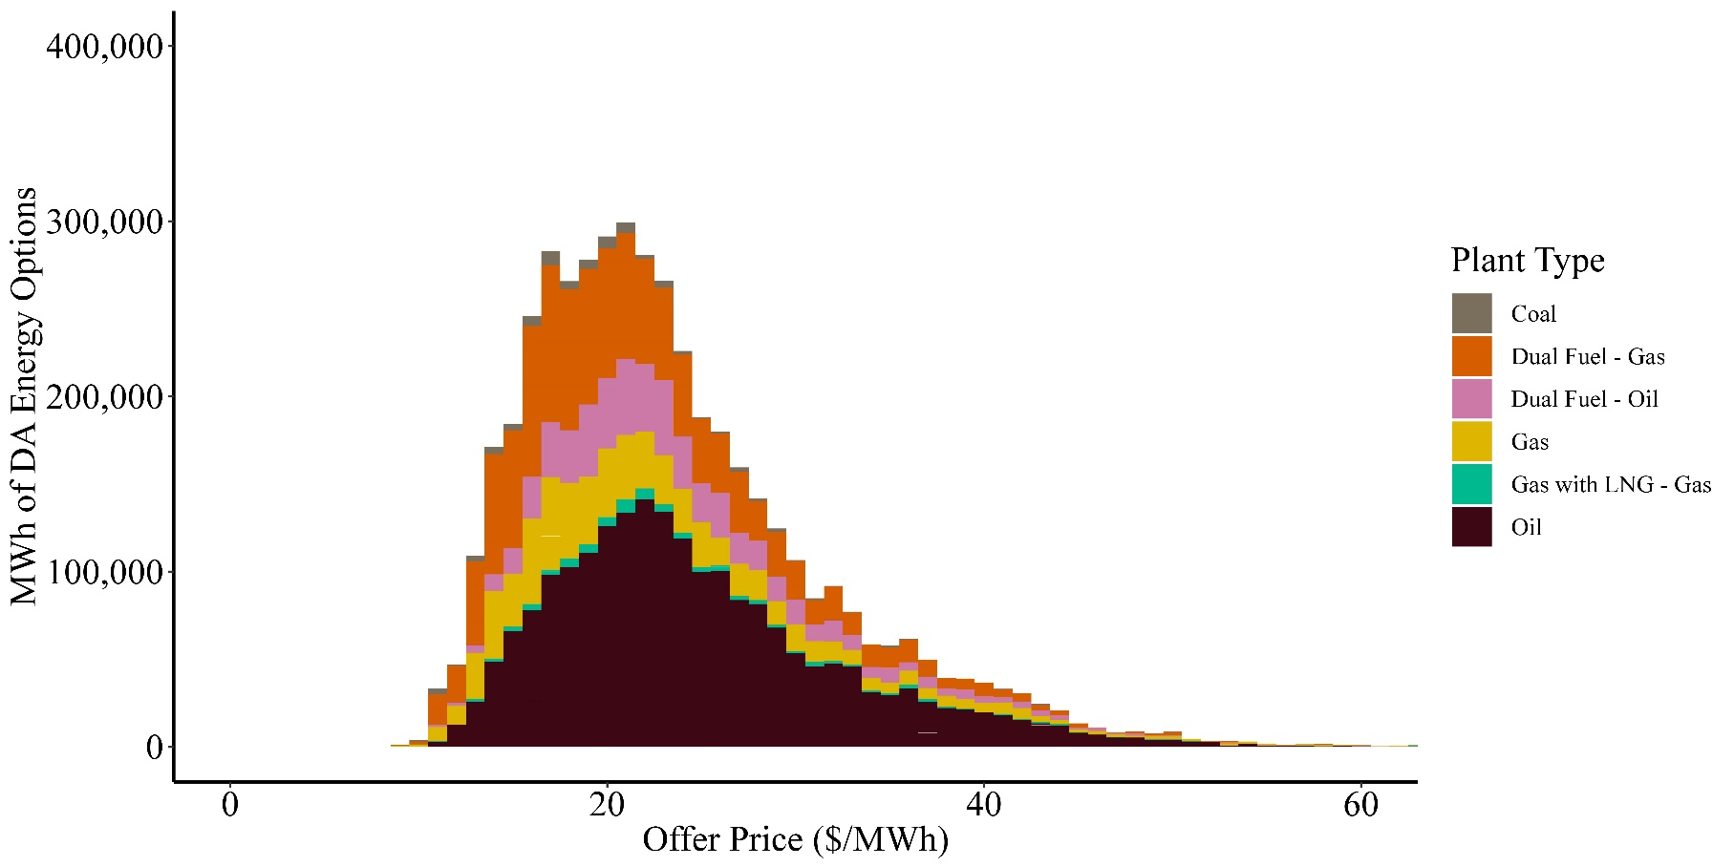
DA Energy Option Offers
Estimated DA Energy Option Offer, MWh by Offer Size & Technology Type
Cleared Offers, Frequent Stressed Case
Notes:
[1] “Gas with LNG – [fuel]” refers to Gas units with an LNG contract, offering with the specified fuel type.

Slide 58
Operational and Reliability Outcomes

Slide 59
Operational / Reliability Metrics
Metrics to Capture Energy Security
  We report multiple metrics related to the fuel system to describe changes in system operations and reliability from ESI (compared to CMR)
    As measured in our model, certain operational metrics, such as operating reserve shortages, are at low levels in the Central Cases
    Metrics are more sensitive under scenarios with lower energy security (e.g., higher load, diminished fuel availability)
  Given certain metrics are relatively insensitive in many scenarios, we develop other metrics aimed at measuring changes in reliance on the fuel system
    With these metrics, analysis can measure the extent to which ESI mitigates energy security risks

Slide 60
Operational / Reliability Metrics
Multiple Metrics to Capture Different Aspects of Energy Security
  Operating reserve shortages. Hours of 10- or 30-minute operating reserve shortage
  Natural gas system physically binding. Hours in which natural gas system is physically binding
  Natural gas consumption during high priced natural gas hours. Change in natural gas consumption during periods when NG prices are high (> $16 / MMBtu), net of NG from forward LNG contracts
  Minimum daily deliverable energy from oil-fired units. Minimum daily quantity of energy (MWh) available from oil-only and dual-fuel resources given actual fuel inventory
  Note: because we limit DA energy and energy option supplies from gas-only resources to available pipeline NG, we no longer evaluate metrics that measure when DA positions are taken without available NG

Slide 61
Operational / Reliability Metrics
Multiple Metrics to Capture Different Aspects of Energy Security
Change in Reliability Metric with ESI compared to CMR
Central Cases
  ESI generally relaxes energy physical and economic constraints
  In several instances, ESI tightens physical NG constraints, suggesting substitution across fuel systems
    For example, in the Extended and Infrequent cases, the NG system is binding in more hours than under current market rules
    This can occur if, under ESI, there is substitution of NG for oil during high priced periods, which allows more oil to be available at later periods, if needed

Slide 62
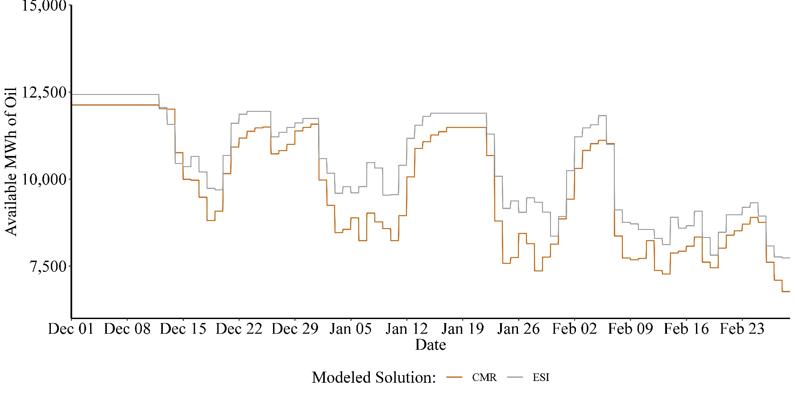
Scenarios - Reliability
Daily Oil Available for Real Time Generation, Frequent Stressed Case (MWh)
Maximum Daily Potential Generation from Oil-fired Resources, CMR vs ESI, Frequent Stressed

Slide 63
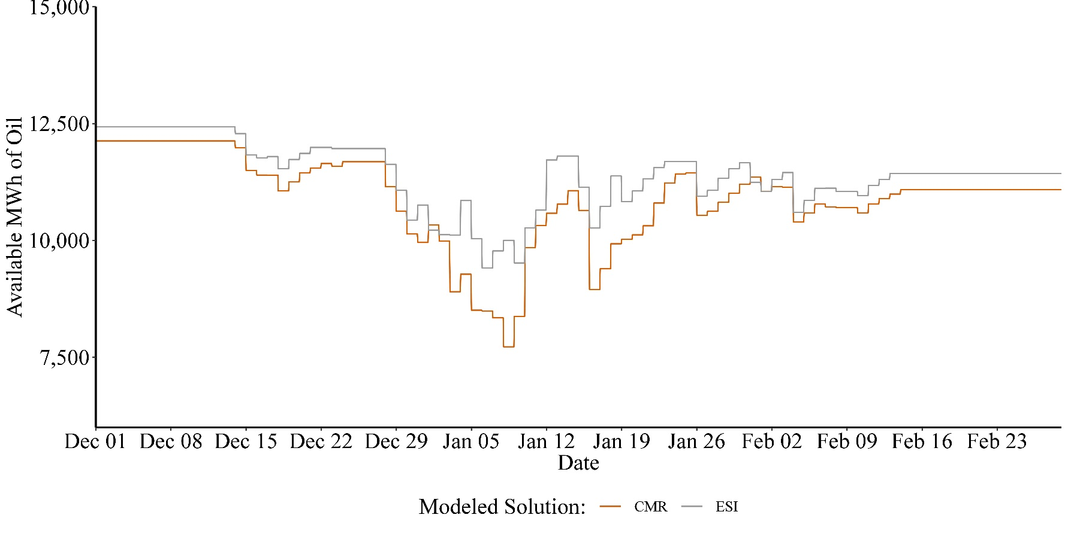
Scenarios - Reliability
Daily Oil Available for Real Time Generation, Extended Stressed Case (MWh)
Maximum Daily Potential Generation from Oil-fired Resources, CMR vs ESI, Extended Stressed

Slide 64
Next Steps
Current plan for providing stakeholders with findings
  January
    Preliminary results of Cases for non-Winter Months
    Preliminary results of Winter Scenarios
  February
    Draft Report

Slide 65
Contact
Todd Schatzki
Principal
617-425-8250
todd.Schatzki@analysisgroup.com

