Slide 1
December 10-11, 2019| Markets committee
ENERGY SECURITY IMPROVEMENTS: MARKET-BASED APPROACHES
Continuing the strike price discussion
Andrew Gillespie
413.535.4088 | agillespie@iso-ne.com

Slide 2
Winter Energy Security Improvements
WMPP ID:
125
Proposed Effective Date: June 1, 2024
In accordance with FERC’s July 2, 2018 order in EL18-182-000, the ISO must develop and file improvements to its market design to better address regional fuel security, and file by April 15, 2020
Key Projects – Energy-Security Improvements
Discussion paper 2019-04-09 and 2019-04-10 MC A00 ISO Discussion Paper on Energy Security Improvements – Version 1

Slide 3
Prior strike price discussions
June ESI presentation
In June, we discussed strike price determination methods and guidelines; slides 55-65
August ESI presentation
In August, we again discussed the strike price, including a brief demonstration using a proxy mark for Peak and Off-Peak hours as a basis for setting the strike price; slides 60-70

Slide 4
Today, we will continue the discussion
We will pay particular attention to two broad stakeholder questions
Can the strike price be ‘shaped’ across the day?
Is there a way to minimize the number of hours wherein the strike price is less than the day-ahead energy price (DA LMP), as compared to using the same DA LMP mark for all Peak hours and the same DA LMP mark for all Off-Peak hours?
Can a bias of some sort be applied to lessen the number of hours with a close-out charge?
Can the hours where the real-time energy price (RT LMP) exceeds the strike price be limited to only those hours wherein there is a material difference between the two?

Slide 5
First, a few clarifications
There are tradeoffs associated with shaping and applying a bias in determining the strike price
Today we will discuss these tradeoffs in addition to examining the technical aspects of how the strike price may be determined
This presentation is not an ISO proposal
The ISO is evaluating these issues, and today we are sharing our current thinking and looking for feedback
As these tradeoffs come into sharper focus the ISO will then be in a better position to formalize any position or proposal
Today, we will discuss how to bring this picture into focus
For this discussion, ‘bias’ will mean the application of some type of adjustment to what would otherwise be the strike price
For example, if a Peak and Off-Peak external mark is used, the strike price would be that mark adjusted by either adding a fixed amount ($/MWh) to the mark, or by adding a percentage amount to the mark

Slide 6
How this presentation is organized
First we will discuss the tradeoff between applying a bias to the strike price and the impact on suppliers’ incentives to be capable of providing energy (i.e., to have ‘advanced fuel arrangements’ as noted in the examples in the discussion paper*)
Then, using historical data, we will quantitatively examine different possible constructs to determine the strike price, and examine the effects on close-out costs of shaping and incorporating a bias in the determination of the strike price
* We use the term ‘fuel’ for convenience to demonstrate the concept; the ESI design is actually fuel/technology neutral.

Slide 7
The tradeoff
Incentives vs. close-out costs

Slide 8
Three important aspects that guide how strike prices should be addressed (from June)
Known before offers due. The numerical value of the strike price must be known to participants in advance of when they must submit offers in the day-ahead market
At the money. The most efficient outcomes are obtained when the strike price is set at approximately the expected value of the energy price at which the options will settle (i.e., real-time LMP)
Close is good enough. In practice, setting the strike price precisely ‘at the money’ doesn’t matter much, within limits
Also see ISO Discussion Paper on Energy Security Improvements: Section 4.3

Slide 9
By ‘at the money’ we mean the expected value of the underlying good
The expected value of the underlying good in this case is the RT LMP
In practice, however, for New England, the best available approximation of the market’s expectation of RT LMPs are the market’s expectation of DA LMPs
Consequently, we will use DA LMPs in the data analysis, and use actual DA LMPs as a benchmark

Slide 10
‘Close is good enough’ means any inaccuracy in the strike price would not impact incentives
In June we noted (slide 60):
A strike price that is set a little bit above the ‘at the money’ level doesn’t change incentives materially
However, a strike price that is set far above the ‘at the money’ level can dramatically undermine incentives and the benefits of the design
In the following slides we will use Example 2 from the discussion paper to show what this means – what is ‘close enough’
This will also demonstrate the tradeoff associated with adding a bias in setting the strike price
In this example we will see the impact on the incentives with higher strike prices

Slide 11
In Example 2 we can quantify the incentive
In Example 2 (Table 3-4, page 74 of the discussion paper), the incentive to make advanced fuel arrangements* is the difference in expected net revenues between the two scenarios
Here, the incentive is $184
The difference between $37 and ($147); row 13 in the table
Recall that in that example:
The strike price is $35/MWh
The marginal (option) offer is from Generator 3, and
Generator 3’s marginal cost (for energy) is $40/MWh
* We use ‘fuel’ for convenience to demonstrate the concept; the ESI design is actually fuel/technology neutral. The incentive is to ensure the resource can produce energy.

Slide 12
Example 2 in the discussion paper (page 74)

Slide 13
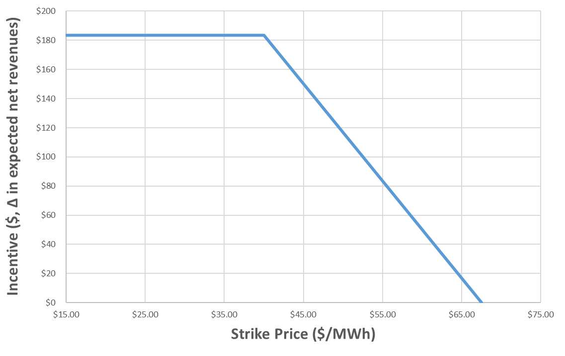
We can see the impact on the incentive by changing the strike price
By changing the strike price used in row 4, we can re-calculate the expected net revenues and quantify the impact on the incentive

Slide 14
So what is the tradeoff and what is ‘close enough’
For this example we can see that there is no impact on Generator 3’s incentive below Generator 3’s marginal cost (for energy) - $40/MWh
Recall, the strike price in the example was $35/MWh
However, at strike prices higher than $40/MWh there is an impact on Generator 3’s incentives – this is the tradeoff
In this case, ‘close enough’ means the strike price could be up to $5/MWh higher without impacting incentives
A strike price that is more than $5/MWh higher (i.e., a strike price greater than Generator 3’s marginal cost for energy) begins to erode the incentive

Slide 15
Takeaway
In assessing whether or not, or to what degree, to apply a bias in the setting of the strike price the impact on the incentives to the marginal unit (for options) should also be considered
How often, and to what degree, does a biased strike price exceed the marginal cost (for energy) of the marginal (option) offer
To assess this tradeoff, we will work with AGI (Analysis Group Inc.) to try and quantify the impacts on incentives

Slide 16
Setting the strike price
In this section, we will examine the effects on close-out costs by shaping the strike price, and the effects of including a bias in the determination of the strike price
We will also examine different practical approaches to determine the strike price

Slide 17
How this section is organized
First, we will establish a benchmark to gauge and contrast the effects of the various constructs examined to set the strike price
Then we will examine, relative to the reference construct, the effects of shaping and biasing
Finally, we will examine some practical approaches for setting the strike price, including the effects of shaping and biasing

Slide 18
We will use the same historical period for all analyses
For comparison purposes, we will use the period from Jan 3, 2019 through September 30, 2019
Because, for this period of time, the external data we will use are available
By using the same period in each case we can fairly compare and contrast each construct

Slide 19
How the data has been compiled
For each hour in the period, the strike price (K) is compared to the RT LMP and a close-out amount for a 1 MWh option, if the RT LMP is greater than K, is calculated
In each different construct it is only the strike price that is different
For the benchmark the strike price is set equal to the actual DA LMP that hour
This data is summarized in tables, showing:
The total close-out amount ($) over the period
The percentage of the hours in the period with a positive close-out amount
The average rate ($/MWh); the total close-out amount divided by the number of hours in the period
The average rate ($/MWh) for hours with a positive close-out amount
The average rate ($/MWh) for hours with a ‘missing’ close-out amount

Slide 20
In practice, there will be close-out differences relative to the benchmark
In some hours the strike price is ‘too low’ compared to the benchmark (DA LMP), and the close-out charge is greater than the benchmark close-out
In some hours the strike price is ‘too high’ compared to the benchmark, and the close-out charge is less than (or completely missing from) the benchmark close-out
These effects can be seen in the average rates for hours with a positive close-out amount, and the average rates for hours with a missing close-out amount

Slide 21
the effects of shaping and biasing

Slide 22
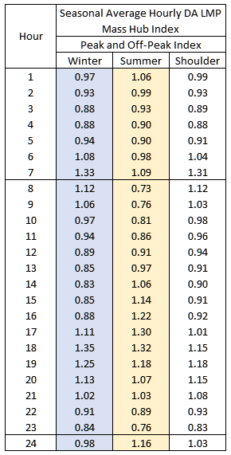
Shaping the strike price
For demonstration purposes, seasonal shapes have been developed (see Appendix A for details on how these shapes were created)
These shapes can be used to convert Peak and Off-Peak marks into unique strike prices for each hour of the day
Peak: hours 8-23
Off-Peak: hours 1-7, and 24
For example, if the Peak mark is $30/MWh, the strike price in hour 8, in the winter, would be $33.60/MWh

Slide 23
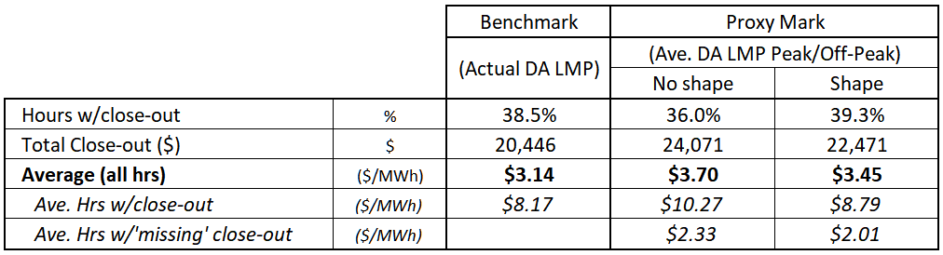
The effect of shaping the strike price
For demonstration purposes, a proxy mark is used for Peak and Off-Peak hours – this is the mark that is ‘shaped’
The proxy Peak mark for a given day is equal to the average of the actual DA LMPs for the Peak hours in that day (and likewise for the Off-Peak mark)
For contrast, a no-shape case is included; the strike price in all Peak hours is the same, and equal to the proxy Peak mark (and likewise for the Off-Peak hours)

Slide 24
Biasing the strike price
We can add a bias to the three prior constructs and observe the effects
For the benchmark, this means biasing the DA LMP
For the no-shape case, this mean biasing the proxy marks (i.e., the average of the actual DA LMPs for both the Peak and Off-Peak hours)
For the shaped case, this means biasing the product of the proxy mark and the hourly index
For demonstration purposes only, two bias methods were examined, and applied to every hour of the period
Fixed method: a $5/MWh bias is applied in every hour
Percentage method: a 5% bias (a 1.05 multiplier) is applied in every hour

Slide 25
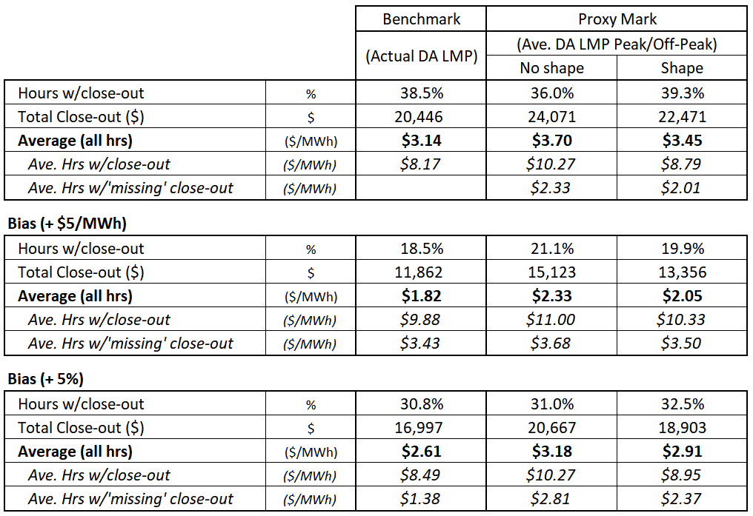
The effect of biasing the strike price

Slide 26
For both shaping and biasing there are other considerations
Presuming a shaping and/or biasing mechanism are used:
What should be the precise method used?
To determine seasonal shapes
To determine a bias amount (whether fixed or percentage based)
How often should shapes and bias amounts be reviewed and updated?

Slide 27
practical approaches

Slide 28
Putting this into practice
To date, we have examined two possible external data sources
Daily power mark construct: We have data provided by Intercontinental Exchange (ICE)
From ICE historical daily Mass Hub Peak and Off-Peak marks are available
Forecast construct: We have data provided by Enverus (previously known as PRTforecast)
From Enverus historical hourly forecasts of Mass Hub DA LMPs are available
The ISO uses these data presently for generator’s reference-price opportunity cost calculations
We will examine each, in turn, next

Slide 29
The pros and cons using a daily (Peak and Off-Peak) power mark construct
Pros:
They are the best available estimate of the market’s expectation of next day RT LMPs (see slide 9)
Cons:
Limited volume and open interest in New England power
There is no specified ‘shape’ to Peak and Off-Peak marks; they are averages
There is a time lag;
The latest exchange’s report from the day (or days) prior would be used to set strike prices for the next day (or days) – fundamentally a two-day ahead mark
The two-day ahead mark may be a ‘balance of week’ or ‘balance of month’ mark instead of a mark for power that one specific day, two days ahead

Slide 30
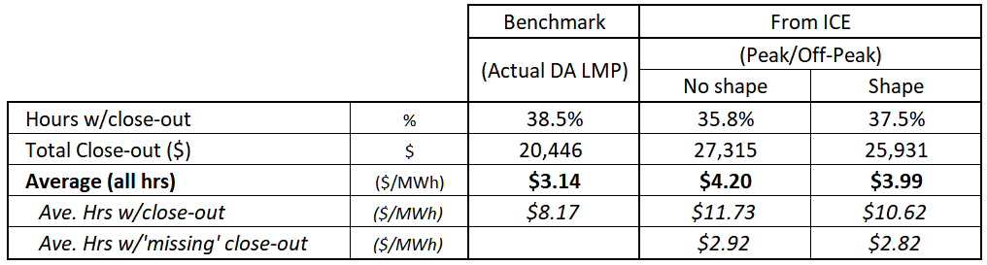
Observations using a daily power mark construct
Here, we will again use the no-shape and shape constructs, but instead of using proxy marks we will use historical data provided by ICE
Specifically, we will use the daily reported (two-day ahead) Peak and Off-Peak marks for day-ahead power

Slide 31
Biasing the daily power mark construct
We can add the same two bias methods ($5/MWh, 5%) and observe the effects
For the no-shape case, this mean biasing both the Peak and Off-Peak marks
For the shaped case, this means biasing the product of the mark and the hourly index

Slide 32
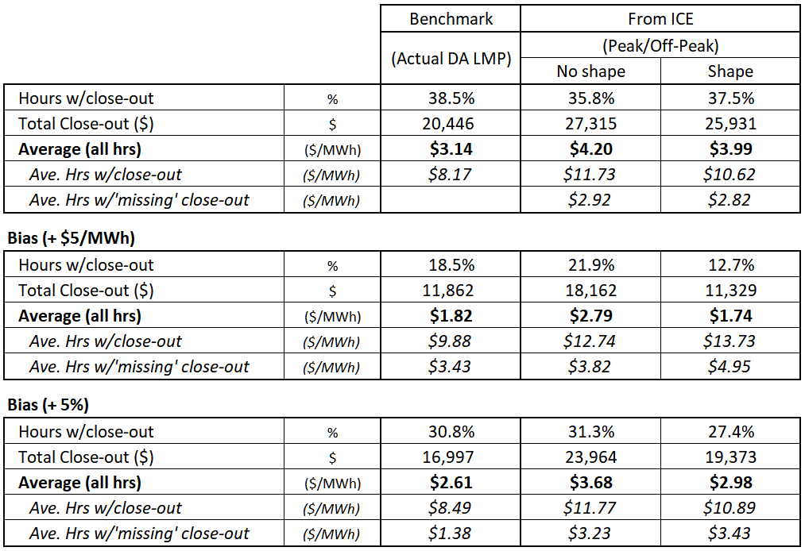
Observations using a biased daily power mark construct

Slide 33
The pros and cons using an independent (commercially available) forecast
Pros:
This being an hourly forecast, no shaping is required
There is no time lag; the latest forecast for tomorrow is available each morning
Cons:
This is a forecast, and technically not an estimate of the market’s expectation of next day RT LMPs

Slide 34
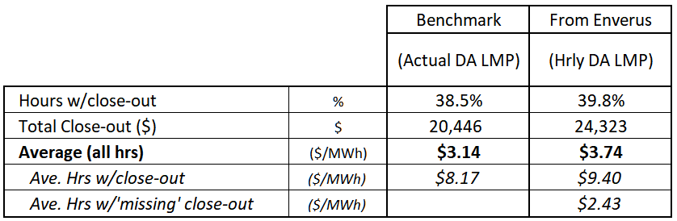
Observations using a forecast construct
No shaping is required

Slide 35
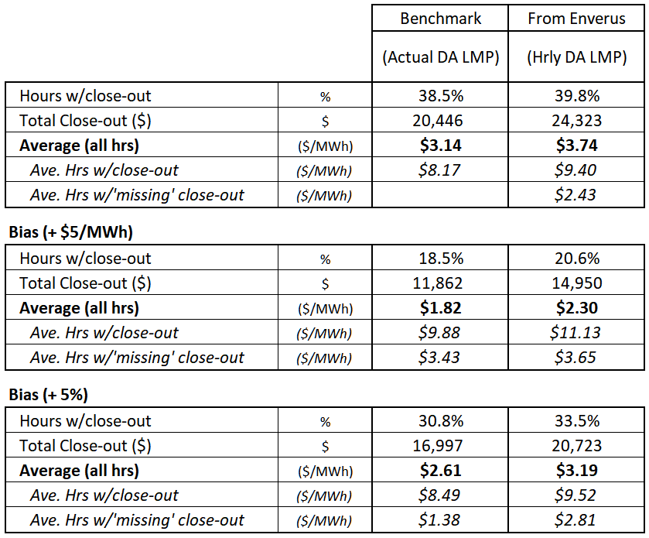
Biasing the forecast construct
The same two bias methods ($5/MWh, 5%) have been applied to each hour’s DA LMP forecast value

Slide 36
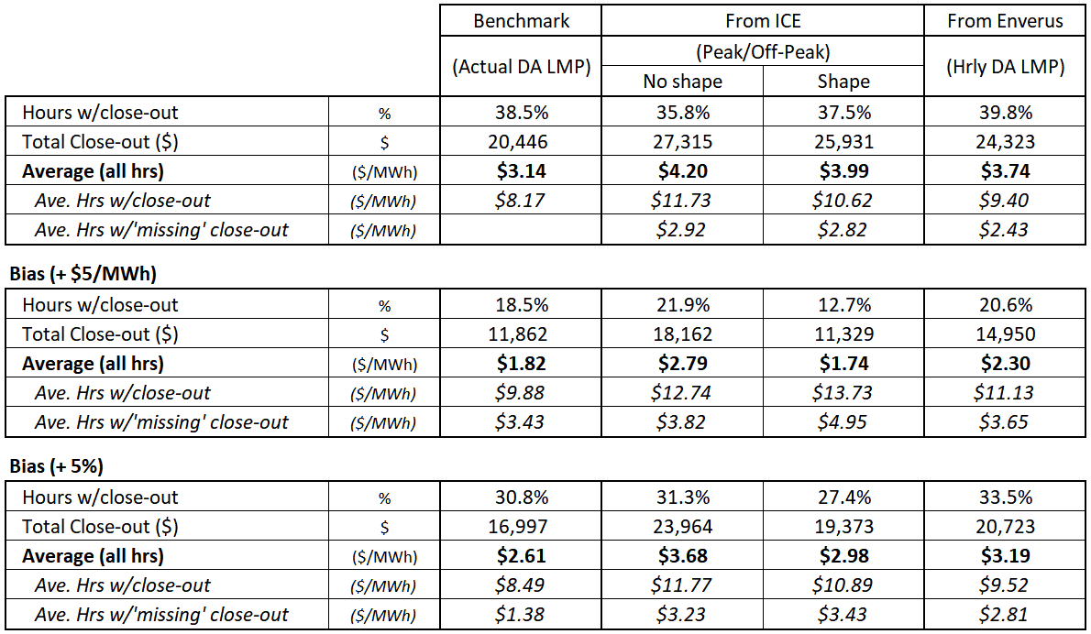
Comparing observations over the same period

Slide 37
Takeaways & Next steps

Slide 38
Takeaways
Practical approaches, and shaping:
For the period examined, the forecast approach produces average close-out costs that are closer to the benchmark than using a shaped daily power mark approach
A forecast approach does not require the administrative procedures to ‘hourly shape’ the strike price
Bias:
Some stakeholders have expressed interest in a higher strike (positive bias) to lower consumer costs, on average
Others have expressed concern that a higher strike may run counter to fuel security benefits
As noted, there is a trade-off, and the ISO is working with AGI to provide quantitative information on this trade-off and will share this with the committee as soon as available

Slide 39
Next steps
Follow up on assessing the impact on incentives with higher (biased) strike prices – can we quantify the tradeoff?
Consider your feedback regarding specific shaping and biasing mechanisms, and if applied how would these mechanisms be implemented and codified

Slide 40
Stakeholder Schedule for ISO Proposal
Stakeholder Committee and Date | Scheduled Project Milestone
Markets Committee November 2019 | Further explanation of how the forecast energy requirement is applied today and review of the forecast energy requirement under ESI; Discussion of impact analysis modeling enhancements; Discussion of ISO memo on plans for developing mitigation of day-ahead ancillary services
Markets Committee December 2019 | Discussion of ISO proposal, refinements as needed; Discussion of impact analysis modeling results;
Markets Committee January 2020 | Discussion of ISO proposal, refinements as needed; Draft ISO Tariff language; Continued discussion of impact analysis modeling results; Discussion of conceptual mitigation design; Update on initial forward market construct assessment
Markets Committee February 2020 | Final review of draft ISO Tariff language and wrap-up; Discussion of draft impact analysis report; Continued discussion of conceptual mitigation design; Discussion of the forward market construct
Markets Committee March 2020 | Continued discussion of conceptual mitigation design; Continued discussion of forward market construct including future plans; Vote on ISO proposed Tariff language and submitted stakeholder amendments
Participants Committee April 2, 2020 | Vote on ISO proposed Tariff language and submitted stakeholder amendments

Slide 41
Appendix A
A brief description of how the seasonal shapes were created

Slide 42
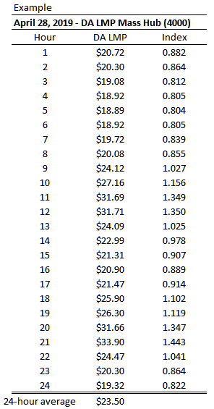
First, a daily hourly index of DA LMPs was created
A daily hourly index of DA LMPs was created for each day over a twelve month period (October 2018 – September 2019)
Example: The index value for hour 8 is hour 8’s DA LMP ($20.08/MWh) divided by the daily average of DA LMPs ($23.50) – yielding an index value of 0.855

Slide 43
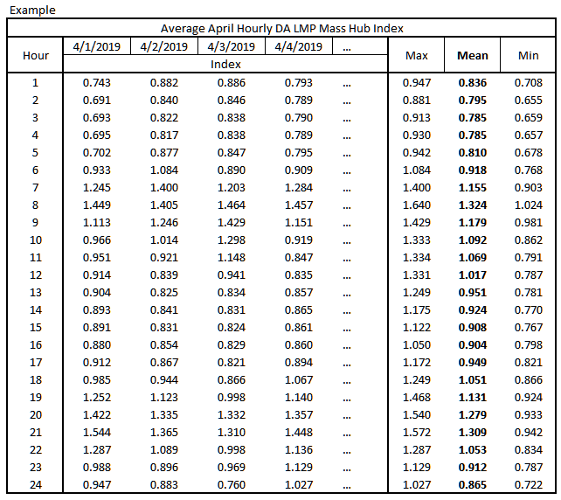
For each month an average index value for each hour was created
The difference between weekdays and weekends/holidays was deemed negligible for this demonstration

Slide 44
A seasonal average hourly index was then determined
Seasons for this demonstration:
Winter (Dec – Jan)
Summer (July – Aug)
Shoulder (all other months)
Using the average hourly index of each month in each season, a seasonal average hourly index was created – see table on next slide

Slide 45
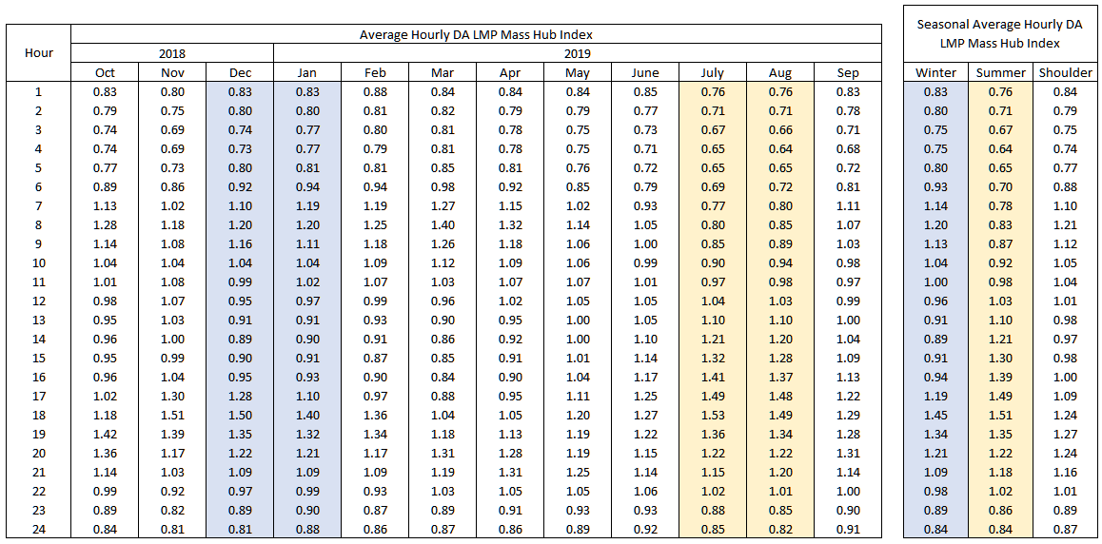
Seasonal average hourly index values

Slide 46
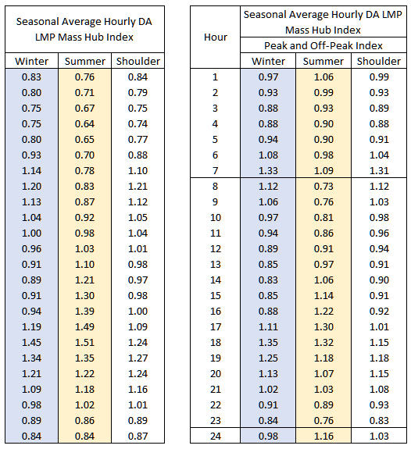
Peak and Off-Peak hourly index values were then created from the seasonal average hourly index values

Slide 47
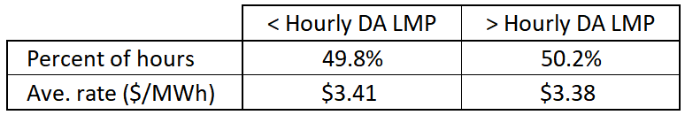
The seasonal Peak and Off-Peak index values were then compared to each hour’s actual DA LMP in the period
Actual average daily Peak and Off-Peak DA LMPs were used to determine, for each day, a proxy mark for Peak and Off-Peak prices
For example, The proxy Peak mark is equal to the average of actual DA LMPs for hours 8-23

Slide 48
Appendix B
A seasonal breakout of the constructs examined today

Slide 49
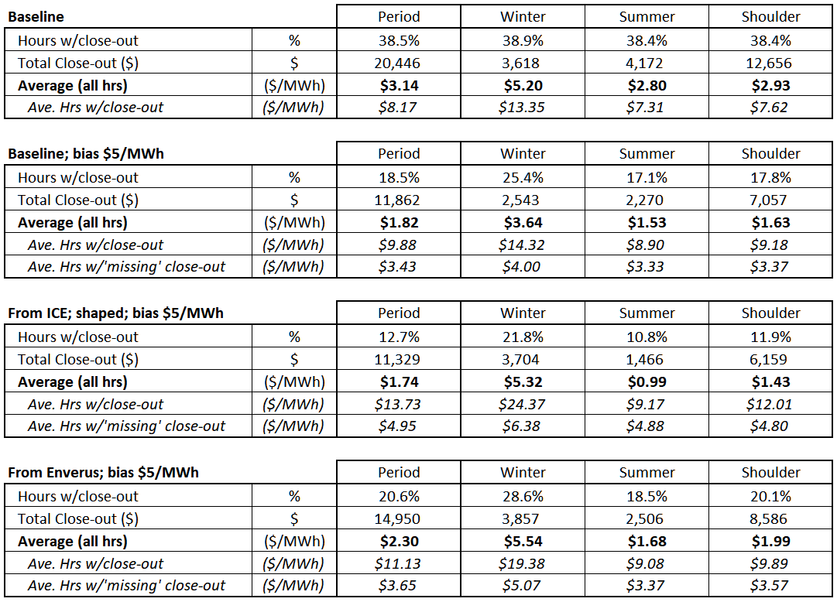
Seasonal breakout of period observations

