Slide 1
Energy Security Improvements Impact Analysis
Todd Schatzki
Principal
January 15, 2020

Slide 2
Agenda
Update to Central Case Results
Winter Case Scenario Analysis
Non-winter Month Analysis
Appendices
Incentives for energy inventory
Detailed Scenario Analysis Results

Slide 3
Status and Progress to Date
Several changes in assumptions
We appreciate the feedback provided by stakeholders, as it has helped inform many of the model's assumptions
We have received many requests for additional results, analysis, and scenarios; we have worked diligently to be as responsive as possible, although time constraints have affected our ability to respond to all requests
Our work continues, and we hope to respond to requests not addressed in upcoming presentations and in the report
Today we present results for:
Winter Month Central Case ‒ updated results
Winter Scenarios ‒ selected scenarios
Non-Winter Months ‒ one Case

Slide 4
Update to Central Case Results

Slide 5
Update to Central Case Results
Several changes in assumptions
Results reflect several changes in assumptions relative to those presented at the December MC
ESI shortage prices
ESI shortages prices were set at levels above the levels currently proposed by ISO-NE
Updated results reflect values consistent with ISO-NE proposal
Adjustment to treatment of variable renewable (solar, wind) participation in the DA market
Other adjustments to model parameters, including day-ahead demand and fuel oil inventory assumptions

Slide 6
Update to Central Case Results
Summary of Changes in Results
Qualitative findings remain consistent with results presented previously
ESI procures new ancillary services day-ahead to improve system reliability, increasing the supply of energy inventory and reducing stress of fuel supply systems
ESI would cause DA markets to clear energy supply levels closer to the ISO forecast load
ESI may cause shifts in energy use through more efficient use of energy inventory that can lower production costs
For example, shifts in energy supply from resources with stored energy inventories to those with just-in-time fuel supply

Slide 7
Update to Central Case Results
Summary of Changes in Results
Modeling updates have led to some changes in estimated ESI’s impacts relative to previously reported preliminary results ‒ for example:
Impact on total customer payments reduced
Impact on net revenues reduced (less positive), with some categories of resources facing reductions in net revenues, on average
Below, key result updates are highlighted, with more detailed results provided in the appendix

Slide 8
LNG Contract Structure is Not a Key Determinant in Model’s Estimates
Observations Regarding Repsol’s Letter and Presentation
Model makes simplifying assumptions to estimate ESI’s impact in a timely manner
Analysis assumes a call-option contract structure ‒ as previously stated:
Estimated impacts do not meaningfully depend on choice of contract structure
Model assumes LNG is used during stressed periods, when it is lower cost than pipeline gas

Slide 9
Changes in Model’s Available LNG are Unlikely to Significantly Affect Model’s Estimated ESI Impact
Observations Regarding Repsol’s Letter and Presentation
Model’s ‘full supply’ assumption may overstate available LNG in some cases
However, incentive to hold LNG increases as system conditions become more stressed
We include a scenario with less available LNG, and ESI’s impact appears similar to Central Cases

Slide 10
Update to Central Case Results: Payments and Prices

Slide 11
Payments and Prices
Key Takeaways
ESI’s impact on total customer payments is ambiguous
Increased payments in 2 of 3 Cases
Depends on level additional energy inventory incented by ESI
Level of some impacts have changed, relative to previously reported preliminary results ‒ for example:
Total customer payments lower across Cases

Slide 12
Total Customer Payments
Central Cases
Total Payments by Case ($ Million)
Total customer payments increases in some Cases (Frequent, Infrequent) and decreases in others (Extended)
Payments increase due to FER payments plus net cost of new DA energy options
These higher payments are partially or more than fully offset by reduced energy (LMP) costs caused, partly, by the incremental energy inventory under ESI

Slide 13
LMPs
Central Cases
Average Day-Ahead and Real-Time LMPs by Case ($ per MWh)
Note: [1] Prices are the unweighted average across hours.
With ESI, LMPs generally decline compared to current market rules
Reductions range from $0.21 to $6.09 per MWh, driven by incremental energy supplies and other factors
DA and RT prices are generally aligned, consistent with arbitrage between DA and RT markets, which will continue to promote efficient pricing in DA markets under ESI

Slide 14
Payments to Day-Ahead Energy
Central Case
Weighted Average DA Energy Payments to Generators, CMR vs ESI ($ per MWh)
Note: [1] Prices are weighted by hourly quantity of generation.
DA energy is compensated with both LMPs and FER payments
Average FER payment (column [C]) is the weighted average across all DA energy
Average compensation (per MWh) to DA energy increases under ESI (compared to CMR) in two of three Cases (Frequent and Infrequent)
In Extended Case, LMPs reductions exceed FER payments, on average
FER payments for DA energy increases the return to holding energy inventory, all else equal

Slide 15
Incremental Fuel Oil Incentives Relative to Current Market Rules
Summary of Changes in Results
Compared to CMR, net incentives to maintain energy inventory increase for all types of oil-fired resources
Updated results ‒ with revised categories ‒ are included in the appendix
As in prior analyses:
In the Frequent and Extended Cases, new FER payments and DA energy options (for ESI AS products) exceed incremental holding costs
In the Infrequent Case, plants with dual fuel capabilities continue to receive positive returns for holding incremental energy inventory, while oil-only, incur negative returns, as these units infrequently supply energy and DA energy options
Incremental energy inventory may not be beneficial under all market conditions, particularly when market conditions (including weather conditions) provide sufficient supplies of energy inventory

Slide 16
Incremental LNG Contract Incentives Relative to Current Market Rules
Summary of Changes in Results
Compared to CMR, net incentives to enter into a forward LNG contracts are increased under ESI
Incremental revenues associated with signing an LNG contract are greater under ESI because of additional revenues from FER payments and award of DA energy options
Results are similar to those presented in December 2019

Slide 17
Update to Central Case Results: Energy Supply

Slide 18
Changes in DA Energy With ESI
Difference in Cleared DA Energy by Resource Type, CMR vs ESI, Central Cases
With ESI, total cleared DA energy increases (compared to CMR)
Adjustment due to cost savings of substituting DA energy for EIR, which does not incur a cost under CMR
This substitution leads EIR to be relatively small in most cases
With ESI, cleared DA energy quantities are more similar to system real-time demand than under current market rules

Slide 19
Energy Supply
DA Energy and Energy Option Mix
With ESI, the mix of energy supply shifts
Under ESI, DA energy supply generally increases for all resource types, with certain exceptions
Increase in DA energy greatest for dual-fuel and gas-only
Oil-fired steam supply increases across Cases, as well
DA energy options supplied largely by pumped storage, GT’s (dual fuel, oil-only and gas-only), hydro and CC’s (dual fuel and gas-only)
Some substitution from DA energy to DA energy options (particularly, oil-fired GT’s)
Detailed results in Appendix

Slide 20
Update to Central Case Results: Net Revenues and Production Costs

Slide 21
Net Revenues and Production Costs
Key Takeaways
Total production costs are reduced in Cases where the incremental fuel ESI incents is used to displace generation from higher cost, less efficient units
Change in production costs may be understated, as distribution of incremental energy inventory across resources may not reflect optimal allocation
Changes in net revenues vary across Cases and resource types, on average
Net revenues reflect multiple factors, including changes to LMPs, new FER payments and ESI awards for DA energy options
Changes sensitive to amount of incremental energy inventory incented by ESI across all resources

Slide 22
Production Costs
Production Costs, with and without ESI, Central Cases
Production costs lower in 2 of 3 cases despite increased DA energy market requirements

Slide 23
Net Revenues
Average Net Revenues by Resource Type, Winter Season, Frequent Stressed Conditions ($ per MW)

Slide 24
Net Revenues
Average Net Revenues by Resource Type, Winter Season, Extended Stressed Conditions ($ per MW)

Slide 25
Net Revenues
Average Net Revenues by Resource Type, Winter Season, Infrequent Stressed Conditions ($ per MW)

Slide 26
Update to Central Case Results: Operational and Reliability Outcomes

Slide 27
Operational / Reliability Metrics
Multiple Metrics to Capture Different Aspects of Energy Security
Operating reserve shortages. Hours of 10- or 30-minute operating reserve shortage
Natural gas consumption when natural gas supply is tight. Change in natural gas consumption during periods when NG supply is tight, as reflected by high prices (> $16 / MMBtu), net of NG from forward LNG contracts
Minimum daily deliverable energy from oil-fired units. Minimum daily quantity of energy (MWh) available from oil-only and dual-fuel resources given actual fuel inventory
Average daily deliverable energy from oil-fired units. Average daily quantity of energy (MWh) available from oil-only and dual-fuel resources given actual fuel inventory
Maximum 4-day drop in energy inventory. Largest drop in energy inventory over a 4-day period.

Slide 28
Operational / Reliability Metrics
Multiple Metrics to Capture Different Aspects of Energy Security
Change in Reliability Metric with ESI compared to CMR
Central Cases
Consistent with prior results, ESI generally relaxes energy physical and economic constraints
Reduced reliance on NG supply when supplies are constrained (prices are high)
Increased energy inventory
Reduced draw-down on energy inventory during periods of need

Slide 29
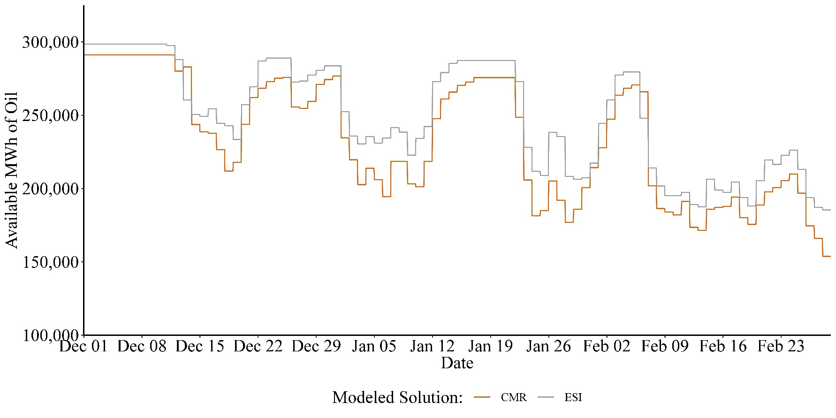
Scenarios - Reliability
Daily Oil Available for Real Time Generation, Frequent Stressed Case (MWh)
Maximum Daily Potential Generation from Oil-fired Resources, CMR vs ESI, Frequent Stressed

Slide 30
System Operations and Reliability
Key Takeaways
ESI generally expected to improve system operations and reliability
Increased energy inventory reduces risk of operational events
Reduced reliance and stress on fixed fuel (natural gas) delivery systems
Compensation for DA energy option helps to preserve energy inventory, while shifting energy supply to resources with just-in-time fuel supplies (i.e., natural gas)
Magnitude of this effect will tend to increase as system conditions become more stressed

Slide 31
Preliminary Scenario Analysis Results

Slide 32
Scenarios Presented
Set of Scenarios Presented Today
The Scenarios evaluated seek to be responsive to the set of stakeholder requests we have received to date
Particular Scenarios being analyzed are described on the following page
These descriptions list all of the changes in assumptions for each Scenario
One Scenario ‒ “Strike Hourly” ‒ assumes an hourly-varying strike price that is consistent with ISO-NE’s current design thinking
Scenarios are organized into two groups:
Changes to ESI Design
Changes to Resource or Demand Assumptions
Results are preliminary, and we continue to evaluate results to develop more insight into expected ESI impacts

Slide 33
Scenarios Presented

Slide 34
Scenarios - Customer Payment Impacts
Impacts Vary Across Cases and Scenarios
ESI’s impact on consumer costs varies across scenarios and Cases
Range from reduction of $316 million to increase of $407 million
Impact is complex, reflecting multiple factors, including:
Changes in and nature of change in market tightness (e.g., High Load, 1- and 5-day Supply Shocks, More/Less LNG supply)
Changes in costs (e.g., higher risk premiums)
ESI design (e.g., higher RER quantity)

Slide 35
Scenarios - Prices
Impacts Vary Across Cases and Scenarios
Across cases:
LMPs decrease due to increased energy inventory incented by ESI and increased DA energy supply (at lower LMPs)
FER prices range from $1.47 to $20.40 per MWh
DA energy option prices vary across Cases, but relatively similar across Scenarios within Cases

Slide 36
Scenarios - Summary Results
Frequent Stressed Case

Slide 37
Scenarios - Summary Results
Extended Stressed Case

Slide 38
Scenarios - Summary Results
Infrequent Stressed Case

Slide 39
Scenarios – Operational and Reliability Outcomes
Impacts Vary Across Cases and Scenarios
Across scenarios, ESI causes positive operational improvements through incremental fuel supply and substitution of resources with just-in-time energy supply for inventoried energy
Fewer operating reserve shortages during 5-day supply contingency (“Shock HQ 5 Days”) in Frequent Case
Use of natural gas when prices are high (i.e., NG supply is tight) decreases under all scenarios, illustrating how ESI reduces stress on fuel systems
System-wide quantity of fuel oil inventory generally higher under ESI
Depletion of oil inventory during periods of high demand (i.e., “cold snaps”) reduced under ESI

Slide 40
Operational / Reliability Metrics
Multiple Metrics to Capture Different Aspects of Energy Security
Change in Reliability Metric with ESI compared to CMR, Frequent Stressed Conditions

Slide 41
Operational / Reliability Metrics
Multiple Metrics to Capture Different Aspects of Energy Security
Change in Reliability Metric with ESI compared to CMR, Extended Stressed Conditions

Slide 42
Operational / Reliability Metrics
Multiple Metrics to Capture Different Aspects of Energy Security
Change in Reliability Metric with ESI compared to CMR, Infrequent Stressed Conditions

Slide 43
Preliminary Non-Winter Month Analysis

Slide 44
ESI Impacts in Non-Winter Months
Fundamentals of Impact Approach
Framework for analysis of ESI during non-winter months is largely the same as the analysis for winter months
Analysis considers different levels of stressed conditions in a future non-winter, 2026:
Moderate Conditions based on 2017 (March through November)
Moderate or typical non-winter market conditions
Results are preliminary, but provide reasonable estimates of impacts for the cases evaluated

Slide 45
Preliminary Non-Winter Central Case – Assumptions
Data and assumptions generally consistent with winter analysis
Key assumptions (discussed in November MC, as well):
Demand escalated in manner consistent with winter approach (reflecting ISO forecasts for 2026)
Supply
Variable renewable profiles consistent with historical output, grown to anticipated future renewable supplies
Available supplies reflect scheduled “shoulder” month maintenance outages
Fuel supply (natural gas and fuel oil) not materially binding on market outcomes in these Cases
No market responses to ESI incentives
DA energy option offer prices adjusted for non-winter market conditions (with limited intra-day fuel price risk)

Slide 46
Preliminary Central Case Results – Overview
Scope of results to be discussed today
Results today will cover the key impacts evaluated in our preliminary analysis, including:
Changes in total customer payments under ESI
Price signals, including LMPs and DA AS prices
Quantities of DA energy and AS procured, and the shifts in DA cleared energy compared to current market rules
Changes in net revenues to resource owners
Operational and reliability outcomes

Slide 47
Non-Winter Results: Payments and Prices

Slide 48
Payments and Prices
Key Takeaways
ESI increases total customer payments in non-winter months for the Case considered
Consistent with procurement of additional reliability services
Reflects assumption of no market responses to ESI incentives
Change in LMPs and total payments to energy is relatively small
In Moderate Case, total change in payments ‒ accounting for change in LMP and new FER payments ‒ is approximately ~ $0.25 per MWh

Slide 49
Total Customer Payments
Central Case
Total Payments by Case ($ Million)
Customers payments under ESI increase by $69 million (2.4%) in the Moderate Case
Increases due to new FER payments and net cost of ESI AS products

Slide 50
LMPs
Central Case
Average Day-Ahead and Real-Time LMPs by Case ($ per MWh)
Note: [1] Prices are the unweighted average across hours.
With ESI, DA LMPs lower than under current market rules
Market clears more DA energy
LMPs “set” at demand offers, which are lower when clearing a greater quantity of supply
No change in RT LMPs, as energy inventories and fuel use decisions unchanged by ESI given lack of tightness in energy supplies

Slide 51
Payments to Day-Ahead Energy
Central Case
Weighted Average DA Energy Payments to Generators, CMR vs ESI ($ per MWh)
Note: [1] Prices are weighted by hourly quantity of generation.
DA energy is compensated with both LMPs and FER payments
Average FER payment (column [C]) is the weighted average across all DA energy
Total compensation to DA energy increases under ESI (compared to CMR) reflecting combined impact to LMPs and new FER payments
FER payments (more than) offset decrease in LMPs

Slide 52
Day-Ahead Option Prices
Central Case
Weighted Average DA Energy Option Clearing Prices ($ per MWh)
Note: [1] Prices are weighted by hourly quantity of each ESI product.
Weighted average hourly prices for EIR, GCR10, GCR30, and RER are:
As with winter Cases, RER and GCR average prices are relatively similar, although this masks significant hour-to-hour variation in each
EIR price is higher because prices are typically highest in hours when EIR quantity is large

Slide 53
Non-Winter Results: Energy Supply

Slide 54
Energy Supply
Key Takeaways
ESI increases cleared DA energy, with cleared amount closer to the ISO forecast
Under ESI, DA energy supply generally increases for all resource types, with certain exceptions
Largest increases for CC units (dual fuel and gas-only)
DA energy options supplied largely by pumped storage, GT’s (dual fuel, oil-only and gas-only), hydro and CC’s (dual fuel and gas-only)

Slide 55
Changes in DA Energy With ESI
Difference in Cleared DA Energy by Resource Type, CMR vs ESI, Central Cases
With ESI, total cleared DA energy increases (compared to CMR) due to cost savings of substituting DA energy for EIR
EIR is small, as energy is substituted for EIR

Slide 56
Total Non-Winter Generation Mix
Energy and DA Options by Resource Type, CMR vs ESI, Moderate Summer Conditions

Slide 57
Non-Winter Results: Net Revenues

Slide 58
Net Revenues and Production Costs
Key Takeaways
Given assumption that there is no change in fuel availability or other response to ESI, total production costs are unchanged between CMR and ESI cases
Net revenues generally increase by resource type, on average
Net revenues reflect multiple factors, including changes to LMPs, new FER payments and ESI awards for DA energy options

Slide 59
Net Revenues
Average Net Revenues by Resource Type, Non-Winter Season, Moderate Summer Conditions
($ per MW)

Slide 60
Net Revenues
Average Net Revenues, Selected Resources, Non-Winter Season, Moderate Summer Conditions

Slide 61
Next Steps
Current plan for providing stakeholders with findings
January
Additional Winter Scenarios
Additional Non-Winter Central Case
February
Draft Report

Slide 62
Appendix

Slide 63
Central Case Detailed Results and Fuel Oil Assumptions

Slide 64
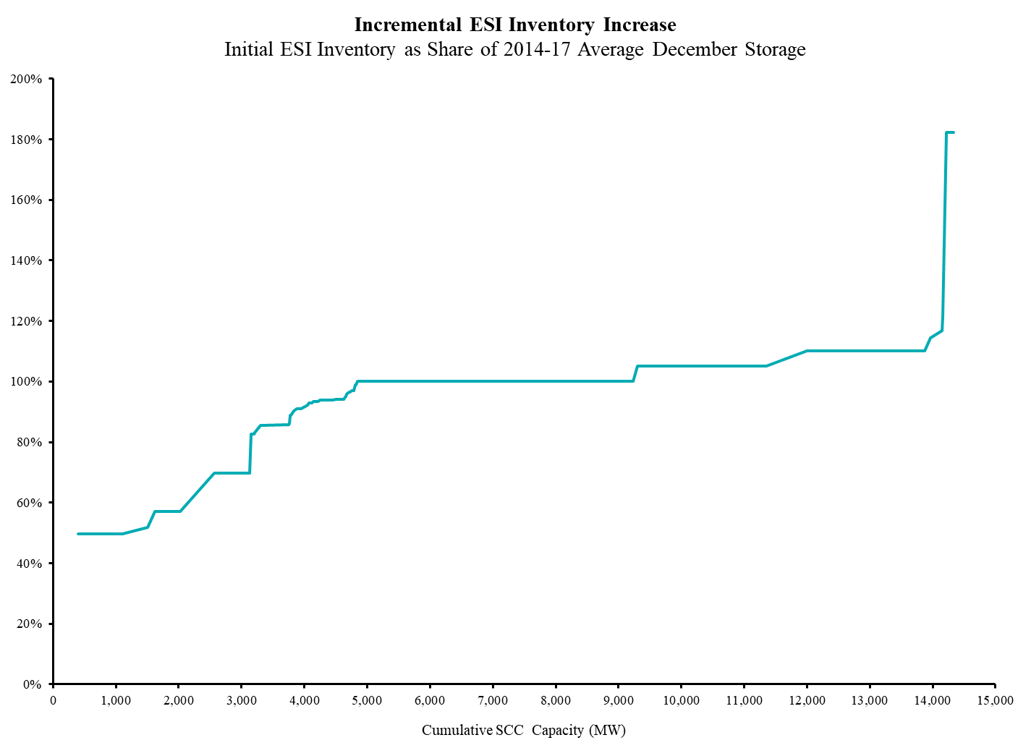
Assumptions Regarding Fuel Oil Inventory and Replenishment
Initial Inventory Under ESI
Initial ESI Inventory Relative to 2014-17 Average December Storage
Under CMR, initial inventory set to December 2017 storage
Under ESI, initial inventory set relative to storage in December 2014-17
Assumed values adjusted from historical values based on analysis of the benefits of additional fuel storage, relative to CMR levels
Analysis reflects multiple factors, including unit’s marginal cost, volume stored under CMR (large for some units), and relative size of historical storage in 2017/18 compared to 2014-17

Slide 65
Assumptions Regarding Fuel Oil Inventory and Replenishment
Fuel Oil Replenishment Assumptions
The Table above provides assumptions for fuel oil inventories and replenishment at oil-only and dual fuel plants
Assumptions vary based on tank size (days of fuel) and means for delivery (truck of barge)
Refill threshold determines the trigger for replenishing fuel, (measured as a percent of maximum storage); for example, a plant with a tank with 4 days of fuel would replenish when the unit has 1.2 days of fuel remaining (4 days x 30%)
When the trigger is hit, the plant receives a shipment, of quantity equal to the Rate of Fuel Delivery, after waiting the Order Lead Time

Slide 66
Day-Ahead Option Prices
Weighted Average DA Energy Option Clearing Prices ($ per MWh)
Note: [1] Prices are weighted by hourly quantity of each ESI product.
Weighted average hourly prices for EIR, GCR10, GCR30, and RER vary across cases, but relatively within Cases, similar to prior results
The weighted average price paid for EIR is generally higher because prices are typically highest in hours when EIR quantity is large
EIR quantity zero in large fraction of hours, as market clearing substitutes energy for EIR to lower costs

Slide 67
Incremental Fuel Oil Incentives Relative to Current Market Rules
Cost Effectiveness of Additional Fuel – Central Case, Frequent Stressed Conditions
Compared to CMR, net incentives to maintain energy inventory increase for all types of oil-fired resources
In the Frequent Case, new FER payments and DA energy options (for ESI AS products) exceed incremental holding costs

Slide 68
Incremental Fuel Oil Incentives Relative to Current Market Rules
Cost Effectiveness of Additional Fuel – Central Case, Extended Stressed Conditions
Results are similar for the Extended Case as the Frequent Case

Slide 69
Incremental Fuel Oil Incentives Relative to Current Market Rules
Cost Effectiveness of Additional Fuel – Central Case, Infrequent Stressed Conditions
In the Infrequent Case, plants with dual fuel capabilities continue to receive positive returns for holding incremental energy inventory
For oil-only plants, additional holding costs of the assumed level of incremental fuel inventory exceeds the total FER and ESI DA AS payments; under infrequent stressed conditions, these units infrequently supply energy and DA energy options
Incremental energy inventory may not always be beneficial, particularly when market conditions provide sufficient supplies of energy inventory

Slide 70
Total Winter Generation Mix
Energy and DA Options by Resource Type, CMR vs ESI, Frequent Stressed Conditions

Slide 71
Total Winter Generation Mix
Energy and DA Options by Resource Type, CMR vs ESI, Extended Stressed Conditions

Slide 72
Total Winter Generation Mix
Energy and DA Options by Resource Type, CMR vs ESI, Infrequent Stressed Conditions

Slide 73
Net Revenues
Frequent Stressed Conditions Case
Average Net Revenues, Selected Resources, Winter Season, Frequent Stressed Conditions

Slide 74
Net Revenues
Extended Stressed Conditions Case
Average Net Revenues, Selected Resources, Winter Season, Extended Stressed Conditions

Slide 75
Net Revenues
Infrequent Stressed Conditions Case
Average Net Revenues, Selected Resources, Winter Season, Infrequent Stressed Conditions

Slide 76
Contact
Todd Schatzki Principal 617-425-8250 Todd.Schatzki@analysisgroup.com

