Slide 1
Planning Procedure 5-6 Revision
February 2020 Reliability Committee – Mike Purdie

Slide 2
Background
Dominion is replacing the Millstone Unit 3 (MPS U3) Generator and Feedwater measurement equipment.
MPS U3 has 1225 MW Summer and 1245 MW Winter of Interconnection.
The new equipment would allow MPS U3 to increase MW output to 1262 MW in Summer and Winter.

Slide 3
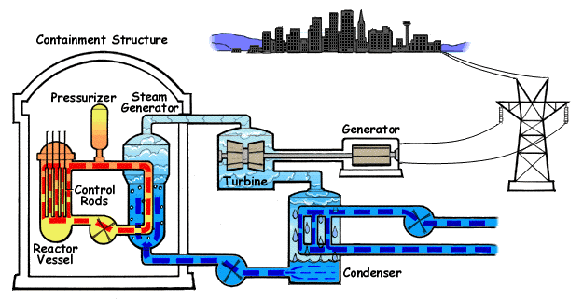
Reference: https://www.nrc.gov/reading-rm/basic-ref/students/animated-pwr.html
Notes:
More detail here

Slide 4
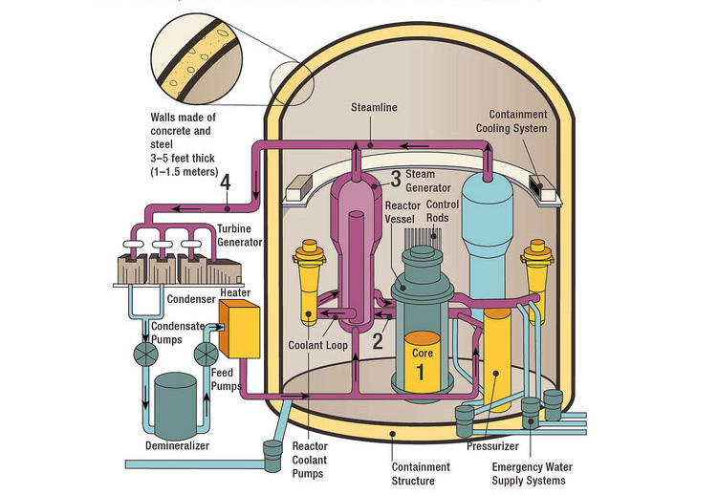
Reference: https://www.nrc.gov/reactors/pwrs.html
Notes:
Feedwater flow is the most significant contributor to core power measurement uncertainty. For the purposes of ECCS LOCA analyses, it is assumed the reactor is operating at 102% of licensed reactor power OR applying a reduced margin based on an accounting of uncertainties due to instrumentation error. Implementing new feedwater flow monitors provides a more accurate measurement of feedwater flow and reduces the uncertainty in feedwater flow measurement.

Slide 5
Problem
Planning Procedure 5-6 (PP 5-6) “Appendix A – General Transmission System Design Requirements for the Interconnection of New Generating Facilities and ETUs to the Administered Transmission System” limits interconnection to 1200 MWs for new resources and ETUs.
Screenshot of Page 19 of PP 5-6 next slide

Slide 6
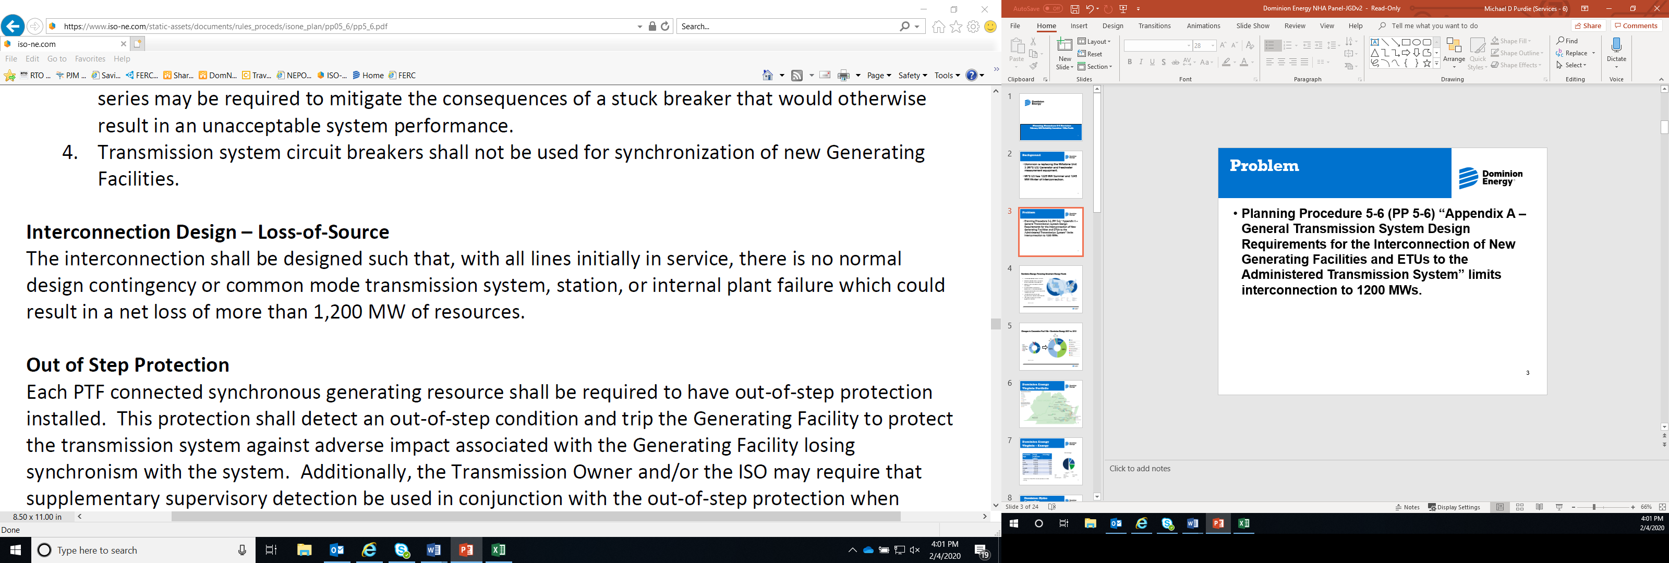
Problem

Slide 7
Problem
Regardless of the results of the System Impact Study ISO-NE indicated they likely could not approve the increase in interconnection rights due to this language.
Revising PP 5-6 would allow ISO-NE to approve the uprate if no issues were found on their review of the System Impact Study.

Slide 8
Solution
Dominion’s proposed solution is to craft language such that existing capacity resources above 1200 MWs that are increasing output as a result of good stewardship of their resources could increase their interconnection rights accordingly.
The equipment Dominion is installing not only improves the operation of Millstone but also provides benefits to the grid.

Slide 9
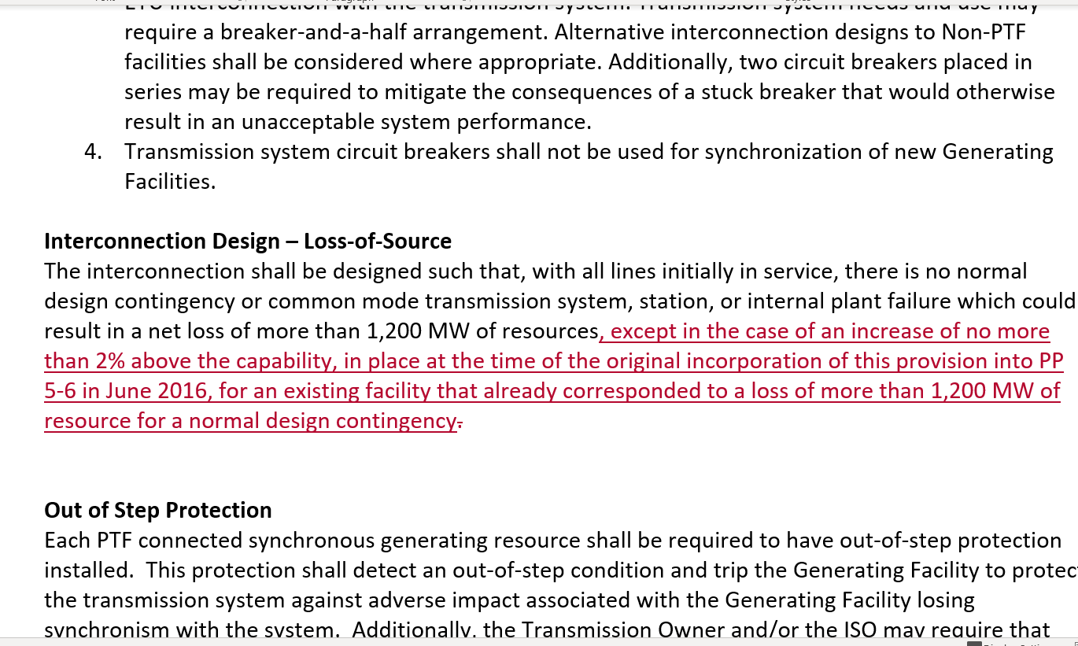
Solution

Slide 10
Contact Information
Michael Purdie
Electric Market Policy
Michael.D.Durdie@dominionenergy.com

