Slide 1
Energy Efficiency Resources
and Capacity Obligations During Scarcity Conditions
New England States Committee on Electricity
February 11, 2020

Slide 2
Today’s Objectives
Explain NESCOE’s revised proposal
Seek additional feedback from the committee on the proposed changes to better inform NESCOE’s understanding
Review proposed tariff and manual language changes

Slide 3
NESCOE Considerations
We would like to put forward a proposal that can achieve broader support from NEPOOL
Based on the committee feedback it became clear “Shaping Option A” would not meet that objective
Status quo cost allocation treatment of EE resources (EERs) is inconsistent with FERC’s directive to ISO-NE.
Want to bring forward a limited proposal targeted solely at that cost allocation issue and not an overall design change

Slide 4
Adjusted Balancing Ratio (“ABR”)
No change to On-peak treatment of EE under Pay-for-Performance (same as before)
The ABR proposal does two things for all intervals outside of EE’s On-Peak or Seasonal-Peak hours :
Explicitly sets the Actual Capacity Provided for EE to zero
Changes “Total CSO” to “(Total CSO – EE CSO)” in the denominator
Make no changes to the mutual insurance pool
Maintains EERs’ responsibility for any stop loss obligations
Continues to allow for possible allocation of overcollection amounts in the mutual insurance pool to EERs
We believe this is effectively a “net neutral” position for EERs in off-peak hours (~96% of all hours)

Slide 5
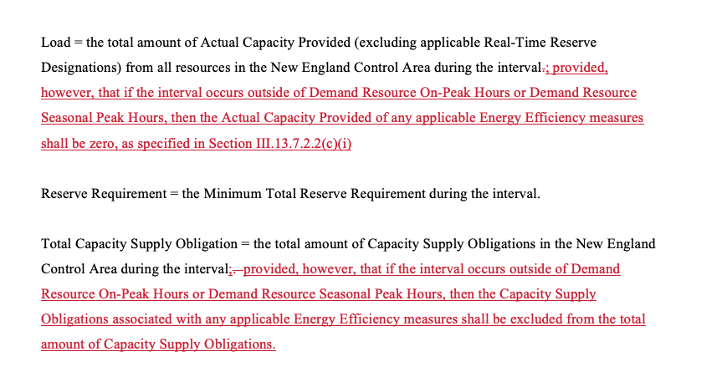
Tariff Changes
Various changes in Section III.13.7.2.3 similar to:
One minor change in III.13.7.2.4

Slide 6
Next Steps
Continue to seek stakeholder feedback.
Seek a March 2020 NEPOOL Markets Committee Vote.
Seek an April 2020 NEPOOL Participants Committee.
Expect late April 2020 FERC filing.

Slide 7
Questions
www.nescoe.com
Jeffbentz@nescoe.com

