Slide 1
February 11-13, 2020 | MARKETS COMMITTEE
Energy Security Improvements (ESI):
Assessing a Strike Price ‘Bias’
How adding a ‘bias’ to the strike price may impact resource incentives
Chris Geissler
413.535.4367 | CGeissler@iso-ne.com

Slide 2
Stakeholder question: To what extent would ‘biasing’ the strike price upward reduce incentives to procure fuel?
Recall: Biasing the strike price upward may reduce the incentive for resources that sell DA options to procure fuel
Therefore reduces ESI’s efficacy in addressing the misaligned incentive problem
This was covered on slides 7-15 of the ISO’s December MC presentation
Stakeholders asked whether the incentive impact is material for modest increases to the strike price
Today: Further discussion of how these incentives are impacted and preliminary quantitative analysis

Slide 3
Today’s discussion
Continued discussion of the conceptual impact of a strike price bias on resource incentives
Preliminary assessment of how significant this impact may be empirically, based on output data from the Analysis Group’s production cost model

Slide 4
Conceptual impact of strike price bias on resource incentives

Slide 5
Background: Relationship between strike prices, marginal costs, and incentives
A resource that sells the DA ancillary services will generally see its financial incentive to procure fuel decrease when the strike price exceeds its marginal costs of producing energy (when it procures the fuel)
Adding a ‘bias’ to the strike price will reduce the financial consequence (i.e., the settlement charge) for a resource with a DA ancillary service award that does not procure fuel

Slide 6
What does this relationship mean for a biased strike price?
A strike price bias impacts resource incentives to procure fuel through two mechanisms:
Likelihood of closeout: A biased strike price (K^{b}) reduces the probability of an option closeout
E.g., increasing the strike from $50/MWh to $60/MWh eliminates a $5/MWh closeout when the RT LMP is $55/MWh
Magnitude of closeout: A biased strike price reduces the closeout cost when the RT LMP exceeds the strike
E.g., increasing the strike from $50/MWh to $60/MWh reduces the closeout by $10 when the RT LMP is $70/MWh (or any value above $60/MWh)
Observation: Bias reduces option closeout costs more significantly in the second mechanism, where costs are reduced by the entire strike price bias

Slide 7
Assessment of a biased strike price’s impact on incentives must consider both mechanisms
Earlier stakeholder discussions have focused on how a biased strike price may reduce likelihood of closeout (mechanism 1)
E.g., what is likelihood K* < RT LMP < K^{b}?
This discussion has not carefully considered the fact that biasing the strike upwards also reduces the magnitude of the closeout (mechanism 2)
This magnitude of the closeout was accounted for in earlier ISO conceptual materials, including the example from its December MC presentation (next)

Slide 8
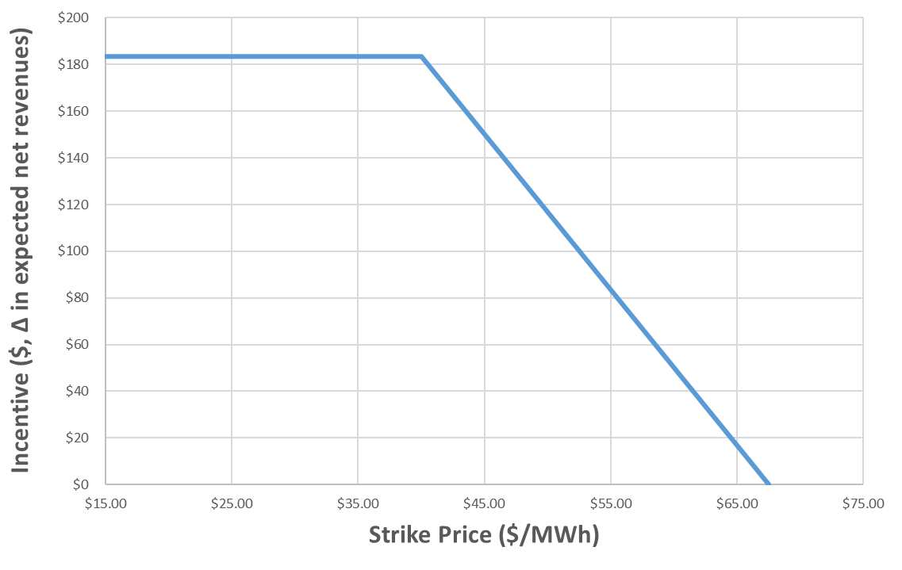
Graphical illustration (from December MC)
In the example presented in December, any increase in the strike price above the resource’s marginal cost of $40/MWh reduces its incentive to make fuel arrangements
Higher strike price reduces the closeout cost during ‘high demand’ states if resource does not make the arrangement

Slide 9
Empirical assessment how a strike price bias impacts resource incentives

Slide 10
Use production cost model to empirically estimate the impact of a strike price bias
Assess impact of adding a ‘bias’ to the strike price using data from the Analysis Group’s three winter Central Cases
For each option MWh sold, calculate the difference between the resource’s marginal costs and the unbiased strike price
Put these option MWh into buckets, showing the fraction of cleared option offers for which the incentive would be reduced
Each bucket represents the fraction of MWh for which the incentive begins to decrease in that price range

Slide 11
Caveats and limitations to this analysis
Magnitude of incentive reduction is dictated by numerous factors including:
Delta between RT LMPs with and without procurement
Resource costs of procuring inventoried energy
Analysis does not estimate the magnitude of this reduction for each option MWh sold
Graphically represented as the change in height associated with rightward shift in earlier figure
Analysis excludes MWh of options for which model does not estimate marginal costs
E.g., pump storage and hydro resources that are assumed to sell energy and options commensurate with historic performance
This exclusion limits quantity of options analyzed to roughly 40% to 50% of those sold in the simulations
These results are based on the three winter Central Cases

Slide 12
Preliminary results for a range of biases and Cases
Next: Present fraction of option MWh sold in central Winter Cases for which the incentives to be able to deliver RT energy would be reduced with a strike price bias
Present results averaged across all hours for each winter Central Case
Results vary across cases, but generally show impact of bias is sensitive to its size
E.g., a $5 bias has a more modest impact on incentives than a $20 bias

Slide 13
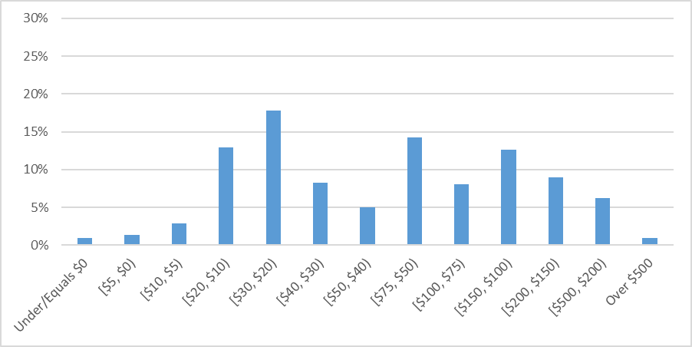
Distribution of MC – K for Sold Option MWh: Extended Stressed Conditions: All Hours
The three bars below $10 are 5% of these data
A bias of $10 reduces the incentive for 5 percent of all DA options sold, among those evaluated (see three left-most bars)
Represents ~183 MWh across entire quantity of options sold

Slide 14
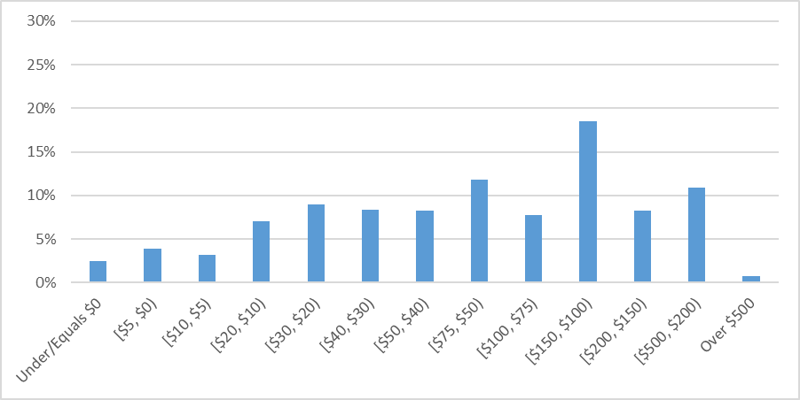
Distribution of MC – K for Sold Option MWh: Frequent Stressed Conditions: All Hours
A bias of $10 reduces the incentive for 9 percent of all DA options sold, among those evaluated
Represents ~341 MWh across entire quantity of options sold

Slide 15
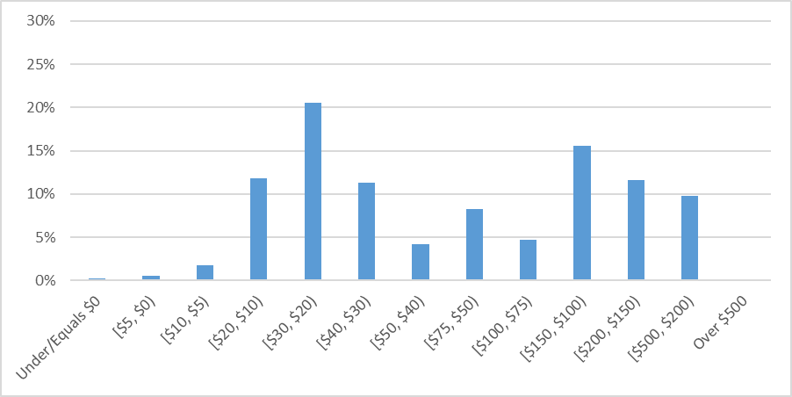
Distribution of MC – K for Sold Option MWh: Infrequent Stressed Conditions: All Hours
A bias of $10 reduces the incentive for 2 percent of all DA options sold, among those evaluated
Represents ~85 MWh across entire quantity of options sold

Slide 16
All-hour results suggest a $10 bias has a modest, but not overwhelming impact on incentives
For example, a $10 bias would impact the incentive to be available in RT for between 2 and 9 percent of option MWh
As the bias increases, the percent of option MWh with a reduced incentive increases
E.g., a $20 bias appears to impact approximately 15 to 20 percent of all option MWh
The magnitude of this incentive reduction also increases
These results are based on model assumptions about option offer prices and marginal costs, and do not consider all MWh of options sold, and should be interpreted accordingly

Slide 17
Preliminary results for varying market conditions
Previous results were averaged across all winter hours
Next: Present results that break out these averages based on RT LMPs
Illustrates how the impact of a strike price bias varies (if at all) with RT LMPs
More specifically, these results will help to address the question of if a bias more/less likely to reduce the incentive to be available in RT when LMPs are high and system conditions are most stressed

Slide 18
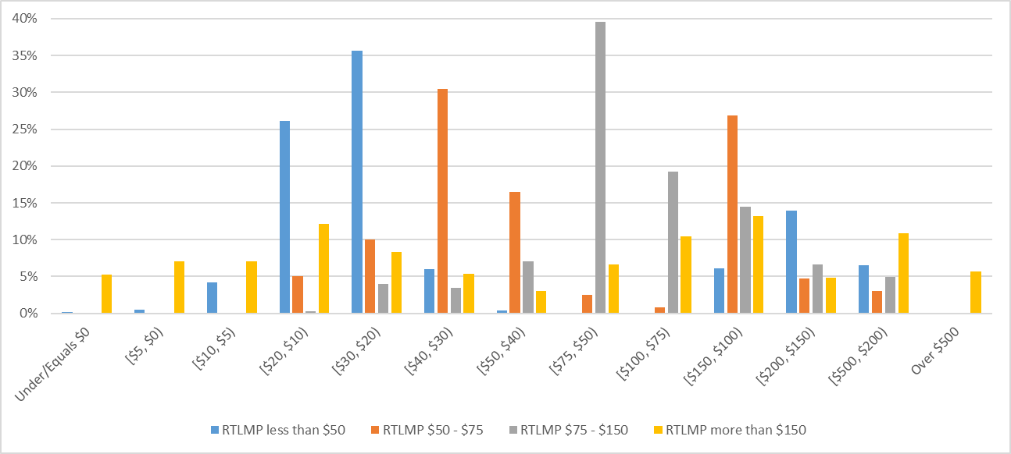
Distribution of MC – K for Sold Option MWh: Extended Stressed Conditions: Breakout by RT LMP
A bias of $10 has a more significant impact on incentives when RT LMPs exceed $150/MWh
Reduces incentives for 19 percent of option MWh

Slide 19
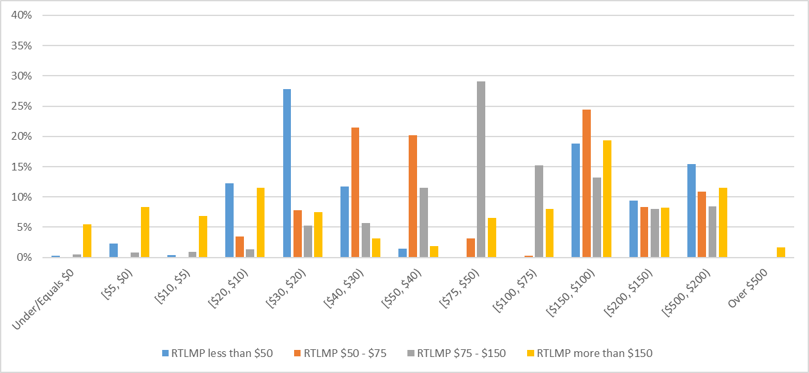
Distribution of MC – K for Sold Option MWh: Frequent Stressed Conditions: Breakout by RT LMP
A bias of $10 reduces the incentive for 21 percent of all DA options sold during periods where the RT LMP exceeds $150/MWh

Slide 20
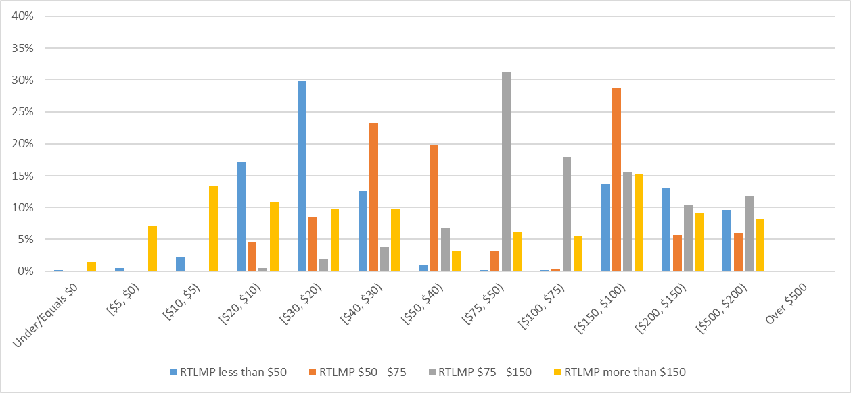
Distribution of MC – K for Sold Option MWh: Infrequent Stressed Conditions: Breakout by RT LMP
A bias of $10 reduces the incentive for approximately 20 percent of all DA options sold during periods where the RT LMP exceeds $150/MWh

Slide 21
Analysis suggests a strike bias appears to impact incentives more significantly during stressed conditions
A modest strike price bias would only affect incentives to be available in RT for a limited percentage of option MWh
However, its impact is more significant during stressed conditions, as ~20 percent of option MWh have a reduced incentive to be available in RT when RT LMPs exceed $150
Corresponds with ~720 MWh across entire quantity of options sold
During such conditions, optimization may be more likely to buy higher priced DA energy so that it can access (lower cost) options from more efficient resources
It is under such system conditions that concerns about system reliability and RT availability are most pronounced

Slide 22
Key takeaways
Preliminary analysis suggests adding a modest bias would reduce the incentive to procure fuel for a portion of the MWh that sell DA options in the winter Central Cases
For example, a $10 bias would reduce the incentive between 2 and 9 percent across all hours in the winter Central Cases
However, the impact is more significant during periods of system stress, as a bias impacts the incentives of ~20 percent of all option MWh sold
ISO has proposed a strike price that is set at the expected RT LMP, but we are open to stakeholder feedback on the pros/cons of a strike price bias

