Slide 1
March 17, 2019 | Westborough, MA
Forward Capacity Auction 2024/2025 (FCA 15): Initial Fuel Security Review Inputs
FCA 15: Fuel Security Review of Retirement De-List Bids
Norman Sproehnle
(413) 540-4755 | NSPROEHNLE@iso-ne.com

Slide 2
FCA 15 Fuel Security Review Inputs Development
The ISO is preparing for fuel-security reliability reviews of FCM Retirement De-List Bids, substitution auction demand bids, bilateral transactions, and reconfiguration auction demand bids submitted in connection with Forward Capacity Auction (FCA) 15
Planning Procedure 10 – Appendix I – Fuel-Security Reliability Review for Forward Capacity Market (FCM) establishes the process and criteria for evaluating the reliability impacts of eligible bids
At today’s meeting, the ISO will review its initial PP10-I static inputs and variable inputs in accordance with PP10-I, Section 2.1

Slide 3
Discussion OF fuel security reliability review: Static INPUTS TO FCA 15

Slide 4
Comparison of Static Inputs for FCA 15 to FCA 14
Below is a summary of some of the changes to the static inputs for FCA 15 to FCA 14, further details on these changes are discussed in the upcoming slides
Variable | FCA 15 | FCA 14 | Delta
90/10 Net Peak Load (MW) | 20,265 | 20,385 | -120
LDC Gas Demand (Bcf/d) | 5.054 | 5.181 | -0.127
Gas Source Capacity from Pipelines (Bcf/d) | 3.70 | 3.59 | 0.11
Satellite LNG Injection (Bcf/d) | Injections commence when the HDD is greater than 40 | Injections commence when the HDD is greater than 40 | Same
Oil Unit Inventories (%) | 69.6% | 69.6% | Same
Resource Seasonal Claimed Capabilities (MW) | 33,804 | 34,154 | -350
PV Nameplate (MW) | 6,109.2 | 5,782.7 | 326.5
Onshore Wind Nameplate (MW) | 1,524.1 | 1,392 | 132.1
Offshore Wind Nameplate (MW) | 1533 | 1029 | 504
Active Demand Response Resources (MW) | 368 | 321 | 47
EFORd Reduction(MW) | 2,193 | 2,292 | -99
Pumped Storage (MW) | 1,851 | 1,785 | 66
Conventional Hydro Capacity Factor (%) | Profiled | Profiled | Same
Notes:
Onshore wind has the additions of Weaver and Roxwind.

Slide 5
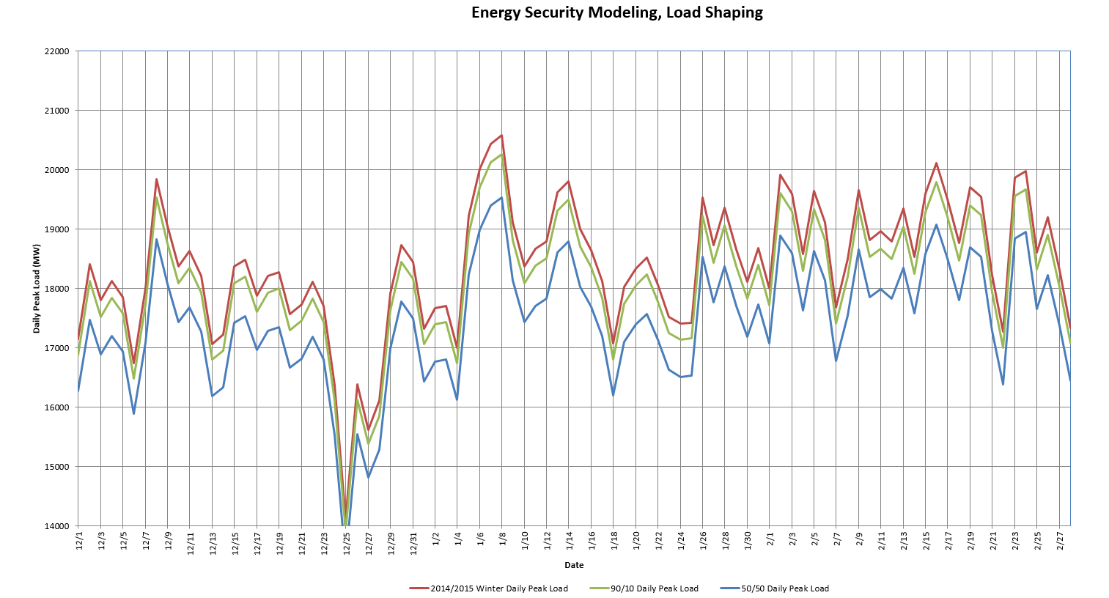
Winter 2024/2025 Peak Load and Energy Profile
Consistent with PP10-I, Section A.i and A.ii:
The hourly demand levels from winter 2014/2015 will be adjusted* to the 2020 CELT winter net peak load forecast, which is in its final stages of development
The 2019 CELT winter 2024/2025 90/10 net peak load forecast is projected to be 20,265 MW (to be used for the FCA 15 fuel security reliability review) and the winter 2024/2025 50/50 net peak load forecast is projected to be 19,528 MW (provided for informational purposes)
*The projected forecast ratio used to create the energy profile load shape was 0.985

Slide 6
Local Distribution Company (LDC) Gas Demand
Consistent with PP10-I, Section A.iii:
The methodology ICF used to generate the LDC gas demand forecast has not changed from previous studies
ICF reviewed the public utility/service commission (PUC/PSC) websites for each of the six New England states to locate the most recently filed Integrated Resource Plans (IRPs) for each utility
The IRPs provide projections for both annual gas demand and peak winter day (design day) gas demand for the utility’s firm customers
Below is a table comparing FCA 14 and FCA 15 modeled peak winter demand values
Variable | Modeled
FCA 15 LDC Winter Peak Demand Forecast (Bcf) | 5.054
FCA 14 LDC Winter Peak Demand Forecast (Bcf) | 5.181

Slide 7
Gas Source Capacity from Pipelines Projected Natural Gas Infrastructure Expansions
ISO is accounting for the following pipeline expansion projects based on ICF’s research:
TGP Line 261 Upgrade
Increases Tennessee Gas Pipeline overall capacity to 1.49 Bcf/d (up from 1.42 Bcf/d)
In service by November 2020
Portland Xpress Project Phase 2 and Phase 3, Westbrook Xpress Project Phase 1, 2, 3
Increases Portland Natural Gas Transmission System overall capacity to 0.35 Bcf/d (up from 0.25 Bcf/d)
In service by November 2022

Slide 8
Gas Source Capacity from Pipelines, cont. Gross Contracted Capacity
Based on ICF’s analysis of each pipeline’s Index of Customer (IOC) data and proposed pipeline expansions, the firmly contracted pipeline capacity into New England on existing pipelines will total 4.03 Bcf/day
*Total may not equal sum due to independent rounding

Slide 9
Gas Source Capacity from Pipelines, cont. Offsets from Natural Gas Entitlements
Iroquois pipeline has contract entitlements of 0.33 Bcf/d moving gas through Algonquin to Long Island, NY, which the ISO has observed over past winters
These firm contracts have a receipt point of Brookfield (AGT to IGT interconnect) and associated delivery points on Long Island / New York City
The contracts have been in place since the 2008 Brookfield interconnection project was brought into service
These ‘pass-through’ contracts will be netted from supply to New England
This ‘pass-through’ out of New England lowers the overall pipeline gas capacity total to the region
Consistent with PP10-I, Section A.iv:
ISO will model pipeline capacity at 3.70 Bcf/d (up from 3.59 Bcf/d)

Slide 10
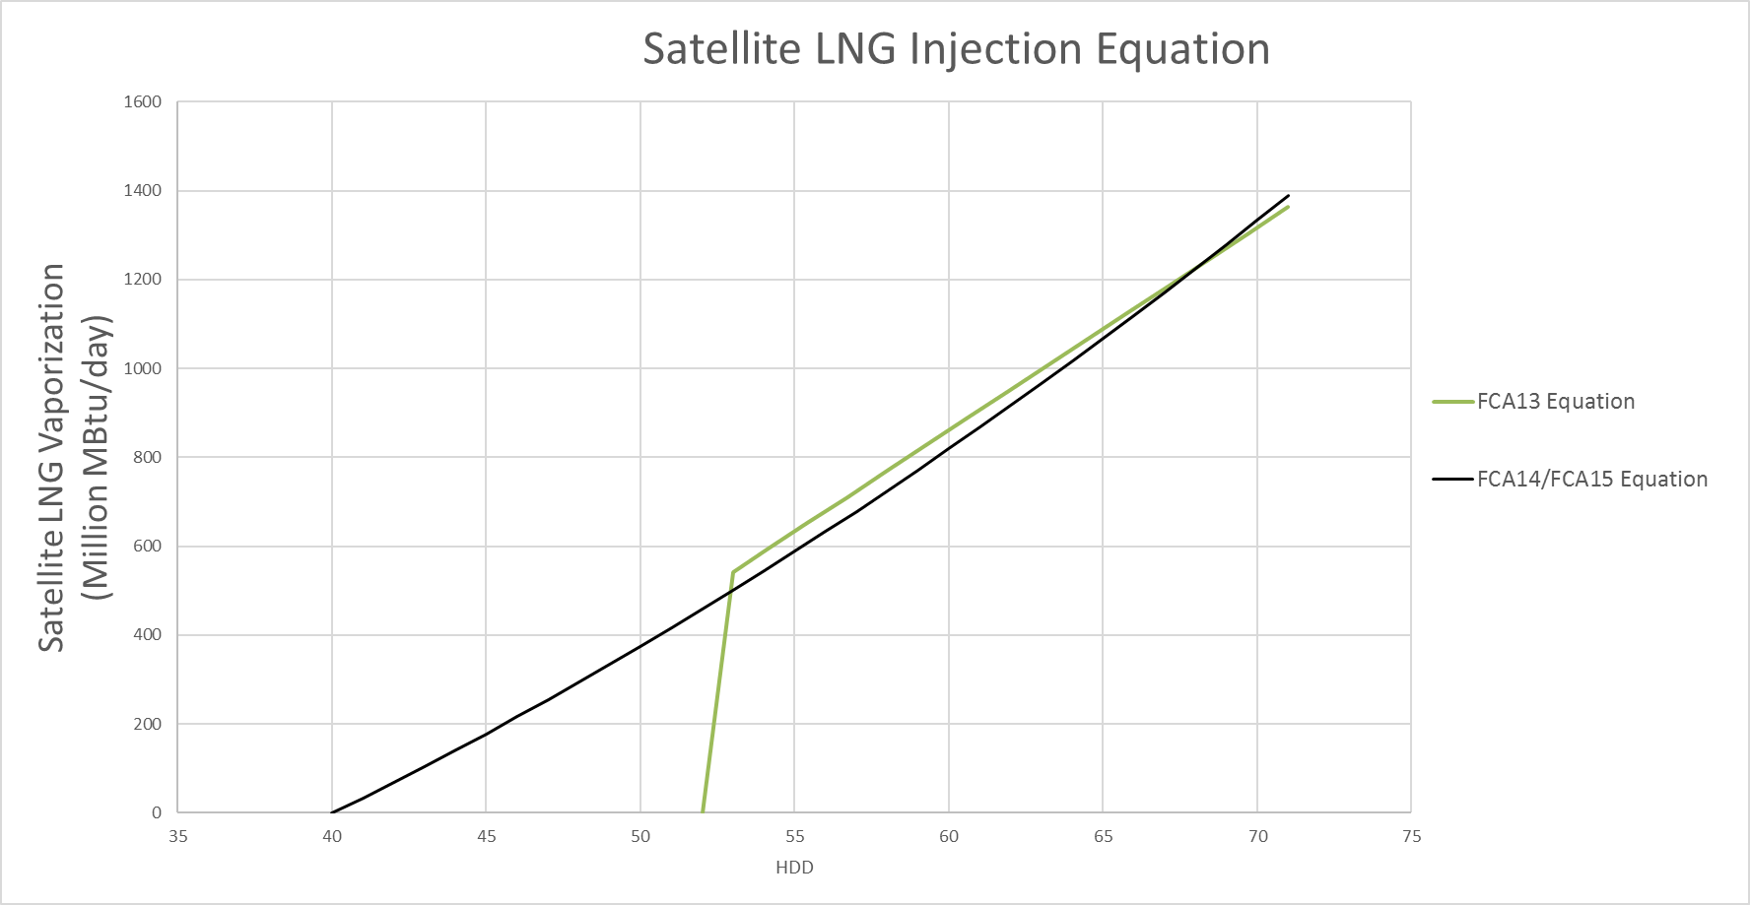
Satellite LNG Injection
Consistent with PP10-I, Section A.v:
For FCA14, ISO, in collaboration with ICF, developed a better Satellite LNG Injection equation with injections starting at 40 Heating Degree Days
For FCA15, ISO will continue to use the updated equation as displayed below

Slide 11
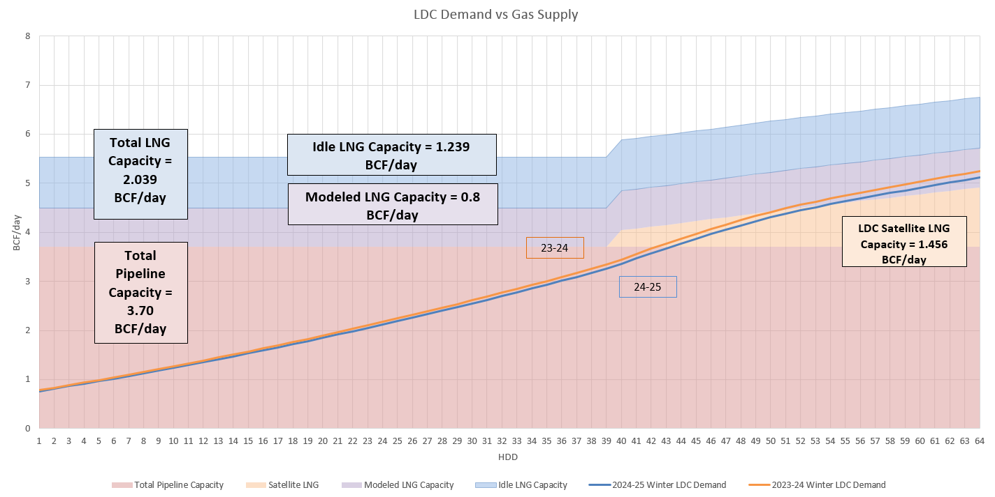
Utilization of Gas Supply vs. LDC Demand
As requested previously, ISO updated the graph below to better understand gas supply versus gas demand utilized within the model

Slide 12
Oil Unit Inventory and Replenishment Levels
Consistent with PP10-I, Section A.vi:
ISO will utilize the oil unit inventory and replenishment level assumptions developed for the Inventoried Energy Program (IEP)
Residual Fuel Oil (RFO) resource inventories will be 69.6% of maximum inventory levels
This percentage of maximum inventory is consistent with the beginning of winter inventories 2017/2018, which was the last year of the winter reliability program
ISO will continue to replenish oil-only resources at a proxy rate of one tanker truck per hour when the reorder level is reached

Slide 13
Resource Seasonal Claimed Capability
As described in PP10-I, Section A.vii:
For Existing Generating Capacity Resources qualified for FCA 15 and energy-only generators active in the ISO-NE markets, the winter SCC from the most recently published CELT
For non-commercial Existing Generating Capacity Resources that are not in the CELT report, the resource’s FCA 15 winter Qualified Capacity will be used
Generation | FCA 15 Total (MW) | FCA 14 Total (MW) | Details
Nuclear | 3,348 | 3,343 | SCC Adjustments
Pump Storage | 1,851 | 1,785 | Resource Uprate, SCC Adjustments
Hydro | 1,586 | 1,586 | No Change
Natural Gas Only | 7833 | 7,779 | SCC adjustments
Combined Cycle Dual-Fuel | 9396 | 9,334 | SCC adjustments
Coal | 535 | 535 | No Change
LNG Only (Mystic 8&9) | 1,693 | 1,700 | SCC Adjustments
Oil Units | 6,595 | 7,103 | Retirements, SCC Adjustments
Bio/Refuse | 967 | 989 | Retirements, SCC Adjustments

Slide 14
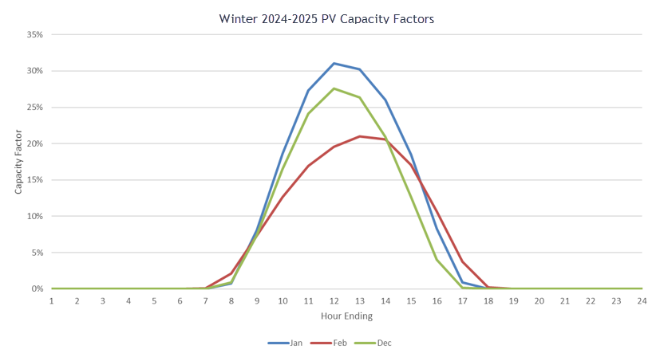
PV Forecast and Profile
Consistent with PP10-I, Section A.viii and A.x:
ISO notes that the 2020 photovoltaic (PV) forecast will be utilized in this analysis; an update will be provided for the next RC meeting once the details are presented at the March Planning Advisory Committee (PAC) meeting
The draft PV forecast-nameplate is 6,109.2 MW* as presented to the February Distributed Generation Forecast Working Group meeting (sum of the Forward Capacity Market, Energy only resources and the Behind-the-meter values)
The forecasted-nameplate will be applied to the hourly sun profile from the winter of 2014/2015 in a similar manner as pump storage and wind resources
Source | FCA 15 (MW) Modeled* | FCA 14 (MW) Modeled
PV Forecast Nameplate | 6,109.2 | 5,782.7
* https://www.iso-ne.com/static-assets/documents/2020/02/draft_2020_pv_forecast_021420.pdf

Slide 15
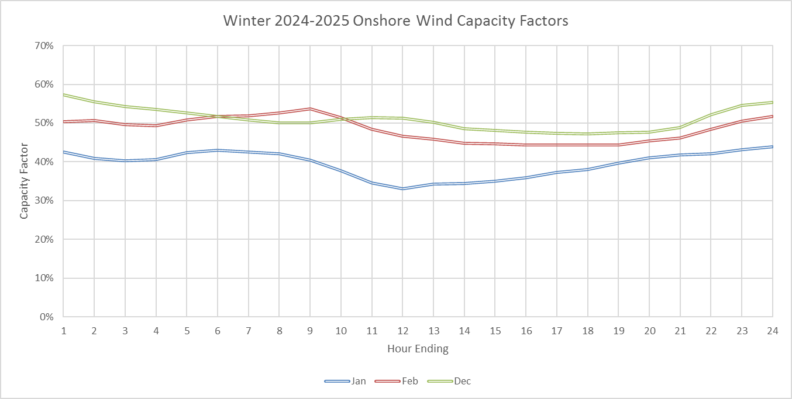
Onshore Wind Nameplate and Profiles
Consistent with PP10-I, Section A.ix, xi:
The onshore wind resource nameplate is 1,524.1 MW as calculated from the information in the May 2019 CELT Report and the additions of Weaver Wind and RoxWind
The forecasted-nameplate will be applied to the hourly wind profile from the winter of 2014/2015 adjusted to reflect the expected performance of the fleet assumed in service for the winter of 2024/2025
Variable | FCA 15 (MW) | FCA 14 (MW)
Onshore Wind Nameplate | 1,524.1 | 1,392
Notes:
Nameplate is 1436.2 MW from current resources
Weaver wind has nameplate of 72.6 MW
RoxWind has nameplate of 15.3 MW

Slide 16
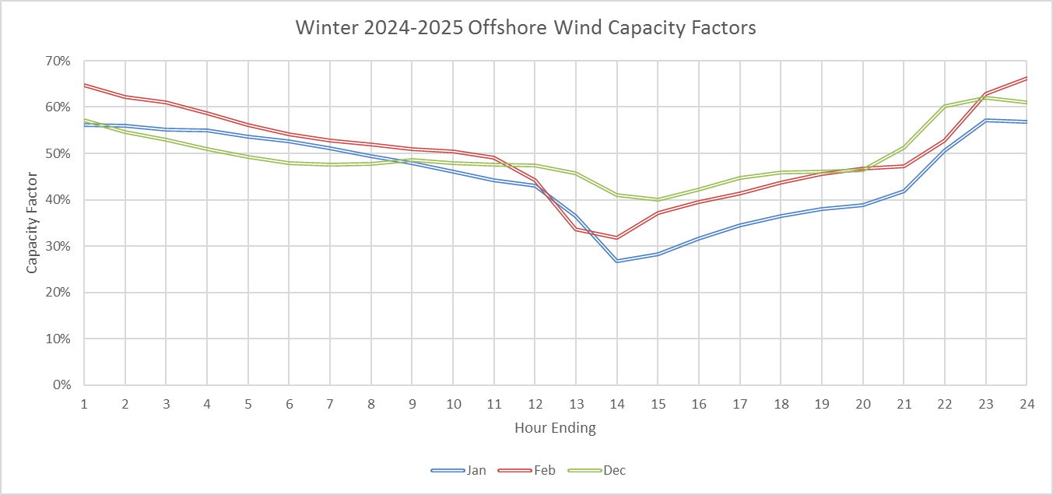
Offshore Wind Nameplate and Profiles
Consistent with PP10-I, Section A.ix and A.xii:
The offshore wind resource nameplate is 29.25 MW as calculated from the information in the May 2019 CELT Report
ISO will include Vineyard Wind 800 MW nameplate
ISO will include Revolution Wind 704 MW nameplate
ISO will utilize 1,533 MW nameplate for Offshore wind resources
The forecasted-nameplate will be applied to the hourly wind profile from the winter of 2014/2015 adjusted to reflect the expected performance of the fleet assumed in service for the winter of 2024/2025
Variable | FCA 15 (MW) | FCA 14 (MW)
Offshore Wind Nameplate | 1,533 | 1,029

Slide 17
Demand Response Resources
Consistent with PP10-I, Section 3.A.xiii:
The winter Seasonal Claimed Capability (MW) reduction value from active Demand Response Resources will be 368 MW for this analysis*
Variable | FCA 15 (MW) | FCA 14 (MW)
Active Demand Response Resources | 368 | 321
* https://www.iso-ne.com/static-assets/documents/2020/02/scc_february_2020.xls

Slide 18
Equivalent Forced Outage Rate Demand (EFORd)
Consistent with PP10-I, Section 3.A.xiv:
ISO will utilize unit specific EFORd as applied in the calculation of the Install Capacity Requirement (ICR)
The asset specific EFORd is derived from GADS data and will be utilized to reduce the asset’s winter SCC in the fuel-security reliability review
Resource Type | FCA 15 EFORd Capacity Reduction (MW) | FCA 14 EFORd Capacity Reduction (MW) | Difference
Dual-Fuel | 452 | 1,085 | -633
Oil | 768 | 730 | 38
Natural Gas | 648 | 234 | 414
LNG | 38 | 17 | 21
Coal | 131 | 76 | 55
Nuclear | 44 | 40 | 4
Pump Storage | 49 | 29 | 20
Other Renewables | 63 | 82 | -19
Total | 2,193 | 2,292 | -99

Slide 19
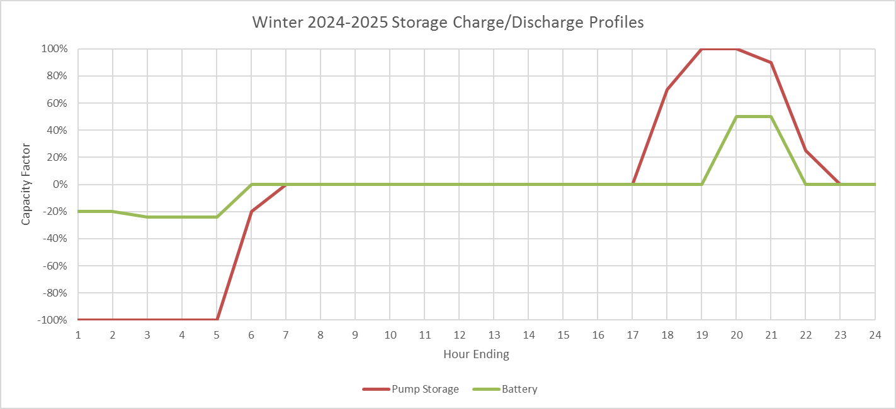
Pumped and Battery Storage
Consistent with PP10-I, Section 3.A.xvii:
The limited energy resources will be set to an hourly profile reflecting operation of storing energy during low load periods and generating electricity during the higher load periods
The SCC of the pumped and battery storage resources will be applied to the hourly profile in a similar manner as PV and wind resources
Variable | Updated FCA 15 (MW) | Updated FCA 14 (MW)
Pumped Storage | 1,851 | 1,785
Battery Storage | 11.5 | 1
Notes:
Bearswamp uprate. ESD additions to Otis, ICETEC, Ocean State

Slide 20
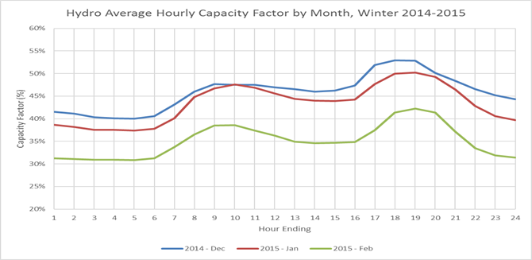
Conventional Hydro-electric Generation
Consistent with PP10-I, Section 3.A.xviii:
Hydro-electric generation hourly profile was shaped to match the observed resource pattern from the 2014/2015 winter
The SCC of the hydro-electric generation will be applied to the hourly profile in a similar manner as PV and wind resources
Variable | FCA 15 | FCA 14
Conventional Hydro (MW) | 1,586.2 | 1,586.2
Conventional Hydro Capacity Factor (%) | Profiled | Profiled

Slide 21
Continued Discussion OF fuel security reliability review: variable INPUTS TO FCA 15

Slide 22
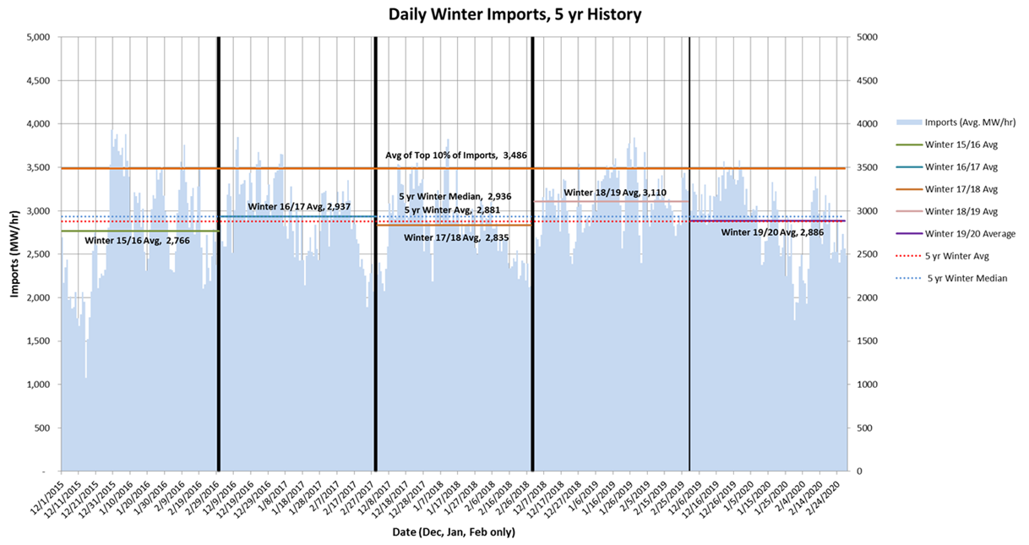
Imports
ISO will continue to use tie-line import values as described in PP-10, Appendix I, Section 3.B Variable Inputs
The total net flow into New England for the 2019/2020 winter has been in alignment with previous winters
The import values of 2,800 MW, 3,000 MW, and 3,500 MW will continue to be used for FCA 15

Slide 23
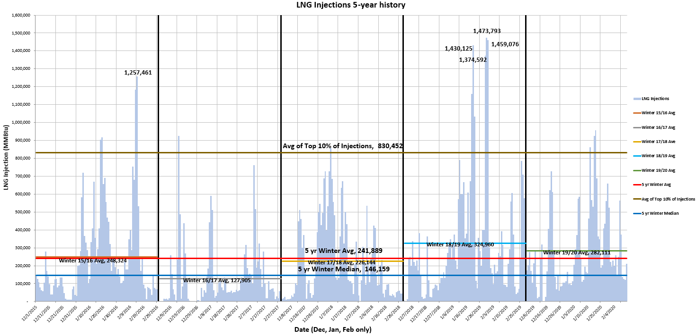
LNG Injections
The 2019/2020 LNG average daily injection, 0.282 Bcf/day, was well below the modeled 0.8 Bcf/day due to the low-stress winter
ISO will continue to use the LNG injections values, 0.8 Bcf, 1.0 Bcf, 1.2 Bcf, as described in PP-10, Appendix I, Section 3.B Variable Inputs

Slide 24
Combined Cycle Dual-Fuel Resource Tank Inventory
The Distillate and Residual Fuel Oil units winter replenishments:
2016/2017 was 3.3% of maximum inventory
2017/2018 was 25.2% of maximum inventory
2018/2019 was 5.3% of maximum inventory
2019/2020 was 2.6% of maximum inventory
This replenishment is well below the modeled 1.25 and 2.0 multiplier of onsite fuel-storage due to the low-stress winter
ISO will continue to use dual-fuel resource tank inventory values as described in PP-10, Appendix I, Section 3.B Variable Inputs

Slide 25
Conclusion
This draft set of assumptions shows that several variable changes from FCA 14 to FCA 15 improve system fuel security
Increase in gas pipeline capacity
Increase in total PV, onshore and offshore wind nameplate
Increase in Demand Response
Lower Peak Load
Lower winter LDC gas demand forecast
Lower EFORd
ISO seeks feedback from stakeholders at this meeting, which it will consider and address at the next scheduled RC meeting on the topic
If PP-10 changes are needed, they should be proposed for discussion at that time
Pursuant to Tariff Section III.13.2.5.2.5A(f), participants that have submitted a Retirement De-List Bid will be notified by the ISO if their resource is needed for fuel security reliability reasons by June 11, 2019
If committee members have a potential input modifications they would like to discuss at an upcoming RC meeting, please contact the committee Secretary (jdwyer@iso-ne.com) to request time on the agenda

Slide 26
Stakeholder Schedule
Stakeholder Committee and Date | Scheduled Project Milestone
Reliability Committee March 17, 2020 | Review initial FCA 15 fuel security inputs applying the existing PP10-I methodology for stakeholder feedback
Reliability Committee April 22, 2020 | Review and address all stakeholder feedback received on FCA 15 fuel security inputs Review proposed PP10-I revisions, if applicable
Reliability Committee May 19, 2020 | Review FCA 15 fuel security inputs and results Vote on proposed PP10-I revisions, if applicable
Participants Committee June 4, 2020 | Vote on proposed PP10-I revisions, if applicable

Slide 27
Norman Sproehnle
(413) 540-4755 | NSPROEHNLE@iso-ne.com

Slide 28
APPENDIX
Regional Pipeline Map

Slide 29
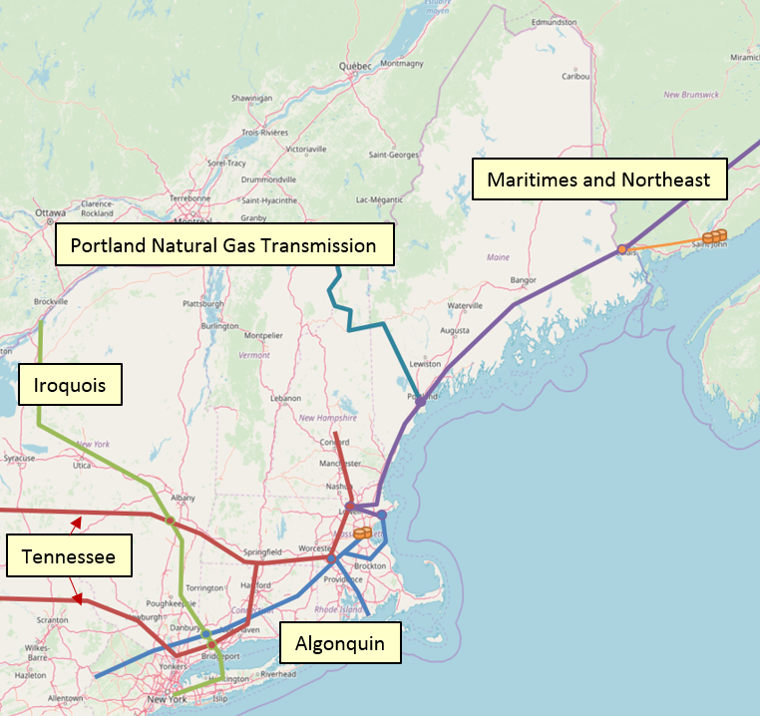
Regional Pipeline Map
The regional pipelines are comprised of:
Maritimes and Northeast Pipeline
Algonquin Gas Transmission Pipeline
Tennessee Gas Pipeline
Iroquois Gas Transmission System
Portland Natural Gas Transmission System
The Maritimes and Northeast pipeline is considered internal to the region and not included in the overall capacity
The Algonquin, Tennessee, Iroquois, and Portland Natural Gas Transmission pipelines remaining pipelines supply New England with natural gas

