Slide 1

NESCOE/MA AGO
Reporting on the Competitiveness of Energy Call Option Offers in the Day-Ahead Energy Market
NEPOOL Markets Committee
March 24, 2020

Slide 2
Purpose of Amendment
We note NESCOE and the MA AGO are considering recent tariff changes and may pull our amendments prior to the vote.
Provide Stakeholders with transparency on:
  The competitiveness of the energy call option offers and resulting day-ahead reserve prices, and
  The degree and price impacts of any market power

Slide 3
Changes Based on Feedback
Eliminated the language that was considered “overly prescriptive”
Eliminated the redundant language about market participants providing the ISO-NE with data

Slide 4
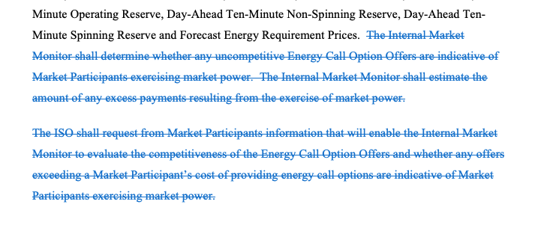
Tariff Redline Changes from March 11, 2020

Slide 5
Tariff Redline
See Section III.A.17.2.5 - Reporting on and Certification of the Competitiveness of Energy Call Option Offers in the Day-Ahead Energy Market

