Slide 1
Energy Efficiency Resources
and Capacity Obligations During Scarcity Conditions
New England States Committee on Electricity
March 10, 2020

Slide 2
NESCOE Considerations
We are putting forward this proposal to achieve broader support from NEPOOL
Status quo cost allocation treatment of EE resources (EERs) is inconsistent with FERC’s directive to ISO-NE.
We appreciate all the work over the last year + by ISO-NE, NEPOOL stakeholders and others to bring forward this limited proposal targeted solely at that cost allocation issue and not an overall design change

Slide 3
Adjusted Balancing Ratio (“ABR”)
We have made no changes from our presentation last month.
We hope to have a positive outcome today and move this proposal forward.
No tariff changes from what was posted last month.

Slide 4
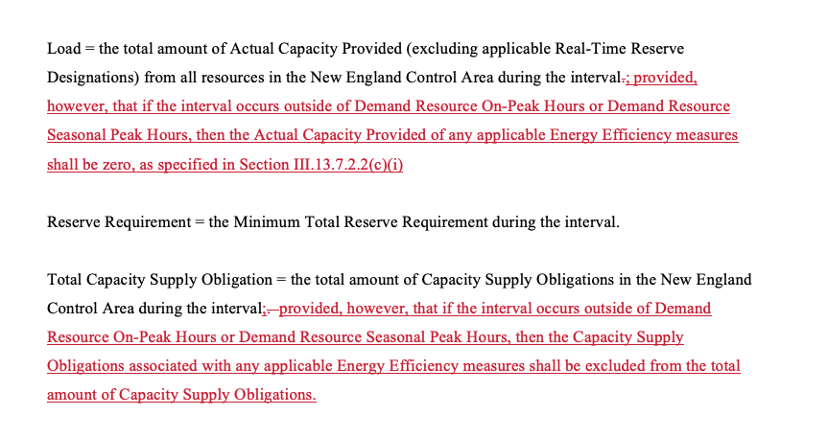
Tariff Changes
Various changes in Section III.13.7.2.3 similar to:
One minor change in III.13.7.2.4

Slide 5
Next Steps
Seek an April 2020 NEPOOL Participants Committee approval.
Expect late April 2020 FERC filing.

Slide 6
Questions
www.nescoe.com
Jeffbentz@nescoe.com

