Slide 1
MaRCH24, 2020| Teleconference
Permanent and Retirement De-List Bids Compliance eTariff Filing
Rehearing Order Directing Corrections to Economic Life Revisions Tariff Language
Timothy Helwick and Gregg Bradley
413-535-4485 | thelwick@iso-ne.com
413-535-4012| gbradley@iso-ne.com

Slide 2
Corrections to Economic Life Revisions
Proposed Effective Date: April 9, 2020
On March 10, 2020, the Commission rejected the previously accepted Economic Life Revisions effective August 10, 2018 and ordered the ISO to correct this in a compliance eTariff filing to be submitted by April 9, 2020 (i.e., within 30 days)
The ISO’s proposed compliance revisions address the Commission’s March 2020 rehearing order for the ISO to reflect the rejection of the Economic Life Revisions effective August 10, 2018 and, in addition, will prospectively apply the Economic Life Revisions beginning with the sixteenth Forward Capacity Auction (FCA)
This presentation will review the background of the Economic Life Revisions, key details from the Commission’s orders associated with these revisions, and the Internal Market Monitor’s proposed compliance revisions to address the March 2020 order

Slide 3
Background
On June 11, 2018, the ISO, joined by NEPOOL, filed revisions to Section III.13.1.2.3.2.1.2.C of Market Rule 1 to modify the calculation of economic life of an Existing Capacity Resource
The proposed modifications changed the calculation from being the maximum evaluation period in which a resource’s net present value is non-negative to being the evaluation period in which the net present value of the resource’s expected future profit is maximized (“Economic Life Revisions”)
On November 9, 2018, the Commission accepted the Economic Life Revisions
On December 10, 2018, the New England Power Generators Association (NEPGA) requested rehearing of the November 9 order
On March 10, 2020, the Commission issued an order granting NEPGA’s rehearing request and rejecting the Economic Life Revisions “effective August 10, 2018.” The Commission ordered the ISO to submit a compliance filing to make all the necessary Tariff revisions to reflect the rejection of the retroactive Economic Life Revisions within 30 days.

Slide 4
Economic Life ReVISions AS APPROVED in the November 9, 2018 ORDER

Slide 5
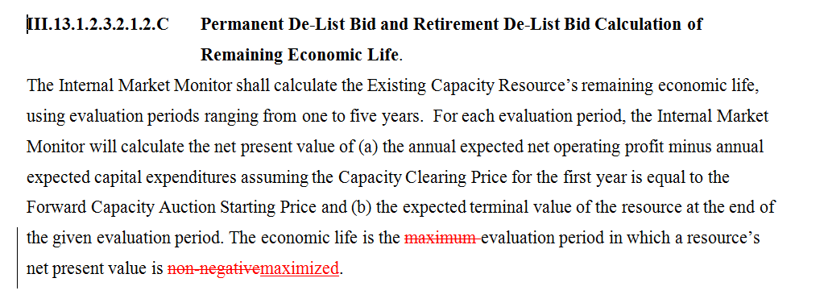
Current Tariff Language (i.e., Economic Life Revisions)
Section | Prior Change | Description
III.13.1.2.3.2.1.2.C | Economic Life Revisions (as compared to Tariff prior to change) | Economic life was changed to be calculated as the evaluation period in which the resource’s net present value is maximized*
*Additional details on the Economic Life Revisions can be found in the April 2018 and May 2018 Market Committee meeting material

Slide 6
Commission’s November 9 Order
“[W]e find the proposed Economic Life Revisions just and reasonable and therefore accept them, to become effective on August 10, 2018, as requested. The Economic Life Revisions will help ensure a competitive outcome for FCA 13, as well as future FCAs, by avoiding the potential that capacity resources will receive inflated FCA clearing prices.” 165 FERC ¶ 61,088 (2018) P 23.
“We also find that the Economic Life Revisions represent a prospective change to the Tariff and, therefore, do not constitute retroactive ratemaking, because they are effective on August 10, 2018, before FCA 13 commences on February 4, 2019.” Id. P 25.
Chairman Chatterjee dissenting: “While I am not opposed to making the proposed change effective for FCA 14, I conclude that, for both policy and legal reasons, it is not just and reasonable to implement the proposed revisions in FCA 13.”

Slide 7
MARCH 10, 2020 Rehearing ORDER

Slide 8
Commission’s March 10 Rehearing Order
“Upon reconsideration, we grant rehearing and find that the Commission erred when it determined that the benefits of the proposed Economic Life Revisions outweigh potential disruptions to market participants’ settled expectations and harm caused by reliance on existing FCM rules.” 170 FERC 61,187 (2020), P 17
“Thus, we reject the Economic Life Revisions in their entirety, effective August 10, 2018.” Id. P 15
“Nonetheless, we find that rerunning FCA 13 and FCA 14 would still create harm in the form of market uncertainty that outweighs the benefits of rerunning those FCAs.” Id. at P 21
“Because we reject the Economic Life Revisions, we direct ISO-NE to make a filing in eTariff, within 30 days of the date of this order, to make all tariff corrections necessary to reflect the rejection of the Economic Life Revisions.” Id. P 19.
“We note that this rejection is without prejudice to ISO-NE filing, at the appropriate time, proposed tariff revisions similar to the Economic Life Revisions, to be effective prospectively.” Id. n.35
Commissioner Glick dissenting: “I note that nothing in today’s order precludes ISO New England from refiling substantially the same provisions tomorrow. Today’s order, as I understand it, is concerned only with the timing of ISO New England’s previous filing and not its merits.”

Slide 9
Summary of Proposed Compliance Revisions
The ISO’s proposed compliance revisions address the Commission’s March 2020 order by reverting the calculation of economic life back to being the maximum evaluation period in which a resource’s net present value is non-negative
This calculation will apply for the Permanent and Retirement De-List Bids analyzed for the fifteenth FCA
In addition, the proposed compliance revisions will prospectively apply the Economic Life Revisions beginning with the sixteenth FCA

Slide 10
Tariff Corrections in Response to Rehearing Order
Section | Change | Description
III.13.1.2.3.2.1.2.C | Economic Life Revisions: revert to prior language and add only prospectively Economic Life Revisions | Economic life is calculated as the maximum evaluation period in which the resource’s net present value is non-negative Effective 4/9/20 beginning with FCM 16, economic life is calculated as the evaluation period in which the resource’s net present value is maximized
III.13.1.2.3.2.1.2.C Permanent De-List Bid and Retirement De-List Bid Calculation of Remaining Economic Life. The Internal Market Monitor shall calculate the Existing Capacity Resource’s remaining economic life, using evaluation periods ranging from one to five years. For each evaluation period, the Internal Market Monitor will calculate the net present value of (a) the annual expected net operating profit minus annual expected capital expenditures assuming the Capacity Clearing Price for the first year is equal to the Forward Capacity Auction Starting Price and (b) the expected terminal value of the resource at the end of the given evaluation period. The economic life is the maximum evaluation period in which a resource’s net present value is maximized non-negative. However, effective April 9, 2020, beginning with the sixteenth Forward Capacity Auction, the economic life is the evaluation period in which a resource’s net present value is maximized.

Slide 11
Next Steps
Vote on these proposed compliance revisions at the March 24, 2020 Markets Committee meeting and at the April 2, 2020 Participants Committee meeting
Make a filing in eTariff by April 9, 2020 to make all Tariff corrections necessary to reflect the rejection of the Economic Life Revisions effective August 10, 2018 (i.e., for FCA 13 through FCA 15)
Beginning with FCA 16, the Economic Life Revisions will apply prospectively effective April 9, 2020, as also reflected in the eTariff filing

Slide 12
Stakeholder Schedule
Stakeholder Meetings | Scheduled Project Milestone
March 24, 2020 Markets Committee | Discussion and vote on proposed Tariff corrections associated with the Economic Life Revisions
April 2, 2020 Participants Committee | Discussion and vote on proposed Tariff corrections associated with the Economic Life Revisions
April 9, 2020 | eTariff Filing in compliance with FERC Rehearing Order

