Slide 1
ESI DESIGN
New England States Committee on Electricity
NEPOOL Markets Committee
March 11, 2020

Slide 2
Energy Security – The (In) Complete Picture
NESCOE is concerned about energy security, of course
ESI is a novel approach for day-ahead reserves without precedent elsewhere; the potential impacts on energy security and costs to consumers are – and will remain – uncertain (notwithstanding impact assessment efforts)
Also uncertain is whether, after experience implementing ESI, ISO-NE, stakeholders, and/or FERC will view ESI as improving energy security sufficiently, or whether future additional energy security-related market reforms will be pursued
Given that additional measures to address energy security are expected, a more conventional approach to Day-Ahead Ancillary Services (based on best practices of other RTOs) would be easier, just as effective, and less risky than ESI.

Slide 3
Overall Design
Questions remain whether the proposal will actually and appreciably change resource behavior to solve the “OFSA” fuel security concerns.
ESI may better align regional energy security incentives if market participation is robust and competitive, but questions remain whether resources will sell the options on high-risk days.
NESCOE remains deeply concerned that consumers will be on the hook if the design fails to create competitive outcomes, potentially through physical withholding or inadequate incentives to participate.
Will the forward market element lessen the need for ESI strong incentives?
As Dr. Patton noted, there are other less expensive ways to price operating reserves in the Day Ahead Market – and will likely achieve the same fuel security benefits.
We have concerns regarding whether the benefits justify the costs.
A just and reasonable market design cannot impose costs on consumers without providing commensurate reliability benefits.

Slide 4
Impact Analysis
According to the Analysis Group (ISO-NE’s Consultant), ESI:
Improves system reliability by providing incentives that increase the supply of energy inventory and reduce stress of fuel supply systems
Would cause day ahead markets to clear energy supply closer to forecast levels
May cause shifts in energy use through more efficient use of energy inventory
However, the results of the ESI Impact Analysis are sensitive to the assumed market participant behavioral responses of
offering the options and
procuring additional fuel oil to cover the option.
Questions remain whether all of the increased fuel measures assumed in the impact analysis will actually occur
The Impact Analysis results also suggest that incremental ESI revenues are unlikely to prevent retirements of certain energy-secure resources in any appreciable way– the objective of “Chapter 2”–or future RMRs

Slide 5
Some Impact Analysis Concerns
Impact Analysis was not set up to apply resource-specific air permit limitations
Whether the results are feasible under state and federal environmental laws is beyond the scope of the impact analysis – but is relevant to ESI’s actual impact
Much of the analysis indicates that dual-fueled natural gas and oil-fired resources stand to economically benefit from ESI participation
The projected results changed significantly from month-to-month, eroding confidence in the predictive ability of the model
Not to diminish the impressive efforts of the consultant to develop a bespoke production cost model with price responsive demand and fuel modules
all within a compliance period
The Impact Analysis was not set up to properly analyze the energy security risk issue:
NESCOE provided a memo recommending an alternative approach
ISO-NE elected not to conduct probabilistic analysis
Fuel diversity does not appear to be a criterion for regional fuel diversity – just least cost
Scenario analysis is not designed to find “optimal” solutions - results open to interpretation
Deterministic scenarios in production cost modeling produce results that are heavily driven by input assumptions, which may or may not reflect likely or the most common future conditions
FCM outcomes are beyond the scope of the modeling
Only examines energy market impacts and the resource types assumed to participate in ESI rely on the FCM – some resource mix scenarios provide the only insights on resource adequacy
Reliability metrics provide directional information but were not designed to be measurements of reliability benefits and there is no consideration of the value of lost load

Slide 6
IA Summary
This was an unusually challenging complex modeling exercise with various assumptions that necessarily adopted many simplifications of the dynamics of the New England electricity and fuel markets. It created many different draft results.
We lack confidence that the results represent real-world energy market dynamics such that the results can be trusted.

Slide 7
Amendments
Strike Price $10 Adder to reduce the cost and risk of the option for sellers.
NESCOE supports the Massachusetts Attorney General’s Office (MA AGO) in its amendment and conclusions related to the RER product. If that amendment fails, then NESCOE proposes the following two amendments:
RER Quantity = 0 Non-Winter months as part of the specification of DA AS quantities.
Remove LFE language until such time that ISO-NE and stakeholders can finalize the discussion on the need to include LFE as part of the design.
Regular Assessments of the competitiveness of ESI and the call option offers to highlight concerns as they occur.
Specific Review of the design’s efficacy and performance with a mandate to correct any deficiencies or unanticipated effects after the design has had a reasonable amount of time to generate performance data.
Discussion of #3 Regular Assessments and #4 Specific Review presented Jointly with MA AGO

Slide 8
#1 Strike Price $10 Adder

Slide 9
Strike Price Amendment: Motivation
The goals of the amendment are to:
Reduce the cost and risk of the energy option for providers (which should reduce clearing prices and cost to consumers), and
Minimize weakening ESI’s incentive properties when they are needed most for regional energy security

Slide 10
Concern about Cost with Little Benefit
Issue: The option settles in-the-money at times when energy security is not an issue - both in the winter and non-winter months - during many hours of each day
ISO-NE’s forecast model will imperfectly forecast prices, causing additional option exercises even when DA and RT prices are consistent with market participant’s expectations
Creates option cost and risk for providers when regional energy security risks are not reflected in DA market prices (“noise”)
Solution: Strike Price Adder = $10
Strike price (as ISO-NE proposes) increased by $10/MWh in all hours
Reduces the frequency of the energy call options settling in-the-money, and magnitude of settlement; should lower consumer costs
Has minor effect on incentives to cover the call option and deliver energy
Minor effect on incentives = minor effect on energy security
This could also increase participation and competitiveness under the ESI proposal
Increases likelihood of design being successful

Slide 11
Reducing “Noise”
Agree with ISO-NE that a strike price that is set far above the expected real time price of energy (the ‘at the money’ level) can undermine incentives and the benefits of the design
Agree that a strike price that is set below the ‘at the money’ level creates inefficiencies and higher than needed day ahead reserve costs.
ISO-NE’s two-day-forward forecast model will introduce “noise” in the strike price, especially if there is bias in the model’s predictions (systematically high or low)
If we err, we would prefer to err on the high side to reduce noise.

Slide 12
$10 Adder is Just and Reasonable
Most hours when fuel security is not an issue – reduces frequency and magnitude of strikes, reduces cost and risk
Hours when fuel security is a potential issue and expected prices are high - $10 Strike Price Adder is small compared to DA reserves prices, has little impact on likelihood of strikes or magnitude of settlement or incentives
$10 falls within an acceptable “range of reasonableness” consistent with long FERC and Court precedent allowing that more than one rate or methodology can be J&R.
E.g., FERC approved (and D.C. Circuit upheld) 200 MW RTR exemption cap tied to load growth while acknowledging actual growth could be greater or less than ISO-NE projections.

Slide 13
Impact of Adder on Incentives
Keep in mind that the incentive to invest in energy security measures (e.g., fuel) created by the energy call option depends on a market participant’s expectations regarding how their output impacts Real Time prices.
For a participant whose lack of output does not appreciably affect Real Time prices: the Energy Option (with or without Adder) does not increase the incentive to invest in fuel.
Also, an adder weakens the incentive to invest in fuel only to the extent RT prices fall in the range [K_{NoAdder} to K_{$Adder}], the participant’s marginal cost is below K_{$Adder}, and the participant believes its output would appreciably affect RT prices at such times
Impact is small for modest adders.

Slide 14
ISO-NE’s Analysis of Adder Was Flawed
ISO-NE provided analysis of a $10 strike price adder on Feb. 12, 2020 and made the counterintuitive assertion that it appears to “impact incentives more significantly during stressed conditions”
The analysis did not evaluate impact on incentives, as ISO-NE acknowledges, only the percentage of option MW that could have a non-zero impact on incentives. No analysis was done of whether impact is material (and percentages of MW were low).
The analysis was flawed in that it did not use appropriate data:
Did not use real K values; used DA LMP for K - assumed away noise.
Used DA not RT marginal costs - understates cost when prices spike.
Did not use RT prices used in Impact Assessment for option settlement – used endogenous RT prices that understate volatility and cost of options.
ISO-NE’s analysis does not change our view of the value of an adder.

Slide 15
Impact of Adder on Incentives – from Impact Analysis
The Impact Analysis indicates:
Minor impact on consumer costs from a $10 Strike Price adder
$2-$22 million dollars per winter less expensive with the adder
No material change to reliability metrics
Only in the most severe winter case, the strike price adder avoided a small amount of natural gas usage during infrastructure constraint conditions
These results suggest no material impact on incentives for energy security provided by ESI’s ancillary services products

Slide 16
Adder Helps Protect Against Unintended Outcomes
Lastly – greater participation and lower consumer cost with a Strike Price Adder, in exchange for possibly somewhat lower incentives – may be especially attractive in the early years of ESI implementation, when there is little or no experience with how the proposal will work under various system conditions, and much uncertainty about its possible cost impacts and vulnerability to exercise of market power.
Adder can be reviewed as part of the “three-year lookback” proposed jointly by the MA AGO and NESCOE.

Slide 17
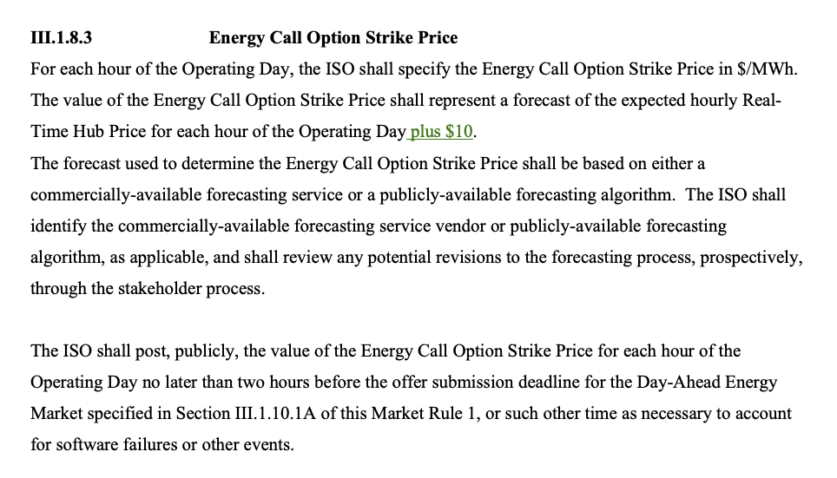
Tariff Redline
TBD

Slide 18
#2 No RER
NESCOE supports the MA AGO position in challenging the need and requirements to purchase RER under this design

Slide 19
#2a RER for Non-Winter Period
If the MA AGO amendment fails.

Slide 20
Winter Only Issue
Over many months developing its ESI proposal, ISO-NE has not established that there is a “fuel security” issue in the nine non-winter months.
ISO-NE FERC presentation July 15, 2019:
Slide 40 - “Model studies winter months, when the proposed solutions are expected to have largest impact on market and reliability outcomes”
Slide 10 - Gas pipelines reaching New England from the West are fully utilized in cold weather
Slide 25 - …predominant resources for replacement energy and load-balancing reserves. (are) Gas-only or dual-fuel, and face production uncertainty during winter
FERC directive focused solely on fuel security – price formation can be addressed separately, as necessary and appropriate.
ISO-NE FERC presentation July 15, 2019, Slide 2: In July 2018, the Commission directed ISO New England “to develop longer-term market solutions” to the region’s energy security challenges

Slide 21
Product is Not Required / Cost is Unreasonable
RER is not required by NPCC in Directory 5.
No other RTO prices “RER”
Historically, infrequent reserve deficiency occurrences
Other actions can be taken to secure reserves in the RT
RER is already priced through capacity payments, the RT energy price signal (RCPFs) and PFP incentives
Pricing “Reserves on Reserves” when not needed is unjust and unreasonable

Slide 22
Other Concerns
Cost impact is approximately $60M for the non-winter months per the Impact Analysis
Neither ISO-NE nor NEPOOL have spent sufficient time evaluating consumer costs and benefits of RER outside the winter months, and ISO-NE’s compliance filing is limited to addressing fuel security
Any delay to further understand the costs and benefits of this change in the non-winter months will not delay winter-only implementation
Mechanism will be in place to determine whether RER is needed or beneficial during non-winter months in future years

Slide 23
Amendment
Calculate RER quantity only from December 1 through February 28/29.

Slide 24
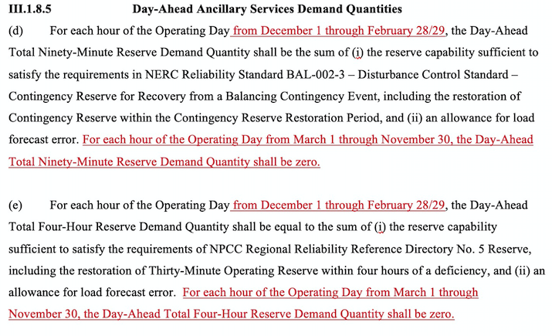
Tariff Redline

Slide 25
#2b Remove Allowance for Load Forecast Error
If the MA AGO amendment fails.

Slide 26
Our Position
ISO-NE has not demonstrated that “RER Goal #2, addressing load forecast error, is rooted in reliability standards”
We agree that reliability standards do not describe how to address load forecast error
The Impact Analysis’s ‘RER plus’ scenario (a proxy for a possible RER scenario including load forecast error) shows cost increases ranging from $16-$99M in the winter months alone.
No justification for shifting away from current, more cost-effective approach
Adding an allowance for load forecast error at this point is premature and not needed as part of the “base design” on which ISO-NE seeks FERC direction

Slide 27
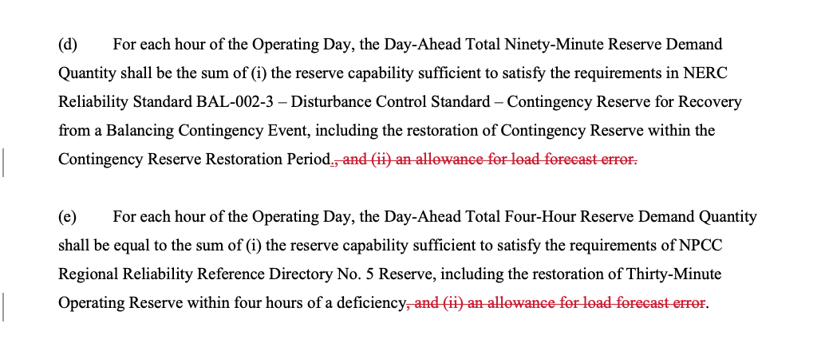
Tariff Redline – Section III.1.8.5

Slide 28
Consumer Costs - Scenarios
 | Millions of Dollars
Winter Months | No RER (savings) | RER Plus (Proxy for Load Forecast Error extra cost)* | $10 Strike Price Adder (Savings)
High Case / Severe Winter / Frequent Stressed | $ 73 | $ 99 | $ 2
Medium / Moderate Winter / Extended Stressed | $ 55 | $ 42 | $ 22
Low / Mild Winter / Infrequent Stressed | $ 9 | $ 16 | $ 13
Non-Winter Months Millions of Dollars per non-Winter (nine months)
Moderate Summer Conditions | $ 43 | n/a | $ 21
Severe Summer Conditions | $ 71 | n/a | $ 19
* The RER plus scenario added 600MWs of RER – ISO-NE initial indication of LFE = ~360MW

Slide 29
Thank You We Look Forward to Your Feedback
www.nescoe.com
Jeffbentz@nescoe.com

