Slide 1
April 22, 2020 | webex
ICR-Related Values Development Schedule
For the Forward Capacity Market Auctions to be conducted in 2021
Manasa Kotha
SENIOR ENGINEER, Resource Studies and Assessment

Slide 2
Today’s Presentation
Provide the RC with the 2020 development schedule for ICR-Related Values that will be used in auctions conducted in 2021*
Includes: HQICCs, ICRs, LSRs, TSAs, LRAs, MCLs and the MRI system & Capacity Zone Demand Curves
Details of the ICR-Related Values development will be discussed with the PSPC then presented to the RC and PC for advisory vote
This presentation includes the schedule of those discussions
All meeting dates and agenda items included in this presentation are tentative and subject to change
*Acronyms used in this presentation can be found in Appendix II

Slide 3
Schedule of FCM Auctions
FCA 15 and ARAs

Slide 4
2021 FCM Annual Auctions
In 2021, ISO-NE will conduct four annual FCM auctions:
FCA 15 Timeline is available at: https://www.iso-ne.com/static-assets/documents/2018/03/fca_15_market_timeline.pdf
The 2021 ARAs Timeline will become available in June 2020 and will be posted on the ISO-NE website at: https://www.iso-ne.com/markets-operations/markets/forward-capacity-market/?document-type=FCM%20Auction%20Calendars&sort=normalized_document_title_s.asc
Auction | Date
FCA 15 for CCP 2024-2025 | February 2021
ARA 1 for CCP 2023-2024 | June 2021
ARA 2 for CCP 2022-2023 | August 2021
ARA 3 for CCP 2021-2022 | March 2021

Slide 5
Background
Load Forecast and FCA ICR-Related Values Development Timeline with Key Discussion Topics

Slide 6
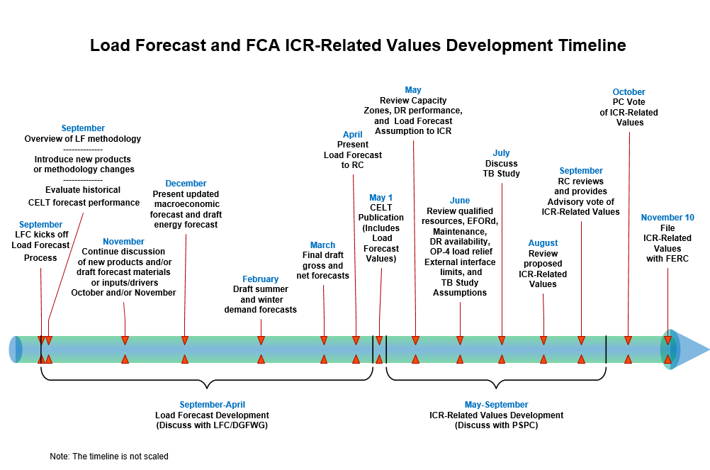
LFC reports periodically to the RC throughout the load forecast development process
The PSPC reports periodically to the RC throughout the ICR-Related Values development process

Slide 7
Anticipated schedule FOR ICR-Related Values Development
FCA 15 for Capacity Commitment Period 2024-2025
ARAs for Capacity Commitment Periods 2021-22, 2022-23 and 2023-24

Slide 8
FCA 15 ICR-Related Values Development Schedule
Date | Topic*
May 28 | PSPC review of Capacity Zone determinations and load forecast assumptions including anticipated BTM PV by Load Zone
June 30 | PSPC final review of all assumptions including assumptions for tie benefits study
July 28 | PSPC review of tie benefits study
August 25 | PSPC review of proposed ICR-Related values
September 1 | RC review of proposed ICR-Related values
September 23 | RC review/vote of proposed ICR-Related Values
October 1 | PC review/vote of proposed ICR-Related Values
By November 10 | File with FERC ICR-Related Values
*Details of each topic to be discussed at the PSPC can be found in Appendix I

Slide 9
ARAs ICR-Related Values Development Schedule
Date | Topic*
August 25 | PSPC review of assumptions for ICR-Related Values for ARAs and assumptions for ARA 3 tie benefits study
September 8 | PSPC review of proposed ICRs for ARAs
October 8 | PSPC review of proposed ICR-Related Values
October 20 | RC review/vote of proposed ICR-Related Values
November 5 | PC review/vote of proposed ICR-Related Values
By November 30 | File with FERC ICR-Related Values for all three 2021 ARAs
*Details of each topic to be discussed at the PSPC can be found in Appendix I

Slide 11
Appendix I
Details of PSPC Meeting Tentative Agenda Items

Slide 12
May 28 PSPC Meeting Agenda Items
Review the FCA 15 objective criteria testing for Capacity Zone determinations
Review the summer 2019 and winter 2019-2020 DR performance
Review the impact of heating and transportation electrification forecast on ICR-Related Values
Provide aggregate BTM PV MWs by Load Zone
Present the updated data related to ADCR performance based on the new methodology discussed at the June 20, 2019 PSPC meeting*
*https://www.iso-ne.com/static-assets/documents/2019/06/adcr_availabilityassumptions_final.pptx

Slide 13
June 30 PSPC Meeting Agenda Items
Review assumptions to be used in the FCA 15 ICR-Related Values calculations
Load forecast
Qualified Existing Capacity Resources for FCA 15
Generating Capacity Resources availability (EFORd and maintenance weeks)
DR availability
Load relief from OP-4 action relating to 5% voltage reduction
External transmission interface availabilities
Review assumptions for the FCA 15 tie benefits study

Slide 14
July 28 PSPC Meeting Agenda Items
Review results of FCA 15 tie benefits study

Slide 15
August 25 PSPC Meeting Agenda Items
Review proposed ICR-Related Values for FCA 15
Assumptions related to ARAs ICR-Related Values development
Review load, resource and availability assumptions for all three ARA ICR-Related Values calculations
Review of assumptions for the 2021-2022 ARA 3 tie benefits study
*Subsequent to the PSPC meeting, the RC will review the ICR-Related Values for FCA 15 on September 1 and September 23 and the PC will review on October 1

Slide 16
September 8 PSPC Meeting Agenda Items
Review the 2020-2021 ARA 3 tie benefits study results

Slide 17
October 8 PSPC Meeting Agenda Items
Review the estimated hours of system operating reserve deficiency for the 2024-2025 Capacity Commitment Period
Review proposed ICR-Related Values for all three ARAs*
*Subsequent to the PSPC meeting, the RC and PC will review the ICR-Related Values for all three ARAs on October 20 and November 5, respectively

Slide 18
Appendix II
Acronyms for ICR-Related Values*
*Not all acronyms are used in this presentation

Slide 19
Acronyms
ADCR – Active Demand Capacity Resource
ALCC – Additional Load Carrying Capability
APk – Gross peak load net of BTM PV
ARA – Annual Reconfiguration Auction
ART – Annual Reconfiguration Transaction
BTM PV – Behind-the-meter Photovoltaic
CCP – Capacity Commitment Period
CDD – Cooling Degree Days
CELT – Capacity, Energy, Loads and Transmission
CSC – Cross Sound Cable
CSO – Capacity Supply Obligation
CT – Connecticut
DGFWG – Distributed Generation Forecast Working Group
DR – Demand Resource
EE – Energy Efficiency
EFORd – Equivalent Forced Outage Rate on Demand

Slide 20
Acronyms, cont.
FCA – Forward Capacity Auction
FCM – Forward Capacity Market
FERC – Federal Energy Regulatory Commission
HQICCs – Hydro-Quebec Interconnection Capability Credits
ICR – Installed Capacity Requirement
ISO – ISO New England
LFC – Load Forecast Committee
LRA – Local Resource Adequacy
LSR – Local Sourcing Requirement
MARS -Multi-Area Reliability Simulation
MCL – Maximum Capacity Limit
MRI – Marginal Reliability Impact
NEPOOL – New England Power Pool
Net ICR – ICR minus HQICCs
NNE – Northern New England

Slide 21
Acronyms, cont.
NPCC – Northeast Power Coordinating Council
OP-4 – Operating Procedure No. 4, Action During a Capacity Deficiency
PAC – Planning Advisory Committee
PC – NEPOOL Participants Committee
PK – Peak (gross load forecast)
PSPC – NEPOOL Power Supply Planning Committee
RC – NEPOOL Reliability Committee
RI – Rhode Island
SEMA – Southeastern Massachusetts
SENE – Southern New England
SWCT – Southwest Connecticut
TSA – Transmission Security Analysis
VR – Voltage Reduction
WEFORd – Weighted Equivalent Forced Outage Rated on Demand

