Slide 1
April 22, 2020 | WEBEX
Forward Capacity Auction 15 (FCA 15): Fuel Security Review Inputs Revisions
Clarity to Planning Procedure No. 10, Appendix I (PP10-I) Inputs, Trigger Criteria and Preliminary Study Results
Norman Sproehnle
(413) 540-4755 | NSPROEHNLE@iso-ne.com

Slide 2
Reliability Reviews for Fuel Security: Planning Procedure No. 10, Appendix I Continued Discussions
At the March 17 Reliability Committee meeting, the ISO reviewed its initial PP10-I static inputs and variable inputs in accordance with PP10-I, Section 2-1
ISO received stakeholder feedback on several inputs for inclusion into the fuel security reliability review for FCA 15
At today’s meeting, the ISO will review Appendix L of Section III of the Tariff, Fuel Security Reliability Review Standard, ‘The Trigger;’ provide preliminary FCA 15 study results; and address the stakeholder feedback

Slide 3
Trigger Criteria

Slide 4
Trigger Criteria
As described in Appendix L of Section III of the Tariff, the ISO is to apply the following multi-prong trigger for the FCA 15 preliminary analysis
If either of the following conditions is met, then a resource is to be retained for fuel security:
  The retirement will result in the depletion of 10-minute reserves below 700 MW in any hour in the absence of a contingency in more than one liquefied natural gas supply scenario case or,
  The use of load shedding in any hour pursuant to Operating Procedure No. 7
Using the trigger criteria and the existing PP10-I inputs, as updated for FCA 15, the ISO has been able to assess the preliminary results of resources that have submitted Retirement De-list Bids (1,935 MW total)

Slide 5
FCA 15 Preliminary Results

Slide 6
Preliminary Details
The preliminary results indicate that no resource that submitted a Retirement De-List Bid for the FCA 15 Capacity Commitment Period (CCP 15), and no resource that was previously retained for fuel security, both totaling 1,935 MW, will be retained for fuel security for CCP 15
The results from this fuel security reliability review are preliminary due to:
  Validation of resources from the 2020 CELT
  Implementation of new resources into the model
  Thorough checking of model inputs
  Thorough checking of study results
The additional work to complete the analysis will not change the outcome of the fuel security reliability review, as the items to be finalized will only improve the fuel security of the system

Slide 7
Preliminary Outputs Table

Slide 8
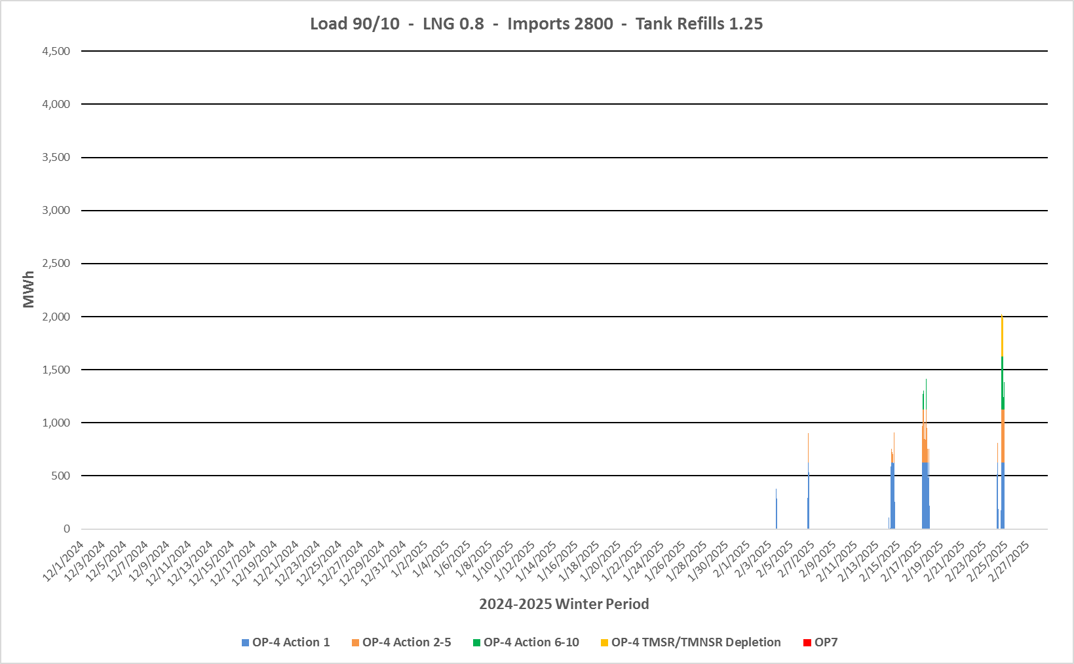
Preliminary Emergency Actions Graph

Slide 9
Full Preliminary Output Table

Slide 10
Stakeholder Feedback

Slide 11
Stakeholder Feedback
At the March meeting, the ISO received feedback on the FCA 15 review inputs, with several requests to update inputs and, in some cases, modify the PP-10, Attachment I input requirements to further improve the reliability outlook of the model
All of the requested changes would directionally improve the reliability of the system in the winter months, making it even less likely that a resource would be retained for fuel security in FCA 15
Given the preliminary results of the FCA 15 fuel security reliability review, the additional changes suggested thus far would not materially alter the outcome, but the ISO is providing the following responses for informational purposes

Slide 12
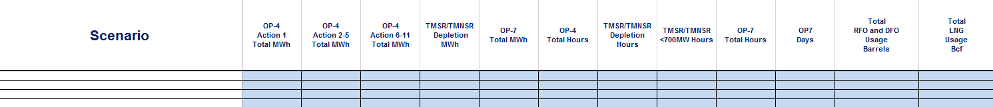
Stakeholder Feedback
A suggestion was made to add oil and LNG burn rates as a scenario output
The ISO currently provides OP-4, 10-Minute Reserve Depletion and OP-7 Load Shedding output metrics per scenario, as these reflect the trigger conditions from the Tariff
The ISO added total oil in barrels and total LNG in Bcf output metrics per scenario for informational purposes

Slide 13
Stakeholder Feedback
A request was made to identify the data source for the battery storage, wind and PV nameplate MW quantities
At the March 17 RC meeting, ISO presented nameplate capabilities based upon known preliminary 2020 CELT data
These inputs were utilized in the fuel security reliability model to generate the preliminary study results
ISO will confirm the preliminary results using the finalized 2020 CELT once available, in accordance with PP10-I

Slide 14
Stakeholder Feedback
A suggestion was made to use the wind profiles utilized by planning instead of the current wind profiles for the fuel security model under PP10-I
  The ISO system planning group contracted with a consultant (DNV-GL) to provide historical hourly power data for all existing wind farms and future offshore wind farms from 2012 to 2018
For the FCA 14 fuel security reliability review, ISO utilized National Renewable Energy Laboratory (NREL) and Modern-Era Retrospective analysis for Research and Applications (MERRA) datasets to create onshore and offshore hourly wind profiles to match the winter of 2014-2015
ISO worked with a number of stakeholders on the hourly profile creation process, validation through histograms and power spectra domains and the accuracy correlating the NREL and MERRA data sets
ISO will continue to utilize the wind profiles used for FCA 14 in the fuel security reliability model

Slide 15
Stakeholder Feedback
Stakeholder asked if the Distrigas LNG tanks will be available and utilized in the fuel security reliability model if Mystic 8 and 9 retire
The ISO derived the three LNG scenarios, 0.8, 1.0 and 1.2 Bcf based on the output of the region’s three LNG facilities and previously observed winter production from the facilities
If the Distrigas facility is not included, the capability of the remaining LNG facilities can support the three LNG scenarios previously studied
Therefore, the ISO will continue to use the 0.8, 1.0 and 1.2 Bcf/day LNG scenarios for the FCA 15 fuel security reliability review

Slide 16
Stakeholder Feedback
A suggestion was made to review the Millstone uprate request and consider it in the fuel security reliability review
Queue Position (QP) 930 details an upgrade at Millstone station for an increase of 37 MW with an operational date of 5/13/2022
Because interconnection studies associated with this upgrade in the planning horizon have not yet been completed, ISO will not be modeling the Millstone uprate in the FCA 15 fuel security reliability review

Slide 17
Stakeholder Feedback
Stakeholders also requested ISO to:
  Review its assumption of 7,400 Btu/kWh for gas to electric conversion
  Consider the New England Clean Energy Connect and increase the import values per scenario
  Consider adjustments to the applied EFORd for increased reliability of resources
Each of these requests will require a change to PP10-I
While these changes would directionally improve the reliability of the system in the winter months, in light of preliminary results that resources that have submitted retirement bids for FCA 15 do not need to be retained to maintain fuel security, the ISO is not planning to pursue them at this time

Slide 18
Conclusion
At today’s meeting, the ISO:
  Reviewed the trigger as applied to the fuel security review results
  Presented preliminary results of all submitted Retirement De-list Bids
  Addressed the stakeholder feedback from the March RC meeting
The FCA 15 timeline for fuel security
  Pursuant to Tariff Section III.13.2.5.2.5A(f), participants that have submitted a Retirement De-List Bid will be notified by the ISO if their resource is needed for fuel security reliability reasons no later than 90 days after the Existing Capacity Retirement Deadline, June 11
    As shown in the preliminary results, no resources with Retirement De-List Bids need to be retained
  Pursuant to Tariff Section III.13.2.5.2.5A(k), the ISO will review Retirement De-List Bids rejected for fuel security reliability reasons with the RC in the same manner as described in Section III.13.2.5.2.5(h), at the August RC meeting
    The ISO will provide the additional details and final results at this time

Slide 19
Stakeholder Schedule
Stakeholder Committee and Date | Scheduled Project Milestone
Reliability Committee March 17, 2020 | Review initial FCA 15 fuel security inputs applying the existing PP10-I methodology for stakeholder feedback
Reliability Committee April 22, 2020 | Review and address all stakeholder feedback received on FCA 15 fuel security inputs Review preliminary results
Reliability Committee August 18-19, 2020 | Review of FCA 15 fuel security analysis results for submitted Retirement De-List Bids

Slide 20
Norman Sproehnle
(413) 540-4755 | NSPROEHNLE@iso-ne.com

