Slide 1
April 7, 2020| NEPOOL Markets Committee
Internal Market Monitor (IMM) Quarterly Markets Performance Report
Fall 2019 Report Highlights
September – November 2019 outcomes
Link to full report
Dave Naughton
Manager, Surveillance & Analysis, IMM

Slide 2
Summary for Fall 2019
Wholesale market costs totaled $1.52bn, a 38% decrease (down $0.91bn) compared to $2.43bn in Fall 2018.
Both energy and capacity market costs decreased significantly.
Large decrease in energy costs, down by 47% (totaled $746m, down by $655m), due to a decrease in natural gas prices, lower loads and higher nuclear availability.
Avg. day-ahead and real-time Hub LMPs were $24.69/MWh and $24.98/MWh; 43% and 45% lower, respectively.
Avg. natural gas price was $2.44/MMBtu (or $19/MWh assuming a 7,800 Btu/kWh heat rate), down 42% on the Fall 2018 avg. price of $4.21/MMBtu (or $33/MWh).
Henry and Marcellus gas prices also down (~30-40%) and New England pipeline demand down by ~20%.
Avg. hourly load of 12,551 MW was down by 6% (≈ 800 MW), due to cooler temperatures in September, and warmer temperatures in late November.
Seasons: Winter: Dec-Feb Spring: Mar-May Summer: Jun-Aug Fall: Sep-Nov

Slide 3
Summary for Fall 2019 (cont.)
Large decrease in capacity market costs, down by 24% (totaled $749m, down by $239m) on Fall 2018 costs.
Fall 2019 was the second quarter of the FCA 10 commitment period, with clearing prices of $7.03/kW-month for rest-of-system, compared to a higher Fall 2018 price (FCA 9) of $9.55/kW-month.
Real-time reserve payments totaled $2.1m, down by $12m on Fall 2018 payments.
Higher Fall 2018 prices and payments were driven by reserve and pay-for-performance shortage conditions on Sep. 3, 2018. There were no comparable system events this fall.
Lower reserve payments also due to lower energy prices (and reserve opportunity costs), and lower frequency of system re-dispatch to meet the reserve requirement.
All reserve payments were for spinning reserve (TMSR). There were no payments for non-spinning reserves.
Total regulation payments were $6.2m, down by $2.7m (31%) compared to Fall 2018.
Decrease in payments reflects a reduction in regulation opportunity costs due to lower energy prices and no significant system evets.
Seasons: Winter: Dec-Feb Spring: Mar-May Summer: Jun-Aug Fall: Sep-Nov

Slide 4
Summary for Fall 2019 (cont.)
Net Commitment Period Compensation (NCPC) costs totaled $8.5m, down by 26% (by $3.9m) on the prior fall.
NCPC costs represented about 1% of the total energy costs, consistent with the historical range.
Economic payments made up 57% ($4.9m) of the total, down by $4.2m (46%) on Fall 2018 costs.
The decrease in economic payments was consistent with lower gas and energy prices.
Local reliability payments were comparable to the prior fall at $1.8m. Most of these payments went to generators in Maine that were needed to support planned transmission work.
First “out-month” auctions under FTR Balance of Planning Period (BoPP) rules held from September, and represented a small share (2-4%) of overall volumes.
Seasons: Winter: Dec-Feb Spring: Mar-May Summer: Jun-Aug Fall: Sep-Nov

Slide 5
Very different gas and energy prices season-over-season
Gas cost conversion assumes a heat rate of 7,800 Btu/kWh
Seasons: Winter: Dec-Feb Spring: Mar-May Summer: Jun-Aug Fall: Sep-Nov

Slide 6
Total costs less than Fall 2018; lower energy and capacity costs
Seasons: Winter: Dec-Feb Spring: Mar-May Summer: Jun-Aug Fall: Sep-Nov

Slide 7
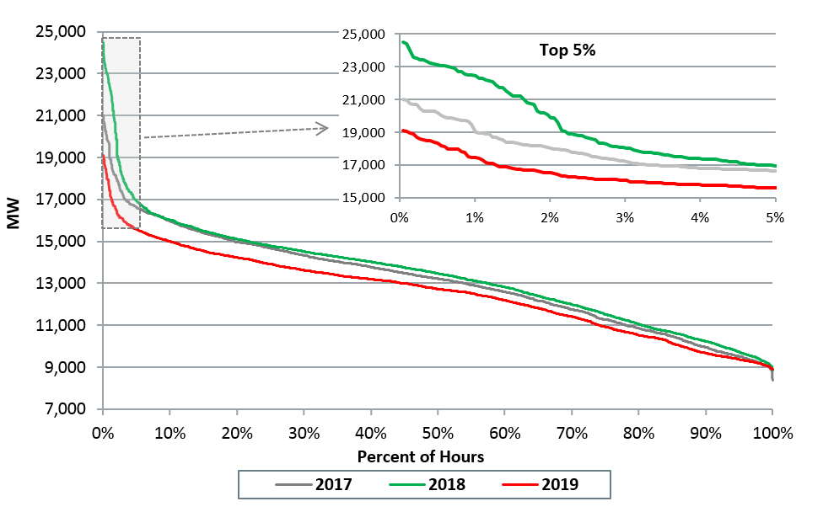
Average and peak loads down significantly on last fall due to milder weather
Load Duration Curves
Average Hourly Load by Season
Seasons: Winter: Dec-Feb Spring: Mar-May Summer: Jun-Aug Fall: Sep-Nov

Slide 8
Lower gas prices and loads drove lower energy prices; lower margins for baseload gas generators
Day-Ahead Prices
Hub: $43/MWh
Gas: $33/MWh
Spark Spread: $10/MWh
Hub: $29/MWh
Gas: $21/MWh
Spark Spread: $8/MWh
Hub: $25/MWh
Gas: $19/MWh
Spark Spread: $6/MWh
Seasons: Winter: Dec-Feb Spring: Mar-May Summer: Jun-Aug Fall: Sep-Nov

Slide 9
More nuclear generation in Fall 2019 displaced natural gas; significant nuclear refueling outages last fall
Higher nuclear generation availability in Fall 2019 put downward pressure on energy prices, compared to Fall 2018 when there were significant refueling outages.
Share of Electricity Generation by Fuel Type
Seasons: Winter: Dec-Feb Spring: Mar-May Summer: Jun-Aug Fall: Sep-Nov

Slide 10
Lower NCPC costs driven by decreased economic payments; consistent with lower gas and energy prices
Seasons: Winter: Dec-Feb Spring: Mar-May Summer: Jun-Aug Fall: Sep-Nov

Slide 11
Second quarter of FCA10; lower clearing prices
FCA 10 prices: $7.03/kW-month for all New England resources and Quebec imports; $6.26/kW-month for New York imports, $4.00/kW-month for New Brunswick imports
Seasons: Winter: Dec-Feb Spring: Mar-May Summer: Jun-Aug Fall: Sep-Nov

Slide 12
First “out-month” auctions under FTR Balance of Planning Period (BoPP) rules held from September
Activity
Out-month volumes totaled 1,197 MW for November and 2,638 MW for December (on-peak and off-peak), representing 2-4% of total volumes. Between eight and eleven companies participated in the out-month auctions that occurred in Fall 2019.
Further Background
On September 17, 2019, the BoPP project was implemented.
Prior to BoPP, participants could only buy or sell FTRs for a given month during the prior month (“prompt-month”).
BoPP allows participants to buy and sell monthly FTRs positions over the remainder of the year before the “prompt-month” auctions take place, known as “out-month” auctions. The out-month auctions don’t make additional network capacity available. However, FTRs can still be purchased in out-month auctions for paths that weren’t completely subscribed in the second annual auction, as the result of counterflow FTR purchases, or as the result of FTR sales.
Monthly On-peak FTR MWs by Auction

Slide 14
Appendix
Further Breakdown of Economic NCPC

Slide 15
Economic NCPC by Category
Seasons: Winter: Dec-Feb Spring: Mar-May Summer: Jun-Aug Fall: Sep-Nov

Slide 16
Dispatch Lost Opportunity Cost NCPC by Fuel Type
Seasons: Winter: Dec-Feb Spring: Mar-May Summer: Jun-Aug Fall: Sep-Nov

