Slide 1
May 19, 2020 | webex
Gross Load Forecast Reconstitution Methodology Changes
NEPOOL Reliability Committee
Jon Black
Manager, Load Forecasting

Slide 2
Today’s Presentation
Provide the RC with information concerning the participation of energy efficiency (EE) and other passive demand resources (PDR) in the annual Forward Capacity Auctions (FCA), including a discussion of EE expiring measures
Provide the RC with an overview of the proposed gross load reconstitution methodology modifications for the FCA
Provide the RC with information concerning PDR participation in annual reconfiguration auctions (ARAs)

Slide 3
Introduction and Background
At the April 22, 2020 Reliability Committee meeting, ISO described the purpose of reconstitution and the issue with the existing methodology
A primary objective of the gross load forecast is to ensure that passive demand resources (PDRs) are not double-counted in the Forward Capacity Auction (FCA)
PDRs receive compensation as a supply-side resource
PDRs also reduce demand, and their demand-reducing impact becomes embedded in historical load data
To ensure that PDRs are not double-counted, ISO must add (i.e., “reconstitute”) PDR demand reductions into historical loads used in the development of a forecast of future loads
The amount reconstituted should approximate the amount of PDRs participating as supply in the FCA
Energy efficiency (EE) measures comprise the majority of PDR MW

Slide 4
The Basis of Reconstitution Existing and Proposed
Since the inception of FCM, the ISO has used all installed EE measures as the basis of reconstitution
Over time, ISO has observed that the total amount of EE measures installed exceeds the amount of EE Capacity Supply Obligations (CSOs) acquired in the FCA
The ISO’s current methodology results in a forecast of gross demand that over-estimates the amount of EE CSOs acquired in the FCA
Shifting to EE CSO as the basis of its gross load reconstitution will better approximate future EE supply-side participation

Slide 5
Demand Resources Active or Passive
Active demand resources, called Demand Response Resources (DRRs), participate in energy markets by offering demand reductions, which are dispatched by the ISO based on price
DRRs are able to participate in FCM
ISO reconstitutes metered performance associated with DRRs into the relevant hourly loads used in developing the gross load forecast
This treats DRRs comparably with metered generation
No change is proposed to the reconstitution of DRR load reductions
PDRs do not actively participate in energy markets
Participation is limited to the FCM
Rather than being dispatched, they reduce demand once the respective measures are installed
Technology types include EE and passive distributed generation (DG)
When bid into Forward Capacity Market (FCM), PDRs are designated as either On-Peak or Seasonal Peak Demand Resources
The remainder of this presentation discusses PDR and ISO’s proposed reconstitution methodology for including it in the gross load forecast

Slide 6
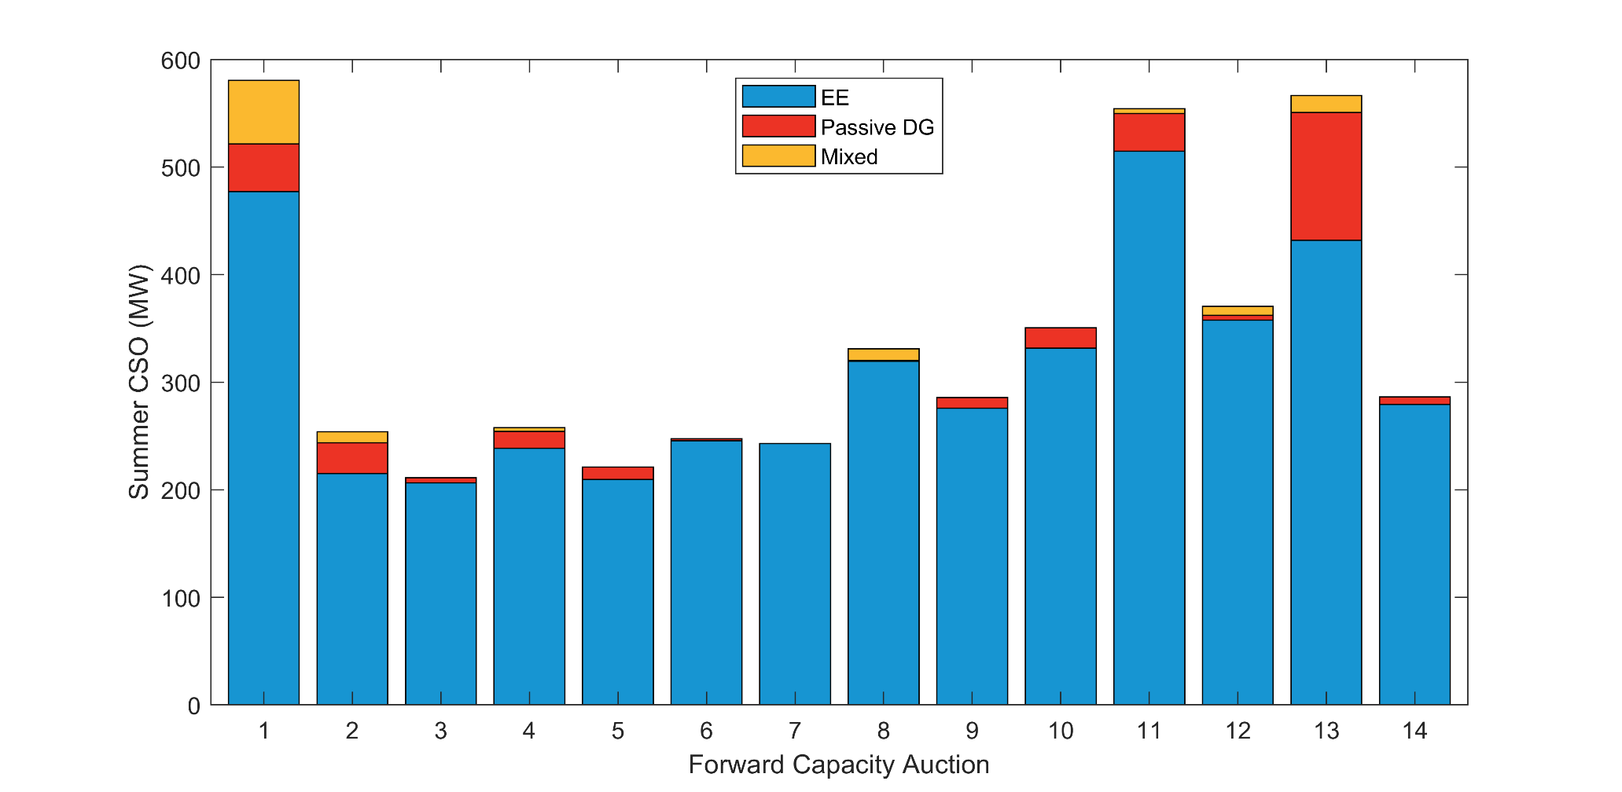
Composition of New Passive Demand Resources FCA 1 Through FCA 14
Notes:
EE = Energy Efficiency measures
Passive DG = Passive Distributed Generation measures
Mixed = Measures that are a mixture of EE and Passive DG

Slide 7
Expiring Measures
Expiring measures are EE measures that have reached the end of their useful measure life (UML) and can no longer participate in the FCM as a capacity resource
Section III.13.1.4.1. Demand Resources: “A Demand Resource may continue to offer capacity into Forward Capacity Auctions and reconfiguration auctions for Capacity Commitment Periods in an amount less than or equal to its remaining Measure Life”
A demand resource may continue to offer capacity for measures that are still within their UML
The UML is a statistically derived estimate of the life (in years) of an EE measure
The prevailing assumption is that when EE measures reach the end of their UML and expire, they will be replaced with technologies of comparable efficiency
Example: a light-emitting diode (LED) light bulb with an operating life of 15,000 hours could have a UML of 15 years if its estimated hours of operation is 1,000 hours per year

Slide 8
Expiring Measures, cont’d
Historical Capacity Commitment Periods (CCPs) up through 2019-2020 have witnessed relatively few expired measures
However, a significant increase in EE measures are set to expire over the FCM horizon, and more are set to expire beyond the FCM horizon
Measure expiration is factored directly into the Existing Capacity calculation of EE CSOs in FCM, and therefore also should be factored into the gross load forecast
The PDR CSO outcome of the most recently completed FCA reflects the cumulative EE measure expiration over several upcoming CCPs
Incorporating this value into the proposed reconstitution would capture the effects of future EE measure expiration in the gross load forecast

Slide 9
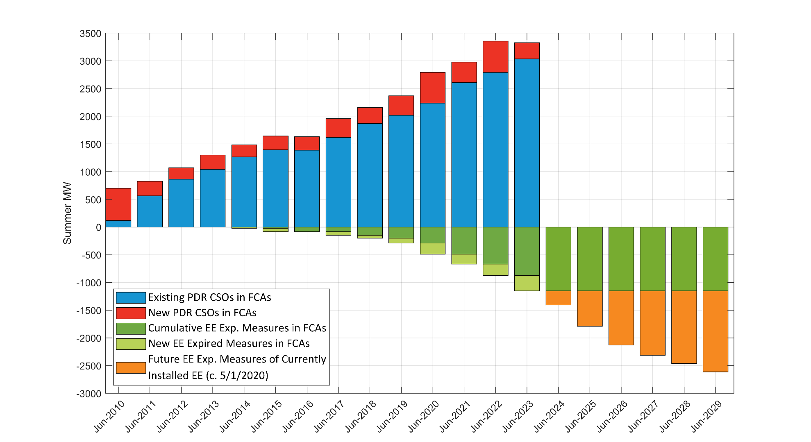
Passive DR in FCAs and EE Expiring Measures Growing Impacts of Expiring Measures on Summer CSO
Notes:
Future EE expiring measures beyond 2023 (i.e., orange bars) are based on expiring measure data obtained from the Energy Efficiency Measure database and reflect the Useful Measure Life of all installed EE as of May 1, 2020. Additionally, note that these quantities of future expiring measures do not reflect supply-side modifications to EE qualification that will be proposed later this year.

Slide 10
Proposed Passive Demand Resources Reconstitution Methodology
Forward Capacity Auctions

Slide 11
Proposed PDR Reconstitution Methodology
The proposed reconstitution methodology used in the gross load forecast used in the development of the ICR and related values for the upcoming FCA will utilize the PDR CSO of the most recently completed FCA, which is held in February of each year, and prior to CELT publication
The proposed PDR reconstitution involves the following steps:
Obtain the total seasonal PDR CSOs (June and December) from the most recent FCA for the corresponding CCP
Apply a linear fit between the time when installation of PDR participating in FCA 1 began (i.e., when PDR equals zero) and the PDR CSO and date of the most recent FCA CCP (June 1st for summer, December 1st for winter)
Assumed starting point for Summer is June 1, 2006
Assumed starting point for Winter is December 1, 2006
Apply the resulting June and December points in this time series to all the appropriate seasonal months in accordance with FCM performance months
This methodology is illustrated on the following slide as it would have applied to CELT 2020

Slide 12
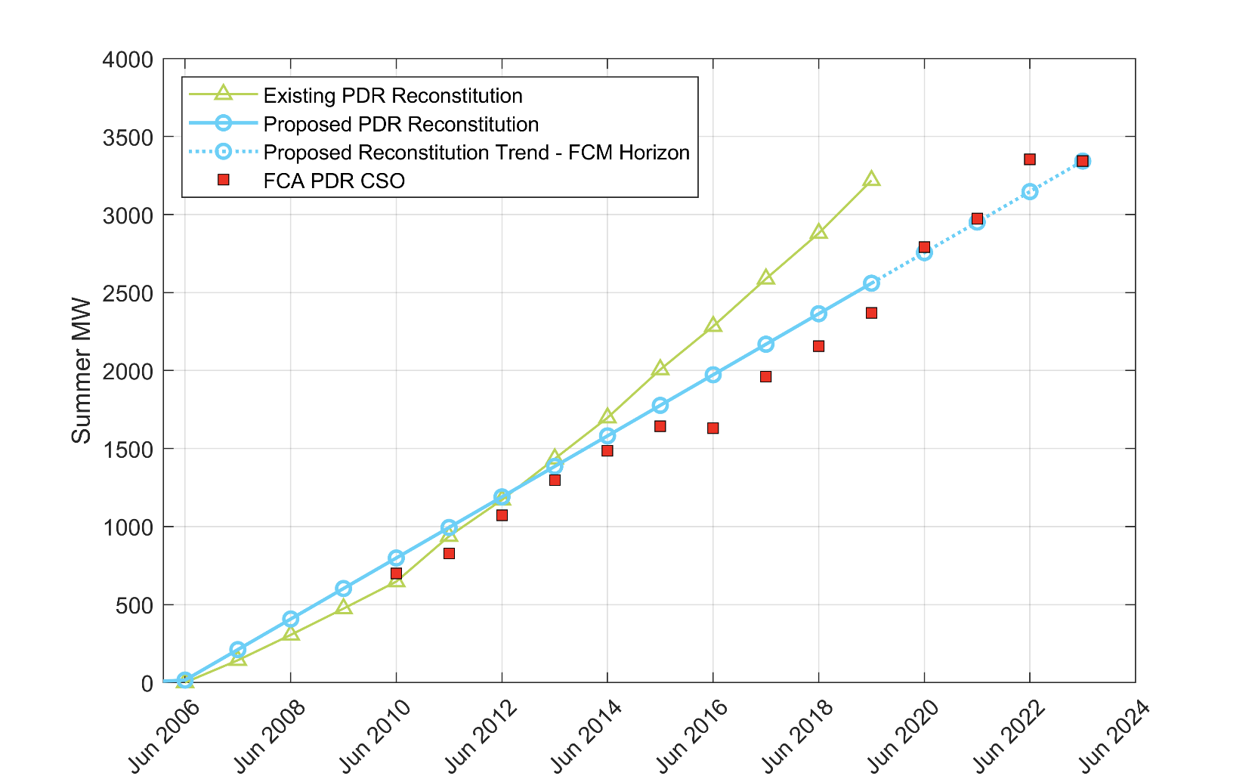
Proposed PDR Reconstitution Methodology CELT 2020 Application - Summer
Reconstitution Trend Line Ends at CSO of Most Recently Completed FCA
Reconstitution Begins

Slide 13
Resulting Changes in the Gross Load Forecast
The changes to the reconstitution methodology are proposed to be implemented for CELT 2021
The CELT 2021 Gross Load Forecast will be used for FCA 16 ICR and Related Values development
Will possibly reflect the effects of any supply-side modifications to PDR qualification to ensure that gross load reconstitution approximates future EE supply-side participation
The proposed reconstitution methodology results in PDR reconstitution that exhibits a lower level and slope, and will therefore result in a lower gross load forecast
The reconstitution no longer includes EE installations in excess of their CSO, and is net of cumulative EE expiring measures that no longer participate as supply in FCM up through the most recently held FCA
Both of these factors will become embedded as load reductions in the gross load forecast as a result of the proposed methodology

Slide 14
Passive Demand Resources in Annual Reconfiguration Auctions

Slide 15
PDR Participation in ARAs Background and Timing
While the proposed reconstitution methodology focuses on the CSOs obtained in the FCA, different amounts of PDR often clear in each of the annual reconfiguration auctions (ARAs)
Below is a table showing the timing of the CELT forecast, FCA and ARAs for CCPs 2019-2020 through CCP 2025-2026
Color coding indicates the vintage of CELT that is used as inputs to ICR calculations for each FCA and ARAs
As an example of the relevant timing, the latest ARA CSO values that are completed prior to CELT 2021 are the green ARA1, ARA2, and ARA3 auctions

Slide 16
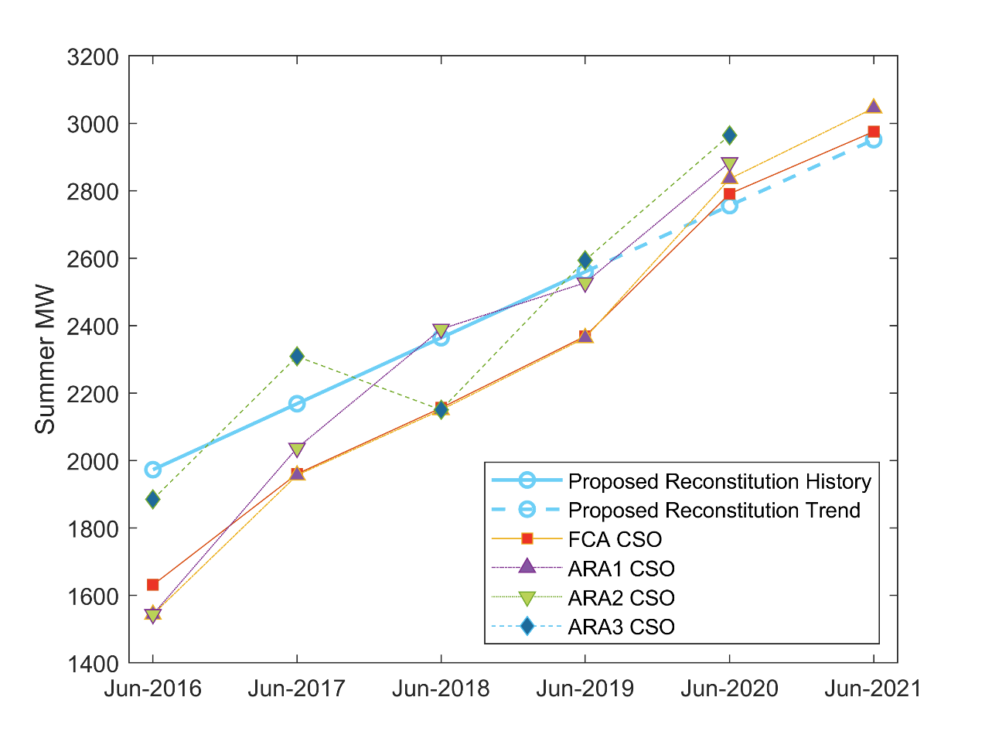
PDR Participation in ARAs Proposed Reconstitution, FCA CSOs, and ARA CSOs
The adjacent graph illustrates the PDR CSOs from historical FCAs and ARAs corresponding to CCP 2016-2017 through CCP 2021-2022
The relevant portion of the proposed PDR reconstitution illustrated on slide 12 is included for reference
As illustrated, CSO amounts acquired through the ARAs are different from those acquired through the FCAs
Note:
The lines illustrating the proposed reconstitution history and trend above reflect the application of the proposed methodology to CELT 2020 and are based on FCA 14 results

Slide 17
PDR Participation in ARAs Potential Adjustments to Gross Load Forecast
To reflect observed differences in the amounts of PDR clearing in ARAs versus the FCAs, the gross load forecast from the FCA would be adjusted to calculate the ICR and related values for the ARAs
This adjustment could be a series of scalar adjustments (up or down) to the gross load forecast based on a comparison of PDR CSO obtained from the most recently available ARAs to that of the proposed PDR reconstitution trend line for each respective CCP
The adjustment could reflect the effects of any supply-side modifications to approximate future EE supply-side participation

Slide 18
Proposed Schedule Timeline for Revising the Existing PDR Reconstitution Methodology
Date | Topic
April 22 | Provide RC with background on EE’s participation in FCM, its reconstitution in the gross load forecast, and the need for revising the current reconstitution methodology
May 19 | Present proposed PDR reconstitution methodology used for FCAs and other relevant information
June 16 | Present proposed method for adjusting the gross load forecast to reflect the amount of PDR participation in ARAs, and tariff changes related to changes to PDR reconstitution
July 21 | RC review/advisory vote of proposed changes
August 6 | PC advisory vote of proposed changes
August 6 | File with FERC proposed tariff changes with a requested effective date of October 5, 2020
Q4 2020 | RC Kick off 2021 CELT forecast using the revised reconstitution methodology; the revised reconstitution methodology will be implemented for 2021 (assuming FERC acceptance of the ISO’s proposed revisions to Section III.12.8 (d))

Slide 20
Appendix
Acronyms

Slide 21
Acronyms
ARA – Annual Reconfiguration Auction
CELT – Capacity, Energy, Loads and Transmission
CSO – Capacity Supply Obligation
DG – Distributed Generation
EE – Energy Efficiency
FCA – Forward Capacity Auction
FCM – Forward Capacity Market
FERC – Federal Energy Regulatory Commission
ICR – Installed Capacity Requirement
ISO – ISO New England
LFC- Load Forecast Committee
PA – Energy Efficiency Program Administrator

Slide 22
Acronyms
PC – NEPOOL Participants Committee
PDR – Passive Demand Resources
RC – NEPOOL Reliability Committee

