Slide 1


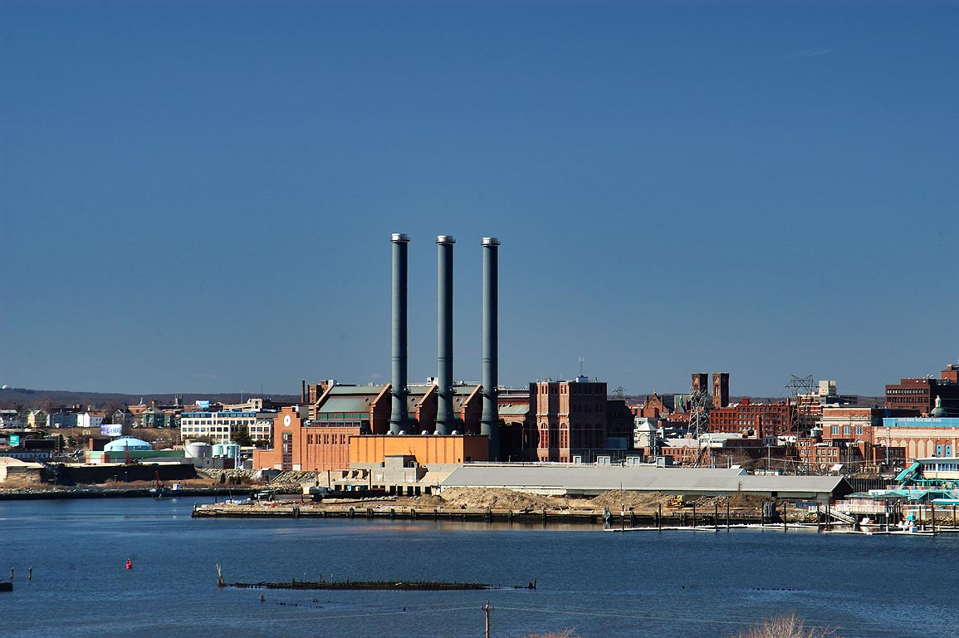


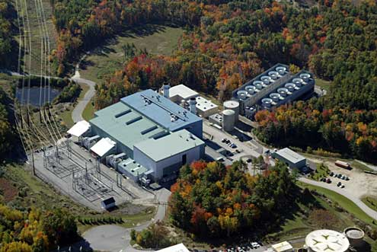

ISO-NE CONE and ORTP Analysis
May 12, 2020
Danielle Powers
Meredith Stone
Keith Paul

Slide 2
Overview & Purpose: CONE Recalculation
Purpose:
To determine the Net CONE parameter to be used in the Forward Capacity Auction for the 2025-26 Capacity Commitment Period (“CCP-16”) and forward
Net CONE is the levelized capacity revenue a new resource would need to be economic, given reasonable assumptions about energy and ancillary services (E&AS) margins and revenues, and costs to build and operate

Slide 3
Overview & Purpose: ORTP Recalculation
Purpose:
To develop a set of benchmark prices at the low end of the competitive range for various resources that act as a proxy for the price at which a given resource type would offer into the FCA were it not to receive out-of-market revenues as defined in Market Rule 1
ORTPs are a screening tool for new resource offers to receive further resource-specific review by the Internal Market Monitor
ORTPs are set at the low end of the competitive range to determine a threshold below which the offers may appear commercially implausible absent out-of-market revenues

Slide 4
Overview & Purpose: Current CONE Values
FCA-15 CONE Values
Type | Value ($/kW-month)
Gross CONE | $11.951
Net CONE | $8.707
Auction Starting Price | $13.932

Slide 5
Overview & Purpose: Current ORTP Values
FCA-15 ORTP Prices
Type | Value
Combustion Turbine | $7.161
Combined Cycle | $8.967
Onshore Wind | $0.00
Energy Efficiency | $0.00
Demand Response – C&I Load Management and Previously Installed Distributed Generation | $1.008
Demand Response – Residential Load Management | $7.559

Slide 6
CONE Technology Scope and
Selection Process

Slide 7
Overview & Purpose: CONE Recalculation
CONE Technology Screening Criteria:
Screening Criteria¹ | Application | FERC Approval
Must be likely to be economic for merchant entry under long-term equilibrium conditions | Net CONE value is high enough to incent new entry into the market, but not so high as to introduce unnecessary costs | Consistent with 2017 FERC approval of CONE/ORTP Recalculation: ER17-795-000
Must have reliable cost information available to calculate a CONE value using a full “bottom-up” analytical approach | Demonstrated interest by developers such that capital costs and E&AS revenues can be estimated with a high level of certainty | Consistent with 2017 FERC approval of CONE/ORTP Recalculation: ER17-795-000
Must reliably be able to meet load when resource adequacy is at risk | Technology is able to be dispatched whenever resource adequacy is at risk | FERC approved past Net CONE reference unit screening criteria: ER14-1639-000
1 - FERC Order Docket ER14-1639-000 147 FERC ¶ 61,173, May 30, 2014
FERC Order Docket ER17-795-000 161 FERC ¶ 61,035, October 6, 2017

Slide 8

CONE Technology Scope and Selection Process: Approach to Technology Selection
Resources likely to meet established criteria:
Simple cycle gas turbines
Combined cycle gas turbines
Resources that do not/unlikely to meet this criteria:
Onshore wind
Offshore wind
Other developing technologies

Slide 9
CONE Technology Scope and Selection Process: Recent Projects in New England

Slide 10
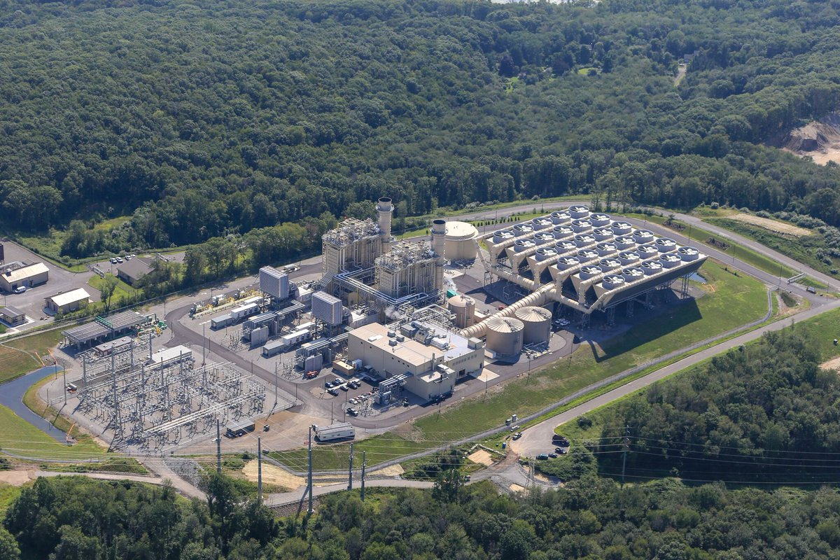
CONE Technology Scope and Selection Process: Turbine Technologies Being Considered for Further Evaluation
Simple cycle gas turbines
Aeroderivative
Frame Machines
Combined cycle gas turbines
Aeroderivative
Frame Machines
Triple pressure steam cycle
Reference: CPV

Slide 11
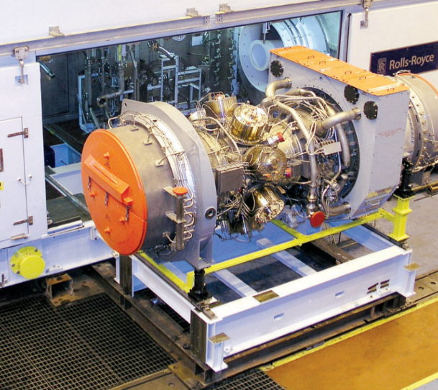
CONE Technology Scope and Selection Process: Simple Cycle Gas Turbines
Aeroderivatives
GE LM6000 PF+
Latest version of one of the most widely installed gas turbines in New England
LM2500
High $/kW installed cost
Often utilized in CHP or industrial process applications
Siemens/Rolls Royce Trent
Viable competitor to LM6000 family
MHI Pratt & Whitney FT8 Swiftpac
Less efficient machine with small NE installed base
Siemens SGT 800
Efficient competitor to LM6000 and Trent with small installed base in NE
Solar Titan 250
Small machine with high heat rate and small installed base in NE
Other technology providers offer smaller machines or have small installed base in New England
Reference: Rolls Royce/Siemens

Slide 12
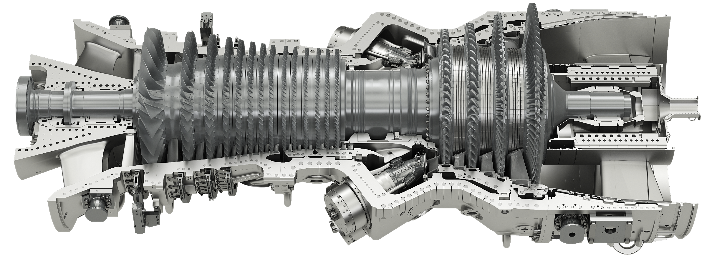
CONE Technology Scope and Selection Process: Large Frame Simple & Combined Cycle Gas Turbines
Gas Turbines
In the middle of step-change improvement in technology
GE 7HA.03
GE’s largest capacity and most efficient air-cooled large frame machine
Currently scheduled to be next in GE test rig
Not yet in operation
GE Guaranteed performance
GE 7HA.02
Largest and most efficient Gas Turbine offered by GE that is operating in New England
GE 7HA.01
Currently in operation in New England
GE 7FA - .04 thru .06
Will continue to be offered for sale, but are smaller and less efficient than the 7HA.03-7HA.02 technology
Reference: GE

Slide 13
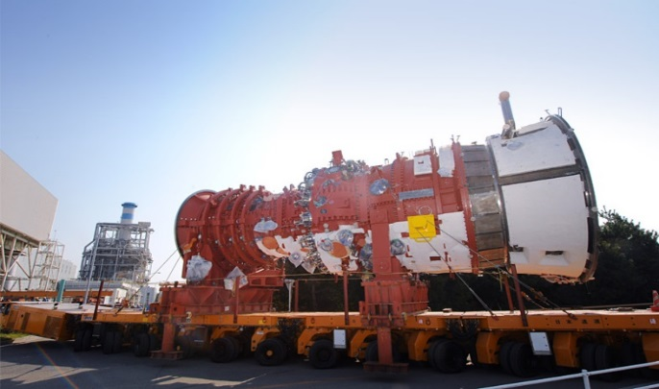
CONE Technology Scope and Selection Process: Large Frame Simple & Combined Cycle Gas Turbines (cont.)
Gas Turbines
MHI M501JAC and J
M501JAC
Currently highest output and lowest heat rate available for a large frame gas turbine
Utilizes an external compressor to provide additional cooling air
Performance guaranteed by MHPS
Project currently under development in New England
M501J is a steam cooled large frame gas turbine
Slightly lower capacity than the M501JAC, but with equal heat rate
MHPS M501GAC
Air Cooled large frame gas turbine from previous generation technology
Reference: MHPS

Slide 14
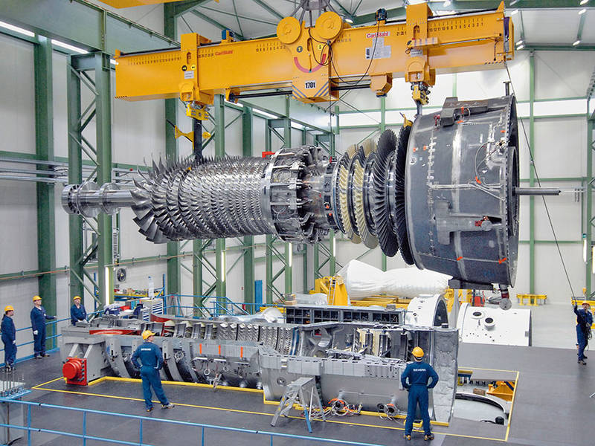
CONE Technology Scope and Selection Process: Large Frame Simple & Combined Cycle Gas Turbines (cont.)
Gas Turbines
Siemens SGT6-9000HL
Highest Output and lowest heat rate available for a Siemens Frame Gas Turbine as of April 2020, but not yet in operation.
Siemens SGT6-8000H
Large installed base for large frame gas turbines
Smaller and less efficient than GE’s or MHPS’s latest technology machines
Other OEM frame machines available
Heat Rate worse than larger frame machines, driving installed $/kW costs higher.
Smaller, more expensive from an installed $/kW perspective,
Small installed base in United States, and New England in particular.
Reference: Siemens

Slide 15
Questions

Slide 16
ORTP Technology Scope and
Selection Process

Slide 17
Overview & Purpose: ORTP Recalculation
ORTP Technology Screening Criteria:
Screening Criteria | Application | FERC Approval
Represent technologies that have been installed in the region and participated in recent FCAs | Technologies have participated in recent FCAs | Consistent with 2017 FERC approval of CONE/ORTP Recalculation: ER17-795-000
Have reliable cost information available to calculate an ORTP using a full “bottom-up” analytical approach | Demonstrated interest by developers such that capital costs and E&AS revenues can be estimated with a high level of certainty | Consistent with 2017 FERC approval of CONE/ORTP Recalculation: ER17-795-000
Have a first-year revenue requirement below the FCA starting price | The levelized revenue requirement is below the expected auction starting price | Consistent with 2017 FERC approval of CONE/ORTP Recalculation: ER17-795-000

Slide 18
ORTP Technology Scope and Selection Process: Approach to Technology Selection
Likely to Meet Stated Criteria | May Meet Stated Criteria | Unlikely to Meet Stated Criteria
Gas-fired generation Simple cycle gas turbines (consistent with CONE technologies) Combined cycle gas turbines (consistent with CONE technologies) Renewables Onshore wind Solar Energy Efficiency Demand Response Storage (Battery) Combined PV + battery | Offshore wind | Biomass Fuel cells Other developing technologies

Slide 19
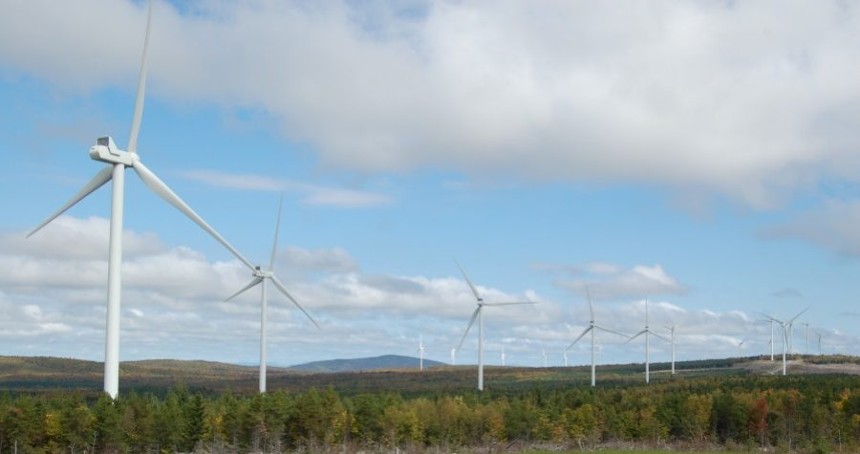
ORTP Technology Scope and Selection Process: Onshore Wind
Step change in onshore technology. Increasing capacity and capacity factor reduces the installed $/kW costs
Site specific performance based on wind resource
Best in areas with elevation differential (which results in high winds) and accessible high voltage transmission
Target areas include New Hampshire, Maine, and Vermont
Wind Turbine Manufacturers considered:
Vestas
General Electric
Siemens
Reference: Bingham Wind Farm

Slide 20

ORTP Technology Scope and Selection Process: Solar
Photovoltaic
Utility Scale
Large land area requirements that are typically expensive in New England
Starting to become more present in large scale due to state renewable initiatives
Prefers higher solar irradiance than available in New England to improve capacity factor
Residential/Commercial
Varied incentives across New England states
Solar Thermal Generation
Industrial focused with large investor requirements
Requires large land area
Not yet present in New England
Hybrid Combined Cycle
Not present in New England, few in the US
Reference: Woods Hill Solar – Pomfret, CT (RES Americas)

Slide 21
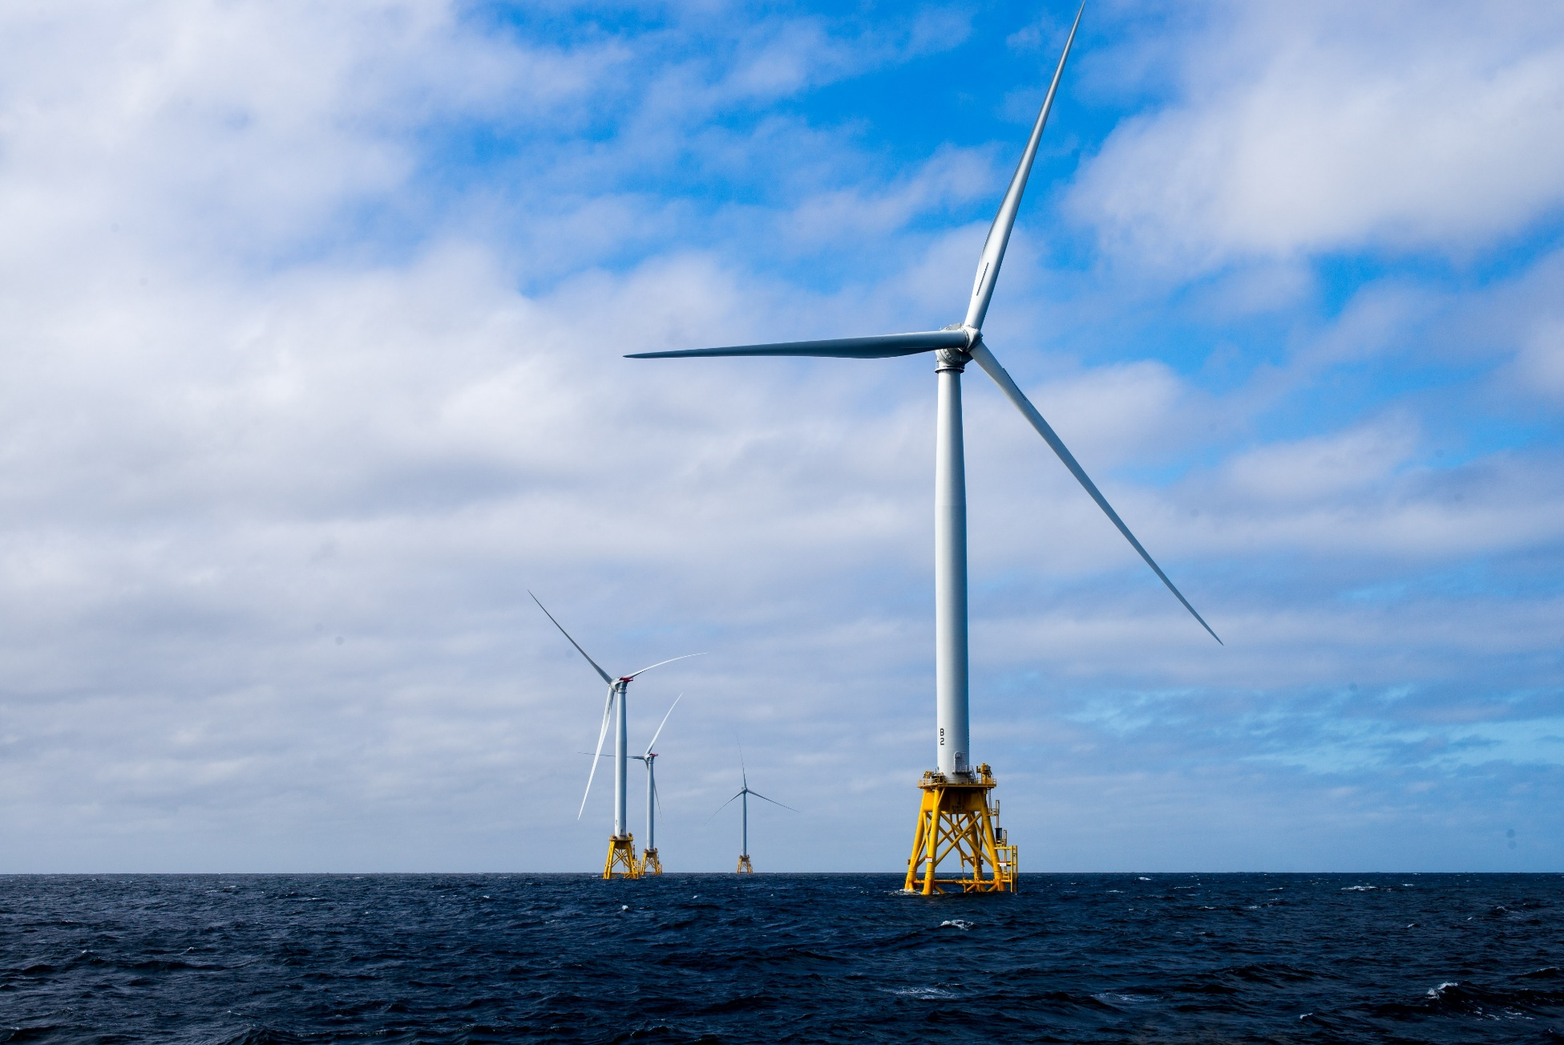
ORTP Technology Scope and Selection Process: Offshore Wind
Block Island - First demonstration project operating in Rhode Island (Alstom/GE)
Multiple Offshore Wind projects in development off the southern New England coast
Tend to require large projects to cover expense of power collection and transmission
Project sizes and arrangements are site or lease specific
Maintenance practices being developed to manage costs
Helicopters
Fast boats
Heavy lift vessels
Jack-up barges
Deep offshore floating designs in development phase
Reference: Mott MacDonald

Slide 22
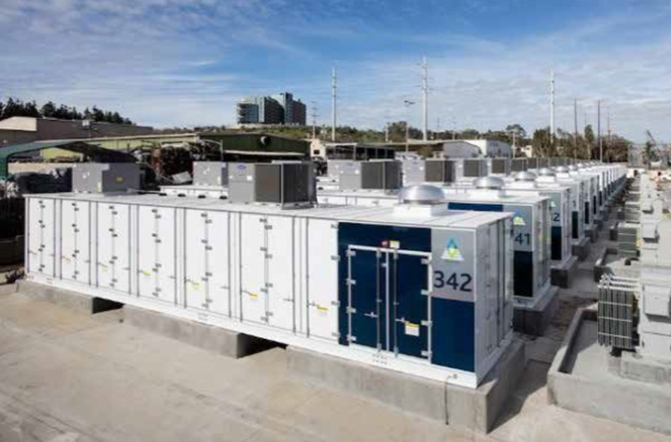
ORTP Technology Scope and Selection Process: Battery Storage
Standalone
Land area requirements that are typically expensive in New England
Increased interest in large scale installations due to state renewable initiatives
Installed primarily to provide ancillary services
Can address variable energy resource integration issues
Large battery projects (>100MW) have been proposed in New England
Combined battery storage and renewable generation
Battery storage located on the same site with a renewable generation technology
Have been proposed in New England
Can regulate the output from co-located renewable resource or shift renewable output to hours with higher market prices
Reference: Mott MacDonald

Slide 23
Preliminary Thoughts on Other Technologies for CONE/ORTP Consideration

Slide 24
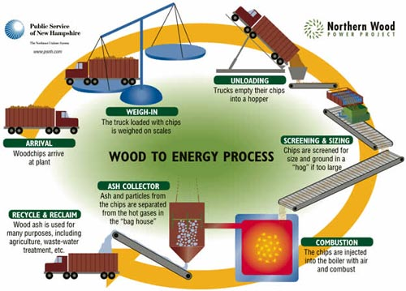
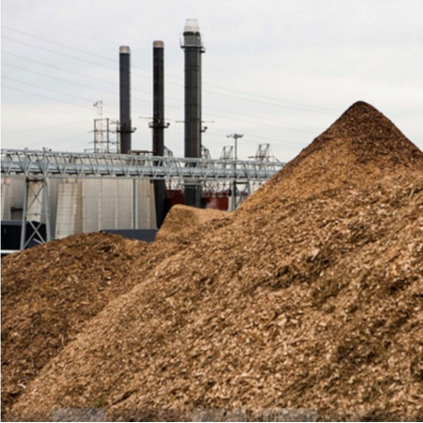
ORTP Preliminary Thoughts on Other Technologies: Biomass
Small installations when compared to combined cycles
Requires fuel gathering infrastructure that is regionally limited
High initial capital costs
Technologies vary depending on fuel availability, and site characteristics
Data cannot be compared across multiple projects
Reference: PSNH

Slide 25
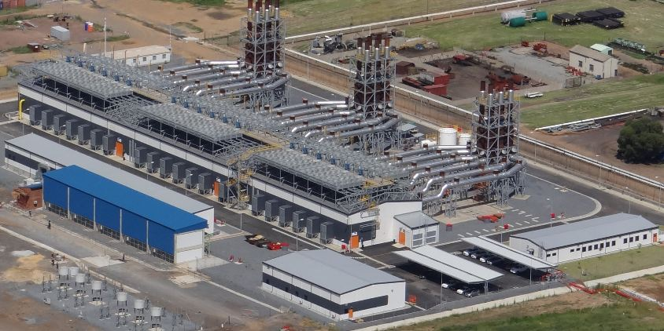
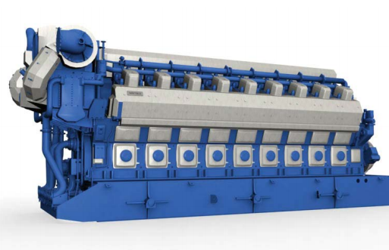
ORTP Preliminary Thoughts on Other Technologies: Reciprocating Engines
Reliable
Fast Start
Efficient engines with low energy exhaust
Low capacity when compared to simple cycle gas turbines
Not as efficient in combined cycle
Expensive capital cost especially for large installations
Large installations not present in New England
Reference: www.wartsila.com
Reference: www.wartsila.com

Slide 26
Questions

Slide 27
CONE Detailed Review of Reference Unit (Preliminary)

Slide 28
CONE Reference Unit: Key Inputs for Evaluation
Installed Costs
Operating Costs
Unit Performance
Interconnection Costs
Contingency Costs
Location
Labor Rates
Environmental Assumptions
Operational Assumptions
Energy and Ancillary Services Margins
Cost of Capital

Slide 29
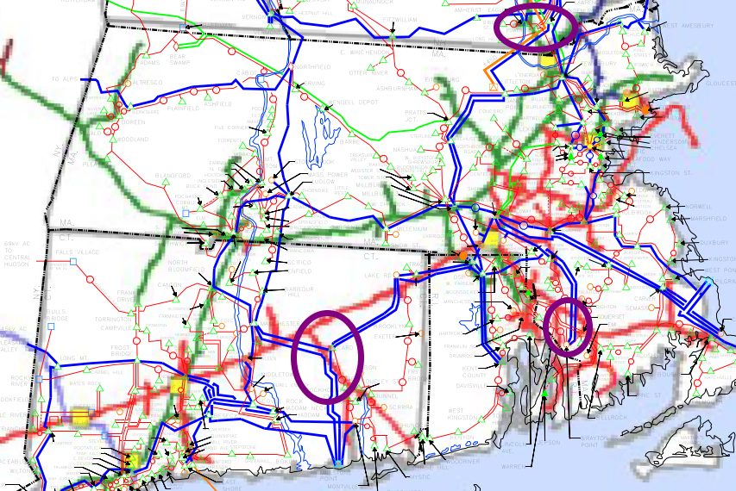
CONE Reference Unit: Reference Location
NATURAL GAS
Eastern Connecticut – New London County
Region with existing Natural Gas transmission and electrical transmission
Region may experience additional retirements
Region has new project currently being completed
Southeastern Massachusetts – Bristol County
Region experiencing retirements of key assets
Region with existing Natural Gas transmission and electrical transmission
Southeastern New Hampshire
Region with existing Natural Gas transmission and electrical transmission

Slide 30
CONE Reference Unit: Levelized Comparison
Gas Turbine Base Technologies
Initial technology comparison conducted on a levelized basis
Manufacturer offerings need to be compared at same ambient conditions
Manufacturer offerings need to be compared using the same economic and financial assumptions
Use same software to run all cases
Heat balances run for each technology
Utilized the GT Pro/GT Master database for performance comparison
Initial levelized cost estimates run for each technology offering
Utilized Thermoflow Peace to run levelized cost estimates for each technology
Structured each estimate using the same technical and financial basis
Results in levelized cost assumptions for each technology
A screening tool; not used for final project costs or for CONE and ORTP estimates

Slide 31
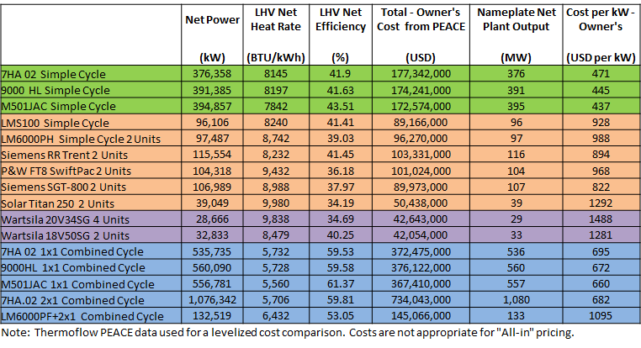
CONE Reference Unit: Preliminary Technology Heat Balances and Cost Estimates

Slide 32
CONE Reference Unit: Preliminary Environmental Assumptions
State and Federal requirements will be met:
Continuous emissions monitoring systems included in all designs
Air cooled machines selected for simple cycle designs
Selective Catalytic Reduction units included for all simple cycle and combined cycle designs
CO catalysts included for combined cycles
Air cooled condensers selected as primary heat sink for combined cycle

Slide 33
CONE Reference Unit: Preliminary Energy and Ancillary Services Estimates
Methods used in previous analyses were based on:
2013 CONE/ORTP calculation included an E&AS estimate based on historical revenues and the ratio of futures prices for the relevant Capacity Commitment Period and historical real-time prices
E&AS Margin = Historical E&AS Margin * Future On-Peak Prices
Historical On-Peak Prices
2016 CONE/ORTP calculation utilized a production cost model to forecast energy prices and to estimate dispatch and net E&AS margins
We are reviewing previous methodologies and assessing alternative methods that provide a reasonable estimate of future expected E&AS margins with an emphasis on being transparent to stakeholders

Slide 34
Questions

Slide 35
Financial Model Overview

Slide 36
ORTP/CONE Model Overview
Real Levelized Discounted Cash Flow Analysis
Capital Costs
Operating Costs
Variable costs
Fixed costs
Revenues
DA and RT E&AS Margins
Pay for Performance (net expected Performance Payments)
New DA ancillary services/ESI revenues
RECs (consistent with Market Rule 1)
Financial Assumptions
Debt Fraction (D/E)
Cost of Debt (COD)
Return on Equity (ROE)
Amortization Period
Depreciation Schedule / Bonus Depreciation
Tax Rates
ITC
Operating cash flows over the amortization period are discounted at the real after-tax weighted average cost of capital
This value is then levelized to produce an annual capacity revenue requirement used for Net CONE and ORTPs by technology

Slide 37
Financial Assumptions: Overview
CONE – Calculation assumes merchant entry by the new resource
ORTP – ISO-NE tariff specifies that the cost of capital will include an assumption for a Power Purchase Agreement (PPA) for a PPA-backed revenue stream (Market Rule 1, Section III.A.21.1.2.b)
Financial parameters to be specified for the CONE reference technology and ORTP technologies
After-tax weighted average cost of capital (ATWACC)
Amortization period
Capital costs (developed by Mott MacDonald), financial assumptions, and net E&AS revenue estimates will be used to calculate cash flows that will be levelized to determine the payment required from the FCM that results in a levelized net present value of zero
Financial assumptions are based on publicly available market data, subject to reasonable adjustments
Concentric has compiled market data for a group of publicly traded Independent Power Producers (IPPs)

Slide 38
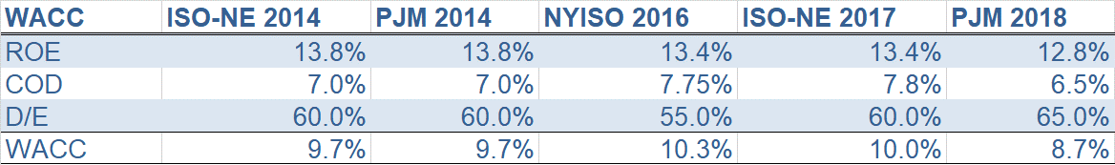
Financial Assumptions: WACC Calculations in Previous Studies

Slide 39
Financial Assumptions: Peer Group
Credit ratings reflect likelihood of debtor repayment, affecting lenders’ willingness to loan funds
Company | Ticker | S&P | Moody's
AES Corporation | AES | BB+ | Ba1
Clearway Energy, Inc. | CWEN | BB | Ba2
NRG Energy, Inc. | NRG | BB | Ba1
Vistra Energy Corp. | VST | BB | Ba1
Atlantic Power Corp | AT | BB- | Ba3

Slide 40
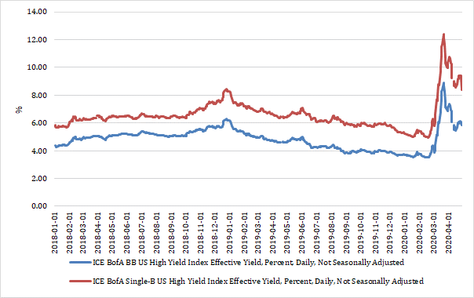
Financial Assumptions: Corporate Bond Yields
Corporate Bond Yield Indices, 2018-2020

Slide 41
Financial Assumptions: Cost of Equity and Amortization
Cost of equity
Same cohort group as COD calculations
Calculation uses standard financial modeling approaches (e.g. CAPM)
Reflects current market conditions and expectations
Amortization period
20 years per the Tariff
Market Rule 1, Section III.A.21.1

Slide 42
Areas of Tariff Assessment

Slide 43
Tariff Review: Overview of Tariff Changes
The use of Bureau of Labor Statistics (BLS) indices for updating CONE and ORTP values is specified in existing tariff language
We will review the accuracy of these indices against actual price and cost increases and will recommend any proposed changes at a future meeting
The Tariff currently requires that “E&AS offset values be updated using the most recent Henry Hub natural gas futures prices from the time of the update through the end of the Capacity Commitment Period associated with the relevant FCA, and the MA Hub on-peak electricity prices and the Algonquin City Gates natural gas prices for the twelve months following the time of the update, as published by the CME Group”.
We will be reviewing this methodology and the appropriate approach to annual updates based on our approach to calculating E&AS offset values for CONE and ORTP

Slide 44
Summary and Next Steps

Slide 45
Summary and Next Steps
CONE: Simple cycle and combined cycle gas turbines are primary candidates for CONE calculation based on established criteria
ORTP: Other renewable, energy efficiency, demand response, and gas-fired generation are primary candidates for ORTP calculation
Next Steps:
Continue our evaluation and analysis of technologies for CONE and ORTP calculations
Finalize initial financial assumptions for financial model
Deliverables for June Markets Committee meeting:
Preliminary technology costs for CONE and ORTP calculations
Determination of ORTP technologies
Preliminary financial assumptions
Indicative FRM revenue-offset component values

Slide 46
Questions

