Slide 1
May 12, 2020 | TELECONFERENCE
Cost of New Entry and
Offer Review Trigger Prices
Recalculation of FCM Parameter Values
for Capacity Commitment Period 16+
Deborah Cooke
413.540.4488 | dcooke@iso-ne.com

Slide 2
Cost of New Entry and
Offer Review Trigger Prices
WMPP ID:
139
Proposed Effective Date: June 1, 2025 (CCP 16)
Tariff requires periodic recalculation of the Cost of New Entry (CONE), Net CONE, and Offer Review Trigger Prices (ORTPs)
  CONE is an estimate of the cost to build a new resource in New England, and Net CONE is an estimate of the net revenue needed by the resource to be economically viable
  ORTPs are low-end estimates of Net CONE for specific types of technologies
Concentric Energy Advisors has been engaged to support these updates

Slide 3
Multiple FCM parameters will be updated concurrently with Net CONE and the ORTPs
Two additional FCM parameters will be updated for use beginning with the 2025-2026 Capacity Commitment Period
  Dynamic De-List Bid Threshold (DDBT) and Performance Payment Rate (PPR)
Concurrent updates best reflect the interdependencies among the FCM parameters
FCM Parameters Update and FRM Sunset for CCP16 memorandum dated April 29, 2020 provides additional context related to the FCM parameter updates

Slide 4
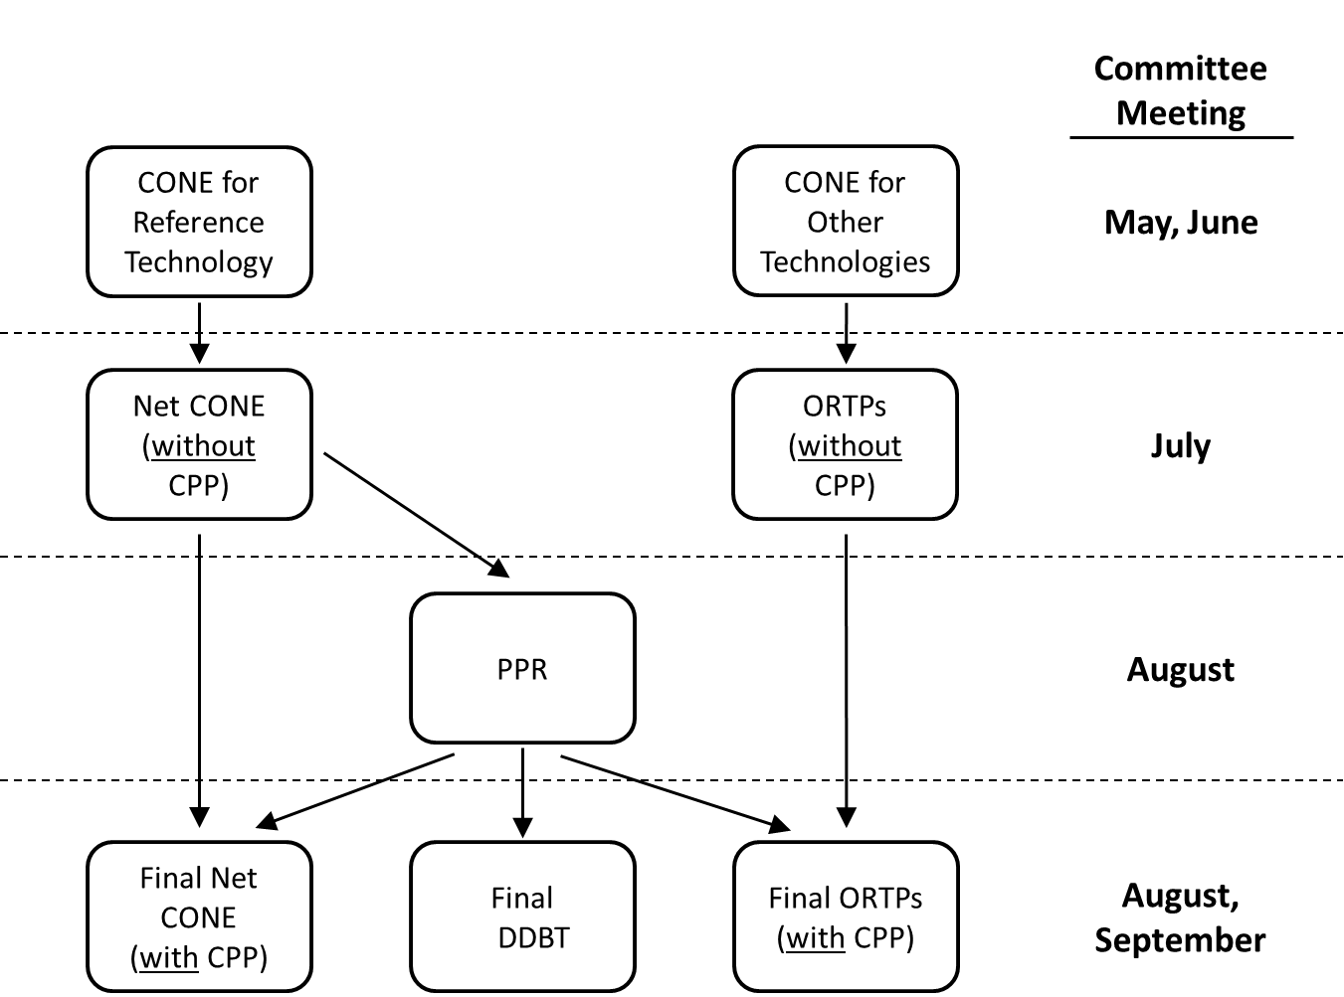
The various FCM parameters updates will be reviewed over the course of multiple meetings
Interdependencies between the various parameters dictate the order in which the parameters are calculated

Slide 5
Proposed market projects are likely to impact Net CONE and ORTP values
Two recently proposed market changes may impact the parameter values
  Elimination of Forward Reserve Market
  Energy Security Improvements
Impacts of these two proposed market changes on the FCM parameters will be estimated and reviewed with stakeholders
  Indicative impact of FRM elimination will be provided in June

Slide 6
CONE, Net Cone, and ORTP

Slide 7
Background: CONE, Net CONE, ORTPs
Most recent recalculation was performed in 2016, for the 2021-2022 Capacity Commitment Period (CCP 12)
Historically, values are updated triennially; the scheduled review was deferred one year to 2020 and to allow for:
  Concurrent updates of related FCM parameters: Dynamic De-List
  Bid Threshold and Performance Payment Rate
  Inclusion of Energy Security Improvements (ESI) revenue

Slide 8
Present applications of CONE, Net CONE and ORTPs in the Forward Capacity Market
Name | Purpose
Cost of New Entry | Input to Forward Capacity Auction (FCA) starting price 2016 value (for FCA12): $11.35 / kW-month
Net Cost of New Entry | Input to calculation of FCA starting price Used in calculation of scaling factor for zonal demand curves 2016 value: $8.04 / kW-month
Offer Review Trigger Prices | Benchmark prices for specific technologies, used to screen new resource offers for further review by the IMM. 2016 values ($/kW-month): Combustion Turbine: $ 6.503 Combined Cycle: $ 7.856 On-shore Wind: $11.025 Demand Response: Comm’l. & Ind. $ 1.008 Load Mgmt. $ 7.559

Slide 9
Net CONE and ORTP recalculations will account for proposed and projected Tariff changes
Forward Reserve Market sunset
  ISO-NE proposes to sunset the Forward Reserve Market (FRM) effective June 1, 2025 (as noted in the April 29, 2020
  FCM Parameters Updates Process and FRM Sunset for CCP16 memo)
  The impact of eliminating Forward Reserve Market revenues will be identified in the energy and ancillary services revenues calculations for various technologies
Energy Security Improvements
  On April 15, 2020, ISO filed Tariff changes to implement the Energy Security Improvements (ESI)
  The impact of these rule changes will be identified in the calculation of energy and ancillary services revenues for various technologies

Slide 10
Update process will also reflect recent FCM participation and a review of scarcity condition hours
New technologies participating in recent Forward Capacity Auctions will be evaluated for ORTPs
Updated estimates of annual expected Capacity Scarcity Condition hours will be developed and reviewed
  This is also an input to other FCM parameters

Slide 11
Existing annual parameter adjustments process for Net CONE and ORTPs will also be reviewed
CONE, Net CONE, and ORTPs are updated annually in between major recalculations
  Using indices such as Bureau of Labor Statistics and changes in fuel prices
Continued applicability of these specific indices will be evaluated
  To ensure they continue to reasonably reflect relevant price and cost increases

Slide 12
Conclusion
CONE, Net CONE, and ORTPs will be recalculated to reflect current costs and revenue estimates
  Impact of the FRM elimination and estimated ESI revenues will be reviewed with stakeholders
  Updated estimates of Capacity Scarcity Condition hours will also be developed and reviewed with the committee
  Two related parameters with interdependencies on CONE and Net CONE will be brought through the committee process concurrently: Dynamic De-List Bid Threshold and Performance Payment Rate reviews
  The annual adjustment process will also be reviewed
  Updated values will apply to the 2025-2026 Capacity Commitment Period (corresponds to FCA 16)

Slide 13
Stakeholder Schedule
Stakeholder Committee and Date | Scheduled Project Milestone
Markets Committee May 12, 2020 | Introduction Approach to technology screening
Markets Committee June 9-10, 2020 | Preliminary technology costs for CONE and ORTPs Indicative FRM revenue-offset component values
Markets Committee July 14-16, 2020 | Updated technology costs Financial modeling approach and inputs
Markets Committee August 11-12, 2020 | Financial modeling: Discounted cash flows; dispatch models (for market revenue offsets); preliminary Net CONE and ORTP values
Markets Committee September 9-10, 2020 | Near-final values of Net CONE and ORTPs Draft report Review of proposed Tariff language
Markets Committee October 6-7, 2020 | Final review and MC vote on Tariff language
Participants Committee November 5, 2020 | PC vote
December 1, 2020 | Proposed FERC filing date

Slide 14
Proposed stakeholder schedule for FCM Parameters
Topic: Meeting Date | CONE, Net CONE, ORTPs | DDBT | PPR | Revenue Offsets | Scarcity Hours | FRM Sunset
May 12 – 13 | X |  |  |  |  | X
June 9 – 10 | X |  |  | X |  | X
July 14 – 16 | X | X | X | X | X | MC Vote
August 6 |  |  |  |  |  | PC Vote
August 10 - 11 | X | X | X | X | X
September 1 |  |  |  |  |  | FERC Filing
September 9 – 10 | X | X | X | X | X
October 6 – 7 | MC Vote | MC Vote | MC Vote
November 5 | PC Vote | PC Vote | PC Vote
December 1 | FERC Filing | FERC Filing | FERC Filing

Slide 16
Acronyms Used in this Presentation
CCP = Capacity Commitment Period
CONE = Cost of New Entry
DDBT = Dynamic De-List Bid Threshold
ESI = Energy Security Improvements
FCA = Forward Capacity Auction
FCM = Forward Capacity Market
FRM = Forward Reserve Market
IMM = Internal Market Monitor
ORTP = Offer Review Trigger Price
PPR = Performance Payment Rate

