Slide 1
RELIABILITY Committee
SEPTEMBER 1, 2020 | WEBEX
Proposed Installed Capacity Requirement Related Values
Fifteenth Forward Capacity Auction (FCA 15)
Manasa Kotha
Senior engineer | Resource Studies and assessments

Slide 2
Objective of this Presentation
Review the ICR-Related Values* development schedule
Review the proposed ICR-Related Values consisting of:
Installed Capacity Requirement (ICR)
Local Resource Adequacy Requirement (LRA), Transmission Security Analysis (TSA), and Local Sourcing Requirement (LSR) for the import-constrained Capacity Zone of Southeast New England (SENE)
SENE is the combined Load Zones of NEMA/Boston, SEMA, and RI
Maximum Capacity Limit (MCL) for the export-constrained Capacity Zones of Northern New England (NNE) and Maine (nested in NNE)
NNE is the combined Load Zones of Maine, VT, and NH
Marginal Reliability Impact Demand Curves (MRI Demand Curves)
* The ICR, LRA, TSA, LSR, MCL, the Marginal Reliability Impact (MRI) system and zonal Demand Curves and the Hydro-Quebec Interconnection Capability Credits (HQICCs) are collectively called the ICR-Related Values

Slide 3
FCA 15 ICR-Related Values Development Schedule
Date | Topic
May 24 | PSPC reviewed the 2020 ICR-Related values development schedule for the FCM auctions to be conducted in 2021
June 30 | PSPC reviewed FCA 15 ICR-Related Values calculation assumptions
August 14 | PSPC reviewed tie benefits study results
August 25 | PSPC to review proposed FCA 15 ICR-Related Values
September 1 | RC review proposed FCA 15 ICR-Related Values
September 23 | RC review/vote proposed FCA 15 ICR-Related Values
October 1 | PC review/vote of proposed ICR-Related Values
By November 10 | File with FERC FCA 15 ICR-Related Values

Slide 4
Proposed ICR-Related Values for FCA 15

Slide 5
ISO Proposed FCA 15 ICR-Related Values for CCP 2024-2025 (MW)
2024-2025 FCA 15 | New England | Southeast New England | Maine | Northern New England
Peak Load (50/50) net of BTM PV* | 29,303 | 12,679 | 2,230 | 5,645
Peak Load (90/10) net of BTM PV* | 31,377 | 13,739 | 2,332 | 5,908
Existing Capacity Resources | 33,332 | 9,665 | 3,483 | 8,324
Installed Capacity Requirement | 34,153
HQICCs | 883
Net ICR (ICR minus HQICCs) | 33,270
Local Sourcing Requirement |  | 10,305
Maximum Capacity Limit |  |  | 4,145 | 8,680
Notes:
The Existing Capacity Resources value reflects the existing resources with Qualified Capacity for FCA 15 at the time of the ICR calculation and reflects applicable retirements and terminations
50/50 and 90/10 peak loads, net of BTM PV (includes both transportation and heating electrification forecast) is shown for informational purpose

Slide 6
Comparison of ICR-Related Values (MW) CCP 2024-2025 (FCA 15) vs CCP 2023-2024 (FCA 14)
 | New England |  | Southeast New England |  | Maine |  | Northern New England
 | 2024-2025 FCA 15 | 2023-2024 FCA 14 | 2024-2025 FCA 15 | 2023-2024 FCA 14 | 2024-2025 FCA 15 | 2023-2024 FCA 14 | 2024-2025 FCA 15 | 2023-2024 FCA 14
Peak Load Net of BTM PV (50/50) | 29,303 | 28,838 | 12,679 | 12,540 | 2,230 | 2,117 | 5,645 | 5,430
Existing Capacity Resources | 33,332 | 34,637 | 9,665 | 10,928 | 3,483 | 3,456 | 8,324 | 8,270
Installed Capacity Requirement | 34,153 | 33,431
HQICCs | 883 | 941
NET ICR (ICR minus HQICCs) | 33,270 | 32,490
Local Resource Adequacy Requirement |  |  | 10,305 | 9,525
Transmission Security Analysis Requirement |  |  | 10,005 | 9,757
Local Sourcing Requirement |  |  | 10,305 | 9,757
Maximum Capacity Limit |  |  |  |  | 4,145 | 4,020 | 8,680 | 8,445
Notes:
The Existing Capacity Resources value reflects the existing resources with Qualified Capacity for FCA 15 at the time of the ICR calculation and reflects applicable retirements and terminations
For details on the calculation of the ICR and related values for FCA 14 (associated with the Capacity Commitment Period 2023-2024) see: https://www.iso-ne.com/static-assets/documents/2019/09/a9_icr_and_tie_benefits_for_fca_14.zip
The 50/50 peak load Net of BTM PV (includes both transportation and heating electrification forecast) is shown for informational purposes

Slide 7
ICR Calculation Details
Total Capacity Breakdown | 2024-2025 FCA 15 ICR (MW)
Generating Capacity Resources | 29,383
Demand Resources | 3,867
Import Capacity Resources | 82
Tie Benefits | 1,735
OP-4 Actions 6 & 8 (Voltage Reduction) | 275
Minimum System Reserve | (700)
Total Capacity | 34,642
Installed Capacity Requirement Calculation Details | 2024-2025 FCA 15 ICR (MW)
Annual Peak | 29,303
Total Capacity | 34,642
Tie Benefits | 1,735
HQICCs | 883
OP-4 Actions 6 & 8 (Voltage Reduction) | 275
Minimum System Reserve | (700)
ALCC | 55
Installed Capacity Requirement | 34,153
Net ICR | 33,270
Reserve Margin with HQICCs | 16.6%
Reserve Margin without HQICCs | 13.5%
Notes:
All values in the table are in MW except the reserve margin which is shown in percent
ALCC is the “additional load carrying capability” used to bring the system to the target reliability criterion
APk is the forecast gross 50/50 peak load net of BTM PV (includes both transportation and heating electrification forecast) is for informational purpose

Slide 8
Effect of Updated FCA 15 Assumptions on Net ICR
Assumption | 2024-2025 FCA 15 |  | 2023-2024 FCA 14 |  | Effect on Net ICR (MW)
Tie Benefits | 258 MW New York |  | 362 MW New York |  | 205
 | 454 MW Maritimes |  | 501 MW Maritimes
 | 883 MW Quebec (HQICCs) |  | 941 MW Quebec (HQICCs)
 | 140 MW Quebec via Highgate |  | 136 MW Quebec via Highgate
Total | 1,735 MW |  | 1940 MW
 | MW | WAEFORd (%) | MW | WAEFORd (%)
Generation & IPR | 29,383 | 6.1% | 30,843 | 5.7% | 50
Demand Resources | 3,867 | 1.0% | 3,885 | 1.0%
Imports | 82 | 0.5% | 82 | 0.5%
 | MW |  | MW
Load Forecast & BTM PV/EV* | (50/50 Gross Load – BTM PV) 29,303 |  | (50/50 Gross Load –BTM PV) 28,838 |  | 545*
 | MW |  | MW
Net ICR | 33,270 |  | 32,490 |  | 780
ICR | 34,153 |  | 33,431 |  | 722
Notes:
Methodology: Using the model associated with the 2023-2024 FCA 14 ICR calculation, change one assumption at a time and note the change in Net ICR
The impact of each assumption change on Net ICR is not additive since they are evaluated one assumption at a time. The approach would not capture the compound effects of these assumptions changes when modeled together
Generation forced outage assumption is a weighted average (WA) of individual generators’ 5-year average EFORd and Intermittent Power Resources assumed 100% available
*The 2020 CELT load forecast (FCA 15) include electrification loads which were not in the 2019 CELT forecast used for FCA 14. Impact of electrification transportation on ICR is approximately 100 MW. See https://www.iso-ne.com/static-assets/documents/2020/05/a07_pspc_impact_electrification_icr.pptx

Slide 9
Comparison of LRA – SENE
 | Local Resource Adequacy Requirement - SENE
Southeast New England Capacity Zone |  | 2024-2025 FCA 15 | 2023-2024 FCA 14
Resource_{z} | [1] | 9,665 | 10,928
Proxy Units_{z} | [2] | 0 | 0
Firm Load Adjustment_{z} | [3] | -604 | 1333
FOR_{z} | [4] | 0.057 | 0.050
LRA_{z} | [5]=[1]+[2]-([3]/(1-[4])) | 10,305 | 9,525
Rest of New England Zone
Resource | [6] | 23,667 | 23,710
Proxy Units | [7] | 0 | 0
Firm Load Adjustment | [8] = -[3] | 603.71 | -1333
Total System Resources | [9]=[1]+[2]-[3]+[6]+[7]-[8] | 33,332 | 34,637
Peak Load Net of BTM PV (50/50)* | 12,679 | 12,540
Notes:
All values in the table are in MW except the Forced Outage Rate_{z} (FOR_{z})
SENE Interface transfer limits have been reduced from 5,700 MW for FCA 14 to 5,150 MW for FCA 15 by 550 MW. See February 20, 2020 PAC presentation (CEII) available at: https://smd.iso-ne.com/operations-services/ceii/pac/2020/02/a4_boston_import_transfer.pdf
The 50/50 peak load Net of BTM PV (includes both transportation and heating electrification forecast) is shown for informational purposes

Slide 10
Comparison of TSA Requirement – SENE (MW)
SENE Capacity Zone | 2024-2025 FCA 15 | 2023-2024 FCA 14
Sub-area 90/10 Load Net of BTM PV | 13,739 | 13,571
Reserves (Largest unit or loss of import capability) | 850 | 1,413
Sub-area Transmission Security Need | 14,589 | 14,984
Existing Resources | 9,665 | 10,928
Assumed Unavailable Capacity | -546 | -530
Sub-area N-1 Import Limit | 5,150 | 5,700
Sub-area Available Resources | 14,269 | 16,098
TSA Requirement | 10,005 | 9,757
TSA Requirement
(Need – Import Limit)
1 - ( Assumed Unavailable Capacity / Existing Resources)
Notes:
The 90/10 peak load Net of BTM PV (includes both transportation and heating electrification forecast) is shown for informational purposes
Line-Line TSA produced higher TSA requirement for FCA 15 and Line-Gen TSA produced the higher TSA requirement for FCA 14
All values have been rounded off to the nearest whole number
Information on the CCP 2023-2024 CCP (FCA 14) TSA calculation available at: https://www.iso-ne.com/static-assets/documents/2019/09/a9_icr_and_tie_benefits_for_fca_14.zip

Slide 11
Comparison of MCL – NNE
LRA - Rest of New England (for NNE MCL calculation)
Rest of New England Zone |  | 2024-2025 FCA 15 | 2023-2024 FCA 14
Resource_{z} | [1] | 25,008 | 26,368
Proxy Units_{z} | [2] | 0 | 0
Surplus Capacity Adjustment_{z} | [3] | 65 | 2150
Firm Load Adjustment_{z} | [4] | 328 | 44
FOR_{z} | [5] | 0.0592 | 0.055
LRA_{z} | [6]=[1]+[2]-([3]/(1-[5]))-([4]/(1-[5])) | 24,590 | 24,046
NNE Zone
Resource | [7] | 8,324 | 8,270
Proxy Units | [8] | 0 | 0
Firm Load Adjustment | [9] = -[4] | -328 | -44
Total System Resources | [10]=[1]+[2]-[4]+[7]+[8]-[9] | 33,332 | 34,637
Maximum Capacity Limit - NNE
Commitment Period |  | 2024-2025 FCA 15 | 2023-2024 FCA 14
NICR for New England | [1] | 33,270 | 32,490
LRA_{RestofNewEngland} | [2] | 24,590 | 24,046
Maximum Capacity Limit_{Y} | [3]=[1]-[2] | 8,680 | 8,445
Peak Load Net of BTM PV (50/50) | 5,645 | 5,430
Notes:
All values in the table are in MW except the FOR_{z}
The 50/50 peak load Net of BTM PV (includes both transportation and heating electrification forecast) is shown for informational purposes

Slide 12
Comparison of MCL – ME
LRA - Rest of New England (for ME MCL calculation)
Rest of New England Zone |  | 2024-2025 FCA 15 | 2023-2024 FCA 14
Resource_{z} | [1] | 29,849 | 31,181
Proxy Units_{z} | [2] | 0 | 0
Surplus Capacity Adjustment_{z} | [3] | 65 | 2,150
Firm Load Adjustment_{z} | [4] | 618 | 417
FOR_{z} | [5] | 0.057 | 0.053
LRA_{z} | [6]=[1]+[2]-([3]/(1-[5]))-([4]/(1-[5])) | 29,125 | 28,470
NNE Zone
Resource | [7] | 3,483 | 3,456
Proxy Units | [8] | 0 | 0
Firm Load Adjustment | [9] = -[4] | -618 | -417
Total System Resources | [10]=[1]+[2]-[4]+[7]+[8]-[9] | 33,332 | 34,637
Maximum Capacity Limit - ME
Commitment Period |  | 2024-2025 FCA 15 | 2023-2024 FCA 13
NICR for New England | [1] | 33,270 | 32,490
LRA_{RestofNewEngland} | [2] | 29,125 | 28,470
Maximum Capacity Limit_{Y} | [3]=[1]-[2] | 4,145 | 4,020
Peak Load Net of BTM PV (50/50) | 2,230 | 2,117
Notes:
All values in the table are in MW except the FOR_{z}
The 50/50 peak load Net of BTM PV (includes both transportation and heating electrification forecast) is shown for informational purposes

Slide 13
FCA 15 Demand curves

Slide 14
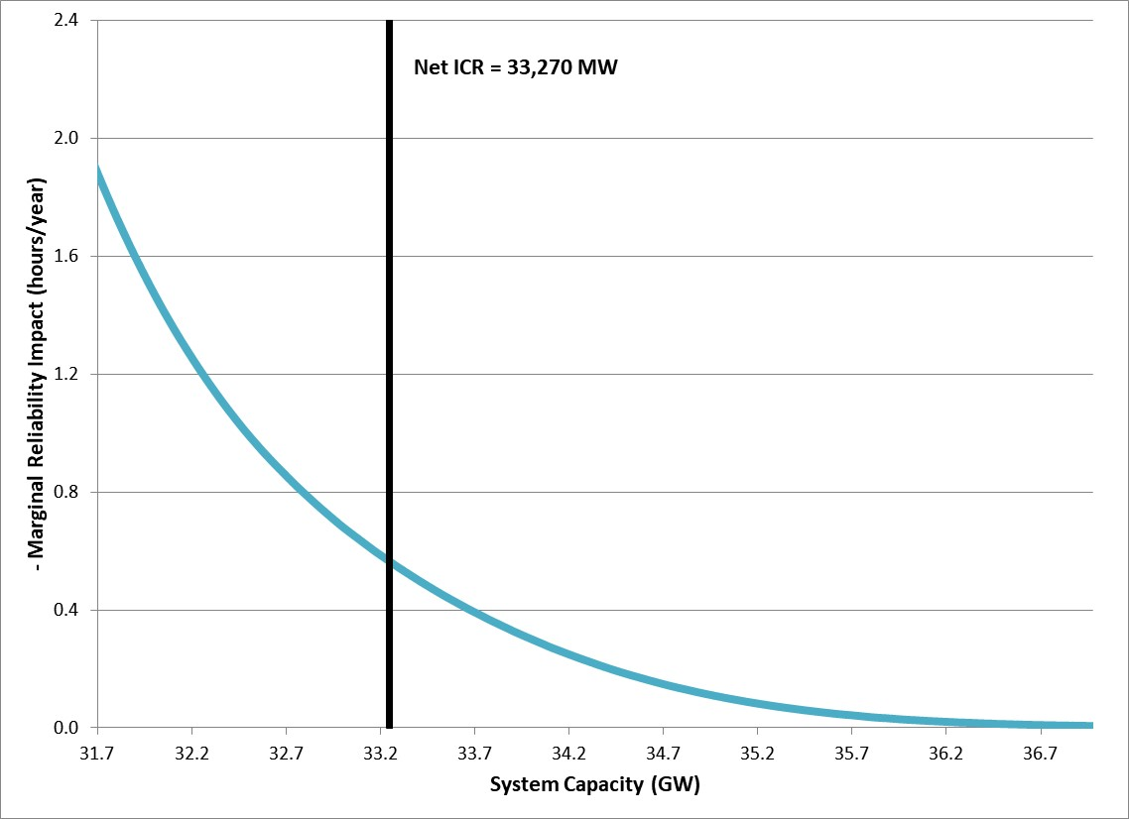
FCA 15 System-wide MRI Curve

Slide 15
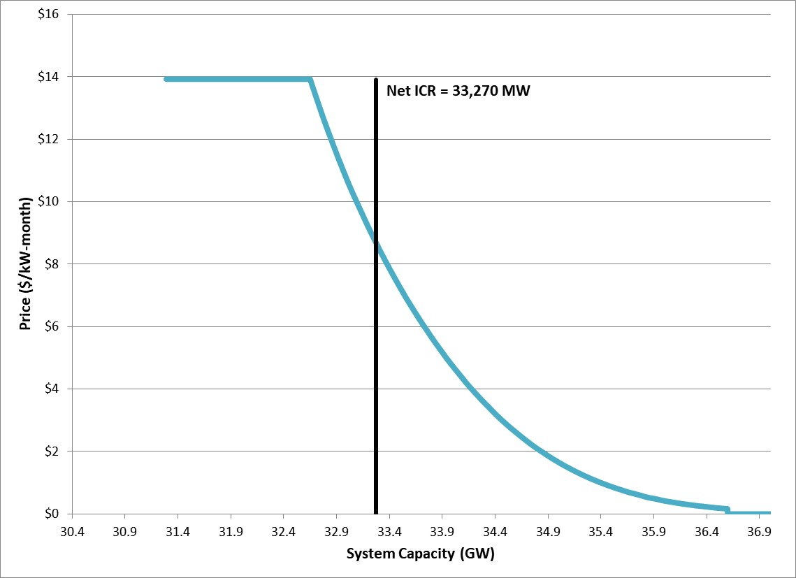
FCA 15 System-wide Demand Curve

Slide 16
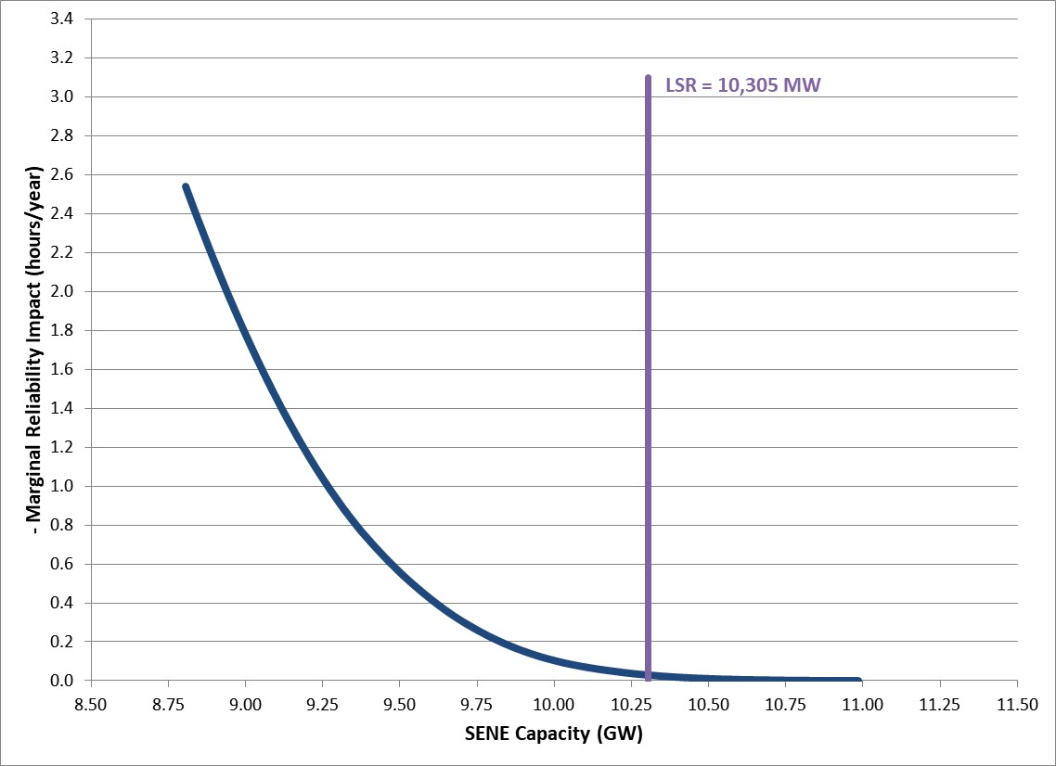
FCA 15 SENE MRI Curve

Slide 17
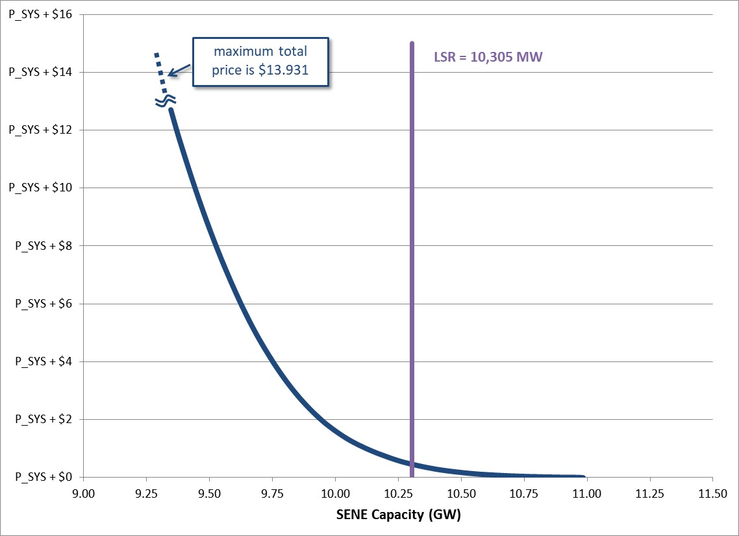
FCA 15 SENE Demand Curve

Slide 18
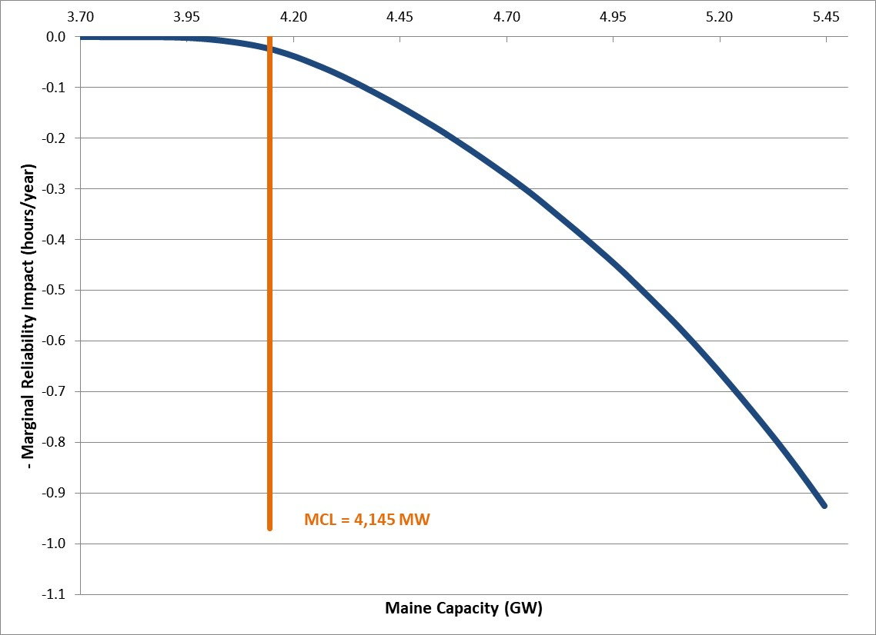
FCA 15 Maine MRI Curve

Slide 19
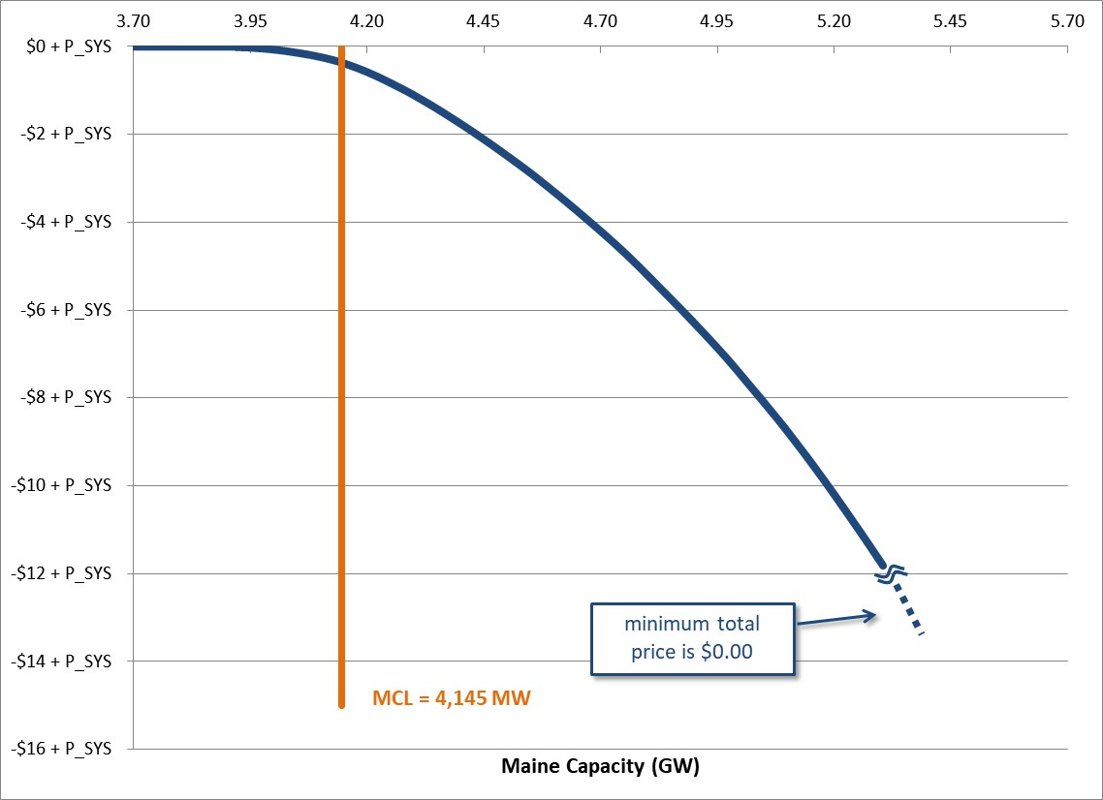
FCA 15 Maine Demand Curve

Slide 20
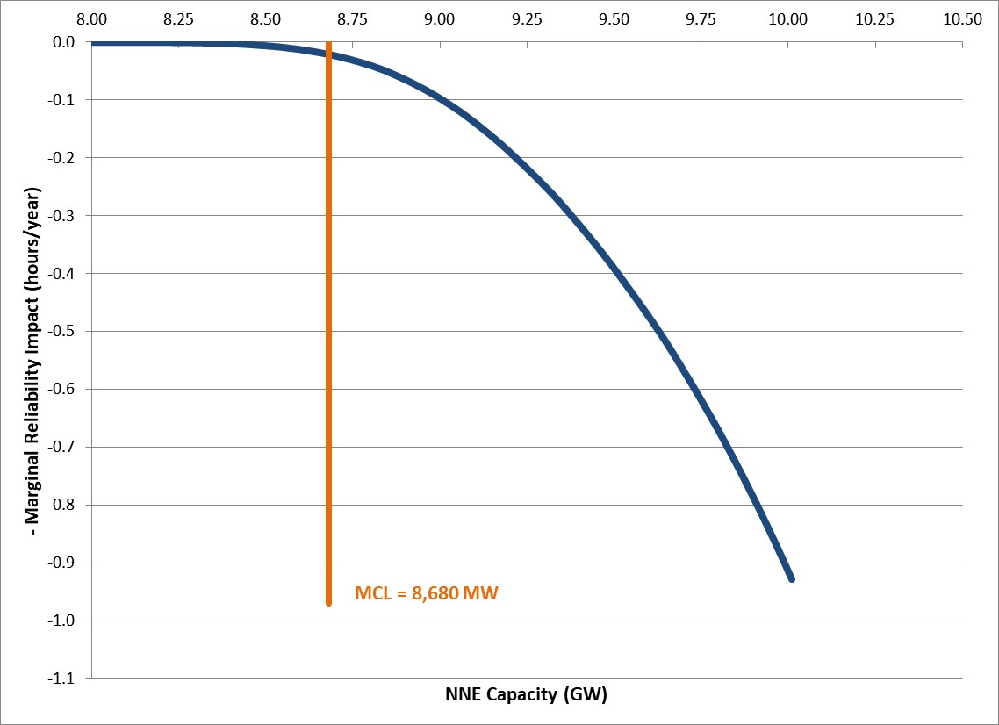
FCA 15 NNE MRI Curve

Slide 21
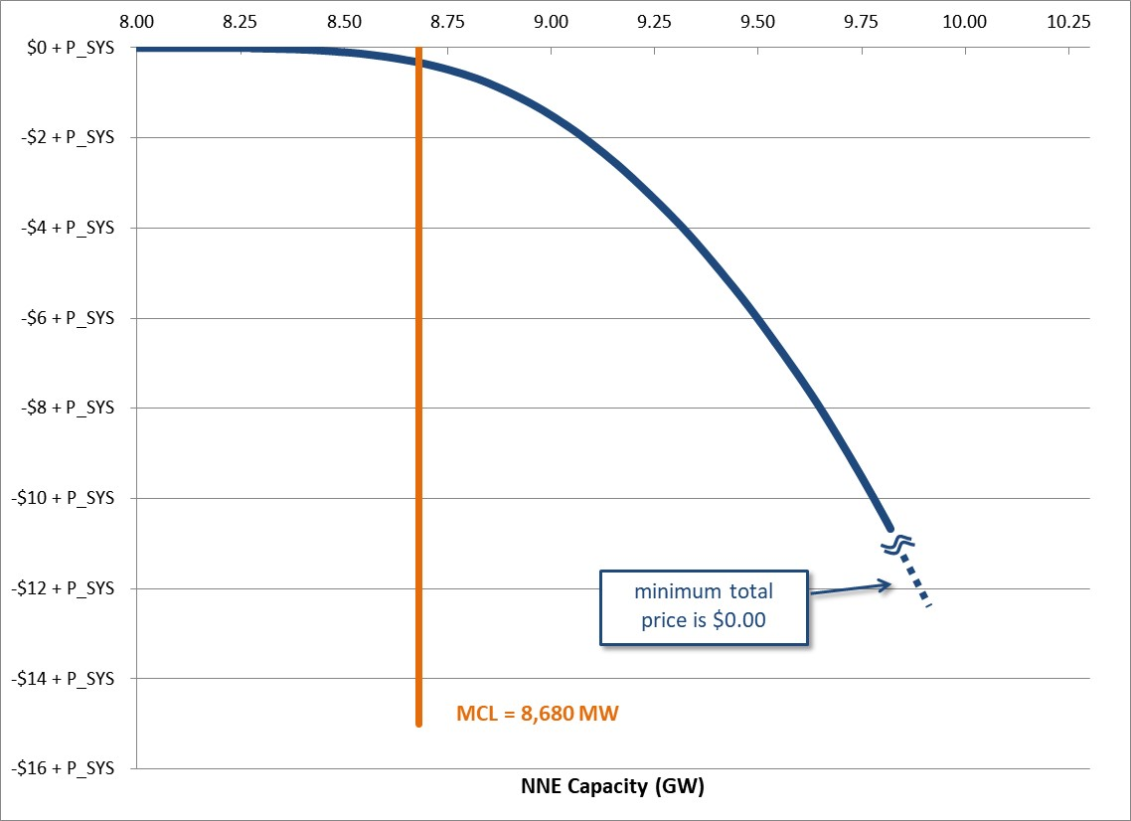
FCA 15 NNE Demand Curve

Slide 22
Demand curve comparison
FCA 15 vs FCA 14

Slide 23
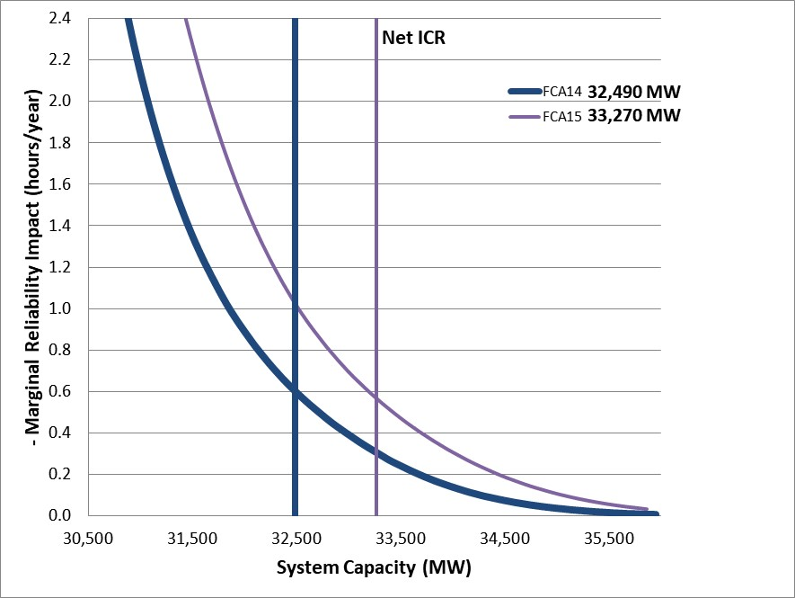
System MRI Curves

Slide 24
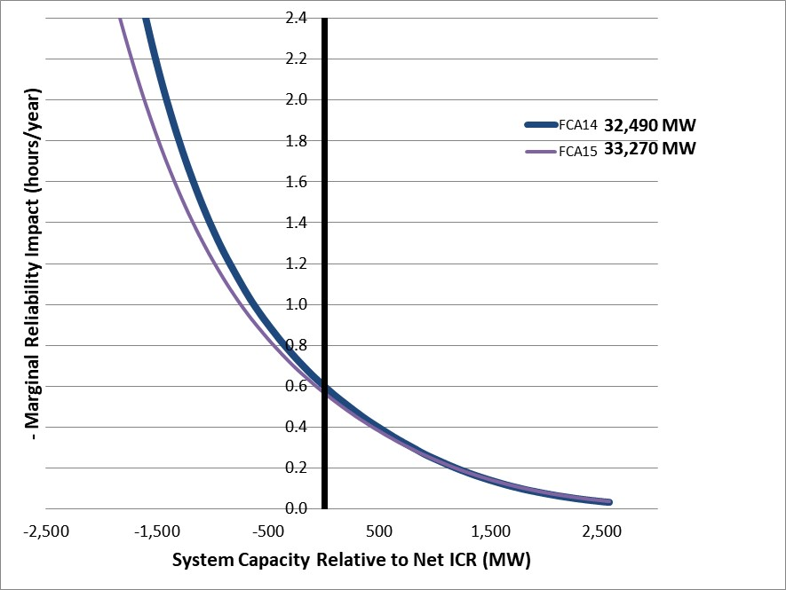
System MRI Curves - Relative to Net ICR

Slide 25
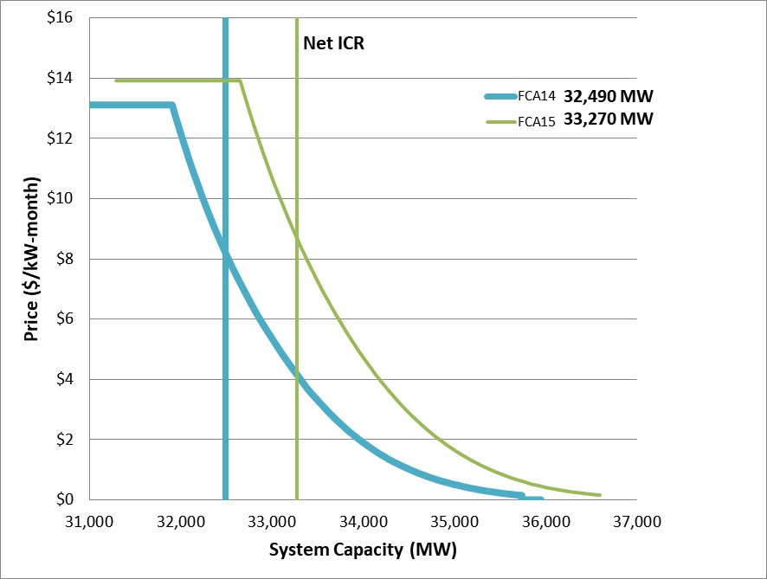
System Demand Curves

Slide 26
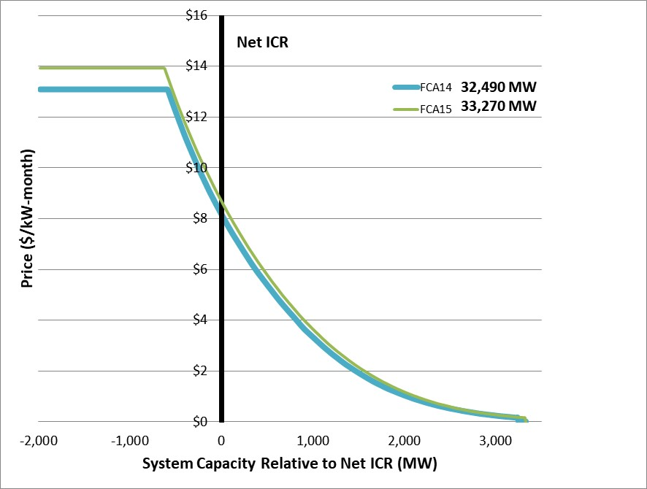
System Demand Curves - Relative to Net ICR

Slide 27
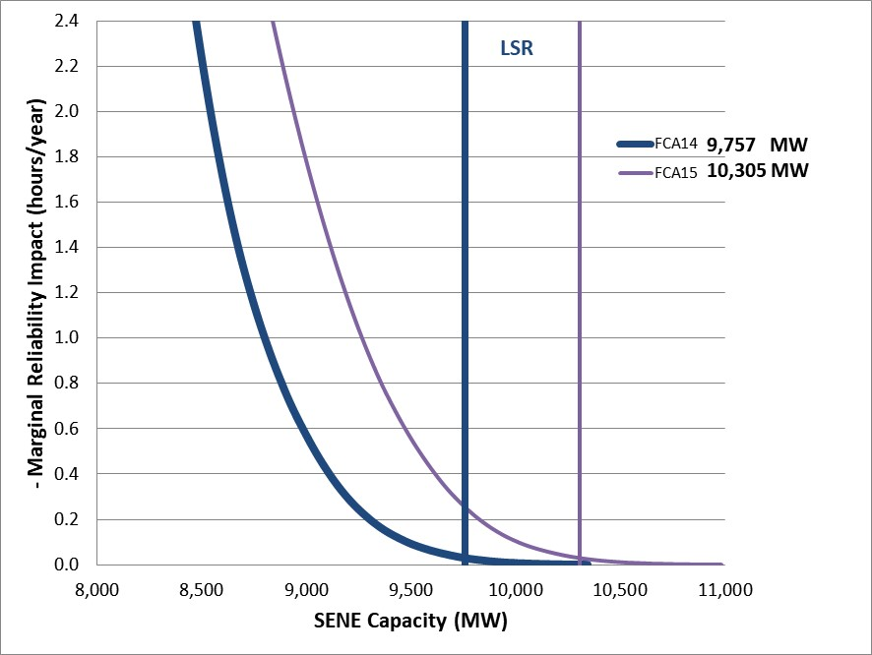
SENE MRI Curves

Slide 28
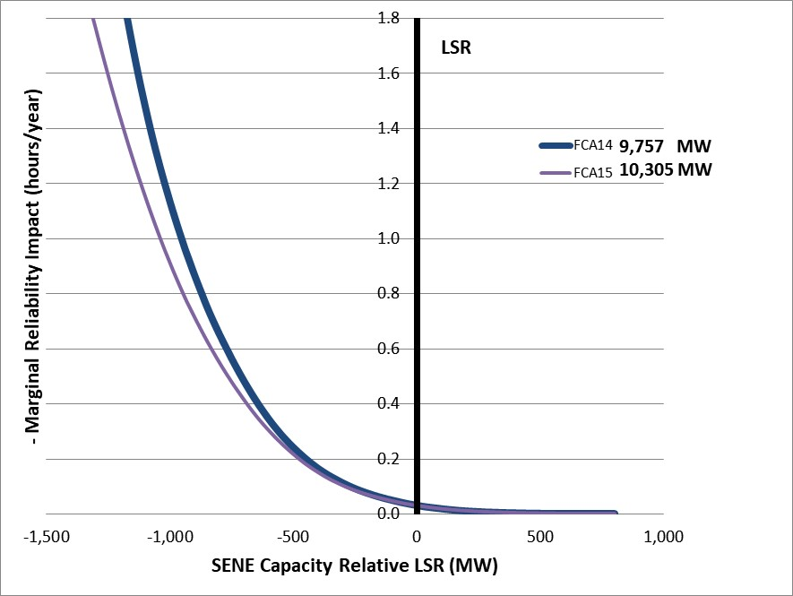
SENE MRI Curves - Relative to LSR

Slide 29
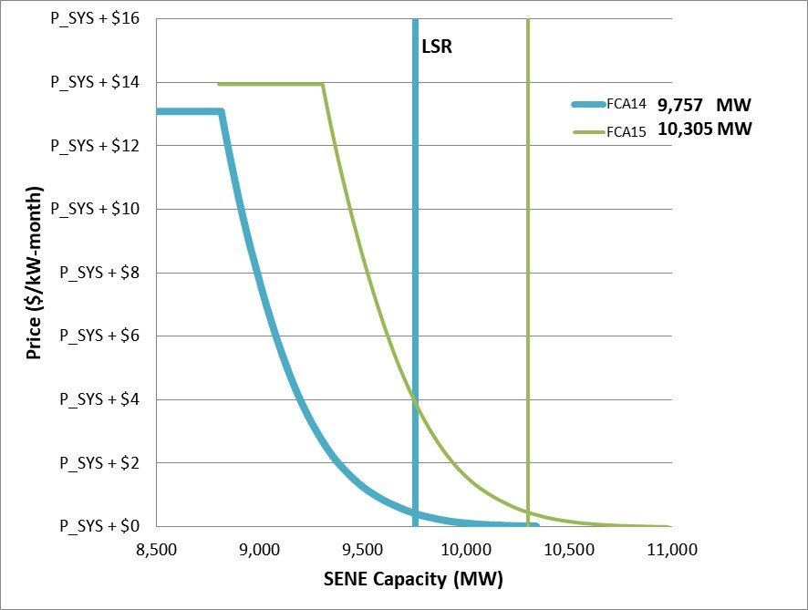
SENE Demand Curves

Slide 30
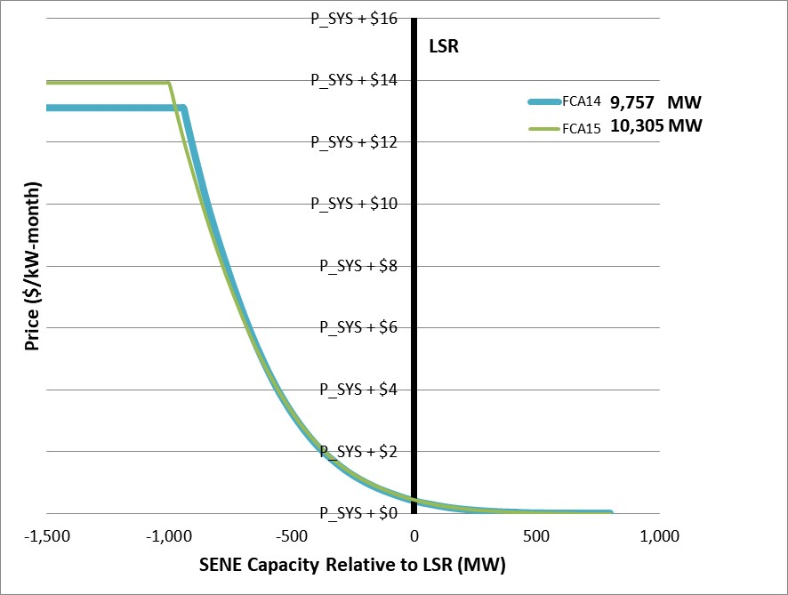
SENE Demand Curves - Relative to LSR

Slide 31
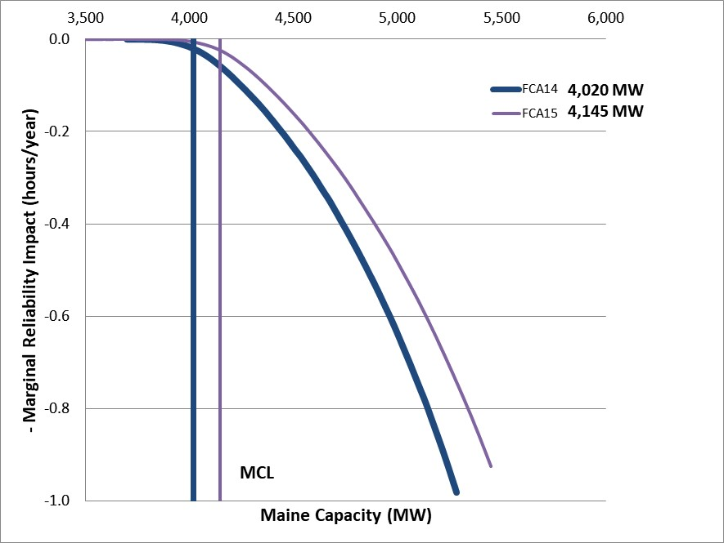
Maine MRI Curves

Slide 32
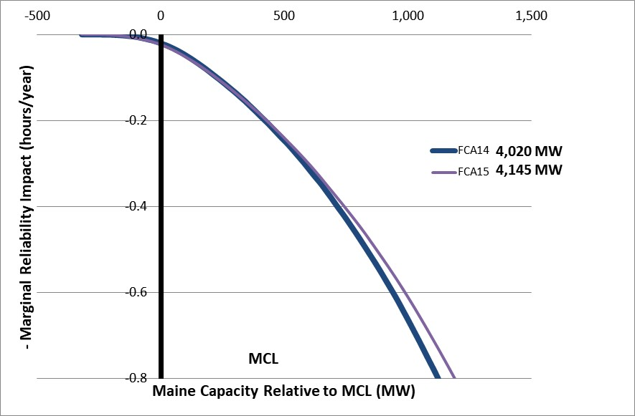
Maine MRI Curves - Relative to MCL

Slide 33
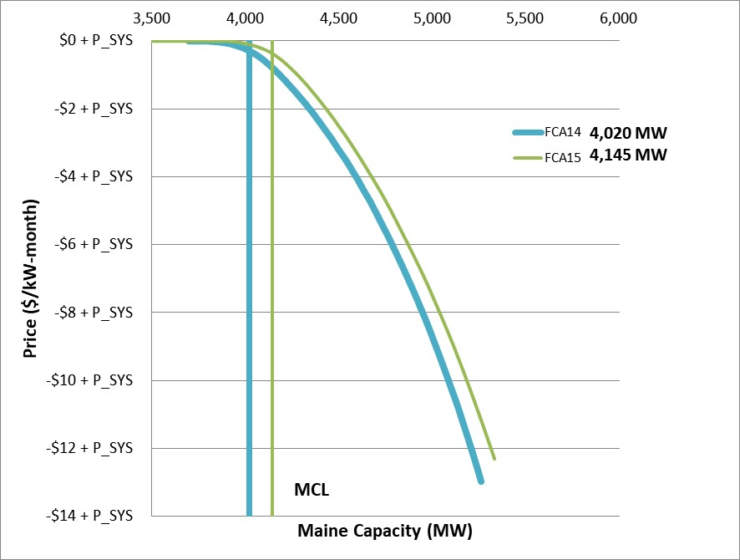
Maine Demand Curves

Slide 34
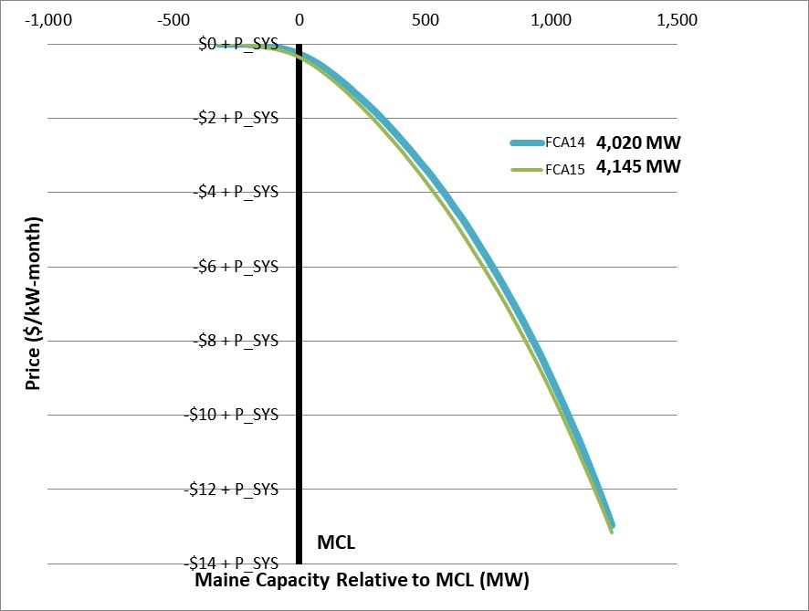
Maine Demand Curves - Relative to MCL

Slide 35
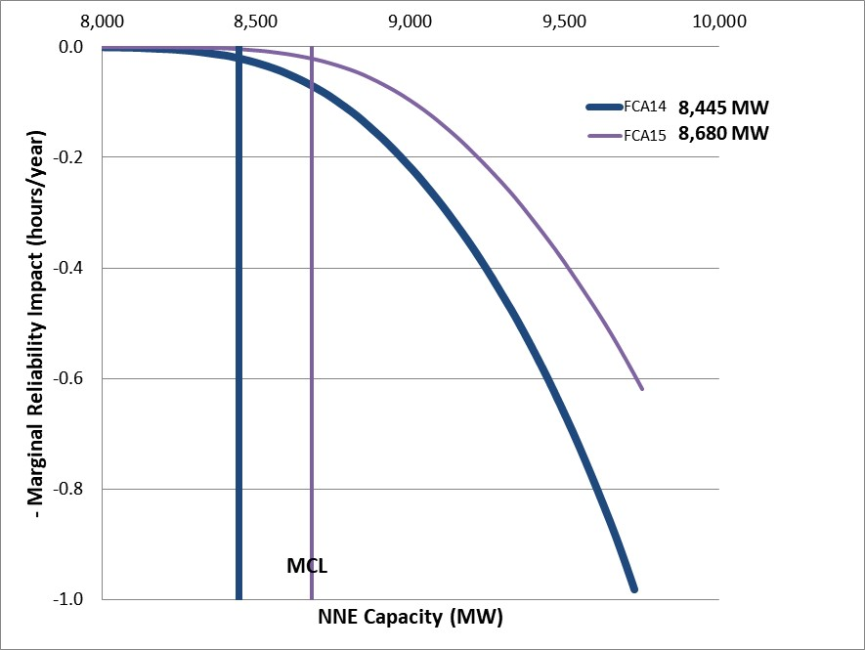
NNE MRI Curves

Slide 36
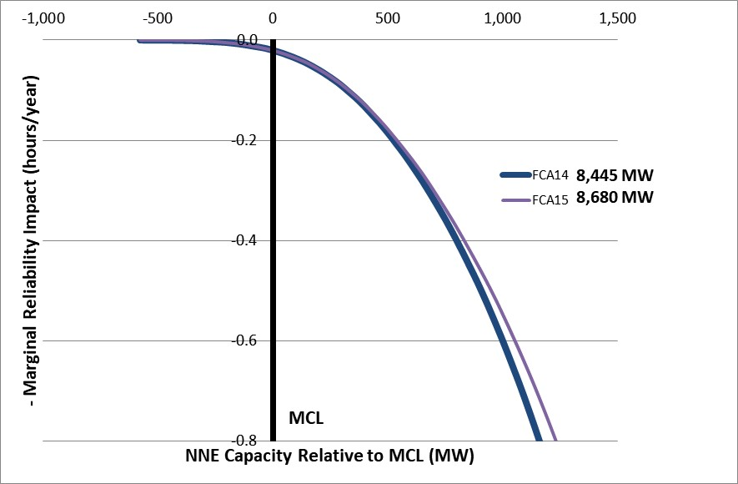
NNE MRI Curves - Relative to MCL

Slide 37
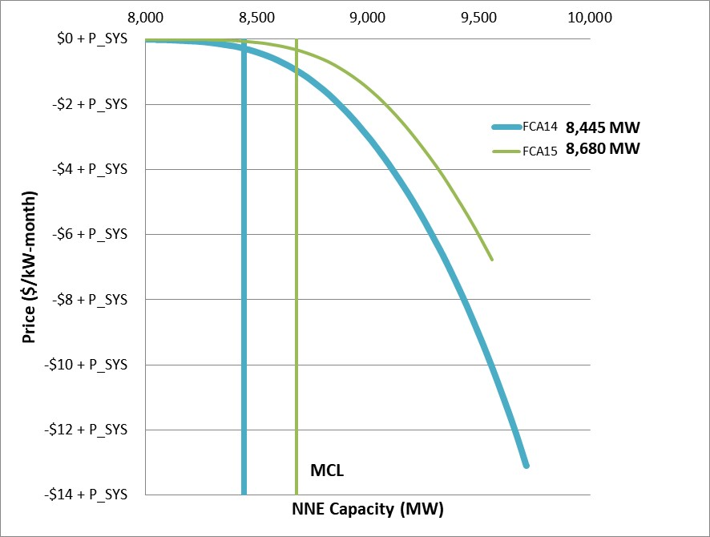
NNE Demand Curves

Slide 38
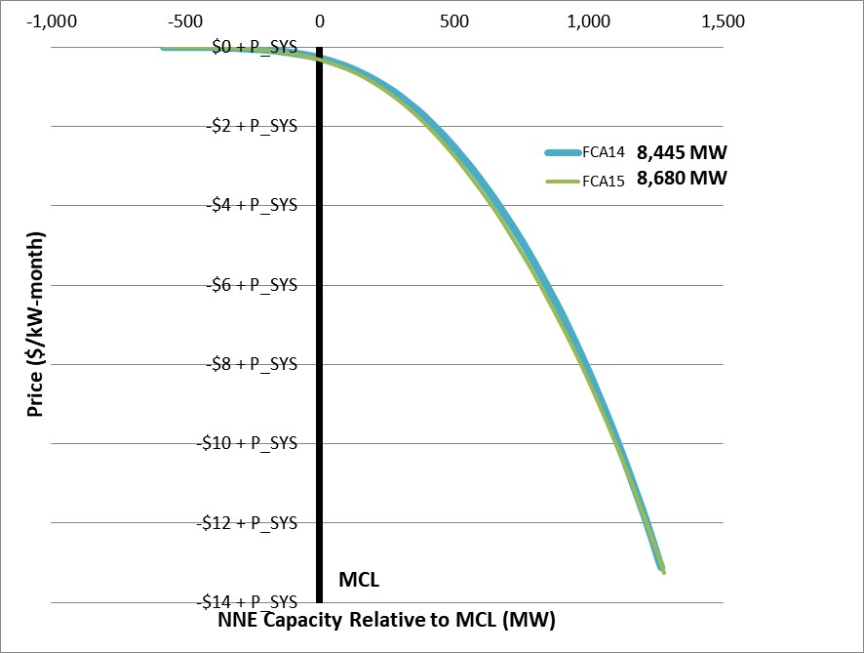
NNE Demand Curves - Relative to MCL

Slide 40
Appendix-I
Assumptions for the FCA 15 ICR-Related Values Calculations

Slide 41
Modeling the New England Control Area for FCA 15
The General Electric Multi-Area Reliability Simulation model (GE MARS) is used to calculate several of the ICR-Related Values
Internal transmission constraints are not modeled in the ICR calculation. All loads and resources are assumed to be connected to a single electric bus
Internal transmission constraints are addressed through the LSR and MCLs
A LSR will be calculated for the import-constrained Southeast New England (SENE) Capacity Zone, consisting of the NEMA/Boston, SEMA and RI Load Zones
MCLs will be calculated for two export-constrained Capacity Zones: the Maine Capacity Zone and the Northern New England (NNE) Capacity Zone, consisting of the combined Load Zones of Maine, New Hampshire and Vermont
The Maine Capacity Zone will be nested in the NNE Capacity Zone
The MRI based method for calculating demand curves will be used to develop System and Capacity Zone Demand Curves
Note:
For more info on the development of FCA 15 Capacity Zones, see https://www.iso-ne.com/static-assets/documents/2020/05/a05_pspc_2020_05_28_fca_15_cap_zone_formation.pdf

Slide 42
Assumptions for the 2024-2025 FCA ICR-Related Values Calculations

Slide 43
Cost of New Entry (CONE) - for the MRI Demand Curve
CONE for the cap of the MRI system Demand Curve for FCA 15 has been calculated as:
Gross CONE: $11.951/kW-month
Net CONE : $8.707/kW-month
FCA Starting Price : $13.932/kW-month
*See link to Forward Capacity Market (FCM) parameters by Capacity Commitment Period: https://www.iso-ne.com/static-assets/documents/2015/09/FCA_Parameters_Final_Table.xlsx

Slide 44
Assumptions for the ICR-Related Values Calculations
Load forecast based on 2020 CELT report
Net of behind-the-meter (BTM) photovoltaic (PV) forecast
Transportation and heating electrification
Load forecast distribution
Resource data will be based on qualified existing capacity values for FCA 15
Non-Intermittent Generating Resources
Intermittent Power Resources (IPR)
Import Capacity Resources
Demand Capacity Resources
These qualified capacity values reflect
Significant decrease of existing qualified resources
Resource retirements and terminations
Permanent and Retirement De-List Bids elected unconditional treatment and that are at or above the FCA 15 Starting Price

Slide 45
Assumptions for the ICR-Related Values Calculations, cont.
Resource availability
Non-Intermittent Generating Resources availability
IPR availability
DR availability
Load relief from Operating Procedure No. 4, Action During a Capacity Deficiency (OP-4) actions
Tie reliability benefits
Quebec
Maritimes
New York
5% voltage reduction

Slide 46
Load Forecast Data
Load forecast assumption from the 2020 Forecast Report of Capacity, Energy, Loads and Transmission (CELT) load forecast
The 2020 CELT load forecast is available at https://www.iso-ne.com/static-assets/documents/2020/04/2020_celt_report.xlsx
The load forecast weather-related uncertainty is represented by specifying a series of multipliers on the peak load and the associated probabilities of each load level occurring
The multipliers used to describe the load forecast uncertainty are derived from the 52 weekly peak load distributions described by the expected value (mean), the standard deviation and the skewness

Slide 47
Load Forecast Data, cont. Modeling of BTM PV
FCA 15 ICR calculations will use an hourly profile of BTM PV corresponding to the load shape for the year 2002, used by the Northeast Power Coordinating Council (NPCC) for reliability studies. For more information on the development of the hourly profile see: https://www.iso-ne.com/static-assets/documents/2017/06/pspc_6_22_2017_2002_PV_profile.pdf
Used for all probabilistic ICR-Related Values calculations
Modeled in GE MARS by groupings using the Regional System Plan (RSP) 13-subarea representation
Includes an 8% transmission and distribution gross-up
Peak load reduction uncertainty is modeled (randomly selected by MARS from a seven day window distribution)
The values of BTM PV published in the 2020 CELT Report are the values of BTM PV subtracted from the gross load forecast to determine the net load forecast
For more info on the PV forecast, see https://www.iso-ne.com/static-assets/documents/2020/04/final_2020_pv_forecast.pdf
The published 90/10 net load forecast for the SENE sub-areas is used in the TSA

Slide 48
Load Forecast Data, cont. Modeling of Transportation and Heating Electrification
Transportation Electrification
The ICR-Related Values calculations will use an hourly profile for transportation electrification forecast
Includes an 8% transmission and distribution gross-up
Uncertainty is currently not modeled due to lack of performance data
More information on the development of the transportation electrification forecast can be found at : https://www.iso-ne.com/static-assets/documents/2020/04/final_2020_transp_elec_forecast.pdf
Heating Electrification
The ICR-Related Values calculations will use the 2020 CELT gross load forecast that include the heating electrification loads which occur during the winter months
The hourly gross load forecast (2020 Forecast Data workbook) is inclusive of heating electrification forecast. The heating electrification loads are weather sensitive and therefore, the uncertainties relating to weather also apply to these loads
More information on the development of the heating electrification forecast can be found at : https://www.iso-ne.com/static-assets/documents/2020/04/final_2020_heat_elec_forecast.pdf

Slide 49
Load Forecast Data, cont. New England System Load Forecast
Monthly Peak Load (MW) - Net of BTM PV
CCP | JUN | JUL | AUG | SEP | OCT | NOV | DEC | JAN | FEB | MAR | APR | MAY
2024-2025 | 26,095 | 28,202 | 27,426 | 24,068 | 19,507 | 21,190 | 23,094 | 24,073 | 23,383 | 21,571 | 19,488 | 22,756
Corresponds to the reference forecast labeled “ISO-NE Control Area & New England States Monthly Peak Load Forecast“ from worksheet “4 Mnth Peak” of the 2020 Forecast Data
https://www.iso-ne.com/static-assets/documents/2020/04/forecast_data_2020.xlsx
There is a distribution associated with each monthly peak. The distribution associated with the seasonal peak load forecast is shown below:
Probability Distribution of Seasonal Peak Load (MW)
 | 10/90 | 20/80 | 30/70 | 40/60 | 50/50 | 60/40 | 70/30 | 80/20 | 90/10 | 95/5
Summer 2024 | 27,771 | 28,202 | 28,581 | 28,933 | 29,303 | 29,836 | 30,251 | 30,667 | 31,377 | 31,889
Winter 2024-25 | 23,958 | 24,073 | 24,158 | 24,255 | 24,329 | 24,464 | 24,634 | 24,814 | 25,020 | 25,195
From Table 1.6 - Seasonal Peak Load Forecast Distributions (forecast is reference with reduction for BTM PV) of the 2020 CELT
https://www.iso-ne.com/static-assets/documents/2020/04/2020_celt_report.xlsx

Slide 50
Resource Data – Generating Capacity Resources (MW)
Load Zone | Non-Intermittent Generating Resource |  | Intermittent Resource |  | Total
 | Summer | Winter | Summer | Winter | Summer | Winter
MAINE | 2844.953 | 3026.457 | 281.313 | 329.956 | 3126.266 | 3356.413
NEW HAMPSHIRE | 4152.612 | 4306.116 | 82.170 | 161.120 | 4234.782 | 4467.236
VERMONT | 206.814 | 245.674 | 64.118 | 107.785 | 270.932 | 353.459
CONNECTICUT | 9741.155 | 10183.737 | 120.887 | 99.409 | 9862.042 | 10283.146
RHODE ISLAND | 1826.126 | 2025.848 | 47.318 | 41.508 | 1873.444 | 2067.356
SOUTH EAST MASSACHUSETTS | 4460.967 | 4763.884 | 289.751 | 357.617 | 4750.718 | 5121.501
WEST CENTRAL MASSACHUSETTS | 3740.827 | 3984.596 | 173.579 | 109.119 | 3914.406 | 4093.715
NORTH EAST MASSACHUSETTS & BOSTON | 1296.241 | 1399.331 | 54.483 | 43.609 | 1350.724 | 1442.940
Total New England | 28269.695 | 29935.643 | 1113.619 | 1250.123 | 29383.314 | 31185.766
Qualified Existing Generating Capacity Resources for FCA 15 reflect:
Significant decreases
Resource retirements and known terminations
Unconditional Permanent and Retirement De-List Bids
Permanent De-List Bids that are at or above the FCA 15 Starting Price
IPR have both summer and winter values modeled; Non-Intermittent Generating Resources winter values provided for informational purpose

Slide 51
Resource Data – Import Capacity Resources (MW)
Import Resource | Summer MW | External Interface
NYPA - CMR | 68.000 | New York AC Ties
NYPA - VT | 14.000 | New York AC Ties
Total MW | 82.000
Notes:
Qualified Existing Import Capacity Resources for FCA 15
The NYPA supplied Import Capacity Resources’ performance (availability) will be modeled with the performance assumptions associated with the New York AC ties

Slide 52
Resource Data – Demand Capacity Resources (MW)
Load Zone | On-Peak Demand Resource |  | Seasonal Peak Demand Resource |  | Active Demand Capacity Resource (ADCR) |  | Total
 | Summer | Winter | Summer | Winter | Summer | Winter | Summer | Winter
MAINE | 224.411 | 201.876 | - | - | 137.803 | 155.699 | 362.214 | 357.575
NEW HAMPSHIRE | 136.625 | 134.384 | - | - | 48.408 | 47.688 | 185.033 | 182.072
VERMONT | 111.485 | 111.751 | - | - | 51.904 | 57.510 | 163.389 | 169.261
CONNECTICUT | 130.311 | 68.194 | 561.440 | 635.793 | 192.829 | 192.123 | 884.580 | 896.110
RHODE ISLAND | 270.390 | 281.671 | - | - | 44.736 | 41.207 | 315.126 | 322.878
SOUTH EAST MASSACHUSETTS | 463.678 | 467.793 | - | - | 56.954 | 55.126 | 520.632 | 522.919
WEST CENTRAL MASSACHUSETTS | 476.249 | 490.808 | 20.010 | 3.616 | 112.074 | 108.419 | 608.333 | 602.843
NORTH EAST MASSACHUSETTS & BOSTON | 727.791 | 712.015 | - | - | 99.906 | 100.007 | 827.697 | 812.022
Grand Total | 2540.940 | 2468.492 | 581.450 | 639.409 | 744.614 | 757.779 | 3867.004 | 3865.680
Notes:
Qualified Existing Demand Resources for FCA 15
Includes the 8% transmission and distribution loss adjustment (gross-up)

Slide 53
Capacity Zone Resource Breakdown and 50/50 & 90/10 Peak Load Forecast Assumptions Used in LRA and MCL Calculations (MW)
Resource Type | SENE | NNE | Maine | New England
Non-Intermittent Generating Resource | 7,583 | 7,204 | 2,845 | 28,270
Intermittent Resource | 392 | 420 | 281 | 1,114
Import Resource | - | - | - | 82
On-Peak Demand Resource | 1,482 | 465 | 221 | 2,541
Seasonal-Peak Demand Resource | 1 | - | - | 581
Active Demand Capacity Resource | 207 | 235 | 136 | 745
Total Capacity | 9,665 | 8,324 | 3,483 | 33,332
 | SENE | NNE | Maine | New England
50/50 Load Forecast Net BTM PV | 12,679 | 5,645 | 2,230 | 29,303
90/10 Load Forecast Net BTM PV | 13,739 | 5,908 | 2,332 | 31,377
Notes:
An LSR will be calculated for the SENE Capacity Zone; MCLs will be calculated for the Maine and NNE Capacity Zones
Zonal requirements will be determined using the load forecast and resource assumptions for the identified Capacity Zones for FCA 15
The 50/50 and 90/10 load forecast values for the Capacity Zones will be the sum of the appropriate RSP sub-areas and are shown for informational purposes
Values are presented based on RSP subarea

Slide 54
LRA, TSA & MCL Internal Transmission Transfer Capability Assumptions
Maine - New Hampshire Export
N-1 Limit: 1,900 MW
Northern New England Export (North-South interface)
N-1 Limit: 2,725 MW
Southeast New England Import
N-1 Limit: 5,150 MW
N-1-1 Limit: 4,300 MW
Note:
Based on transmission transfer capability limits presented at the March 17, 2020 Reliability Committee meeting. The presentation is available at: https://www.iso-ne.com/static-assets/documents/2020/03/a08.0_rc_2020_03_17_presentation.pdf

Slide 55
Availability Assumptions - Non-Intermittent Generating Resources
Forced outages assumption
Each generating unit’s Equivalent Forced Outage Rate on Demand (non-weighted EFORd) will be modeled
Based on a 5-year average (January 2015 – December 2019) of Generation Availability Data System (GADS) data submitted by generators
NERC GADS class average data will be used for immature/non-commercial units
Scheduled outage assumption
Each generating unit’s weeks of maintenance modeled
Based on a 5-year average (January 2015 – December 2019) of each generator’s actual historical average of planned and maintenance outages scheduled at least 14 days in advance
NERC GADS class average data will be used for immature/non-commercial units

Slide 56
Availability Assumptions - Non-Intermittent Generating Resources
Resource Category | Summer MW | Average EFORd (%) Weighted by Summer Ratings | Average Maintenance Weeks Weighted by Summer Ratings
Combined Cycle | 13,222 | 4.1 | 4.8
Fossil | 5,030 | 15.4 | 5.4
Combustion Turbine | 3,463 | 10.2 | 2.6
Nuclear | 3,326 | 1.2 | 3.1
Hydros (includes pumped Storage) | 3,050 | 2.1 | 5.4
Diesel | 115 | 8.3 | 2.3
Miscellaneous | 63 | 13.1 | 5.7
Total | 28,270 | 6.4 | 4.5
Note:
Average summer MW weighted EFORd and maintenance weeks are shown by resource category for informational purposes. In the LOLE simulations used for determining ICR and Related Values, individual unit assumptions will be modeled.

Slide 57
Availability Assumptions - IPR
Modeled as 100% available since their outages have been incorporated in their 5-year historical output used in calculating their existing Qualified Capacity

Slide 58
Availability Assumptions – Demand Resources (DR)
Load Zone | On-Peak Demand Resource |  | Seasonal Peak Demand Resource |  | Active Demand Capacity Resource (ADCR) |  | Total
 | Summer (MW) | Performance (%) | Summer (MW) | Performance (%) | Summer (MW) | Performance (%) | Summer (MW) | Performance (%)
MAINE | 224 | 100 | - | - | 138 | 100 | 362 | 100
NEW HAMPSHIRE | 137 | 100 | - | - | 48 | 98 | 185 | 99
VERMONT | 111 | 100 | - | - | 52 | 98 | 163 | 99
CONNECTICUT | 130 | 100 | 561 | 100 | 193 | 97 | 885 | 99
RHODE ISLAND | 270 | 100 | - | - | 45 | 85 | 315 | 98
SOUTH EAST MASSACHUSETTS | 464 | 100 | - | - | 57 | 94 | 521 | 99
WEST CENTRAL MASSACHUSETTS | 476 | 100 | 20 | 100 | 112 | 91 | 608 | 98
NORTH EAST MASSACHUSETTS & BOSTON | 728 | 100 | - | - | 100 | 88 | 828 | 99
Total New England | 2,541 | 100 | 581 | 100 | 745 | 95 | 3,867 | 99
DR average performance percentages will be applied to FCA 15 qualified Existing DR
Average of 2015 – 2019 historical summer and winter DR performance
Modeled as a forced outage rate of 1-performance in blocks by DR type and Load Zone
Historical DR performance in ICR
FCA 12 total New England DR modeled was 3,211 MW at 98%
FCA 13 was 3,502 MW at 99%
FCA 14 was 3,859 MW at 99%
Note:
For calculation details on ADCR Availability (performance), see https://www.iso-ne.com/static-assets/documents/2020/05/a04_pspc_dr_avail_assumptions_icr.pdf

Slide 59
Availability Assumptions – Import Capacity Resources
System Import Capacity Resources
The forced and planned outage assumptions will be based on the availability assumptions associated with the transmission line used to import the capacity resource. The following table shows the availability assumptions updated for the external ties based on the new proposed methodology for developing external tie lines’ forced and scheduled outage rates:
Unit/plant Import Capacity Resources
The forced and planned outage assumptions will be based on the assumptions associated with the unit/plant supplying the import capacity
External Ties | Forced Outage Rate (%) | Maintenance (Weeks)
Cross Sound Cable | 0 | 3.4
Highgate | 0 | 0.9
HQ Phase II | 1.3 | 2.9
New Brunswick Ties | 0.1 | 2.6
New York AC Ties | 0.5 | 5.9

Slide 60
Comparison of Availability Assumptions – Tie Benefits
Annual maintenance weeks and forced outage rates associated with the external transmission ties are applied to their corresponding tie benefit assumptions. These maintenance weeks and forced outage rates are developed based on each tie line’s 5-year (2015- 2019) historical rolling average performance data
These assumptions are calculated using the methodology established in 2019
https://www.iso-ne.com/static-assets/documents/2019/05/a5_tie_line_availability_05302019.pdf
 | Cross Sound Cable |  | Highgate |  | HQ Phase II |  | New Brunswick Ties |  | New York AC Ties
 | FCA 14 | FCA 15 | FCA 14 | FCA 15 | FCA 14 | FCA 15 | FCA 14 | FCA 15 | FCA 14 | FCA 15
Annual maintenance requirement (weeks) | 6 | 3.4 | 1.2 | 0.9 | 3.2 | 2.9 | 3.2 | 2.6 | 5.3 | 5.9
Annual forced outage rate (%) | 0 | 0 | 0.1 | 0 | 0.9 | 1.3 | 0 | 0.1 | 0.5 | 0.5
Note:
These are the same values used to model the performance of the Import Capacity Resources that are system based as shown in previous slide

Slide 61
OP-4 Assumptions Action 6 & 8 (5% Voltage Reduction (MW))
 | 90-10 Peak Load (Net BTMPV) | Passive DR | ADCR | Actions 6 & 8 5% Voltage Reduction
June 2024-Sept 2024 | 31,377 | 3,122 | 745 | 275
October 2024-May 2025 | 25,020 | 3,108 | 758 | 212
Note:
Uses the 90-10 peak Gross load (including both transportation and heating electrification forecast) forecast minus BTM PV and all passive DR and Active Demand Capacity Resources (ADCR)
Multiplied by the 1.0% estimated relief obtainable from OP-4 voltage reduction

Slide 62
OP-4 Assumptions, cont. Minimum Operating Reserve Requirement (MW)
The system reserves assumption will be consistent with those needed for reliable system operations during Emergency Conditions
Modeled at 700 MW in the ICR calculations

Slide 63
Summary of all MW Modeled in the ICR-Related Values Calculations
Resource Type/OP-4 | FCA 15
Non-Intermittent Generating Resource | 28,270
Intermittent Power Resource | 1,114
Import Capacity Resource | 82
Demand Resource | 3,867
OP-4 voltage reduction | 275
Minimum Operating Reserves | -700
Tie benefits | 1,735
Total MW modeled in ICR | 34,642
Notes:
The tie benefits assumptions are based on the study. See https://www.iso-ne.com/static-assets/documents/2020/08/a02_pspc_2020_08_14_.results_tie_benefits.pptx
IPRs have both the summer and winter capacity values modeled
OP-4 voltage reduction includes Action 6 and Action 8 MW assumptions

Slide 64
Appendix-II
Acronyms for ICR-Related Values*
*Not all acronyms are used in this presentation

Slide 65
Acronyms
ADCR – Active Demand Capacity Resource
ALCC – Additional Load Carrying Capability
APk – Gross peak load net of BTM PV
ARA – Annual Reconfiguration Auction
ART – Annual Reconfiguration Transaction
BTM PV – Behind-the-meter Photovoltaic
CCP – Capacity Commitment Period
CDD – Cooling Degree Days
CELT – Capacity, Energy, Loads and Transmission
CSC – Cross Sound Cable
CSO – Capacity Supply Obligation
CT – Connecticut
DR – Demand Resource
EE – Energy Efficiency
EFORd – Equivalent Forced Outage Rate on Demand

Slide 66
Acronyms, cont.
FCA – Forward Capacity Auction
FCM – Forward Capacity Market
FERC – Federal Energy Regulatory Commission
HQICCs – Hydro-Quebec Interconnection Capability Credits
ICR – Installed Capacity Requirement
ISO – ISO New England
LRA – Local Resource Adequacy
LSR – Local Sourcing Requirement
MARS -Multi-Area Reliability Simulation
MCL – Maximum Capacity Limit
MRI – Marginal Reliability Impact
NEPOOL – New England Power Pool
Net ICR – ICR minus HQICCs
NNE – Northern New England

Slide 67
Acronyms, cont.
NPCC – Northeast Power Coordinating Council
OP-4 – Operating Procedure No. 4, Action During a Capacity Deficiency
PAC – Planning Advisory Committee
PC – Participants Committee
PK – Peak (gross load forecast)
PSPC – Power Supply Planning Committee
RC – Reliability Committee
RI – Rhode Island
SEMA – Southeastern Massachusetts
SENE – Southern New England
SWCT – Southwest Connecticut
TSA – Transmission Security Analysis
VR – Voltage Reduction
WEFORd – Weighted Equivalent Forced Outage Rated on Demand

